Slide 1
Linear Algebra
Lecturer: Xia Liao
Email: xliao@hqu.edu.cn
Homepage: https://hirzebruch.github.io/main.html
Time: every Tuesday 1-2, Thursday 3-4

Slide 2
A need for fast solving systems of linear equations
The working process of CFD involves repeatedly solving a system of linear equations which contains up to 2 million variables.

Slide 3
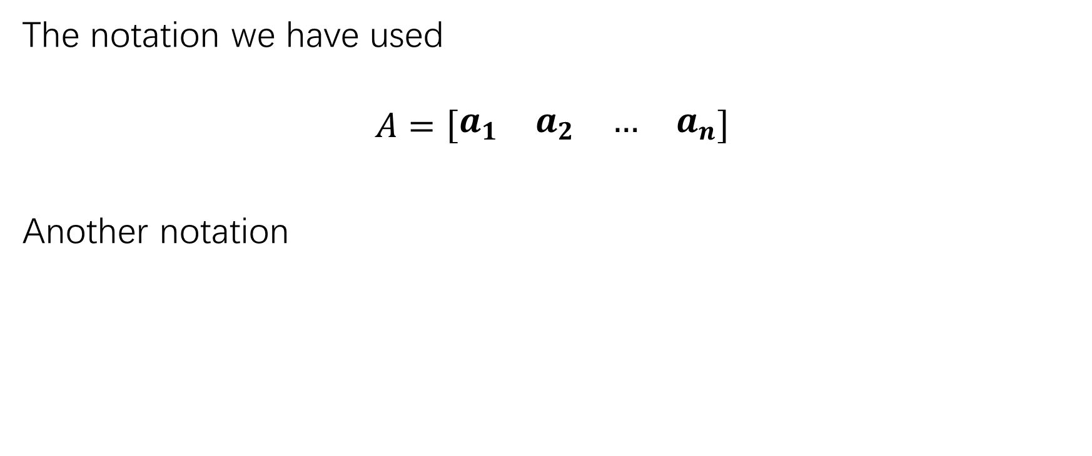
Matrix notations
The notation we have used
$$A=\left[\begin{matrix}a_{1} & a_{2} & … & a_{n}\end{matrix}\right]$$
Another notation

Slide 4
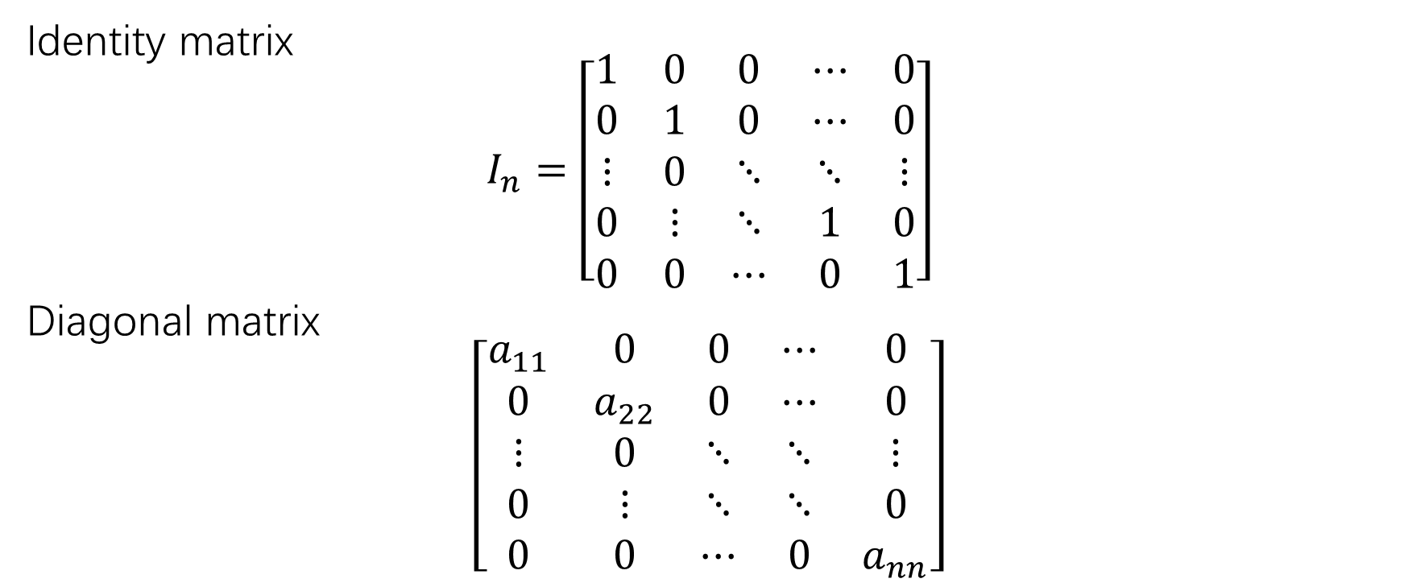
Matrix notations
Identity matrix
$$I_{n}=\left[\begin{matrix}1 & 0 & 0 & ⋯ & 0 \\ 0 & 1 & 0 & ⋯ & 0 \\ ⋮ & 0 & ⋱ & ⋱ & ⋮ \\ 0 & ⋮ & ⋱ & 1 & 0 \\ 0 & 0 & ⋯ & 0 & 1\end{matrix}\right]$$
Diagonal matrix
$$\left[\begin{matrix}a_{11} & 0 & 0 & ⋯ & 0 \\ 0 & a_{22} & 0 & ⋯ & 0 \\ ⋮ & 0 & ⋱ & ⋱ & ⋮ \\ 0 & ⋮ & ⋱ & ⋱ & 0 \\ 0 & 0 & ⋯ & 0 & a_{nn}\end{matrix}\right]$$

Slide 5
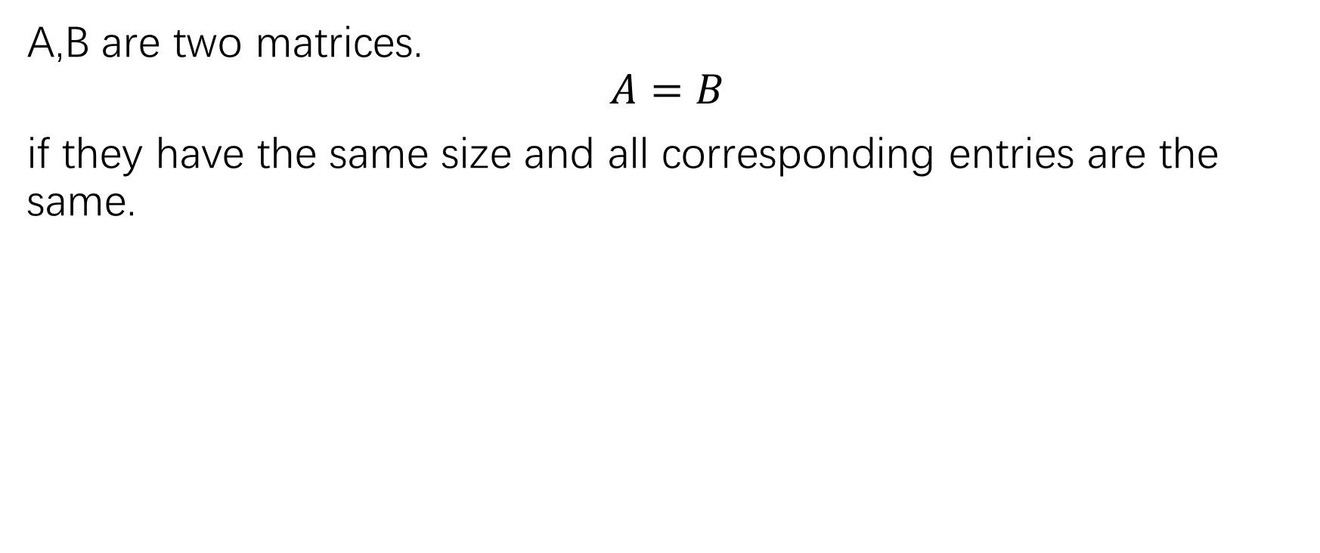
Equality of matrices
A,B are two matrices.
$$A=B$$
if they have the same size and all corresponding entries are the same.

Slide 6
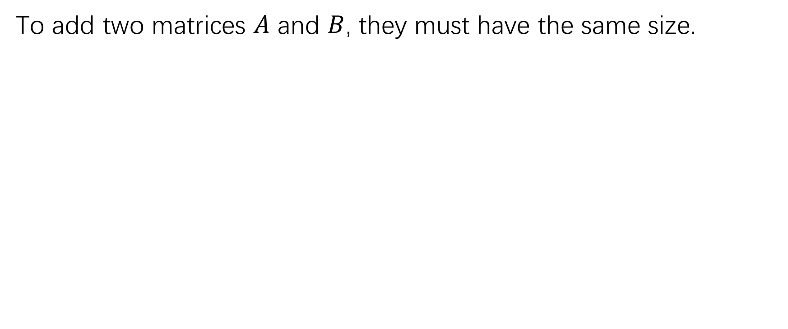
Sum of two matrices
To add two matrices $A$ and $B$, they must have the same size.

Slide 7
Scalar multiples

Slide 8
Relation between matrix addition and scalar multiplication

Slide 9
Matrix multiplication

Slide 10
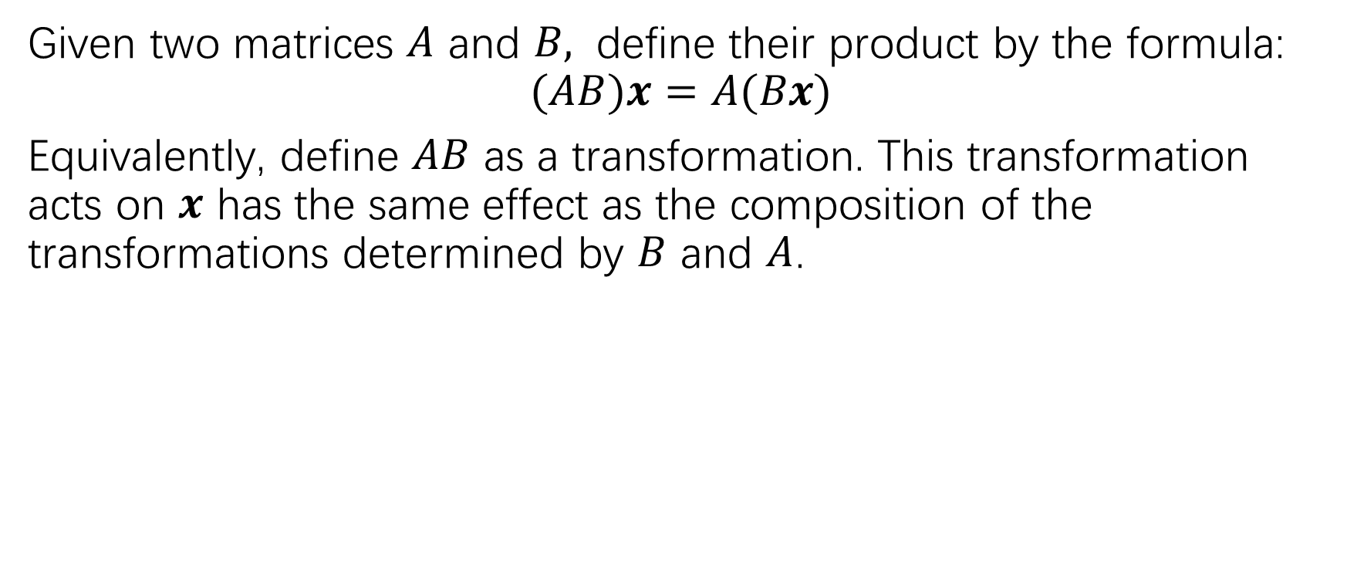
Matrix multiplication
Given two matrices $A$ and $B,$ define their product by the formula:
$$(AB)x=A(Bx)$$
Equivalently, define $AB$ as a transformation. This transformation acts on $x$ has the same effect as the composition of the transformations determined by $B$ and $A$.

Slide 11
Matrix multiplication

Slide 12
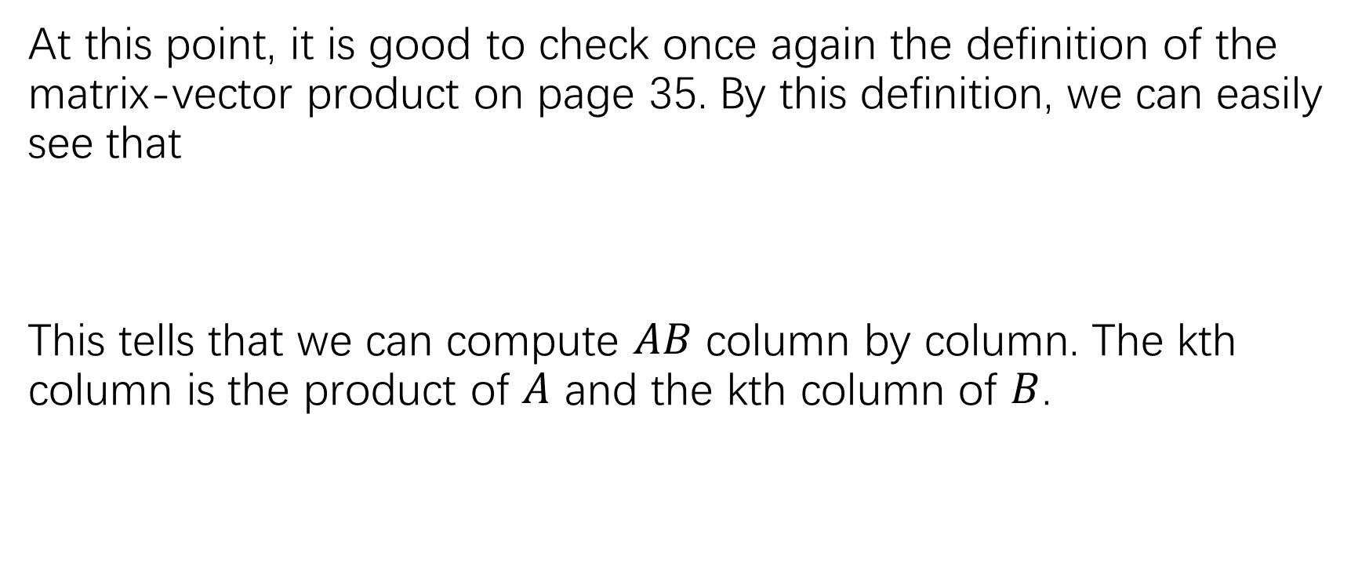
Matrix multiplication
At this point, it is good to check once again the definition of the matrix-vector product on page 35. By this definition, we can easily see that
This tells that we can compute $AB$ column by column. The kth column is the product of $A$ and the kth column of $B$.

Slide 13
The computation of the matrix product

Slide 14
The computation of the matrix product

Slide 15
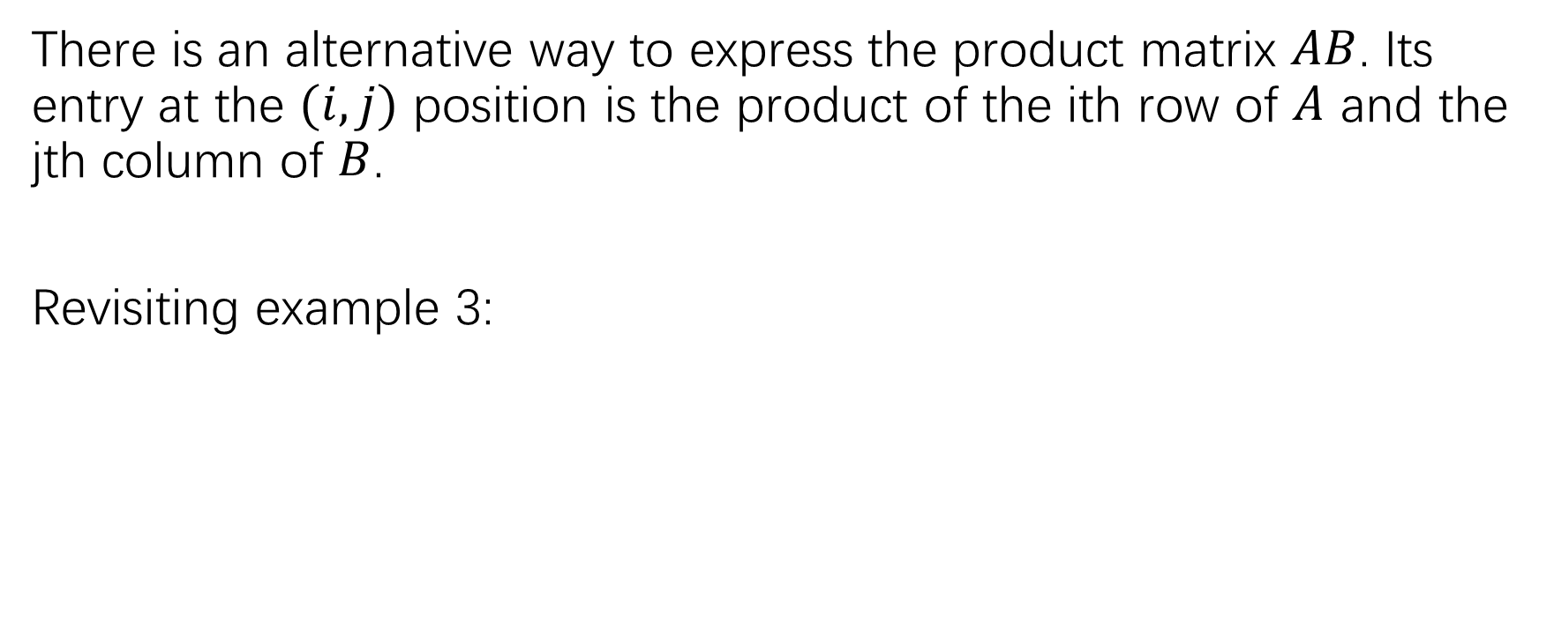
The computation of the matrix product
There is an alternative way to express the product matrix $AB$. Its entry at the $(i,j)$ position is the product of the ith row of $A$ and the jth column of $B$.
Revisiting example 3:

Slide 16
The computation of the matrix product

Slide 17
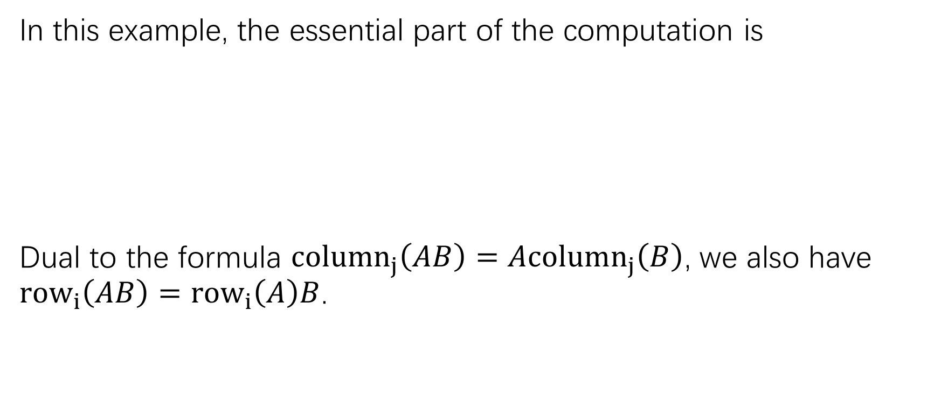
The computation of the matrix product
In this example, the essential part of the computation is
Dual to the formula $column_{j}\left(AB\right)=Acolumn_{j}\left(B\right)$, we also have $row_{i}\left(AB\right)=row_{i}\left(A\right)B$.

Slide 18

How are $AB$ computed by a computer?

Slide 19
Properties of matrix multiplication

Slide 20
Properties of matrix multiplication
Proof of (a):

Slide 21
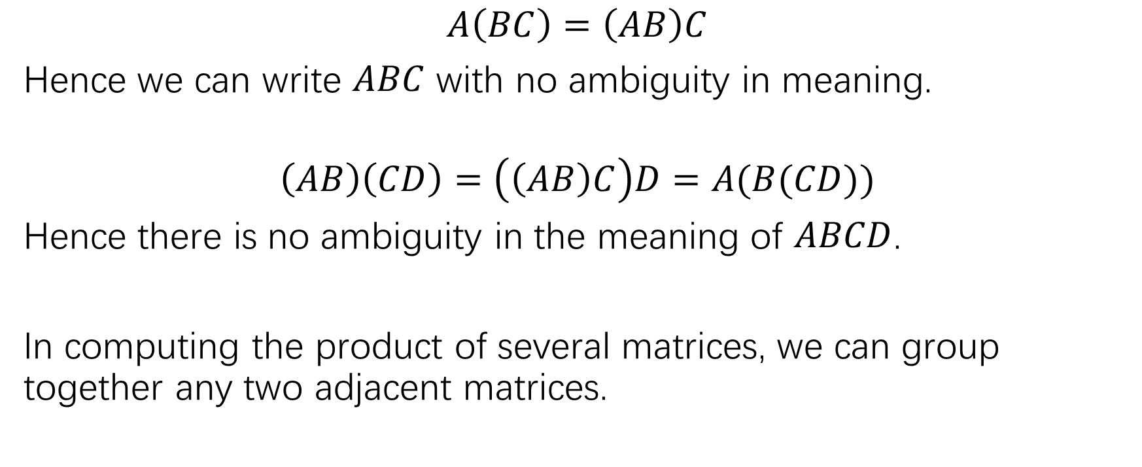
The associativity of the matrix product
$$A\left(BC\right)=\left(AB\right)C$$
Hence we can write $ABC$ with no ambiguity in meaning.
$$\left(AB\right)\left(CD\right)=\left(\left(AB\right)C\right)D=A(B(CD))$$
Hence there is no ambiguity in the meaning of $ABCD$.
In computing the product of several matrices, we can group together any two adjacent matrices.

Slide 22

Non-commutativity of matrix product
In general, $AB≠BA$!

Slide 23
The difference between matrix algebra and the ordinary algebra of real numbers
P108: Exercise 9-12

Slide 28
The difference between matrix algebra and the ordinary algebra of real numbers

Slide 29
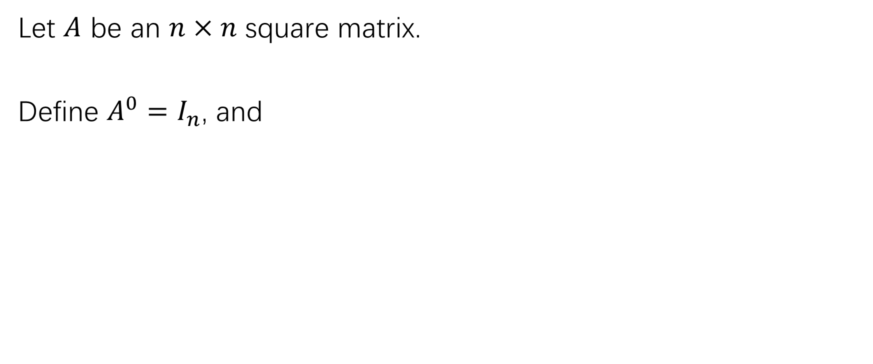
Powers of a matrix
Let $A$ be an $n×n$ square matrix.
Define $A^{0}=I_{n}$, and

Slide 30
Powers of a matrix
P110: Exercise 40

Slide 32
The transpose of a matrix

Slide 33
The properties of matrix transpose

Slide 34
practice
P108: 1,2,5,
P109: 15-25, 29-32

