Slide 1
Linear Algebra
Lecturer: Xia Liao
Email: xliao@hqu.edu.cn
Homepage: https://hirzebruch.github.io/main.html
Time: every Tuesday 1-2, Thursday 3-4

Slide 2
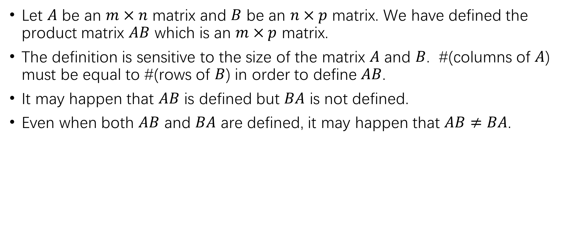
Review of matrix product
Let $A$ be an $m×n$ matrix and $B$ be an $n×p$ matrix. We have defined the product matrix $AB$ which is an $m×p$ matrix.
The definition is sensitive to the size of the matrix $A$ and $B$. #(columns of $A$) must be equal to #(rows of $B$) in order to define $AB$.
It may happen that $AB$ is defined but $BA$ is not defined.
Even when both $AB$ and $BA$ are defined, it may happen that $AB≠BA$.

Slide 3
Review of matrix product
The matrix product is defined by the following formula:

Slide 4
Review of matrix product
Examine example 5 again:

Slide 5
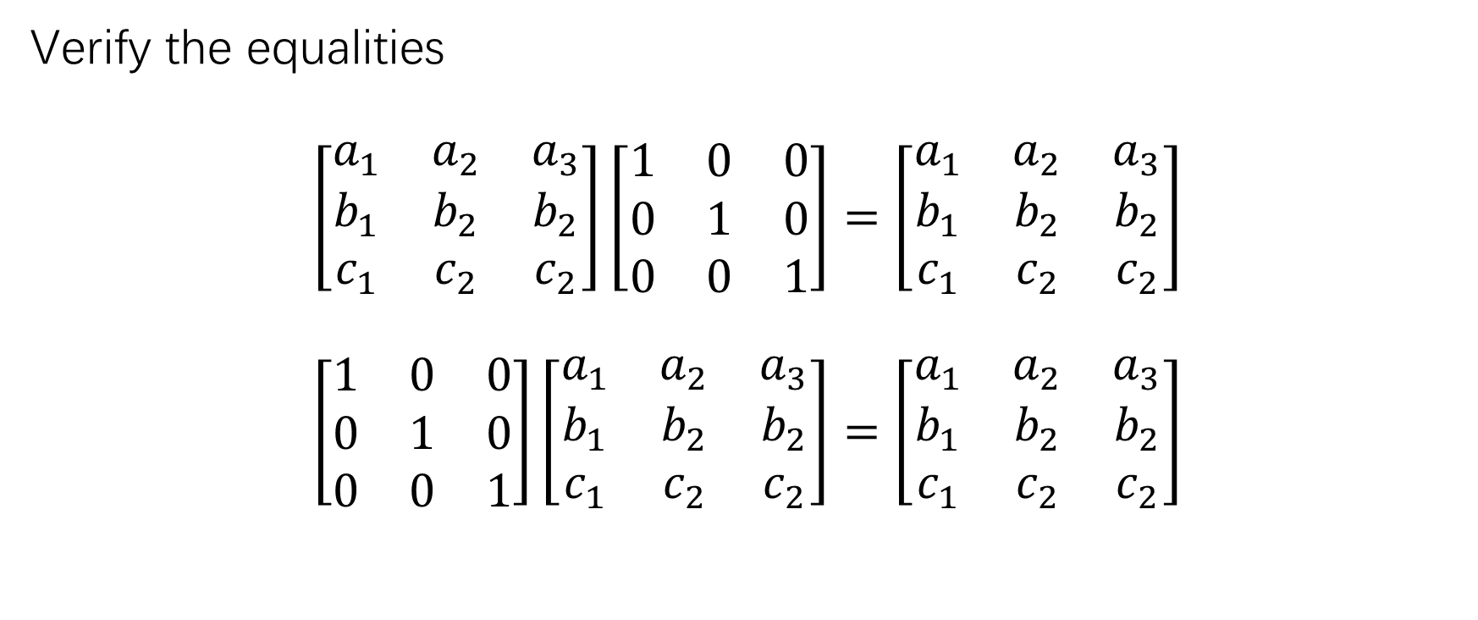
Review of matrix product
Verify the equalities
$$\left[\begin{matrix}a_{1} & a_{2} & a_{3} \\ b_{1} & b_{2} & b_{2} \\ c_{1} & c_{2} & c_{2}\end{matrix}\right]\left[\begin{matrix}1 & 0 & 0 \\ 0 & 1 & 0 \\ 0 & 0 & 1\end{matrix}\right]=\left[\begin{matrix}a_{1} & a_{2} & a_{3} \\ b_{1} & b_{2} & b_{2} \\ c_{1} & c_{2} & c_{2}\end{matrix}\right]$$
$$\left[\begin{matrix}1 & 0 & 0 \\ 0 & 1 & 0 \\ 0 & 0 & 1\end{matrix}\right]\left[\begin{matrix}a_{1} & a_{2} & a_{3} \\ b_{1} & b_{2} & b_{2} \\ c_{1} & c_{2} & c_{2}\end{matrix}\right]=\left[\begin{matrix}a_{1} & a_{2} & a_{3} \\ b_{1} & b_{2} & b_{2} \\ c_{1} & c_{2} & c_{2}\end{matrix}\right]$$

Slide 6

Review of matrix product
Convince yourself that
$$I_{m}A=A$$
and
$$AI_{n}=A$$
for any $m×n$ matrix $A$.

Slide 7
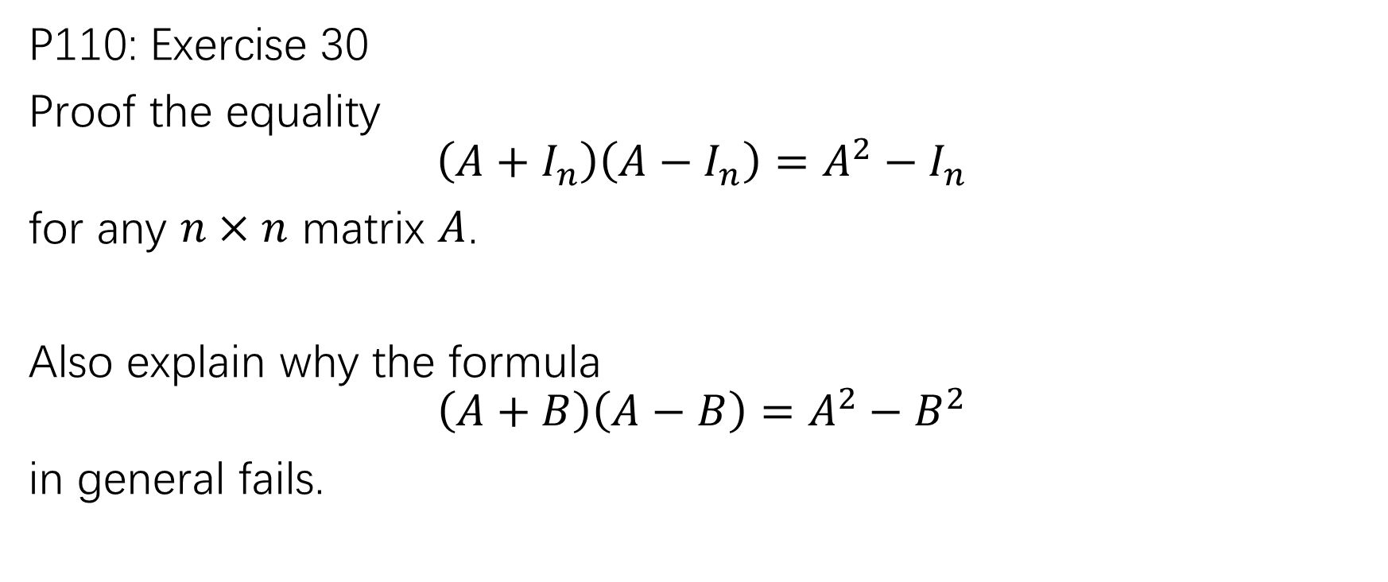
Review of matrix product
P110: Exercise 30
Proof the equality
$$\left(A+I_{n}\right)\left(A−I_{n}\right)=A^{2}−I_{n}$$
for any $n×n$ matrix $A$.
Also explain why the formula
$$\left(A+B\right)\left(A−B\right)=A^{2}−B^{2}$$
in general fails.

Slide 8
Inverse of nonzero numbers
How does one define the inverse of a matrix analogously?

Slide 9
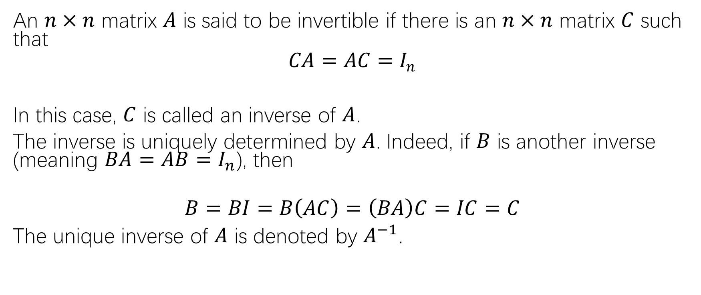
The inverse of a matrix
An $n×n$ matrix $A$ is said to be invertible if there is an $n×n$ matrix $C$ such that
$$CA=AC=I_{n}$$
In this case, $C$ is called an inverse of $A$.
The inverse is uniquely determined by $A$. Indeed, if $B$ is another inverse (meaning $BA=AB=I_{n}$), then
$$B=BI=B\left(AC\right)=\left(BA\right)C=IC=C$$
The unique inverse of $A$ is denoted by $A^{−1}$.

Slide 11
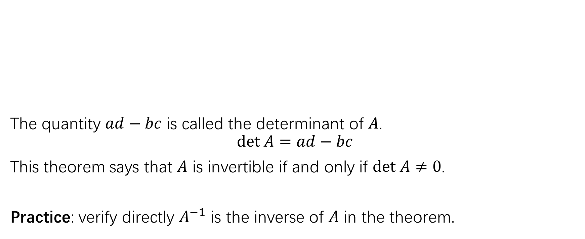

Criterion for the invertibility of $2×2$ matrices
The quantity $ad−bc$ is called the determinant of $A$.
$$det A=ad−bc$$
This theorem says that $A$ is invertible if and only if $det A≠0$.
Practice: verify directly $A^{−1}$ is the inverse of $A$ in the theorem.

Slide 13
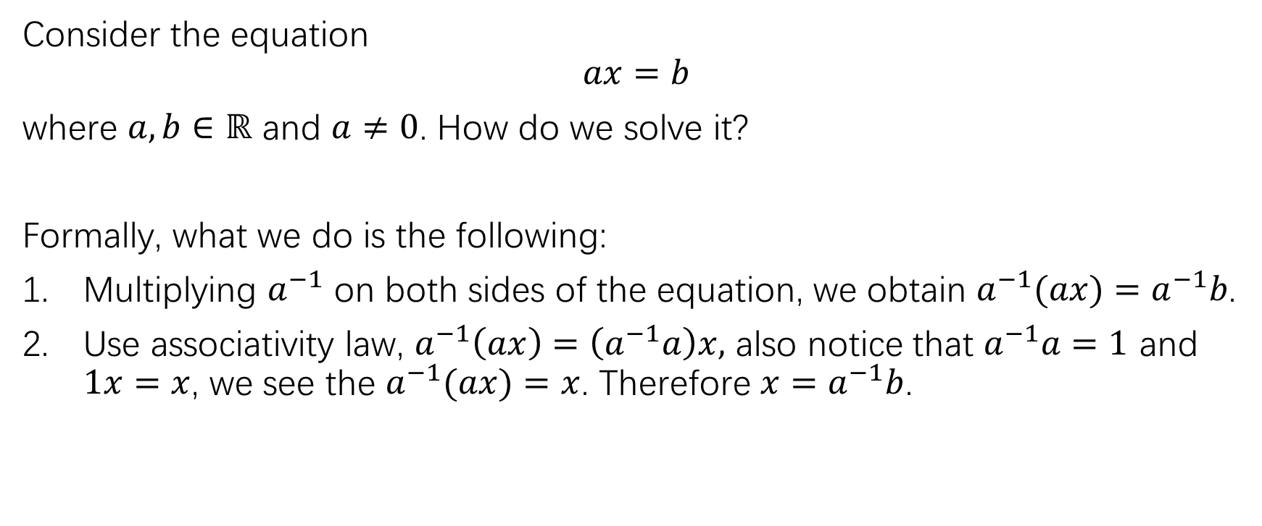
Significance of matrix inverse for solving system of linear equations
Consider the equation
$$ax=b$$
where $a,b∈ℝ$ and $a≠0$. How do we solve it?
Formally, what we do is the following:
Multiplying $a^{−1}$ on both sides of the equation, we obtain $a^{−1}(ax)=a^{−1}b$.
Use associativity law, $a^{−1}\left(ax\right)=\left(a^{−1}a\right)x,$ also notice that $a^{−1}a=1$ and $1x=x$, we see the $a^{−1}(ax)=x$. Therefore $x=a^{−1}b$.

Slide 14
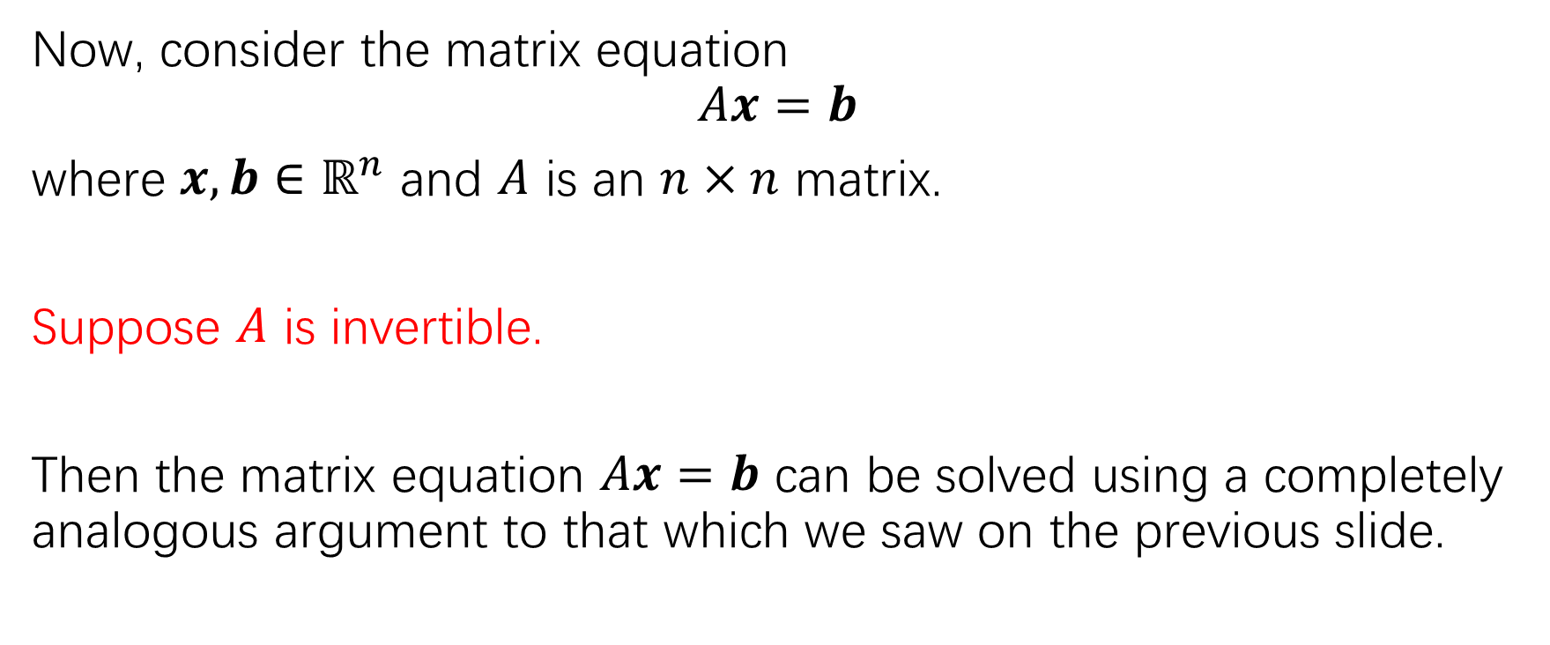
Significance of matrix inverse for solving system of linear equations
Now, consider the matrix equation
$$Ax=b$$
where $x,b∈ℝ^{n}$ and $A$ is an $n×n$ matrix.
Suppose $A$ is invertible.
Then the matrix equation $Ax=b$ can be solved using a completely analogous argument to that which we saw on the previous slide.

Slide 15
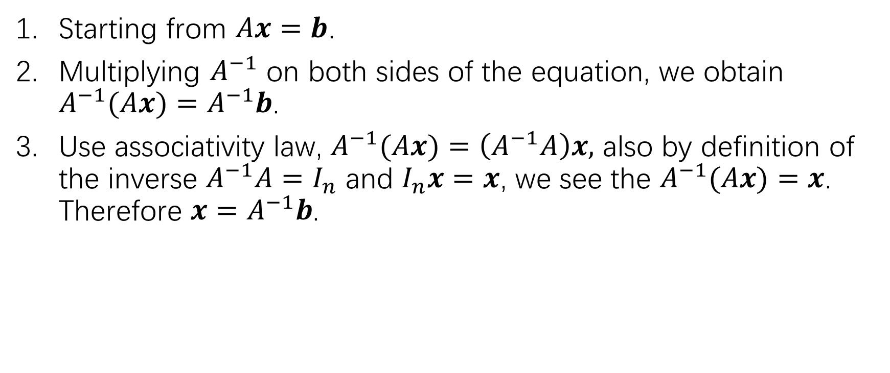
Significance of matrix inverse for solving system of linear equations
Starting from $Ax=b$.
Multiplying $A^{−1}$ on both sides of the equation, we obtain $A^{−1}(Ax)=A^{−1}b$.
Use associativity law, $A^{−1}(Ax)=\left(A^{−1}A\right)x,$ also by definition of the inverse $A^{−1}A=I_{n}$ and $I_{n}x=x$, we see the $A^{−1}(Ax)=x$. Therefore $x=A^{−1}b$.

Slide 16
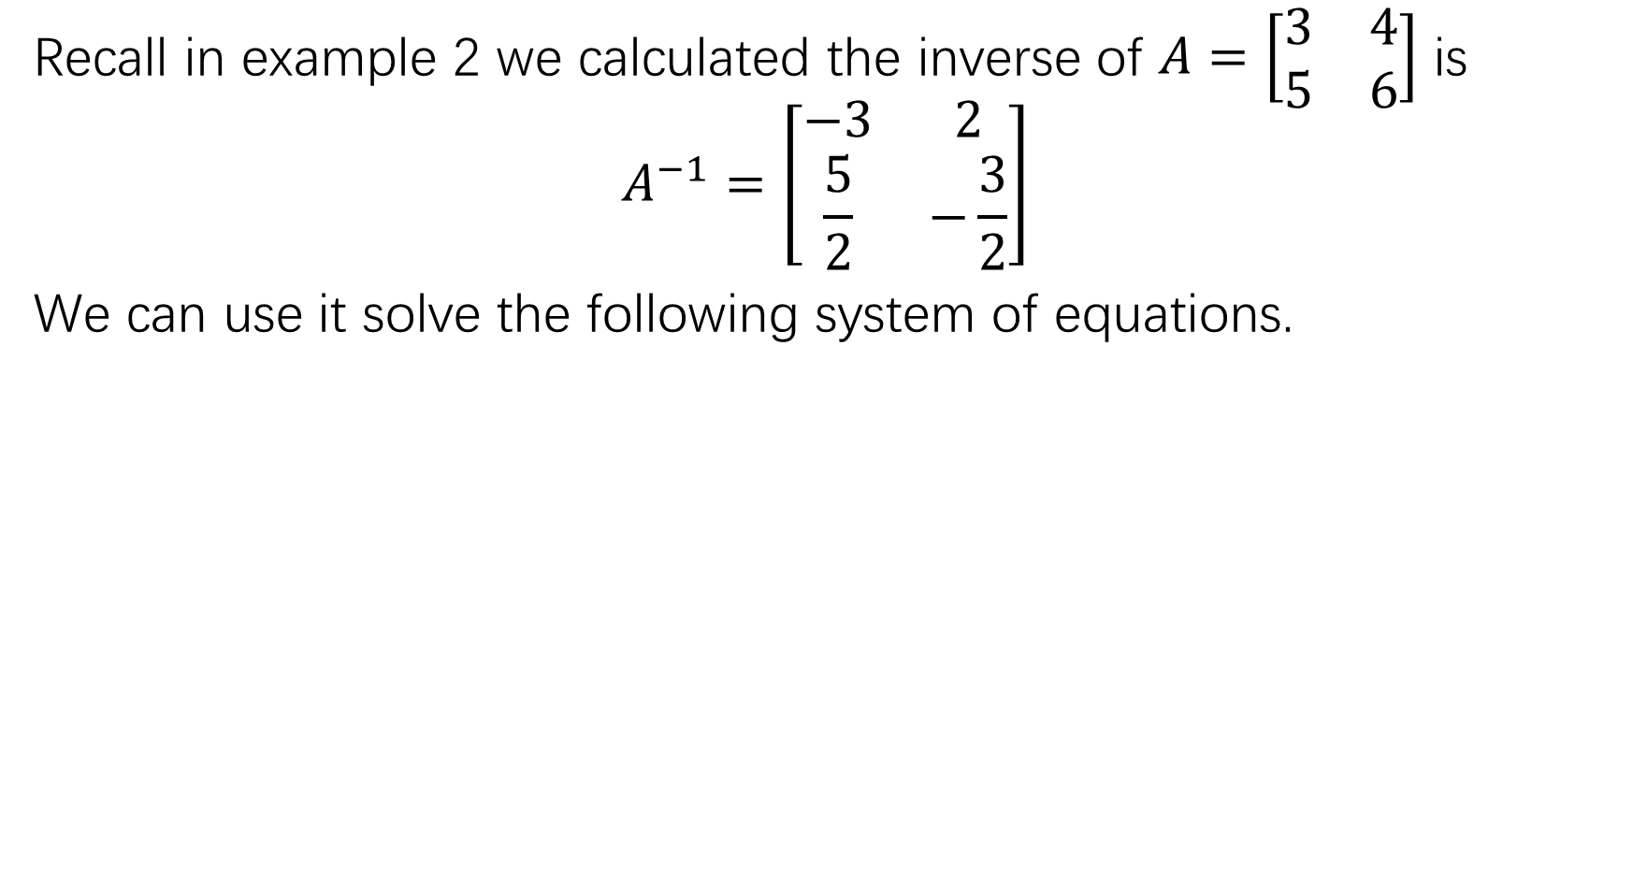
Recall in example 2 we calculated the inverse of $A=\left[\begin{matrix}3 & 4 \\ 5 & 6\end{matrix}\right]$ is
$$A^{−1}=\left[\begin{matrix}−3 & 2 \\ \frac{5}{2} & −\frac{3}{2}\end{matrix}\right]$$
We can use it solve the following system of equations.

Slide 17
Cautions:
This method does not apply to all systems of linear equations! It applies only when
The number of the variables equals the number of the equations.
The coefficient matrix is invertible.
When the method is applicable, we can conclude that the solution of the system of linear equations is unique.

Slide 18
Formal properties of matrix inverse
Here we give a proof of (b). You may check the proof of the other two properties in the book.

Slide 19
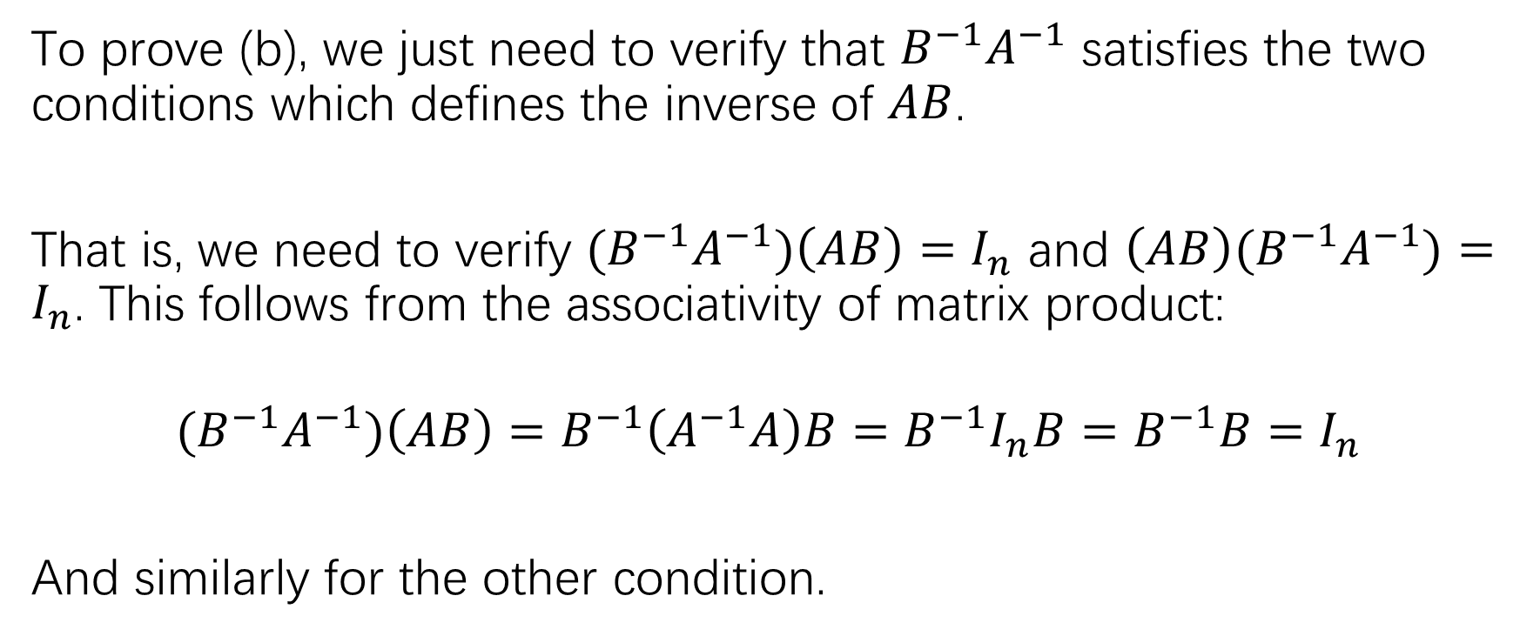
Proof of (b)
To prove (b), we just need to verify that $B^{−1}A^{−1}$ satisfies the two conditions which defines the inverse of $AB$.
That is, we need to verify ${(B}^{−1}A^{−1})\left(AB\right)=I_{n}$ and $\left(AB\right){(B}^{−1}A^{−1})=I_{n}$. This follows from the associativity of matrix product:
$${(B}^{−1}A^{−1})\left(AB\right)=B^{−1}\left(A^{−1}A\right)B=B^{−1}I_{n}B=B^{−1}B=I_{n}$$
And similarly for the other condition.

Slide 20
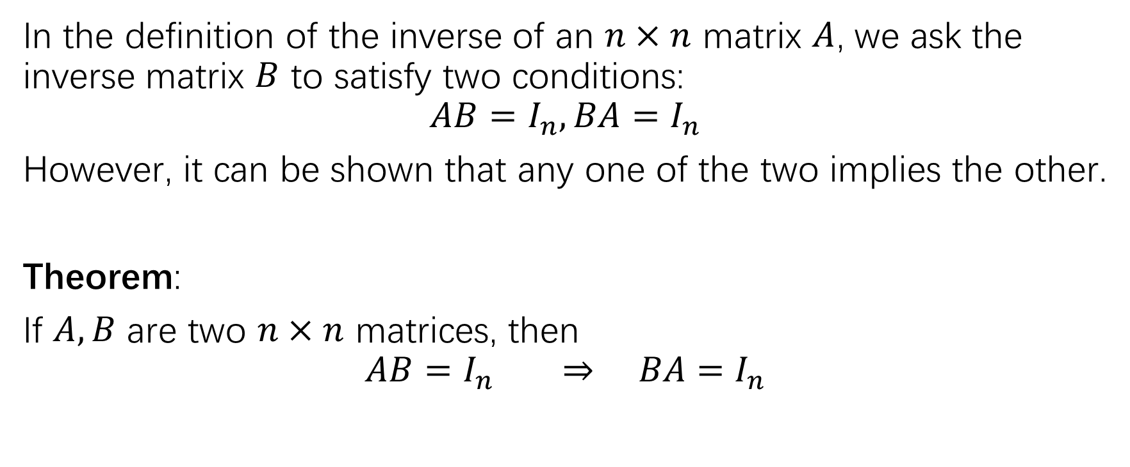
A useful theorem about matrix inverse
In the definition of the inverse of an $n×n$ matrix $A$, we ask the inverse matrix $B$ to satisfy two conditions:
$$AB=I_{n}, BA=I_{n}$$
However, it can be shown that any one of the two implies the other.
Theorem:
If $A,B$ are two $n×n$ matrices, then
$$AB=I_{n} ⇒ BA=I_{n}$$

Slide 21
An algorithm to compute the matrix inverse

Slide 24
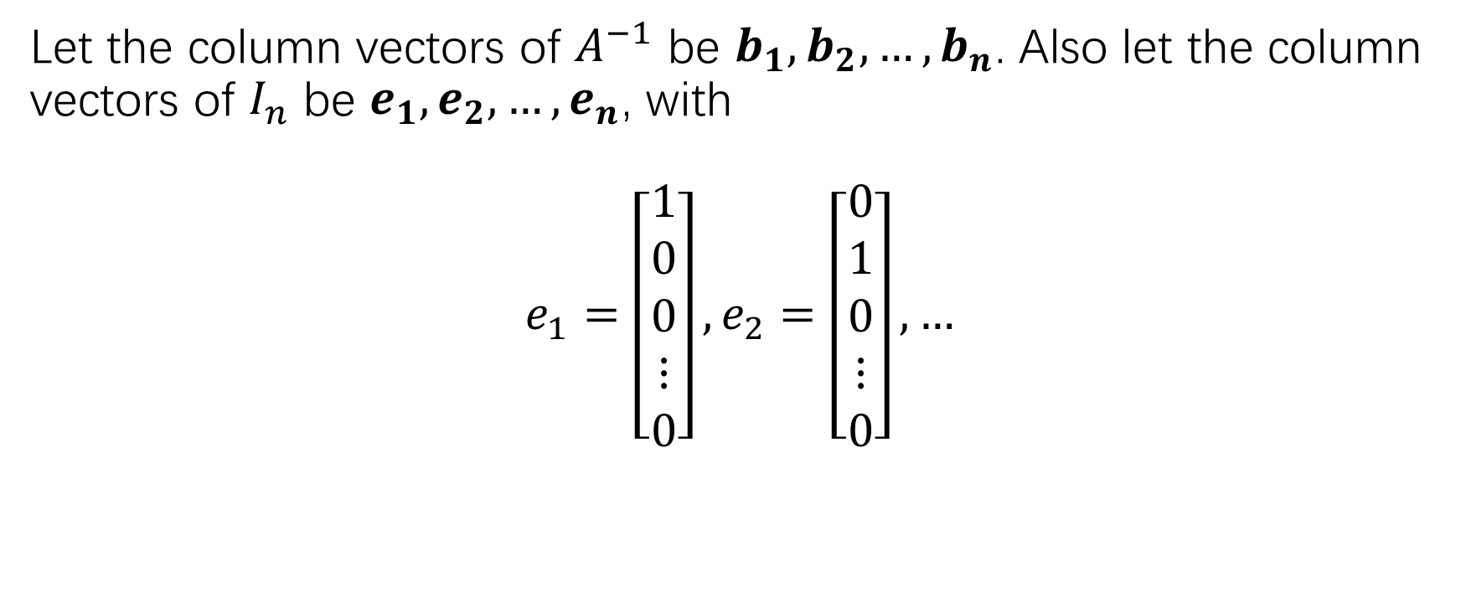
Another view of matrix inversion
Let the column vectors of $A^{−1}$ be $b_{1},b_{2},…,b_{n}$. Also let the column vectors of $I_{n}$ be $e_{1},e_{2},…,e_{n}$, with
$$e_{1}=\left[\begin{matrix}1 \\ 0 \\ 0 \\ ⋮ \\ 0\end{matrix}\right], e_{2}=\left[\begin{matrix}0 \\ 1 \\ 0 \\ ⋮ \\ 0\end{matrix}\right],…$$

Slide 25
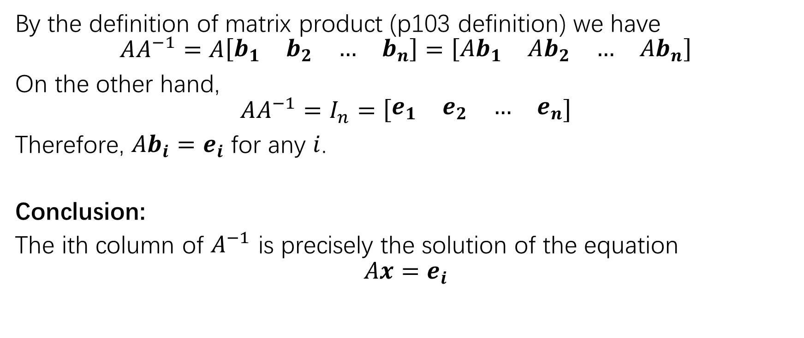
Another view of matrix inversion
By the definition of matrix product (p103 definition) we have
$$AA^{−1}=A\left[\begin{matrix}b_{1} & b_{2} & … & b_{n}\end{matrix}\right]=\left[\begin{matrix}{Ab}_{1} & Ab_{2} & … & {Ab}_{n}\end{matrix}\right]$$
On the other hand,
$$AA^{−1}=I_{n}=\left[\begin{matrix}e_{1} & e_{2} & … & e_{n}\end{matrix}\right]$$
Therefore, $Ab_{i}=e_{i}$ for any $i$.
Conclusion:
The ith column of $A^{−1}$ is precisely the solution of the equation
$$Ax=e_{i}$$

Slide 27
P117: Practice Problems 1,2
P117: Exercise: 1,3,5,6
P118: 29-34

