Slide 1
Linear Algebra
Lecturer: Xia Liao
Email: xliao@hqu.edu.cn
Homepage: https://hirzebruch.github.io/main.html
Time: every Tuesday 1-2, Thursday 3-4

Slide 2
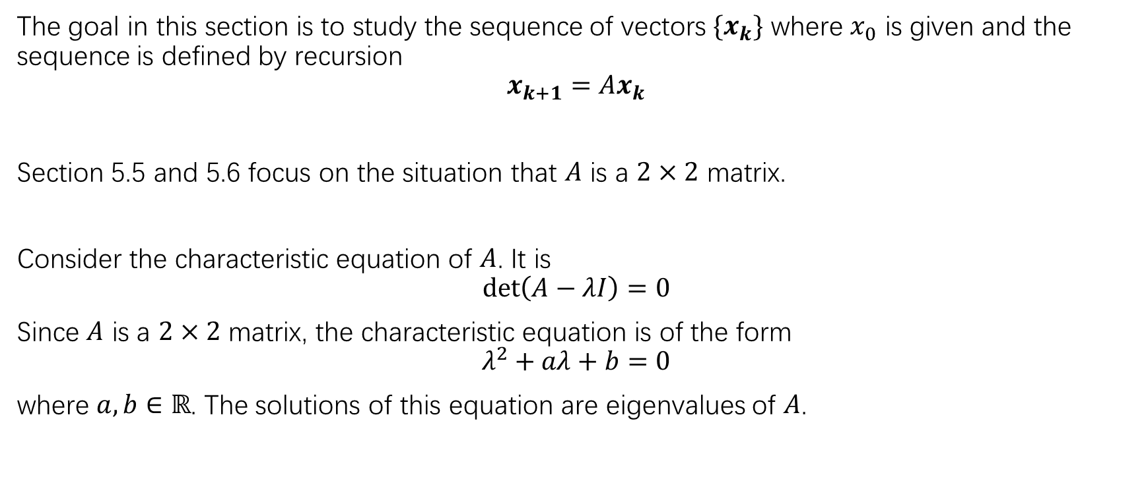
Discrete dynamic systems
The goal in this section is to study the sequence of vectors $\{x_{k}\}$ where $x_{0}$ is given and the sequence is defined by recursion
$$x_{k+1}=Ax_{k}$$
Section 5.5 and 5.6 focus on the situation that $A$ is a $2×2$ matrix.
Consider the characteristic equation of $A$. It is
$$\det\left(A−λI\right)=0$$
Since $A$ is a $2×2$ matrix, the characteristic equation is of the form
$$λ^{2}+aλ+b=0$$
where $a,b∈ℝ$. The solutions of this equation are eigenvalues of $A$.

Slide 3
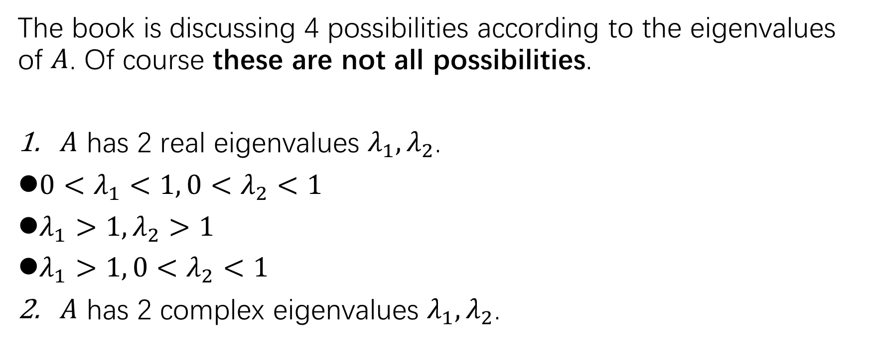
4 cases of 2-dimensional discrete dynamic systems
The book is discussing 4 possibilities according to the eigenvalues of $A$. Of course these are not all possibilities.
$A$ has 2 real eigenvalues $λ_{1}, λ_{2}$.
${0<λ}_{1}<1,{0<λ}_{2}<1$
$λ_{1}>1,λ_{2}>1$
$λ_{1}>1,{0<λ}_{2}<1$
$A$ has 2 complex eigenvalues $λ_{1}, λ_{2}$.

Slide 4
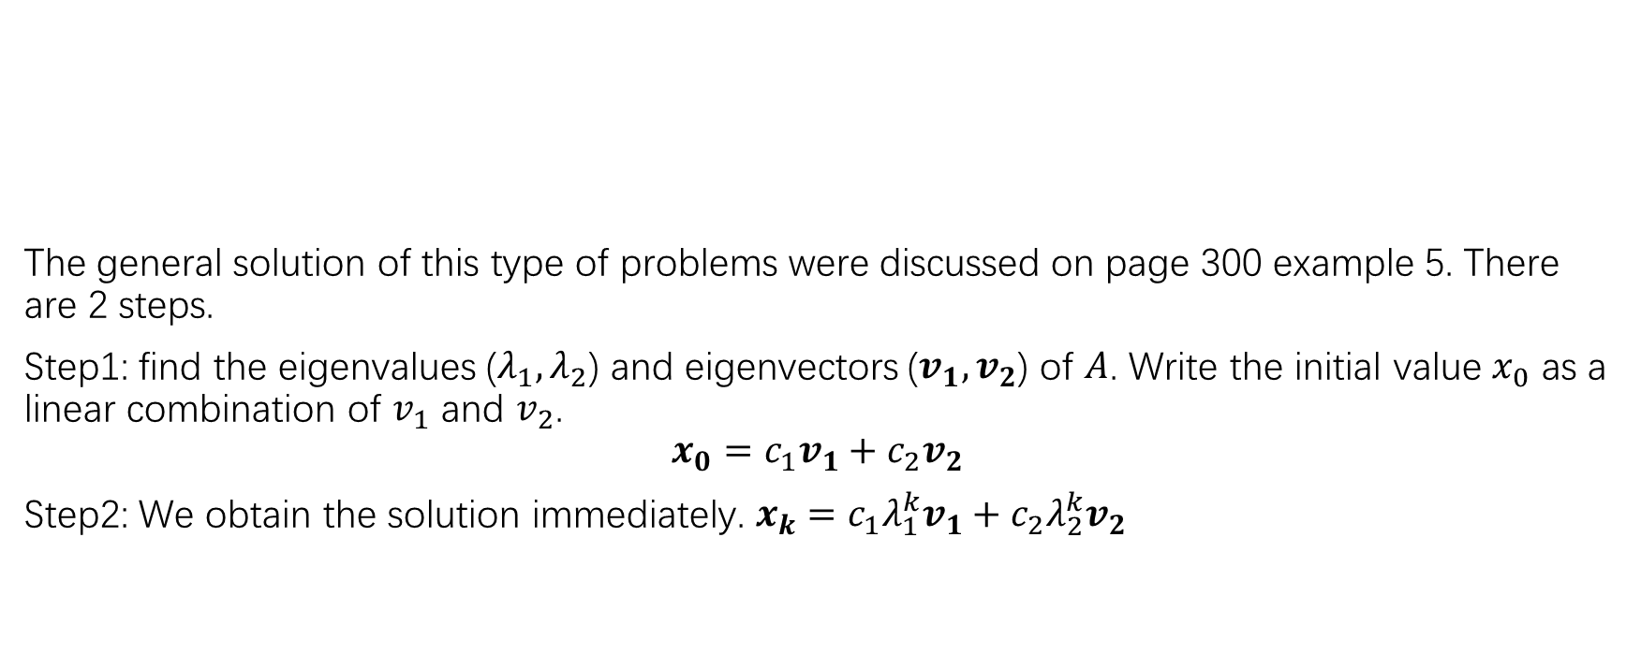

$${0<λ}_{1}<1,{0<λ}_{2}<1$$
The general solution of this type of problems were discussed on page 300 example 5. There are 2 steps.
Step1: find the eigenvalues ($λ_{1},λ_{2}$) and eigenvectors ($v_{1},v_{2}$) of $A$. Write the initial value $x_{0}$ as a linear combination of $v_{1}$ and $v_{2}$.
$$x_{0}=c_{1}v_{1}+c_{2}v_{2}$$
Step2: We obtain the solution immediately. $x_{k}=c_{1}λ_{1}^{k}v_{1}+c_{2}λ_{2}^{k}v_{2}$

Slide 7
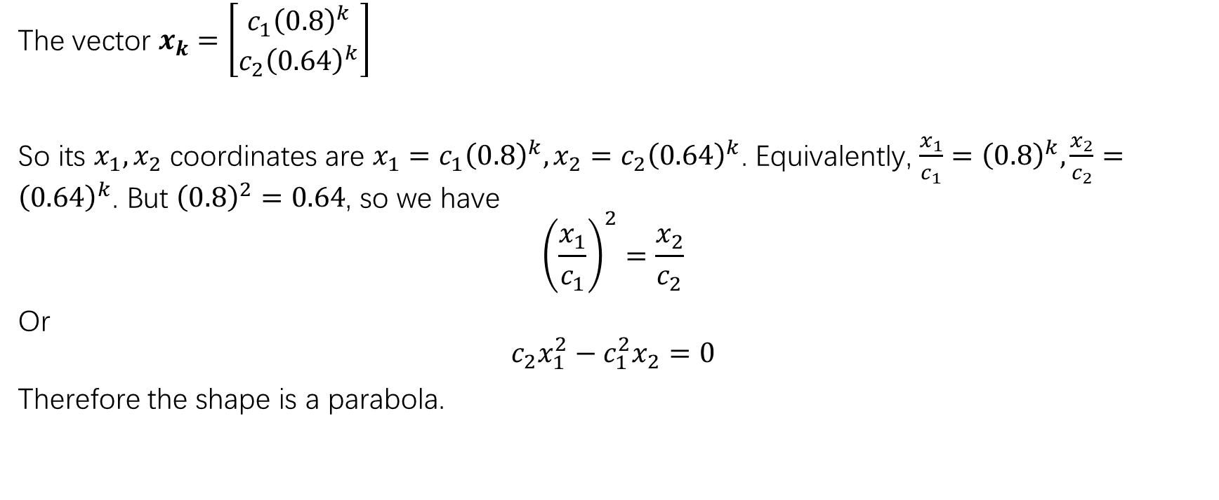
The reason for the parabolic shapes of the trajectories
The vector $x_{k}=\left[\begin{matrix}c_{1}{\left(0.8\right)}^{k} \\ c_{2}{\left(0.64\right)}^{k}\end{matrix}\right]$
So its $x_{1},x_{2}$ coordinates are $x_{1}=c_{1}{\left(0.8\right)}^{k}, x_{2}=c_{2}{\left(0.64\right)}^{k}$. Equivalently, $\frac{x_{1}}{c_{1}}={\left(0.8\right)}^{k},\frac{x_{2}}{c_{2}}={\left(0.64\right)}^{k}$. But ${\left(0.8\right)}^{2}=0.64$, so we have
$${\left(\frac{x_{1}}{c_{1}}\right)}^{2}=\frac{x_{2}}{c_{2}}$$
Or
$$c_{2}x_{1}^{2}−c_{1}^{2}x_{2}=0$$
Therefore the shape is a parabola.

Slide 8
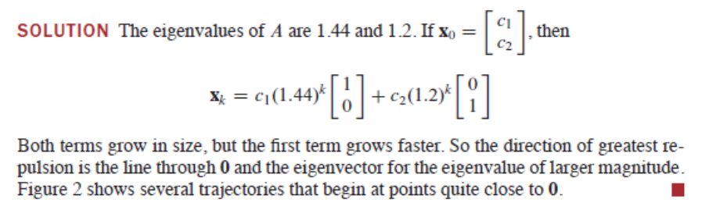

$$λ_{1}>1,λ_{2}>1$$

Slide 9
The origin as a repeller
Ex: try to explain the parabolic shape of the trajectory

Slide 10

$$λ_{1}>1,{0<λ}_{2}<1$$

Slide 11
The origin as a saddle point

Slide 13
The eigenvectors generate the asymptotes

Slide 14
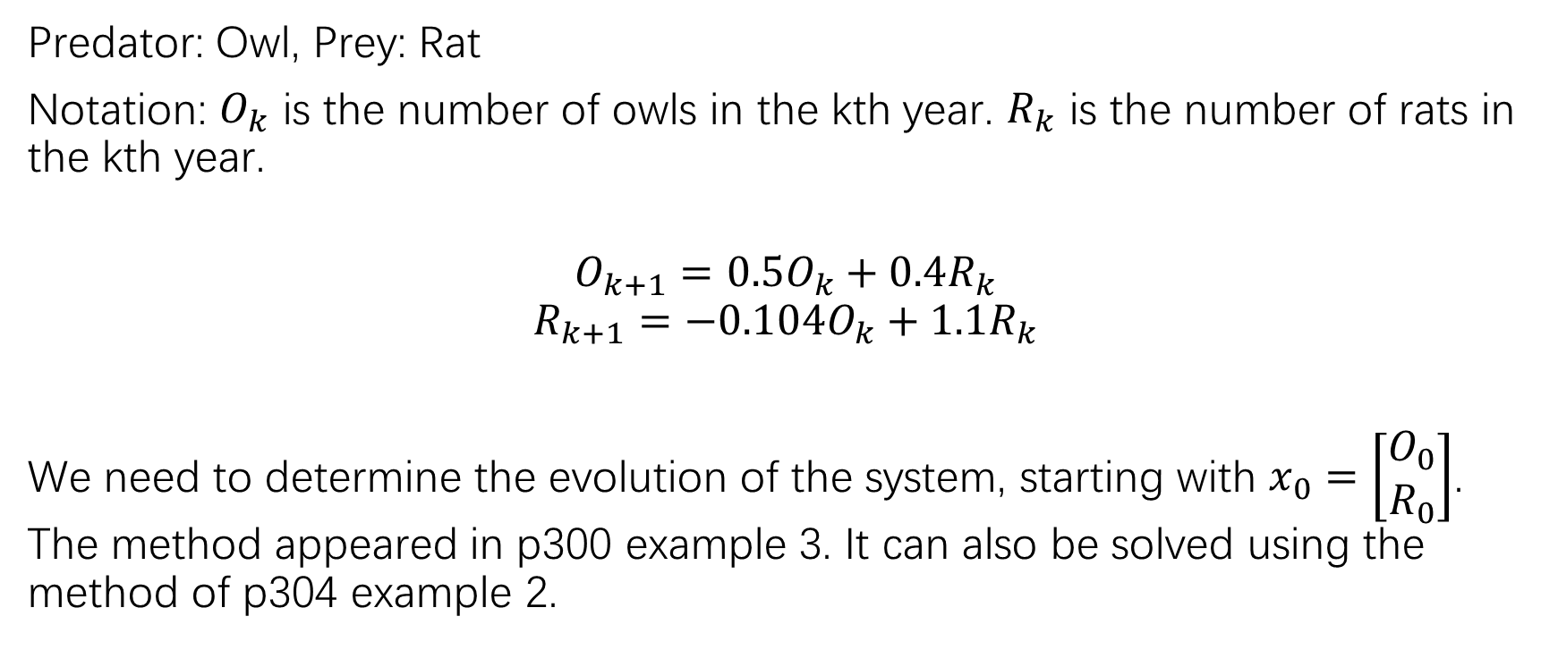
A predator prey system
Predator: Owl, Prey: Rat
Notation: $O_{k}$ is the number of owls in the kth year. $R_{k}$ is the number of rats in the kth year.
$$O_{k+1}=0.5O_{k}+0.4R_{k}$$
$$R_{k+1}=−0.104O_{k}+1.1R_{k}$$
We need to determine the evolution of the system, starting with $x_{0}=\left[\begin{matrix}O_{0} \\ R_{0}\end{matrix}\right]$. The method appeared in p300 example 3. It can also be solved using the method of p304 example 2.

Slide 15
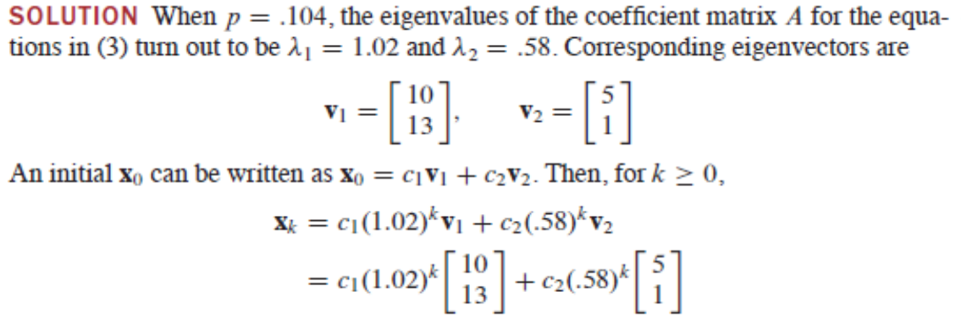
Ex: Analyze the asymptotic behavior of the solution. Also demonstrate the meaning of the asymptotic solution in the original ecosystem.

Slide 16
Complex eigenvalues
There are also several subcases. We briefly discuss 2 cases.
If the norm of the complex eigenvalues are 1, then the trajectory of the discrete dynamic system is a closed ellipse.
If the norm of the complex eigenvalues are less than 1, then the origin is an attractor.

Slide 17
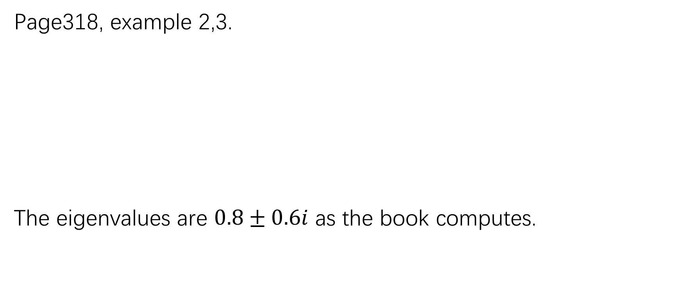
Norm=1
Page318, example 2,3.
The eigenvalues are $0.8±0.6i$ as the book computes.

Slide 18
Norm=1, trajectory

Slide 20
Norm<1, the origin as an attractor
P329: example 6

Slide 22
The extinction of the spotted owl
The mathematical model:

Slide 23
Looking for eigenvalues:
Writing out the general solution and analyze the asymptotic behavior of the solutions:

Slide 24
Model revision: the survivial

Slide 26
HW
The homework will not be collected on Thursday, but do not skip doing it at home by yourself. Impose self-mastery!
P331: 1,2
P332: read the solution of 3-6

