Slide 1
Linear Algebra
Lecturer: Xia Liao
Email: xliao@hqu.edu.cn
Homepage: https://hirzebruch.github.io/main.html
Time: every Tuesday 1-2, Thursday 3-4

Slide 2
Invertible matrices

Slide 3
Algorithm for computing invertible matrices

Slide 5
Elementary matrices
Elementary matrices are special invertible matrices.
They are called elementary matrices because they are related to elementary row operations.
There are 3 types of elementary matrices, just as there are 3 types of elementary operations.
Recall on page 6 the three elementary operations are called (1) replacement, (2) interchange, (3) scaling.

Slide 6
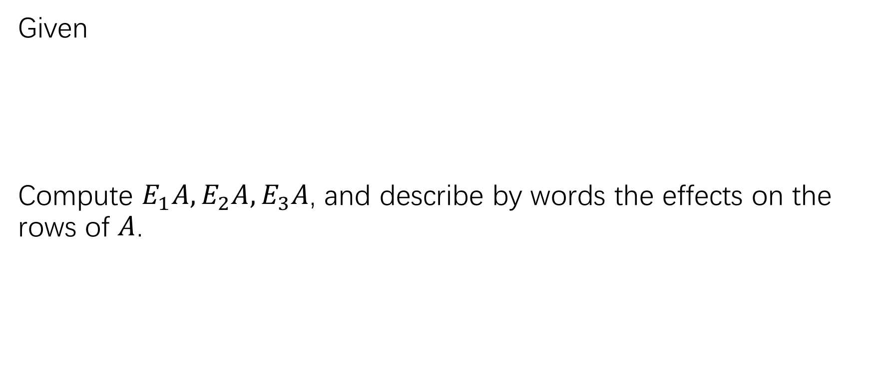
Elementary matrices
Given
Compute $E_{1}A, E_{2}A, E_{3}A$, and describe by words the effects on the rows of $A$.

Slide 7
Elementary matrices

Slide 8
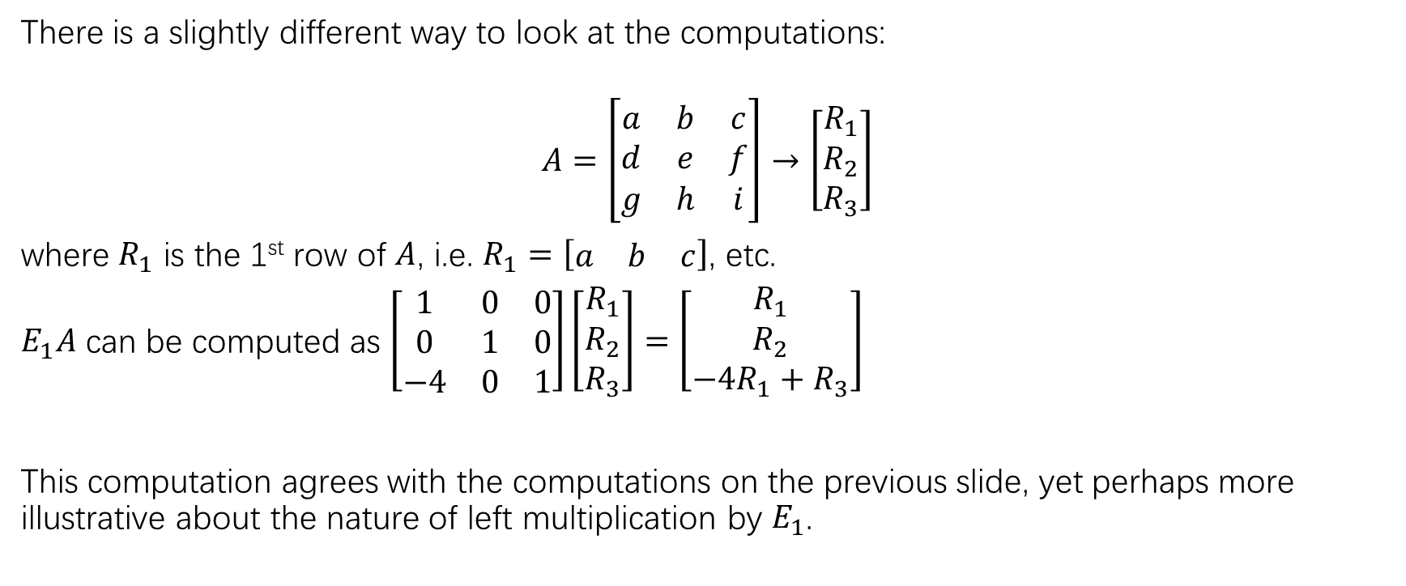
Elementary matrices
There is a slightly different way to look at the computations:
$$A=\left[\begin{matrix}a & b & c \\ d & e & f \\ g & h & i\end{matrix}\right]→\left[\begin{matrix}R_{1} \\ R_{2} \\ R_{3}\end{matrix}\right]$$
where $R_{1}$ is the 1st row of $A$, i.e. $R_{1}=\left[\begin{matrix}a & b & c\end{matrix}\right]$, etc.
$E_{1}A$ can be computed as $\left[\begin{matrix}1 & 0 & 0 \\ 0 & 1 & 0 \\ −4 & 0 & 1\end{matrix}\right]\left[\begin{matrix}R_{1} \\ R_{2} \\ R_{3}\end{matrix}\right]=\left[\begin{matrix}R_{1} \\ R_{2} \\ {−4R_{1}+R}_{3}\end{matrix}\right]$
This computation agrees with the computations on the previous slide, yet perhaps more illustrative about the nature of left multiplication by $E_{1}$.

Slide 9
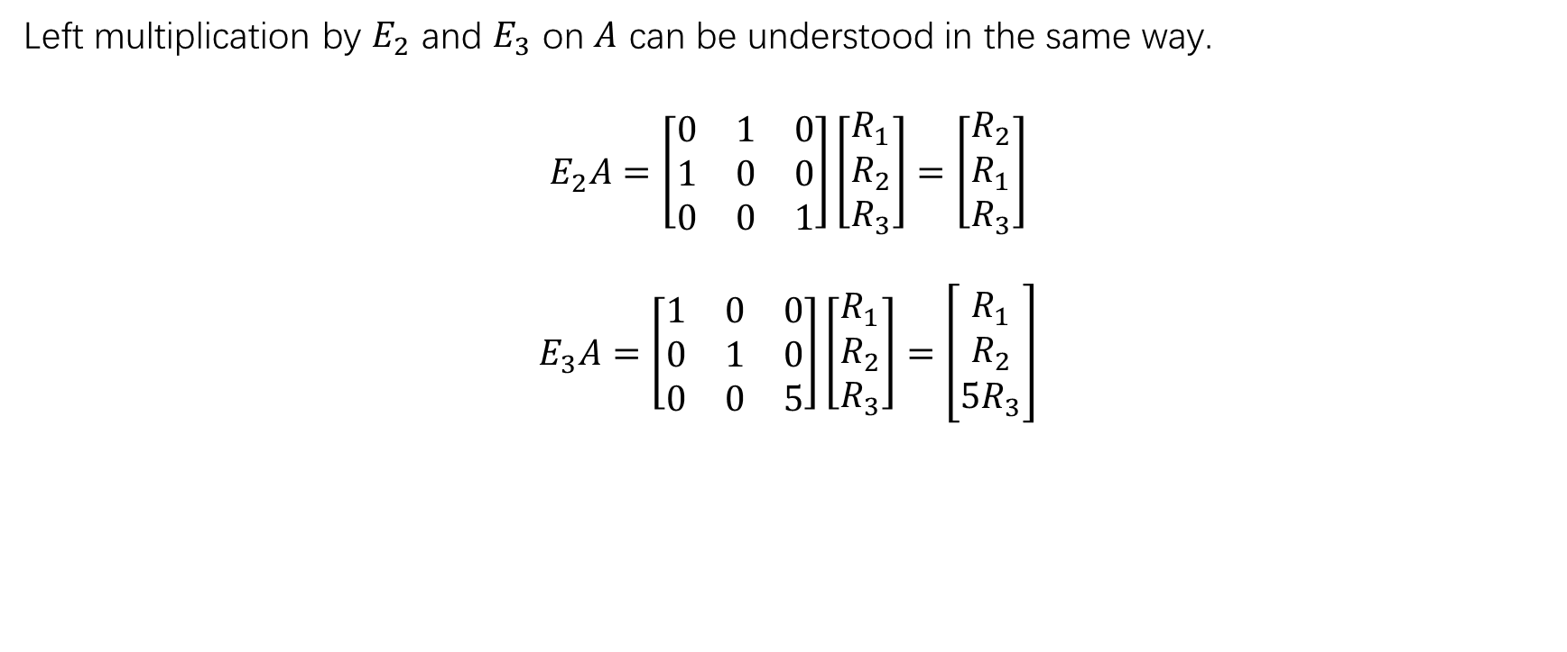
Elementary matrices
Left multiplication by $E_{2}$ and $E_{3}$ on $A$ can be understood in the same way.
$$E_{2}A=\left[\begin{matrix}0 & 1 & 0 \\ 1 & 0 & 0 \\ 0 & 0 & 1\end{matrix}\right]\left[\begin{matrix}R_{1} \\ R_{2} \\ R_{3}\end{matrix}\right]=\left[\begin{matrix}R_{2} \\ R_{1} \\ R_{3}\end{matrix}\right]$$
$$E_{3}A=\left[\begin{matrix}1 & 0 & 0 \\ 0 & 1 & 0 \\ 0 & 0 & 5\end{matrix}\right]\left[\begin{matrix}R_{1} \\ R_{2} \\ R_{3}\end{matrix}\right]=\left[\begin{matrix}R_{1} \\ R_{2} \\ {5R}_{3}\end{matrix}\right]$$

Slide 10
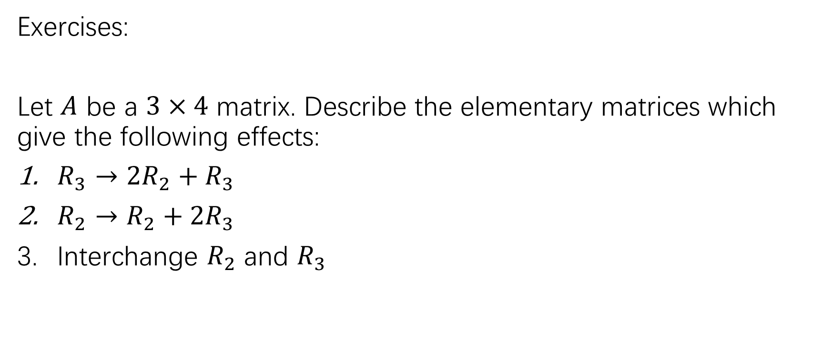
Elementary matrices
Exercises:
Let $A$ be a $3×4$ matrix. Describe the elementary matrices which give the following effects:
$R_{3}→2R_{2}+R_{3}$
$R_{2}→R_{2}+2R_{3}$
Interchange $R_{2}$ and $R_{3}$

Slide 11
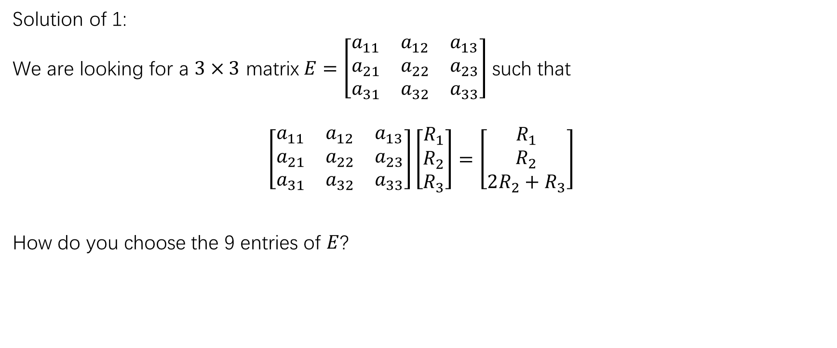
Solution of 1:
We are looking for a $3×3$ matrix$E=\left[\begin{matrix}a_{11} & a_{12} & a_{13} \\ a_{21} & a_{22} & a_{23} \\ a_{31} & a_{32} & a_{33}\end{matrix}\right]$ such that
$$\left[\begin{matrix}a_{11} & a_{12} & a_{13} \\ a_{21} & a_{22} & a_{23} \\ a_{31} & a_{32} & a_{33}\end{matrix}\right]\left[\begin{matrix}R_{1} \\ R_{2} \\ R_{3}\end{matrix}\right]=\left[\begin{matrix}R_{1} \\ R_{2} \\ 2R_{2}+R_{3}\end{matrix}\right]$$
How do you choose the 9 entries of $E$?

Slide 12
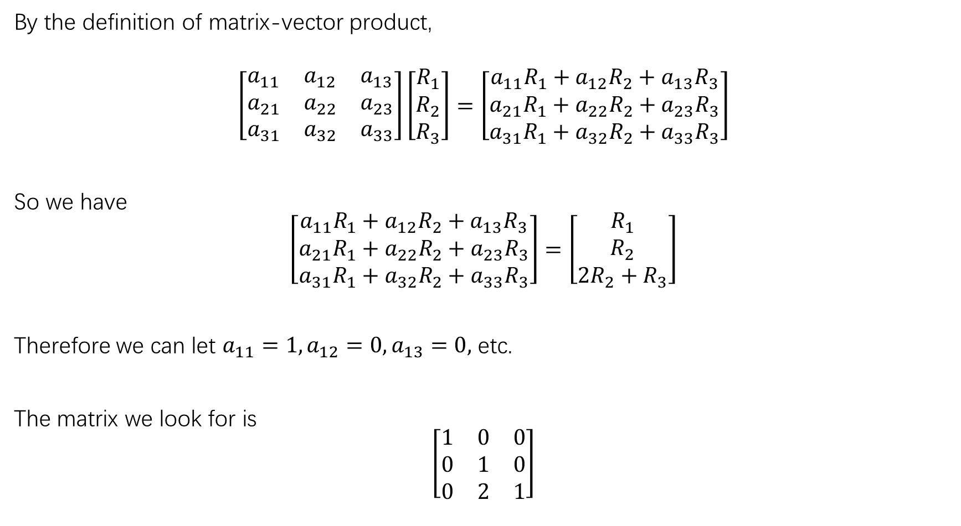
By the definition of matrix-vector product,
$$\left[\begin{matrix}a_{11} & a_{12} & a_{13} \\ a_{21} & a_{22} & a_{23} \\ a_{31} & a_{32} & a_{33}\end{matrix}\right]\left[\begin{matrix}R_{1} \\ R_{2} \\ R_{3}\end{matrix}\right]=\left[\begin{matrix}{a_{11}R}_{1}+a_{12}R_{2}+a_{13}R_{3} \\ a_{21}R_{1}+a_{22}R_{2}+a_{23}R_{3} \\ a_{31}R_{1}+a_{32}R_{2}+a_{33}R_{3}\end{matrix}\right]$$
So we have
$$\left[\begin{matrix}{a_{11}R}_{1}+a_{12}R_{2}+a_{13}R_{3} \\ a_{21}R_{1}+a_{22}R_{2}+a_{23}R_{3} \\ a_{31}R_{1}+a_{32}R_{2}+a_{33}R_{3}\end{matrix}\right]=\left[\begin{matrix}R_{1} \\ R_{2} \\ 2R_{2}+R_{3}\end{matrix}\right]$$
Therefore we can let $a_{11}=1,a_{12}=0,a_{13}=0,$ etc.
The matrix we look for is
$$\left[\begin{matrix}1 & 0 & 0 \\ 0 & 1 & 0 \\ 0 & 2 & 1\end{matrix}\right]$$

Slide 13
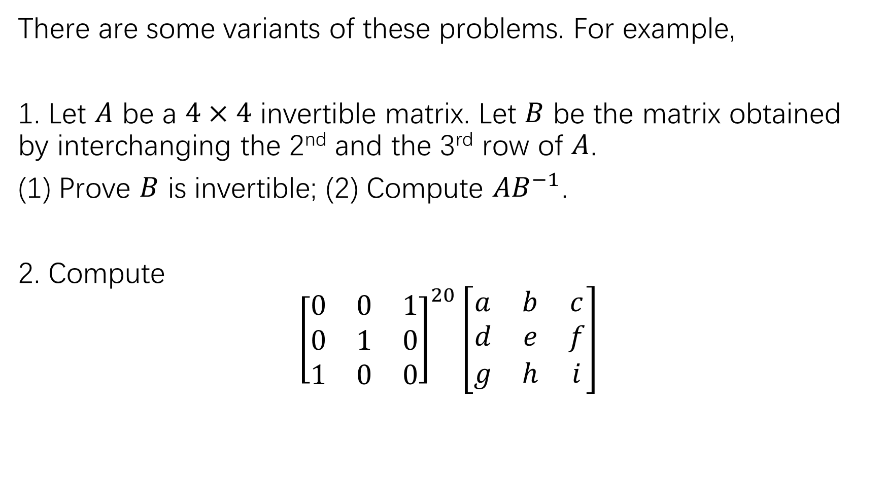
There are some variants of these problems. For example,
1. Let $A$ be a $4×4$ invertible matrix. Let $B$ be the matrix obtained by interchanging the 2nd and the 3rd row of $A$.
(1) Prove $B$ is invertible; (2) Compute $AB^{−1}$.
2. Compute
$${\left[\begin{matrix}0 & 0 & 1 \\ 0 & 1 & 0 \\ 1 & 0 & 0\end{matrix}\right]}^{20}\left[\begin{matrix}a & b & c \\ d & e & f \\ g & h & i\end{matrix}\right]$$

Slide 14
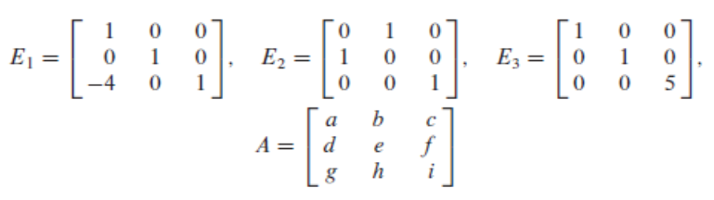
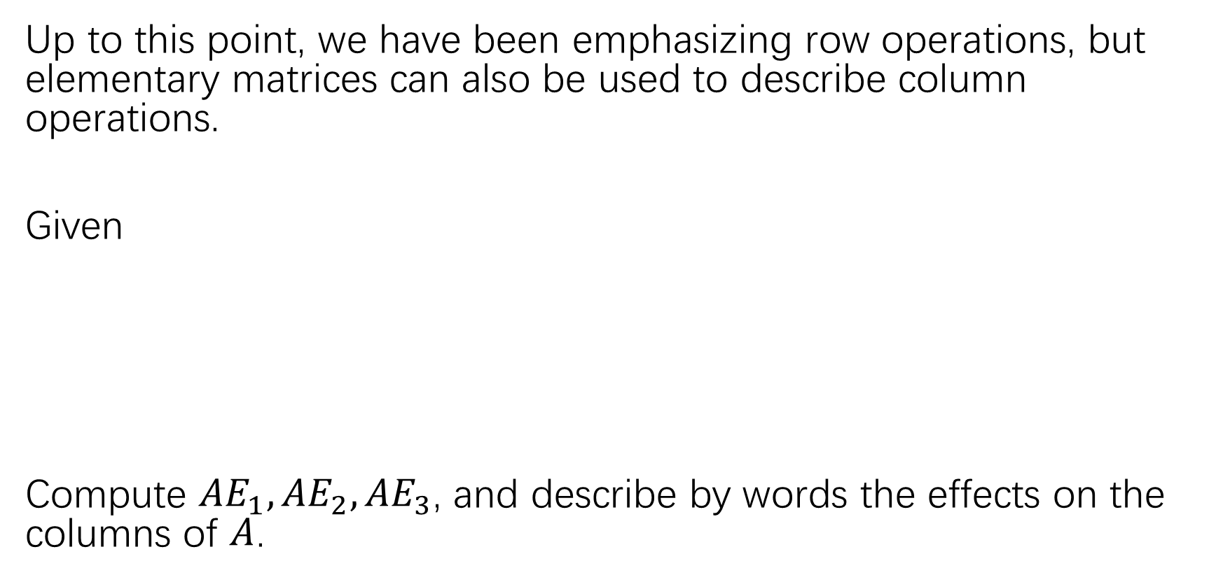
Column operations
Up to this point, we have been emphasizing row operations, but elementary matrices can also be used to describe column operations.
Given
Compute ${AE}_{1}, {AE}_{2}, {AE}_{3}$, and describe by words the effects on the columns of $A$.

Slide 15
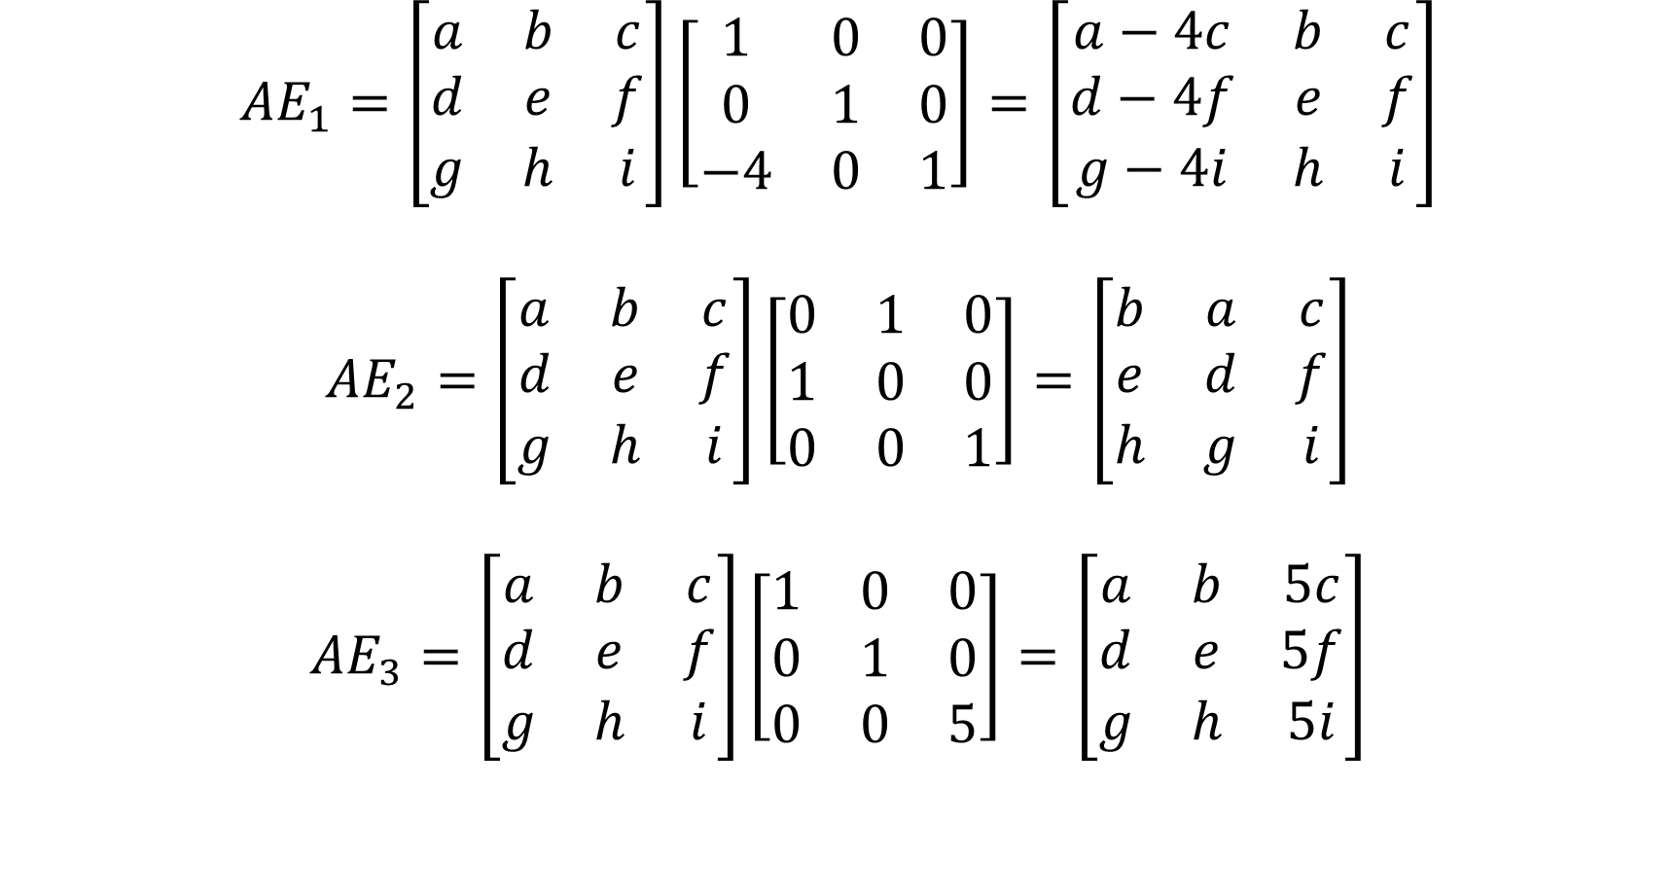
$${AE}_{1}=\left[\begin{matrix}a & b & c \\ d & e & f \\ g & h & i\end{matrix}\right]\left[\begin{matrix}1 & 0 & 0 \\ 0 & 1 & 0 \\ −4 & 0 & 1\end{matrix}\right]=\left[\begin{matrix}a−4c & b & c \\ d−4f & e & f \\ g−4i & h & i\end{matrix}\right]$$
$${AE}_{2}=\left[\begin{matrix}a & b & c \\ d & e & f \\ g & h & i\end{matrix}\right]\left[\begin{matrix}0 & 1 & 0 \\ 1 & 0 & 0 \\ 0 & 0 & 1\end{matrix}\right]=\left[\begin{matrix}b & a & c \\ e & d & f \\ h & g & i\end{matrix}\right]$$
$${AE}_{3}=\left[\begin{matrix}a & b & c \\ d & e & f \\ g & h & i\end{matrix}\right]\left[\begin{matrix}1 & 0 & 0 \\ 0 & 1 & 0 \\ 0 & 0 & 5\end{matrix}\right]=\left[\begin{matrix}a & b & 5c \\ d & e & 5f \\ g & h & 5i\end{matrix}\right]$$

Slide 16
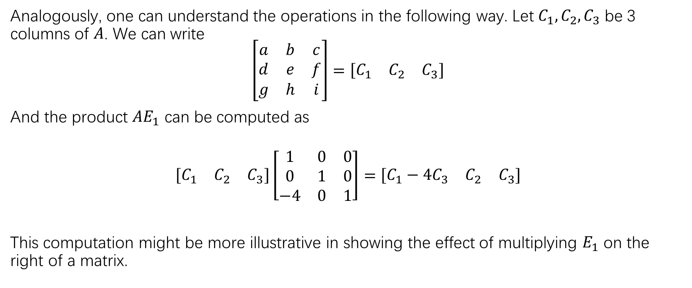
Column operations
Analogously, one can understand the operations in the following way. Let $C_{1},C_{2},C_{3}$ be 3 columns of $A$. We can write
$$\left[\begin{matrix}a & b & c \\ d & e & f \\ g & h & i\end{matrix}\right]=\left[\begin{matrix}C_{1} & C_{2} & C_{3}\end{matrix}\right]$$
And the product $AE_{1}$ can be computed as
$$\left[\begin{matrix}C_{1} & C_{2} & C_{3}\end{matrix}\right]\left[\begin{matrix}1 & 0 & 0 \\ 0 & 1 & 0 \\ −4 & 0 & 1\end{matrix}\right]=\left[\begin{matrix}C_{1}−4C_{3} & C_{2} & C_{3}\end{matrix}\right]$$
This computation might be more illustrative in showing the effect of multiplying $E_{1}$ on the right of a matrix.

Slide 17
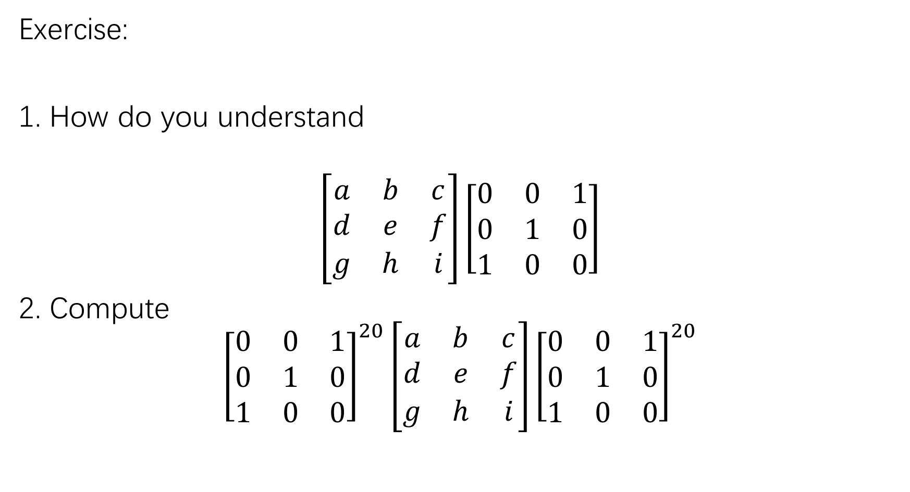
Exercise:
1. How do you understand
$$\left[\begin{matrix}a & b & c \\ d & e & f \\ g & h & i\end{matrix}\right]\left[\begin{matrix}0 & 0 & 1 \\ 0 & 1 & 0 \\ 1 & 0 & 0\end{matrix}\right]$$
2. Compute
$${\left[\begin{matrix}0 & 0 & 1 \\ 0 & 1 & 0 \\ 1 & 0 & 0\end{matrix}\right]}^{20}\left[\begin{matrix}a & b & c \\ d & e & f \\ g & h & i\end{matrix}\right]{\left[\begin{matrix}0 & 0 & 1 \\ 0 & 1 & 0 \\ 1 & 0 & 0\end{matrix}\right]}^{20}$$

Slide 18
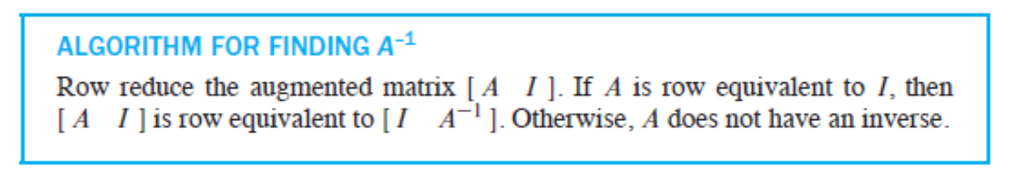
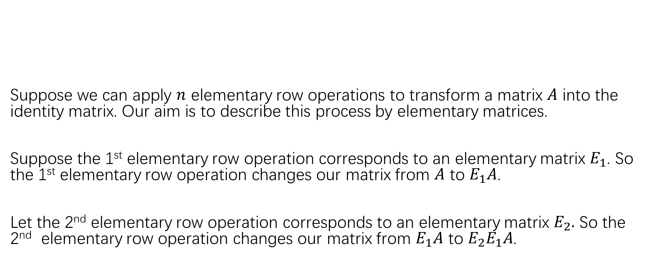
The proof of the algorithm for finding the invertible matrix
Suppose we can apply $n$ elementary row operations to transform a matrix $A$ into the identity matrix. Our aim is to describe this process by elementary matrices.
Suppose the 1st elementary row operation corresponds to an elementary matrix $E_{1}$. So the 1st elementary row operation changes our matrix from $A$ to $E_{1}A$.
Let the 2nd elementary row operation corresponds to an elementary matrix $E_{2}.$ So the 2nd elementary row operation changes our matrix from $E_{1}A$ to $E_{2}E_{1}A$.

Slide 19
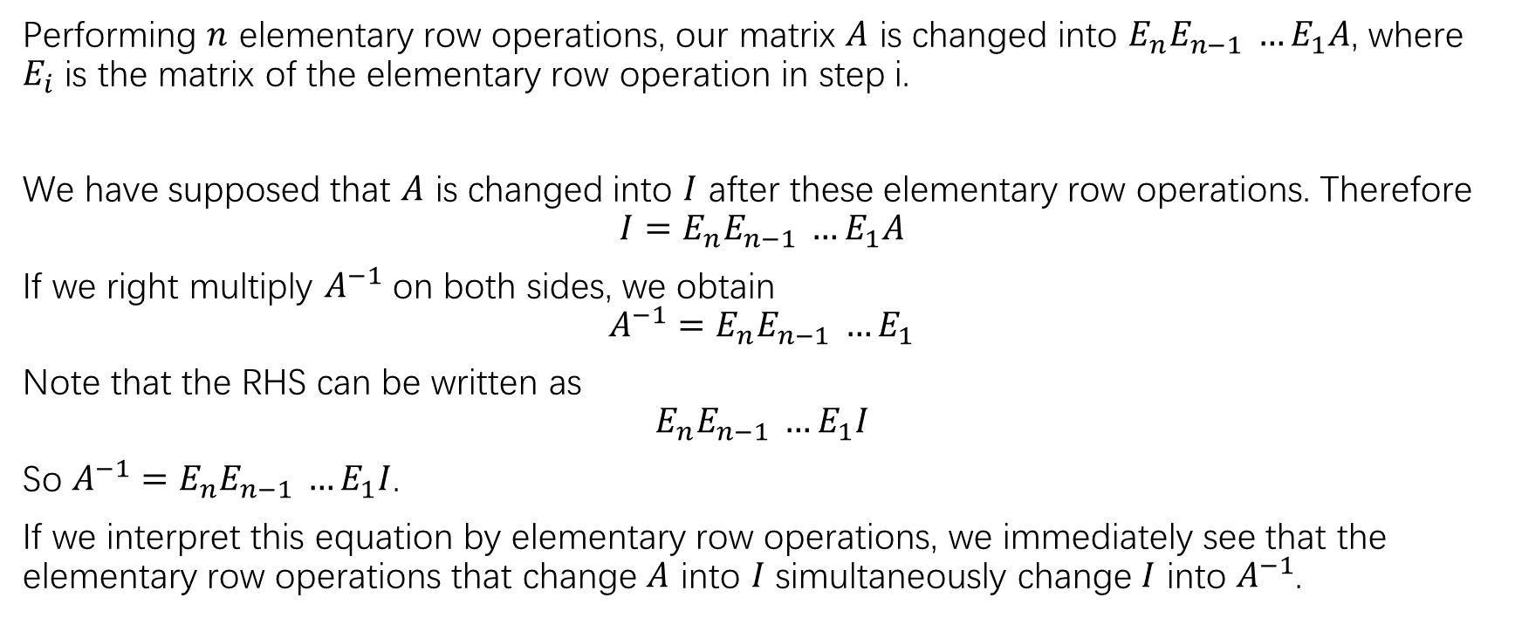
The proof of the algorithm for finding the invertible matrix
Performing $n$ elementary row operations, our matrix $A$ is changed into $E_{n}E_{n−1} …E_{1}A$, where $E_{i}$ is the matrix of the elementary row operation in step i.
We have supposed that $A$ is changed into $I$ after these elementary row operations. Therefore
$$I=E_{n}E_{n−1} …E_{1}A$$
If we right multiply $A^{−1}$ on both sides, we obtain
$$A^{−1}=E_{n}E_{n−1} …E_{1}$$
Note that the RHS can be written as
$$E_{n}E_{n−1} …E_{1}I$$
So $A^{−1}=E_{n}E_{n−1} …E_{1}I$.
If we interpret this equation by elementary row operations, we immediately see that the elementary row operations that change $A$ into $I$ simultaneously change $I$ into $A^{−1}$.

Slide 20
Characterization of invertible matrices

Slide 21
Proof of equivalence

Slide 22
Applications of invertible matrix theorem

Slide 23
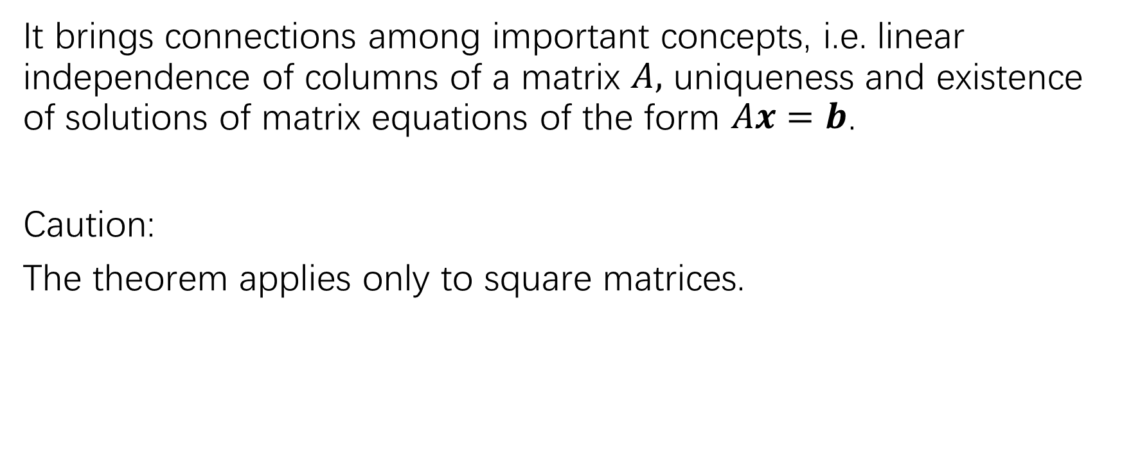
Significance of invertible matrix theorem
It brings connections among important concepts, i.e. linear independence of columns of a matrix $A,$ uniqueness and existence of solutions of matrix equations of the form $Ax=b$.
Caution:
The theorem applies only to square matrices.

Slide 24
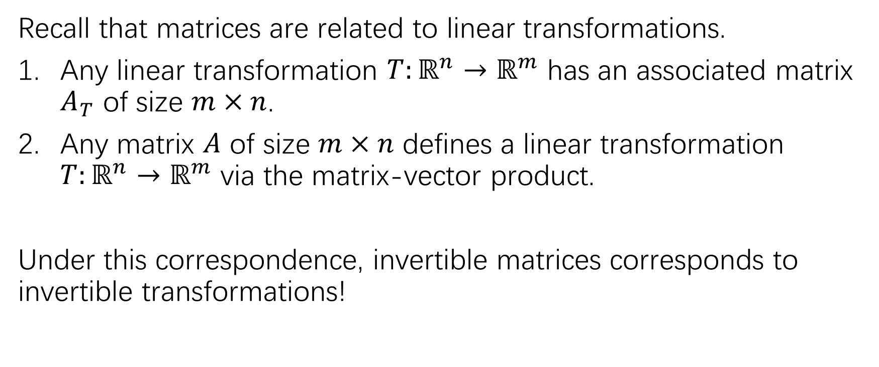
Invertible linear transformations
Recall that matrices are related to linear transformations.
Any linear transformation $T:ℝ^{n}→ℝ^{m}$ has an associated matrix $A_{T}$ of size $m×n$.
Any matrix $A$ of size $m×n$ defines a linear transformation $T:ℝ^{n}→ℝ^{m}$ via the matrix-vector product.
Under this correspondence, invertible matrices corresponds to invertible transformations!

Slide 25
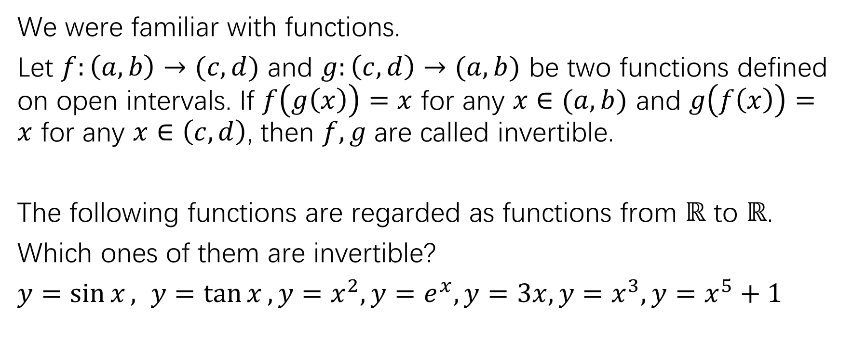
Invertible functions
We were familiar with functions.
Let $f:\left(a,b\right)→(c,d)$ and $g:\left(c,d\right)→(a,b)$ be two functions defined on open intervals. If $f\left(g\left(x\right)\right)=x$ for any $x∈(a,b)$ and $g\left(f\left(x\right)\right)=x$ for any $x∈\left(c,d\right)$, then $f,g$ are called invertible.
The following functions are regarded as functions from $ℝ$ to $ℝ$.
Which ones of them are invertible?
$y=\sin{x}, y=\tan{x}, y=x^{2}, y=e^{x}, y=3x, y=x^{3}, y=x^{5}+1$

Slide 26
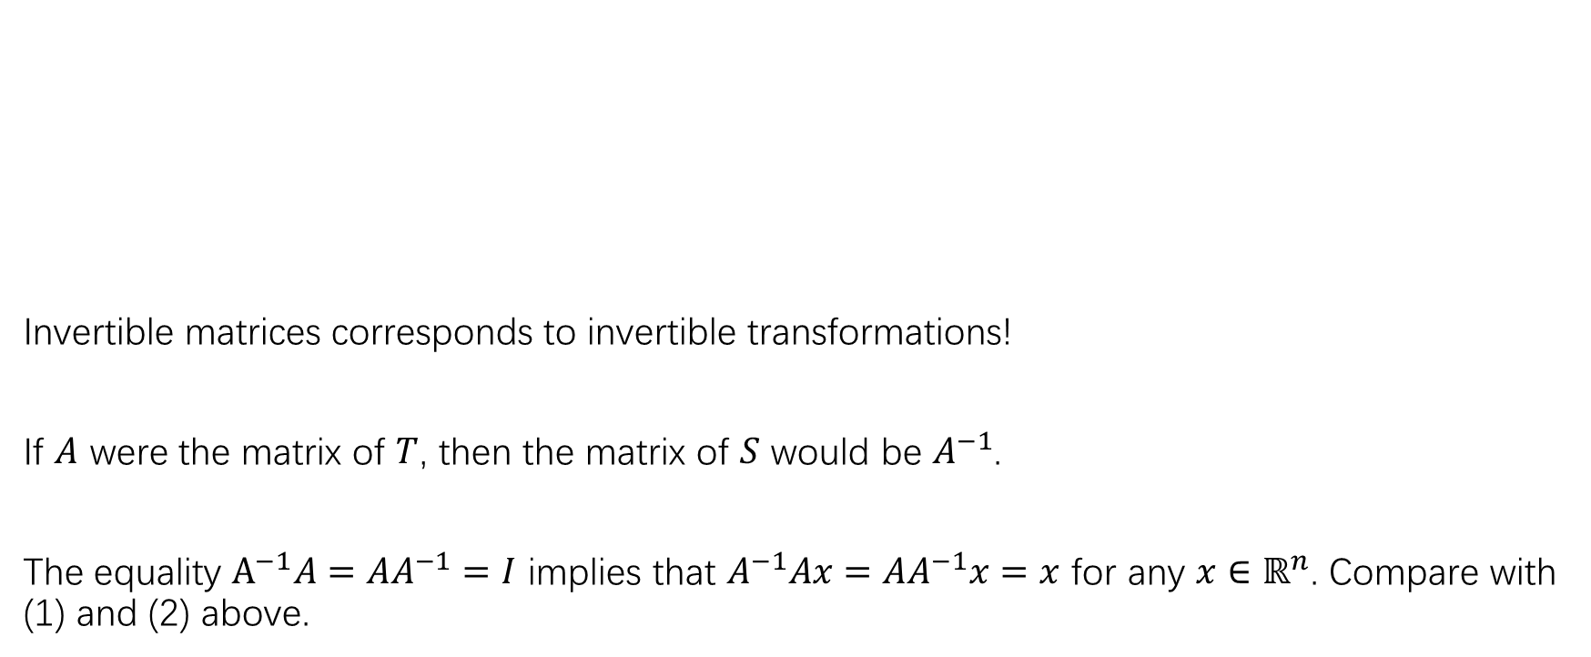
Invertible transformations
Invertible matrices corresponds to invertible transformations!
If $A$ were the matrix of $T$, then the matrix of $S$ would be $A^{−1}$.
The equality $A^{−1}A=AA^{−1}=I$ implies that $A^{−1}Ax=AA^{−1}x=x$ for any $x∈ℝ^{n}$. Compare with (1) and (2) above.

Slide 27
Mental/conceptual image of invertible transformations

Slide 28
Exercises:
P123: 11-29
HW:
P123:5-8

