Slide 1
Linear Algebra
Lecturer: Xia Liao
Email: xliao@hqu.edu.cn
Homepage: https://hirzebruch.github.io/main.html
Time: every Tuesday 1-2, Thursday 3-4

Slide 2

Subspaces of $ℝ^{n}$

Slide 3
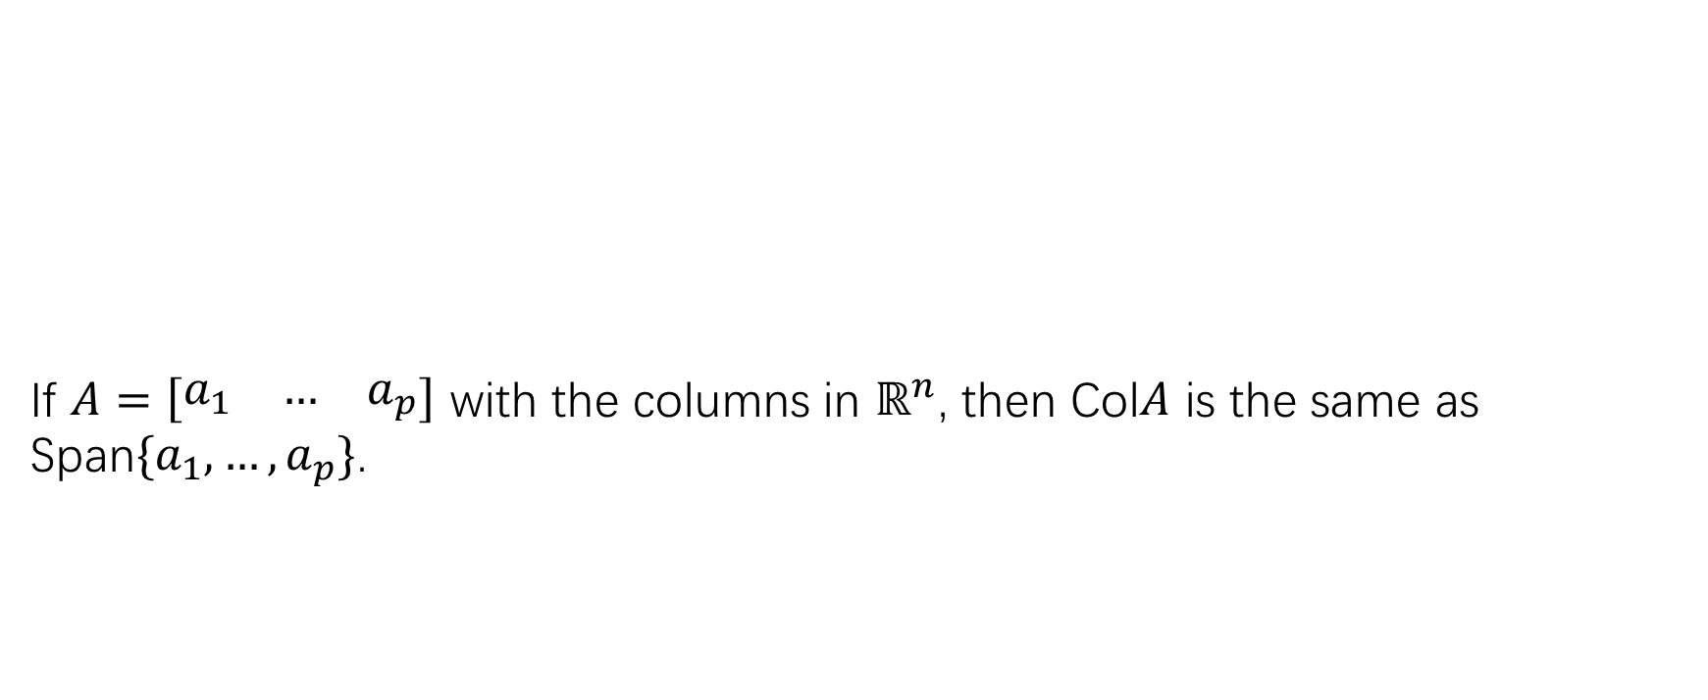
Column space of a matrix
If $A=\left[\begin{matrix}a_{1} & … & a_{p}\end{matrix}\right]$ with the columns in $ℝ^{n}$, then Col$A$ is the same as Span$\{a_{1},…,a_{p}\}$.

Slide 4

The null space of a matrix $A$

Slide 5
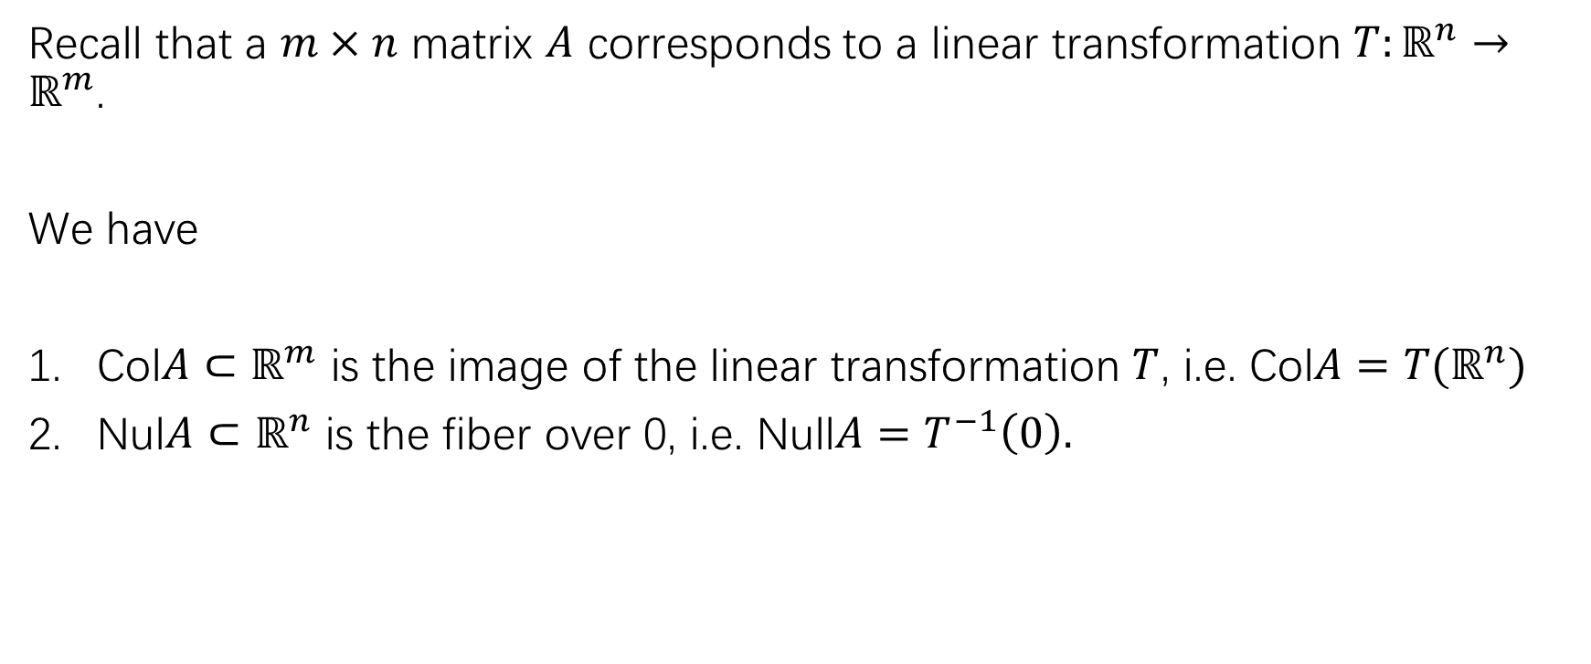
Relation with linear transformations
Recall that a $m×n$ matrix $A$ corresponds to a linear transformation $T:ℝ^{n}→ℝ^{m}$.
We have
Col$A⊂ℝ^{m}$ is the image of the linear transformation $T$, i.e. Col$A=T(ℝ^{n})$
Nul$A⊂ℝ^{n}$ is the fiber over 0, i.e. Null$A=T^{−1}\left(0\right).$

Slide 6
Basis for a subspace

Slide 7
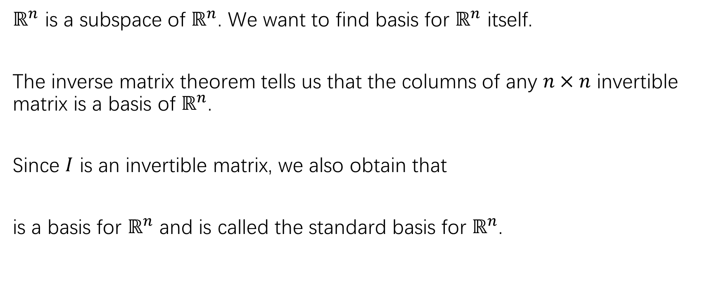

Basis for $ℝ^{n}$
$ℝ^{n}$ is a subspace of $ℝ^{n}$. We want to find basis for $ℝ^{n}$ itself.
The inverse matrix theorem tells us that the columns of any $n×n$ invertible matrix is a basis of $ℝ^{n}$.
Since $I$ is an invertible matrix, we also obtain that
is a basis for $ℝ^{n}$ and is called the standard basis for $ℝ^{n}$.

Slide 8
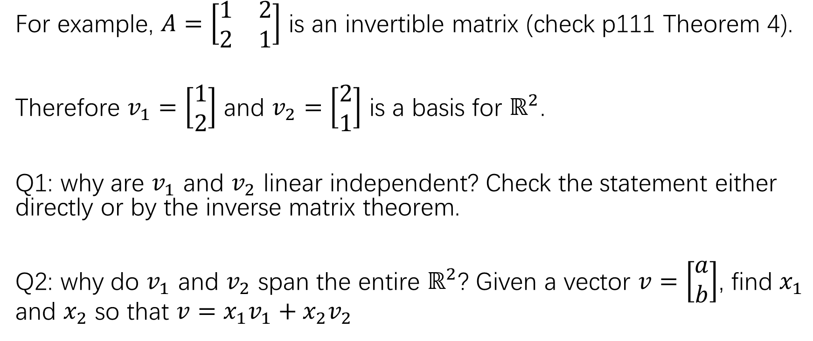
Basis for $ℝ^{n}$
For example, $A=\left[\begin{matrix}1 & 2 \\ 2 & 1\end{matrix}\right]$ is an invertible matrix (check p111 Theorem 4).
Therefore $v_{1}=\left[\begin{matrix}1 \\ 2\end{matrix}\right]$ and $v_{2}=\left[\begin{matrix}2 \\ 1\end{matrix}\right]$ is a basis for $ℝ^{2}$.
Q1: why are $v_{1}$ and $v_{2}$ linear independent? Check the statement either directly or by the inverse matrix theorem.
Q2: why do $v_{1}$ and $v_{2}$ span the entire $ℝ^{2}$? Given a vector $v=\left[\begin{matrix}a \\ b\end{matrix}\right]$, find $x_{1}$ and $x_{2}$ so that $v=x_{1}v_{1}+x_{2}v_{2}$

Slide 9
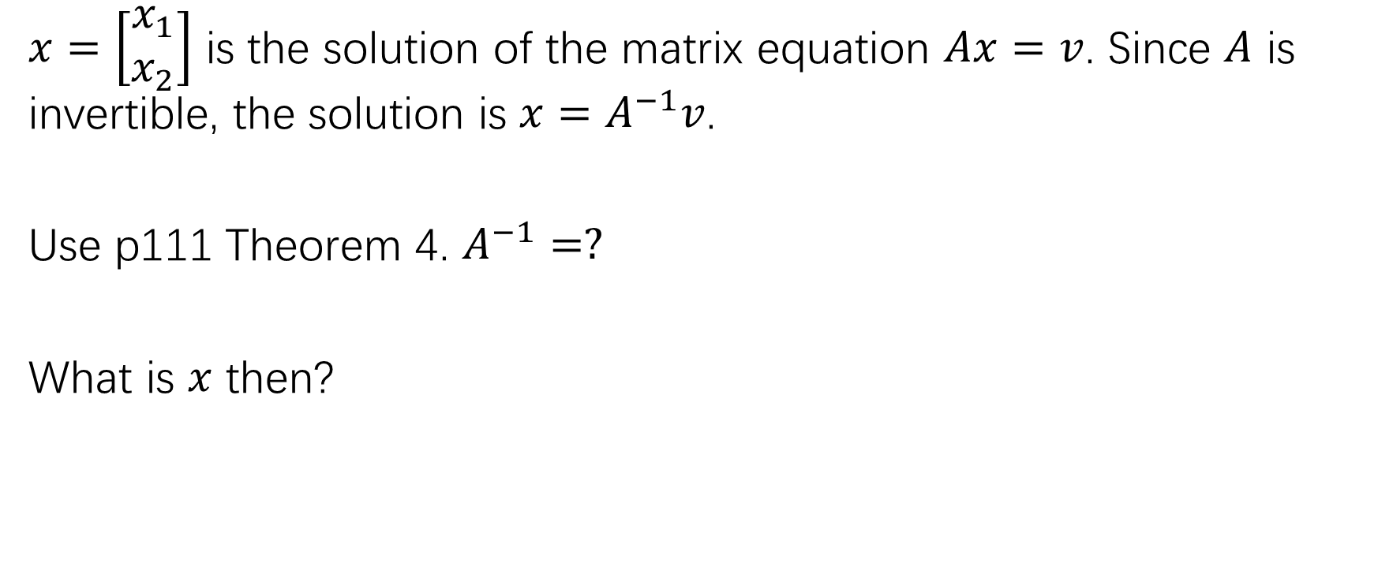
Solution of Q2
$x=\left[\begin{matrix}x_{1} \\ x_{2}\end{matrix}\right]$ is the solution of the matrix equation $Ax=v$. Since $A$ is invertible, the solution is $x=A^{−1}v$.
Use p111 Theorem 4. $A^{−1}=?$
What is $x$ then?

Slide 10
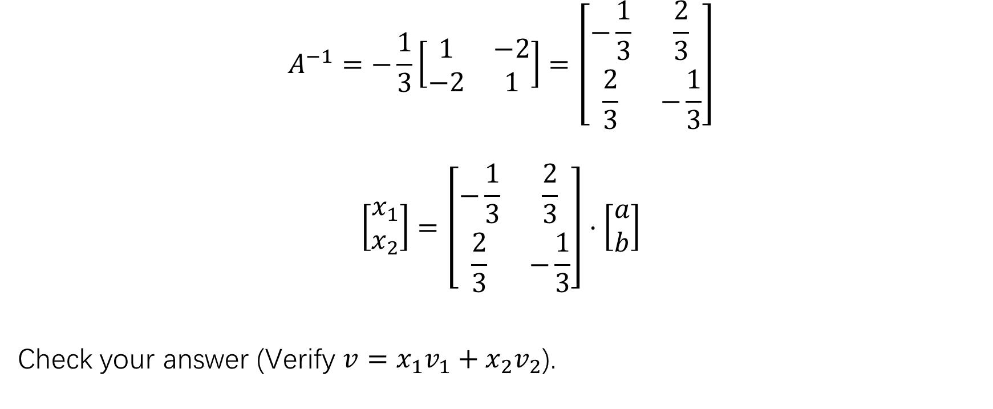
Solution of Q2
$$A^{−1}=−\frac{1}{3}\left[\begin{matrix}1 & −2 \\ −2 & 1\end{matrix}\right]=\left[\begin{matrix}−\frac{1}{3} & \frac{2}{3} \\ \frac{2}{3} & −\frac{1}{3}\end{matrix}\right]$$
$$\left[\begin{matrix}x_{1} \\ x_{2}\end{matrix}\right]=\left[\begin{matrix}−\frac{1}{3} & \frac{2}{3} \\ \frac{2}{3} & −\frac{1}{3}\end{matrix}\right]⋅\left[\begin{matrix}a \\ b\end{matrix}\right]$$
Check your answer (Verify $v=x_{1}v_{1}+x_{2}v_{2}$).

Slide 11
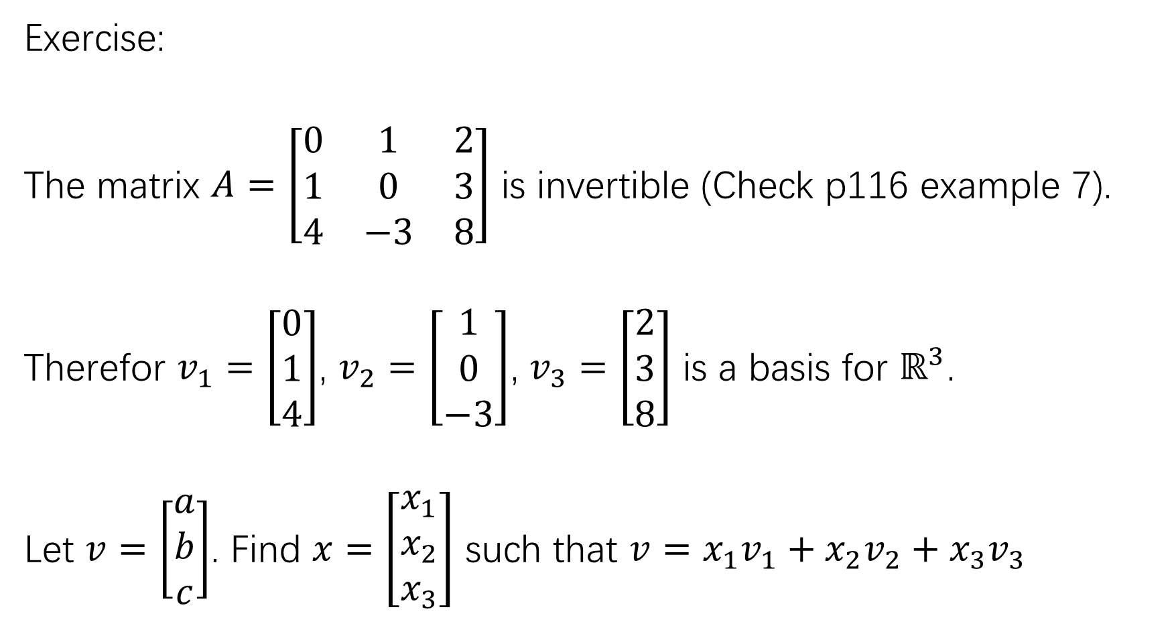
Exercise:
The matrix $A=\left[\begin{matrix}0 & 1 & 2 \\ 1 & 0 & 3 \\ 4 & −3 & 8\end{matrix}\right]$ is invertible (Check p116 example 7).
Therefor $v_{1}=\left[\begin{matrix}0 \\ 1 \\ 4\end{matrix}\right]$, $v_{2}=\left[\begin{matrix}1 \\ 0 \\ −3\end{matrix}\right]$, $v_{3}=\left[\begin{matrix}2 \\ 3 \\ 8\end{matrix}\right]$ is a basis for $ℝ^{3}$.
Let $v=\left[\begin{matrix}a \\ b \\ c\end{matrix}\right]$. Find $x=\left[\begin{matrix}x_{1} \\ x_{2} \\ x_{3}\end{matrix}\right]$ such that $v=x_{1}v_{1}+x_{2}v_{2}+x_{3}v_{3}$

Slide 12
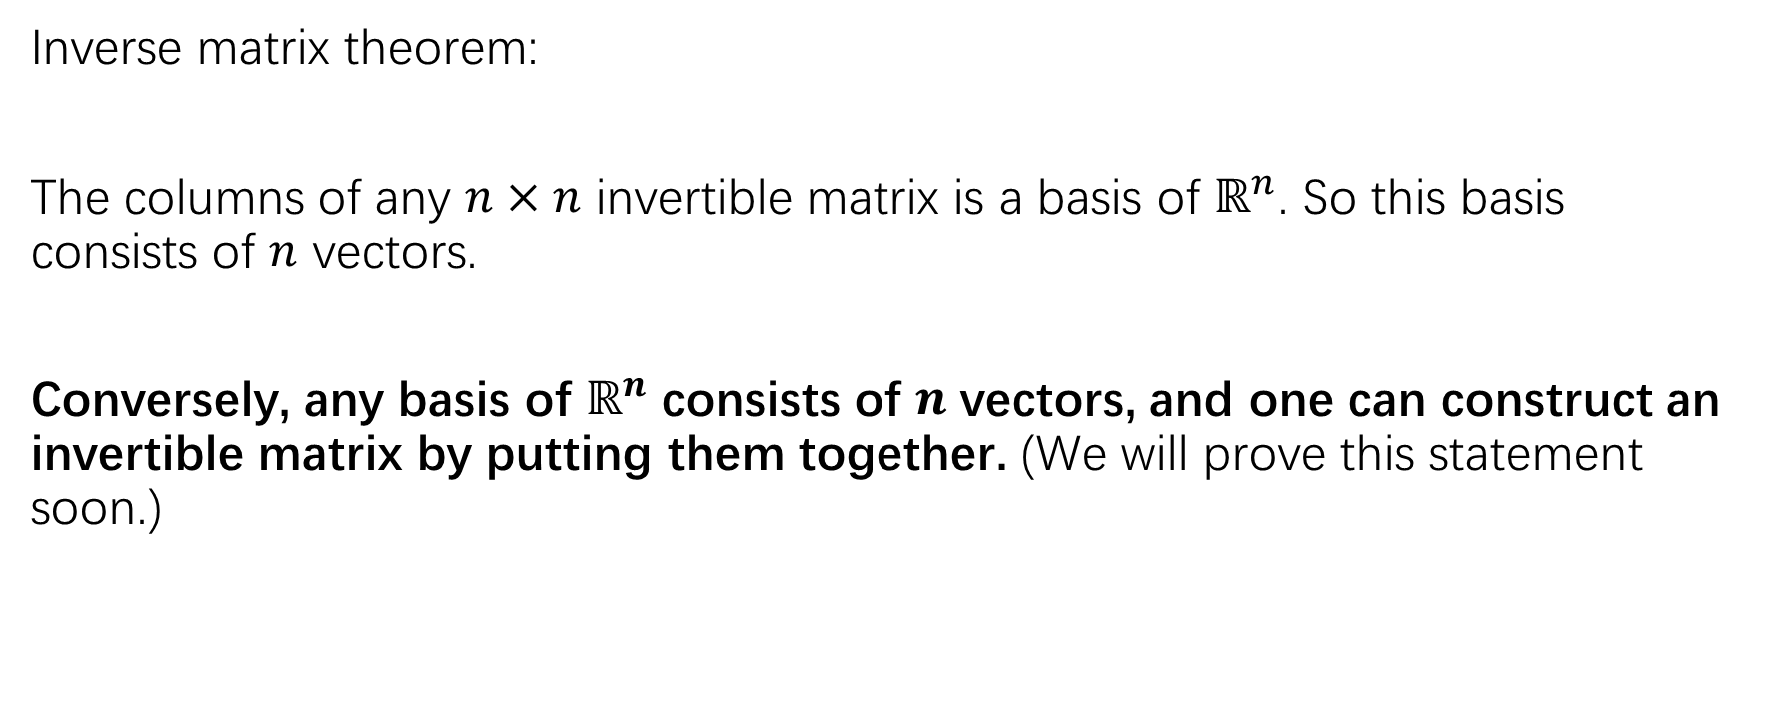
Basis for $ℝ^{n}$
Inverse matrix theorem:
The columns of any $n×n$ invertible matrix is a basis of $ℝ^{n}$. So this basis consists of $n$ vectors.
Conversely, any basis of $ℝ^{n}$ consists of $n$ vectors, and one can construct an invertible matrix by putting them together. (We will prove this statement soon.)

Slide 13
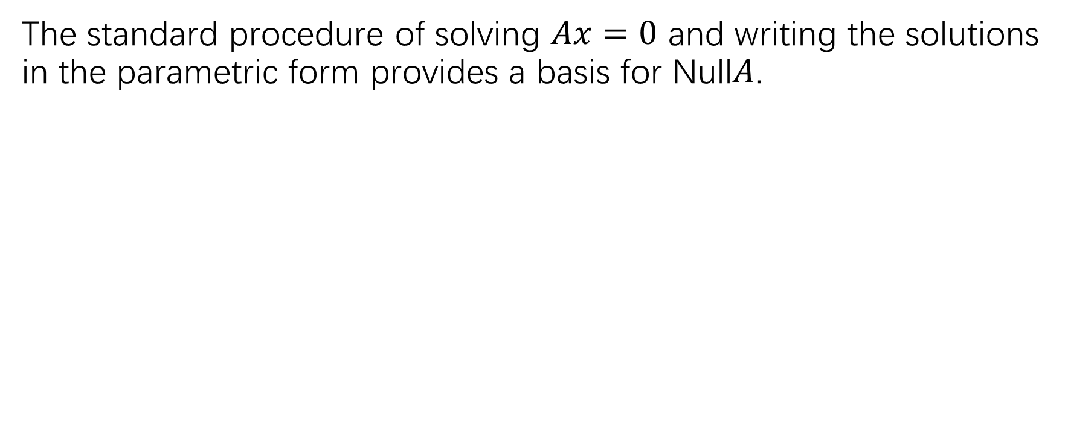

Finding a basis for Null$A$
The standard procedure of solving $Ax=0$ and writing the solutions in the parametric form provides a basis for Null$A$.

Slide 15
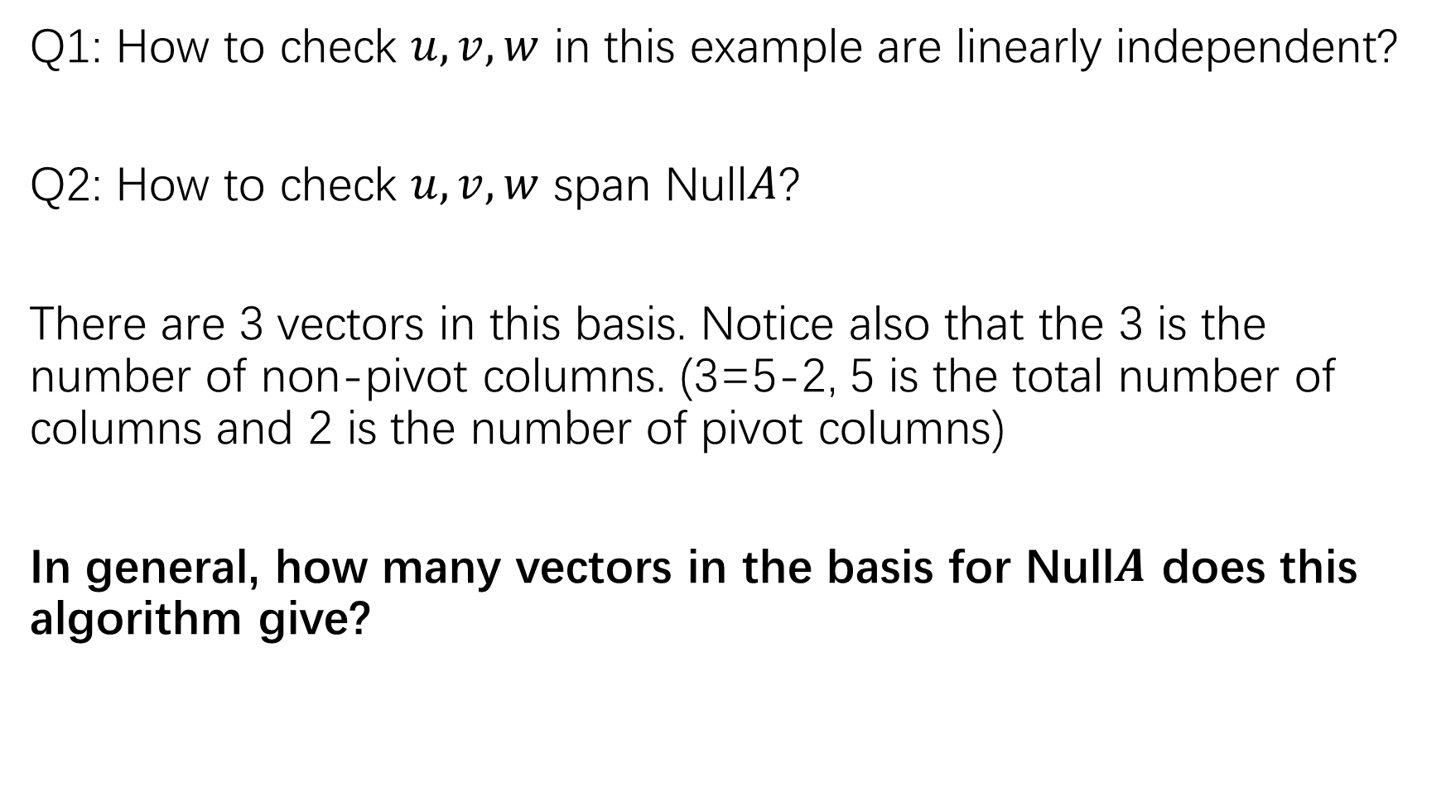
Q1: How to check $u,v,w$ in this example are linearly independent?
Q2: How to check $u,v,w$ span Null$A$?
There are 3 vectors in this basis. Notice also that the 3 is the number of non-pivot columns. (3=5-2, 5 is the total number of columns and 2 is the number of pivot columns)
In general, how many vectors in the basis for Null$A$ does this algorithm give?

Slide 16
Exercise:
P160: 23,24

Slide 17
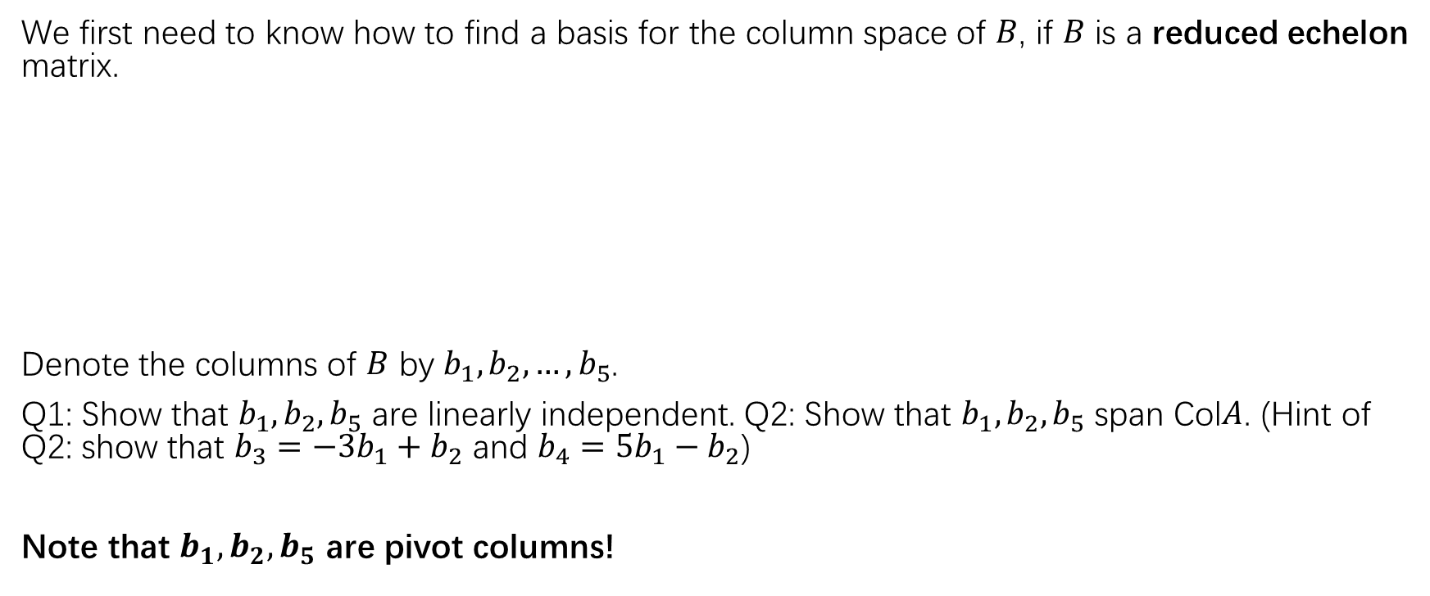
Finding a basis for the column space of a matrix
We first need to know how to find a basis for the column space of $B$, if $B$ is a reduced echelon matrix.
Denote the columns of $B$ by $b_{1},b_{2},…,b_{5}$.
Q1: Show that $b_{1},b_{2},b_{5}$ are linearly independent. Q2: Show that $b_{1},b_{2},b_{5}$ span Col$A$. (Hint of Q2: show that $b_{3}=−3b_{1}+b_{2}$ and $b_{4}=5b_{1}−b_{2}$)
Note that $b_{1},b_{2},b_{5}$ are pivot columns!

Slide 18
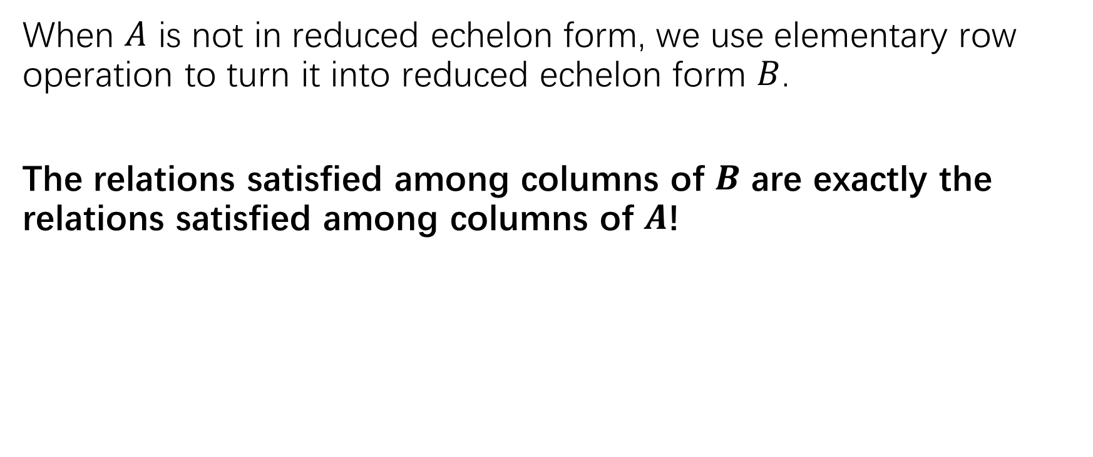

Finding a basis for the column space of a matrix $A$
When $A$ is not in reduced echelon form, we use elementary row operation to turn it into reduced echelon form $B$.
The relations satisfied among columns of $B$ are exactly the relations satisfied among columns of $A$!

Slide 19
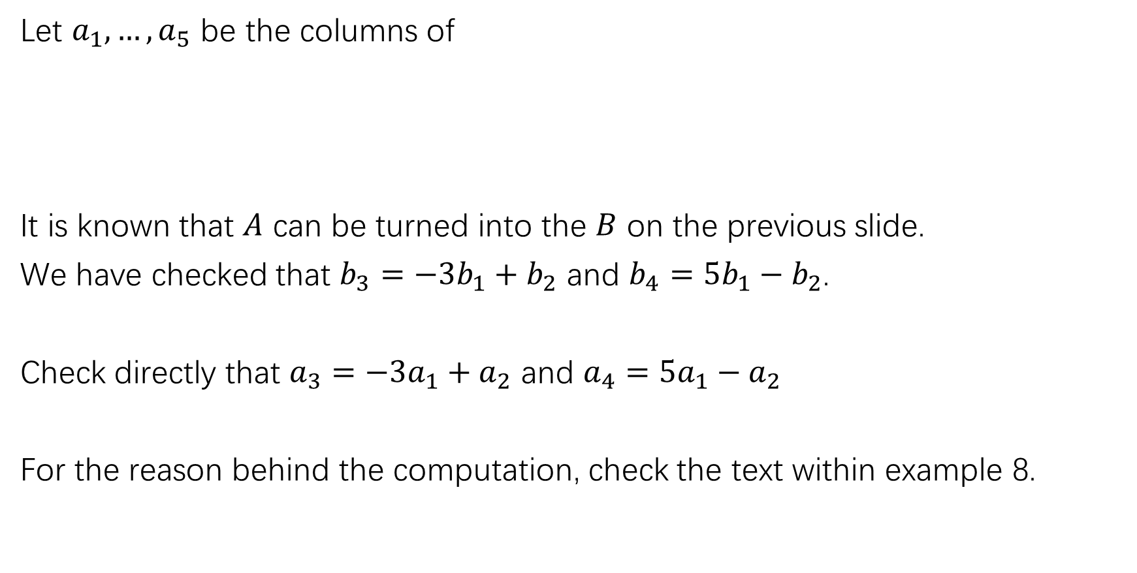
Let $a_{1},…,a_{5}$ be the columns of
It is known that $A$ can be turned into the $B$ on the previous slide.
We have checked that $b_{3}=−3b_{1}+b_{2}$ and $b_{4}=5b_{1}−b_{2}$.
Check directly that $a_{3}=−3a_{1}+a_{2}$ and $a_{4}=5a_{1}−a_{2}$
For the reason behind the computation, check the text within example 8.

Slide 20
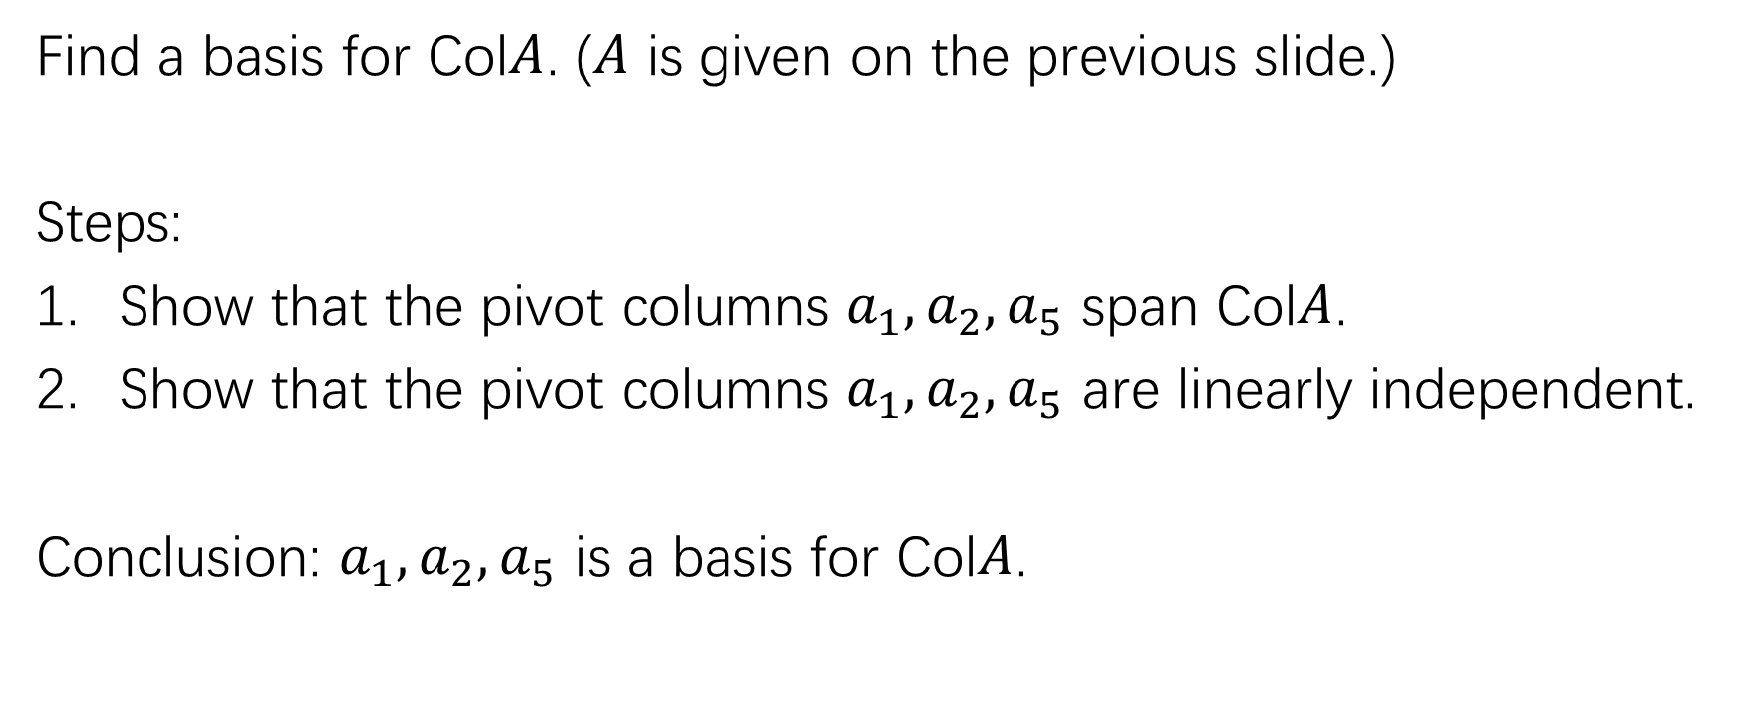
Finding a basis for the column space of a matrix $A$
Find a basis for Col$A$. ($A$ is given on the previous slide.)
Steps:
Show that the pivot columns $a_{1},a_{2},a_{5}$ span Col$A$.
Show that the pivot columns $a_{1},a_{2},a_{5}$ are linearly independent.
Conclusion: $a_{1},a_{2},a_{5}$ is a basis for Col$A$.

Slide 21
Finding a basis for the column space of a matrix $A$
Exercise: p160: 23,24. In this two questions, what are the relations among the columns?

Slide 22
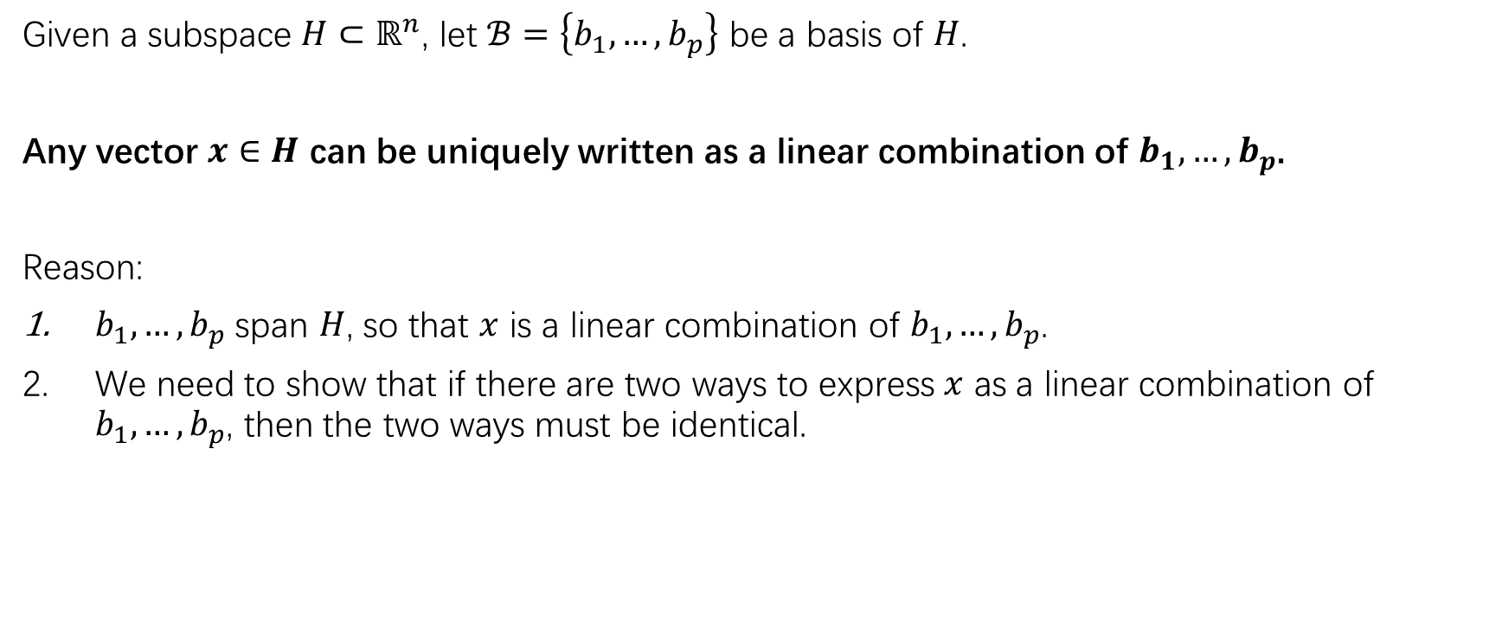
The most important property of a basis.
Given a subspace $H⊂ℝ^{n}$, let $ℬ=\left\{b_{1},…,b_{p}\right\}$ be a basis of $H$.
Any vector $x∈H$ can be uniquely written as a linear combination of $b_{1},…,b_{p}$.
Reason:
$b_{1},…,b_{p}$ span $H$, so that $x$ is a linear combination of $b_{1},…,b_{p}$.
We need to show that if there are two ways to express $x$ as a linear combination of $b_{1},…,b_{p}$, then the two ways must be identical.

Slide 24
Coordinates

Slide 26
Geometric meaning

Slide 27
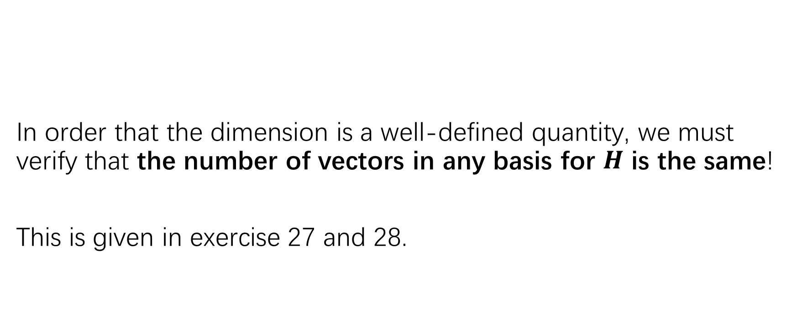
The dimension of a subspace
In order that the dimension is a well-defined quantity, we must verify that the number of vectors in any basis for $H$ is the same!
This is given in exercise 27 and 28.

Slide 28
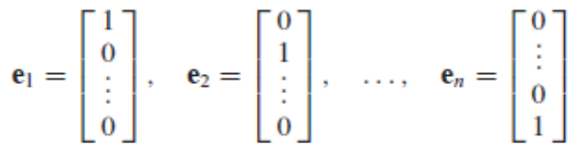
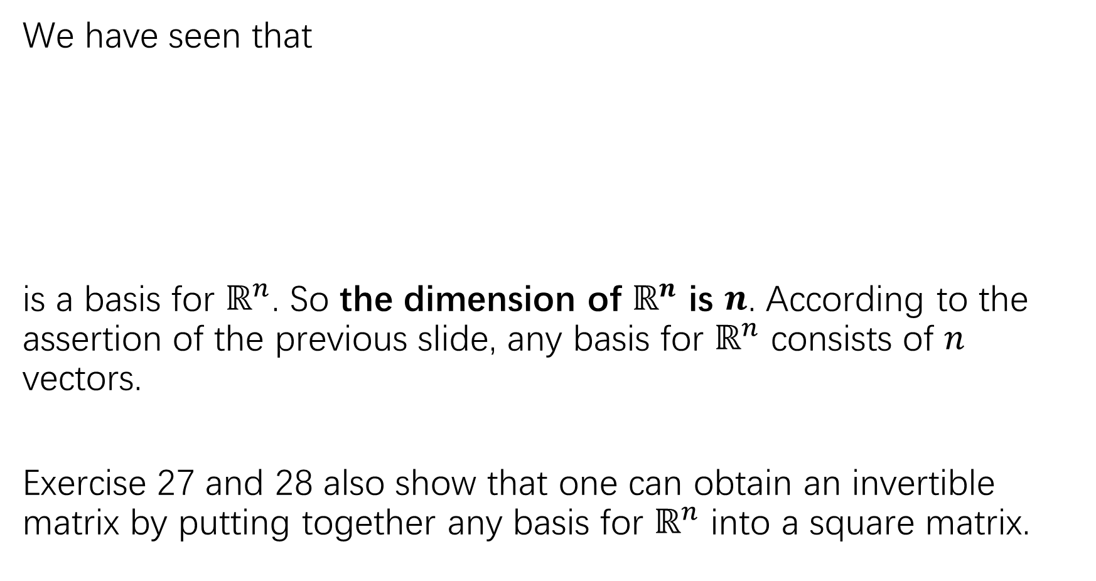
We have seen that
is a basis for $ℝ^{n}$. So the dimension of $ℝ^{n}$ is $n$. According to the assertion of the previous slide, any basis for $ℝ^{n}$ consists of $n$ vectors.
Exercise 27 and 28 also show that one can obtain an invertible matrix by putting together any basis for $ℝ^{n}$ into a square matrix.

Slide 29
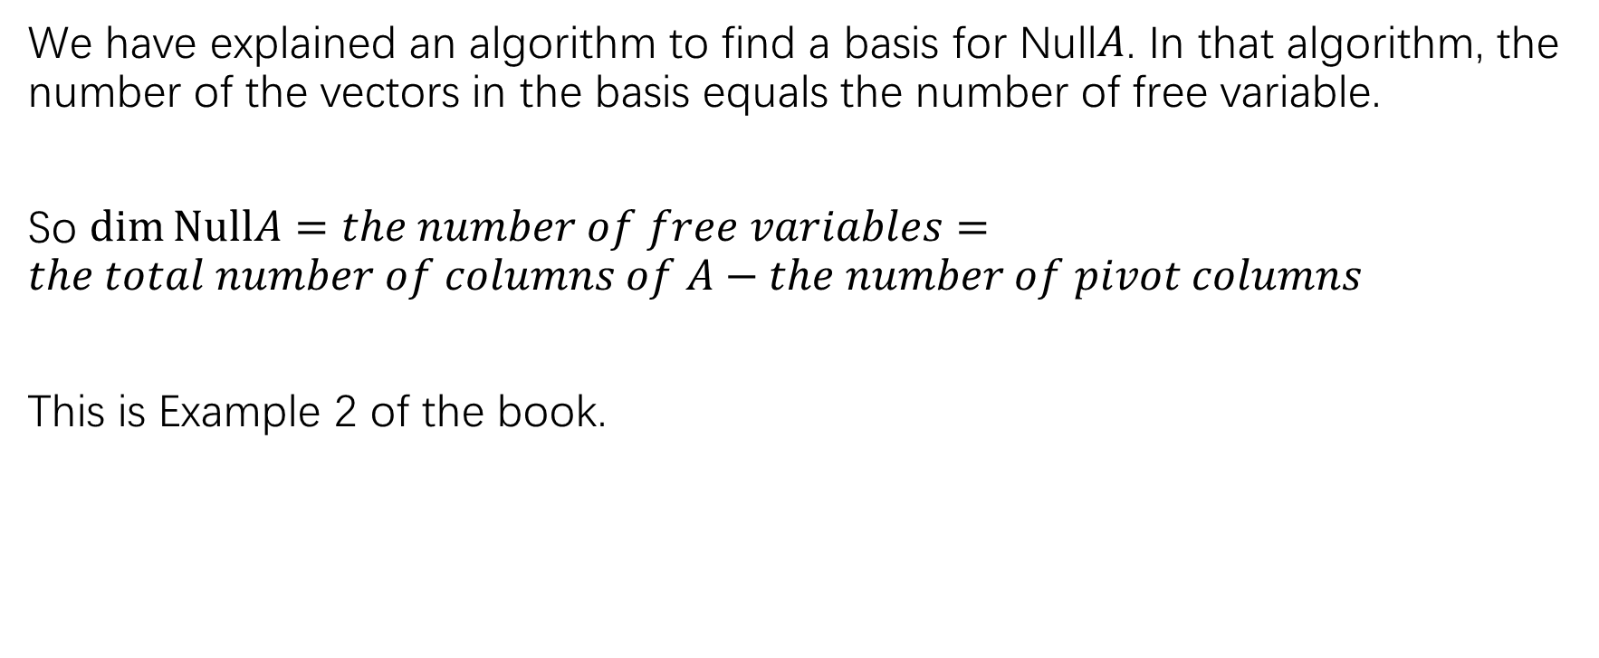

The dimension of Null$A$
We have explained an algorithm to find a basis for Null$A$. In that algorithm, the number of the vectors in the basis equals the number of free variable.
So $\dim{NullA}=the number of free variables=the total number of columns of A−the number of pivot columns$
This is Example 2 of the book.

Slide 30
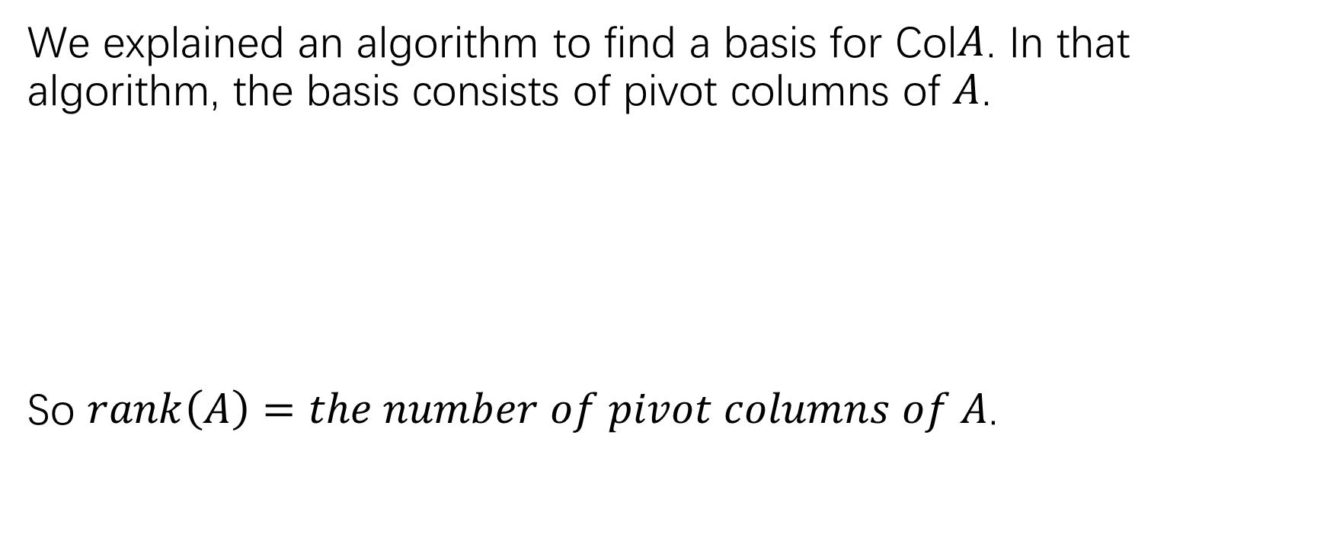

The dimension of Col$A$
We explained an algorithm to find a basis for Col$A$. In that algorithm, the basis consists of pivot columns of $A$.
So $rank\left(A\right)=the number of pivot columns of A$.

Slide 32
The Rank theorem

Slide 33
HW
P165: 3-6, p166: 9-12

