Slide 1
Linear Algebra
Lecturer: Xia Liao
Email: xliao@hqu.edu.cn
Homepage: https://hirzebruch.github.io/main.html
Time: every Tuesday 1-2, Thursday 3-4

Slide 2
Summary of 4.3
In a vector space, the meaning of linear dependence/independence
The basis for a vector space
The spanning set theorem and applications

Slide 3
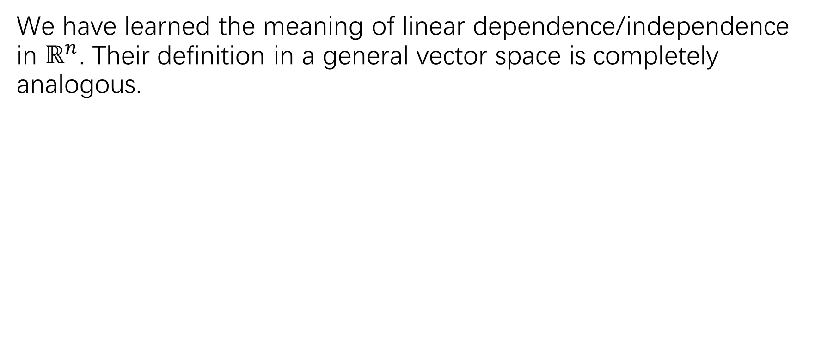
The definition of linear dependence/independence in a vector space
We have learned the meaning of linear dependence/independence in $ℝ^{n}$. Their definition in a general vector space is completely analogous.

Slide 5
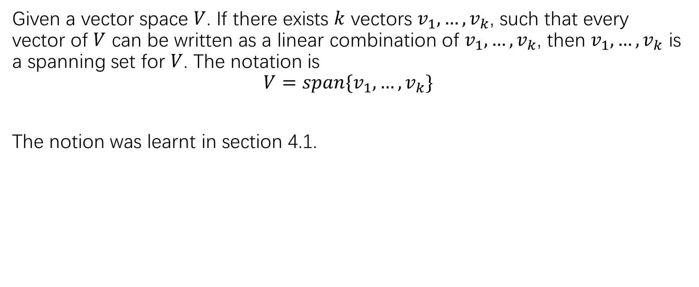
Spanning set
Given a vector space $V$. If there exists $k$ vectors $v_{1},…,v_{k}$, such that every vector of $V$ can be written as a linear combination of $v_{1},…,v_{k}$, then $v_{1},…,v_{k}$ is a spanning set for $V$. The notation is
$$V=span\{v_{1},…,v_{k}\}$$
The notion was learnt in section 4.1.

Slide 6
The basis of a vector space

Slide 8
In a vector space, how to obtain a basis?
This means that we can start from a finite spanning set of vector space (a vector space may not have a finite spanning set, but in most applications they do.), delete ‘extra’ spanner one after another, and finally we will obtain a basis.

Slide 9
proof

Slide 10
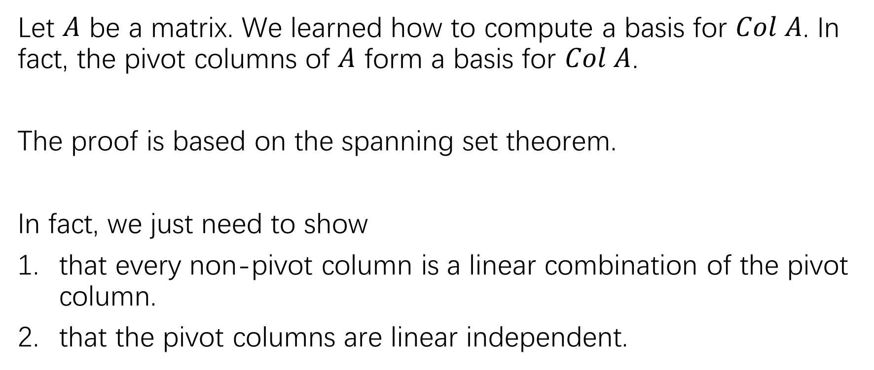
An application of spanning set theorem
Let $A$ be a matrix. We learned how to compute a basis for $Col A$. In fact, the pivot columns of $A$ form a basis for $Col A$.
The proof is based on the spanning set theorem.
In fact, we just need to show
that every non-pivot column is a linear combination of the pivot column.
that the pivot columns are linear independent.

Slide 11
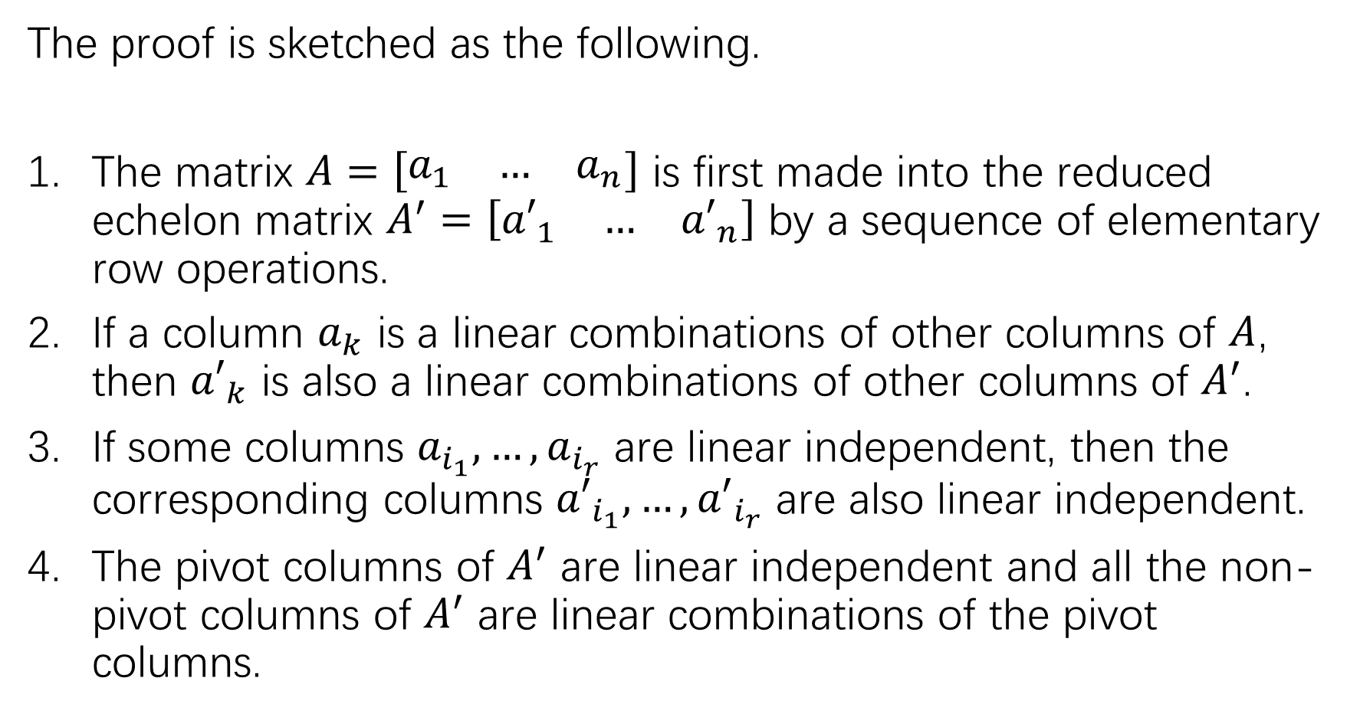
The proof is sketched as the following.
The matrix $A=\left[\begin{matrix}a_{1} & … & a_{n}\end{matrix}\right]$ is first made into the reduced echelon matrix $A^{′}=\left[\begin{matrix}{a′}_{1} & … & {a′}_{n}\end{matrix}\right]$ by a sequence of elementary row operations.
If a column $a_{k}$ is a linear combinations of other columns of $A$, then ${a′}_{k}$ is also a linear combinations of other columns of $A^{′}$.
If some columns $a_{i_{1}},…,a_{i_{r}}$ are linear independent, then the corresponding columns ${a′}_{i_{1}},…,{a′}_{i_{r}}$ are also linear independent.
The pivot columns of $A^{′}$ are linear independent and all the non-pivot columns of $A^{′}$ are linear combinations of the pivot columns.

Slide 12
The last point is clear by staring at the shape of some reduced echelon matrices.
For example:

Slide 13
Two views of basis
A basis for a vector space is any minimal spanning set, by the spanning set theorem.
A basis for a vector space is also any maximal linearly independent set. If you think for a while, this statement is basically the definition of basis.

Slide 14
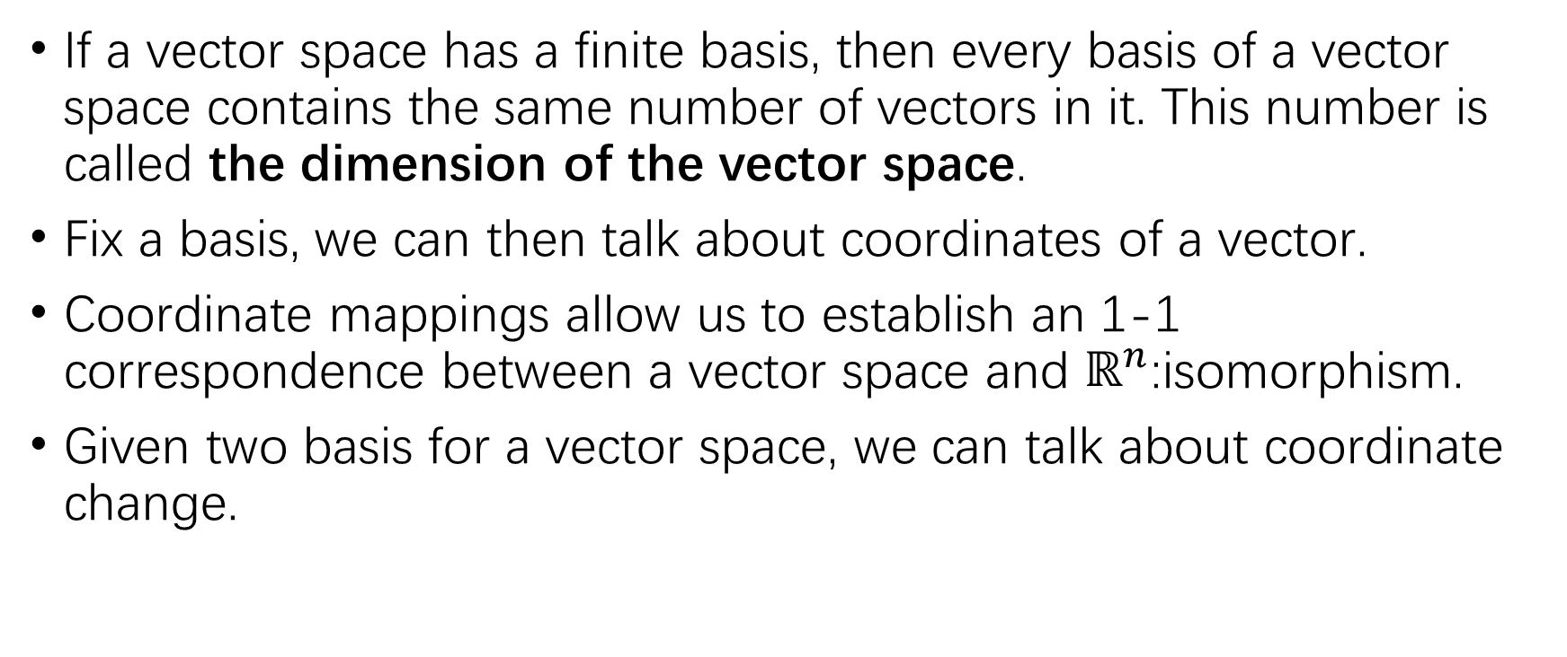
Summary of 4.4/4.5
If a vector space has a finite basis, then every basis of a vector space contains the same number of vectors in it. This number is called the dimension of the vector space.
Fix a basis, we can then talk about coordinates of a vector.
Coordinate mappings allow us to establish an 1-1 correspondence between a vector space and $ℝ^{n}$:isomorphism.
Given two basis for a vector space, we can talk about coordinate change.

Slide 15
P242 key theorem

Slide 16
The dimension of a subspace

Slide 17
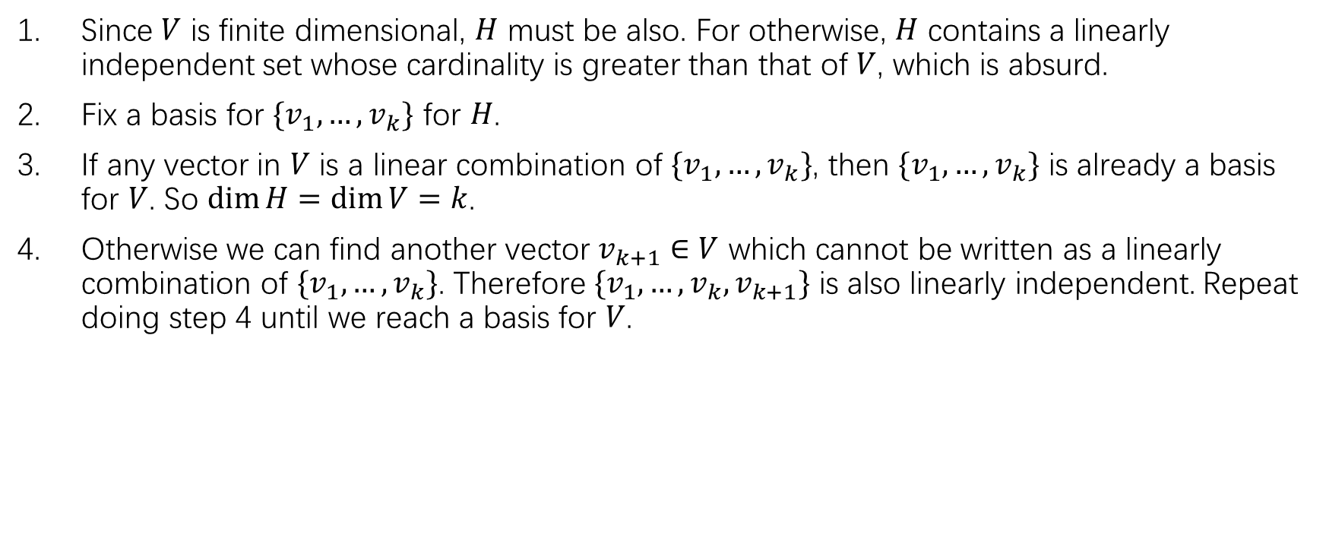
Sketch of the proof
Since $V$ is finite dimensional, $H$ must be also. For otherwise, $H$ contains a linearly independent set whose cardinality is greater than that of $V$, which is absurd.
Fix a basis for $\{v_{1},…,v_{k}\}$ for $H$.
If any vector in $V$ is a linear combination of $\{v_{1},…,v_{k}\}$, then $\{v_{1},…,v_{k}\}$ is already a basis for $V$. So $\dim{H}=\dim{V=k}$.
Otherwise we can find another vector $v_{k+1}∈V$ which cannot be written as a linearly combination of $\{v_{1},…,v_{k}\}$. Therefore $\{v_{1},…,v_{k},v_{k+1}\}$ is also linearly independent. Repeat doing step 4 until we reach a basis for $V$.

Slide 18
Given a basis ℬ, the definition of a ℬ-coordinate system

Slide 19
The coordinate mapping

Slide 21
Graphical explanation
Summary: we are considering the same vector, but using different grid.

Slide 22

Given a basis ℬ for $ℝ^{n}$ and a vector, we need to know how to find its ℬ-coordinates

Slide 23
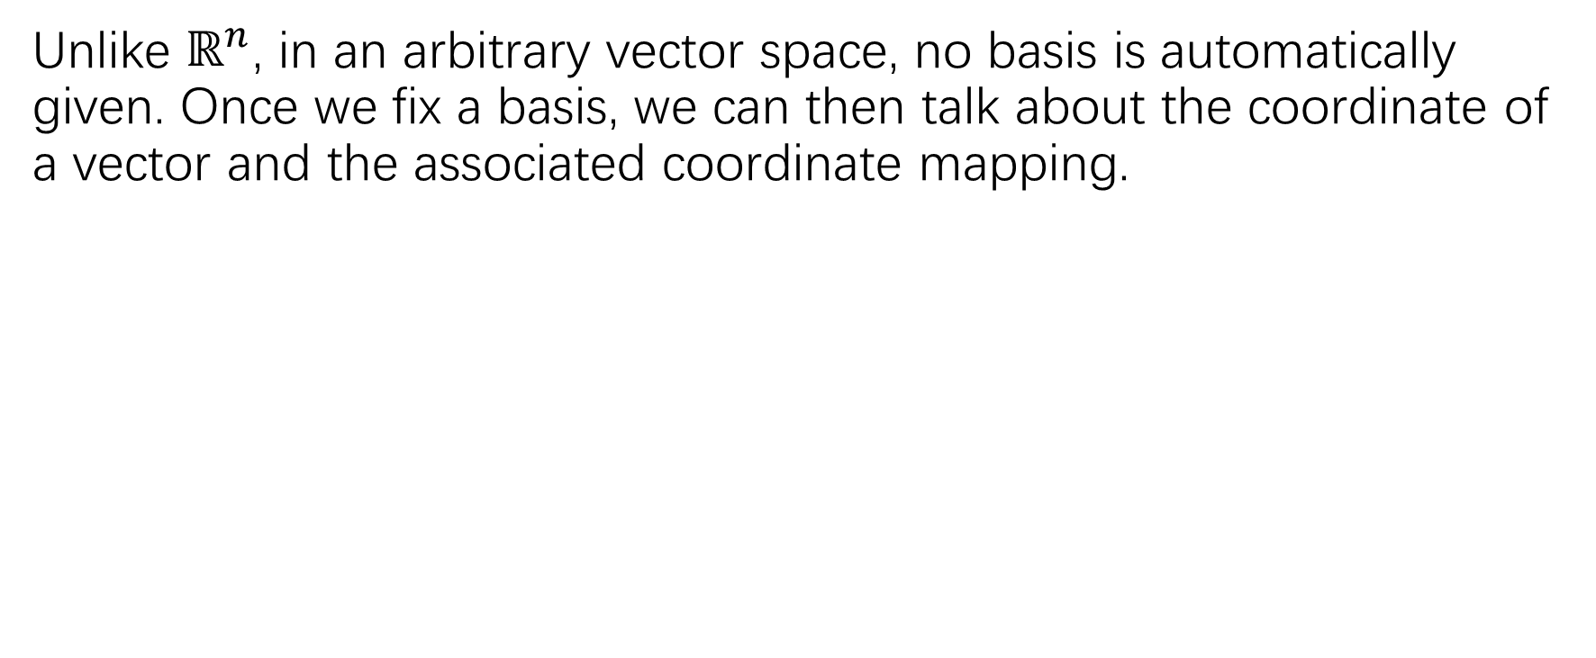
Coordinate mapping
Unlike $ℝ^{n}$, in an arbitrary vector space, no basis is automatically given. Once we fix a basis, we can then talk about the coordinate of a vector and the associated coordinate mapping.

Slide 25
isomorphism
The coordinate mapping is 1-1. In mathematics, it is a typical example of isomorphism.

Slide 26
An example of isomorphism

Slide 28
Checking linearly independence using coordinate mapping

Slide 29
练习/作业
P230:21,22,26; p231:38
P239:14-16, 29,30,31(a)
P245:19-24; P246:29,30

