Slide 1
Computer Vision (SPRING 2019) Problem Set #1
Jijun Hu
Jijun.hu.0930@gatech.edu
Computer Vision @ GT

Slide 2
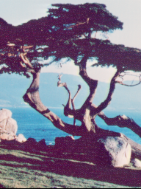
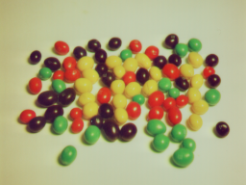
1a: Interesting Images
Image 1 - ps1-1-a-1.png
Image 2 - ps1-1-a-2.png
Computer Vision @ GT

Slide 3
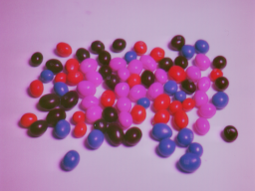
2a: Swapped Green and Blue
ps1-2-a-1.png
Computer Vision @ GT

Slide 4
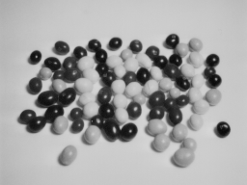
2b: Monochrome Green
Img1_green - ps1-2-b-1.png
Computer Vision @ GT

Slide 5
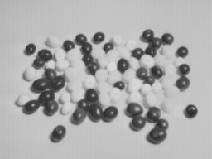
2c: Monochrome Red
Img1_red - ps1-2-c-1.png
Computer Vision @ GT

Slide 6
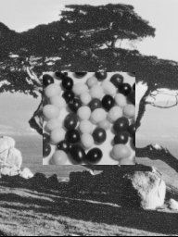
3a: Replacement of Pixels
ps1-3-a-1.png
Computer Vision @ GT

Slide 7
4a: Image Stats
Min: 9.0
Max: 214.0
Mean: 165.2079874674479
Standard deviation: 56.89940073389302
Computer Vision @ GT

Slide 8
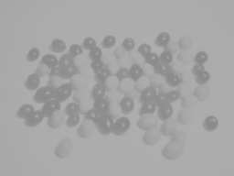
4b: Arithmetic Operation
ps1-4-b-1.png
Computer Vision @ GT

Slide 9

4c: Shifted Image
ps1-4-c-1.png
Computer Vision @ GT

Slide 10
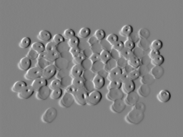
4d: Difference Image
ps1-4-d-1.png
Computer Vision @ GT

Slide 11

5a: Noisy Green Channel
ps1-5-a-1.png
Computer Vision @ GT

Slide 12

5b: Noisy Blue Channel
ps1-5-b-1.png
Computer Vision @ GT

Slide 13
6a: Discussion
Between all color channels, which channel, in your opinion, most resembles a grayscale conversion of the original. Why do you think this? Does it matter for each respective image? (For this problem, you will have to read a bit on how the eye works/cameras to discover which channel is more prevalent and widely used)
A: The green channel grayscale conversion of the original seems to be most resembles.
Also, I think this will apply to all kinds of images, based on my reading & understanding, when camera captures the image, it usually places green filter over half of the sensor, which equals the sum of both green & blue filters. So the final image comes out weights more to the green channel than red and blue channels. Therefore, we will always fell the green channel grayscale conversion of the original seems to be most resembles to the original one.
Computer Vision @ GT

Slide 14
6b: Discussion
What does it mean when an image has negative pixel values stored? Why is it important to maintain negative pixel values?
A: I think image pixel values is just a definition and can have any range in Real number. If we obtain a negative pixel value, that most likely means the image type is not uint8, if we define pixel value from -128 to 127 with 0 in the middle, a negative sign means the color is more closer to black instead of white. Also the absolute value here is just a measure of how far we are from gray but the sign is actually telling us whether we are closer to black or white, which is why maintain the negative sign here is so important.
Computer Vision @ GT

Slide 15




6c: Discussion
In question 5, noise was added to the green channel and also to the blue channel. Which looks better to you? Why? What sigma was used to detect any discernible difference?
A: adding noise to blue channel seems to be better.
Adding noise to the green channel is more visible/discernible than doing that to the blue channel.
With sigma = 10, noises added to green channel can be easily observed, but still very difficult to spot the noises added to blue channel and I think the reason here is the eye is much more sensible to green than blue.
Below are four pictures, 1st one is the original, the next 3 are adding same noise to red/green/blue channel correspondingly, and we can see the noises added to the green channel are most obvious.
Computer Vision @ GT

