Slide 1
StackFury

Slide 2
Our Team
Fahd Imran
Ali asad
Hissaan ali
Identified patterns & Scrapped web for all the data, and stored it in local storage.
Implemented data structures to hold large amount of data that can be efficiently queried.
Programmed the core algorithm to search, rank and display search results

Slide 3
What is StackFury

Slide 4
Components:
01
Data set to work on
Used webscrapping in python
02
Storage
Analyze data and store on local storage
03
Datastructures
Load contents and maintain data structures
04
Apply algorithms
Apply searching and ranking algorithms to list results

Slide 5
Webscrapping
01
02
Gather links
Scrap answers
03
04
Analyzed data and removed corrupted lines
Store in local storage

Slide 6
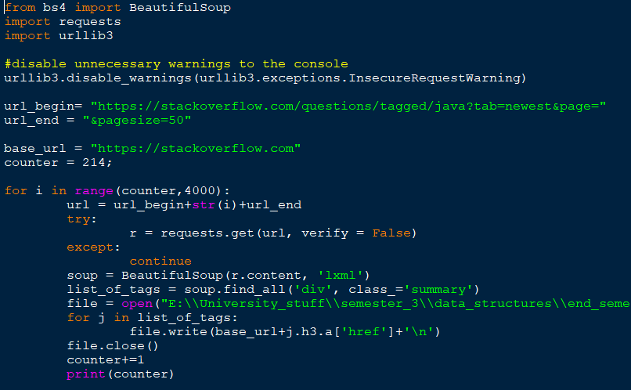

Slide 7
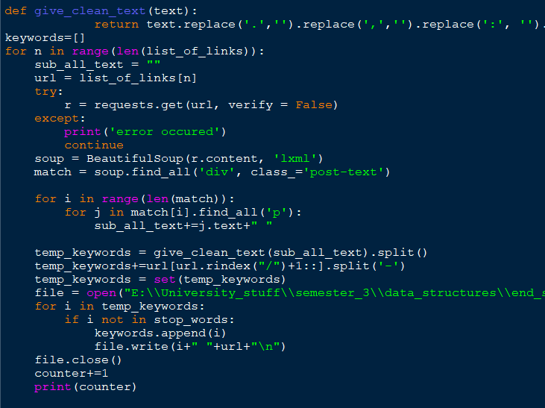

Slide 8
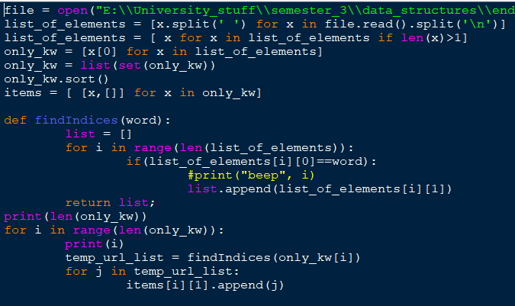

Slide 9
Data structures
Load Data from file
Populate Data structures
Prepared structure
Sort

Slide 10
About data structures
Backward indexing
Trees within Trees
AVL trees make searching really faster

Slide 11
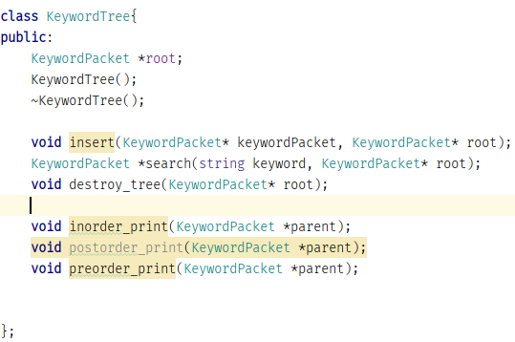
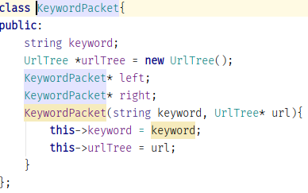

Slide 12
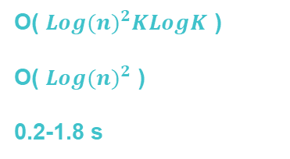
Algorithms
Find websites for those keywords
Extract keywords
O( ${Log(n)}^{2}KLogK$ )
O( ${Log(n)}^{2}$ )
0.2-1.8 s
Compute rank
List best matched results

Slide 13
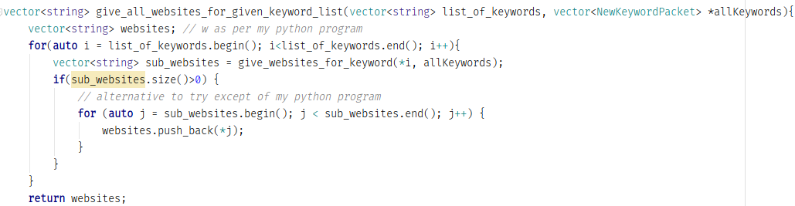

Slide 14

Questions ?

