Slide 1
CA: A WATER-SIDE VIEW
Hisham Hussain – Arwa Abdelaziz
DAB-6 Python Project

Slide 2
HYPOTHESES
A greater disadvantaged community increases the time with which the leaks get fixed.
Counties with more disadvantaged communities would have a greater number of leaks.
Most of the amount of the common contaminants are concentrated in a few counties.
Being closer to water bodies affects the number of leaks.

Slide 3
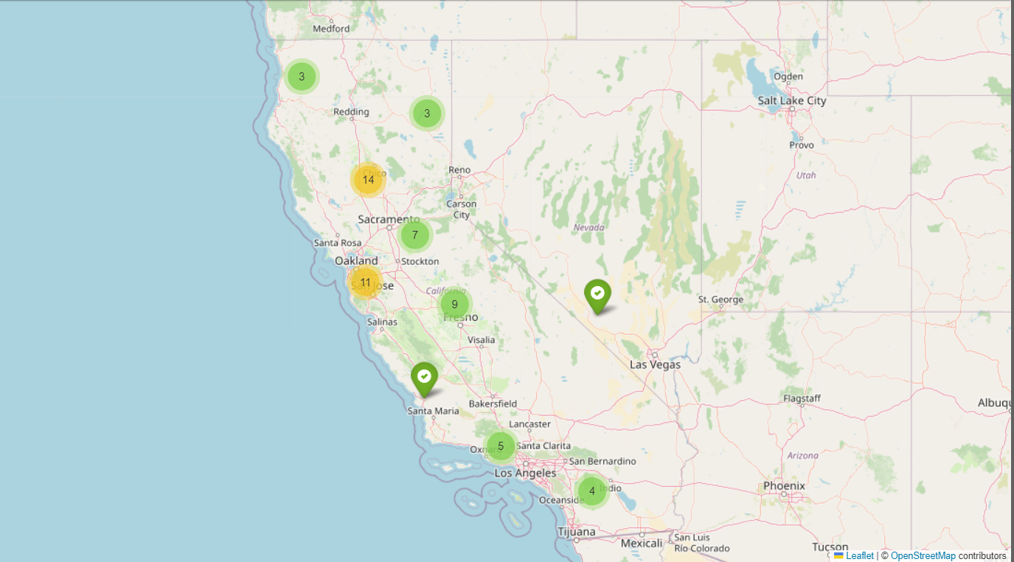
COUNTIES IN CA

Slide 4
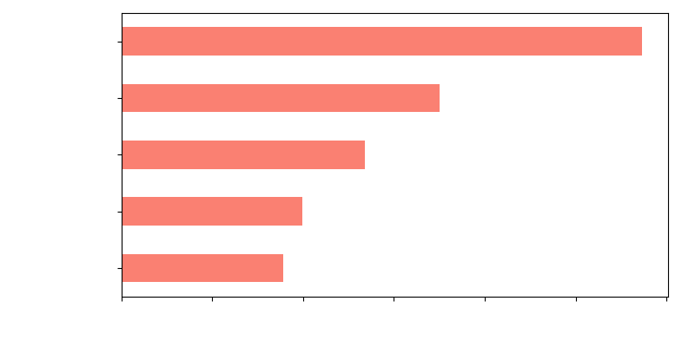
AVERAGE DAYS TO REPORT THE LEAK (TOP 5 COUNTIES)
Days to Report the Leak

Slide 5
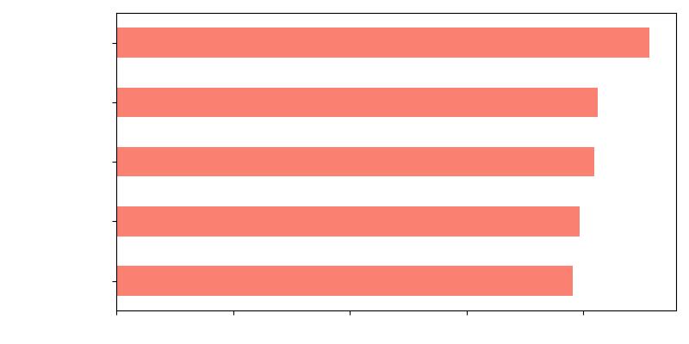
AVERAGE DAYS TO FIX THE LEAK (TOP 5 COUNTIES)
Days to Fix the Leak

Slide 6
Community classification

Slide 7
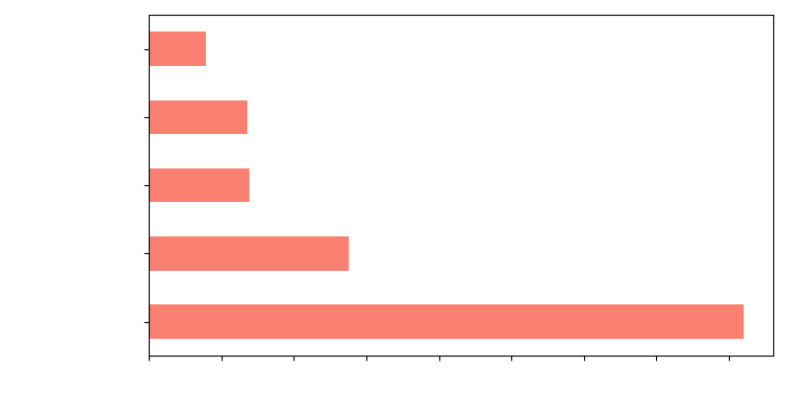
Is there a connection?
Distribution

Slide 8
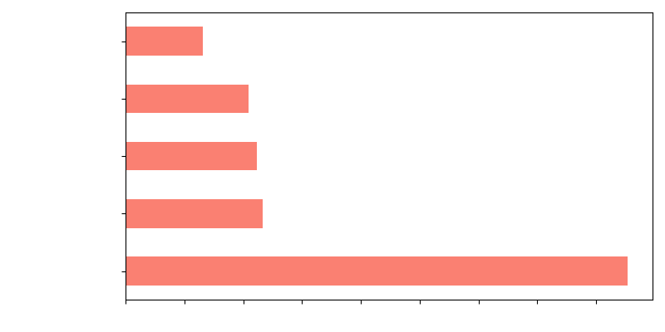
Is there a connection?
Distribution

Slide 9
Longest to Report Leakage
Longest to Fix Leakage
San Francisco
Yuba
Sutter
Glenn
Stanislaus
Tuolumne
Modoc
Contra Costa
Monterey
Sonoma

Slide 10
Greatest amount of Disadvantaged
Greatest amount of Severely Disadvantaged
Los Angeles
Kern
San Deigo
Alameda
San Bernardino
Los Angeles
Alameda
Sacramento
San Deigo
San Bernardino

Slide 11
Greatest amount of Disadvantaged
Longest to Report Leakage
Los Angeles
Kern
San Deigo
Alameda
San Bernardino
San Francisco
Yuba
Sutter
Glenn
Stanislaus
Greatest amount of Severely Disadvantaged
Longest to Fix Leakage
Los Angeles
Alameda
Sacramento
San Deigo
San Bernardino
Tuolumne
Modoc
Contra Costa
Monterey
Sonoma

Slide 12
CONTAMINANT DISTRIBUTION/CA

Slide 13
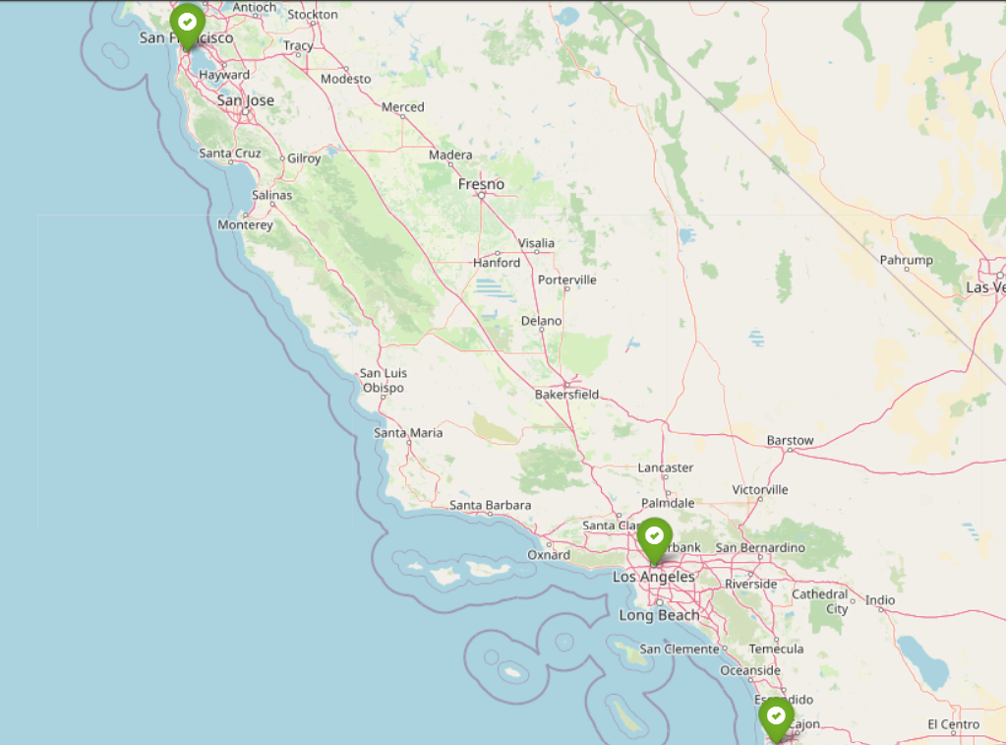
Counties with the top contaminants

Slide 14
CONCLUSION
No correlation between community classification and the length of time of leak reporting and fixing.
The counties with the most disadvantaged have a higher chance to also have a great amount of severely disadvantages communities.
The most common contaminants are concentrated in a few counties.

Slide 15
THANK YOU

