Slide 1
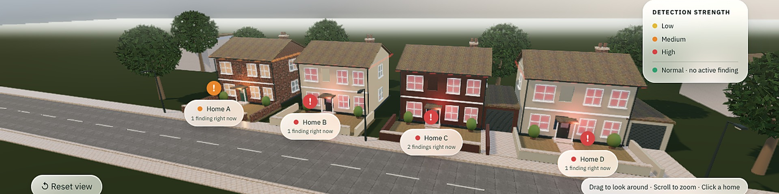
wattswrong
A closer look at home. Four real UK homes, nine months of electricity, replayed in 3D.
H. A. T. M., AI Dormathon
Replay position: Fri 24 Oct 2014, 05:00
Notes:
Open on the street and say nothing for a beat. This is the app: four real UK homes from the REFIT dataset, replayed in 3D. The strip along the bottom of every slide is the app's own timeline, with every finding in the four homes drawn on it. The white line shows which moment of the replay the slide is about. This one is 24 Oct 2014, 05:00.

Slide 2
Your bill says what you spent. It can't say what went wrong.
A heater left on for three nights just makes next month's bill a little bigger.
Replay position: Mon 25 Aug 2014, 00:00
Notes:
The problem in one line. A monthly bill is a single number. It cannot tell you that something ran when it should not have. The next two slides show a real example from Home A. The playhead is back at the start of the replay, 25 Aug 2014.

Slide 3
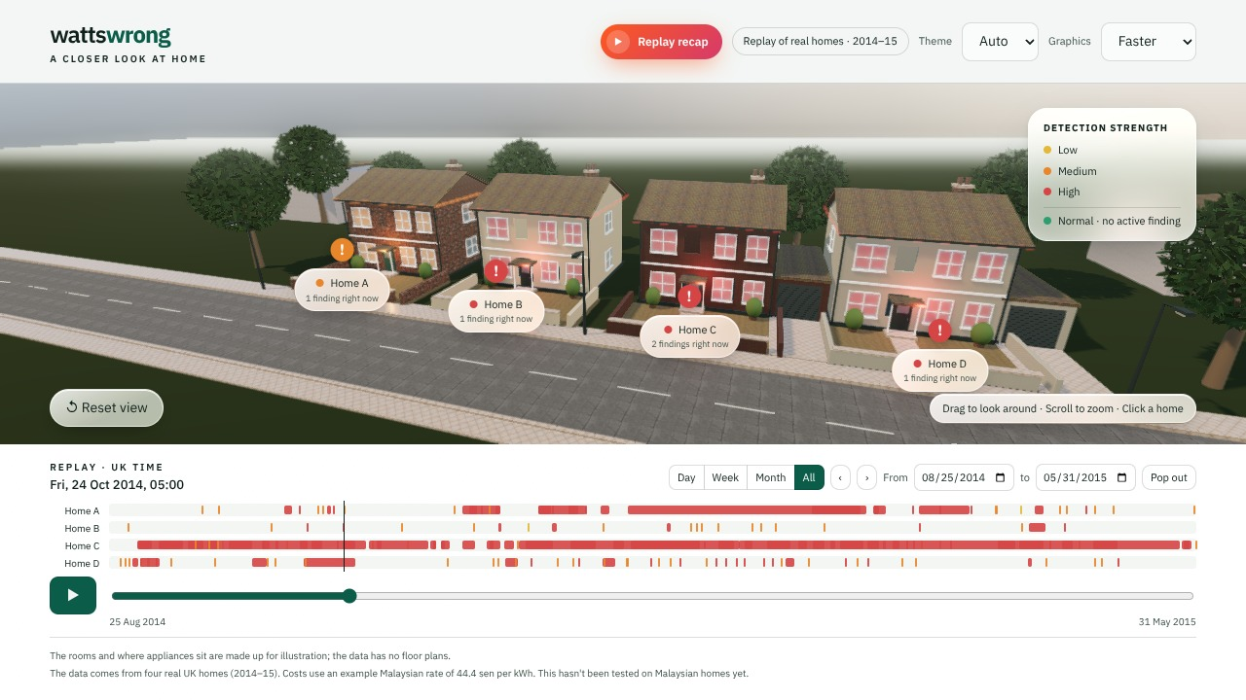
One street, four real homes
Each home is a real household from the REFIT study. A badge on the street shows what is wrong right now, and it changes as the replay moves.
4 homes, 16 meters, 81,046 hourly readings, 179 findings.
Replay position: Fri 24 Oct 2014, 05:00
Notes:
Four homes, Homes A to D, are REFIT Houses 1, 3, 10 and 18: real UK households measured between 2014 and 2015. The rooms are made up, because REFIT has no floor plans, but the readings are real. The street shows a badge for each home, and the badge changes as you scrub or play the replay. Totals in the data: 16 meters, 81,046 hourly readings, 179 findings. Everything here is a historical replay, not a live feed.

Slide 4
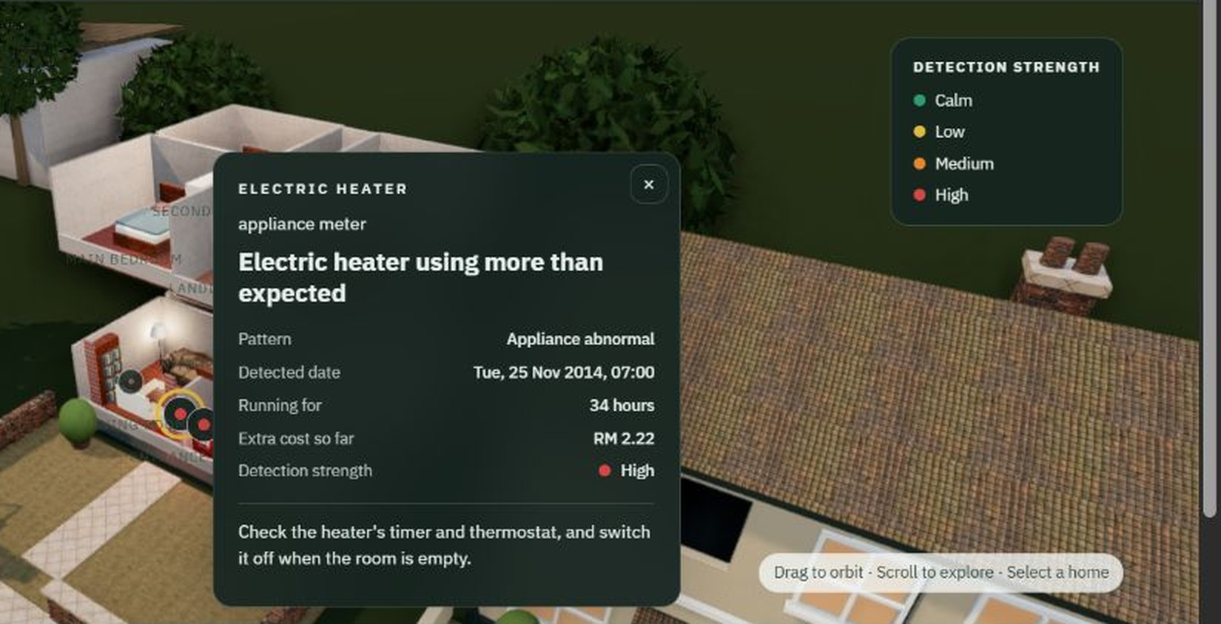
Click twice and you're inside
The rooms are illustrative. The meters and the findings are real.
Click a meter and its card shows what was found, how long it has run, the extra cost so far and what to check.
Replay position: Wed 26 Nov 2014, 11:00, Home A
Notes:
Click a home once to see its card, and click it again to go inside. Click a meter to open its card. This one is Home A's electric heater on Wed 26 Nov 2014: running for 34 hours, detection strength high. The advice is plain: check the heater's timer and thermostat, and switch it off when the room is empty. This screenshot is from an earlier look of the app; the content is the same.

Slide 5
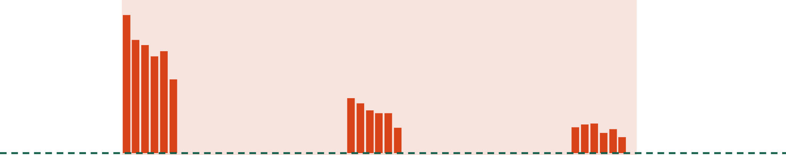
A heater, on through three early mornings
5.80 kWh more than forecast across 2.2 days. Flagged on 25 Nov at 07:00, six hours after it began.
Actual use, per hour
Expected use
Time covered by the finding
Tue 25 Nov, 01:00
Wed 26 Nov, 01:00
Thu 27 Nov, 01:00
Replay position: Tue 25 Nov 2014, 07:00, Home A
Notes:
Home A's electric heater, 24 to 28 Nov 2014. The finding starts at 01:00 on Tue 25 Nov and runs until 07:00 on Thu 27 Nov, 2.2 days. The heater drew 5.80 kWh more than its day-ahead forecast, which is near zero. It was flagged at 07:00 on the 25th, six hours in. The finding is a usage pattern worth checking, not a confirmed fault: possible causes are that it was left on longer than usual, or that the timer or thermostat setting changed.

Slide 6
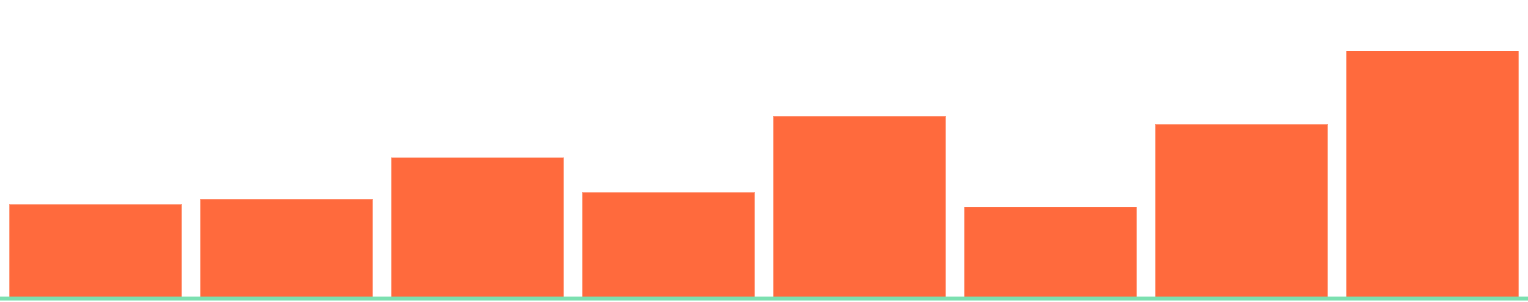
A slow climb, 473 kWh over 60 days
Home A's whole-house meter used 473 kWh more than forecast between 5 Jan and 5 Mar 2015, and the last week was the worst.
Extra use above forecast, about one week per bar
Forecast
103 kWh
40 kWh
5 Jan
5 Mar
Replay window: 5 Jan to 5 Mar 2015, Home A
Notes:
This is the finding called "Usage creeping up day by day". Home A's whole-house meter, 5 Jan to 5 Mar 2015, 60 days. Each bar is the extra use above the day-ahead forecast in one block of about a week: about 40 kWh in the first block and about 103 kWh in the last. Total extra use is 473 kWh. A slow climb like this is the thing a monthly bill hides.

Slide 7
One button replays the whole story
Replay
Your homes' 2014–15 in energy: 4 homes, 16 meters, 25 Aug 2014 to 31 May 2015.
Spotted
Press Replay recap and the app walks through all nine months.
About one finding every 6 days in each home.
Your turn
Open any home to see what was found, what it cost and what to check.
Replay position: Sun 31 May 2015, 00:00
Notes:
The Replay recap button in the header plays the whole nine months as three short cards: the overview, what was spotted, and an invitation to open each home. Note: the app's recap card states a finding count itself; the data export holds 179 findings in total, so quote the app's own number only if you check it first.

Slide 8

How a finding is made
Forecast
Compare
Flag
A LightGBM model predicts each meter's use a day ahead, from readings at least 24 hours old.
Actual minus forecast, scored against how noisy that meter usually is. The gap has to last, not just blip.
A finding gets a detection strength of low, medium or high, cut at 0.50 and 0.75, in one of six categories.
A finding is a pattern worth checking, not a confirmed fault.
Trained on data before 25 Aug 2014. Settings chosen on the shaded stretch, 25 Aug 2014 to 31 Jan 2015.
Notes:
The pipeline in three steps. One: a LightGBM model per meter forecasts a day ahead, using only readings at least 24 hours old, so it cannot peek at what it is judging. Two: the gap between actual and forecast is scored against that meter's usual spread, and has to persist. Three: it becomes a finding with a detection strength; bands are cut at 0.50 and 0.75. The six categories in the data are burst of extra usage, appliance using more than expected, gradual drift, creeping always-on use, peak-hour waste and overnight excess. The shaded stretch on the strip is the validation window, where all settings were chosen. The model was trained on data before 25 Aug 2014. Config is frozen.

Slide 9
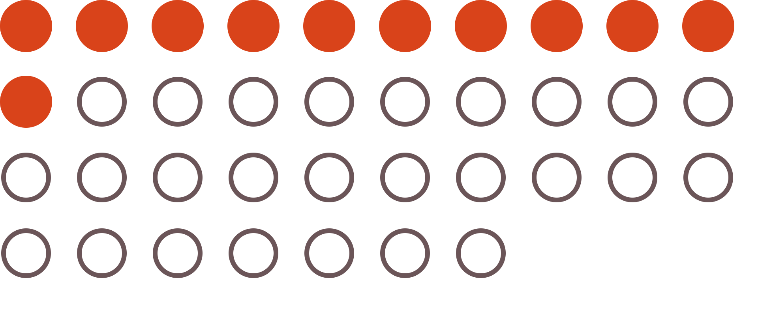
Scored once, shown as it came out
11 of 37
labelled events found, with a median delay of 7.3 hours.
Precision is 16%, with about 5 unmatched findings per home per month. Houses 10 and 18 were scored blind.
Each circle is one labelled unusual event in the test window. Filled circles were found by a finding.
Test window: 31 Jan to 31 May 2015, scored once, with no tuning.
Notes:
The honest slide. The test window, 31 Jan to 31 May 2015, was scored once, on a frozen config, with no tuning. Across all four homes and all meters, 37 labelled events were eligible and 11 were matched by a finding: recall 30%. There were 67 findings in the window, so precision is 16%, with 5.2 unmatched findings per home per month. Median delay to detection is 7.3 hours. Whole-house findings alone matched 4 of 37, with a median delay of 26.5 hours. Houses 10 and 18 were scored blind. The labels are REFIT annotations of unusual appliance behaviour (Rashid et al. 2019), not confirmed faults, and the annotation may be incomplete. The first scoring attempt crashed while writing the manifest, after scoring; only serialisation was fixed, and it is disclosed in the repo.

Slide 10
Next: catch more, nag less
Catch more
Lift the 11 of 37 labelled events found, starting with the whole-house meter, which found 4.
The scoring slide shows where the work is.
Nag less
Cut the unmatched findings, now about 5 per home per month.
More homes
Test the forecasts on more homes than the four so far.
The replay ends on Sun 31 May 2015.
Notes:
Draft slide: swap in your real plan. All three rows come from the scoring slide: 11 of 37 labelled events found, the whole-house meter alone matched 4 of 37, and about 5.2 unmatched findings per home per month. Add or replace a row with your own next step, such as a pilot or a partner.

Slide 11
Know what went wrong, not just what you spent.
wattswrong
Try the replay: wattswrong.vercel.app
Code: github.com/HishamAbdulhak/wattswrong-3d. Team: H. A. T. M., AI Dormathon.
Data: REFIT Electrical Load Measurements (Murray and Stankovic), CC BY 4.0. Event labels: Rashid et al. 2019.
Notes:
Close on the line, then the demo. Remove the code line if the repository is private. Credit the dataset: REFIT is licensed CC BY 4.0.

