Slide 1

Car Price Project
Prepared by: Hisham Abulfeilat
ID: 19110095
School of Computer & Informatics
11/8/2021

Slide 2
The Problem
An automobile company aspires to enter the US market by setting up their manufacturing unit there and producing cars locally to give competition to their US and European counterparts.
They have contracted an automobile consulting company to understand the factors on which the pricing of cars depends. Specifically, they want to understand the factors affecting the pricing of cars in the American market, since those may be very different from other markets. The company wants to know:
Which variables are significant in predicting the price of a car
How well those variables describe the price of a car
Based on various market surveys, the consulting firm has gathered a large dataset of different types of cars across the American market.

Slide 3
Goals
To model the price of cars with the available independent variables.
It will be used by the management to understand how exactly the prices vary with the independent variables.
To help management manipulate the design of the cars, the business strategy etc. to meet certain price levels.
Good way for management to understand the pricing dynamics of a new market.

Slide 4
Questions
What is T (Task), E (Experience), P (Performance) for this specific problem?
The T is to compare & predict the price of a car with features of the car like horsepower and citympg.
The E is the cars and their features which is the dataset (training data) we gathered.
The P is the accuracy.
What is the size of the training data? How many features do we have?
The size is 205 cars which we have 205 training instances or observation
We have 23 features

Slide 5
Methods Used
Linear Regression:
Scikit-learn package

Slide 6
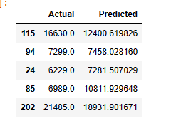
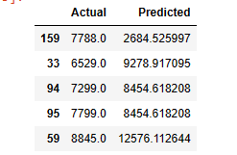
Conclusions
Horsepower/Price
Citympg/Price

Slide 7
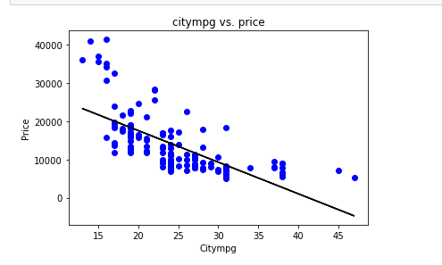
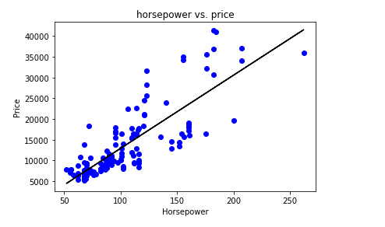

Slide 8
Future Work
In future we can compare the price with other features to come up with top 5 features that affect car price
Obstacle faced:
Data size is a little big so processing the information is hard
Wrong data
Citympg increases while price decreases which doesn’t make sense

Slide 9
Different models
We can model the effect of both horsepower and citymapg using Multilabel Classification model.
Multi-label classification is a predictive modeling task that involves predicting zero or more mutually non-exclusive class labels.
Neural network models can be configured for multi-label classification tasks

Slide 10

Thank you for listening

