Slide 1



SURFERS
Home
Photo
About Us
Contact
FT_TRANSCENDENCE

Slide 2
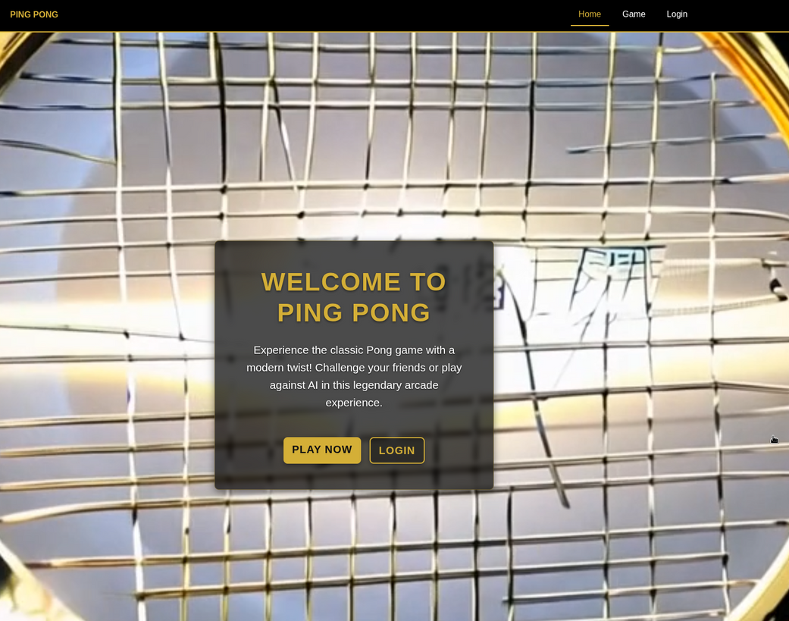
SURFERS
Home
Photo
About Us
Contact
OVERVIEW
Full-stack SPA Ping Pong Game with multiplayer & tournament modes.
Secure user management (OAuth, 2FA), PostgreSQL data, immutable tournament results on Ethereum blockchain.
Focuses on Django, Vanilla JS, Docker, Nginx, ELK.

Slide 3
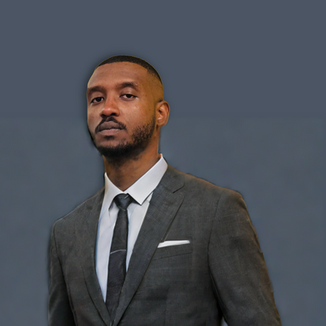
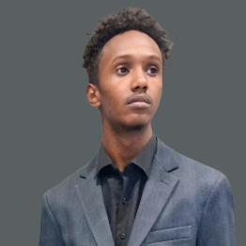
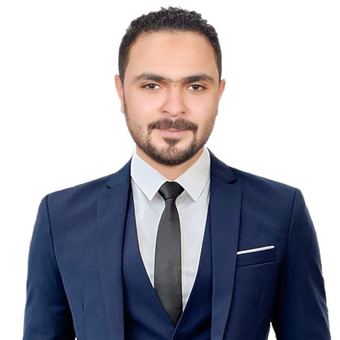
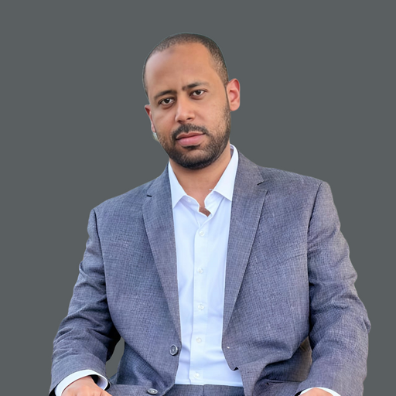

SURFERS
Home
Photo
About Us
Contact
MEET OUR TEAM
Mohammed Mohammed
Ahmed Ibrahim
Backend Lead & API Development
Blockchain Integration & Smart Contracts
Deiaaeldin Hamad
Mohamed Nour
Hisham Eltayb
Frontend Lead & UI/UX
Game Logic & Frontend Development
DevOps & Infrastructure

Slide 4


SURFERS
Home
Photo
About Us
Contact
OUR MODULES

Slide 5
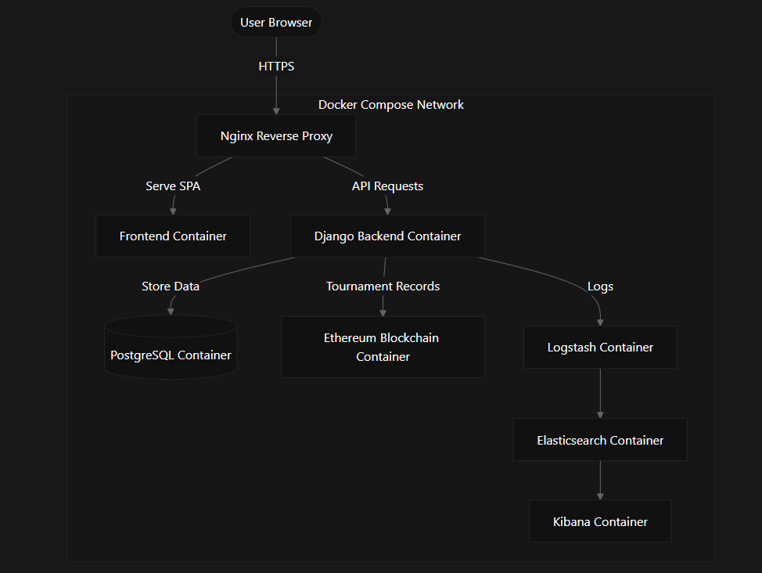
SURFERS
Home
Photo
About Us
Contact
INFRASTRUCTURE
All services Dockerized
Docker Compose for orchestration
Nginx as reverse proxy
ELK Stack for logging & monitoring
Makefile for easy management

Slide 6
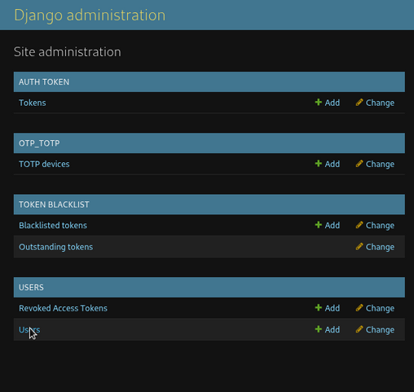
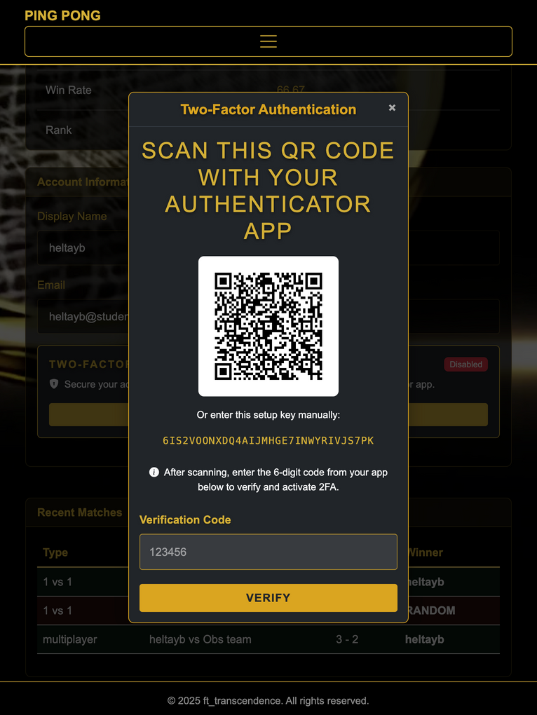
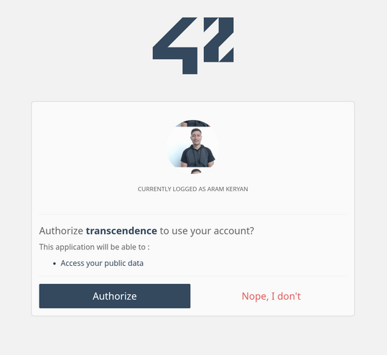
SURFERS
Home
Photo
About Us
Contact
2. BACKEND
Django/DRF for RESTful APIs
Native & 42 OAuth 2.0 login
JWT cookies & optional 2FA (TOTP)
Django ORM (Object Relational Mapper)

Slide 7
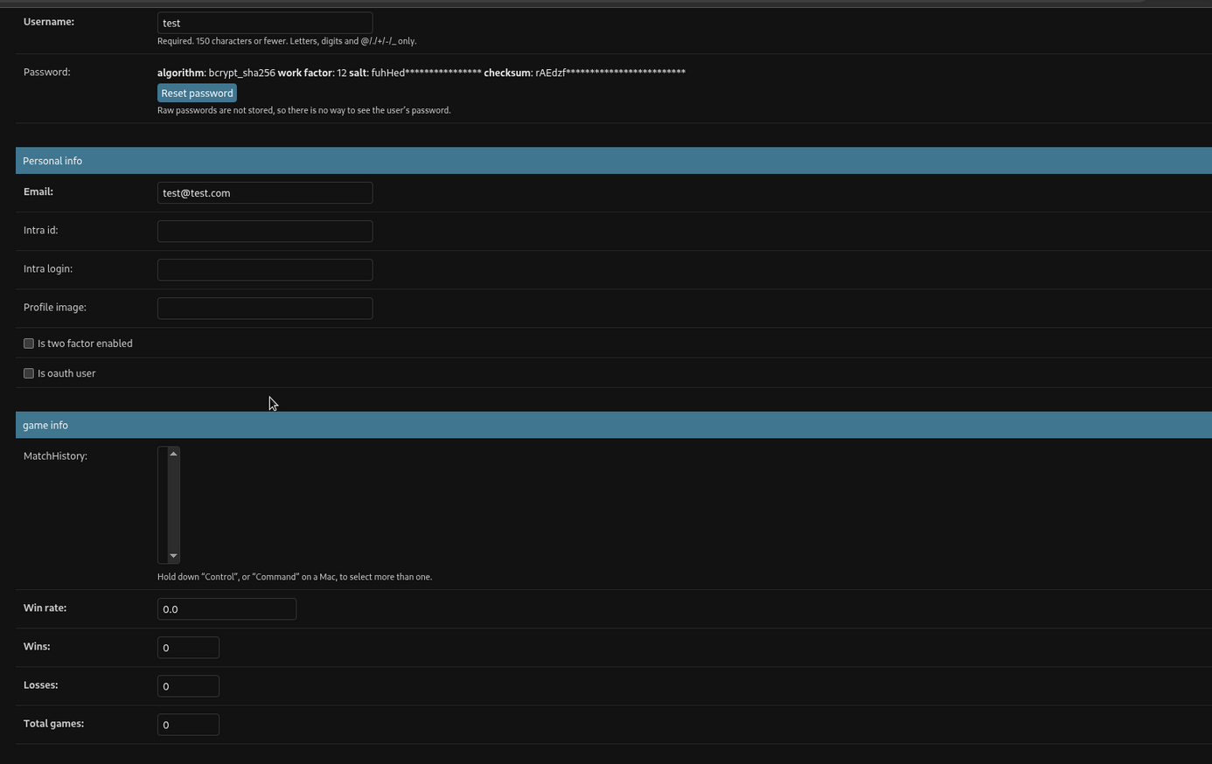
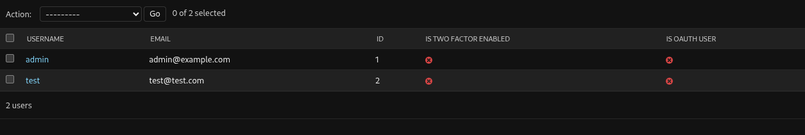
SURFERS
Home
Photo
About Us
Contact
3. DATABASE
PostgreSQL as primary DB
Stores users and matches
Storing hashed password
PostgreSQL for data storing
Structured for game statistics

Slide 8

SURFERS
Home
Photo
About Us
Contact
4. BLOCKCHAIN
Ethereum blockchain
Solidity smart contracts for data
Web3.py for backend-blockchain link
Dockerized Geth node

Slide 9
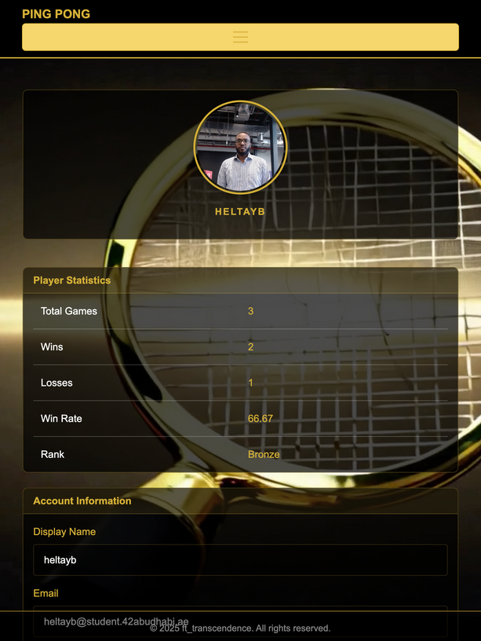
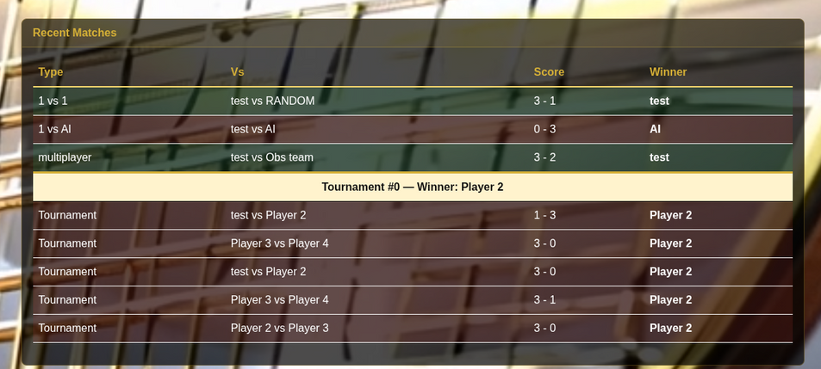
SURFERS
Home
Photo
About Us
Contact
5. FRONTEND
Vanilla JS, SPA, no reloads
Bootstrap 5 for responsive UI
JS for UI, navigation, API calls
Keyboard navigation, high-contrast

Slide 10
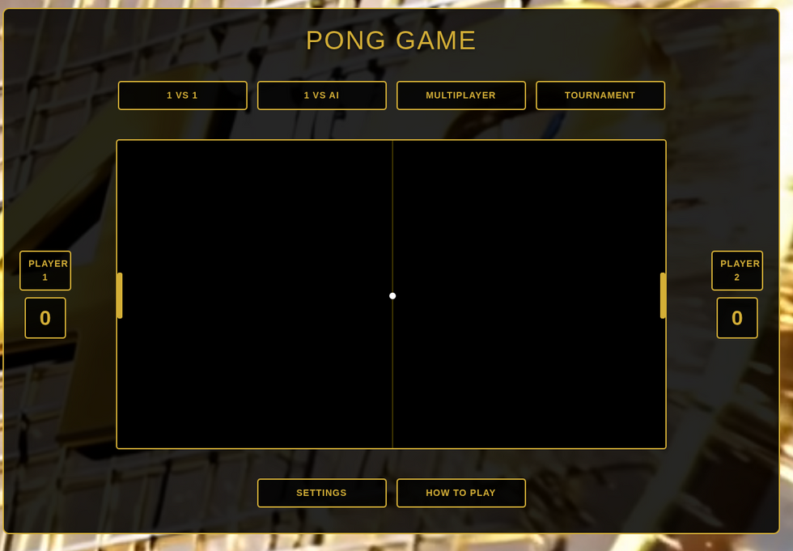
SURFERS
Home
Photo
About Us
Contact
6. CORE GAME
1v1 game, Multiplayer and tournaments
AI Opponent
User-customizable game experience
Real-time score & game state updates

Slide 11












SURFERS
Home
Photo
About Us
Contact
Technology Stack

Slide 12
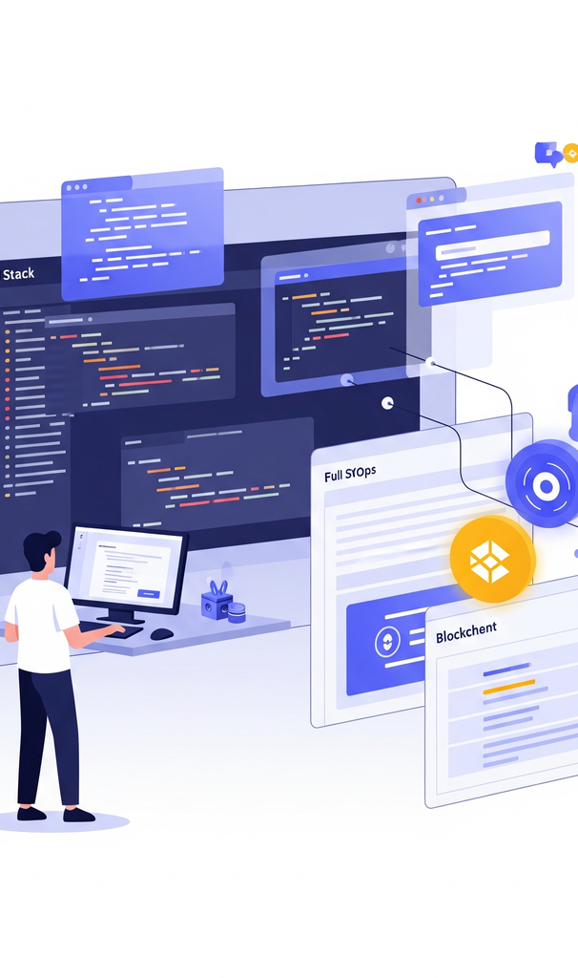
SURFERS
Home
Photo
About Us
Contact
CONCLUSION & IMPACT

Slide 13
SURFERS
Home
Photo
About Us
Contact
THANK YOU

