Slide 1

Insights into the Restaurant Industry for Year 4 (2015-2016) of the NYSE Data Set
Project 2 of UDACITY’s Business Analytics NanoDegree
By
Hisham D Macaraya

Slide 2
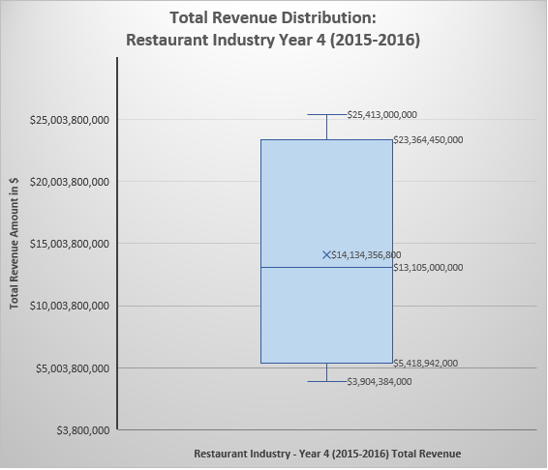
What is the total revenue distribution of the Restaurant Industry on Year 4 (2015-2016) of the NYSE data set? How does the distribution affect the market share of the companies in the Restaurant Industry, in this data set? (1/2)
The total sum revenue for the year 4 (2015-2016) of the NYSE data set’s Restaurant sub-sector is $70.671 Billion. It is a little less than a $500 Million from the previous year’s total sum revenue, as shown bellow. The uptrend from the past 4 years is still intact, though it went down a little. If the total sum revenue goes down in the next period, then it might be of a concern.
The mean of the total revenue distribution for the year 4 (2015-2016) of restaurant industry is $14,134 Billion, while the median is $13,105 Billion. *
*Continued on next slide

Slide 3
What is the total revenue distribution of the Restaurant Industry on Year 4 (2015-2016) of the NYSE data set? How does the distribution affect the market share of the companies in the Restaurant Industry, in this data set? (2/2)
This is a little less than $1 Billion which makes the total revenue distribution almost a symmetrical or normal distribution. This means that there are no outlier, and the share of the market is not being dominated with just one company as seen in the pie graph on the left. Furthermore, the standard deviation for the total revenue is $9.169 Billion which is lower than the mean $14.134 Billion. The standard deviation for this data set is close to the mean, which is a positive sign in finance.
The range for this data set is $21.5 Billion, which at first glance could be a substantial gap. But as stated above, the total revenue distribution is almost symmetrical, which means that the total share of market for this particular data set is almost evenly distributed. We could categorize total market share into 3 sections, 36 % for fast-food (MCD), 30% for coffee (SBUX), and the other 34% for fast-casual and fine-dining (YUM, DRI, CMG).

Slide 4
What company is the most and least profitable in terms of earnings before interest and tax (EBIT) in the Restaurant Industry on Year 4 (2015-2016) of the NYSE data set?
Based on the year 4 (2015-2016) of the NYSE’s restaurant sub-sector data set, the most profitable, in terms of EBIT (earning before interest and tax), is MCD or the McDonald's Corp – a fast food company. In contrast, the least profitable is CMG (Chipotle Mexican Grill, Inc.) a fast casual dining company.
It is also interesting to look at the gross profit margin of each of the restaurant. We found, as shown in the graph bellow, that SBUX (Starbucks) has the highest gross profit margin – 60%. This means that SBUX’s Cost of Goods Sold account for 40% of the total revenue, which is within the 30%-40% industry standard (National Restaurant Association, 2013).

Slide 5
References:
https://www.kaggle.com/datasets/dgawlik/nyse
National Restaurant Association, 2013, Controlling Foodservice Costs
Udacity.com

