Slide 1
Home Word Checkout Data set

Slide 2
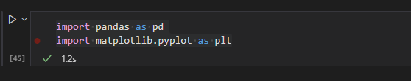
Import Files
Pandas lib is used to read and write file
Matplotlib is used to draw graph of analysis

Slide 3
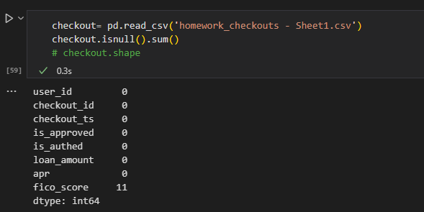
2. File reads and chek error and null values
Find there are null values in fico_score column
Add the mean value of fico_score column in null field

Slide 4
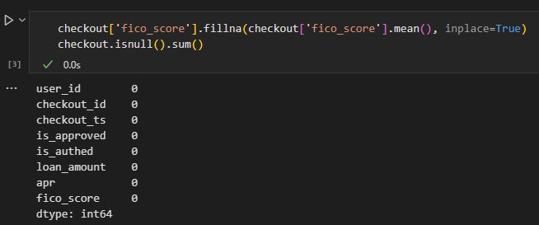
3. Added mean value in fico_score

Slide 5
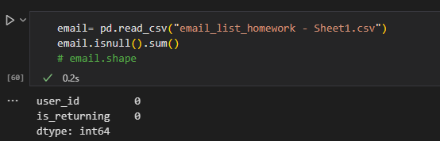
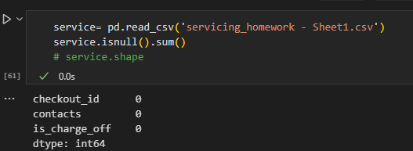
4. Read file and check errors
No error or null value in other file

Slide 6
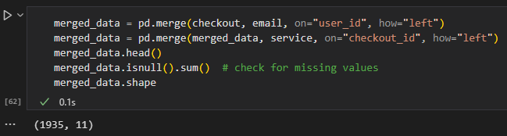
5. Merge all datasets
Merge all datasets based on same columns and check the dataset

Slide 7
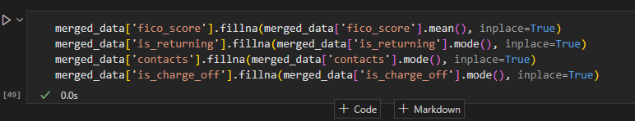
6. Resolve issue in Merge dataset

Slide 8
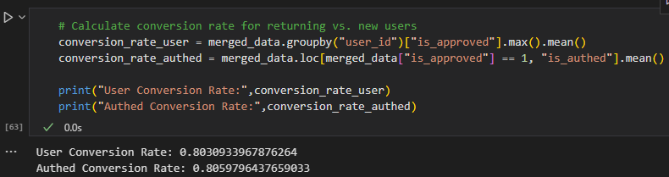
7. Calculate conversion rate

Slide 9
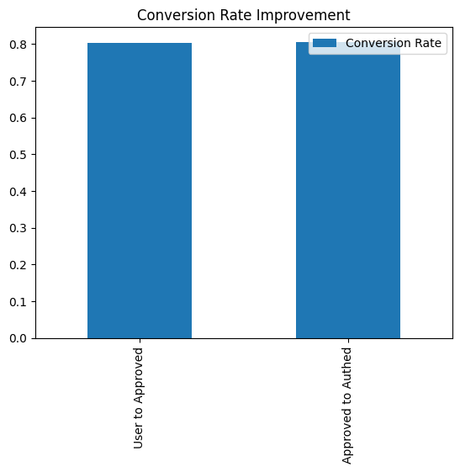
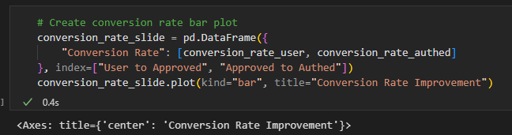
8. Plot and analysis Conversion rate

Slide 10
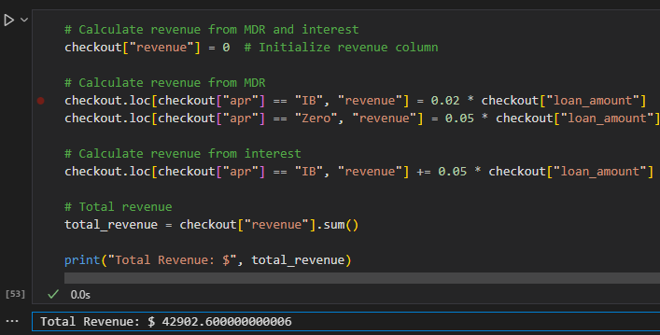
9. Calculate revenue from MDR and interest

