Slide 1

CAN YOU FEEL IT?
by Cem Baykal
Notes:
Hi, I am Cem Baykal. Today, I will present my project.

Slide 2

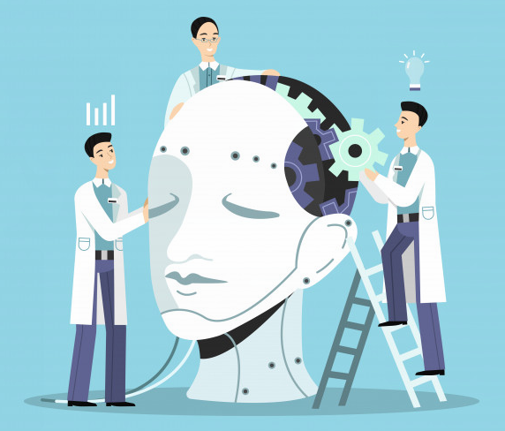
CAN YOU FEEL IT?
What is the purpose of AI?
How to be good at it?
Can AI catch humans feelings?
Notes:
No matter what, AI will become a massive part of our lives, and one of the predicted final goal is to make AI a perfect servant to humans.
To better understand humans, AI has to catch humans' feelings.
In this project, artificial intelligence is created to predict humans' current feelings by analyzing their facial expressions.

Slide 3
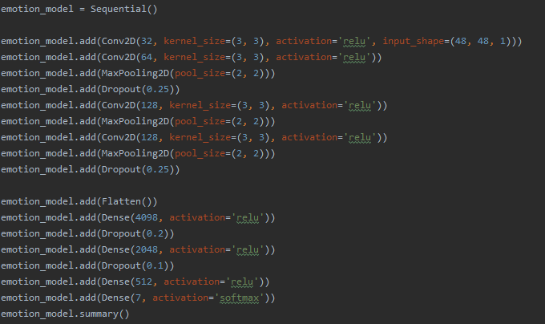
How to detect emotion?
Kaggle FER2013 dataset
28709 faces with the following labels:
0:angry
1:disgust
2:fear
3:happy
4:sad
5:surprise
6:natural
https://www.kaggle.com/msambare/fer2013
Notes:
Kaggle facial expression recognition 2013 dataset is used which is consisting of 48*48 pixel grayscale face images.
These are my kernels and pooling layers with relu activation.
After the flatten I have 2048 by 1 vector as my feature vector.

Slide 4
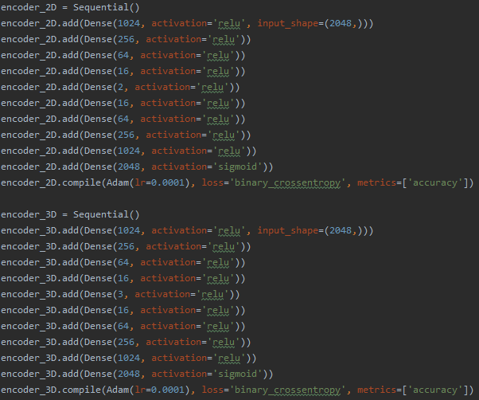
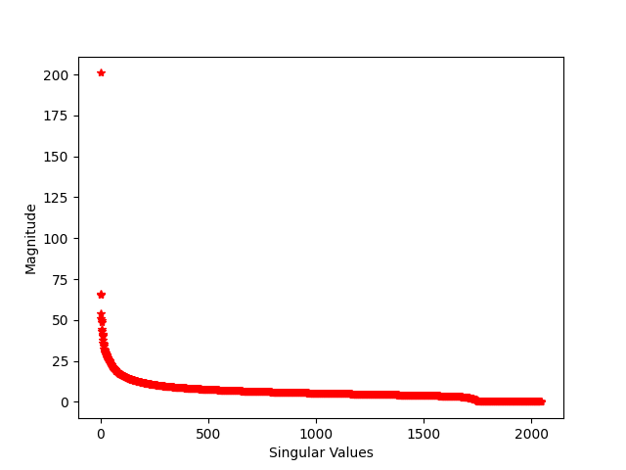
Feature vector - 2048x1
[1] M. Gavish and D. L. Donoho, "The Optimal Hard Threshold for Singular Values is 4/sqrt(3)," in IEEE Transactions on Information Theory, vol. 60, no. 8, pp. 5040-5053, Aug. 2014, doi: 10.1109/TIT.2014.2323359.
Notes:
The training result is 60% accuracy, which is not perfect; but, it is a good start. After the training is completed, feature vectors of all images are generated to obtain the feature matrix.
Two different approaches are analyzed with the feature matrix, encoders, and Singular Value Decomposition. With the encoders and decoders, the feature vector's size decreased to two or three to visually analyze the data. However, it failed.
Singular Value Decomposition is applied to this feature matrix, and singular values are shown right. Even though it seems only the first eigenvalue is the important one, only 20% of the total energy is in the first eigenvalue.
Gavish and Donoho[1] suggestion decreases the feature vector size to approximately 500 by keeping 80% of the energy. SVD indicates total energy is stored in approximately 1800 features. Due to time limitations, I do not try to decrease the feature vector's size, and I will use it as it is, with 2048 features.

Slide 5
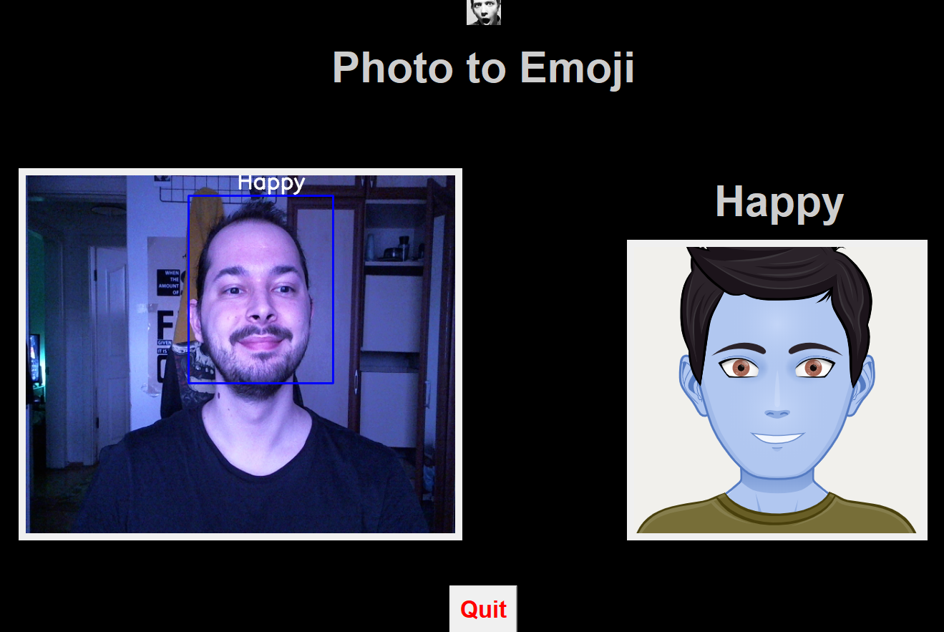
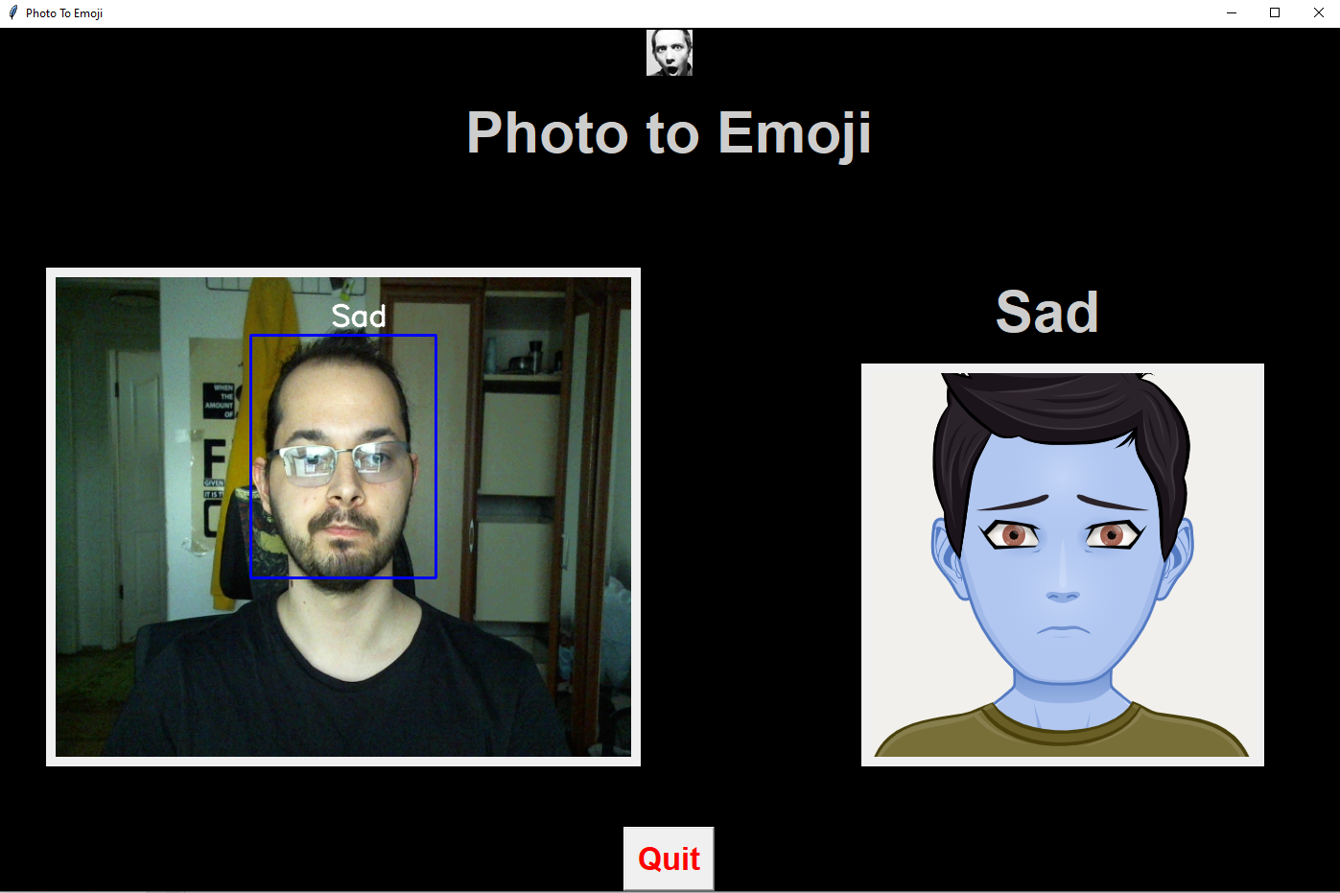
Can It Work Real Time?
cv2.CascadeClassifier()
Notes:
Even though it seems working it is not. It works with 3-4 FPS and the reason may be my computer.
Opencv library is used.
Accuracy is 60% as i said.

Slide 6
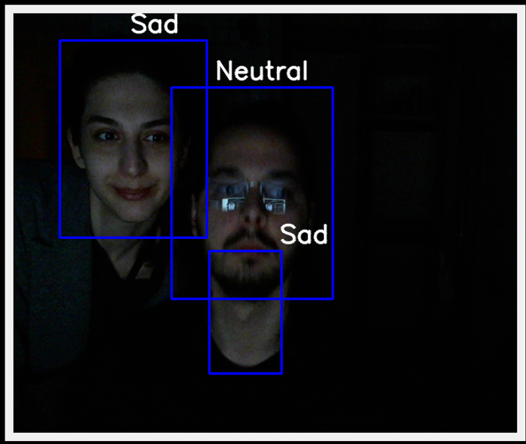
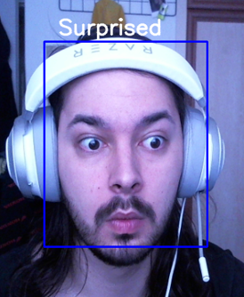
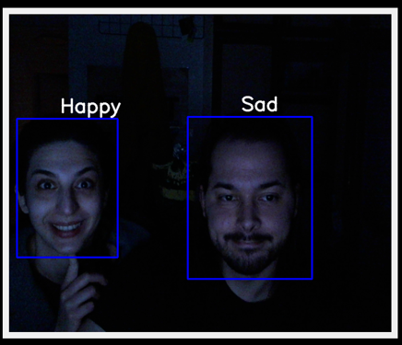
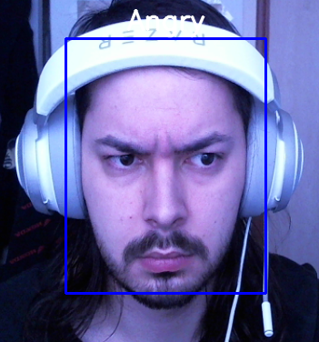
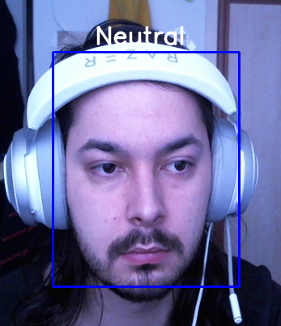
Can It Work Real Time?
Notes:
detectMultiScale() command to catch more than one person.

Slide 7
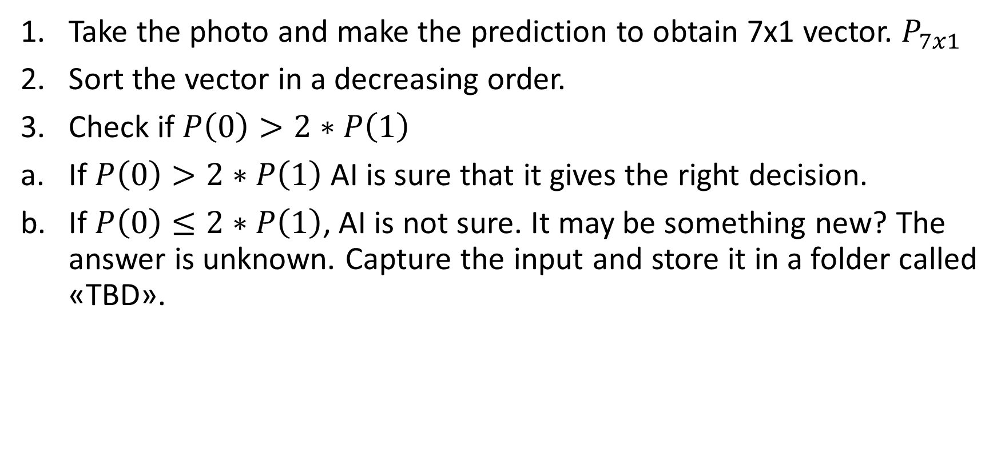
How to decide?
Take the photo and make the prediction to obtain 7x1 vector. $P_{7x1}$
Sort the vector in a decreasing order.
Check if $P\left(0\right)>2∗P\left(1\right)$
If $P\left(0\right)>2∗P\left(1\right)$ AI is sure that it gives the right decision.
If $P\left(0\right)≤2∗P\left(1\right)$, AI is not sure. It may be something new? The answer is unknown. Capture the input and store it in a folder called «TBD».
Notes:
I trained 7 different emotions. There are more.
I want to remind you that softmax is used at the last layer.

Slide 8
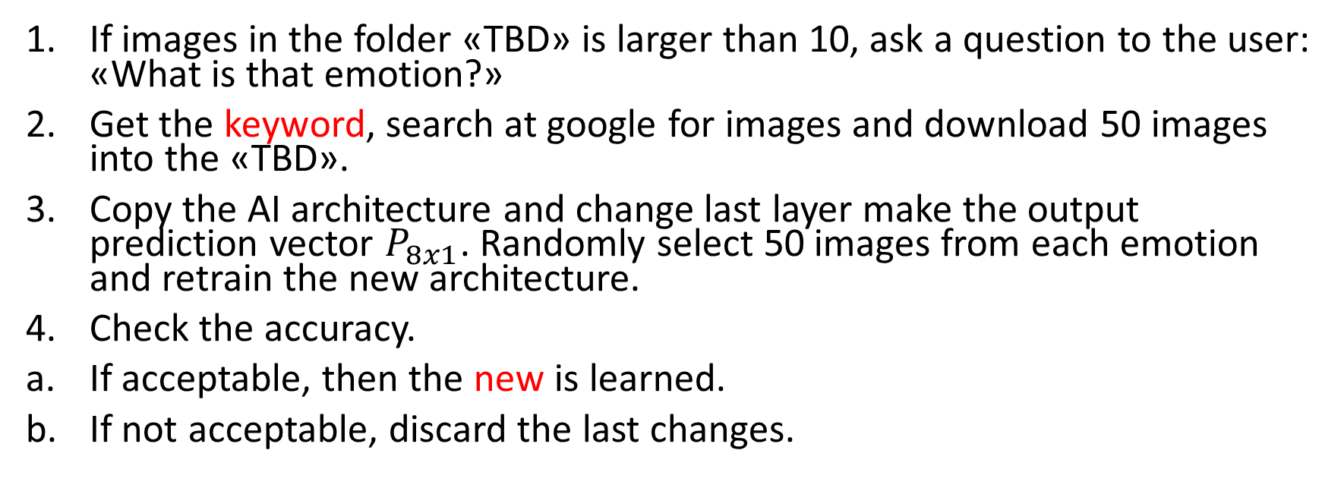
What happens to the «TBD» folder?
If images in the folder «TBD» is larger than 10, ask a question to the user: «What is that emotion?»
Get the keyword, search at google for images and download 50 images into the «TBD».
Copy the AI architecture and change last layer make the output prediction vector $P_{8x1}$. Randomly select 50 images from each emotion and retrain the new architecture.
Check the accuracy.
If acceptable, then the new is learned.
If not acceptable, discard the last changes.

Slide 9
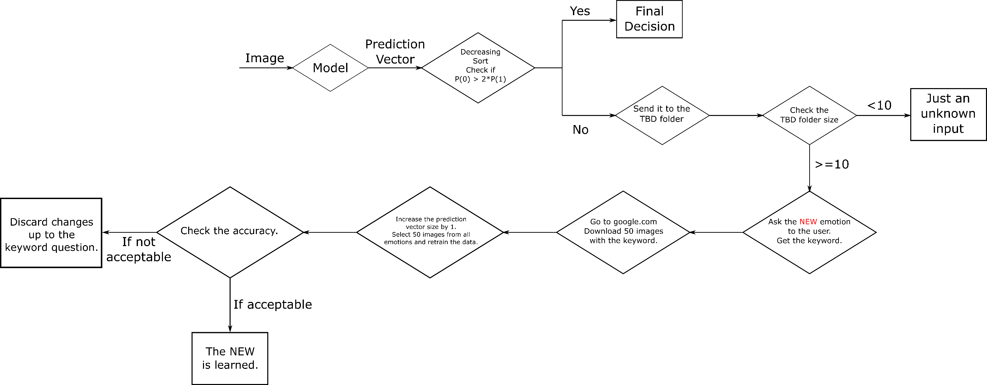
The Flow Chart

Slide 10
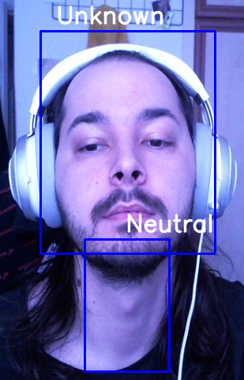
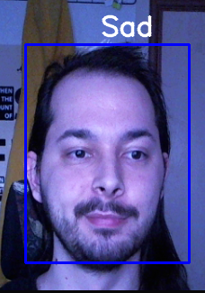
Conclusion
Low accuracy was a big problem.
Do it learn new right now?
Notes:
My dataset was not good enough. If i wear my glasses, results are changing drastically.
It is not learning because I could not implemented the flowchart into python. Could not find enough time.
.

