Slide 1
Happy plant Project
Course: SEIS 744 -IOT
Instructor: Mr. Justin Grammens & Mr. John Pritchard
Student: Hissah Alturki

Slide 2
The reason?
Read plants feeling.
The plant feels sad means it needs to be watered.
The plant feels happy means have watered.

Slide 3
The solution:
Internet of Things
Simply can test/read our plants feeling.

Slide 4
The project Components:
The microcontroller: SparkFun RedBoard
The sensor: Soil Hydrometer Sensor
The power: Battery V9& Battery clip
The output indicator: LED matrix 8X8

Slide 5
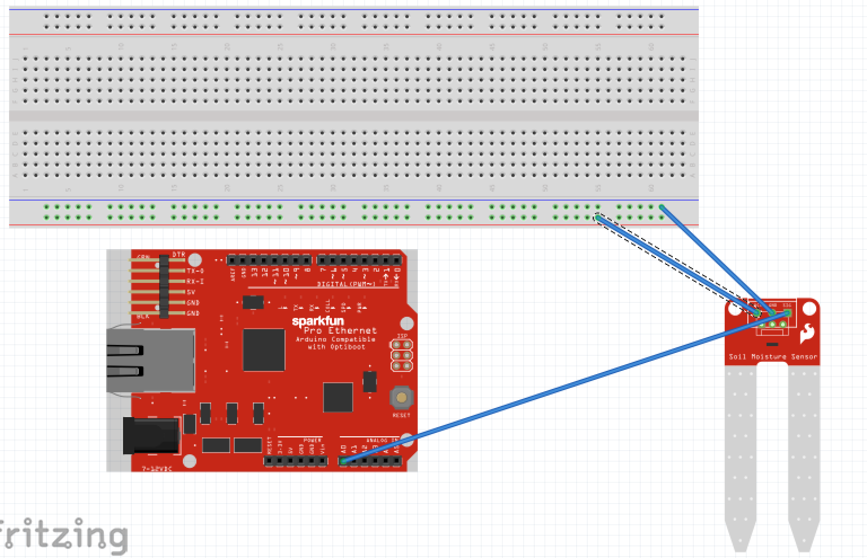
Happy plant hardware connections:
The connection among Soil Hydrometer Sensor, RedBoard, and Breadboard:
Sensor Pin A0 –> RedBoard A0
Sensor Pin GND -> Breadboard GND (-)
Sensor Pin VCC -> Breadboard V5(+)

Slide 6
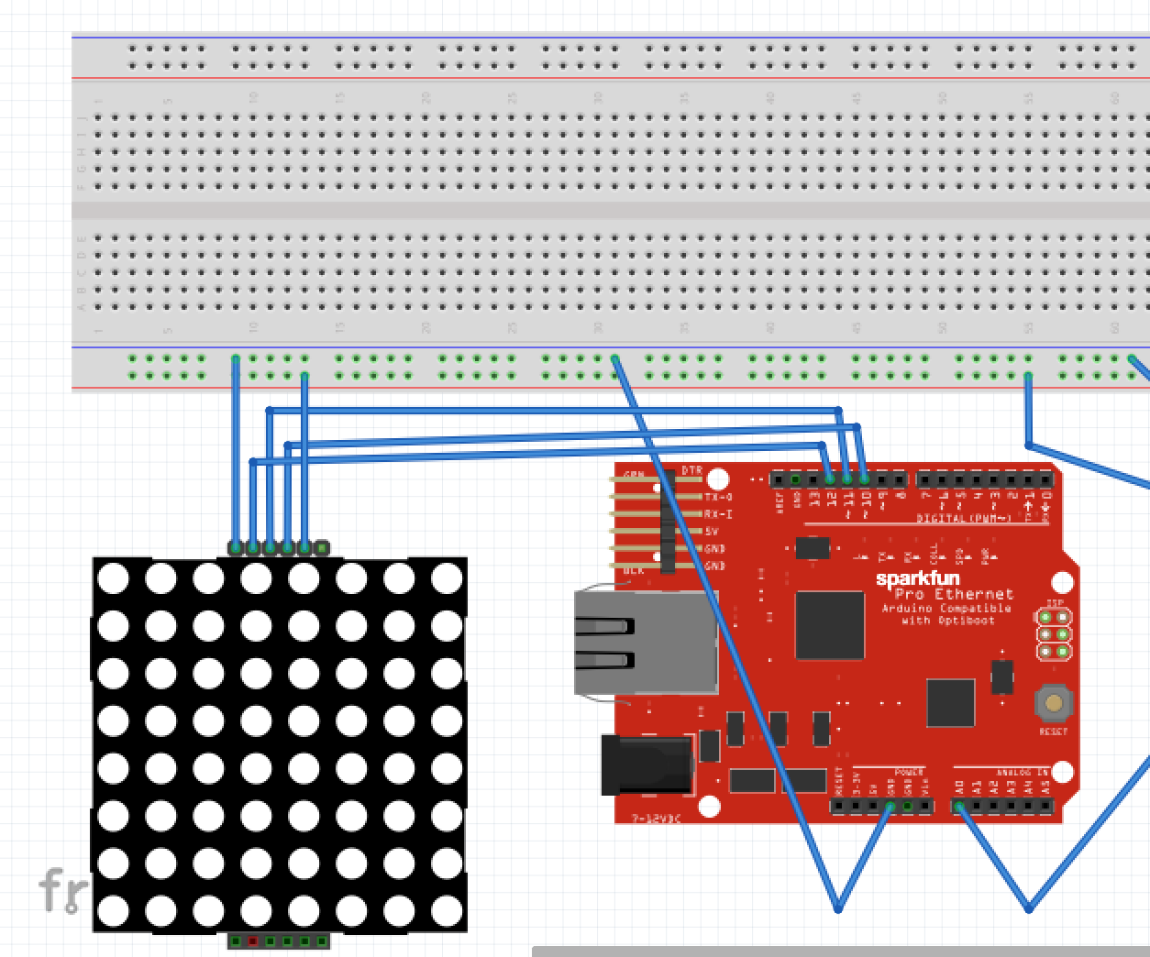
Happy plant hardware connections:
The connection among LED matrix, RedBoard, and Breadboard:
LED pin CLK -> RedBoard A10
LED pin CS -> RedBoard A11
LED pin DIN -> RedBoard A12
LED pin GND -> Breadboard GND (-)
LED pin VCC -> Breadboard V5(+)

Slide 7
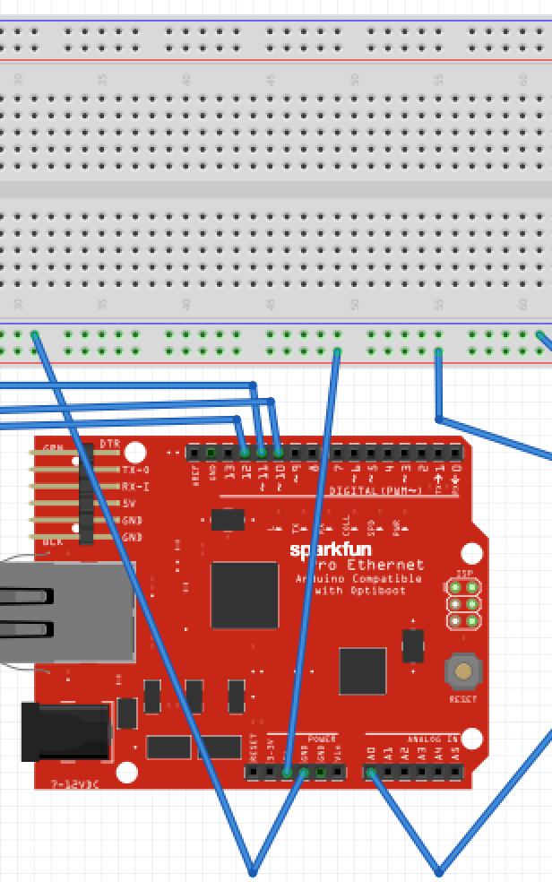
Happy plant hardware connections:
The connection between RedBoard, and Breadboard:
RedBoard pin V5(+) -> Breadboard V5(+)
RedBoard pin GND (-) -> Breadboard GND (-)

Slide 8

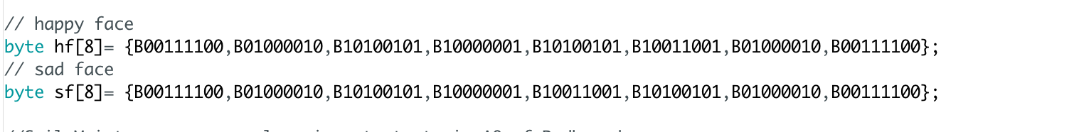
Happy plant software code:
1- Define the LED matrix:
2- Define the LED matrix dots by binary array:
3- Define Soil sensor pin A0 that connected to ReadBoard A0 :

Slide 9

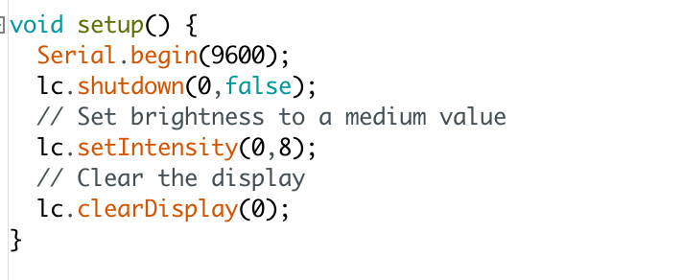
Happy plant software code:
4- Define integer variable which is called value:
5- Setup a contrast for LED matrix brightness:

Slide 10
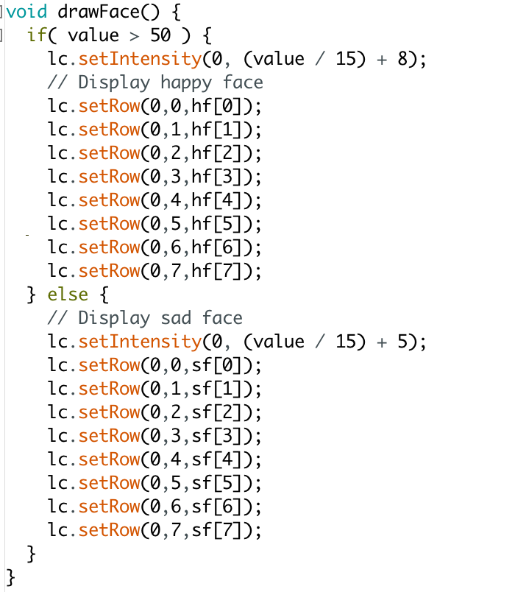
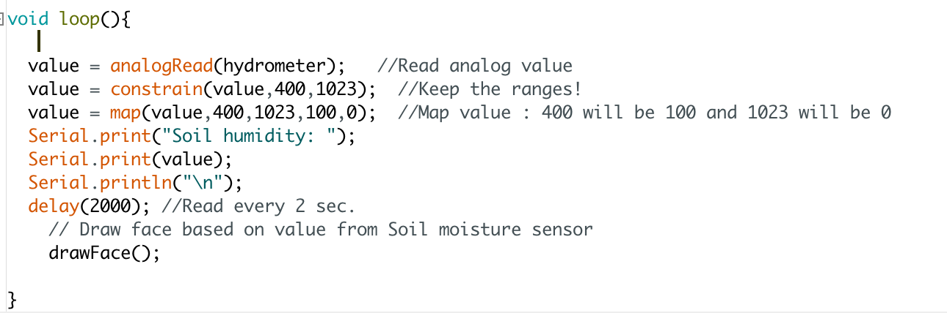
Happy plant software code:
6- Define drawface function to set a loop
for displaying a happy face and a sad face:
7- Define loop function to read
the value from the sensor to show it up
in the serial window and call drawface():

Slide 11
Future..
IoT companies OR gardening companies.
Be attractive design for marketing.
Will be supplied by App.

Slide 12
Thank you..
Questions?

