Slide 1
Pen and Printers
Practical exam for
Professional Data Analysis
Submitted by: Rafael B. Bashan

Slide 2
Data Validation
week: 6 unique values (1-6), no cleaning needed.
sales_method: Adjusted for 3 methods (Call, Email, Email+Call).
customer_id: No missing values, no cleaning required.
nb_sold: 10 numeric categories (7-16), no cleaning needed.
revenue: 1,074 missing values dropped.
years_as_customer: Outliers (47 and 63 years) removed.
nb_site_visits: No missing values, no cleaning required.
state: 50 values, no missing entries, no cleaning needed.

Slide 3
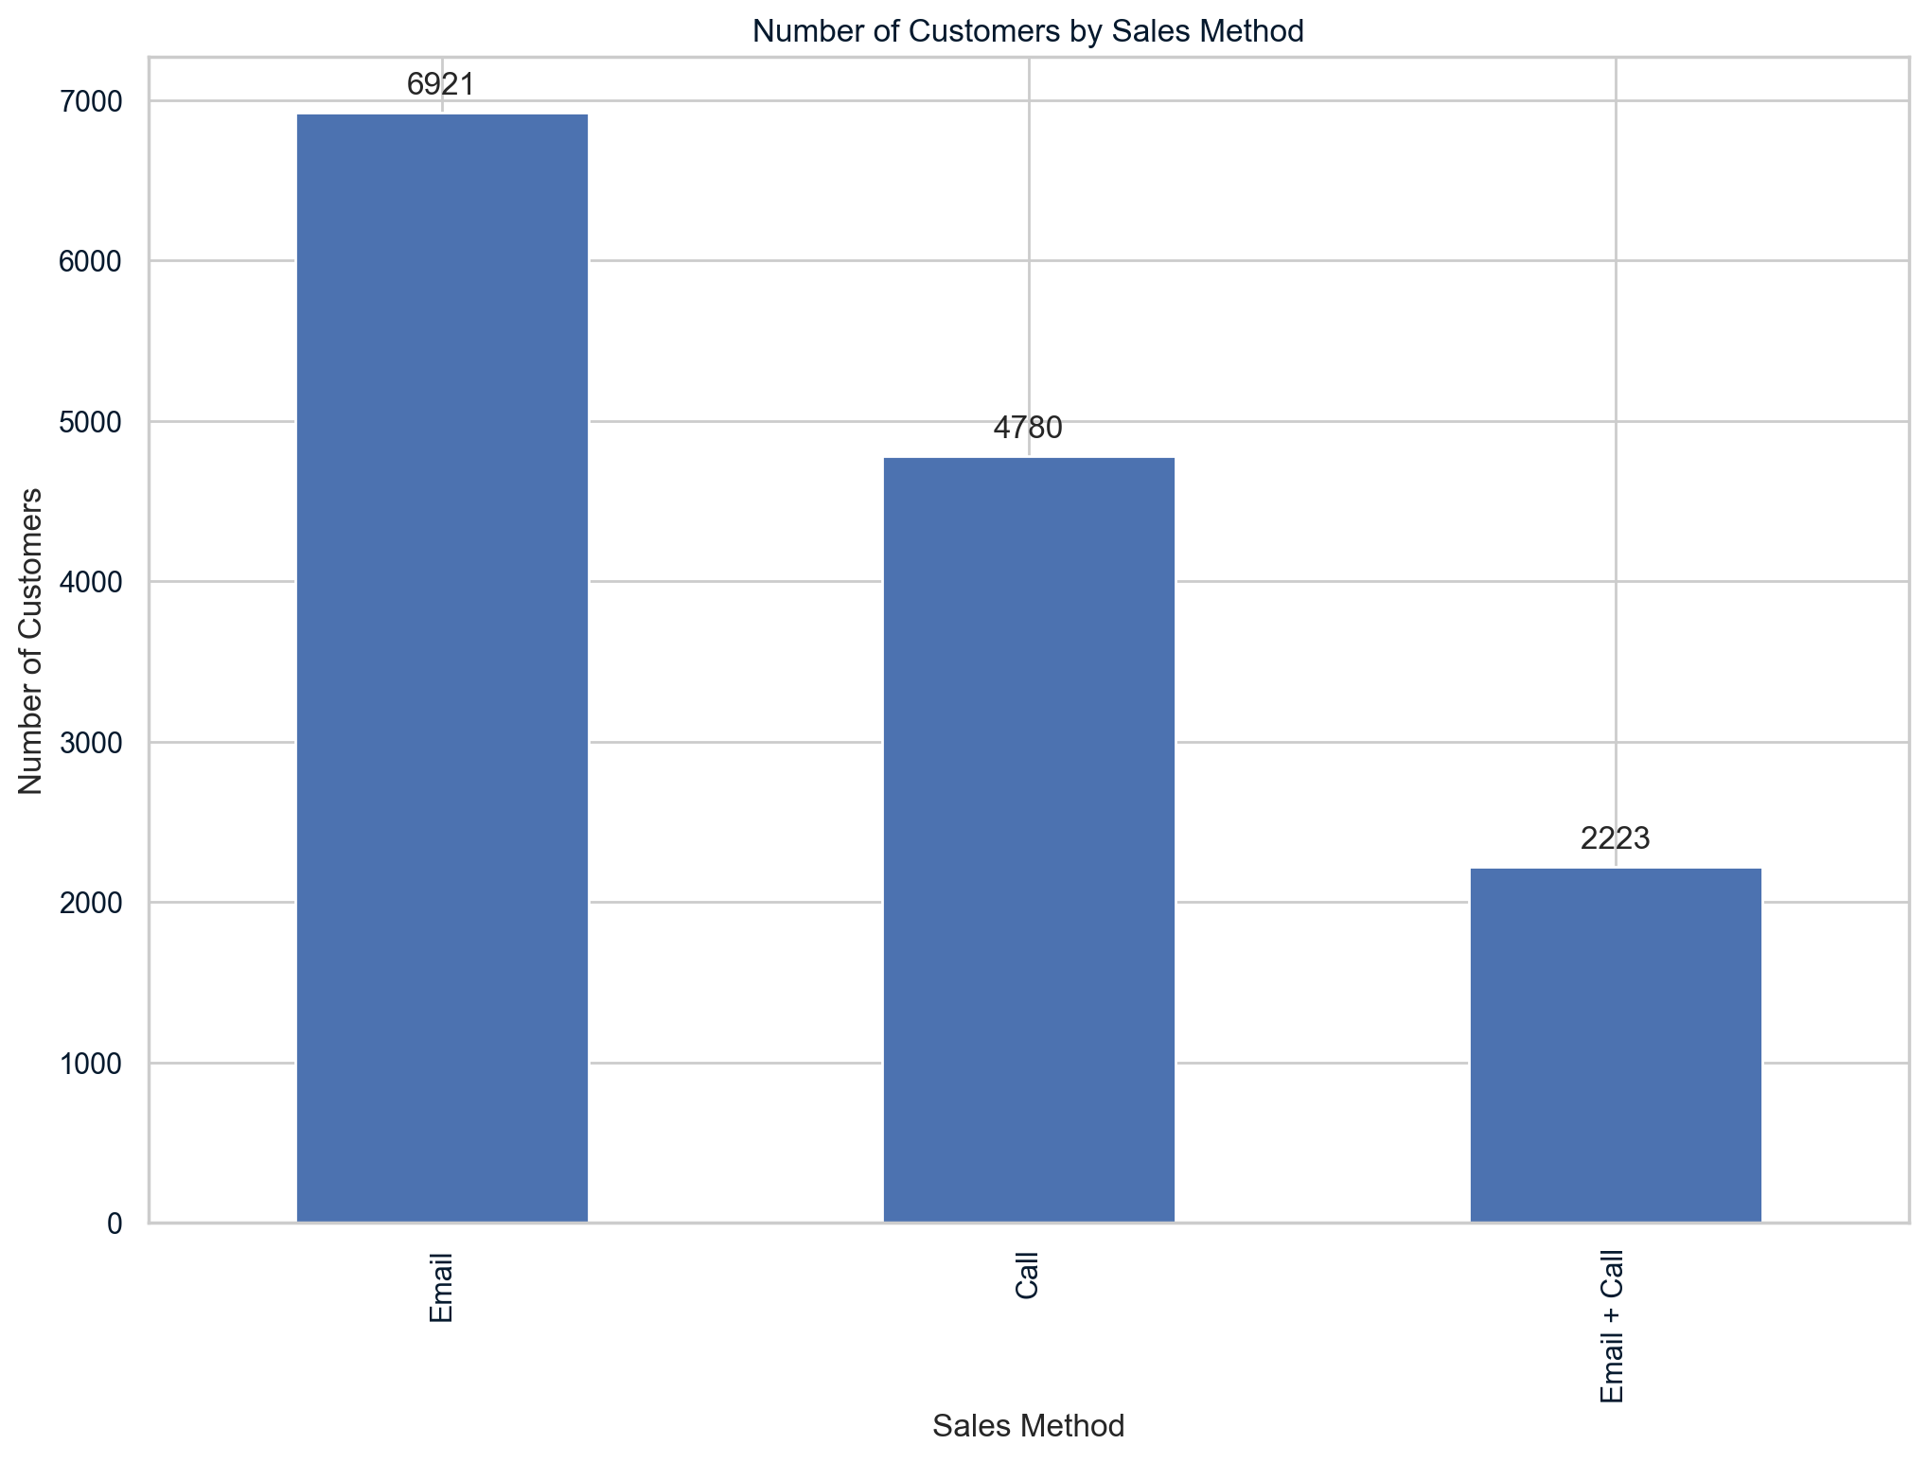
Exploratory Analysis
1. How many customers were there for each approach?

Slide 4
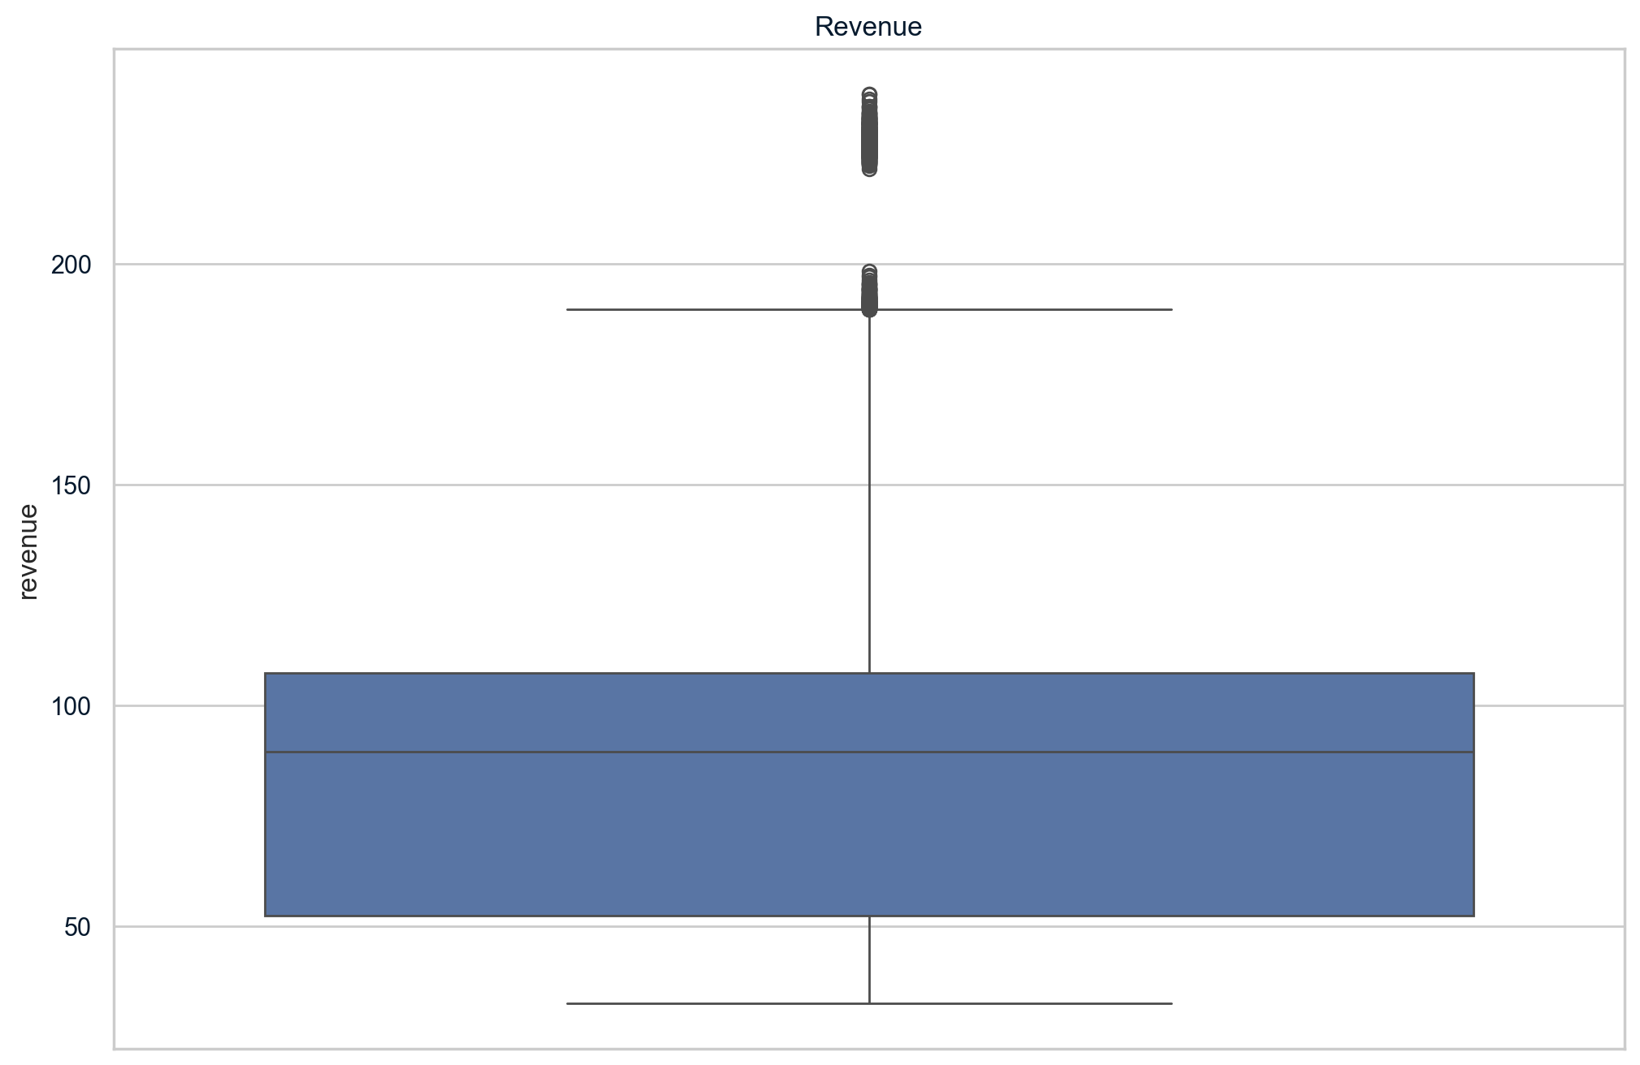
2.1 What does the spread of revenue look like overall?

Slide 5
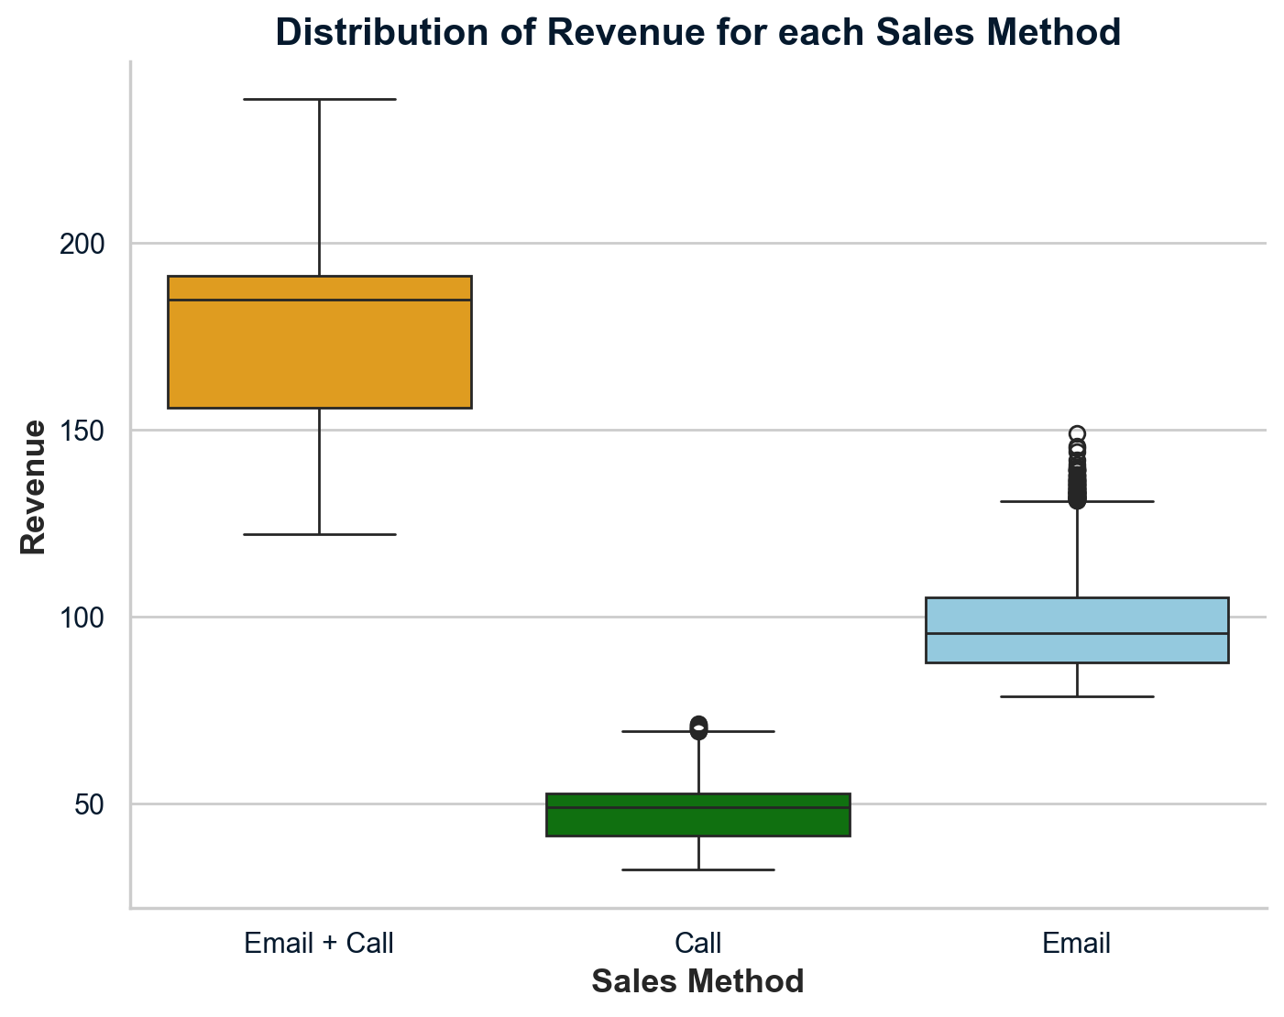
2.2 What does the spread of revenue look like for each sales method?

Slide 6
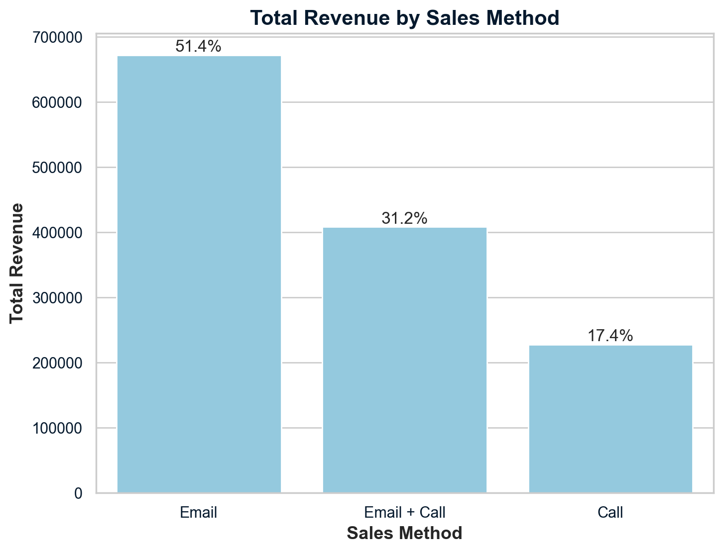
Percentage of the Total Revenue

Slide 7
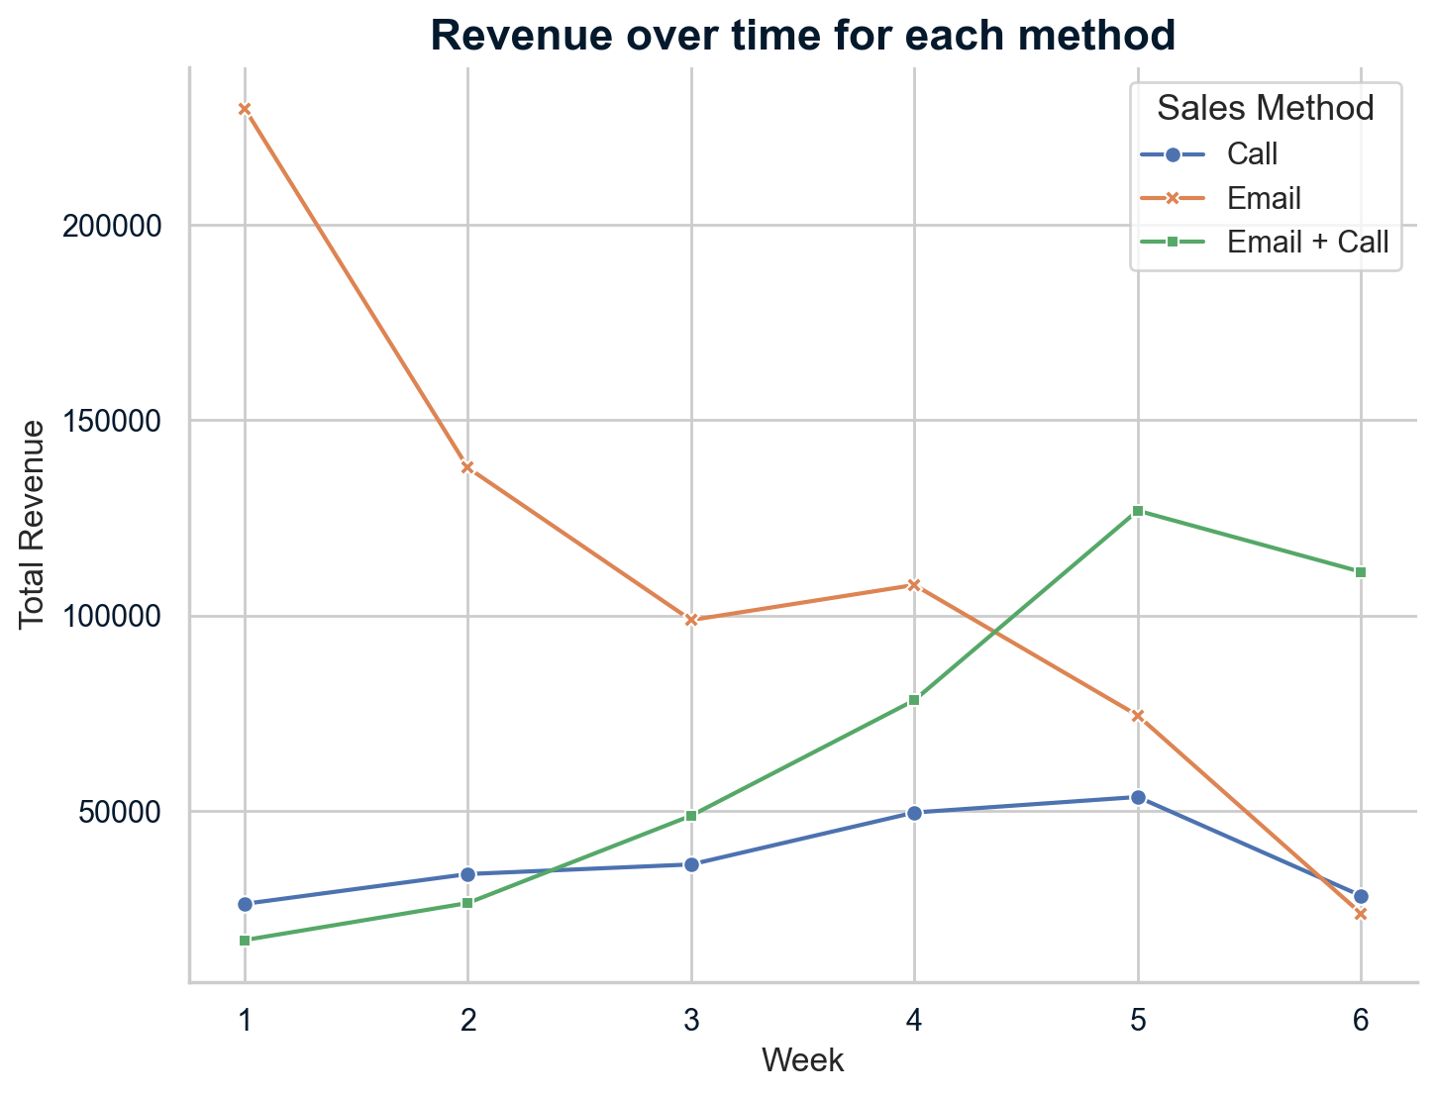
3. Was there any difference in revenue over time for each of the methods?

Slide 8
Recommendations
4. Based on the Data, which method would you recommend we continue to use?
Call strategy: Low ROI, high time demand.
Email integration: Enhances standalone calls.
Email + Call strategy: Highly effective, time-efficient.
Recommended strategies: Email + Call primary, Email secondary.
Moving from Call: Poor performance, time-consuming.
Sales benchmark: Increase in new products sold.

Slide 9
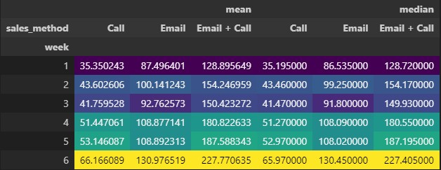
Business Metric to Monitor
Prioritize Performance Metrics
Superiority of Email + Call
Detailed Revenue Analysis
Continuous Monitoring and Adjustment

Slide 10
Final Summary and Conclusion
In the coming weeks, we recommend focusing on several
strategic actions to boost sales:
1. Monitoring Key Metrics
2. Launching a Loyalty Campaign
3. Maintaining Awareness of Marketing Trends
4. Enhancing Data Collection for In-depth Analysis

Slide 11
Email + Call Method: Multi-channel approach
Higher ROI on time invested
Enhances operational efficiency
Follow-up Strategy: Key to Success
Day-after email: Optimal timing
Boosts engagement and sales conversion rates
Conclusion: Strategic Advantage
Outperform competition
Excel with focused strategies

