Slide 1
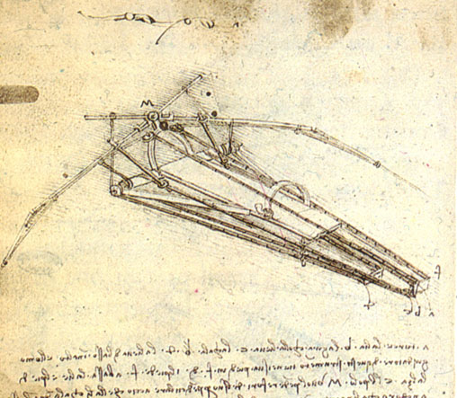
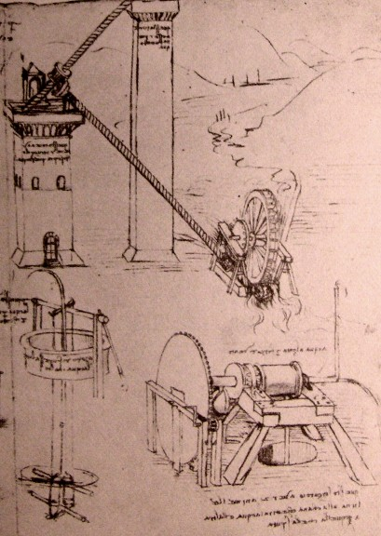
HY540 – Advanced Topics in Programming Language Development
Lecture 2

Slide 2
Untyped classes – introduction (1/4)
Relate to languages where no class-related data type is supported, even class is not a keyword
However, objects are supported, though not typed by classes but by a generic object type
Object creation is allowed via library functions, special expressions, or all variables are objects
The languages of our focus are classless

Slide 3
Untyped classes – introduction (2/4)
Class design (design model)
Class definition (model specification)
Object model (runtime model)
Object (model instance)
Design domain
Language domain
Runtime domain

Slide 4
Untyped classes – introduction (3/4)
Classless languages have commonly reference semantics for object values (i.e. no deep assignment, no call by value)
Replication maybe possible with a reserved library function or operator, typically as shallow copy
In the vast majority object disposal is automatic (garbage collection)
They are considered (type) unsafe due to absence of typing (though some language adopt type tags)
But they are very popular due to simplicity of use and economy of expression (making objects of a particular kind is straightforward in code)

Slide 5
Untyped classes – introduction (4/4)
Next we discuss
  Language examples
  Object model
  Prototypes
  Duck typing (object protocols)
  Implementation details

Slide 6
Language examples (1/14)
Self language (1/5)
student name: ‘john‘ age: 10 residence: ‘New York’. student name print. student _AddSlots: (| nationality <- ‘Greek'|). student _AddSlots: (| doWork = ( statements (method) ) |). self x: ((self x) + add) // ala C++ this->x += d [i < thresh] whileTrue: [i: i * 2] [condition block] whileTrue: block // sending whileTrue message to block n even ifTrue: [h: n / 2] // var: rv is an assignment message for var condition ifTrue: block // sending ifTrue message to expression
The OO programming model in Self adopts the message passing style object (message [parameters])∗ where a message carries information about the invocation to be done (it is left associative if a parameter is message invocation too).

Slide 7
Language examples (2/14)
Self language (2/5)
  The first large-scale object-based language - Sun, 1986-2006, still available via http://selflanguage.org
  Objects as containers of indexed slot values (via ids)
  Strongly affected by Smalltalk, however, dropping all the class-based stuff and static typing
  Everything is an object (a Smalltalk slogan), even control flow statements
    Sending ifTrue, whileTrue, ifFalse, whileFalse messages (with code as a parameter) to expressions or code blocks (evaluated, not merely executed)
  Every slot is late bound (always runtime dispatching)
  Compiled to byte code with a comprehensive virtual machine

Slide 8
Language examples (3/14)
Self language (3/5)
  The Self language introduced many innovations
    traits, polymorphic inline caching, code of practice for prototype programming, inheritance by delegation
  The idea of traits is Self is that objects looking alike (of the same class) should not copy their methods
  Instead, they should all share from a special object carrying such common methods representing the class
  This class object is called a trait in Self and aims to provide a model of making classes real objects
  In Self, editing of such a trait slot is possible through a parent* slot that is a list (meaning can have multiple traits)

Slide 9
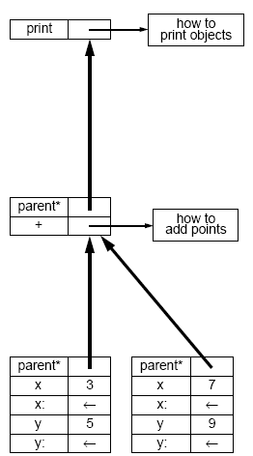
Language examples (4/14)
Self language (4/5)
Printable
class object
(shared)
sharing (delegation)
Point
class object
(shared)
sharing (delegation)
sharing (delegation)
value slot
value slot
Point
distinct instances
setter
setter
value slot
value slot
setter
setter

Slide 10
Language examples (5/14)
Self language (5/5)
3. Method owner object found
(grey path)
4. Method called binding ‘self’ to receiver
2. Delegation lookup over parents links
(dotted arrows )
How the delegation mechanism works
1. Message received (method invocation)

Slide 11
Language examples (6/14)
Perl language (1/2)
%student = ( #hash (object) constructor expression name => ‘John', age => 10, residence => ‘New York' ); $student{nationality} = ‘Greek’ #setting a scalar in %student hash $student{f} = sub (formal arguments here (proto in Perl) ) { body } $student{f}(%student, actual arguments here) #method invocation style

Slide 12
Language examples (7/14)
Perl language (2/2)
  The language evolved in a very surprising way with many changes looking mostly arbitrary and not quite thoughtful
  Originally with an object-based language kernel, lacking support for self or this in method invocations (as Python does)
  Adopting type tags (sigils) to declare the variable type with declaration by use style (i.e. array x is abbreviated to @x)
  Latter (version 5.0) introduced typed classes and explicit class model specification for better typing
    but still looks that the underlying implementation (interpreter) adopts universally the field dictionary model
  We return back to Perl (and Python and other languages) latter when discussing inheritance and methods

Slide 13
Language examples (8/14)
Java Script (1/3)
// Functions setting this by default call Object() to create a new object on which // this applies inside the function function student (name, age, nationality, rename) { this.name = name; this.age = age; this.nationality = nationality; this.rename = rename; } function student_rename (name) // A method is a function using ‘this’ { this.name = name;} st = new student(“John”, 10, “Greek”, student_rename); st.registry_number = 13; // Can add slots dynamically address = new Object(); // Makes a default empty object address.city = “Gotham”; // Can freely add or edit slots

Slide 14
Language examples (9/14)
Java Script (2/3)
  Probably the first popular languages with a clean, truly dynamic, untyped object-based model
  Entirely typeless, with a generic object model as an extensible dictionary, and a language design pattern for object constructors (object templates)
    We will revisit this pattern latter
  Methods are syntactically normal global functions accessing this, something that requires naming conventions to avoid name conflicts
    or else can assign directly inside constructors as anonymous functions
  Whether a function is called as a constructor or not is statically resolved and affects the way the function works internally
  Interpreted, but there is a plan for a compiled JavaScript on the DLR (Dynamic Language Runtime, on top of CLR) running under Silver Light 2.0 (.NET)

Slide 15
Language examples (10/14)
Java Script (3/3)
Constructor is any function assigning internally to this slots and encompasses no return statements in its body. We trivially turn constructor invocation as normal functions. In constructor functions we always add an extra first argument this and the following two extra statements in the function body: Head: if (!this) this = new Object(); Tail (fallback): return this; If in a function call expression an object slot (field) is the function value, then we pass as the first argument to the call the object value
ObjectExpr . Id (Args) => a = <ObjectExpr>.Var t_f = get(a, <Id>) push a emit push for every <Args> call t_f | function student_rename (name) { if (!this) this = new Object(); this.name = name; return this; } st.rename(“Lee”) ≡ student_rename(st, “Lee”); rename(“Lee”) ≡ student_rename(nil, “Lee”);

Slide 16
Language examples (11/14)
Lua (1/2)
student = { name = “John”, age = 10} // no semicolons needed student.nationality = “Greek” student:rename(this, name) // ‘this’ not a keyword { this.name = name } function sudent.rename(this, name) // equivalent to the previous code { this.name = name } student.rename = function(this, name) // equivalent to the previous code { this.name = name } student:rename(“Lee”) // method invocation convention student.rename(student, “Lee”) // equivalent to previous expression student..rename(“Lee”) // alpha language (CS340) syntactic sugar for methods Lua does not have true methods (they are only syntax), meaning they are not first-class methods

Slide 17
Language examples (12/14)
Lua (2/2)
  Has a long history (1991 – today), PUC, Rio (Brazil)
  Was not designed initially with a high-level goal, but evolved by demands, experimentation and good will
  Not proposing innovative features as such, but combines simplicity, good set of features and performance (written in C, 18 KLOC for the 2009 version), with great portability
  Objects as hash tables model initially inspired by Smalltalk, Perl and JavaScript
  Compiled to byte code with dedicated instructions for object management
  Pseudo methods are an important weakness of the language for OOP

Slide 18
Language examples (13/14)
Delta (1/3)
student = [ {.name : “John”}, {.age : 10 }, {.rename : ( method(name){ self.name = name; } )} ]; student.nationality = “Greek”; rn = student.rename; // First class methods, ‘self’ is keyword rn(“Lee”); ≡ student.rename(“Lee”); // Method values retain ‘self’ binding (owner) rn.owner = []; // But objects can change their owner on-the-fly rn(“Bruce”); // Will apply the method to the previous empty object
First-class methods are implemented as pairs of a function address (number) and an owner (self) object (pointer). Invoking a method value is handled as a function call with the extra work of implicitly passing the owner as an extra first argument (meaning the user need not do it, as in Lua). Similar to AS3 bound methods and Python methods, though in Python the ‘self’ is not reserved but is strongly suggested (…a poor design choice) and the owner is immutable (so can’t move methods around).

Slide 19
Language examples (14/14)
Delta (2/3)
Callable methods retaining internally ‘self’ object are adequate to allow program very fast generic binders (together with the argument passing support of the language). function bind_1st (f, x) { return [ {.x : x}, { .f : f }, {.rebind: (method(x) { self.x = x;}) }, ( method(){ return self.f(self.x, |arguments|); } ) ][0]; } bind_1st(print, 10)(); ≡ print(10); bind_1st(bind_1st, print)(20)(); ≡ print(20); bind_1st((function(f){f();}), bind_1st(print, 30))(); ≡ print(30); bind_1st(bind_1st(…bind_1st(bind_1st(f, a₁),a₂)…,a_{n-1}),a_{n})() ≡ f(a₁,a₂,…,a_{n-1},a_{n}) The previous has theoretical value only, as making a generic lazy (delayed) evaluation binder call is very easy (need to store all arguments). You know binders from C++, right?

Slide 20
Footnote (1/2)
And what binders are?
  In general, higher-order functions = functions returning other functions or accepting functions as arguments
    The result of a binder f is a function g that can be normally called where f()() ≡ g()⇔ g ≡ f()
  In particular, a binder is a restriction of a function by ‘freezing’ some of its arguments to constant supplied values
  Thus, to make binders the language should support function values which may refer to some sort of associated memory
    The latter is called a function closure
    For methods the closure is the owner object
    Persistent variables retained across invocations are member variables referred through self or this

Slide 21
Footnote (2/2)
Can we support closures in C?
  No by retaining the original syntax and semantics for functions
Can you do that in Java?
  Still not, the reason is mainly the lack of a syntactic abstraction: should adopt a.f() instead of f() directly, given method f with closure a being its owning object
What about C++?
  Yes through instances a of a class implementing operator() to have the semantics of f with its closure being a and invocation allowed with the syntax a()
And in Lua?
  No way, since there are no true methods, neither any facility for treating entire objects as functions (functors) like in C++
In Python?
  Sure, in two ways: callable method values (as in Delta), and classes defining __call__ method (similar to operator() in C++), with object-based support also in Delta / alpha
In C#?
  Yes via instance method delegates, similar to method values of Python and Delta (method binders freezing ‘this’ value). Delegates are superior to operator() overloading
  f' = delegate x.f => f '(1,2) ≡ x.f(1,2)

Slide 22
Language examples (12/12)
Delta (3/3)
  Compiled, virtual machine, two generations: 1999-2000 and 2004-present; nothing was done for the language in-between
  Still built on the original language source, although radically evolved by refactoring and extensibility
  Design emphasizing compositionality and reusability
    continuously in progress, soon on the quest for other Holly Grails (current mission is meta-programming, next mission is concurrency)
  Delivery emphasizing support by extensible high-end tools (on which research is also done) – Sparrow (IDE), Zen and Disco (debuggers)
  Various features inspired by Lua, Python, Smalltalk, Action Script and Self

Slide 23
Object model (1/7)
The untyped classless object model
  Should allow craft any object
  Should allow add or remove members freely
  Can’t predict how objects evolve, meaning models of static calculations for member access can’t apply
Member dictionary model is the only viable alternative
  A member can carry any value allowed in the language
  Can’t treat methods differently since can’t attach methods to classes because classes do not exist
  So methods are normal members of a method value type with a special treatment of self

Slide 24
Object model (2/7)
The object model is an generalization of the member dictionary where entries are:
  Dynamically typed and freely updatable
  Commonly indexed by identifiers with the syntactic sugar of field-like access: a.x ≡ a[“x”]
  Late bound so the compiler may tell nothing about a.x
Reference semantics for object values
  assignment, comparison, argument passing
Copy or comparison semantics (shallow or deep) offered as library functions
  Sometimes serialization is offered as a built-in feature

Slide 25
Object model (3/7)
Object is Dictionary [Key : Value]
Key commonly allowed as String or Number
Value is a disjoint union type (discriminated record or algebraic data type) as follows:
disjoint union value {
tag is {T₁,…,T_{n}}
variant is S₁+…+ S_{n} for distinct type domains S_{i}
}
domain(value) = (tag T₁ | variant ∈ S₁) ∪… ∪ (tag T_{n} | variant ∈ S_{n})

Slide 26
Object model (4/7)
In most languages disjoint unions are directly supported or else they have to be emulated using objects
Theoretically the following compile-time operators are required for disjoint unions:
  construction of a disjoint-union value from its tag and variant
  tag test to determine from which S_{i} the variant value was chosen
  projection to recover the variant value from S_{i}

Slide 27
Object model (5/7)
Implementation (untyped objects)
  Basic operators
    object new()
    value set (object, key, value)
    value get (object, key)
  Message passing (depends on the language)
    value send (object, message) | message = list [key, value]
    message make_message ([key,value]∗)
  Copy and comparison (preferable is the lib style)
    object deep_copy (object) bool deep_cmp (object, object)
    object shallow_copy (object) bool shallow_cmp (object, object)

Slide 28
Object model (6/7)
Choice of syntax to reflect underlying semantics
  construction styles
    object construction separate from field editing
      a = new object // via a new meta operator
      a = [] // via object constructor expression
      a = new_object() // via a library function
    object construction embedding field definition
      a = new object (name:”John”)
      a = [ name = “John” ]
      a = new_object(new_field(“name”, “John”))
    method definition
      similarly separate from, or embedded with, object construction

Slide 29
Object model (7/7)
Choice of syntax to reflect underlying semantics
  Field access
    dot and index operators
      a.x = y; a[i] = y; y = a.x; y = a[i];
      optionally untyped support for properties, as in Delta
        @x { @set ( method(x) {@x = x;} )
        @get ( method(){ return @x; } )
        }
    message passing style
      a :set x y. y = a :get x.
  Invocation (functorization)
    a(1,2) // call operator style
    a :call 1 2. // message passing style
    a :get x :call 3 4 :set y 30. ≡ a.x(3,4).y = 30;

Slide 30
Prototypes (1/7)
A prototype is a special object that
  plays the role of producing objects of a respective class
  carries class-based behavior (functions) and state (data) sharable by all respective objects
The notion of a class is used here only as a concept of a design domain having no language-specific mapping
The term prototype came from the assumption that prototypes are just prototypical objects from which new objects are produced by replication

Slide 31
Prototypes (2/7)
Question (latter)
  if a prototype P produces objects of class A then is the class of object P also A?
Prototypes make designers think in an object-first fashion and then solve the problem of how objects are created
  The notion of a class is implied latter at the design domain as a model of objects
Prototypes are a design pattern in classless languages to emulate classes as object factories

Slide 32
Prototypes (3/7)
Think of an object, say a point, generally Point, and define its state and behavior x, y, move
The language should allow to either:
  implement a function that produces such objects
    factory method
  define an object with a method to produce such objects
    factory object
function Point (x,y) { // JavaScript, factory method
this.x = x; this.y = y;
this.move = function (dx,dy) { this.x+=dx; this.y+=dy; };
}
pt = new Point(10,20); // Special syntax, not as normal function
function Point(x,y) { // Delta, factory method
return [ {.x : x}, {.y : y},
method move(dx,dy){ self.x += dx; self.y += dy;}
];
}
pt = Point(10, 20); // Uniform syntax, as any other function

Slide 33
Prototypes (4/7)
The differentiation on JavaScript amongst prototype functions (i.e. constructors) from normal functions relates to program interpretation:
  new Point(x,y) ⇒ Point(new Object(), x, y)
  We presented earlier an interpretation pattern avoiding this separation, making constructors first-class values
  However, as we see there is reason JavaScript distinguishes such functions, since they are treated implicitly like classes
Factory methods make prototypes look also like design concepts, since a prototype is never referenceable
But factory objects turn prototypes to first-class values, though requiring more definitions
Prototypes are first-class values allowing emulate in the language first-class classes by sharing (delegation)

Slide 34
Prototypes (5/7)
function Point() { // Method returning factory object
if (isundefined(static proto))
proto = [
{.x : 0}, {.y : 0},
method move (dx,dy){ self.x += dx; self.y += dy;},
method new (x, y) {
local a = tabcopy(self);
if (arguments[0]) a.x = x;
if (arguments[1]) a.y = y;
return a;
}
];
return proto;
}
pt = Point().new(10,20); // Construction via prototype accessor
proto = Point(); // Prototype is first class value
pt2 = proto.new(); // Possible to abstract over prototypes
Prototype accessor pattern: function <Class name> (…) {…}
Instance creation pattern: <Class name>().new();
Delta (example shows a prototype only as an object factory)

Slide 35
Prototypes (6/7)
If factory methods are supported they can emulate classes only regarding the needs of object construction
In this case the constructor plays the role of a prototype value if construction is the only task required in the program
To cope with variable arguments (alternative construction signatures) the language should support:
  overloading: requires constructor functions to be distinguished in the language by signatures
    for this to make sense typed signatures are always needed
  argument handling: to dispatch internally to the constructor according to dynamically extracted signature
    probable choice, transfer the responsibility to the programmer

Slide 36
Prototypes (7/7)
Prototypes may have no special meaning in the language, meaning they are like any other object
So their distinction as prototypes or not is only a matter of program design
  if they are used for object construction and behavior sharing (as in Self) then their role is that of a prototype
In some languages prototypes are explicit
  associated to objects
  being sharable items
  editable during runtime
  allowing extend the behavior of existing objects
Firstly we show that in all cases prototypes are singletons, meaning they are not prototypical objects

Slide 37
Prototypes as singletons (1/3)
Let prototype P producing class(A) objects. We prove that class(P) ≠ A
Assume P is prototypical, meaning P is an A object
∃ object A x where x ≠ P ⇔ x is created through P
∃ only one A object x in the program ⇒ x=P
no A object exists in the program ⇔ no A object can be made
can produce A objects ⇔ the P object exists (retained)

Slide 38
Prototypes as singletons (2/3)
∀ C class C.invariant() ⇒ any C object a exists ⇔ the application state reached a point implying that a had to be constructed
given any object x satisfying its class invariant any copy x' is not guaranteed to satisfy the invariant too
if classes should retain an object during the entire runtime then this may contradict their invariant
P may break A class invariant ⇒ class(P) ≠ A

Slide 39
Prototypes as singletons (3/3)
The proof shows prototypes to be the wrong metaphor, although they are widely used. Class objects is a better term.
With prototypes we should always distinguish amongst two different classes
  The class concerning the produced objects, say A
  The class concerning the prototype itself, say A_IMPL
  The behavior of a prototype is different from the behavior of the produced objects, meaning they semantically map to different classes
Reflecting our remark, given any class A and object x the following hold:
  x produces A objects ⇔ x is an A_IMPL object
  x is an A_IMPL object ⇔ x is an A prototype
In analogy to class-based languages where there is only one implementation of a given class, prototypes are by definition singletons

Slide 40
Prototype details (1/10)
A prototype represents the default behavior for a concept, and new objects can re-use part of the knowledge stored in the prototype by saying how the new object differs from the prototype (Lieberman, 1986)
In some languages prototypes are part of the language with sharing semantics, meaning they are not merely object factories
Prototype is a special object shared by all objects of a class, offering an extra dynamic lookup space for members not found originally in the object
Prototype object for class A shared by all its objects
class A objects at runtime

Slide 41
Prototype details (2/10)
emit_field_get (Class* c, Expr* a, char* x, Expr* lv) { // compile time a.x FieldPtr* f = c->GetFieldPtr(x); if (f) { // field statically-defined within its class emit t1 = mem[a->GetAddress() + f->GetOffset()] t1 = a[x] emit mem[lv->GetAddress()] = t1 lv = t1 } else { // allow field to be looked-up dynamically within the prototype object emit t1 = mem[a->GetAddress() + a->PrototypeOffset()] t1 = a.proto emit param x, t1 push x, t1 emit call _getfield_ call _getfield_ emit getretval t2 t2 = retval emit mem[lv->GetAddress()] = t2 lv = t2 } }
bool field_get (Object& a, string& x, Value* at) { // runtime time a.x return straight_get(a, x, at) || straight_get(a.prototype, x, at); }
class-based languages (e.g. AS3)
object-based languages (e.g. JS)

Slide 42
Prototype details (3/10)
Action Script 3.0 (1/2)
  Although mainly a class-based language, has object-based roots with a preference by programmers to deploy mostly the dynamic features
  It supports prototypes as objects shared by all instances of a class, meaning extending prototypes practically extends the class itself
  Currently supported only for objects of dynamic or static classes, meaning code generation is that of the class-based language family

Slide 43
Prototype details (4/10)
Action Script 3.0 (2/2)
var student1 : Object = { // can make objects without classes name : "John", age: 256 }; public class Student { public var name:String; public var age: Number; public function Student (iName:String, iAge: Number) // ctor { name = iName; age = iAge; } public function print():void { trace(“Name:” + name); } } var student2 = new Student(“Lee”, 1024); var boundMethod:Function = student2.print(); // methods with closures boundMethod(); // like student2.foo() Student.prototype.rename = function (newName: String):void { this.name = newName; } student2.rename(“Lee”); // calls student2.prototype.rename

Slide 44
Prototype details (5/10)
JavaScript (1/3)
  In JavaScript one prototype entry is reserved for every constructor function
    thus JavaScript implicitly treats a constructor as a class
  While every object has a reference to its prototype, initially set to be the prototype of its constructor function (if made through a constructor, else nil)
    A.prototype can be changed (all objects using it will be affected)
      internally it is A.prototype.__proto__ which actually changes
    x.__proto__ can be changed (only x is affected)
A.prototype
Let any built-in or user-defined constructor A
.__proto__
.__proto__
Let any two objects made via new A()
.__proto__

Slide 45
Prototype details (6/10)
var circle = { radius:10, cx:0, cy:0 }; var myCircle = {}; myCircle.__proto__ = circle;
function Circle(r, x, y) { this.radius = r; this.cx = x; this.cy = y; }; Circle.prototype.pi = 3.141628; Circle.prototype.area = function() { return this.pi * this.radius * this.radius; }; Circle.prototype.perimeter = function() { return 2 * this.pi * this.radius; }; circle = new Circle(10, 0, 0); circle.area(); circle.perimeter();
JavaScript (2/3)

Slide 46
Prototype details (7/10)
function ColoredCircle(r, x, y, c) { this.radius = r; this.cx = x; this.cy = y; this.color = c; }; ColoredCircle.prototype = new Circle(0,0,0); coloredCircle = new ColoredCircle(20, 0, 0,'red'); coloredCircle.area(); coloredCircle.perimeter();
Object.prototype.trace = function() { alert(this); }; ‘hello, world'.trace(); (coloredCircle).trace();
JavaScript (3/3)
The last object in the prototype chain of every object is Object.prototype

Slide 47
Prototype details (8/10)
Delta (1/3)
  To support prototypes as class objects shared by all respective instances, the model of the Self language has been implemented:
    Although it supports prototypes is has no reserved syntax and semantics for prototypes
    Some objects can be shared by other objects through the delegation mechanism
    It is up to the programmer to let the shared object populate state and behavior that imply a prototype and link new instances to this shared object
    Multiple delegates are allowed, cycles are detected on lookup

Slide 48
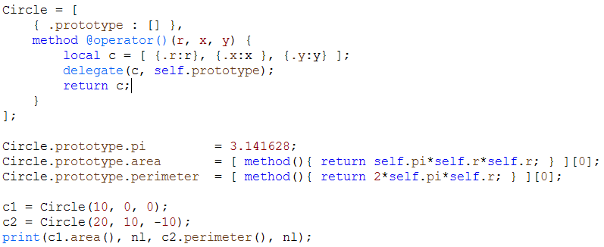
Prototype details (9/10)
Delta (2/3)
← Circle is an object that plays the role of a factory
← Circle stores locally the object shared by all its instances (i.e. prototype)
← Circle behaves as a functor emulating the constructor method
← Delegation applied upon construction
Circle
(instance)
share
Circle
(instance)
creates
Circle
(prototype)
Circle
(instance)
Circle
(factory)
owns

Slide 49
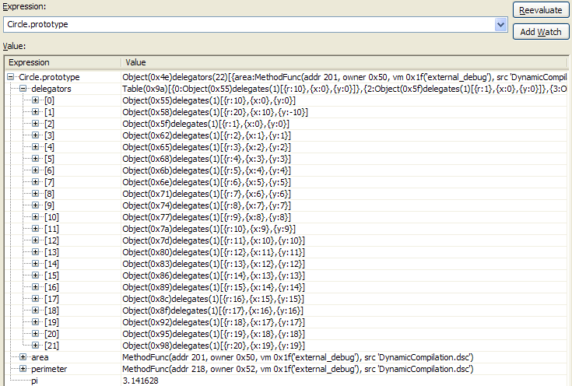

Prototype details (10/10)
Delta (3/3)
When a prototype is accessible for tracing, and the delegation links can be inspected by the debugger, it virtually enables view all instances of a class in the program (Zen debugger, in Sparrow IDE, Delta language).

Slide 50
Duck typing (object protocols) (1/6)
It is an approach to dynamic typing where the assumed type of an object does not depend on typing relationships
Instead, it is defined by its current external view in terms of the properties and methods that it offers to the outside world
In other words, typing is defined by the capability to use it with a certain deployment image in a specific context
Meaning we are concerned with just those aspects of an object that are used, rather than with the precise type of the object itself

Slide 51
Duck typing (object protocols) (2/6)
The terminology comes from the, not very well known, duck test of inductive reasoning
If it looks like a duck, swims like a duck and quacks like a duck, then it probably is a duck
Thus, duck typing allows polymorphism without inheritance
  Meaning an object is eligible to an operation once it displays the required properties and methods
Duck typing is a bad term anyway, as it was far earlier defined with a theoretical foundation by the notion of objector protocols
  [Abadi & Cardelli, A Theory of Objects]

Slide 52
Duck typing (object protocols) (3/6)
In general, an object protocol is a view of an object, like: it has property x and method f(a,b)
Notably, everything mentioned in a protocol should obey further protocol constraints (i.e., what is the protocol of x)
Object protocols allow generic functions (or polymorphic ones) without relying on subtyping but on requirements expressed about
  Genericity should rely on what we expect from an object to offer rather than on its specific designated data type
In classless languages the only way to define protocols is as documented design constraints
  and the only way to ensure code will not fail, since can’t test statically, is via unit testing

Slide 53
Duck typing (object protocols) (4/6)
Class-based (!) sample: C++ Requirements (object protocols, or concept in C++ forthcoming standard): Iterator<I>, Addable<value_type>, Assignable<value_type>, CopyConstructible<value_type> template<typename I> typename iterator_traits<T>::value_type sum(I start, I end, typename iterator_traits<T>::value_type init) { for (I current = start; current != end; ++current) init = init + *current; return init; }

Slide 54
Duck typing (object protocols) (5/6)
Classless sample: Delta function Intersection (a, b) { local box = [ {.x, .y, .w, .h : 0 } ]; if (a.x + a.w <= b.x or b.x + b.w <= a.x) return box; if (a.y + a.h <= b.y or b.y + b.h <= a.y) return box; box.x = max(a.x, a.y); box.y = max(a.y, b.y); box.w = (b.x < a.x ? min(b.w – (a.x-b.x), a.w) : min(a.w - (b.x-a.x), b.w)); box.h = (b.y < a.y ? min(b.h – (a.y-b.y), a.h) : min(a.h - (b.y-a.y), b.h)); return box; } b1 = Intersection(aSprite, aRect); b2 = Intersection(anImage, aWindow);
required members:
x, y, w, h
required operators on members:
arithmetic, relational

Slide 55
Duck typing (object protocols) (6/6)
Protocols relate to interfaces of class-based languages
  static commitment of a class in implementing the number of methods appearing in the interface
  in fact, some languages use the term protocol for interface protocols (like Objective C)
Protocol-based polymorphism is when a generic function is written whose object parameters are constrained by protocol (or interface) compliance
  it is more liberate to subtype polymorphism, i.e. when argument types should be derived from a supertype
  some languages impose protocol compliance to be expressed during class definition (Java and C# interfaces)
  others may allow express how classes can adapt to protocols independently of their original definitions (C++ concepts)

Slide 56
Implementation details (1/3)
Common instruction set for objects
new_object | Dynamic object creation (construction)
new_object_by_constructor | Invocation of a constructor to make an object
call_method | Invocation of a method (using name)
new_prototype | Creation of a new prototype associated to a class
get_prototype | Extraction of an prototype from an object
set_member / get_member | Member access
set_attribute / get_attribute | Attribute / property member access
delete_member | Removal of members
has_member | Queries member presence
add_delegate | In case sharing is done by delegates.
remove_delegate | Can remove a delegate on the fly
get_delegates | Getting list of shared objects

Slide 57
Implementation details (2/3)
Dynamic optimization (1/2)
Good optimization for classless languages is a real hell. As everything is late bound, and everything can change due to a call, can’t tell statically what is constant and what not. Consider the following example: for (…) { p.f(); // Is p.f a loop invariant? q.g(); // Is q.g invariant as well? } The code generation situation is as follows: N: get_member p “f” _t call _t or at the best case (depending on the VM instruction set): N: call_method p “f” But both require a lookup (hashing) in p with index “f” at every call.

Slide 58
Implementation details (3/3)
Dynamic optimization (2/2)
We may try a dynamic optimization scheme as follows: After the first invocation we set the method address directly on the target instruction. Store an update function which restores the original instruction if p.f or p change (meaning we return to p.f calculation only when f or p change). Automatically unregister the update function from p and p.f when exiting from the scope of p and restore the original instruction. The previous should be applied for loops, and may work, but complicates heavily the Virtual Machine implementation. This means Virtual Machine vendors should perform such dynamic optimizations, something that was traditionally the job of compiler writers.

Slide 59
Lessons learned (1/2)
Member dictionary is the only viable object model
Object management support means provide methods
  as syntactic abstractions (sugar) if they are invoked always with an object - caller is explicit
    makes the implementation easier, but still allows moving methods around since methods are just global functions
    should avoid commit with a self or this keyword since they are pseudo methods
  as values carrying the object owner if they can be invoked standalone - caller is implicit
    this way methods become functions with closure (closure= owner) enabling program function generators in the language
    allow extract and mutate the owner object: the implementation is easy, while increasing the programming power of the language

Slide 60
Lessons learned (2/2)
Prototypes allow emulate classes as shared mutable objects carrying
  class functionality - as methods in the prototype
  static class data - as fields in the prototype
Sharing is possible by implementing a delegation mechanism
  the language may further expose prototypes as first-class concepts, but delegation is always the engine
  if delegation links can be inspected via the debugger it is analogous to enabling track down all instances of a class
Object management functions are included as high-level instructions of the virtual machine
  In some cases you offer some key language features as library functions that you transform latter to instructions
  This makes execution faster, but may require extra syntax while downgrades such features from first-class values (functions)

