Slide 1
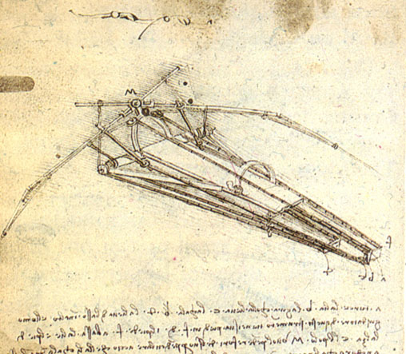
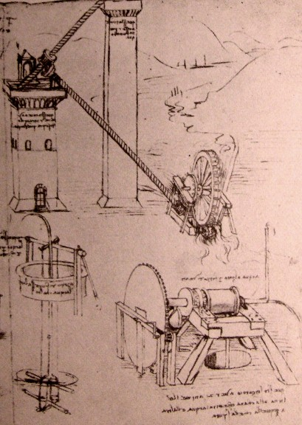
HY540 – Advanced Topics in Programming Language Development
Lecture 4

Slide 2
Untyped inheritance – introduction (1/2)
Untyped inheritance is the analogy of class-based inheritance in the object-based world
  how to produce objects compliant to a designed subclass
  but without rewriting code that corresponds to the bases classes
  while respecting late binding semantics
Class-based notions and techniques are not totally abandoned in object-based inheritance
  Rather they resurface naturally with more flexible implementation techniques

Slide 3
Untyped inheritance – introduction (2/2)
Irrespective of the language features, there are two possible design patterns for untyped inheritance
  perform inheritance at the levels of class-emulating objects (prototypes or class objects)
    class graph emulation - objects share their heritage
  perform inheritance at the level of individual objects
    object structure emulation - objects copy their heritage
We will study whether and how the existing mechanisms for untyped inheritance support both

Slide 4
Roadmap
Patterns
  Class graph emulation
  Object structure emulation
Methods
  Embedding
  Delegation
  Subobject trees
Issues
  Uninheritance
  Non-monotonic object evolution
  Mode switching

Slide 5
Class graph emulation (1/5)
In this method the language allows to convert the designed class graph to a corresponding runtime object graph
  each node in the graph represents a distinct class
    implemented as a prototype for this class
  every class node delegates to the nodes corresponding to its base classes
    subclassing implies delegation among prototypes
  note that dynamic updates on a class node alter the objects of all subclasses

Slide 6
Class graph emulation (2/5)
Respective runtime object graph
Sample class structure (graph)
D
class D;
class A subclass of D;
class B subclass of D;
class C subclass of A,B;
A
B
c
If we affect D then all subclasses A, B and C are directly affected
***Class graph emulation results in runtime webs of prototypes isomorphic to the static class graphs that is produced during compilation.

Slide 7
Class graph emulation (3/5)
Every object will have to delegate to the node of its respective class
  we did that before with normal prototypes
  but also every subobject should delegate to the node of the of the bottommost class in the tree
    this is necessary to guarantee late binding
Linking of prototypes via delegation should be done carefully
  in a way that delegation lookup is equivalent to MRO (like linearization)
Rule is that state is copied methods are shared

Slide 8
Class graph emulation (4/5)
class Person {
var name:string = “”;
virtual GetName():string { return self.name;}
}
subclass Worker of Person {
var pin:integer = 0;
virtual GetPin(): integer { return self.pin; }
}
Sample class design (exists in the design domain only)
subclass Athlete of Person {
var steroids: list[string];
virtual GetSteroids(): list[string] { return seroids; }
}
subclass Hobbyist of Athlete, Worker {
var: workoutDays: integer[0…7] = 0;
override GetSteroids(): list[string] { return nil; }
method GetWorkoutDays():integer[0…7] { return workoutDays; }
}

Slide 9
Class graph emulation (5/5)
Person Instance
PI.name
Person
GetName()
We do not yet commit to an object model about copied state.
Worker Instance
WI.pin
Person Instance
PI.name
Worker
GetPin()
Athlete Instance
AI.steroids
Worker Instance
WI.pin
Person Instance
PI.name
Athlete
GetSteroids()
Delegation links
Hobbyist
GetSteroids()
GetWorkoutDays
[This is a naïve view] The idea is simply to make all subobjects allow dynamic dispatching by linking them to the beginning of the lookup chain. State is copied.

Slide 10
Object structure emulation (1/2)
Every object is complete and contains all the data and methods of its respective class
  normally we adopt a structure in which a main object (most derived) is composed of subobjects
    but in all cases we need guarantee late binding
Our definition of subobject: an object being part of another object due to inheritance
Prototypes may optionally exist but they are never linked to each other
  meaning they are not to linked according to subclassing
  but since prototypes are not linked, the MRO should be implied by the way objects are structured
Rule is that state and methods are copied

Slide 11
Object structure emulation (2/2)
Runtime prototypes being unlinked
Optional delegation links
An instance of C subclass
Sample class structure (graph)
D
D
class D;
class A subclass of D;
class B subclass of D;
class C subclass of A,B;
A
A
B
B
C
c
The subobjects copy state and behavior of their class and are somehow glued or linked together
If we affect D then all D objects are directly affected. The effect on subclass objects depends on their object structure.

Slide 12
Embedding (1/11)
Embedding or concatenation is an inheritance method in which all attributes inherited from a base become an integral part of the derived
  thus derived objects become independent and unrelated at runtime to their bases
Since embedding packs all inherited attributes together it means
  overridden method names should map always to their most recent version
  if data fields are also late bound in the language then they should similarly map to most recent versions

Slide 13
Embedding (2/11)
When earlier versions (like super) of overridden methods (or fields) can be invoked in the language
  then their addresses (or storage) should be somehow retained within the packed structure
When inherited data fields are late bound then similar qualified access (like local) should be necessarily allowed
  else the semantics of base methods involving late bound fields reappearing in derived objects may be broken

Slide 14
Embedding (3/11)
class Person {
var name:string = “”; ← person name
virtual GetName():string { return self..name;}
}
***Assume self.id is late bound access and that self..name implies local access
Person Factory
name
GetName()
#super:Nil
GetName(self,owner){ get_local(owner,name); }
The #super field is reserved and hidden (can’t be referenced) and is used to identify the upper object in the embedding chain.
Owner is the subobject reference actually ‘owning’ the invoked method.
subclass Role of Person {
var name:string = “”; ← role name
override GetName():string { return self..name;}
method ToString():string
{ return self..name + super.name };
}
Role Factory
name
GetName()
#super:Nil
name
GetName()
ToString()
#super: Nil
GetName(self,owner){ get_local(owner,name); }
record Method { Address addr; // Code address Attributes begin; // First attribute of owner object. }; a.f() is equivalent to a.f.addr(a.begin≡self, a.f.begin ≡owner) self.x → get(self, x) self..x → get_local(owner, x) super → self.#super ***Local means search attributes until a #super index is met
ToString(self, owner){ return get_local(owner,name) + get(super(self),name; }

Slide 15
Embedding (4/11)
No upcasting / down casting is necessary
  We pass the object reference of an entire object in all cases
  Being actually a reference to the first item of the attribute list
Late binding is guaranteed by lookup
  resolution of the most recent attribute version is mandated
  since we search attributes from begin (bottom) to end (top)
  inherently objects are attribute lists (not a field dictionary)
  this is the only time we adopt such an object model
In methods we set the begin field only once, upon construction of the object owning the method

Slide 16
Embedding (5/11)
cell = object { value:0, method get() { return self..value; }, method set(x) { self..value = x; }, }; backup_cell_sub = object { backup:0, method set(x) { self..backup = self.value; super.set(x); }, method restore() { self.value = self..backup; } }; backup_cell = embed(backup_cell_sub, cell); backup_cell.set(10)→backup_cell.set(backup_cell.begin, backup_cell.set.owner, 10); backup_cell.restore();
set(self, owner, x) { of backup_cell set_local(owner, “backup”, get(self, “value”)); get_local(super(self), “set”)(x); }
cell
value
get()
set()
#super:Nil
begin
backup_cell
value
get()
set()
#super:Nil
backup
set()
restore()
#super
begin

Slide 17
Embedding (6/11)
An earlier version of x to the base object being N levels up the inheritance chain is visible through (super.)^{K}x
  K≤N: K is the number of classes in the chain of N base classes which also have an attribute x
Prototypes are used only as object generators
  Interestingly, due to embedding, a derived prototype can embed a copy of its base prototypes
    So one could use an embedded prototype to produce a respective object

Slide 18
Embedding (7/11)
class A
  object A
subclass B of A
  object B = embed(partial(B), A)
subclass C of B
  object C = embed(partial(C), B)
subclass D of A, C ***assume C more recent
  object D = embed(partial(D), embed(C,A))
  but what we do in case of multiple inheritance?

Slide 19
Embedding (8/11)
D
x
y
f()
#super:Nil
w
g()
#super
x
f()
g()
#super
x
y
f()
#super
y
f()
w
#super
A { x, y, f() }
B : A { w, g() }
C : B { x, f(), g() }
D : A, C { y, f(), w }
C
x
y
f()
#super:Nil
w
g()
#super
x
f()
g()
#super
A
A
B
B
A
x
y
f()
#super:Nil
C
begin
partial(C)
B
x
y
f()
#super: Nil
w
g()
#super
begin
A
A
partial(B)
super(x) ≡ x.begin().get()
x.super.f ≡ get_local(super(x), “f”)
partial(D)
begin
begin

Slide 20
Embedding (9/11)
A[B₁,…,B_{n}] where B_{i+1} more recent than B_{i}
embed(A, embed(B_{n}, embed(B_{n-1},… ,embed(B₂,B₁)…))
To avoid attribute renaming it is mandatory in embedding to implement an ordered sequential lookup with a list, rather than have traditional hashing
  hashing requires unique names
  thus embedding would have to rename base attributes recursively in case of name conflicts
  that’s why in the list implementation more recent attributes are closer to the beginning of the list
In multiple inheritance, access to base attributes requires good knowledge of the embedding mechanism and the ‘more recent’ priorities

Slide 21
Embedding (10/11)
We usually support only packing of objects but never unpacking
  although with a few extensions unpacking is also feasible
Dynamic attribute addition or removal is straightforward on the list
  Usually we only allow editing of the most derived object
  If we can extend or reduce selectively any base object
    then the semantics of base methods involving local attribute access may break
    but you may decide that such a discrepancy is a program design issue not a language flaw as such

Slide 22
Embedding (11/11)
In embedding (concatenation) every object is self-contained by definition
  being a flattened ordered collection of all inherited attributes (properties and methods)
  thus allows objects live independently of any class objects carrying attributes specific to their class
Due to this feature embedding is appropriate for object structure emulation
  linking individual objects to their prototypes is impossible since a sharing mechanism is lacking
  but it can be emulated with explicit selective or global propagation mechanism (e.g. broadcast method m to all objects of set s)

Slide 23
Delegation (1/10)
We have seen delegation before, so we will skip the details of the method
Since delegation is a sharing mechanism we study the way we can implement the basic inheritance patterns
  class graph emulation
    intuitively, this seems to be a perfect match for delegation since class inheritance is by definition sharing
  object structure emulation
    intuitively, we can only think of modeling individual objects as webs of their subobjects

Slide 24
Delegation (2/10)
Class graph emulation (1/4)
  Since through class nodes we may only share behavior (methods), individual objects should carry their own state copy (properties, variables)
    this is analogous to class-based inheritance were instances carry only data state
      with the exception of pointers to vtables and to shared subobjects
  Since a derived object inherits state we also need an appropriate way to package inherited state together
    in a way that conflicts are avoided and access is preserved as with class-based inheritance

Slide 25
Delegation (3/10)
Class graph emulation (2/4)
  We assume ex nihilo object creation is supported via the dynamic field dictionary style
    [ a:10, b:20, method f(){ return self.a + self.b; } ]
  the basic delegate and undelegate operations are offered
  and super(i) returning delegate #i as if it was found through delegation lookup (i.e. self.super(0).f() still invokes f on self)
A
f()
A { x, y, f() }
B : A { w, g() }
C : B { x, f(), g() }
D : A, C { y, f(), w }
***Assume that any method of a class should access its attributes but also inherited attributes and methods (i.e., qualified super access).
B
g()
C
f()
g()
D
f()

Slide 26
Delegation (4/10)
Class graph emulation (3/4)
class-based design → method B::g() { A::f();}
object-based implementation → method g() {
self.f();  f is late bound
self.super(0).f();  f still late bound
self.B.super(0).f();  f called on B, not self
self.super(1).super(0).f() ☑ self.B.A.f called on self
}
***Without our extra requirement that super. preservers binding of self upon method invocation to the original self, the previous function cannot be implemented!
---The way the B::g is implemented is not derivation enabled since, while self is essentially late bound in delegation, B::g involves super path access that assumes self (start) is always a B object!
---Access via super paths is painful, unreadable and requires expressions whose size depends on the distance of the class owning the method (e.g. A) from the class access the method (e.g. B).
A state
x
y
A
f()
B
g()
A state
x
y
C
f()
g()
B state
w
D
f()

Slide 27
Delegation (5/10)
Class graph emulation (4/4)
class-based design → method B::g() { A::x;}
class-based design → method C::g() {C::x; x ^{late bound}; }
object-based implementation → method B::g() {
self.x;  for self:C is C::x
self.super(0).super((0).x;  works only for self:C
self.A.x; ☑ yes, explicit up refs
}
object-based implementation → method C::g() {
Implementing C::x
self.x  works only for self:C
self.C.x; ☑ yes, to ensure from C Implementing x ^{late bound}
self.x  only on most derived
self.most_derived.x  rather impractical
}
***With delegation we cannot have late binding for data attributes (fields). Whether this is really an inadequacy of the language for object-oriented programming we do not know yet.
A state
x
y
A
f()
B
g()
A state
x
y
C
f()
g()
B state
w
A
D
f()
C state
x
B
C
most derived

Slide 28
Delegation (6/10)
Summary for class graph emulation:
  For qualified base-method invocation super must be part of the language with delegation lookup semantics
  With multiple delegates the ordering must be well-defined and be part of the language semantics so that super(i) is unambiguous
  A better alternative is a design pattern: client programmers introduce explicit base reference fields in derived objects named as the designed classes
    In this case self binds to the method owner
    The pattern allows also qualified access to base-data members
  Due to parental lookup, late binding for data members is possible only when a reference to the most derived subobject is used
    Thus late binding for data members can’t be supported

Slide 29
Delegation (7/10)
Object structure emulation (1/2)
  We extend the model of linking data subobjects by incorporating method addresses inside subobjects
  There are two main consequences:
    Qualified base-method invocation must be revisited
      Since we do not have separate class objects on which we may refer
    Late bound method invocations using base subobjects must be asserted
      As method lookup no longer relies on the class node graph
A
f()
x
y
B
g()
w
C
f()
g()
x
D
f()
y
w

Slide 30
Delegation (8/10)
Object structure emulation (2/2)
  For qualified access to base methods we apply the same trick as with qualified base data
    ask programmers resolve this through extra base references inside objects
  Late bound method invocation with a base-subobject reference suffers with the same issue as late bound data members
    Parental lookup disables resolution downwards the subobject structure
A
f()
x
y
B
g()
w
A
C
f()
g()
x
B
D
f()
y
w
C
A

Slide 31
Delegation (9/10)
win_manager = object { method display() { for each w in local list do w.display(); }, method add(w) { add w in a local list } … }; win_proto = object { x, y, w, h:0, method new() { w = clone self; win_manager.add(w); return w; }, method display() { display a normal window } … }; shadowed_win_proto = object { shadow_w, shadow_h : 1, method new() { w = clone self; delegate(w, win_proto.new()); return w; }, method display() { super(0).display(); display the shadow }… }; When a shadowed window is created, will its shadow be displayed after win_manager.display() is invoked?
win_manager
display()
list: [.... ]
win
display()
auditory_win
display()
win
display()
win
display()
shadowed_win
display()

Slide 32
Delegation (10/10)
Summary for object structure emulation:
  Client programmers should handle qualified access to base attributes writer
    We may agree that this is an acceptable overhead
  Lookup for data members (properties) is late bound only when the most derived object is involved
    The analogy to class-based inheritance it that when doing upcasting we loose the dynamic dispatching behavior
    We may agree that this loss is acceptable when it comes to data members as most language don’t support late bound variables
    But since lookup for methods is similar, late method binding is not guaranteed for base subobjects
    Thus can’t allow polymorphic functions, being unacceptable
Thus object structure emulation is not feasible in delegation

Slide 33
Subobject trees (1/15)
The idea is to make an object model in which derived objects are made up with a structure similar to the respective class tree
  besides other advantages, it is easier for programmers to assimilate a structure being mostly isomorphic to the class hierarchy
A
Class scheme
A { x,y,f() }
B : A { x,f(),g() }
C : B { z,g(),h() }
E { m() }
D : C, E { m(),f(),a }
A
A
donates
ISA
B
B
B
donates
ISA
C
E
C
E
C
E
ISA
ISA
donates
donates
D
D
Class tree
D
Subobject tree

Slide 34
Subobject trees (2/15)
The tree is composed of distinct nodes with every node corresponding to a class and encompassing all members (data and methods) appearing in the ‘body’ of its respective class
  meaning inside a node we never add what is inherited
  a node is a partial object for subclasses and a fully working object for top level classes
A
x
y
f()
Class scheme
A { x,y,f() }
B : A { x,f(),g() }
C : B { z,g(),h() }
E { m() }
D : E, C { m(),f(),a }
***assume C more recent than E in D subclass
E
m()
B
x
f()
g()
C
z
g()
h()
D
m()
f()
a

Slide 35
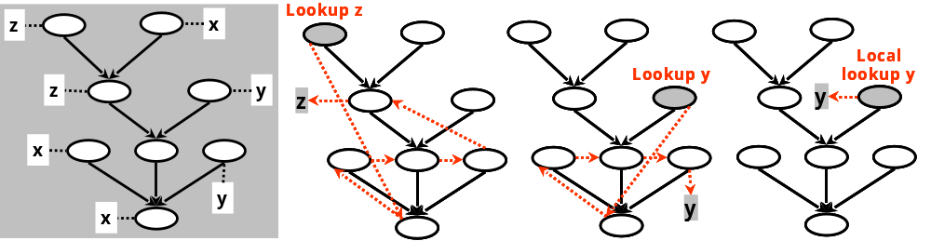
Subobject trees (3/15)
The lookup semantics are very simple
  the search order is a breadth-first search, left to right for siblings, always starting from the root
    notably, the search order does not depend on the node from which a lookup is invoked
    thus, for a given index, the lookup returns always the same result from any node of the tree

Slide 36
Subobject trees (4/15)
Assuming the root at level 0 (leaves at the top) the lookup algorithm visits nodes with the following rules:
  the nodes of level n are visited before the nodes of level n+1
    the root being at level 0 is always visited first
  a node at level m is visited before its rightmost siblings at the same level
For nodes β at level n+1 and α at level n where α is linked with β we denote αβ
  we say α inherits from β and β is a direct base of α
  we may refer to β as an inheritance parent of α, or simply a parent, with a meaning on inheritance and not on tree connectivity

Slide 37
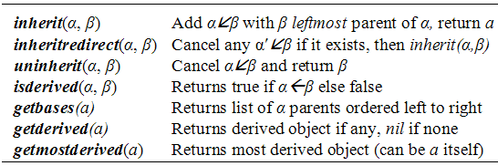
Subobject trees (5/15)
A
x
y
f()
E
m()
1: inherit(B,A) BA
2: inherit(C,B) CB
3: inherit(D,E) DE
4: inherit(D,C) DC
1:
3:
B
x
f()
g()
C
z
g()
h()
D
m()
f()
a
2:
4:
Lookup (visit) ordering: D→C → E → B → A

Slide 38
Subobject trees (6/15)
Rule. In invocations self is always the method owner.
Axiom. Late binding applies for methods and properties.
class-based design → method A::f() { x ^{early bound}; y ^{late bound}; }
object-based implementation → method A::f() {
self..x; ☑ local access via self guarantees absolute addressing
self.y; ☑ late bound by definition
}
class-based design → method B::g() { A::f() ^{base method invocation};}
object-based implementation → method B::g() {
getbases(self)[0]..f(); ☑ works due the rule: we get the bases of B self
self..A..f(); ☑ alternatively, handled explicitly by clients
***In our last case we use self..A and not merely self.A to ensure we get the local A of B just in case there is another most derived A field in B derivatives.
}
record Method {
Address address;
Object owner;
}
In methods we set the owner field only once upon construction of the object actually owning the method.
When a method is invoked, self binds always to its owner.
The language may allow self to be mutable for advanced programming patterns.
A
x
y
f()
B
x
f()
g()
C
z
g()
h()
D
m()
f()
a
E
m()

Slide 39
Subobject trees (7/15)
Assume that @<id> is syntactic sugar for self..<id> (local access): cell = object { value:0, method get() { return @value; }, method set(x) { @value = x; }, }; backup_cell = object { backup:0, method set(x) { @backup = self.value; getbases(self)[0]..set(x); }, method restore() { self.value = @backup; } }; inherit(backup_cell, cell); cell.restore(); Well defined. backup_cell.set(23); Well defined. backup_cell.restore(); Well defined.
cell
object
value
get()
set()
base
object
backup
set()
restore()
backup_cell

Slide 40
Subobject trees (8/15)
The fact that a lookup in a tree returns the same result regardless of the subobject from which it is initiated is an interesting property
subobject substitutability
  Assume a tree T of subobjects α₁,…,α_{Ν} and an expression E involving any subobject α_{j}∈T
  Let eval denote the evaluation of E at runtime.
    We require that during the evaluation of E, T may be changed only after the last access of α_{j} is performed
  We define E(α_{j} by α_{κ}) to be the expression gained when substituting every occurrence of α_{j} in E by another α_{k} ∈T
  Then the following holds:

Slide 41
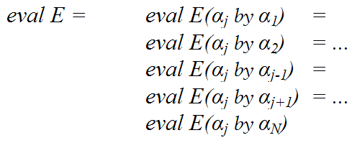
Subobject trees (9/15)
In other words, for functions involving only late-bound member access, thus not applying qualified local access, the subobjects of the same tree behave as synonyms to each other
Thus they are referentially equivalent, since we can substitute any subobject with another in an expression and still gain the same evaluation outcome
This feature, not supported in delegation, is crucial to allow implement generic / polymorphic functions

Slide 42
Subobject trees (10/15)
Now lets explain why a tree structure is an appropriate and adequate model for subclass instances
We define the opposite of inheritance, being donation as a relationship among objects in the context of subclassing
Let B : A₁,…,A_{n} be a subclassing scheme T
  Then instB contains instA₁ ,…,instA_{n} and the members introduced explicitly in B
    donates(instA_{j}→instB in T)
  Additionally, instB contains instS₁ ,…,instS_{k} for S_{i} a shared base class in the inheritance scheme of any Aj
    donates(instS_{j}→instB in T)

Slide 43
Subobject trees (11/15)
Lemma. Given donate(instX→instY in T) there can be no instZ ≠ instX where donate(instX→instZ in T)
Proof.
  (α) If X is a shared base class of Y and Z then instX appears only once by definition, thus we come to contradiction.
  (β) Let Y:X aT₁ subschema of T, Z:X a T₂ subschema of T. Since X is repeatedly inherited it holds:
    donate(instX' →instY in T₁) ∧ donate(instX'' →instZ in T₂) for distinct X objects instX' ≠ instX'' (by repetition semantics)
    By hypothesis ⇒ instX=instX ' ∧ instX=instX'' ⇒ instX ≠ instX, thus we come to contradiction

Slide 44
Subobject trees (12/15)
Our proof essentially states that in object structure models, defining how subclass instances are composed, base objects donate only once to their derived objects
Subobject trees impose that a base object has only one outgoing donation link
  i.e., can to donate only to one object
Thus subobject trees are sufficient to model the object structure of subclass instances
  i.e., the single derivation link is not restrictive

Slide 45
Subobject trees (13/15)
Shared base objects will have to appear only once in a subobject tree
  but to which subobject in the tree they donate?
  we define the donation rules in a way preserving the lookup semantics of class-based shared inheritance
Lets assume S a shared base class in the inheritance schema T of a subclass
  Let A₁,…,A_{n} be all subclasses of S in T so A_{i}:S
  Assume A_{r} be the more recent of those in T
  Then donate(instS→instA_{r} in T)

Slide 46
Subobject trees (14/15)
Class scheme (linearization exists)
A { x, y, f() } A
B: shared A { x, f(), g() } BA
C: shared A { z, g(), h() } CA
D: A, B, shared C { m() } DCBAA
E: shared C, D { m(),f(),a } EDCBAA
B
A
D
C
E
class graph
Hint: Never use the class graph to extrapolate ordering (it says nothing about that). Refer to the subclass definitions and the language rules about the ordering semantics when specifying the list of base class names.
A (shared)
B
C (shared)
D
A (repeated)
E
object model

Slide 47
Subobject trees (15/15)
B
x
f()
g()
A (repeated)
x
y
f()
A (shared)
x
y
f()
A shared object donated to the subobject of the most recent subclass of A being C
D
m()
C (shared)
z
g()
h()
C shared object donated to the subobject of the most recent subclass of C being E
A { x, y, f() }
B: shared A { x, f(), g() }
C: shared A { z, g(), h() }
D: A, B, shared C { m() }
E: shared C, D { m(),f(),a }
E
m()
f()
a
Lookup sequence: E→D→C→B→A→A

Slide 48
Issues (1/10)
Uninheritance (1/4)
  Since inheritance is applied at runtime we could be able to undo it – at least in principle
  In case of object structure emulation, where objects are self-contained, uninheritance seems to be well defined
    could imply unpacking or unlinking of subobjects
    undo effect is local on the subject object with no other implications on the rest of the program
  Uninheritance at the level of class objects, with graph structure emulation, requires special attention
    effect on behavior would apply on all related instances
    but uninheritance on state requires per-object intervention

Slide 49
Issues (2/10)
Uninheritance (2/4)
  But is uninheritance needed in real practice anyway?
    In general, need-driven criteria are dangerous as they imply a language feature is unnecessary unless it address a known demand of the current practice
    In some cases features do appear from current practice but in other cases they shape out future practices
      like function-call operator overloading of C++ (clearly, one may live without it, but its use leads to very interesting patterns)
      or imagine a language designer in the early sixties 60’s arguing “who would need inheritance?”
  There is one well known design pattern that is strongly linked to object-based uninheritance
    The State pattern

Slide 50
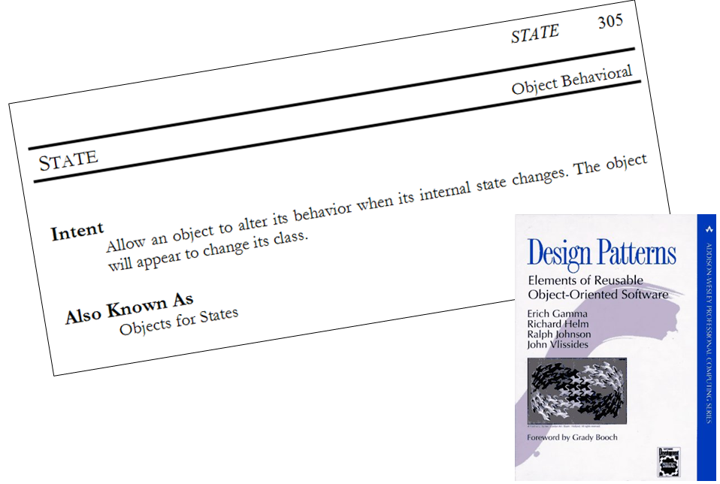
Intermezzo

Slide 51
Issues (3/10)
act()
Uninheritance (3/4)
attacker
attack()
think()
act()
via inheritance preceded by uninheritance
sense()
attacker
attack()
think()
lazy
attacker
act()
sense()
attack()
think()
1. Assume an attacker instance in a game and the AI module storing a reference to it.
sense()
3. Then latter the attacker is turned to lazy, changing the entire strategy.
attacker
act()
act()
attack()
think()
attacker
attack()
think()
sense()
sense()
lazy
attacker
act()
smart
attacker
attack()
think()
attack()
think()
sense()
2. At some point during gameplay the attacker is decided to become smart, updating its think() style and attack() strategy.
smart
attacker
attack()
think()
4. Finally, the lazy attacker gets smarter.

Slide 52
Issues (4/10)
Uninheritance (4/4)
attacker = object { method sense(){…}, method think(){…}, method act(){…}, method attack() {…} }; AI.register(attacker); smart_attacker = object { method think(){… getbases[0]..think(); }, method attack(){… getbases[0]..attack(); } }; lazy_attacker = object { // Assume all super calls are done method sense(){…}, method think(){…}, method act(){…}, method attack() {…} }; // Notice that derived objects need not know if they inherit directly from // ‘attacker’ or another object already inheriting from ‘attacker’. inherit(smart_attacker, getmostderived(attacker)); uninherit(smart_attacker, getmostderived(attacker)); inherit(lazy_attacker, getmostderived(attacker));`

Slide 53
Issues (5/10)
Non-monotonic evolution (1/5)
  An instance may dynamically deviate from with the object model of its respective class due to:
    addition or removal of attributes
    inheritance
      getting extra heritage comparing to what is defined in its class
    uninheritance
      abandoning part of the heritage defined in its class
  When the latter takes place an instance may sometimes offer less than its original object model
  In this case the object is said to evolve non-monotonically
    i.e. not preserving subclass ordering

Slide 54
Issues (6/10)
Non-monotonic evolution (2/5)
  To support monotonic evolution an object may only ‘expand’ but never ‘shrink’
    with monotonic evolution an object can still be used in ways compliant to its subclass
  But one should not so easy assume non-monotonic evolution to be an evil design idea
    Consider a program in which instances are manipulated through superclass interfaces
    Then it will not necessarily break if objects evolve non-monotonically regarding their subclasses
    But always guarantee to offer their superclass goodies
      like the State pattern

Slide 55
Issues (7/10)
Non-monotonic evolution (3/5)
  Furthermore, a program may be designed to handle safely non-monotonic evolution
    An algorithm may conditionally perform actions depending on presence of certain attributes or heritage from specific objects
  In other cases adding or removing layers of inheritance is the actual design intent
    Like dynamic decorators, e.g. having dynamic shadows or special effects added or removed on windows
      the Decorator pattern
    Recall the shadowed window example: we could simply uninherit the shadowing part and have a working program on a valid state
    We could even further donate shadowed behavior to another instance

Slide 56
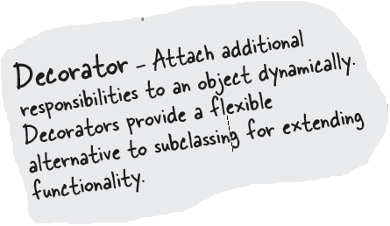
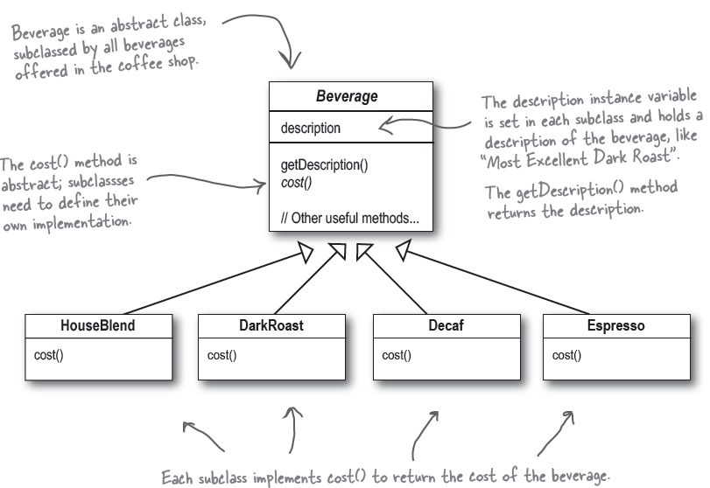
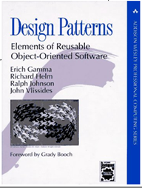
Intermezzo

Slide 57
Issues (8/10)
Non-monotonic evolution (4/5)
uninherit(shadow, win); Case 1: if we have both inherit(shadow, another); uninherit(shadow = getderived(win), win); Case 2: if we have the ‘win’ (super) uninherit(shadow, another); uninherit(shadow, getbases(shadow)[0]); Case 3: f we have the ‘shadow’ (derived) uninherit(shadow, another);
The general situation in which an object freely changes its type during runtime is called dynamic reclassification
Monotonic evolution is the special case of reclassification where an object may only change types down its inheritance tree, meaning it changes to a subtype, thus preserving the subtype ordering
Monotonic evolution can be implemented via successive dynamic inheritance operations. It is like decoration, though with absolutely safe upcasting.

Slide 58
Issues (9/10)
Non-monotonic evolution (5/5)
Monotonic evolution: starting from an initial class, only downwards evolution is allowed (i.e. can’t uninherit)
Non-monotonic inheritance evolution: starting from an initial class, any evolution resulting in a subclass object is allowed (i.e. can uninherit).

Slide 59
Issues (10/10)
Mode switching (1/3)
  Consider that an object is allowed to change its base type during runtime
    it looks similar to the State pattern, but the idea is more general as we can think of altering any class in the class tree of an object
  In this scenario a class is replaced by another offering at least the same attributes
    but with alternative semantics
  Such a feature would allow modularly switch the behavior of objects from one mode to another
    and is called mode switching

Slide 60
Issues (11/10)
Mode switching (2/3)
  The technique could be implemented per object with all three mechanisms we have studied
    embedding: by substitution of base packets or overwriting
    delegation: by reparenting
    subobject trees: by uninheritance
  Notably, delegation could allow mode switching to be applied globally at the class level
    but if the state model (data) changes massive reconstruction of affected instances is needed (how is this done?)
  In any case, mode switching requires copy or convert object state from the previous mode to the new mode
    An example will clarify this issue

Slide 61
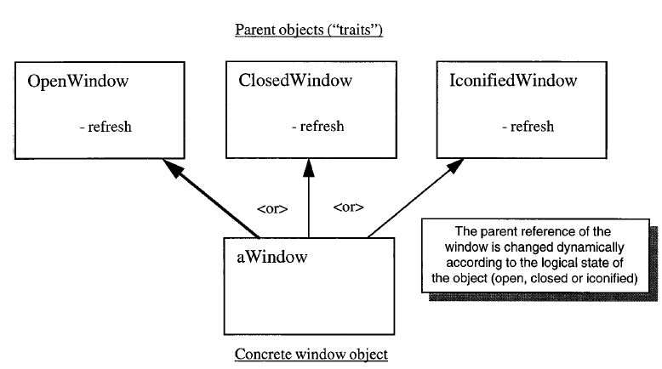
Issues (12/12)
Mode switching (3/3)
When changing window modes via type change, some state of the old subobject (e.g. an OpenWindow subobject) may have to be transferred or converted to the new subobject (e.g., a ClosedWindow subobject).
But there is no guarantee that the two classes reveal their intrinsic state so as to make such state propagation possible. Usually the latter is bypassed as most object-based languages have no access qualifiers.

