Slide 1
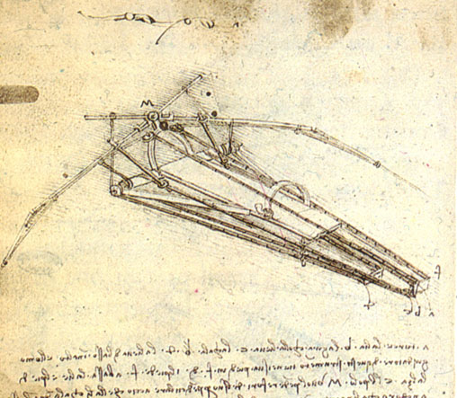
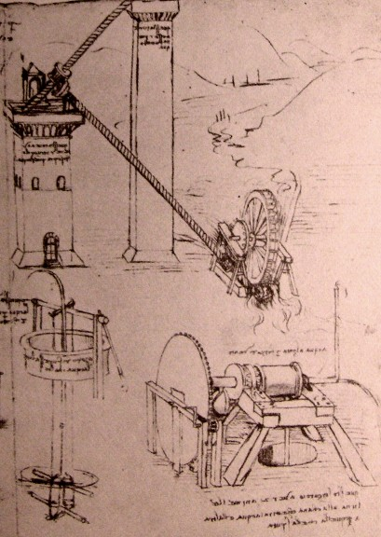
HY540 – Advanced Topics in Programming Language Development
Chapter 5 (three lectures)

Slide 2
Methods
A method is a function associated to an object that is syntactically visible in the main block of the function through some kind of reserved symbol like self or this
Methods are defined as part of the class model with a typed signature
Methods may be overridden by subclasses in which case dispatching is dynamic
In classless languages due to lack of compile-time information every invocation is late bound

Slide 3
Roadmap
Reification: first-class concepts
Lambda: anonymous methods
Closures: persistent local state
Typed world
  Invariance, covariance and contravariance
  Single, double and multiple dispatching
Untyped world
  Summarizing dispatch policies
  Reifying the dispatch mechanism: editable vtables

Slide 4
Reification (1/2)
Reification means to support the concrete handling of previously abstract, hidden or intrinsic items
Informally it can be seen as the transformation of a second-class element to a first-class element
Linguistically it can be translated as thing-making, that is turning something abstract into a concrete thing

Slide 5
Reification (2/2)
Pointer - C
  reifies the low-level details of memory addresses
Function - C / C++
  reifies the low-level details of code addresses
RTTI - Java, C#
  reifies types
eval function – Lisp, JavaScript, ActionScript
  reifies the language interpreter
sizeof - C/C++
  reifies the details of memory size requirements

Slide 6
Lambda functions and methods (1/6)
Supporting anonymous functions starts from the need to generate unique hidden names
  only if functions must be named in the language
  in some interpreted languages all function definitions are universally lambda
    essentially carrying an AST of function type
    so referencing requires assignment to a variable
      f = lambda x y . x + y
      f = (function(x,y) { return x + y; });
(x,y)
function
y
+
x

Slide 7
Lambda functions and methods (2/6)
A little of lambda calculus (1/2)
  λ x.x ≡ function(x) { return x; }
    lambda definitions accept only one argument
  multiple arguments are provided by nested lambda definitions a technique known as currying (Curry)
  λ x.λ y.x+y ≡ function(x,y) { return x+y; }
  the notion of invocation is named application in lambda calculus and requires parenthesis wherever ambiguity may arise
    (λ x. x * x) 9 ≡ (function(x){ return x*x; })(9)
    same as (λ x. x * x) (9)

Slide 8
Lambda functions and methods (3/6)
A little of lambda calculus (2/2)
  Variables that are found in the argument list of a lambda expression are called bound and said to be in the scope of the lambda expression
    x is a bound variable of λ x.x and inside its scope
  Variables not bound are called free
  All variables bind to their nearest lambda
    x is a free variable of λ y.x+y inside λ x.λ y.x+y
  Lambda expressions with no free variables are said to be closed, e.g. λ x.x is closed
    they are analogous to functions referring only to their formal arguments
  Clearly, unclosed lambda expressions will refer to free variables of outer lambda expressions

Slide 9
Lambda functions and methods (4/6)
We need support recursive lambda functions
  consider the lambda factorial function below
    function(n) { return n * what_we_put_here(n-1); })
  in Delta the keyword lambda is reserved for this purpose, so the previous code becomes now
    function(n) { return n * lambda(n-1); }
  lambda is also a first-class value so the following code is legal (it implements application of unary functions)
    f = (function(g,x){g(x); return lambda; });
    f(print,1)(print,2)(print,3);
  Interpreted languages will bind lambda to the root of the function AST
  Compiled languages will bind lambda to the address of the anonymous function

Slide 10
Lambda functions and methods (5/6)
To support lambda methods more work is needed
  only if methods can be called in the context of their owner without requiring syntactically the owner itself (as in in Python and Delta)
    Given f method of a object and ff = a.f ⇒ ff() ≡ a.f()
  then lambda should be a method value, not merely a function address, which can be handled as follows
    void make_method (value* at, node* f, object* owner)
    interpreted languages
    void make_method (value* at, address f, object* owner)
    complied languages
  Thus lambda is evaluated by calling make_method using the currently called function (node or address) and the self object passed as the owner

Slide 11
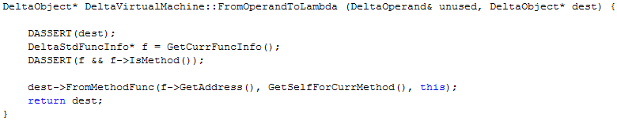
Lambda functions and methods (6/6)
In Delta all methods are anonymous
  method move(dx,dy){…} is syntactic sugar for
  { “move” : (method(dx,dy){…})}
Although one may refer to move inside its body via self.move use of lambda is safer and generic
  it is not affected by renaming
  it allows a method to be copied to another object with a different index (key)
value* at
address f
object* owner

Slide 12
Closures (1/6)
Lets consider an unclosed function f whose address can be gained somehow to a global variable a
In stack-based language implementations, calling f via a may result in undefined behavior
  since the activation records of outer functions, whose bound variables are referred by f, are not on the stack at the time of the call
function f(x) {
function g() { return x; }
return g;
}
f10 = f(10);
What is the value of f10()?
(λ x. (λ.x)) ( 10 )( ) ≡ 10
Lazy evaluation

Slide 13
Closures (2/6)
To have safe execution of unclosed functions the environment, that is the actual arguments and the local data, of every outer function must be copied at the time an unclosed function is used
  it should be attached to the unclosed function
  this environment copy actually closes the function, thus the term closure
function bind1(f,x) {
function g() { return f(x); }
return g;
}
p10 = bind1(print,10);
With closures, p10()is print(10)
(λ f. λx.(λ. f x)) (print 10 )( ) ≡ print(10)
Lazy evaluation for binders

Slide 14
Closures (3/6)
For closures to be supported
  we treat function values as pairs of a function address and a snapshot of their environment (including their closure too)
  the activation records (environments) must be now kept on the heap, not on the stack, and be reference counted (so that they can be collected automatically)
  internally functions accept their environment as an explicit hidden parameter (no stack pointers for local access)
  access to locals is redirected to the environment, not the stack pointers
  environment management this way is slower to stack implementations due to the extra indirections and allocations
  a reference to the environment of the enclosing function (closure, if any) is also included in the current environment to support access to non-locals

Slide 15
Closures (4/6)
Example program
function f(a,b) {
function g(x,y) {
print(a,b);
function h() { print(a); }
return h;
}
return g;
}

Slide 16
Closures (5/6)
In the environment, the element with index 0 is a pointer to the environment of the enclosing function (can be null for global functions).
Initially the environment of an invoked function is created by the caller to initially include its own environment and the actual arguments, while it is expanded inside the callee to include the local data.
function f (env* _ef, a, b) {
expand_ef with the size of f local data (initially contains only f actual arguments)
function g (env* _eg, x, y) {
expand _eg with the size of g local data (initially contains only g actual arguments)
print(
_eg[0][1], // env::f then f::a (offset 1)
_eg[0][2] // env::f then f::b (offset 2)
);
function h (env* _eh) {
expand _eh with the size of h local data (initially contains only h actual arguments)
print(_eh[0][0][1])); // env::g then env::f then f::a
}
return _func_(h, _eg); // function value with enclosing env
}
return _func_(g, _ef); // function value enclosing env
}

Slide 17
Closures (6/6)
With closures we can easily implement objects (closure is object state and methods are inner functions accessing the saved and shared outer environment).
Interestingly, compared to field dictionaries, the object state via closures is entirely opaque to clients!
Popular languages with closures are Python, JavaScript, ActionScript and Lua.
function Circle(x,y,radius) {
return {
move : function(dx,dy) {x += dx; y += dy; },
area : function() { return pi()*sqr(radius); }
};
}
c1 = Circle(0,0,10);
c2 = Circle(100,-100, 20);
c1.move(1,1);
print(c2.area());

Slide 18
Invariance, covariance and contravariance (1/10)
Lets consider a superclass S with an overridable method f having the signature A f (B b, C c) where A, B and C are classes in a language with reference semantics for objects
  thus type A is a reference to an A object (for languages with stack objects reference or pointer qualifier is assumed)
Assume any number of subclasses of S refining method f. Then we need to define the rules regarding:
  The allowed return types when overriding f
  The allowed argument types when overriding f
We will try to induce the rules and then set what they formally imply

Slide 19
Invariance, covariance and contravariance (2/10)
Lets focus on the return type. One may assume that the type system should be rigid and force an identical return type upon overriding
  thus, in any R subclass of S, the refined f may only return a value of type A
  that definitely guarantees type safety and substitutability
Lets recall the substitutability principle
  Let S subtype of T and a function accepting arguments of type T. Then we may replace them with arguments of type S without having to alter any of the desirable properties of this function
Lets study what happens if the refined f in R is allowed to return a value of type A' being a subtype of A

Slide 20
Invariance, covariance and contravariance (3/10)
class S {
overridable A f (B, C);
}
subclass A' of A {
…
}
subclass R of S {
override A' f (B, C);
}
function g (x:S) {
var a:A = s.f(…);
}
x:S = new S;
g(x); // type matching
y:R = new R;
var a:A = y.f(); // Safe, upcasting on A
g(y); // Call allowed, upcasting on S
When the refined method returns a subtype of the return type of the base method, substitutability is preserved
  since the refined method returns a value safely convertible to the return type of the base method

Slide 21
Invariance, covariance and contravariance (4/10)
subclass A'' of A' {
…
}
subclass Q of R {
override A'' f (B, C);
}
Refinement order
A S::f (B, C);
A' R::f (B, C);
A'' Q::f (B, C);
Subclassing order
Q <: R <: S
A'' <: A' <: A
We observe that the return type of a refined method in a subclass can vary only in a way that it is a subclass of the return type of the base method
  thus the return type of methods can vary with subtyping in a way similar to the subclasses hosting the refined methods
  more formally, the return types of refined methods should preserve the subclass ordering of the classes hosting them
  thus, they must vary with the same ordering, i.e. vary together, that is why this support of variant return types for overridable methods is coined the term covariance on return types

Slide 22
Invariance, covariance and contravariance (5/10)
As expected, if the return type cannot change at all, that is cannot vary across subclasses, we have invariance on return types
  clearly, the latter is always type safe
Now, what if you try to refine a method so that it returns something “smaller”, in particular a supertype of the base method’s return type?
Lets try formulate such a rule: we allow refined methods to vary their return type only when it is a supertype of the base methods’ return type

Slide 23
Invariance, covariance and contravariance (6/10)
class S {
overridable A f (B, C);
}
subclass R of S {
override A' f (B, C);
}
subclass Q of R {
override A'' f (B, C);
}
Refinement order
A S::f (B, C);
A' R::f (B, C);
A'' Q::f (B, C);
class A'' {
…
}
subclass A' of A'' {
…
}
subclass A of A' {
…
}
Subclassing order
Q <: R <: S
A'' :> A' :> A
y:R = new R;
var a:A = y.f(); // Unsafe, returns A' supertype of A
g(y); // Call allowed, but internally unsafe
When the return types vary with subtyping on the opposite direction of the method refinement ordering we call this contravariance on return types
Since it is unsafe, this sort of contravariance is, as expected, avoided in programming languages

Slide 24
Invariance, covariance and contravariance (7/10)
Now lets study if, and how, we may vary on the argument types of overridable methods upon refinement
Again, invariance on the argument types is type safe and could constitute the default rule in a language
So, lets firstly study whether we covariance on argument types is type safe as it proved to be for the return types

Slide 25
Invariance, covariance and contravariance (8/10)
class S {
overridable A f (B, C);
}
subclass B' of B {
…
}
subclass R of S {
override A f (B' , C);
}
function g (x:S) {
var b:B = new B;
x.f(b,…);
}
y:R = new R;
g(y);
x.f(b,…) ≡ y.R::f(b,…) Here, R::f expects b:B' but b:B with B' <: B inside g, so the call is unsafe since no viable conversion is possible
As shown in the example, covariance on argument types of overridable methods is unsafe, thus avoided
Intuitively, although one is allowed to invoke an overridable method with a supertype reference and supply arguments of type implied in the method signature appearing in the supertype
  the actually called refined method, due to late binding, may assume (expect) “larger” objects are supplied, which would lead to type clashes

Slide 26
Invariance, covariance and contravariance (9/10)
Lets study the only remaining choice, if contravariance on argument types is type safe
Intuitively, it means a refined method expects less from its arguments compared to what is declared in the base method signature
Formally, it means the refined method’s argument types can be subtypes of the respective base method’s argument types
Thus a value of a refined argument type is substitutable by a value of the respective base method argument type since the former is a subtype of the latter

Slide 27
Invariance, covariance and contravariance (10/10)
class S {
overridable A f (B, C);
}
subclass B of B' {
…
}
subclass R of S {
override A f (B' , C);
}
function g (x:S) {
var b:B = new B;
s.f(b,…);
}
y:R = new R;
g(y);
s.f(b,…) ≡ y.R::f(b,…) Here, R::f expects b:B' but b:B and B <: B' so the call is safe since the conversion is automatic upcasting
Summary
  covariance on return types is safe
  contravariance on argument types is safe
  invariance on both is safe, but too rigid

Slide 28
Single, double and multiple dispatch (1/10)
Single dispatch is when an invoked method is determined using the actual type of a single argument
  the argument is usually intrinsic, not part of the signature, and is explicitly supplied upon invocation with a reserved syntax
  class A { virtual f (); };
    no A argument explicitly provided
  A a = new A; a.f();
    the A argument is supplied via a.
  alternative method versions usually vary with respect the a subclass argument type
    then they are called refined methods and are defined in the syntactic scope of the respective subclass
    class B : A { virtual f (); };
      an f version when the argument is B

Slide 29
Single, double and multiple dispatch (2/10)
Single dispatch is not overloading as the latter dispatches by the designated type of an argument
  lets say we use two keywords: overload and dispatch to distinguish among function overloading and dynamic dispatching (late binding)
  the example below clarifies the difference and shows that we could have refined methods with an alternative syntax than subclass methods (assume B subclass of A)
var a = new A; var b = new B;
overload void f (a:A){} void f(b:B){}
f(a); f(b); a=b; f(a); all cases invoke the first version
dispatch void f (a:A){} void f(b:B){}
f(a); f(b); a=b; f(a); last case invokes the second version (late binding)

Slide 30
Single, double and multiple dispatch (3/10)
And why is single dispatch rendered problematic? we will study an example and spot a potential software engineering issue
class Bonus {…};
class Weapon : public Bonus {…};
class Health : public Bonus {…};
class Key : public Bonus {…};
class Creature {
virtual void Claim (const Bonus&);
};
Now, lets assume that different kinds of game creatures have different ways of claiming bonus subclasses such as:
  attackers for weapons, players for health, saboteurs for keys

Slide 31
Single, double and multiple dispatch (4/10)
class Saboteur : public Creature {
We should introduce argument-type specific versions
void Claim_Health (const Health* b);
void Claim_Weapon (const Weapon* b);
void Claim_Key (const Key* b);
virtual void Claim (const Bonus& b) {
if (const Health* h = dynamic_cast<const Health*>(&b))
Claim_Health(h);
else
if (const Weapon* w = dynamic_cast<const Weapon*>(&b))
Claim_Weapon(w);
else
if (const Key* k = dynamic_cast<const Key*>(&b))
Claim_Key(k);
else
throw CantClaimThisKindOfBonusException(b);
}
};
The implementation requires resolve manually the actual type of the second argument and dispatch internally as necessary.

Slide 32
Single, double and multiple dispatch (5/10)
class Saboteur : public Creature {
What about dispatching on multiple arguments directly ?
void Claim (const Health& b);
void Claim (const Weapon& b);
void Claim (const Key& b);
};
..or with an alternative syntax one may have the following (global cope)
dispatch void Claim (Saboteur& b, const Health& b);
dispatch void Claim (Saboteur& b, const Weapon& b);
dispatch void Claim (Saboteur& b, const Key& b);
Creature c = …;
Bonus b = …;
Claim(*c, *b); is dynamically dispatched on both arguments
To solve the software dependencies of the previous style the language should allow decouple classes and require awareness of subclasses only inside methods. The latter can be done only if the methods are defined independently of classes.
This technique is called multiple dispatch and the methods dispatching on multiple arguments are called multi-methods

Slide 33
Single, double and multiple dispatch (6/10)
Lets view a way to avoid the chain of if…else and the heavy-load dynamic_cast operator.
class Bonus {
virtual void ClaimedBy (Attacker&) const = 0;
virtual void ClaimedBy (GateKeeper&) const = 0;
virtual void ClaimedBy (Saboteur&) const = 0;
};
class Health : public Bonus {
void ClaimedBy (Saboteur* s) const
{ similar code to previous Saboteur::Claim_Health implementation }
};
class Saboteur : public Creature {
virtual void Claim (const Bonus& b)
{ b.ClaimedBy(*this); }
};
Bonus* b = new Health; Creature* c = new Saboteur;
c->Claim(*b); is firstly dispatched as c->Saboteur::Claim(b); calling
b.ClaimedBy(*this) which is dispatched as b.Health::ClaimedBy(b);
Because of the two dispatch steps involved this design pattern is called double dispatching.

Slide 34
Single, double and multiple dispatch (7/10)
In summary, multi-methods are more general to typical overridable methods since the latter are dispatched on the caller argument only
They are related to typed languages while they introduce extra non-trivial typing problems. For example:
class A;
class B : A;
class C;
class D : C:
dispatch f(A, D);
dispatch f(B, C);
B b = new B;
D d = new D;
f(b,d) → f(b:A (by upcasting),d:D) but also
f(b,d) → f(b:B,d:C (byupcasting))
Which one should be chosen by the compiler?

Slide 35
Single, double and multiple dispatch (8/10)
The typing problem regarding multi-methods is that the compiler must provide an ordering defining the dispatch priority for the various versions
As multiple arguments with distinct types are allowed, multiple class hierarchies are involved, thus so no global ordering criterion is possible
  as shown in the previous example where we miss a rationale criterion to provide higher priority to either A or C hierarchies
The problem is solved by defining a resolution order according to the argument position
  usually a left-to-right ordering is adopted (CLOS, Dylan)
  a multi-method signature B is more specific to A when for an argument at position j: (a) the type in B is a subtype of the type in A; and (ii) left to j all argument types of A and B are identical

Slide 36
Single, double and multiple dispatch (9/10)
class A;
class AA : A;
class AAA : AA;
class B;
class BB : B;
class BBB : BB;
class C;
class CC : C;
class CCC : CC;
A
AA
AAA
B
BB
BBB
C
CC
CCC
dispatch f(A, B, C);
dispatch f(AAA, BB, CCC);
dispatch f(AA, BBB, C);
dispatch f(A, BBB, C);
dispatch f(AA, BB, CC);
dispatch f(AAA, BBB, CCC);
dispatch f(AA, B, CCC);
Step I: order on A
f(AAA, BB, CCC);
f(AAA, BBB, CCC);
f(AA, BBB, C);
f(AA, BB, CC);
f(AA, B, CCC);
f(A, B, C);
f(A, BBB, C);
a:A = new AAA;
b:B = new BB;
c:C = new CCC;
f(a,b,c) which method version is invoked?

Slide 37
Single, double and multiple dispatch (10/10)
Step II: order on B
f(AAA, BBB, CCC);
f(AAA, BB, CCC);
f(AA, BBB, C);
f(AA, BB, CC);
f(AA, B, CCC);
f(A, BBB, C);
f(A, B, C);
Step II: order on C (no change)
f(AAA, BBB, CCC);
f(AAA, BB, CCC);
f(AA, BBB, C);
f(AA, BB, CC);
f(AA, B, CCC);
f(A, BBB, C);
f(A, B, C);
f(AAA, BB, CCC) is handled with three steps of dispatching (left to right) using vtable trees
1: [AAA] vtable
2: [AAA][BB] vtable
3: [AAA][BB][CCC] vtable
f(AAA, BBB, CCC);
f(AAA, BB, CCC);
f(AA, BBB, C);
f(AA, BB, CC);
f(AA, B, CCC);
f(A, BBB, C);
f(A, B, C);
f(AAA, BB, CCC);
f(AA, BB, CC);
f(AA, B, CCC);
f(A, B, C);
f(AAA, BB, CCC);
f(AA, BB, CC);
f(AA, B, CCC);
f(A, B, C);
Multiple dispatching on N arguments requires N indirections to detect the target vtable in the vtable tree
4: [AAA][BB][CCC][0] method
f(AAA, BB, CCC);

Slide 38
Reifying the dispatcher (1/7)
In most object languages the field access operator is hidden and represents inaccessible underlying language mechanisms
But interesting programming patterns arise if languages reify their dispatcher
  meaning they allow programmers set their own function to map field keys to field storage
Terms relating to dispatcher reification are dot overloading and editable vtables
The technique is uncommon to class-based languages and is better suited to object-based languages

Slide 39
Reifying the dispatcher (2/7)
The C++ language allows a limited form of reification with arrow overloading for objects and references (but not for pointers!)
struct B { int x, y; };
struct A {
B b;
B* operator->(void) { return & b; }
};
void f (A& a) {
a->x = 10; } // Notice ‘a’ is not A*
a.operator->()->x = 10; // Compile-time interpretation
}
The previous feature is extensively used to allow intuitive syntactic access to the current element of an iterator in STL

Slide 40
Reifying the dispatcher (3/7)
Reification of the dispatcher is more easy in untyped object-based languages where no compile-time field binding is applied
Since everything is late bound one could support reification of the late binding function
Normally this would apply to both read / write versions, thus two dispatchers are needed
With a language reifying the dispatcher clients are allowed to implement their own object models and inheritance policies

Slide 41
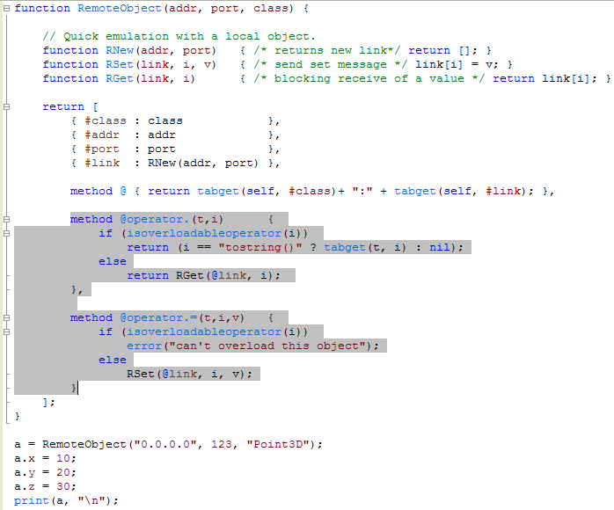
Reifying the dispatcher (4/7)
RemoteObject is a constructor function producing an object whose implementation is at a remote side.
The vtable overloading, reader version as @operator. and writer version as @operator.=, makes remote binding entirely transparent to clients.
The RNew, RSet and RGet inner functions are those to handle remote communication for object creation and editing.
The vtable overloading in Delta works in cooperation to inheritance and delegation as it affects only local lookup to objects.

Slide 42
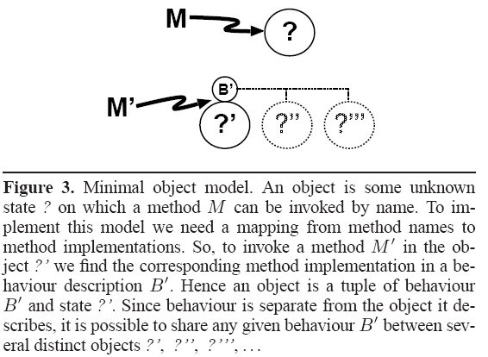
Reifying the dispatcher (5/7)
The runtime mapping of a method names to a method implementations is called dispatcher while the respective syntax is called selector.
objects being pairs of state and sharable behavior actually committing method invocation requests

Slide 43
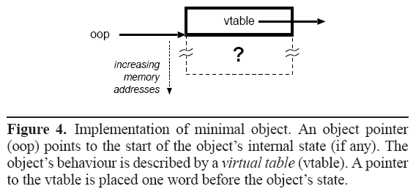
Reifying the dispatcher (6/7)
an example object memory layout for dynamic vtables on the minimal object model (minimal = we pose no restriction on how state is represented – can be memory region or field dictionary)

Slide 44
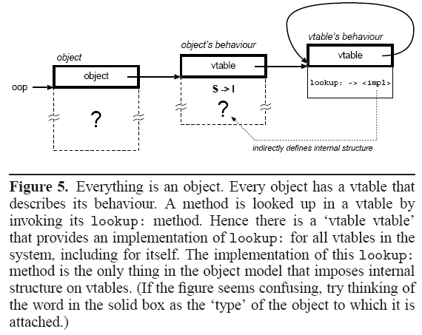
Reifying the dispatcher (7/7)
an example object memory layout for dynamic vtables on the minimal object model (the basic vtable viewed as an object offering ‘lookup’ is for bootstrapping reasons)

