Slide 1
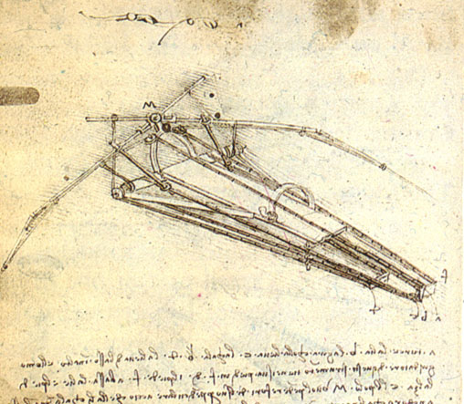
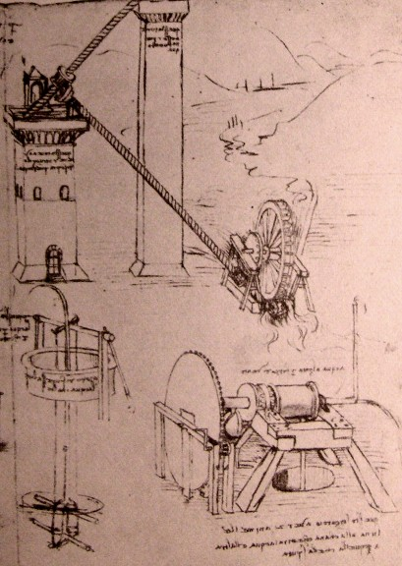
HY540 – Advanced Topics in Programming Language Development
Lecture 1

Slide 2
Introduction (1/7)
Languages are tools
Languages define programming ages
Languages progress incrementally
Languages progress mainly by practical demands
Different languages may look very similar
Old languages may look prehistoric at present
But still a lot of prehistoric code around
Newer languages will soon become obsolete
No language will rule them all
Language dominance depends on support and tools

Slide 3
Introduction (2/7)
Development
  Language design
    Novel programming constructs
    Enhanced programming practices
    Coherence of elements
  Language implementation
    Algorithms and data structures
    Software design and organization
    Architecture solutions and patterns

Slide 4
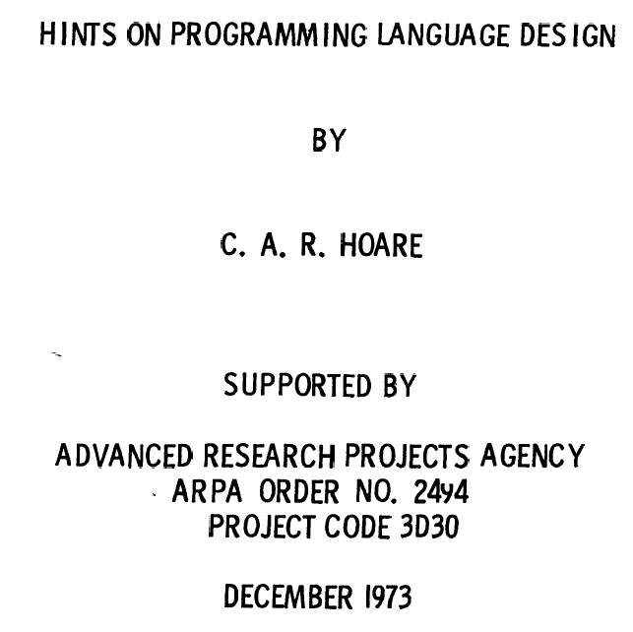
Introduction (3/7)
This original technical report by Tony Hoare in 1973 makes the earliest known separation among the role of feature designers and entire language developers.

Slide 5
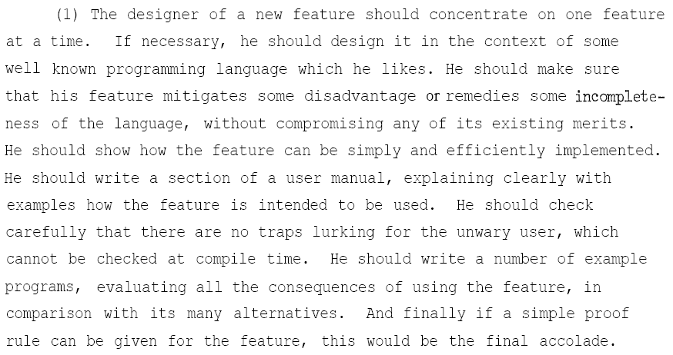
Introduction (4/7)

Slide 6
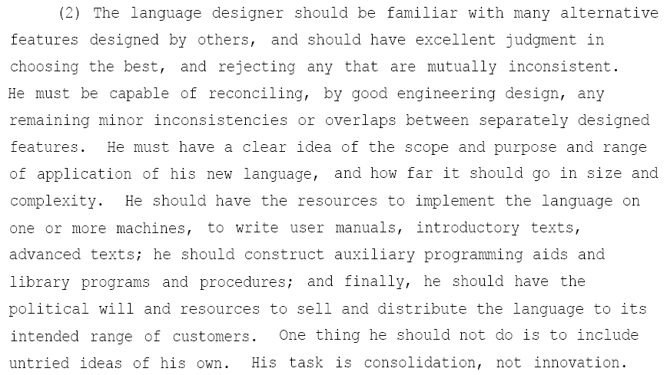
Introduction (5/7)

Slide 7
Introduction (6/7)
Holly Grails (yes, there are many in programming languages)
  Ultimate concurrency
  Ultimate safety
  Ultimate reusability
  Ultimate performance
  Ultimate compositionality
  Ultimate portability
  Ultimate simplicity
Unfortunately, in practice they may expose conflicting requirements or incompatible solutions
We do not know if all of them can be accomplished in a single language so we are in a constant quest

Slide 8
Introduction (7/7)
Our view: that of a language developer
Our targets: reusability and compositionality
Our vehicles: polymorphism and genericity
Our focus: dominant modern techniques
Our bias: imperative programming paradigm
Our philosophy: no language can have it all
Our hobby: dig into debugger development
Our lectures: based on selected papers and practice
Your benefits: upgrade of programming philosophy
Our advice: avoid becoming language developers

Slide 9
Roadmap
classes
debugger
typed
untyped
architectures
backend
inheritance
generic / meta
programming
typed
untyped
methods
domain languages
(focus on UIs)
object
system
embedded
languages
OO related
paradigms
concurrency
elements
packages
exceptions,
garbage collection

Slide 10
Classes (1/2)
What is a class?
  Classes are models of objects
  They define state (data) and behavior (methods)
  The structure of objects (runtime model or object structure model) is a matter of implementation
  Objects are usually forbidden to access directly (from within their methods) the state of other objects
  There is a relationship instance(C, O) among classes C and objects O linking objects to their class
  Classes are a key ingredient of the OOP paradigm

Slide 11
Classes (2/2)
Where did classes came from?
  An analogy of real world modeling - where objects exist - applied to software systems
    Conceptual design perspective (chicken-egg issue)
  Natural evolution of languages to support and model system components directly by the language
    System design perspective (object comes first)
  The explicit support of modules by the language reflecting the principles of modular design
    Software engineering perspective (class comes first)

Slide 12
Typed classes – introduction (1/3)
Concern languages offering ways (elements) to define new classes
Every class definition implies the definition of a corresponding distinct data type
Object creation is made possible using classes as factories
The instance relationship is an integral part of the language semantics
Classes may be values (first-class classes)
The languages of our focus are class-based

Slide 13
Typed classes – introduction (2/3)
Class design (design model)
Class definition (model specification)
Object model (runtime model)
Object (model instance)
Design domain
Language domain
Runtime domain
Our focus is on the language domain

Slide 14
Typed classes – introduction (3/3)
Next we study
  Object models
  Class details
  Typing issues
  Dynamic classes

Slide 15
Object models
Object models define the runtime image of instances encapsulating both state and behavior
There is an object meta-model defining how concrete models are derived
The meta-model defines how field access is handled
Class-based languages compute object models by parsing class definitions and mapping them on the meta models
The meta-model may be visible to the programmer and may be part of the language semantics

Slide 16
Object models
Memory region (1/5)
Meta-model of any class A { T₁ a₁ … T_{n} a_{n} } is
  Continuous program memory region
  Region size is sizeof(A) ≥ sizeof(a₁)+…+sizeof(a_{n})
  sizeof(T) for non-class types (built-in or user defined if supported) is well-defined
  Alignment bytes may be added by the compiler
  Memory layout is usually ... low|a₁|a₂|…|a_{n}| high ...
  Field offset offs(a_{i})= if i=1 0 else offs(a_{i-1} )+sizeof(a_{i-1} ) Field or any other policy giving distinct offsets to fields
  Methods are kept separately by the compiler
  Field binding is static, meaning field access at runtime is merely memory indirection, thus very fast

Slide 17
Object models
Memory region (2/5)
Assume class Point { double x, y; }
For the compiler classes are kept as objects encompassing hash tables for field and method access, trivially:
  Class* point = new Class(“Point”);
point->AddField(“x”, sizeof(double), “double”);
  point->AddField(“y”, sizeof(double), “double”);

Slide 18
Object models
Memory region (3/5)
Depending on the target instruction set, the class memory size may appear in the target code when claiming object memory (static, stack or heap)
  Object(x): sizeof(x) = GetObject(“x”)->GetClass()->SizeOf()
  Class(A): sizeof(A)= Classes::Get(“A”)->SizeOf()
Let (C++) Point pt1;
  Local: sizeof(pt1) added to current block’s computed size
  Global: sizeof(pt1) added to current files’ computed data size
Let(C++) Point∗ pt2 = new Point;
  sizeof(Point) appears as a constant value in the target code instructions claiming the required dynamic object storage

Slide 19
Object models
Memory region (4/5)
Special treatment for non-trivial field access (C++):
Field pointer types: double Point::*x = &Point::x; pt.*x = 10;
    FieldPtr* x = new FieldPtr(Classes::Get(“Point”), “x”);
    Offset offs = GetObject(“pt”)->GetOffset() + x->GetOffset();
  Upon initialization (decl) they gain the field offset (constant value in the target code)
  The .* special dereference operator is evaluated statically as offs(pt) + offs(Point:x)
Getting field address: double* px = &pt.x;
  The & operator is evaluated statically as offs(pt) + offs(Point:x)

Slide 20
Object models
Memory region (5/5)
Languages adopting the compiled memory region model (partially or entirely)
  C++: visible to programmers, not part of the language documentation (implementation dependent), memory is addressable (and corruptible) by the program
  Java, C#, Action Script (static classes): invisible to programmers, memory part of the virtual machine or runtime, not addressable by the program (untouchable)
  You cache memory loves the memory region model

Slide 21
Object models
Field dictionary (1/5)
Meta-model of any class A { T₁ a₁ … T_{n} a_{n} } is
  String key (id) hash table with elements of a generic content type (can hold any value allowed in the language and method addresses), associated explicitly to its class via a reflection mechanism
  Comes with reference semantics for objects (else a generic content value cannot be defined)
  Common operations required by the dictionary are:
    New New<special_types> GetClass
    GetField SetField GetStatic SetStatic
    IsInstanceOf IsConvertibleTo
    GetMethod InvokeMethod (redirected automatically to the class)
  Field binding is dynamic, meaning field access at runtime is hashing (or search anyway), thus with a performance penalty

Slide 22
Object models
Field dictionary (2/5)
They are supported by class-based languages either compiling to byte code (run by virtual machines) or being interpreted
Classes are usually represented at runtime as immutable referable objects (reflection)
The dictionary model compromises speed for increased flexibility, which, for class-based language, means:
  introduce and deploy new classes on-the-fly
  extend objects beyond class boundaries
Non-virtual methods are statically bound in class-based languages (even for dictionary object models)
However, the performance penalty on field access requires field lookup caching

Slide 23
Object models
Field dictionary (3/5)
Languages adopting the field dictionary model (partially or entirely)
  Compiled:
    C#, Java (… only as a programmer model in some cases)
      Support memory regions, but allow more dynamic features via: compiler invocation, code / class loading and object creation and deployment via reflection, making the programmer think that field dictionary is on control (but is not)
    Action Script
      Mainly memory region (AS3), though allows to add fields and methods on objects of dynamic classes (true field dictionary)
  Interpreted (class-based)
    Python, Ruby, Cecil, Diesel
  You cache memory hates the field dictionary model

Slide 24
Object models
Field dictionary (4/5)
The big challenge is when models are mixed, that is we support both static and dynamic compilation, as supported in Java and C#
At least the following language components should be part of the language library:
  Compiler
  Loader
  Type information (Introspection / reflection / RTTI)
  Execution (dynamic invocation)
The dynamic objects cannot be statically typed, meaning they can only be generic object references.
Thus, type checking should be done by client code using runtime type information (introspection).

Slide 25
Object models
Field dictionary (5/5)
Code memory
(static byte code)
Data memory
invocation
1. Code producing code
5. Dynamic code
Dynamic code
generation
Reflection
introspection
2. Code loading and invoking dynamic code
3. Dynamic code
4. Dynamic-code producing code
loader
compiler
Language core runtime library
Virtual machine

Slide 26
Object models
Examples (1/12)
Java: dynamic class loading
  Provides Class that can be retrieved from every program object or be loaded dynamically like:
    Class foo = Class.forName^{static}(“foo”);
    Foo obj = (Foo) foo.newInstance();
  The compiled class binary should reside in a place that the currently used class loader can get (e.g., in the class path, imported package, Jar file, etc)
    For custom loading policies, one should build a custom made class loader
  The Class API provides the required introspection and dynamic invocation functions
    Access qualifiers do not apply, meaning encapsulation (information hiding) evaporates

Slide 27
Object models
Examples (2/12)
Java: instantiation and invocation
  The Class is a built-in type that offers introspection enabling to dynamically access methods and fields
  Method[] getDeclaredMethods()
  Method getDeclaredMethod(String name, Class[] argTypes)
  As observed, argTypes is necessary to be able retrieve versions of overloaded methods.
  Normally, when unknown classes are loaded one cannot have type casting in the source code, meaning all access is bound to reflection.

Slide 28
Object models
Examples (3/12)
Java: Sun JVM memory layout (1/2)
  The JVM specification does not define a memory layout (!!!), but leaves it open to JVM developers choose one.
  For example, to save memory, the Sun JVM doesn't lay out object's attributes in the order they are declared.
  Instead, fields are organized in memory with the following descending type priority:
      double long int float short char boolean byte Object
  But then, how is field access compiled to support memory layouts, though not forcing one, and still be able to run by different JVMs using memory regions? We address this latter.

Slide 29
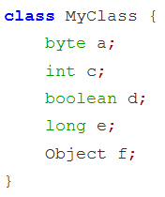
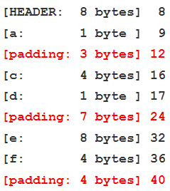
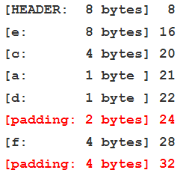

Object models
Examples (4/12)
Java: Sun JVM memory layout (2/2)
Without reordering
After reordering
An instance of the java.lang.Boolean class takes 16 bytes of memory!

Slide 30
Object models
Examples (5/12)
Java: code generation trick
  The Java compiler does not compute field offsets, but produces symbolic references for fields and methods
  A symbolic reference is a numeric index (like #3) to the constant program pool where an entry exists with all information about the field (name, type, order)
  The JVM will firstly compute the precise memory layout per class upon loading
  Then, when loading the program code, for every field access it will produce a table (normal, not hashing) converting symbolic references to memory offsets
    e.g., offsets[4] is the offset of field with symbolic reference #4

Slide 31
Object models
Examples (6/12)
Java: hybrid field access
  Static field access is similar to memory indirection, though an extra table access as explained before
  Dynamic field access for objects created via reflection, although accessing objects of the same model (memory region), is technically similar to field dictionary
x.getField(“a”).getByte(x)
Object of class A in memory
Field
Memory for field a
Class A metadata,
including
field →offset hashing

Slide 32
Object models
Examples (7/12)
C# : on-the-fly compilation
using System; using System.IO; using Microsoft.CSharp; using System.CodeDom.Compiler; using System.Reflection; // Create C# compiler instance CSharpCodeProvider csc = new CSharpCodeProvider(); ICodeCompiler icc = csc.CreateCompiler(); // Set input params for the compiler CompilerParameters co = new CompilerParameters(); co.OutputAssembly = “foo.dll"; co.ReferencedAssemblies.Add("system.dll"); // Force to generate a DLL co.GenerateExecutable = false; // Run the compiler for the source file icc.CompileAssemblyFromFile(co, “foo.cs");
This feature allows write programs that produce code which can extend a running system.
Such programs can be seen as meta-programs.
This technique can be used as a limited form of meta-programming.
Interestingly, debugging of dynamically compiled code should not be a problem.

Slide 33
Object models
Examples (8/12)
C# : instance creation and method invocation
// Load newly generated assembly into ApplicationDomain namespace Assembly asm = Assembly.LoadFrom(“foo.dll"); Type t = asm.GetType(“Foo"); BindingFlags bf = BindingFlags.DeclaredOnly | BindingFlags.Public | BindingFlags.NonPublic | BindingFlags.Instance; // Construct an instance of the desirable class Object obj = t.InvokeMember( “FooConstructor", // or “” if none bf | BindingFlags.CreateInstance, null, null, null ); // Invoke a method t.InvokeMember( “Bar", bf | BindingFlags.InvokeMethod, null, obj, null );

Slide 34
Object models
Examples (9/12)
Meta Data
(RTTI)
Runtime
Compilation and Code Loading
Field / Method
Introspection and Object Access
Dynamic
Invocation
Library
Reflection

Slide 35
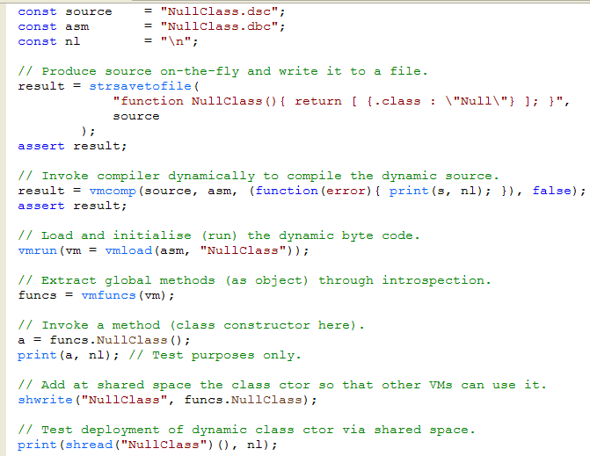
Reflection in Delta (1/2)
Code manipulation is trivial (string handling)
Runtime compilation
Dynamic code loading
Method introspection
Dynamic invocation, field and method access
Dynamic objects and methods are all normal first-class values

Slide 36
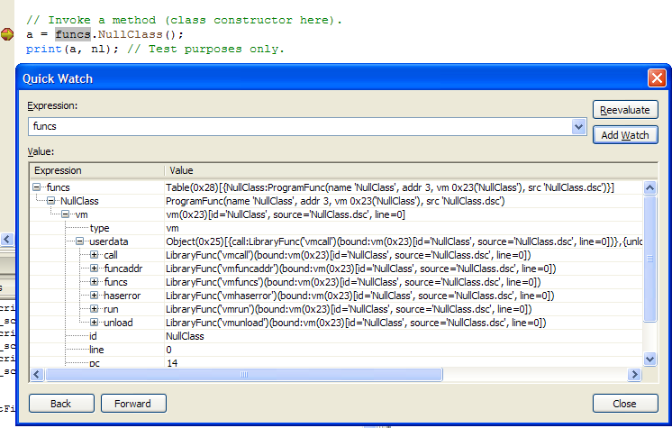
Reflection in Delta (2/2)
Zen debugger, within the Sparrow IDE of Delta: Full runtime debugging and inspection of dynamically loaded constructor methods and objects produced by these constructors

Slide 37
Object models
Examples (10/12)
Action Script 3: sealed and dynamic classes
  Sealed is a (normal) class whose objects can only have the fields and methods defined within the class definition
    The best object model of a sealed class is memory region (memory efficient and fast), but this information is not available
      Although typed, it is surprising why some errors are runtime
  Dynamic is a class whose objects can introduce new public fields and methods not appearing in the respective class definition (note: term dynamic class is misused in AS3)
    The best object model of a dynamic class is a memory region with one extra reference field as a field dictionary, but again this information is hidden

Slide 38
Object models
Examples (11/12)
Action Script 3: sealed and dynamic classes
  There are also some rules among sealed and dynamic classes that break polymorphism, although they preserve typing
    sealed classes derived from dynamic are sealed (entirely)
dynamic class Person { var name:String; } Person p = new Person(); p.Name = ”Joe”; p.Age = 25; p.printMe = function () { trace (p.name, p.age); } p.printMe(); // Joe 25 | public class Student extends Person {} var ts:Person = new Student(); st.Age = 25; >>>ReferenceError: Error #1056: Cannot create property Age on Student.

Slide 39
Object models
Examples (12/12)
Action Script 3: sealed and dynamic classes
  The hybrid object model is inevitable in languages allowing statements that introduce (or remove) extra slots (attributes or methods) beyond the class definition boundaries
Memory region (statically added members)
Field dictionary (dynamically added members)
Reserved object (reference): Dynamic attributes and methods
Key | Value

Slide 40
Class details (1/10)
Static members: shared by all objects of a class
  Their support is easy by simply applying extra scoping rules, treating statics as global elements in the closed namespace of the class
  May support special initialization blocks for statics in the scope of a class called during global initialization
    Sometimes called static constructors (C#)
    Handling requires support for code execution during initialization (C++ allows that via static objects, java not)

Slide 41
Class details(2/10)
Member access qualification: usually handled by trivial compile-time checking to force access rules
  Unbiased (i.e. apply equally to all other classes)
    Common private / public qualifiers
  Biased (i.e. some classes are treated differently)
    Unselective (i.e. apply to all members, as friend qualifier in C++)
    Selective (i.e. can have member-specific privileges per class)
  Care: when objects can extend beyond their class, dynamically added methods may be restricted only to public access (as in Action Script 3)
    Such violations can be detected only at runtime

Slide 42
Class details(3/10)
Constructors: an automation of a common object initialization pattern
  Single with no arguments – very uncommon
  Multiple overloaded versions - C++, Java, C#
  Explicitly callable
    Inside class - C++, Java, C#
    Outside classes as a normal method - C++ yes, not in Java, C#
  First-class value – not in C++, Java, C#

Slide 43
Class details(4/10)
Supporting constructors is no different than supporting class methods, with some simple extra work
  Same code generation as with methods (member functions) when treating this pointer
  Constructor overloading is handled exactly like function or method overloading
  Automatic base constructor invocation is addressed by emitting an extra instruction to explicitly invoke it
  First-class constructors could be easy; not clear why languages with all the required machinery don’t support them
    e.g., in C++ once we accept that the return type of constructors is implicitly void, we may assign their address to pointers to member functions

Slide 44
Class details(5/10)
Destructors: an automation of a common object disposal pattern
  Reserved method that is called automatically upon object collection (manual or automatic)
    In most cases invocation is statically bound (easy implementation) with the exception of virtual destructors
  Automatic base (super) destructor invocation requires emitting an extra instruction to invoke base destructor
    As we do for constructors
  In garbage collected languages their presence is really degenerate
    Should never introduce destructors (finalizers) in garbage collected languages (do you agree?)

Slide 45
Class details(6/10)
Properties / attributes: an automation of a common field access pattern
public class A { private T y; public T x { get { return y; } set { y = value; } } public T x { get; set; } }; A a = new A(); a.x = <expression of T type>; // C#
Class A { private var y:T; public function get x():T { return y; } public function set x(v:T): void { y=v; } } var a:A = new A(); a.x = <expression of T type>; // AS3

Slide 46
Class details(7/10)
Properties / attributes: implementation
  Language syntax is extended with the forms of the pattern (optional set / get, auto complete)
  Code generation is managed by emitting anonymous private set and get class methods (or use hidden names, like $set_x and $get_x)
  Auto complete case requires code generation as if the user has explicitly supplied the methods
    Can be handled by handing code over the AST or appending on the intermediate byte code
    Since no source code is present no step-in tracing is applied during debugging

Slide 47
Class details(8/10)
Properties / attributes: set overloading
  Concerns cases where an attribute of type T is assigned from alternative data types
  Requires support for multiple signatures, handled statically via overloading (easy)
  Supporting multiple arguments means the language defines if priority is given on multi-value assignments over expression lists and that no ambiguities arise
    Assume x where set (T₁ a, T₂ b) { x= priv_f(a,b) }
    x = expr₁, expr₂ ≡ x.set(expr₁, expr₂) priority
    f (x = expr₁, expr₂) ≡? f(x.set(expr₁, expr₂)) ambiguity
    f (x = expr₁, expr₂) ≡? f(x.set(expr₁), expr₂) ambiguity

Slide 48
Class details(9/10)
Nested classes: classes inside other classes
  Syntactic nesting
    The nested class just gains the namespace of the owner (outer) class, being semantically as any other class - C++, Java (static nested classes), C#
    No extra privilege of the nested class in accessing the owner is involved
    The implementation requires some extra naming and scoping
Outer
class
scope
Nested
class
scope
Circles represent scopes

Slide 49
Class details(10/10)
Nested classes: classes inside other classes
  Semantic nesting
    Nested class hidden outside the owner class, while an instance of nested class can exist only in an instance of an owner class and has access to the members of its enclosing instance - Java (inner classes), I-GET language (child agent classes)
    When an instance of the owner class is destroyed all instances of the nested class it created are auto collected
      Java (by garbage collection), I-GET language (by agent destruction semantics)
Outer
class
instance
Nested
class
instance
Circles represent objects

Slide 50
Typing issues (1/4)
The type system of a language provides the rules for assigning types to expressions and for ensuring that illegal type uses are all tractable
When it comes to classes, since we did not yet introduce inheritance, the question is the following:
  Let A a and B b for distinct classes A and B
  Provide the function Equivalent(A,B)
    Type checker
  Provide the compilation for a=b
    Code generator

Slide 51
Typing issues (2/4)
There are two dominant methods for type equivalence:
  Nominal equivalence (nominative type system)
    A≡B ⇔ A=B or A ≡ alias(B) or B ≡ alias(A)
    Rigid type system (C, C++, Java, Eifel, C#)
  Structural equivalence (structural type system)
    Let A ⊆ B ⇔ ∀ a∈A ∃ b∈B : T(a)≡T(b)
    Then A ≡ B ⇔ A⊆B ∧ A⊇A ∧ A.total = B.total
    That is, for each member of a class there must be a corresponding and identical member in the other class, and the two classes should have the same number of members

Slide 52
Typing issues (3/4)
Questions about structural equivalence
  Should the equivalent members have same names?
    If names do not match, to guarantee correct use in substitution copy by value semantics maybe forced for arguments
    Or else, temporary member aliases compatible to the original type parameters need to be introduced
      This may affect macroscopically your language implementation since with every call we need:
        to establish member aliases for use in the invoked method
        as an object may be further used as an argument, stacks of such alias lists are needed
        upon call return we should pop the alias list
      Performance issues may well reduce your appetite for such fancy features

Slide 53
Typing issues (4/4)
Questions about structural equivalence
  Should we involve both fields and methods in the equivalence test or just the methods?
    Method-based equivalence will work only when the fields are exclusively used inside methods by invocations to accessor methods (attributes)
  Should the equivalent members be ordered identically?
    i.e., class treated as a tuple (ordered list), not as a set
    If classes are treated as sets, then the code generation should ensure that field access at runtime is independent to their order of appearance (like Java symbolic names)

Slide 54
Dynamic classes (1/5)
Also called first-class classes, i.e. classes that can be the used as normal values
  Consequently, a dynamic class can be the outcome of a computation (or expression evaluation)
  We have seen one way of implementing dynamic classes, but without typing support by the language
    Reflection mechanisms, essentially libraries
  But now we will study them in the perspective of genuine language support (i.e. no library)

Slide 55
Dynamic classes (2/5)
; Normal class definition in Lisp, foo←bar. ; Syntax is (defclass id ( [bases] ) ( [slots] )) (defclass bar () ()) (defclass foo (bar) ()) (defclass baz () ()) ; Using LISP MOP (Meta Object Protocol) to change classes dynamically. ; The > is interpreter prompt, upper case messages are its responses. > (class-direct-superclasses (find-class 'foo)) (#<STANDARD-CLASS BAR>) > (ensure-class 'foo :direct-superclasses '(bar baz)) #<STANDARD-CLASS FOO> > (class-direct-superclasses (find-class 'foo)) (#<STANDARD-CLASS BAR> #<STANDARD-CLASS BAZ>)
We will observe that most cases where dynamic classes are allowed are in interpreted languages.
There are compiled versions of Lisp too.
MOP is a sort of an object-system protocol description through which the original program can be modified (like write-mode self reflection).

Slide 56
Dynamic classes (3/5)
> (defclass ball () ((%radius :initform 10 :accessor radius))) #<STANDARD-CLASS BALL> > (defclass tennis-ball (ball) ()) #<STANDARD-CLASS TENNIS-BALL> > (defvar *my-ball* (make-instance 'tennis-ball)) *MY-BALL* > (radius *my-ball*) 10 > (defclass ball () ((%radius :initform 10 :accessor radius) (%volume :initform (* 4/3 pi 1e3) :accessor volume))) #<STANDARD-CLASS BALL> > (volume *my-ball*) 4188.790204786391d0
Redefining a class at runtime will cause modifications to propagate immediately among instances and subclasses of the class.
For example in the example on the left we redefine ball to have an extra slot (attribute) with an initial value.
If we check we realized my-ball has also the extra attribute.

Slide 57
Dynamic classes (4/5)
In general the problem with dynamic classes is that to have absolute power we should:
  Sacrifice static type safety and make everything apply at runtime
    Thus type faults may appear as runtime errors, which is not always desirable
    Or type-checking client code is needed, which is not always performance-wise acceptable
    Overall, such dynamic languages will come up with programming directives about type-specific unit testing
  Support structural equivalence, since expressions may return anonymous classes
    Or else we will be bound to nominal typing of objects from the names of the methods that return dynamic classes and the types classes supplied as arguments (a dynamic analogy to C++ templates being static class generators)

Slide 58
Dynamic classes (5/5)
Let Class be the type of a class value. Then a Class value is an actual class. Assume structural equivalence requiring matching of member names. Assume we have the necessary language operators to freely edit (add / remove / query) the fields and methods of a class value. Assume a Class value A. Then new A() will create an instance of the respective class. Let Class F(Class C₁,Class C₂) be a class generator function accepting two class arguments while returning a class value. Then if A₁ ≡ A₂ and B₁ ≡ B₂ we define F(A₁,B₁) ≡ F(A₂,B₂). This is analogous to the case F<A₁,B₁> ≡ F<A₂,B₂> applied for generators.
Possible semantics to support statically-typed dynamic classes with generator functions resembling templates but enabling class generation algorithmically. The typing consistency is based on the hypothesis that generators return equivalent values for equivalent arguments.

