Slide 1

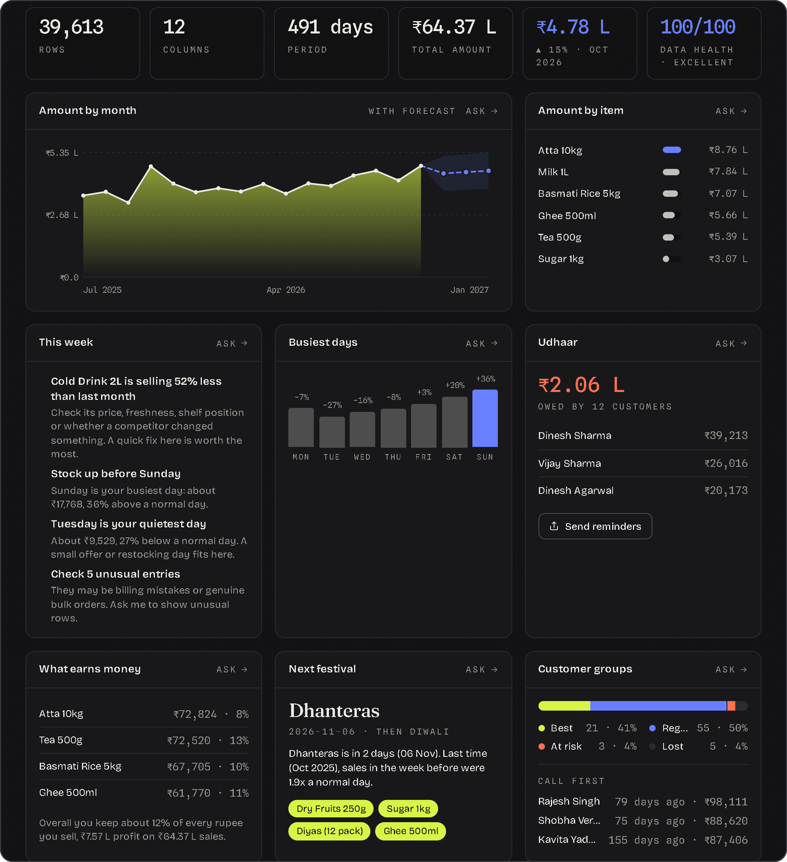
PredictWise AI
SPECIALIZATION PROJECT · 5 BCA A
Your shop's records, answered in plain words.
Explainable AutoML and decision intelligence for small shops, running on AWS.
Hiten Mandhyan · Register No. 24215117
CHRIST (Deemed to be University), Delhi NCR · November 2026
Notes:
SAY: Good morning. PredictWise AI turns a shop's own spreadsheet into answers in plain words, and it runs on AWS. I will show it from two sides: the shopkeeper's, and the analyst's.
BEFORE YOU START: the app is open on the home screen (start.bat), the left column says 'AI assistant on (Groq)', and the Sharma General Store sample has been opened once so the first briefing is warm.
The picture on the right is the real dashboard on the demonstration file: 16 months of bills from a provision store.

Slide 2




Shops have the records, not the answers
Skill gap
Owners keep bills and udhaar books, but turning them into decisions takes a data analyst.
THE IDEA
Upload a spreadsheet. Ask in plain words. Get answers calculated from your own file.
Cost
Analytics tools are built for companies and priced for companies.
Trust
Chatbots can't see the shop's file, and they guess numbers instead of calculating them.
SIMPLE MODE
For the shopkeeper: English, Hindi or Hinglish.
Language and privacy
TECHNICAL MODE
Most tools are English-only and send customer data to outside services.
For the analyst: clean, model, explain, audit.
Notes:
SAY: Small shops already keep sales records: bills, udhaar books, stock registers. But four things stop them using those records. They lack the skill, the tools cost too much, a chatbot cannot see their file and guesses numbers, and most tools are English-only and send customer data to outside services.
Every feature in this project answers one of those four gaps. The idea is simple: upload a spreadsheet, ask in plain words, and get answers that are calculated from your own file. There are two modes on one engine: Simple for the shopkeeper, Technical for the analyst.

Slide 3




How it is built
Browser
FastAPI backend (Python)
Storage
React 18 and Vite
Tailwind design system
Simple and Technical mode
Hindi, voice, dark and light theme
SQLite, then PostgreSQL on RDS
Local disk, then Amazon S3
One setting switches them
Shop toolkit
What-if simulator
pandas and NumPy
Monte Carlo replays
AutoML
Trust layer
AI, optional
scikit-learn and joblib
Shapley, fairness, drift
Groq LLM behind a privacy shield,
a sandbox and a grounding check
43 API endpoints · SQLAlchemy · Pydantic
BUILT TO BE CHECKED
116 automated tests
30-question accuracy suite
Docker image
GitHub Actions CI
CloudFormation
LIVE Point at the header badge: Local · SQLite · Disk
Notes:
SAY: Three layers. The browser is a React app with two modes. The backend is FastAPI in Python, about 43 endpoints, with four kinds of engine: the shop toolkit in pandas, the what-if simulator, AutoML in scikit-learn, and a trust layer for explanations, fairness and drift. Data goes to a database and a file store: SQLite and local disk on this laptop, PostgreSQL on Amazon RDS and S3 in the cloud. One environment variable decides which. The AI is optional and sits behind a privacy shield.
SHOW THE DATABASE: the header badge reads 'Local · SQLite · Disk'. In Technical mode the Data stage lists the files straight from the datasets table. To show the table itself, run:
python -c "import sqlite3; print(sqlite3.connect('backend/predictwise.db').execute('select id,file_name,row_count from datasets').fetchall())"
IF ASKED HOW YOU TEST IT: 116 automated tests plus a 30-question accuracy suite that checks the app's answers against independent pandas calculations; both run in GitHub Actions.

Slide 4
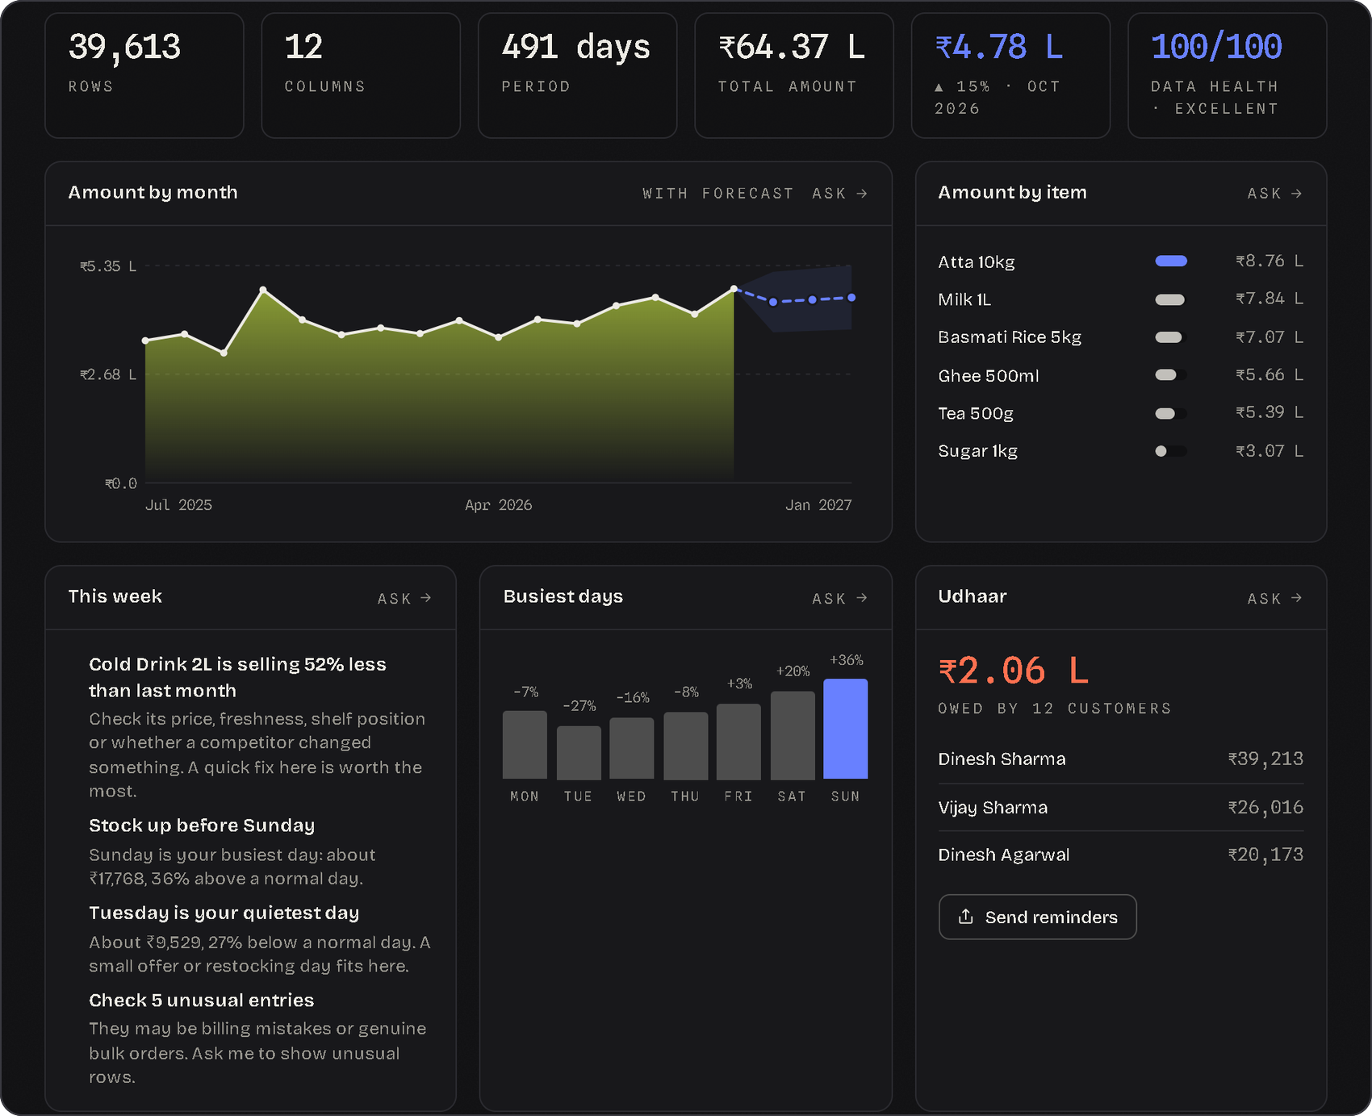



Simple mode: the whole shop in four tabs
Chat
Ask in English, Hindi or Hinglish. Type, speak, or go private.
Dashboard
Trend, udhaar, busy days, festival and stock at a glance.
Look up
One customer or product: spend, udhaar, the next message.
What if
Rehearse a decision before you make it.
SHOP TOOLKIT, CALCULATED FROM THE BILLS
Profit
Udhaar
Festival stock
Order plan
Busy days
Bought together
Customer groups
WhatsApp messages
LIVE Sharma store → Dashboard → Look up
Notes:
CLICK: choose 'Sharma General Store: 16 months of bills' under 'try it without a file'. The briefing appears by itself, before anyone asks anything.
SAY: Simple mode has four tabs. Chat answers questions. Dashboard shows the shop at a glance: every tile is one of the engines, calculated from the shop's own bills, and each tile has an Ask button that sends the matching question to the chat. Look up shows one customer or product. What if lets the shopkeeper rehearse a decision.
POINT AT: udhaar owed (about 2 lakh by 12 customers), busiest day (Sunday, 36% above normal), next festival (Dhanteras, then Diwali, with the items that sold last time), customer groups (21 best customers bring 41% of spend), next week's order.
CLICK: Look up, then Dinesh Sharma: rank 5 of 84, owes 39,213 rupees, and a ready WhatsApp reminder. Then Cold Drink 2L (falling) and Candles (stopped selling).
ALSO SHOW (30 seconds): the हिन्दी button, Private mode (nothing leaves the computer), the toolkit buttons in the left column, the book icon beside the question box (a library of ready questions built from this file), Share on WhatsApp under any answer, and the microphone for voice.
OTHER THINGS IT DOES, IF ASKED: 'Share today's summary' sends a short daily digest to WhatsApp; 'Compare with an older file' lists what changed between two uploads; 'Download cleaned data' gives a CSV; asking 'who is most likely to buy' ranks customers with the trained model; a whole new file can be scored at once.

Slide 5
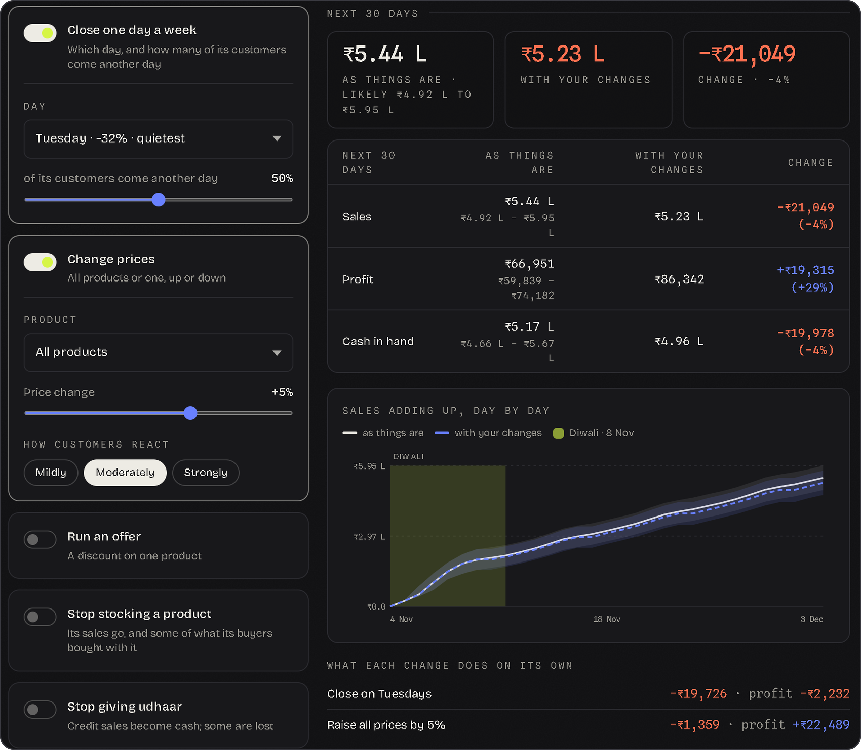
What if: rehearse the decision first
2,000
12
6
replays of the next 30 days
weeks of your own bills
decisions to try
1
Replay
Each day of next month is re-drawn from your last 12 weeks: Sundays from past Sundays.
2
Decide
Close a day, change prices, run an offer, drop a product, stop udhaar, call back quiet customers.
3
Compare
Every change hits the same 2,000 futures, so you see the range and the difference.
Sharma store: raise prices 5%, sales stay flat, profit rises about ₹22,000 a month.
LIVE What if → close a day → change prices
Notes:
SAY: This is the part I added last, and it is different in kind. Everything else answers 'what happened'. This answers 'what would happen if'. The shop's own last 12 weeks are replayed 2,000 times over the next 30 days, drawing each day from past days of the same weekday, so a Sunday comes from past Sundays and ordinary ups and downs are kept. Diwali falls inside this period, so its week is taken from last year's Diwali week, scaled to this year's level: that is the green band on the chart. Every change is applied to the same 2,000 futures, which is why the 'change' has a tight range even though the totals spread.
CLICK: What if tab. Switch on 'Close one day a week' (Tuesday, the quietest): about 20,000 rupees less in the month, assuming half those customers come another day. Change the day to Sunday: about 46,000 less. 'The day off has a price, and now he knows it.'
Switch on 'Change prices', +5%, customers react moderately: sales barely move, profit rises about 22,000. Click 'Strongly' to show the assumption matters; it is shown and editable.
Switch on 'Stop giving udhaar': sales fall about 8,000 but cash in hand rises about 19,000. A trade-off, in numbers.
Switch on 'Message quiet customers': about 8,000 more if one in five of the eight come back.
IF ASKED: 'Is it a machine-learning model?' It is a Monte Carlo bootstrap, not a fitted model. The three things a file cannot say (how customers react to a price change, how much an offer lifts sales, how many quiet customers return) are shown as assumptions you can change. Nothing here is guessed by an AI.
ALSO: type 'What if I close on Sundays?' in the chat and the same answer appears inline.

Slide 6
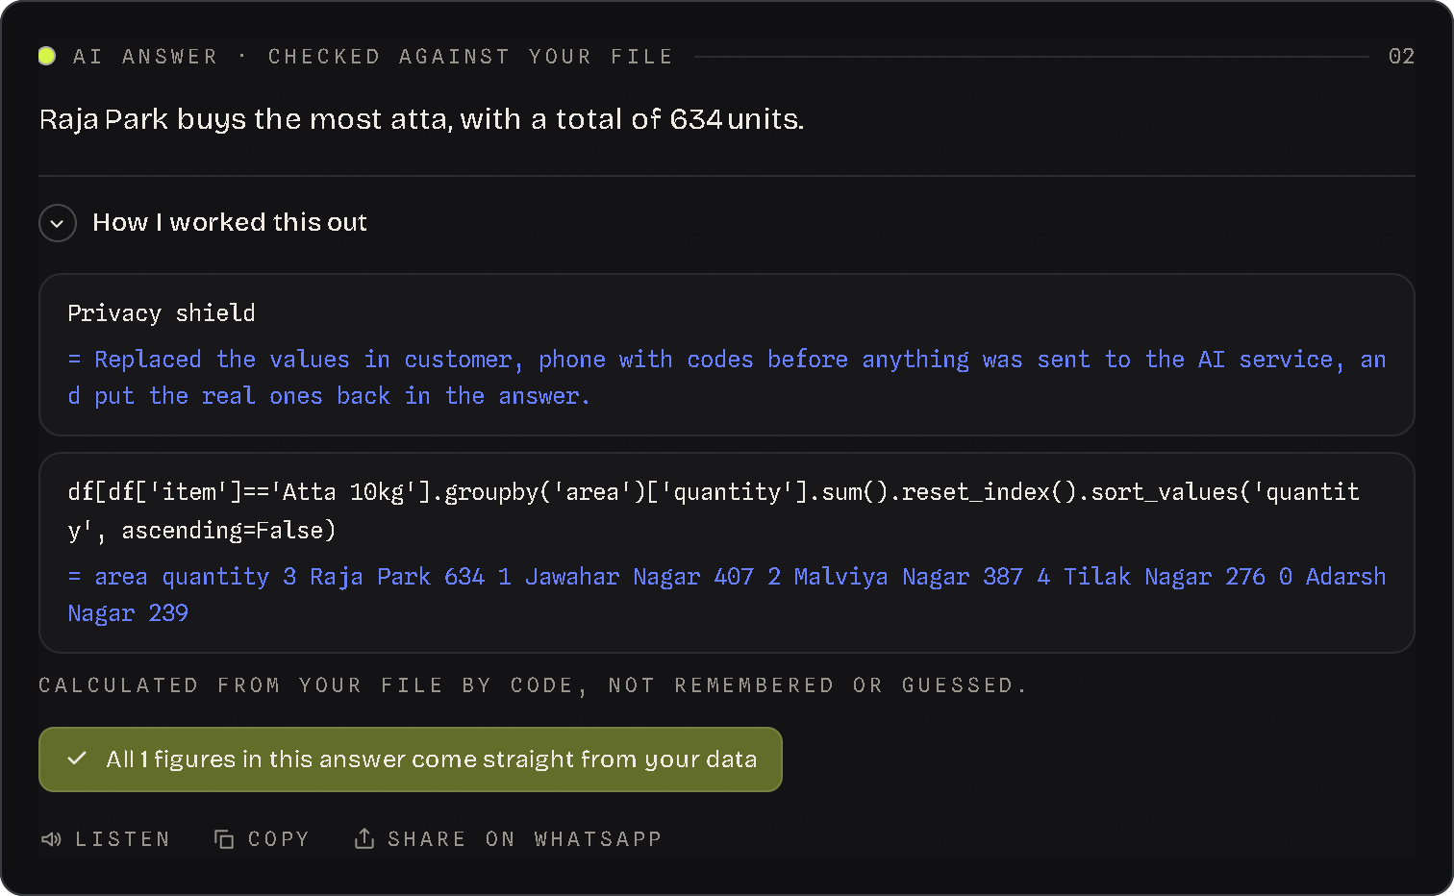
Why not just ChatGPT?
Which area buys the most atta, and how many units?
1
2
3
4
Privacy shield
AI writes a query
Code runs it
Figures checked
names become codes
it never does the maths
in a restricted sandbox
each one traced to a result
 | A general chatbot | PredictWise
Numbers | Recalled or guessed | Calculated from your file
Proof | None | Working shown, figures traced
Customer data | Sent as typed | Names become codes; Private mode sends nothing
No internet or key | Nothing works | Toolkit, forecasts and groups still work
30 / 30
116
answers match independent pandas checks
automated tests pass
LIVE Ask: which area buys the most atta?
Notes:
SAY: A general chatbot is excellent for writing and brainstorming. Here the job is narrower: from records to decisions. So three rules. One, the AI never does the maths. It writes a single pandas query; my code runs it in a restricted sandbox and hands back the number. Two, every figure in the answer is checked against what the calculation returned. Three, names and phone numbers are replaced by codes before anything leaves the computer, and Private mode sends nothing at all.
CLICK: type 'Which area buys the most atta, and how many units?' in the chat. When the answer appears, open 'How I worked this out': the privacy-shield note, the exact query, the result (Raja Park, 634 units), and the line 'calculated from your file by code, not remembered or guessed'.
SAY: Without a key or internet, the toolkit, forecasts, customer groups and offline queries still work, so the app degrades instead of failing.
EVIDENCE: the accuracy suite asks 30 questions through the real chat endpoint and compares each answer with a value computed separately in pandas: 30 of 30 match. It caught two real bugs during development (counting rows instead of customers, and ranking single bills instead of totals). 116 automated tests pass.
NOTE: the free AI quota allows about two or three open-ended questions a minute. The dashboard, look-up, What if and toolkit never use it.

Slide 7
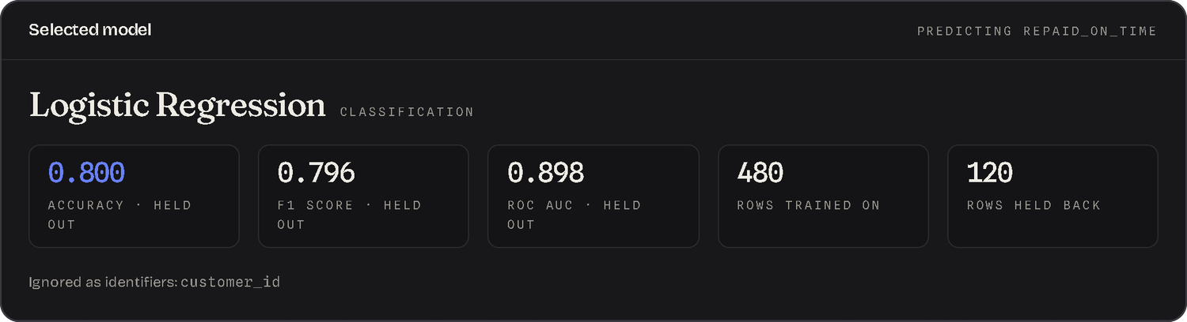
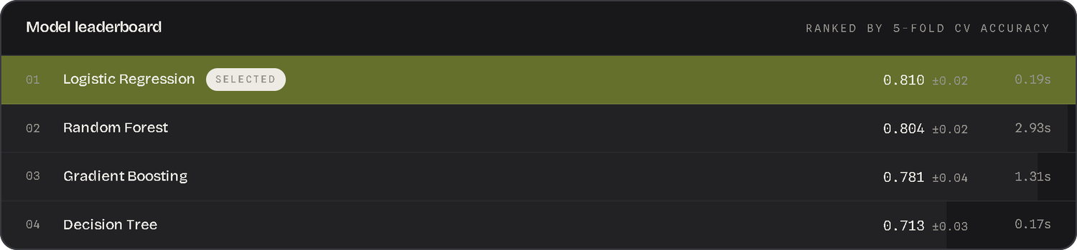
Technical mode: from file to model
01
02
03
04
05
06
Data
Clean
Explore
Model
Predict
Audit
Upload; stored in the database
Fill gaps; every step logged
Distributions, correlations
4 algorithms, cross-validated
A prediction, and why
Fairness, drift, reports
WHAT HAPPENS WHEN YOU CLICK TRAIN
1
IDs like customer_id are dropped, and the task is detected: classification.
2
80% of rows train. 20% are held back and never used to choose a model.
3
Four algorithms train in one pipeline, so filling and scaling use training rows only: no leakage.
4
Five-fold cross-validation ranks them. The winner is scored once on the held-back rows.
5
Permutation importance shows what drives the answer. The model is saved and logged.
LIVE Udhaar khata → Technical → Model → Train models
Notes:
CLICK: back in Simple mode, open 'Udhaar khata: who repays on time' (600 customers), then switch to Technical in the header. The rail on the left is the pipeline; stages unlock as you go.
01 DATA: the file list comes from the datasets table in the database. Every upload is a row with its stored path, row count and columns.
02 CLEAN: set 'Extreme values' to 'Cap using the IQR rule', then click Clean dataset. The 'What changed' panel is the cleaning log: repeated rows removed, 18 ages and 12 average bills filled with the median, extreme udhaar amounts capped (including two absurd 90,000 amounts). Every operation is written to the cleaning_logs table. 'Preprocessing is logged, not hidden.'
03 EXPLORE: shape tiles, a histogram per number column, the correlation matrix (cobalt positive, red negative).
04 MODEL: 'Column to predict' is already repaid_on_time. Click Train models, then walk through the five points on the right. Key sentence: selection by cross-validation, reporting on rows the model never saw. Choosing on the test set would leak it into the choice and inflate the number.
IF ASKED why the held-out score differs a little from the cross-validation score: the held-out set is only 120 rows, so it moves a few points either way; the cross-validation figure averages five folds and is the steadier number. Quote both and trust the cross-validation one.
IF ASKED how you know it beats guessing: 70% of customers repaid on time, so always saying 'repaid' scores about 70%; the model scores about 80%, with a ROC AUC near 0.9.

Slide 8
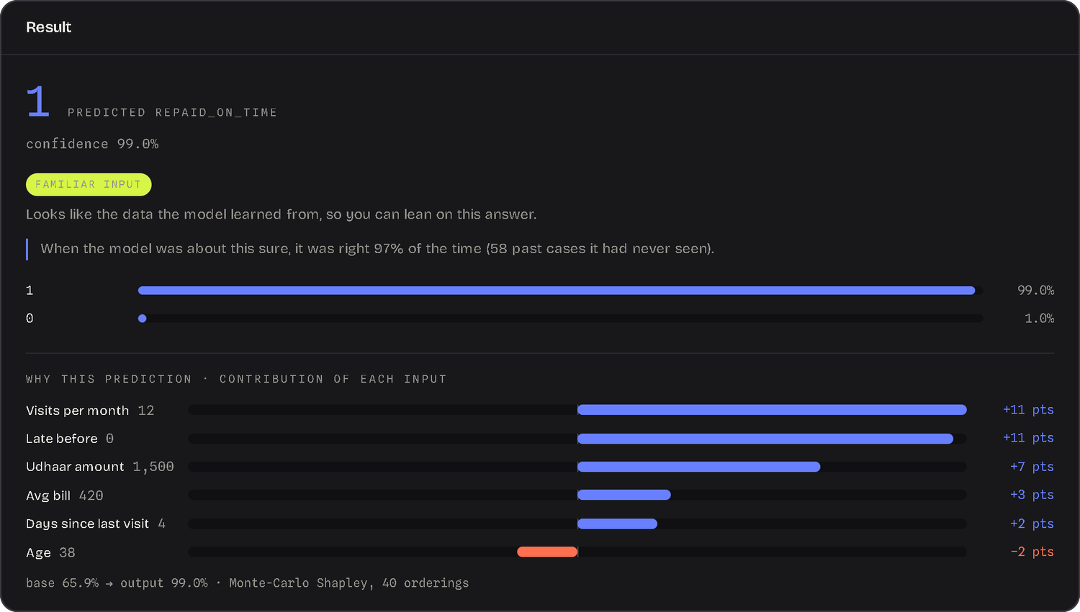
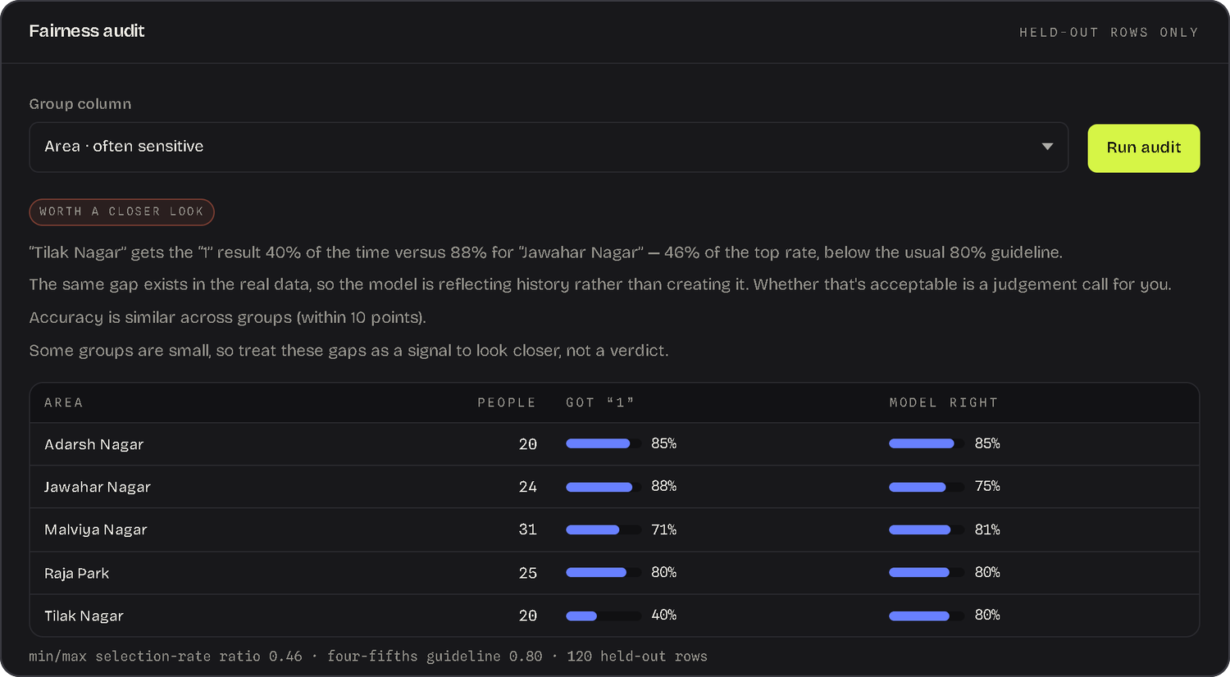


Predictions you can trust
Why this prediction
Knows its limits
A track record
Fairness and drift
Shapley values add up exactly to output minus base.
Warns when an input is outside the training data.
Says how often it was right when this sure, on unseen rows.
Compares groups under the four-fifths rule; watches live inputs.
LIVE Predict (udhaar 99999) → Audit by area
Notes:
CLICK: Predict stage. Fill a safe row: area Jawahar Nagar, gender Female, age 38, months as customer 36, visits per month 12, average bill 420, udhaar amount 1500, previous udhaar 3, late before 0, days since last visit 4. Click Predict.
SAY: Four things come with every prediction. A trust note: the inputs are checked against the training data's fingerprint. A track record: 'when the model was about this sure, it was right so many percent of the time on rows it had never seen'. Why this prediction: exact Shapley values, contributions that add up to the output minus the base. And a what-if: vary one input across its real range and watch the probability move.
CLICK: now change area to Tilak Nagar, udhaar amount to 99999, late before to 3, days since last visit to 90, visits per month to 3, and predict again. The trust note changes to 'Outside the data' with the reason for each input. 'It knows what it doesn't know.' Every prediction is logged to the predictions table with its trust level.
CLICK: Audit stage. Group column: Area, then Run audit. The held-out rows are rebuilt with the same split, and selection rate and accuracy are compared per group under the four-fifths rule. Tilak Nagar gets a repaid-on-time result far less often than the best area (ratio about 0.46 against the 0.80 guideline), and the report says the same gap already exists in the real data, so the model is reflecting history rather than creating it. Then pick Gender: no large gap. 'A screening tool, not a legal audit.' Live monitoring and the printable reports (plain-language and technical with a model card) are on the same stage.

Slide 9






On AWS: built from code, billed by the hour
VPC · two availability zones · security groups chain the tiers
Users
Load balancer
EC2 Auto Scaling
RDS PostgreSQL
CloudFormation
Any browser, one web address
Health checks; spreads traffic across both zones
1 to 4 servers, keeping CPU near 50%. Docker image: FastAPI plus the React app.
Private, encrypted, daily backups
1
network
2
data
3
app
≈ $0.08
an hour in lean mode: one server, no NAT gateway
S3 bucket
Lambda
4
monitoring
Torn down after the demo, so nothing keeps billing.
uploads, cleaned files, models
profiles every CSV as it lands
One script builds all four. Another removes them.
CloudWatch
Secrets Manager
dashboard and 7 alarms, with optional SNS email alerts
database password and API key
LIVE Badge: Live on AWS · S3 · RDS PostgreSQL
Notes:
IF AWS IS DEPLOYED (say 'connect it to AWS' beforehand; it takes about ten minutes): the header badge reads 'Live on AWS · S3 · RDS PostgreSQL' instead of 'Local · SQLite · Disk'. Refresh /health to show which EC2 server answered behind the load balancer.
SAY: The same code runs in the cloud. A load balancer spreads traffic across two availability zones and health-checks the servers. An Auto Scaling group runs the Docker image on one to four servers, adding servers to keep CPU near 50%, and rolls out new versions one server at a time with automatic rollback. State is not on the servers: the database is Amazon RDS PostgreSQL, private and encrypted with daily backups, and files go to S3. When a CSV lands in S3, an EventBridge rule triggers a Lambda that profiles it and publishes CloudWatch metrics, so the dashboard shows upload volume and data quality without touching the web servers. CloudWatch has a dashboard and seven alarms, and SNS can email them to you if you give the deploy script an address. Secrets Manager holds the database password and the API key.
SAY: All of it is created from four CloudFormation templates, network, data, app and monitoring, by one script, and removed by another. Lean mode (one server, no NAT gateway) costs about 8 cents an hour, so it is torn down straight after the demo.
SHOW IN THE AWS CONSOLE: S3 (uploads, cleaned files, models), RDS (the PostgreSQL instance), EC2 Auto Scaling group and load balancer, CloudWatch dashboard.
IF AWS IS NOT DEPLOYED: show the badge reading 'Local · SQLite · Disk' and open the four templates in the infra folder. Say that switching to the cloud is one environment variable.

Slide 10
Live demo: twelve minutes, in this order
SIMPLE MODE · 5 MIN
TECHNICAL MODE · 5 MIN
CLOUD · 2 MIN
Sharma General Store
Udhaar khata
AWS console
1
Open the sample: the briefing appears by itself
1
Technical, Clean: cap extremes, read the log
1
Header badge: Live on AWS
2
Dashboard: udhaar, busy days, festival stock
2
Explore: distributions and correlations
2
/health: which server answered
3
Look up: Dinesh Sharma, then Cold Drink 2L
3
Model: Train models, read the leaderboard
3
S3, RDS and the CloudWatch dashboard
4
What if: close a day, raise prices 5%
4
Predict: a safe row, then udhaar 99999
No AWS deployed? Show the badge reading Local · SQLite · Disk, then open the four templates in the infra folder.
5
Ask which area buys the most atta, open the working
5
Audit: fairness by area, then by gender
Thank you. Questions?
If time is short: Dashboard, What if, one AI question, Train models, Predict.
Notes:
TIMING: about twelve minutes of live demo after the slides. If time is short, do the Dashboard, What if, one AI question, Train models and Predict.
BEFORE: run start.bat, check the left column says 'AI assistant on (Groq)', open the Sharma sample once so the first briefing is warm, and keep the Udhaar khata sample one click away.
QUOTA: the free AI quota allows about two or three open-ended questions a minute; the app waits a few seconds or moves to another model by itself. The dashboard, look-up, What if and toolkit never touch it.
IF SOMETHING BREAKS: switch Private mode on (everything except open-ended AI still works) and carry on with the Technical stages, which need no AI.
CLOSE: 'PredictWise brings large-retailer analytics to small shops: asked for in plain words, calculated from their own records, and explained well enough to check by hand. On AWS it runs as a secure, load-balanced, auto-scaling and monitored service, built from code and removed after use.'

