Slide 1
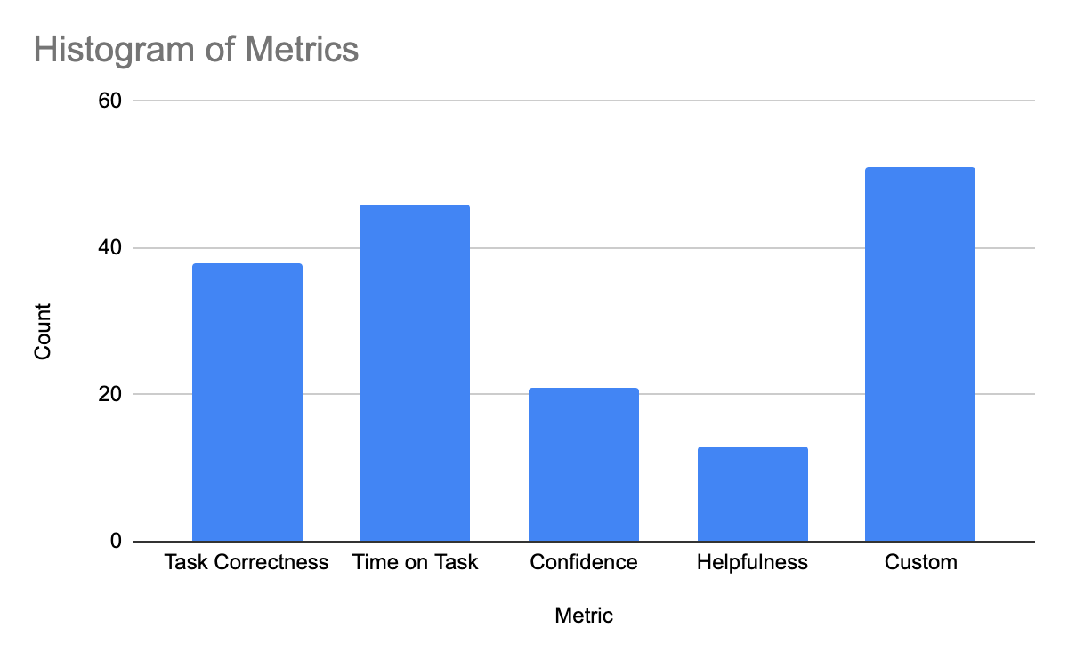
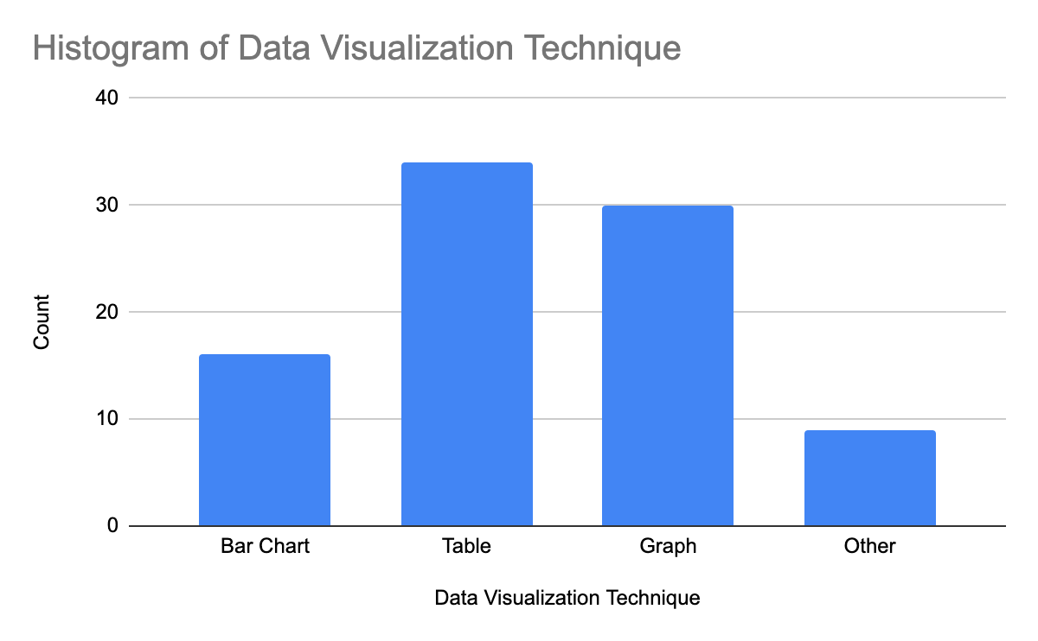
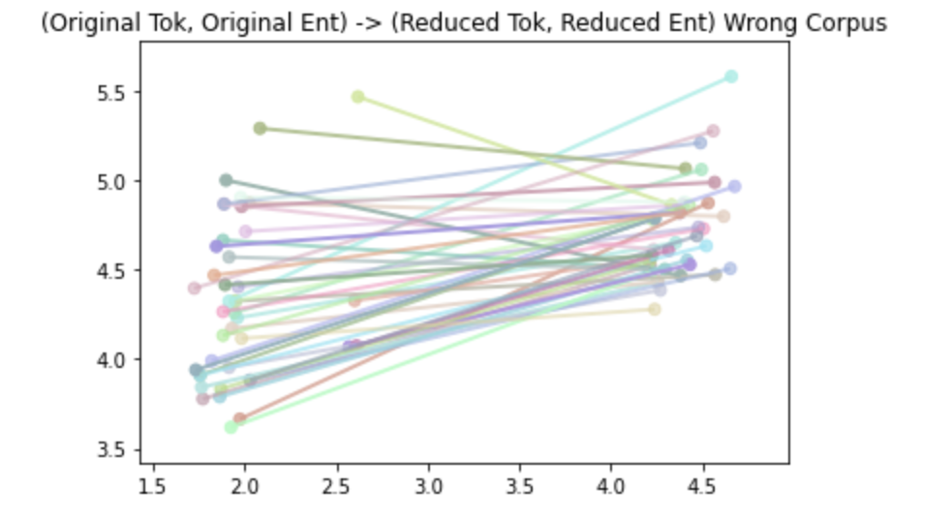
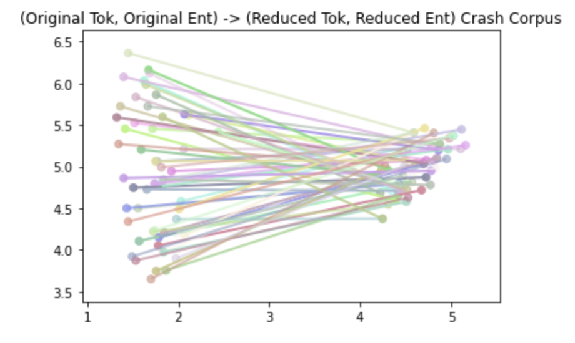
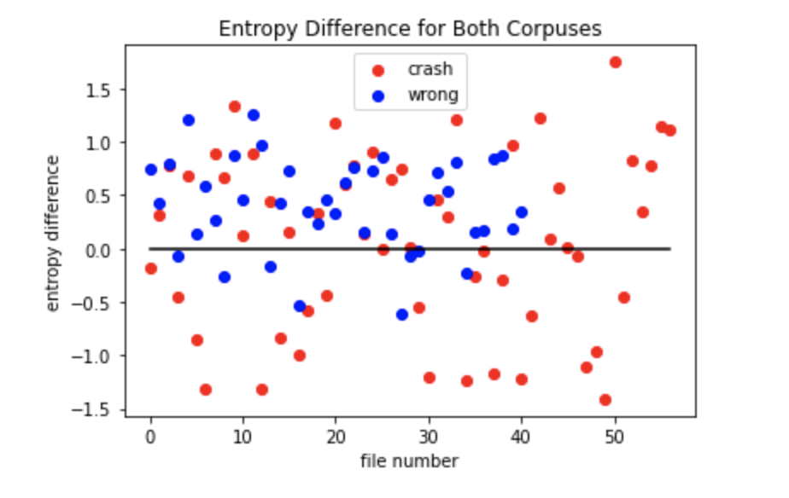
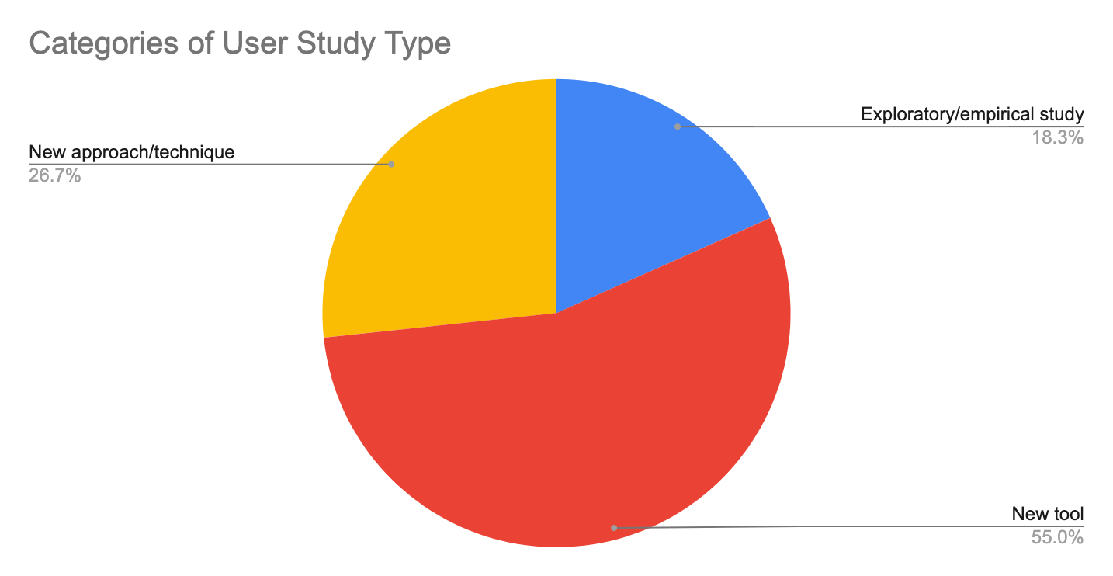
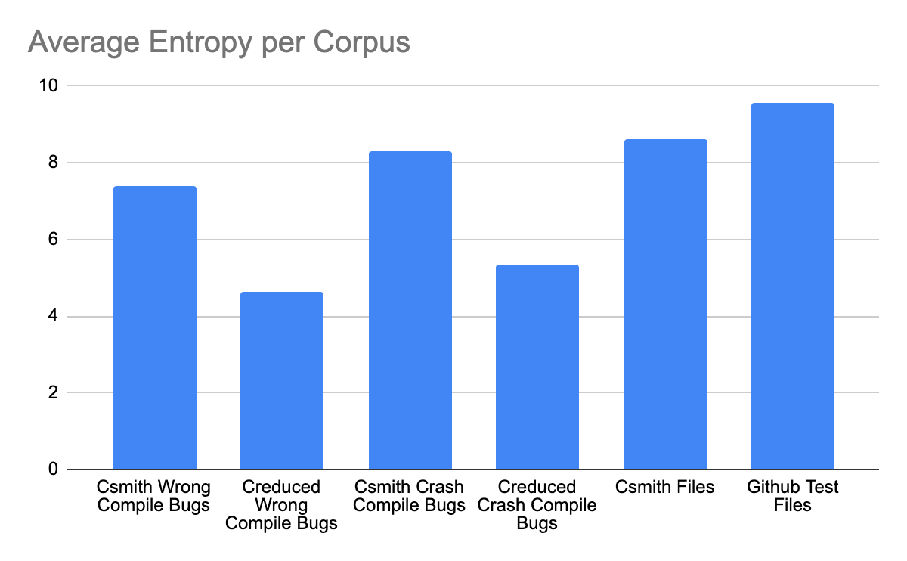
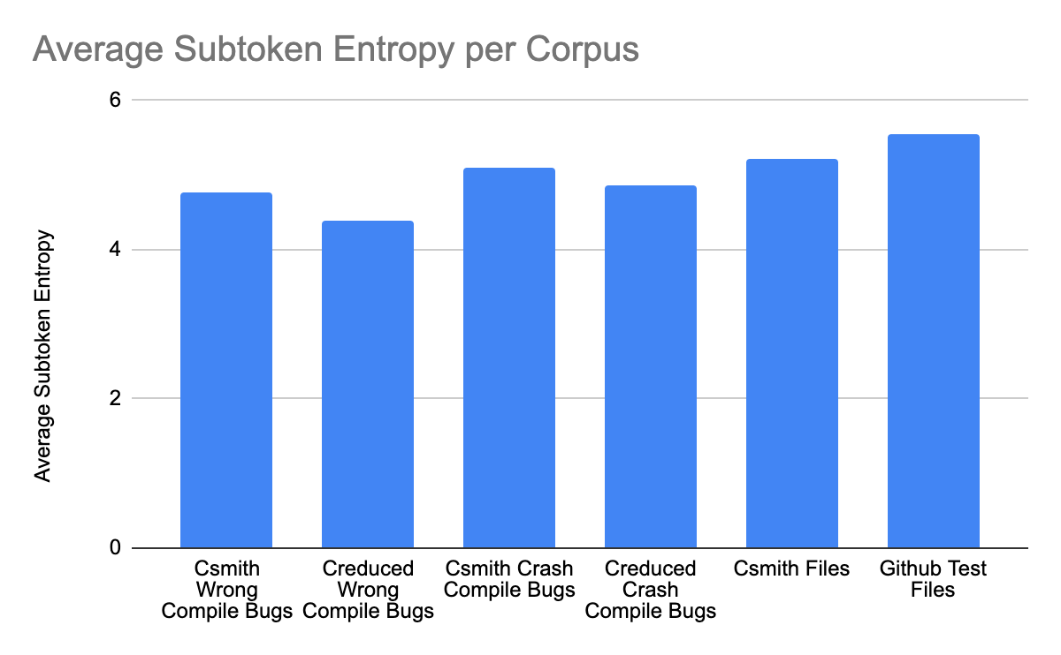
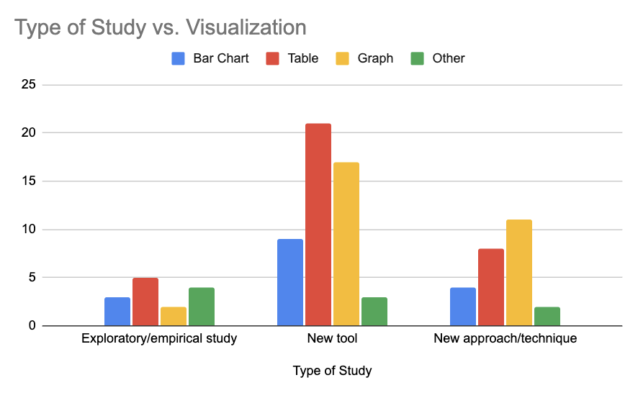
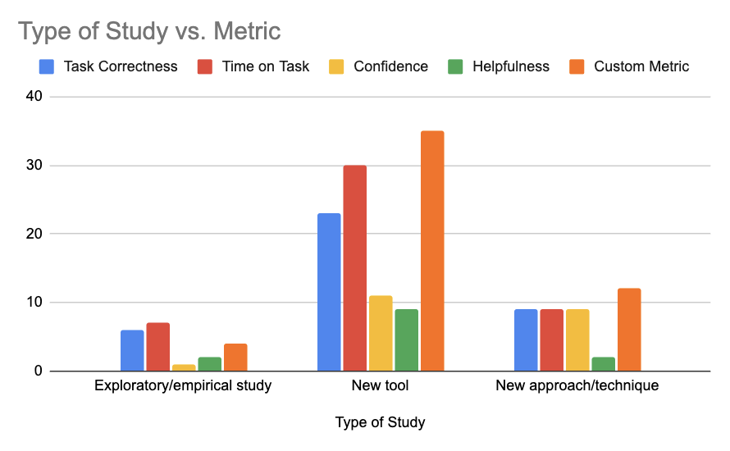
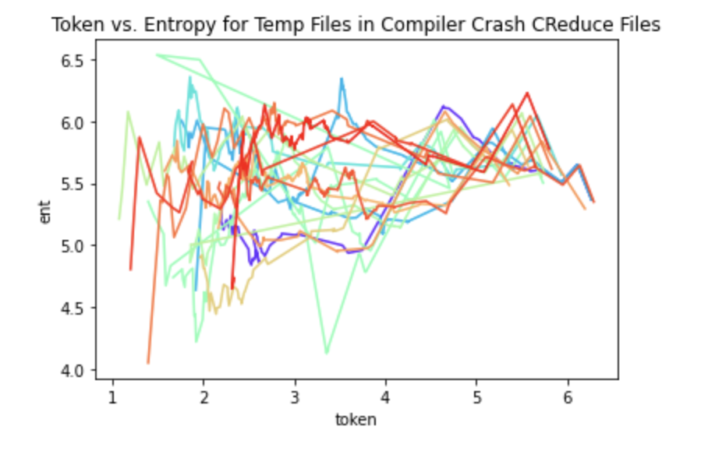
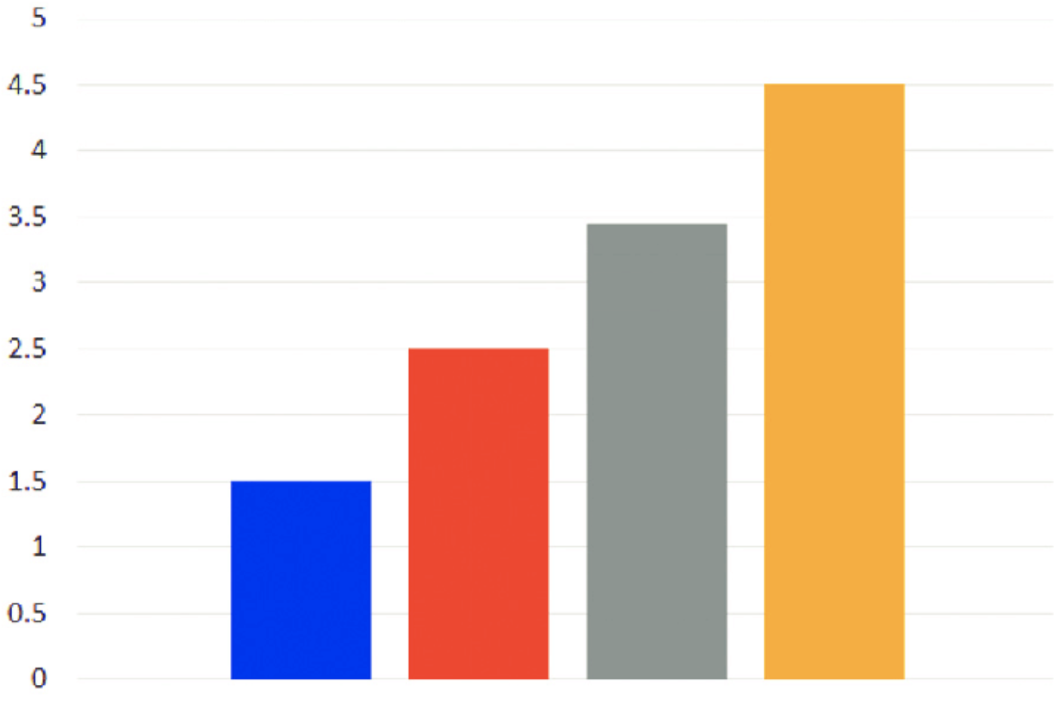



Visualizing User Studies in
Software Engineering
Empirical Study on the Entropy of Fuzz-Generated Tests
Hita Kambhamettu, Joshua Sunshine
Hita Kambhamettu, Tomi Oluwaseun-Apo, John Billos, Ben Gafford, Rohan Padhye, Vincent Hellendorn
Introduction
Results
Abstract
Results
User studies, a principal method of evaluation in software engineering, allow for researchers to test their findings with the intended users and result in more credible, realistic, and robust results. There are two categories to user studies, experiment building and data analysis/visualization.
We present an empirical study of the current state of software engineering user studies, particularly characterizing the means of data analysis and visualization to inform the construction of a data visualization tool for user studies
Automatic test generation allows for developers to discover complex bugs in their programs. Fuzzers have been a popular brute-force approach to testing software by generating millions supposedly random inputs at tools (primarily compilers) to discover bugs. But exactly how random are they?
We utilize a language model trained on human-written code and conduct the first empirical study exploring the predictability of automatically generated C compiler test cases and fuzzer found bugs, using the metric of average entropy​.
Research Questions
Research Questions
Are automatically generated programs less predictable than human written code?
Are fuzzer found C bugs highly predictable?
What happens to predictability as test case reduction tools are applied?
In SE user studies…
What are trends in data visualization techniques?
What metrics and data analyses are used?
Are there correlations between type of user study and visualization/analysis used?
CSmith Corpus
57 Compiler Crash Bugs
41 Wrong Bugs
Random, non-buggy code
Methodology
Methodology
SE User Study Corpus
16 New approach/technique
33 New tool
11 Empirical/Exploratory study
Fuzzers
Developer Proxy
Conclusion
Conclusion
Github Data
Transformer
Fuzzer generated code is more predictable than regular developers
Surprised? Us too!
The key lies in repetition: language models don’t seem to like human-written code
Contemporary fuzzers don’t explore “random” or “weird” code, and we should explore better metrics for understandability of resulting programs
Is this specific to CSmith or universal amongst fuzzers?
CReduce often reduces average entropy
Categorize Visualizations
Categorize Metrics
Correlation between Type of User Study and Visualizations and Metrics
There is enough uniformity in data visualization technique to warrant a tool in SE user studies
Because most studies use custom metrics, a tool that visualizes uploaded data is more viable than a tool that analyzes data automatically
Post-processing
Entropy Scores

