Slide 1
ivy output csv files and the ivy output csv file loader Excel tool
2016-03-30
Allart Ian Vogelesang ian.vogelesang@hds.com +1 408 396 6511

Slide 2
About this presentation
Prerequisite
"introduction to ivy" PowerPoint material.
Please go over this presentation to learn how to explore the ivy demo output.
The "programming ivy reference" presentation has full details and can actually be read standalone, but it's recommended to go through this presentation and review the demo video series first.

Slide 3
ivy engine control statements
The [hosts] statement specifies the test hosts (I/O driver hosts) to use, and the [select] clause in that statement is used to filter "all discovered LUNs" to arrive at "available test LUNs".
The [CreateWorkload] sets up I/O driver threads on test LUNs.
The [CreateRollup] statement sets up two-way structures used to centrally roll up detail data from test host workloads, and to send out I/O driver parameter updates to those workloads.
The [Go] statement runs a subinterval sequence.

Slide 4
[hosts] statement – configuration discovery
command line: ivy test2
Separate vendor-proprietary SCSI Inquiry tool outputs csv file decoding LUN attribute names & values
test2.ivyscript
testhost3
[hosts] "testhost1" to "testhost3"
testhost2
ivyslave executable
testhost1
master host
ivyslave executable
ivy executable
ivyslave executable
showluns.sh executable
csv column headings become selectable in ivy
Host,LUN,HDS Product,LDEV,PG testhost1,/dev/sdxy,VSP,00:00,1-1
testhost2,/dev/sdxy,VSP,00:01,1-2
testhost3,/dev/sdxy,VSP,00:02,1-3
Host,LUN,HDS Product,LDEV,PG testhost1,/dev/sdxy,VSP,00:00,1-1

Slide 5
"All discovered LUNS"
Host,LUN,HDS Product,LDEV,PG testhost1,/dev/sdxy,VSP,00:00,1-1
testhost2,/dev/sdxy,VSP,00:01,1-2
testhost3,/dev/sdxy,VSP,00:02,1-3
The "showluns.sh" csv files from all the test hosts are combined
Each data line is loaded into a "LUN" object where for each column in the csv file, we file the data value into the LUN under the attribute name taken from the corresponding header line column.
Later on, if we find out more information about this LUN, using a command device, we may fill in more attribute values.
KEY ivy CONCEPT: ivyscript [select] clauses operate on LUN attributes.

Slide 6
Available test LUNs
All discovered LUNs
Cmd dev ?
Command devices
Since "all discovered LUNs" contains every /dev/sdxx entry, including test host boot drives, for safety the [hosts] statement [select] clause must specify a value for at least one of serial_number or vendor.
[select] clauses for other ivyscript statements apply to "available test LUNs" and the default is to select all available test LUNs.
matches [hosts] statement [select] ?
Available test LUNs

Slide 7
Augmenting SCSI Inquiry data using cmd. dev.
For every Available Test LUN that is mapped to a Hitachi RAID subsystem LDEV for which we have a command device:
We augment the Available Test LUN SCSI Inquiry attributes with the RMLIB API attributes of the underlying LDEV
Enables things like [select] "drive_type = \"NFH1B-P3R2SS\""
Using the RMLIB API configuration data and using static tables of relationships for the specific subsystem model, we further augment the LUN with "indirect" attributes.
Tagging the LUN with the names of the associated subsystem configuration elements of different types enables us to filter real-time RMLIB API performance data by the workload LUNs which comprise a rollup instance.

Slide 8
Setting up test host workload threads
[hosts] statement
test host
[CreateWorkload] statement
[hosts] statement
OS
Workload
LUN
Workload
Workload
HBA
ivy master host
Workload
LUN
NIC
Workload
Workload
Each workload thread can issue multiple I/Os in parallel up to the specified maxTags workload parameter.
Each workload thread is attached to an available workload LUN
Ivyslave main thread
Workload
LUN
by-host subthread
Workload
Workload
HBA
Ivy main thread
by host subthread
NIC
Workload
LUN
Workload
Workload
test host
by host subthread
OS
Workload
LUN
Workload
Workload
HBA

Slide 9
The [go] statement launches a "test step"
[go] starts the workload threads running a series of "subintervals", typically each 5 seconds long.
At the end of each subinterval, data are rolled up to the ivy master host.
Test host workload data
Command device data, if a command device was discovered
The master host examines the data, optionally sends out real-time I/O generator updates to the workload threads, and then decides whether to continue for another subinterval or not.

Slide 10
For each subinterval within a test step …
You get a csv line in each csv file within the test step subfolder
Within the test step subfolder
There is a subfolder for each rollup with a csv file for each rollup instance.
For example, for a rollup by host, you might have csv files for testhost1, testhost2, and testhost3, in the host subfolder.
There is a subfolder for each subsystem we have a command device for, and within that there is a subfolder for each type of command device resource type for which we collect data.
E.g., a csv file for 00:00 in the LDEV folder in the 410034 subfolder.

Slide 11
Test step "success" vs. "failure"
A test step may run for a fixed number of "warmup_seconds" and "measure_seconds", in which case the test step is always a "success".
However, if "measure=on" is specified on the [Go] statement, warmup_seconds and measure_seconds specify minimum times. After that, ivy keeps running more subintervals until it has "seen enough" to make a statistically valid measurement to the required accuracy (success), or until timeout_seconds have been reached (failure).
If the test step is a "success", a summary csv result line is written describing the rollup over the measurement subintervals, otherwise an error message line is written to the summary csv files.
Note: Even if a statistically valid measurement was observed, the test step may still be marked a failure if other test configuration validity criteria are not met.

Slide 12
Success = warmup, measure, cooldown
warmup
measurement
cooldown
Subinterval 0
Subinterval 1
Subinterval 2
Subinterval 3
Subinterval 4
First measurement subinterval
Last measurement subinterval
For each test step, there is one "measurement" csv line in the "summary" csv files.
For each rollup, there is a "summary" subfolder in the root test output folder containing a csv file for each rollup instance.
The equivalent of the summary.html file in vdbench is the "all=all" csv file in the "all" rollup subfolder.
There is always an "all" rollup that has one instance "all" covering all workload threads.
With a command device, there are no measurement summary csv files for RMLIB API data like there are for by-subinterval RMLIB API data within a test step subfolder, but some RMLIB API data is filtered by rollup instance, and there are filtered RMLIB API columns within workload csv files.

Slide 13
Now we are ready to look at ivy output

Slide 14
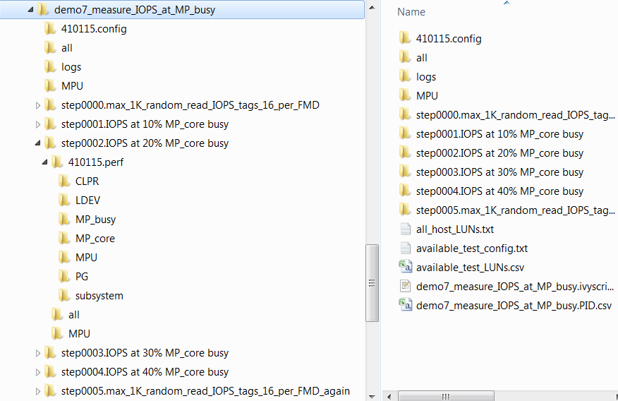
ivy output folder structure
The test output folder name is the ivyscript filename with ".ivyscript" removed.
This is also called the "test name", and can be retrieved using the testName() ivyscript library function.
This test folder is a subfolder of the [OutputFolderRoot] folder, which defaults to /scripts/ivy/ivyoutput.

Slide 15
Files in the test output folder itself
All discovered LUNs
Particularly with a command device, a concise summary of available test LUNS
Available test LUNs
A copy of the source .ivyscript program
A file to help visualize DFC=PID dynamic feedback control

Slide 16
Subfolders of the ivy test output folder
If a command device is discovered, a folder containing detailed set of command device configuration csv files is put here
This is a measurement summary csv folder for the "all" rollup with one summary line for each test step.
Each ivy process thread on both the master host and the test hosts has its own log file. Use the -log command line option to turn on logging of routine events.
This is a measurement summary csv folder for the "MPU" rollup with one csv file for each MPU containing a summary line for each test step.
There is a subfolder for each test step containing by-subinterval csv files

Slide 17
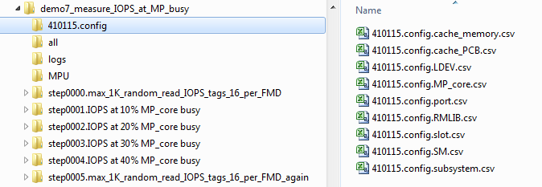
Ivy records the subsystem configuration
… if there is a command device present

Slide 18
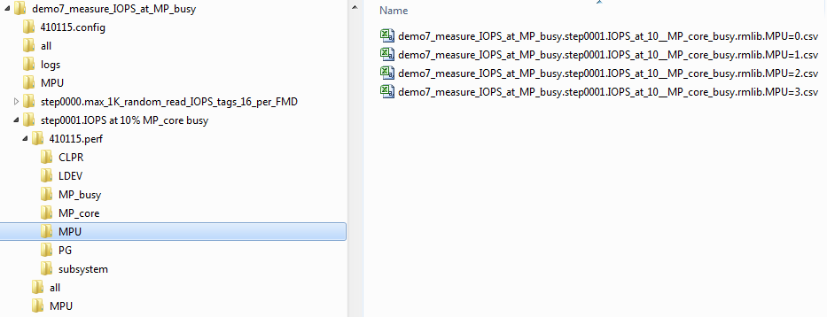
Ivy records subsystem performance data
With a command device, data for the entire subsystem is recorded synchronized with test step subintervals.

Slide 19
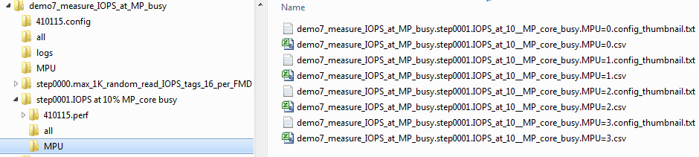
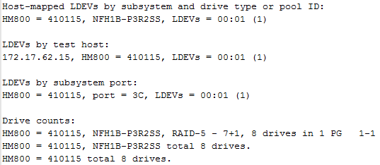
Config thumbnails for each rollup instance
(Drive counts only available with a command device)

Slide 20
There's a tool to automatically load ivy output csv files into an Excel spreadsheet

Slide 21
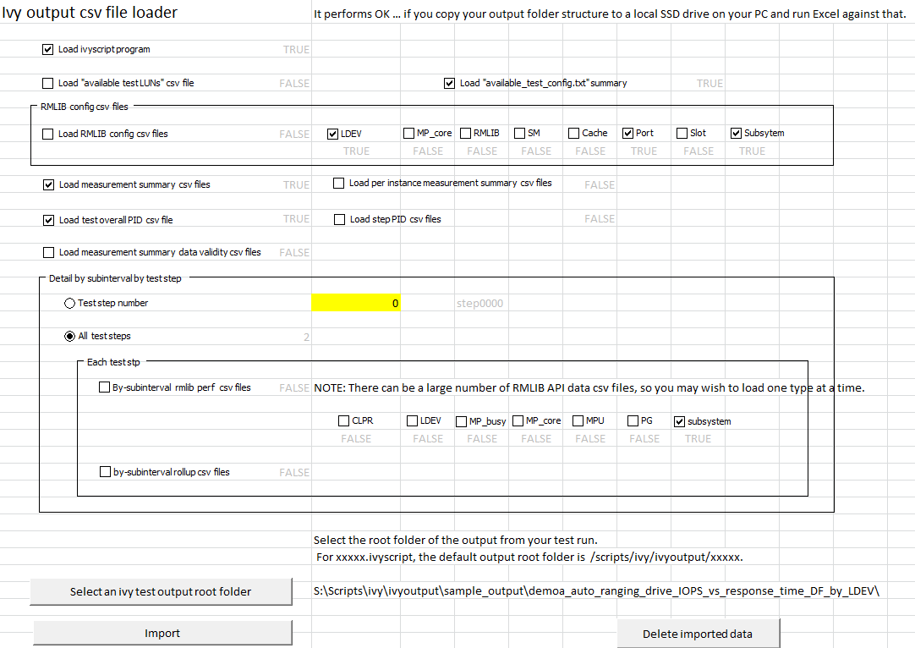
load_ivy_output.xlsm
Makes it easy to look at the data you want to see
Loads both .txt as well as .csv files.
Use this to explore the ivy demo output.

Slide 22
Questions and Discussion

Slide 23
Thank You

