Slide 1
ivy dedupe / compression support
Allart Ian Vogelesang ian.vogelesang@hds.com
2016-06-17

Slide 2
Review
testhost1
In ivy, you can layer multiple named “workload” I/O generator threads on LUNs
A "workload name" is unique on each host LUN.
[CreateWorkload] "owl" [select] "port" is { "1A", "2A" } [iogenerator] "random_steady" [parameters] "IOPS=max, fraction_read=\"50%\", blocksize = \"4KiB\" ";
This creates a workload thread called "owl" on each host LUN that is mapped to port 1A or port 2A.
Each workload thread uses an I/O sequencer plug-in that generates I/Os in scheduled I/O start time sequence.
OS
Workload
LUN
Workload
Workload
HBA
ivy master host
Workload
LUN
NIC
Workload
Workload
Ivyslave main thread
Workload
LUN
by-host subthread
Workload
Workload
HBA
Ivy main thread
by host subthread
NIC
Workload
LUN
Workload
Workload
testhost2
by host subthread
OS
[hosts] statement
Workload
LUN
Workload
Workload
[CreateWorkload] statement
HBA

Slide 3
.ivyscript dedupe syntax
[CreateWorkload] "owl" [select] "port" is "1A" [iogenerator] "random_steady" [parameters] "IOPS=max,fraction_read=\"50%\", blocksize = \"4KiB\" dedupe = 1.5 ";
The dedupe parameter (default dedupe = 1.0) controls the average number of copies of a generated pattern that is written across the set of workload threads each mapped to a LUN on a test host with the same workload name (e.g. "owl")
dedupe must set to a value greater than or equal to 1.0
It is an error if some workload threads are set to a different dedupe value than other workload threads with the same name.
The dedupe parameter is ignored for fraction_read = 100%.

Slide 4
.ivyscript compressibility syntax
[CreateWorkload] "owl" [select] "port" is "1A" [iogenerator] "random_steady" [parameters] "IOPS=max,fraction_read=\"50%\", blocksize = \"4KiB\" pattern = random ";
The pattern parameter selects a pattern generator to fill the contents of a block before it is written to the LUN.
The default is pattern = random.

Slide 5
.ivyscript pattern parameter
pattern = random
Random binary noise. Not compressible. This is the ivy default
pattern = trailing_zeros, compressibility = 50%
Each block has an incompressible section and a section with repeated zeros.
compressibility specifies the % of the block that is repeating zeros.
pattern = ascii
Random ascii characters. Fixed degree of compressibility
pattern = gobbledegook
Pseudo-English text generated by randomly selecting words from a dictionary.
Fixed degree of compressibility.
Using the first 32 Ki Words appearing in the 1913 public domain edition of Webster's dictionary.

Slide 6
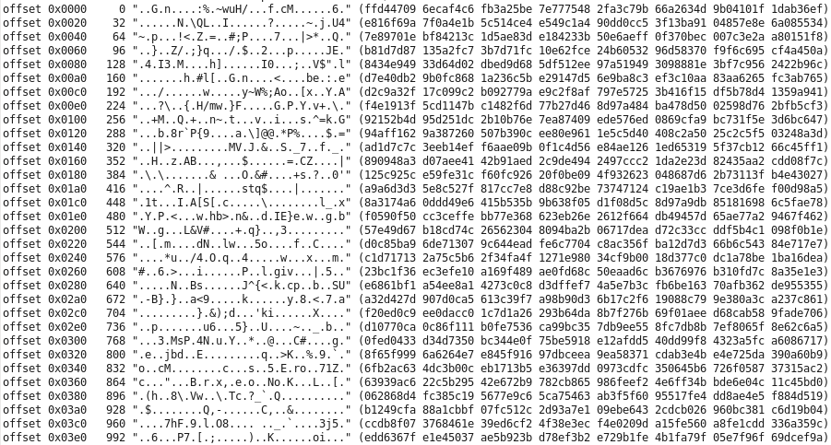
pattern=random
Random binary data
(incompressible)

Slide 7
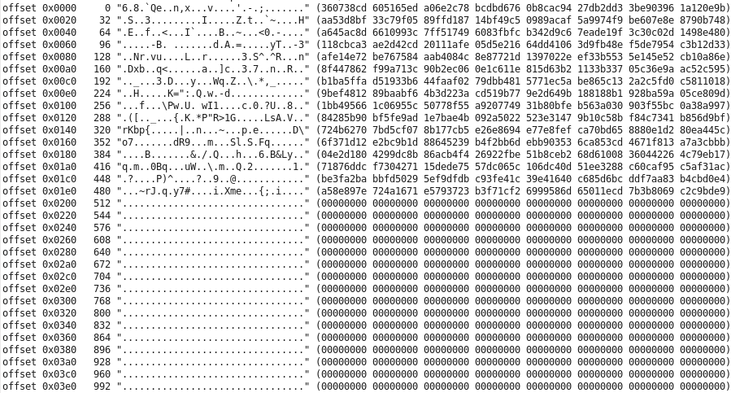
pattern=trailing_zeros,compressibility=50%
Leading part of block is random binary data
(incompressible)
compressibility = 50% means 50% trailing binary zeros

Slide 8
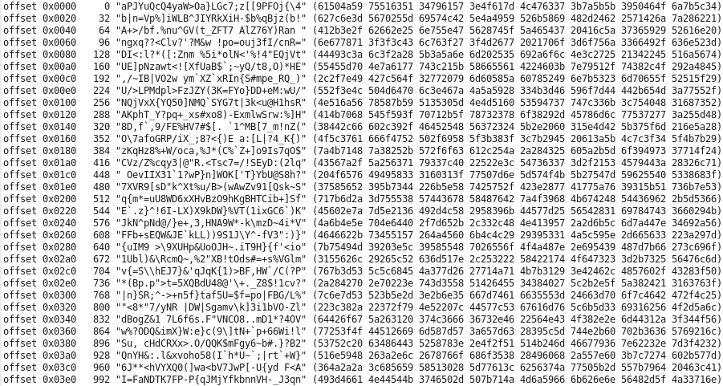
pattern=ascii
Randomly selected printable ASCII characters
(fixed degree of compressibility)

Slide 9
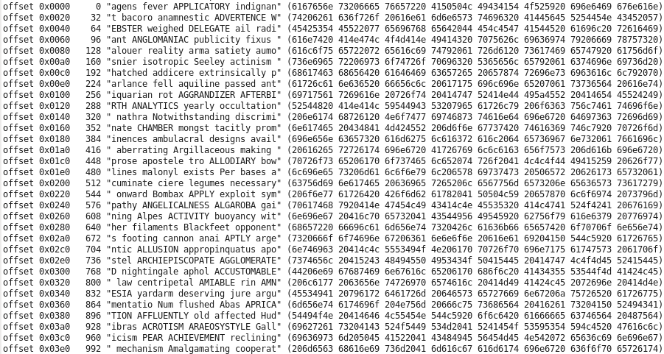
pattern=gobbledegook
Randomly selected words from Webster's 1913 dictionary.
(fixed degree of compressibility)

Slide 10
dedupe mechanism

Slide 11
Goal for ivy dedupe design
Enable selection of dedupe "scope" to one LUN, across multiple LUNs, across test hosts, or across an entire subsystem.
The "scope" means the extent across which multiple copies of the same pattern are written.
Use a method which is "self-contained" within a workload thread
No interlock, no communication between workload threads / test hosts.
Enable layering of multiple workloads, each with different characteristics including dedupe blocksize and/or compressibility characteristics.

Slide 12
Method
A deterministic method is used to generate a sequence of I/O patterns
Deterministic means that given the same initial parameters, the same sequence of patterns is generated.
"pattern" means the data written in a block.
Even though a deterministic method, given the same input parameters, will produce the same sequence of data patterns written, by using "pseudo-random" number generators we can generate unique and apparently random patterns.
The scope of dedupe pattern generation is across the group of workload thread instances of the same "workload name".

Slide 13
Scope of dedupe is across a "workload name"
Workload name is "owl" for all 4 workload threads.
The "workload thread ID" is hostname + LUN name + workload name
Host "blade1"
Host "blade2"
"owl"
"owl"
"owl"
"owl"
Workload
Workload
Workload
Workload
LUN
LUN
LUN
LUN
/dev/sdx
HBA
/dev/sdy
/dev/sdx
HBA
/dev/sdy
workload ID =>
blade1+/dev/sdx+owl
blade1+/dev/sdy+owl
blade2+/dev/sdx+owl
blade2+/dev/sdy+owl
thread # within workload name "owl"
1 of 4
2 of 4
3 of 4
4 of 4
A "serpentine sequence" is the key to the ivy dedupe pattern generation concept
< thread #1, I/O #1 > (Serpentine # 1)
< thread #2, I/O #1 > (Serpentine # 2)
< thread #3, I/O #1 > (Serpentine # 3)
< thread #4, I/O #1 > (Serpentine # 4)
< thread #1, I/O #2 > (Serpentine # 5)
< thread #2, I/O #2 > (Serpentine # 6)
< thread #3, I/O #2 > (Serpentine # 7)
< thread #4, I/O #2 > (Serpentine # 8)
< thread #1, I/O #3 > (Serpentine # 9)
< thread #2, I/O #3 > (Serpentine # 10)
< thread #3, I/O #3 > (Serpentine # 11)
< thread #4, I/O #3 > (Serpentine # 12)

Slide 14
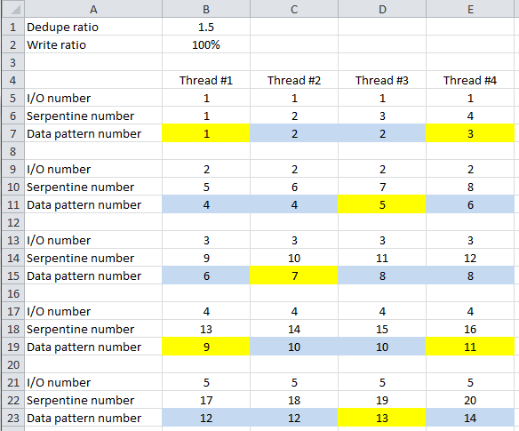
Example for 100% writes, dedupe_factor = 1.5
Formula for data pattern number:
round up to next higher integer (serpentine number * write ratio / dedupe ratio)
round up to next higher integer (serpentine number * 100% / 1.5)
Note that each data pattern is written on average 1.5 times

Slide 15
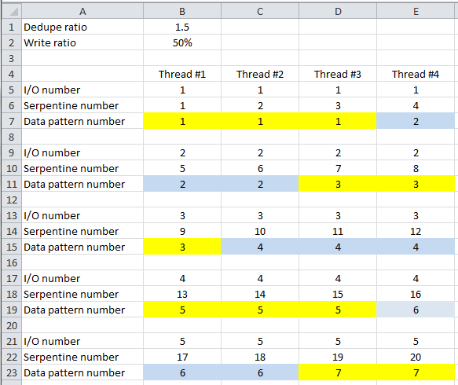
Example for 50% writes, dedupe_factor = 1.5
Formula for data pattern number:
round up to next higher integer (serpentine number * write ratio / dedupe ratio)
round up to next higher integer (serpentine number * 50% / 1.5)
With 50% writes, we still compute a pattern number for each I/O, whether it is a read or whether it is a write.
Note that for 50% writes, each data pattern now occurs 3 times.
This is deterministic
(For 50% writes, a random number between 0.0 and 1.0 is selected for each I/O, and if the number is below 0.5, the I/O will be a write.)
On average, 50% of the patterns shown on the left will be written, so we will write on average 1.5 copies of each pattern

Slide 16
Simple arithmetic to calculate pattern number
For the first I/O, the serpentine number for a workload thread is the number of the thread within the group of threads with the same workload name
Thread #2 of 4 threads starts with serpentine number 2.
For each successive I/O, the serpentine number is incremented by the number of threads with the same name.
For each I/O, the I/O pattern number is calculated from the serpentine number
round up to next higher integer (serpentine number * write ratio / dedupe ratio)

Slide 17
Starting "pattern seed" sent by ivy master
For each workload name with a dedupe setting greater than 1.0
The ivy master thread comes up with a 64-bit unsigned starting "pattern seed" value that gets sent out to all threads with the same workload name.
Along with sending out the pattern seed value that is common to all threads with the same workload name, each thread individually is told you are workload "x" of total "y" threads in a dedupe group.
This lets each thread calculate the pattern number for each of that thread's I/Os according to the serpentine method.
If dedupe = 1.0, each individual workload thread is given a unique starting "pattern seed" and is told it is "1" of "1" in the dedupe group

Slide 18
"pattern seed" sequence
The I/O sequencer calculates the pattern number from the serpentine number.
The pattern number may increment multiple times from one I/O to the next, or the pattern number may stay the same from one I/O to the next, depending on the dedupe parameter value and the number of threads with the same workload name.
Each time the pattern number increments, the next 64-bit "pattern seed" is generated using a simple non-cryptographic quality pseudo-random generator
"xorshift64star" - see https://en.wikipedia.org/wiki/Xorshift.

Slide 19
"block seed" derived from "pattern seed"
In order that a unique but deterministic sequence of pseudo-random numbers is used to generate the contents of each block, a "block seed" is derived from the "pattern seed" by XORing the "pattern seed" with the 64-bit pattern number.
This derived value is the seed for the sequence of numbers used to generate the contents of a block.
This makes sure that the contents of any one block are not just shifted by one pseudo-random number compared to the contents of the block for the previous pattern number.

Slide 20
Implications of selecting this design
Works for either random or sequential I/O generators
Sequential I/O sequences are either all reads, or all writes
Multiple instances of a particular data pattern are written at roughly the same time.
With dedupe=3 and writes to random locations, there will be 3 copies of the most recently-written data.
Over time, like the math for radioactive decay, any one older block will have an increasing probability of having been over-written with a newer value.
The older the data, the fewer the copies that will remain.
A long-term "steady state" random dedupe will stabilize on fewer copies than the dedupe parameter value. (Haven't done the math on a long term correction factor.)

Slide 21
Compressibility of data patterns

Slide 22
Compressibility is a "difficult" subject
ivy offers several simplistic workload patterns to exercise storage compression features.
It is relatively easy to generate a pattern that compresses a pre-defined amount
Real life workloads may be more complex
Longer term, some advanced methods may be needed to not only to generate patterns that compress to a specified amount, but to also required the same amount of CPU resource to perform the compression.

Slide 23
Questions and Discussion

