Slide 1



Core Java Inheritance and Polymorphism
Project
Team Members
Hemant Singh Dodiya
Hitanshi Upadhyay
Vishal Malviya

Slide 2

Overview
Project on inheritance and polymorphism in Java.
Explanation of basic inheritance principles.
Illustration of polymorphism with practical examples.
Creation of a class hierarchy:
Base class: Person
Derived class: Employee
Further specializations: Manager, Programmer, etc.

Slide 3



Technology Used
Development Tools:
Eclipse IDE: For coding and debugging.
Figma: For designing the class diagrams and planning UI/UX (if applicable).
PowerPoint: For creating this presentation.

Slide 4
Content
Understanding Inheritance
Exploring Polymorphism
Applying Inheritance and Polymorphism

Slide 5
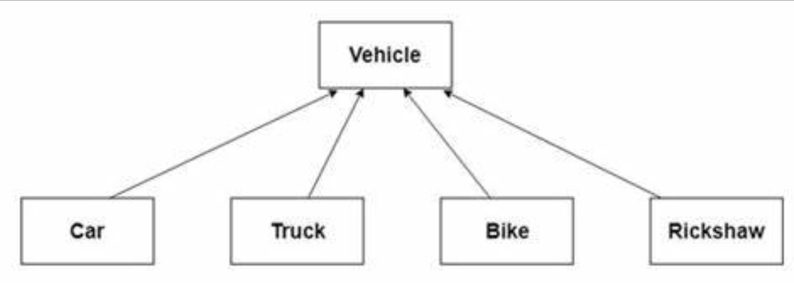
Inheritance ( Is – a relation )
The concept allows us to inherit or acquire the properties of an existing class (Super class) into a newly created class (Sub class). It is known as inheritance. It provides code reusability.

Slide 6
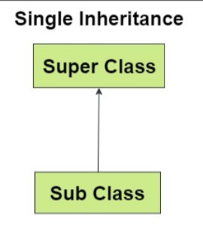
Types of Inheritance Single Inheritance
In single inheritance, a sub-class is derived from only one super class. It inherits the properties and behavior of a single-parent class. Sometimes it is also known as simple inheritance.

Slide 7
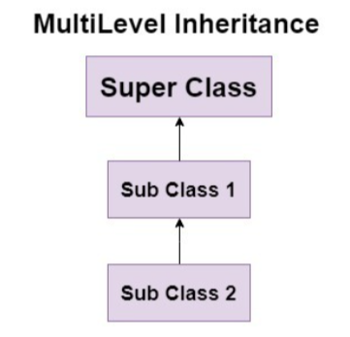
Multi-level Inheritance
In multi-level inheritance, a class is derived from a class which is also derived from another class is called multi-level inheritance . For example, ClassC inherits from ClassB, which in turn inherits from ClassA.

Slide 8
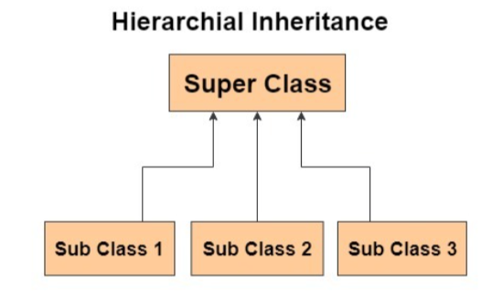
Hierarchical Inheritance
Multiple classes inherit from a single superclass. For instance, ClassB and ClassC both inherit from ClassA , in simple words we can say that one parent (superclass) have multiple child(subclass).

Slide 9
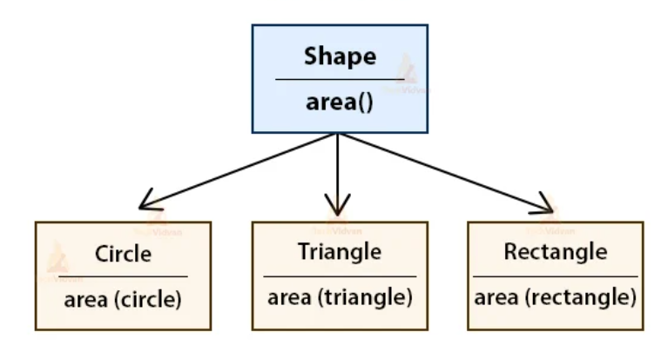
Polymorphism
Polymorphism in Java is a concept by which we can perform a single action in different ways. The word "poly" means many and "morphs" means forms. So polymorphism means many forms.

Slide 10
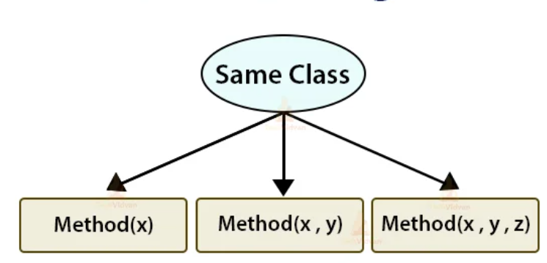
Compile-time Polymorphism (Method Overloading) :
This occurs when multiple methods have the same name but differ in parameters (number, type, or both). It allows different ways to perform a similar operation within the same class.

Slide 11
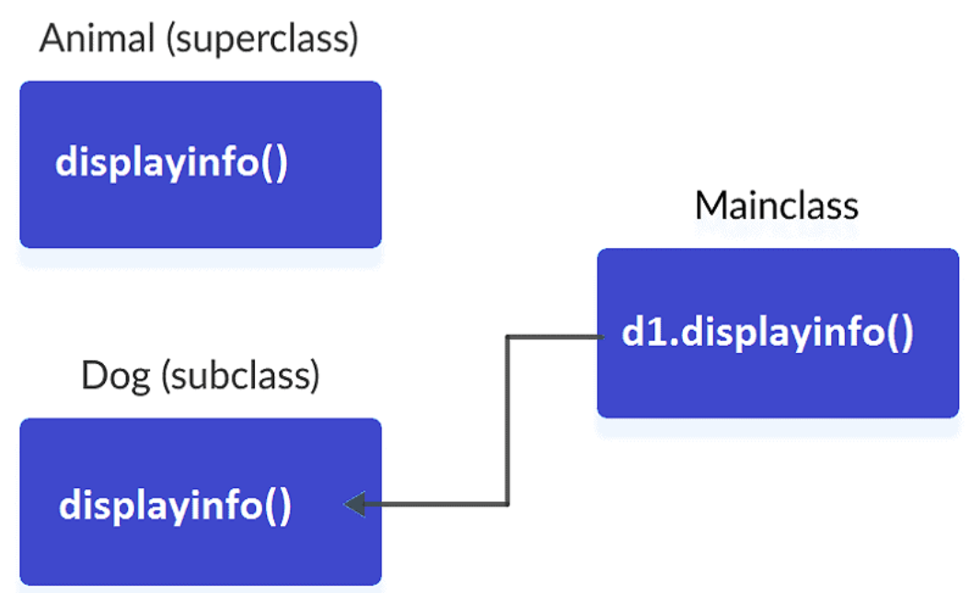
Runtime Polymorphism (Method Overriding):
This happens when a subclass provides a specific implementation of a method already defined in its superclass. It is called Method Overriding .

Slide 12
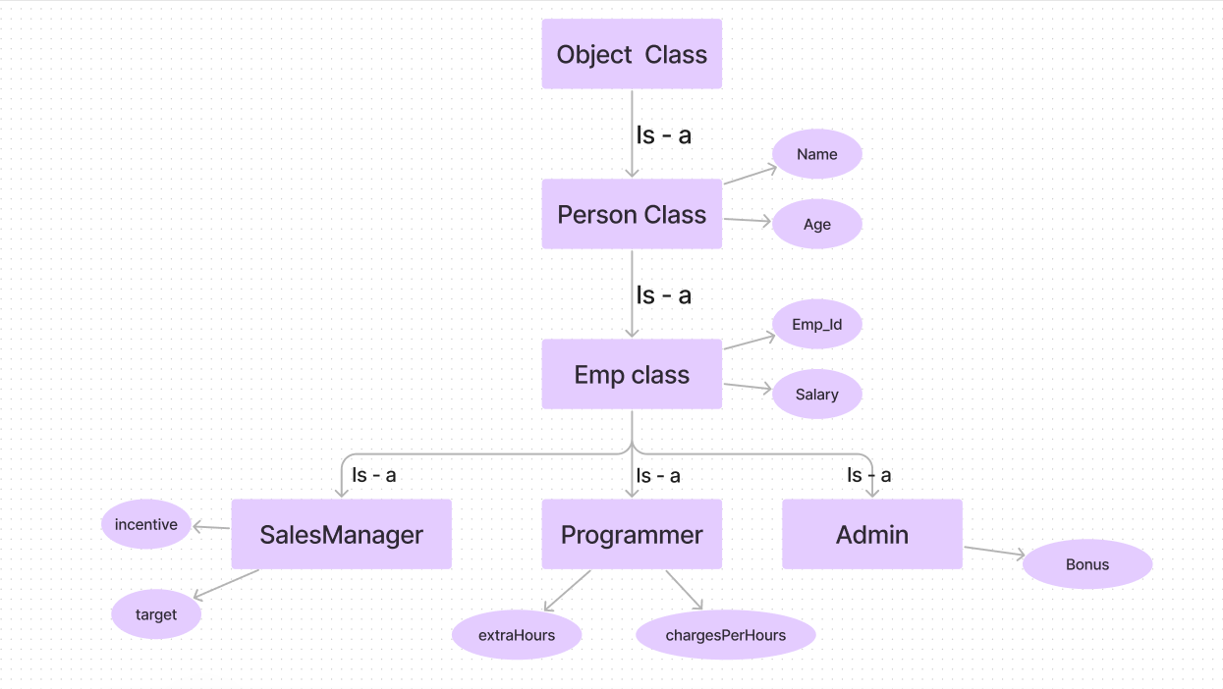
Overview of class hierarchy

Slide 13
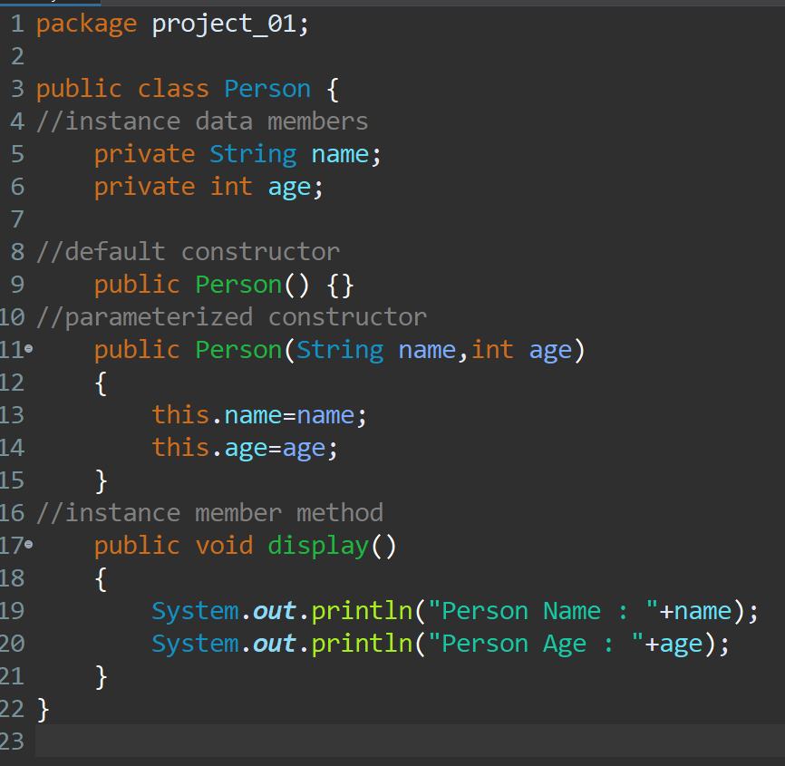

Slide 14
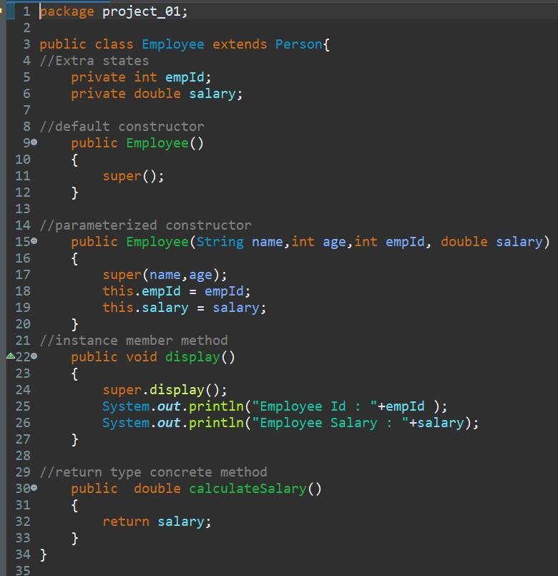

Slide 15
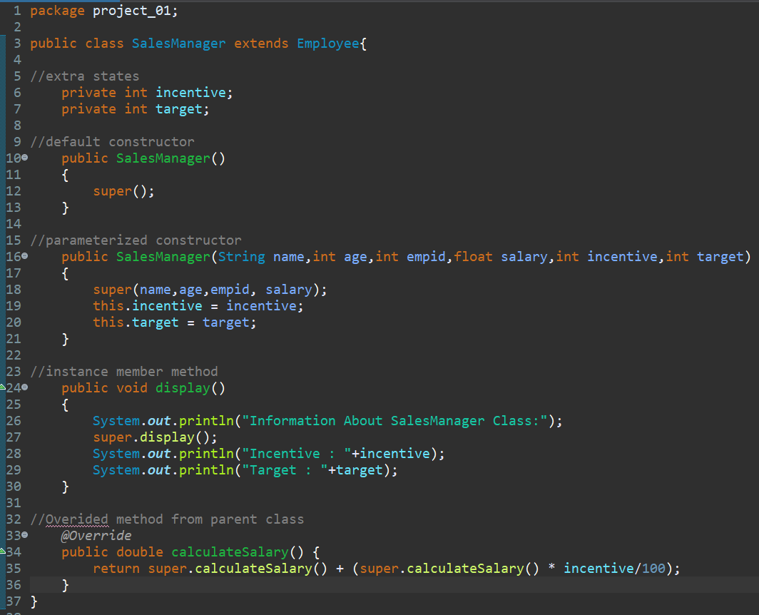

Slide 16
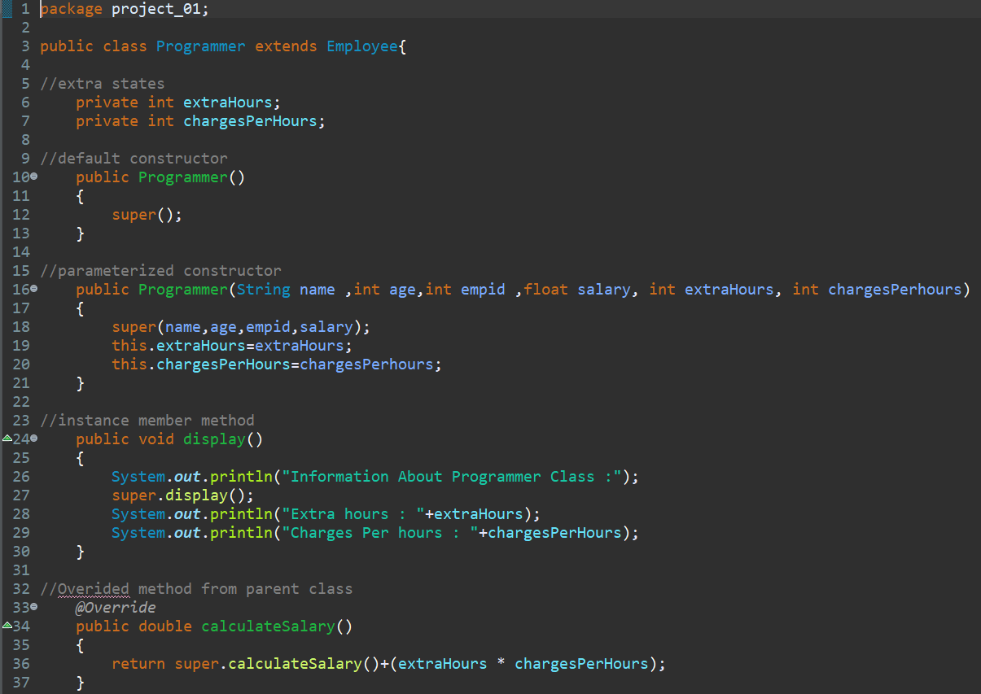

Slide 17
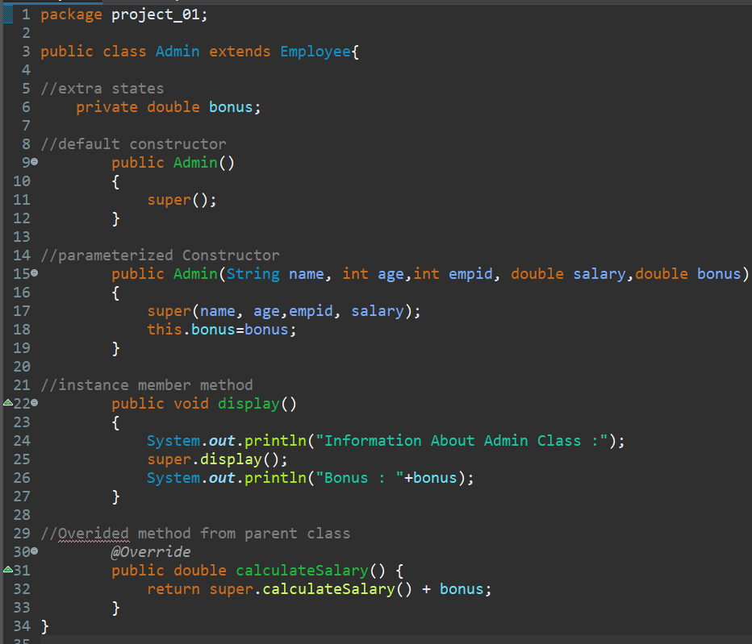

Slide 18
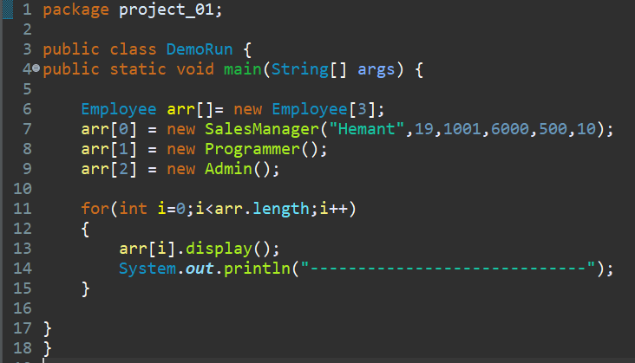

Slide 19
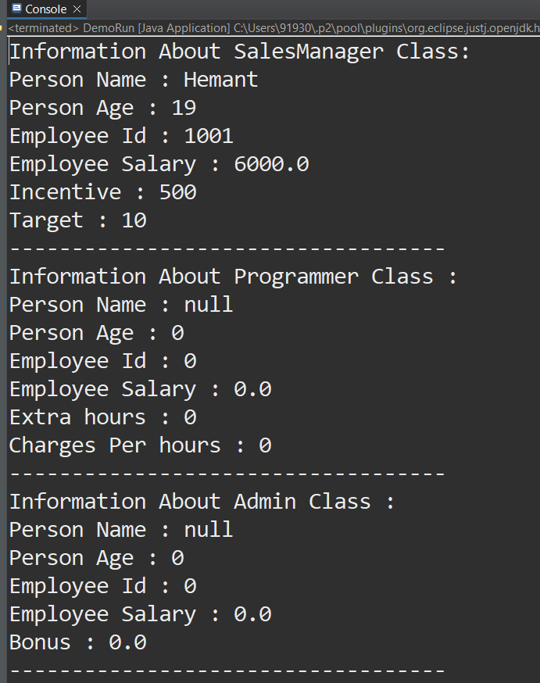
Final Output

Slide 20

hh

