Slide 1
Minimum Spanning Tree
Krushkal

Slide 2
Minimum Spanning Trees
Problem: Connect a set of nodes by a network of minimal total length
Some applications:
  Communication networks
  Circuit design
  Layout of highway systems

Slide 3
Formal Definition of MST
Given a connected, undirected, graph G = (V, E), a spanning tree is an acyclic subset of edges T⊆ E that connects all the vertices together.
Assuming G is weighted, we define the cost of a spanning tree T to be the sum of edge weights in the spanning tree
w(T) = ∑_{(u,v)∈T} w(u,v)
A minimum spanning tree (MST) is a spanning tree of minimum weight.

Slide 4
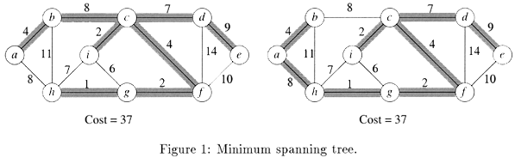
Figure1 : Examples of MST
Not only do the edges sum to the same value, but the same set of edge weights appear in the two MSTs. NOTE: An MST may not be unique.

Slide 5
Generic Approaches
Two greedy algorithms for computing MSTs:
  Kruskal’s Algorithm (similar to connected component)
  Prim’s Algorithm (similar to Dijkstra’s Algorithm)

Slide 6
Facts about (Free) Trees
A tree with n vertices has exactly n-1 edges
(|E| = |V| - 1)
There exists a unique path between any two vertices of a tree
Adding any edge to a tree creates a unique cycle; breaking any edge on this cycle restores a tree
For details see CLRS Appendix B.5.1

Slide 7
Intuition Behind Greedy MST
We maintain a subset of edges A, which will initially be empty, and we will add edges one at a time, until equals the MST.
We say that a subset A⊆ E is viable if A is a subset of edges in some MST. We say that an edge (u,v) ∈ E-A is safe if A∪{(u,v)} is viable.
Basically, the choice (u,v) is a safe choice to add so that A can still be extended to form an MST.
Note that if A is viable it cannot contain a cycle. A generic greedy algorithm operates by repeatedly adding any safe edge to the current spanning tree.

Slide 8
Generic-MST (G, w)
1. A ← ∅ // A trivially satisfies invariant
// lines 2-4 maintain the invariant
2. while A does not form a spanning tree
3. do find an edge (u,v) that is safe for A
4. A ← A ∪ {(u,v)}
5. return A // A is now a MST

Slide 9
Definitions
A cut (S, V-S) is just a partition of the vertices into 2 disjoint subsets. An edge (u, v) crosses the cut if one endpoint is in S and the other is in V-S. Given a subset of edges A, we say that a cut respects A if no edge in A crosses the cut.
An edge of E is a light edge crossing a cut, if among all edges crossing the cut, it has the minimum weight (the light edge may not be unique if there are duplicate edge weights).

Slide 10
When is an Edge Safe?
If we have computed a partial MST, and we wish to know which edges can be added that do NOT induce a cycle in the current MST, any edge that crosses a respecting cut is a possible candidate.
Intuition says that since all edges crossing a respecting cut do not induce a cycle, then the lightest edge crossing a cut is a natural choice.

Slide 11
MST Lemma
Let G = (V, E) be a connected, undirected graph with real-value weights on the edges. Let A be a viable subset of E (i.e. a subset of some MST), let (S, V-S) be any cut that respects A, and let (u,v) be a light edge crossing this cut. Then, the edge is safe for A.

Slide 12
Proof of MST Lemma
Must show that A ∪ {(u,v)} is a subset of some MST
Method:
  Find arbitrary MST T containing A
  Use a cut-and-paste technique to find another MST T’ that contains A ∪ {(u,v)}
This cut-and-paste idea is an important proof technique

Slide 13
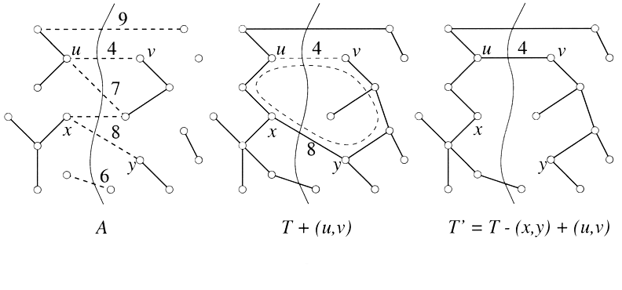
Figure
Figure 3: MST Lemma

Slide 14
Step 1
Let T be any MST for G containing A.
  We know such a tree exists because A is viable.
If (u, v) is in T then we are done.

Slide 15
Constructing T’
If (u, v) is not in T, then add it to T, thus creating a cycle. Since u and v are on opposite sides of the cut, and since any cycle must cross the cut an even number of times, there must be at least one other edge (x, y) in T that crosses the cut.
The edge (x, y) is not in A (because the cut respects A). By removing (x,y) we restore a spanning tree, T’.
Now must show
  T’ is a minimum spanning tree
  A ∪ {(u,v)} is a subset of T’

Slide 16
Conclusion of Proof
T’ is an MST: We have
w(T’) = w(T) - w(x,y) + w(u,v)
Since (u,v) is a light edge crossing the cut, we have w(u,v) ≤ w(x,y). Thus w(T’) ≤ w(T). So T’ is also a minimum spanning tree.
A ∪ {(u,v)} ⊆ T’: Remember that (x, y) is not in A. Thus A ⊆ T - {(x, y)}, and thus
A ∪ {(u,v)} ⊆ T - {(x, y)} ∪ {(u,v)} = T’

Slide 17
MST Lemma: Reprise
Let G = (V, E) be a connected, undirected graph with real-value weights on the edges. Let A be a viable subset of E (i.e. a subset of some MST), let (S, V-S) be any cut that respects A, and let (u,v) be a light edge crossing this cut. Then, the edge is safe for A.
Point of Lemma: Greedy strategy works!

Slide 18
Basics of Kruskal’s Algorithm
Attempts to add edges to A in increasing order of weight (lightest edge first)
  If the next edge does not induce a cycle among the current set of edges, then it is added to A.
  If it does, then this edge is passed over, and we consider the next edge in order.
  As this algorithm runs, the edges of A will induce a forest on the vertices and the trees of this forest are merged together until we have a single tree containing all vertices.

Slide 19
Detecting a Cycle
We can perform a DFS on subgraph induced by the edges of A, but this takes too much time.
Use “disjoint set UNION-FIND” data structure. This data structure supports 3 operations:
  Create-Set(u): create a set containing u.
  Find-Set(u): Find the set that contains u.
  Union(u, v): Merge the sets containing u and v.
Each can be performed in O(lg n) time.
The vertices of the graph will be elements to be stored in the sets; the sets will be vertices in each tree of A (stored as a simple list of edges).

Slide 20
MST-Kruskal(G, w)
1. A ← ∅ // initially A is empty
2. for each vertex v ∈ V[G] // line 2-3 takes O(V) time
3. do Create-Set(v) // create set for each vertex
4. sort the edges of E by nondecreasing weight w
5. for each edge (u,v) ∈ E, in order by nondecreasing weight
6. do if Find-Set(u) ≠ Find-Set(v) // u&v on different trees
7. then A ← A ∪ {(u,v)}
8. Union(u,v)
9. return A
Total running time is O(E lg E).

Slide 21
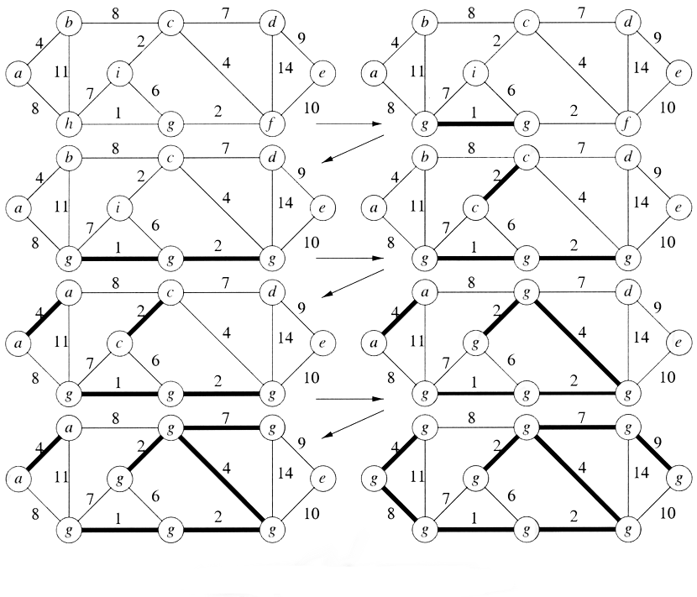
Example: Kruskal’s Algorithm
Figure 4: Kruskal’s Algorithm

Slide 22
Analysis of Kruskal
Lines 1-3 (initialization): O(V)
Line 4 (sorting): O(E lg E)
Lines 6-8 (set-operation): O(E log E)
Total: O(E log E)

Slide 23
Correctness
Consider the edge (u, v) that the algorithm seeks to add next, and suppose that this edge does not induce a cycle in A. Let A’ denote the tree of the forest A that contains vertex u. Consider the cut (A’, V-A’). Every edge crossing the cut is not in A, and so this cut respects A, and (u, v) is the light edge across the cut (because any lighter edge would have been considered earlier by the algorithm). Thus, by the MST Lemma, (u,v) is safe.

