Slide 1
AlgoTrading-24
Trading Strategy for ETH/USDT Market
Date: 14 June 2024
Hitarth Jain (21116044)
B.Tech. ECE 3rd Year
Department of Electronics and Communication
IIT Roorkee

Slide 2
Agenda
Introduction
Strategy Overview
Rationale
Backtesting Results
Risk Management
Conclusion

Slide 3
Introduction
Brief overview of ETH/USDT market
High Liquidity: Facilitates quick trades with minimal slippage.
Volatility: Presents both high-risk and high-reward opportunities
Importance of having a structured trading strategy
Helps in minimizing losses and protecting capital.
Structured strategies can be adjusted based on market analysis and trends
Objectives of the strategy
Utilize market opportunities to achieve the highest possible returns
Implement risk management techniques to protect investments.

Slide 4
Strategy Overview
Objective: To capture potential trends in the market using moving average crossovers while incorporating the Relative Strength Index (RSI) for additional confirmation and risk management.
Components:
Moving Averages (SMA):
Utilizes two Simple Moving Averages (SMAs) with periods of 140 and 150 to identify long-term trends.
Signals a potential trend reversal when the shorter SMA crosses above or below the longer SMA.
Relative Strength Index (RSI):
Incorporates RSI with a period of 150 to assess the momentum of price movements.
RSI values below 20 indicate oversold conditions, suggesting a potential buying opportunity.
RSI values above 70 indicate overbought conditions, signaling a potential selling opportunity.

Slide 5
Strategy Overview(continued)
Trading Rules:
Buy Signal: Initiates a buy order when the shorter SMA crosses above the longer SMA and the RSI is below 20, indicating oversold conditions.
Sell Signal: Initiates a sell order when the shorter SMA crosses below the longer SMA and the RSI is above 70, indicating overbought conditions.
Risk Management:
Helps manage risk by incorporating RSI levels to avoid entering trades during extreme market conditions.
Positions are entered and exited based on the intersection of moving averages, providing clear entry and exit points.
This strategy aims to capitalize on potential trends in the market while incorporating risk management techniques to protect capital and enhance overall performance.

Slide 6
Rationale
Trend Identification:
Using SMAs to identify the direction of the trend
Short-term SMA reacts faster to price changes, while long-term SMA provides a stable trend direction
Momentum Confirmation:
RSI helps in confirming the strength of the trend
Combining trend and momentum provides a robust entry signal
ETH/USDT Specifics:
ETH/USDT market is highly volatile, making it suitable for trend-following strategies
SMA crossover can capture significant price movements in such a market

Slide 7
Backtesting Setup
1. Data Selection:
Historical market data for Ethereum (ETH) obtained from Yahoo Finance.
Time frame: January 1, 2021, to December 31, 2023.
2. Trading Strategy:
Implemented a moving average crossover strategy combined with RSI (Relative Strength Index) indicator.
Parameters:
Short-term SMA (Simple Moving Average): 140 periods
Long-term SMA: 150 periods
RSI: 150 periods
3. Data Processing:
Close price used for analysis.

Slide 8
Backtesting Setup(continued)
4. Backtesting Platform:
Backtrader library used for backtesting the trading strategy.
Python-based framework for evaluating trading ideas using historical data.
5. Simulation Settings:
Initial capital: $100,000.
Transaction commission: 0.1% per trade.
Exclusive orders enabled to prevent simultaneous buy and sell actions.
6. Performance Metrics:
Key performance metrics assessed include:
Cumulative returns
Maximum drawdown
Sharpe ratio
Profit factor

Slide 9
Backtesting Results
Performance Metrics:
Total Return: 108.8%
Annualized Return: 27.8%
Maximum Drawdown: -44.3%
Sharpe Ratio: 0.45
Trade Analysis:
Number of trades: 6
Average profit per trade: 13.13%
Win Rate: 66.6%

Slide 10
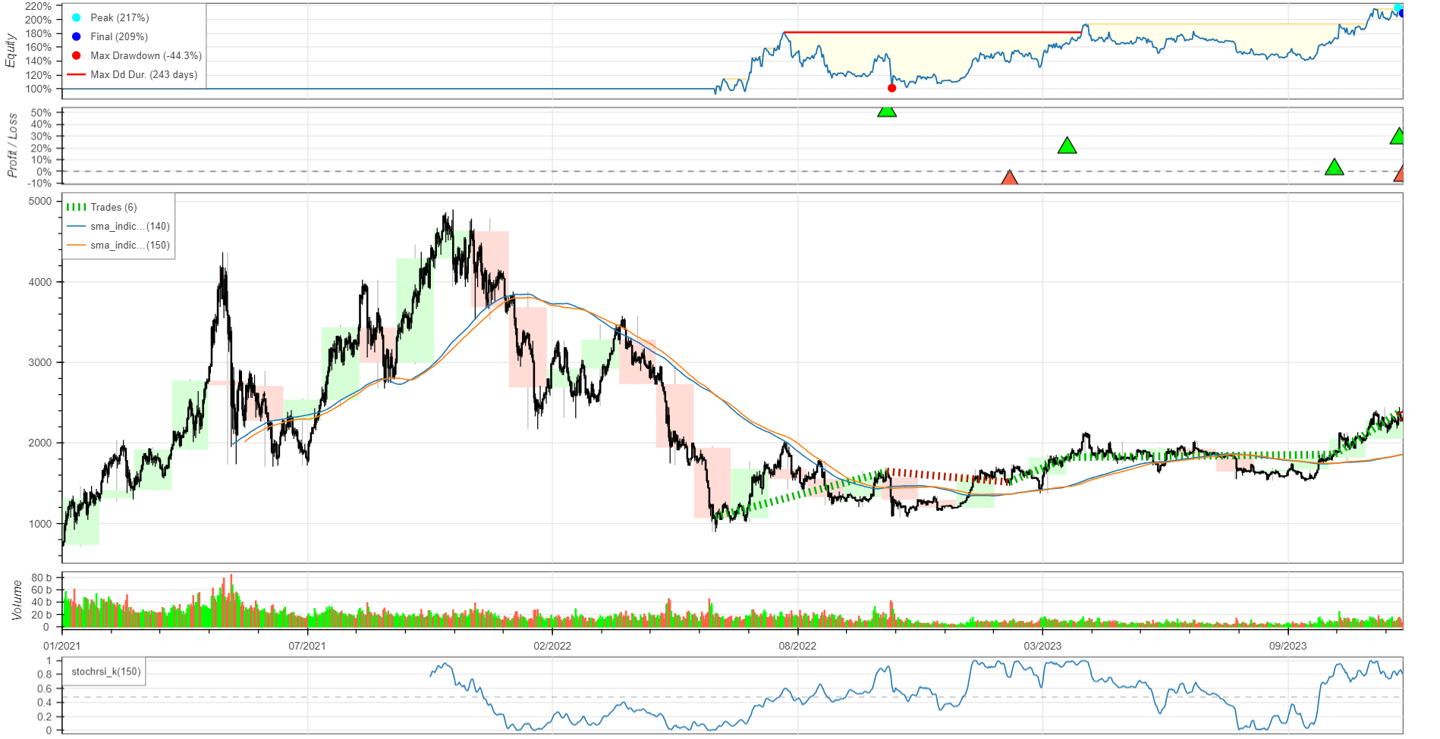
Backtesting Results(Continued)
Equity Curve:
Graph showing the equity curve over the backtesting period

Slide 11
Risk Management
Position Sizing:
Using a fixed percentage of total capital for each trade
Example: Risking 2% of total capital per trade
Stop Loss:
Setting stop loss at a fixed percentage below the entry price
Example: 2% below the entry price
Take Profit:
Setting take profit at a fixed percentage above the entry price
Example: 4% above the entry price
Risk/Reward Ratio:
Ensuring a favorable risk/reward ratio (e.g., 1:2)

Slide 12
Conclusion
Summary of the strategy and its effectiveness
1. Strategy Overview:
Implemented a moving average crossover strategy combined with the Relative Strength Index (RSI) indicator.
Parameters optimized for the SMA (Simple Moving Average) and RSI to maximize returns and minimize risks.
2. Effectiveness:
Backtesting results indicate promising performance with an average trade return of 13.14%.
Strategy demonstrates the ability to capture profitable trading opportunities in the Ethereum market.

Slide 13
Thank You

