Slide 1
IPv6 Routing Protocol for Low Power and Lossy Networks
RPL
王瑜

Slide 2
目录
CONTENTS
ROLL
4
Downward
routing
1
RPL
Network
management
2
5
Building a DAG –
Upward routing
Performance
evaluation
3
6

Slide 3
ROLL Working Group
RPL

Slide 4
What is ROLL?
Routing Over Low power and Lossy networks (2008)
http://www.ietf.org/html.charters/roll-charter.htmlROLL
Co-chairs: JP Vasseur (Cisco), David Culler (Arch Rock)
Mission: To define routing solutions for LLNs
Application specific LLN routing requirements developed
Industrial (RFC5673)
Urban (RFC5548),
Home Automation (RFC5826)
Building Automation (RFC5867)
Specifying the routing protocol for smart object networks
Routing Protocol for LLNs (RPL) adopted as WG document

Slide 5
Where Should Routing Take Place ?
Historically, a number of interesting research initiatives on WSN
Work on Wireless Sensors Network focussed on algorithms … not architecture
Most work assumed the use of MAC addresses
Layer 2 “routing” (mesh-under)
Support of multiple PHY/MAC is a MUST
IEEE 802.15.4, Low Power Wifi, Power Line Communications (PLC)
Use IP to route
Supports multiple PHY/MAC
Moves from mesh-under (L2) to router-over(L3)

Slide 6
Characteristics for Smart Object Routing
Current Internet | LLN
Nodes are routers | Nodes are sensor/actuators and routers
IGP with typically few hundreds of 100 nodes | An order of magnitude larger in nodes
Links and Nodes are stable | Links are highly unstable Nodes fail more frequently
Node and link bandwidth constraints are generally non-issues | Nodes & links are high constrained
Routing is not application aware | Application-aware routing, in-Band processing is a MUST

Slide 7
Technical Challenges
Energy consumption is a major issue (battery powered sensors/actuators)
Limited processing power
Very dynamic topologies
Link failure (LP RF)
Node failures (triggered or non triggered) Node mobility (in some environments),
Data processing usually required on the node itself
Sometimes deployed in harsh environments (e.g. Industrial)
Potentially deployed at very large scale
Must be self-managed (auto-discovery, self-organizing networks)

Slide 8
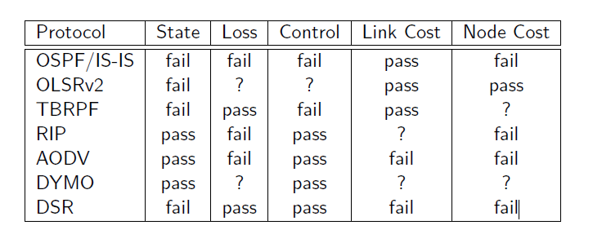
Current Routing Protocols
Routing State - limited memory resources of low-power nodes.
Loss Response - what happens in response to link failures.
Control cost - constraints on control traffic.
Link & Node cost - link and node properties are considered when choosing routes.

Slide 9
Routing over low Power Lossy networks
RPL

Slide 10
Specific Routing Requirements
Deliberate choice of 4 main application areas
Support of unicast/anycast/multicast
Adaptive routing with support of different metrics (latency, reliability, …)
Support of constrained-based routing (energy, CPU, memory)
Support of P2MP, MP2P and P2P with asymmetrical ECMP
Scalability
Discovery of nodes attributes (aggregator)
0-config (Warning not to add too many options !)
Performance: indicative (lesson learned from the Internet)
Security
RPL应该怎样使用、与特定目标功能结合、进行配置以满足特定应用和环境的需求？

Slide 11
Protocol Design Choices
Difficult tension between {flexibility, wide set of requirements, constrained devices}
Option 1: take the union … Not a good choice …_(:зゝ∠)_
If at all possible not always a good choice to overload the protocol with features not used by the application
An aspect that has been neglected by several protocol “Designers”
Option 2: take the intersection and make the design modular O(∩_∩)O~
Typically a subset of the RPL specification can be implement in light in the network requirement
Allows for minimal footprint implementations

Slide 12
低功耗有损网络路由协议（ RPL）是 IETF 的 ROLL（Routing Over Low power and Lossy networks ）工作组，专门针对低功耗有损网络 LLN（Low power and Lossy network）新提出来的路由协议。低功耗有损网络是由功率、存储空间、处理能力等资源受限的嵌入式设备所组成的网络。它们可以通过多种链路连接，比如 IEEE 802.15.4、蓝牙、低功率 Wi-Fi，甚至低功耗电力线通信（PLC）等等。

Slide 13
ROLL 将 LLN 网络的应用主要划分为四个领域：城市网络（包括智能电网应用）Urban LLNs [RFC5548] 、建筑自动化Building Automation LLNs [RFC5867] 、工业自动化Industrial LLNs [RFC5673]以及家庭自动化Home Automation LLNs [RFC5826] ，并且分别制定了针对四个应用领域的路由需求
Common Characteristics
Low power and Lossy Networks (LLNs) consisting largely of constrained nodes.
Lossy and unstable links, typically supporting low data rates, relatively low packet delivery rates.
Traffic patterns are not simply point-to-point, but in many cases point-to-multipoint or multipoint-to-point.
Potentially comprising up to thousands of nodes.

Slide 14
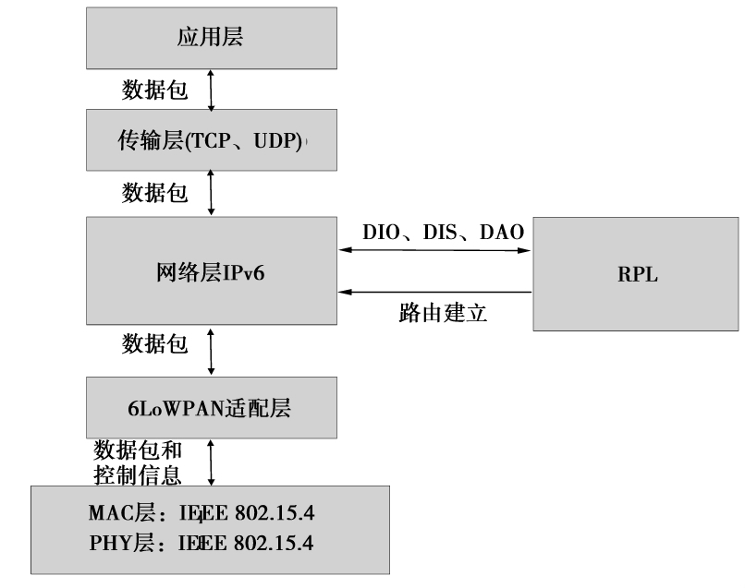

Slide 15
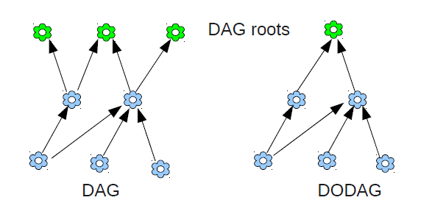
术语
DAG(Directed Acyclic Graph)：有向无循环图形，有向图有这样的性质，即，所有边缘均以没有循环存在的方式定向。所有边缘均被包含在定向到或终结在一个或多个根节点的路径中。
DAG root：DAG根是没有出站边缘的DAG内的节点。因为图形是非循环的，根据定义，所有DAGs必须至少有一个DAG根，并且所有路径终结在DAG根。
Destination-Oriented DAG (DODAG)：目标导向的有向无环图，扎根于单个目的地的DAG，即，扎根于没有出站边缘的单个DAG根(DODAG根)的DAG。
DODAG root： DODAG根是DODAG的DAG根。DODAG根可以充当DODAG的边缘路由器；尤其是，它可以聚合DODAG中的路由，可以重新分配DODAG路由到其他路由协议中。

Slide 16
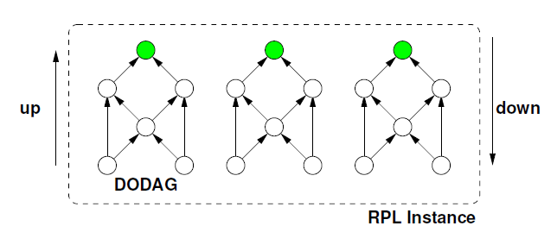
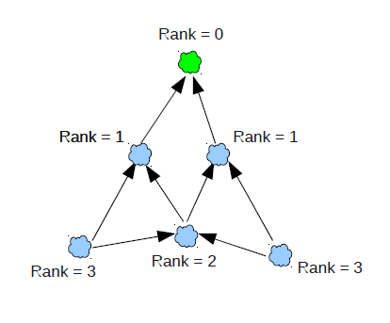
术语
Up： Up指沿着DODAG边缘，从叶节点朝向DODAG根的方向。这与在图形和深度优先搜索(depth-first-search)中使用的通用术语意思相同，在那里，认为离根更远的端点“更深”或“在下”，认为更为贴近根的端点“更浅”或“在上”。
Down： Down指从DODAG根朝向叶节点的方向，与DODAG边缘方向相反。认为离根更远的端点“更深”或“在下”，认为更为贴近根的端点 “更浅”或“在上”。
Rank： 节点的Rank定义就DODAG根而言，节点相对其他节点的具体位置。Rank在向下(Down)方向严格增加，在向上(Up)方向严格减少。计算Rank的精确方法取决于DAG的Objective Function (OF)。Rank可以类似于跟踪简单的拓扑距离，可以作为链路度量的函数计算，可以看作是诸如约束的其他特性。

Slide 17
术语
Objective Function (OF)：定义RPL节点如何选择和优化RPL Instance中的路由。OF由DIO Configuration选项中的Objective Code Point (OCP)标识。OF定义节点如何将一个或多个度量和约束(度量和约束在[RFC6551]中定义)转换成称作Rank的值，Rank近似为节点离开DODAG根的距离。OF也定义节点如何选择父代
Objective Code Point (OCP)：OCP是标识符，指出DODAG使用哪一个OF。
RPLInstanceID：RPLInstanceID是网络中唯一的标识符。有相同RPLInstanceID的DODAGs共享相同OF。
RPL Instance：RPL Instance是一组共享RPLInstanceID的一个或多个DODAG。在大多数情况下，RPL节点归属RPL Instance中的一个DODAG。每个RPL Instance独立于其他RPL Instances运行。

Slide 18
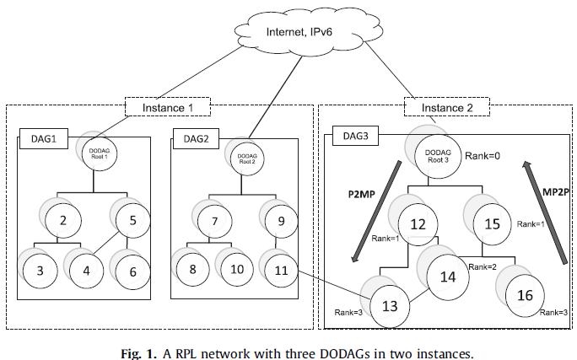

Slide 19










































Physical topology
Concept of Multiple RPL Instances (a la MTR)
LBR
5
10
10
Battery Operated Node
Poor Quality (LQL=3) Fair Quality (LQL=2) Good Quality (LQL=1)
80
11
50
12
5
13
20
10
10
21
10
22
23
24
X
Latency in milliseconds
5
10
10
10
20
10
DAG Instance 1: high quality – no battery operated nodes DAG Instance 2: low latency
31
32
10
33
10
34
20
35
LBR
LBR
11
12
13
11
12
13
21
22
23
24
21
22
23
24
31
32 33
RPL instance 1
34
35
31
32 33
RPL instance 2
34
35

Slide 20
术语
DODAG parent：DODAG内节点的父代是在朝向DODAG根路径上节点的直接后继者之一。DODAG父代的Rank比节点的低。
Sub-DODAG：节点的子DODAG是一组其他节点，这些节点到DODAG根的路径经过该节点。在节点的子DODAG中的节点有比该节点更大的Rank。
Local DODAG：Local DODAGs包含一个且只有一个根节点，Local DODAGs使该单个根节点能够分配和管理由本地RPLInstanceID标识的RPL Instance，不需要与其他节点协调。一般，这样做是为了优化到LLN内目的地的路由。
Global DODAG：Global DODAG使用可以在几个其他节点中协调的全局RPLInstanceID。

Slide 21
术语
DODAGID：DODAGID是DODAG根的标识符。在LLN中RPL Instance范围内DODAGID唯一。元组(RPLInstanceID、DODAGID)唯一标识DODAG。
DODAG Version：DODAG Version是带有给定DODAGID的DODAG的具体迭代(“Version”)。
DODAGVersionNumber：是序贯计数器，它由根增加，以便形成DODAG的新Version。DODAG Version由(RPLInstanceID、DODAGID、DODAGVersionNumber)元组唯一标识。

Slide 22
术语
Goal：Goal是特定应用目标，它的定义超出RPL范围。任何扎根于DODAG的节点需要知道这个Goal，以便决定是否能够满足该Goal。典型的Goal按照特定OF构建DODAG，以及保持与一组主机的连接(例如，使用这样的OF，该OF尽量减少度量并连接到用于保存所收集数据的特定数据库主机)。
Grounded：如果DODAG根能够满足Goal，该DODAG是接地的。
Floating：如果DODAG没有接地，它是浮动的。浮动DODAG预期不会有满足目标需要的性能。然而，浮动DODAG可以提供到DODAG内其他节点的连接。

Slide 23
术语
DIO：DODAG Information Object. A DIO carries information that allows a node to discover an RPL Instance, learn its configuration parameters and select DODAG parents
DAO：Destination Advertisement Object. A DAO propagates destination information upwards along the DODAG
DIS：DODAG Information Solicitation. A DIS solicits a DODAG Information Object from an RPL node

Slide 24
术语
LBRs(LowPower and Lossy border Routers)：低功耗有损路由的边界路由节点。这类节点通常是DODAG的根节点,它是网络中数据流动的终点,同时也负责DAG的构建。LBR.另外一个作用是作为网关节点,用以做为LLN阿络和互联网之间数据传输的中介。
Router：路由节点。这类节点是网络中数据转发的中转站,但是它与LBRs节点的作用不一样,Router节点无法构建一个DAG,只能选择去加入一个已经存在的DAG网络中。
Host：主机节点。它是网络中的叶子节点,能产生数据,但不具备转发数据的功能。

Slide 25
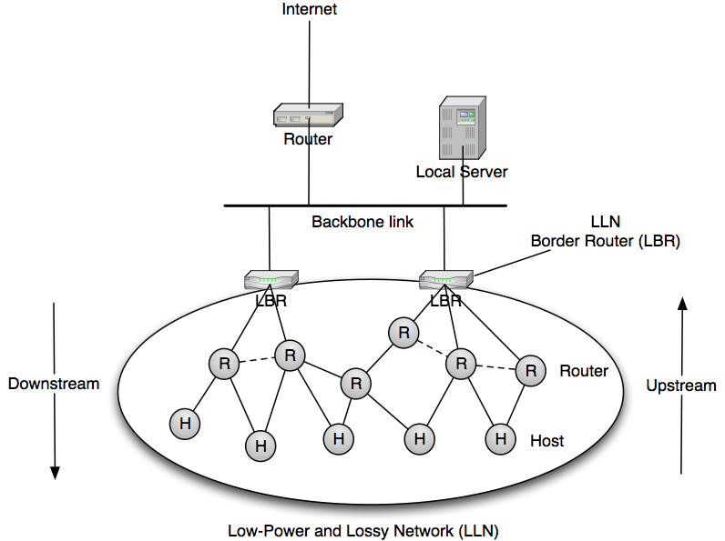
LLN

Slide 26

RPL Terminology
RPL Instance
Consists of one or more DODAGs sharing SAME service type (Objective Function) Identified by RPL INSTANCE ID
Direction Oriented DAG (DODAG)
Comprises DAG with a single root
Rank = n
Node (OF configured)
DODAG
Towards DODAG
leafs
DOWN (DIO Messages)
DODAG
Rank > n
UP (DAO Messages)
Towards DODAG
Root
Siblings
Rank decreases
4
4
Rank
Sub-DODAG
Rank increases
3
3
4
3
3
DODAG parent to adjacent “4”s
2
2
2
1
1
1
1
Rank < n
Rank = n
0
0
DODAG Root
(Typically an LBR - LLN Border Router)
DODAG Root Identified by DODAG ID
Non-LLN Network
(IPv6 Backbone)

Slide 27
RPL Instances
RPL can form multiple instances
Each instance honours a particular routing objective/constraint
Instance consists one or more DODAGs derived from the same objective function
Nodes select a parent (towards root) based on metric, OF and loop avoidance
Allows upwards and downwards routing (from DODAG root)
Trickle timers used to suppress redundant messages
Saves on energy and bandwidth (Like OSPF exponential backoff)
Under-react is the rule
Local repair preferred versus global repair to cope with transient failures

Slide 28
RPL DODAGs
RPL enables nodes to discover each other and form DODAGs
Uses special ICMPv6 control messages
Each root uses a unique {DODAG ID} to identify itself within an RPL Instance
Routing performed over the DODAG using distance vector techniques
Every hop to the root MUST have an alternate path
(Quite possible with Wireless/Radio Networks)
A DODAG will ensure nodes always have a path up towards the root
A DODAG is identified by {RPL Instance ID, DODAG ID}

Slide 29
Objective Function (OF)
An OF defines how nodes select paths towards DODAG root
Dictates rules on how nodes satisfy a optimisation objective (e.g., minimise latency) Actual routing metrics and constraints carried ICMPv6 control messages
A rank in the DODAG reflects its distance from the root
Objective Function
Optimization Objective
•Energy Minimisation
•Latency
•Other Constraints
Routing Metrics
•Link Metrics
•Node Metrics
Rank =
Rank is higher as distance increases from DODAG root
There is a single Objective Function per RPL Instance
An instance can comprise one or more DODAGs (share same OF)
http://datatracker.ietf.org/doc/draft-ietf-roll-of0/ (Basic OF specification)

Slide 30
ICMPv6 RPL Control Messages
4
4
3
3
4
DIO - Used for DODAG discovery, formation and maintenance
DIS - Used to probe for DIO messages from RPL nodes
DAO - Propagates prefix availability from leaves up the DODAG Supports P2MP and P2P traffic
DAO-ACK - Unicasted by a DAO recipient in response to a unicast DAO message
2
2
1
1
DIO
DIS
UP
DOWN
0
Root
Link-local Destination | Link-local Source | RPL Control Payload
All-RPL-Nodes FF02::1A | Link-local Source | RPL Control Payload
Most RPL control messages have scope of a link
Global or Unique-Local
Global or Unique-Local
DAO/DAO-ACK in non-storing mode passes over multiple hops
RPL Control Payload

Slide 31
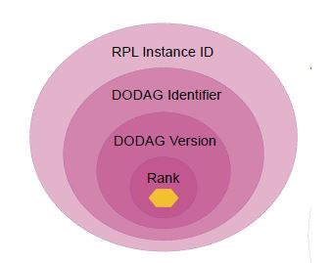
RPL标识符
Four values used to identify and maintain DODAG topology Nodes in a particular topology will belong to the same DODAG version Rank within {RPL Instance ID, DODAG ID, DODAG Version} scope
RPL Instance 16
5
5
4
4
4
3
3
4
3
3
2
2
2
2
1
DODAG ID 25
1
1
DODAG ID 25
1
0
0
Identifies unique DODAG topology within RPL Instance
{16, 25, Version)
Topology Event
{16, 25, Version+1)

Slide 32
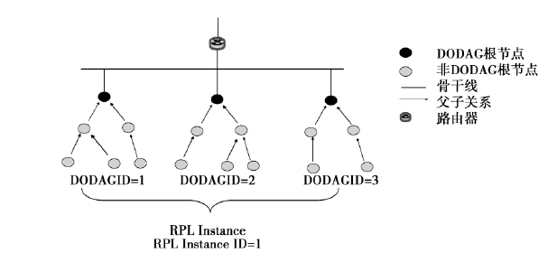
拓扑结构：
RPLInstanceID
DODAGID

Slide 33
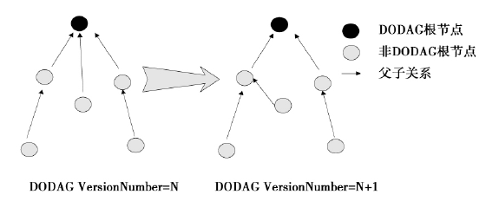
拓扑结构：
RPLInstanceID
DODAGID
DODAGVersionNumber

Slide 34
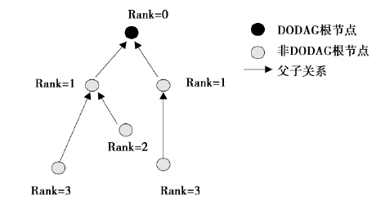
拓扑结构：
RPLInstanceID
DODAGID
DODAGVersionNumber
Rank

Slide 35




RPL Supported Traffic Flows
Multipoint to Point
DIO messages
Point to Multipoint
DAO messages
Subset of devices
Point to Point Storing Mode, DAO Fully Stateful
Point to Point
Non-Storing Mode, DAO Source routed to root
4
4
4
4
4
4
4
4
3
3
4
3
3
4
3
3
4
3
3
4
2
2
2
2
2
2
2
2
UPwards routes
1
1
1
1
1
1
1
1
DOWNwards routes
DODAG Root 0
DODAG Root 0
DODAG Root 0
DODAG Root 0
IPv6
IPv6
IPv6
IPv6

Slide 36
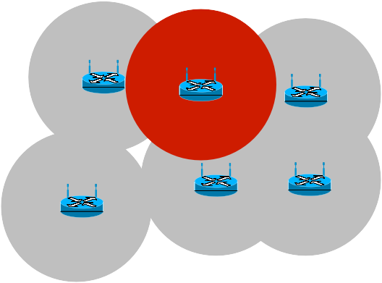









DODAG Neighbours and Parent Selection (Upward Routes)
Set of Candidate Neighbours
Set of
Parents Preferred Parent
Geographic Layout
IPv6
Core
IPv6
Core
IPv6
Core
IPv6
Core
Logical sets of link-local nodes
Upward route discovery
Comprises three logical sets of link-local nodes
Neighbours are learnt from DIO advertisements
Candidate Neighbour Set
Subset of nodes reachable via link-local multicast
Elements in the set may belong to different DODAG versions
Parent Set
Consists of nodes with a higher rank (lower #)
Elements in the set must belong to SAME DODAG version
Preferred Parent
Preferred next-hop to the DODAG Root
Multiple preferred parents possible if ranks are equal

Slide 37
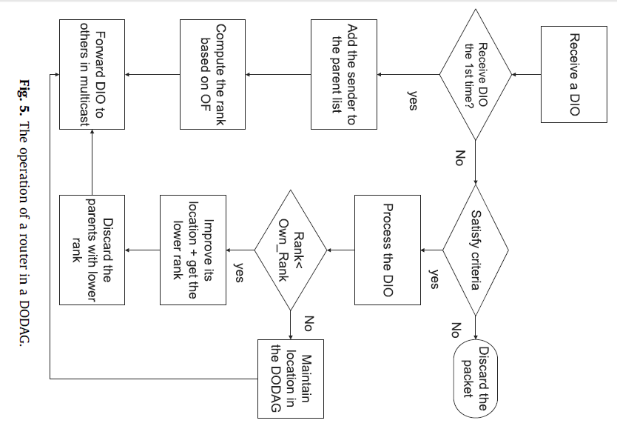

Slide 38
Building a DAG – Upward routing
RPL

Slide 39
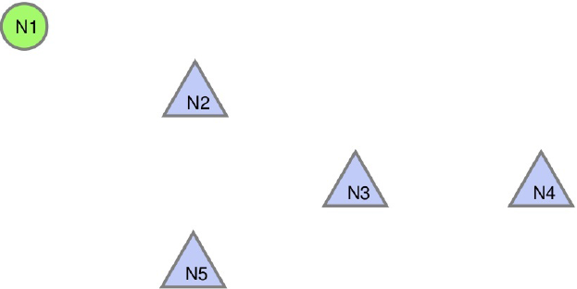
Network formation

Slide 40
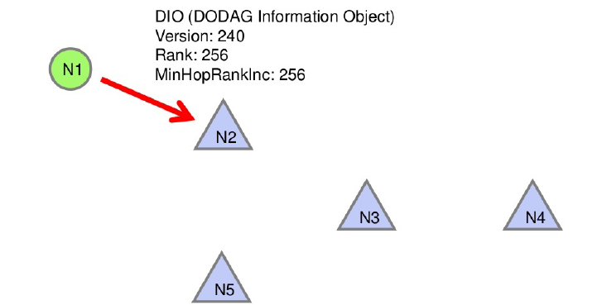
Network formation

Slide 41
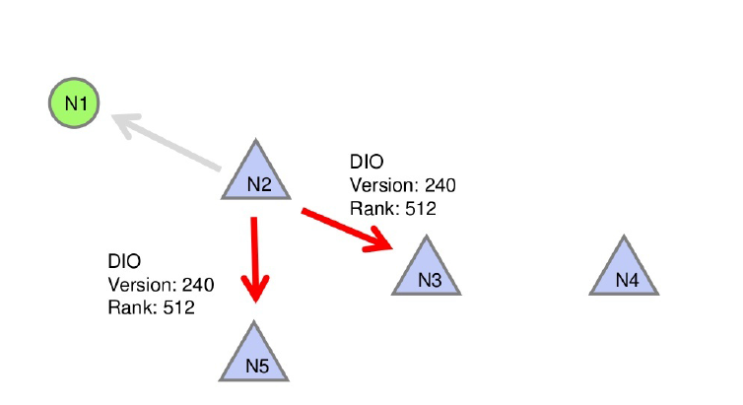
Network formation

Slide 42
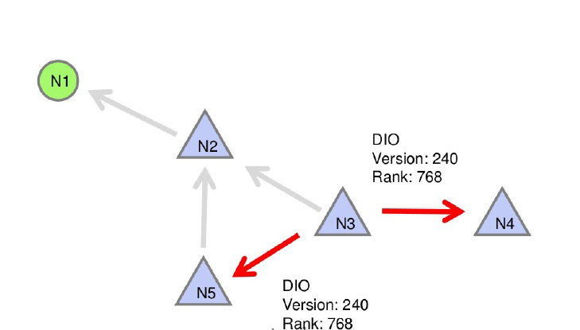
Network formation

Slide 43
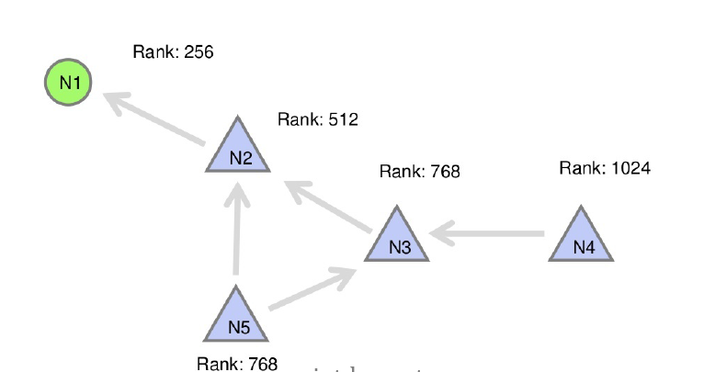
Network formation

Slide 44
DAG Construction
LLN links are depicted
Links are annotated w/ ETX
It is expected that ETX variations will be averaged/filtered as per [ROLL-METRICS] to be stable enough for route computation
Nodes are also to observe the metric and gain confidence before use
LBR-1
1
2
3
A
1
B
1
C
1
1
1
F
1
D
4
E
1
1
1
1
G
1
H
I

Slide 45
DAG Construction
Objective Code Point for example
Metric: ETX
Objective: Minimize ETX
Depth computation: Depth ~ ETX
Note that a practical computation may be more coarse
LBR-1
1
2
3
A
1
B
1
C
1
1
1
F
1
D
4
E
1
1
1
1
G
1
H
I

Slide 46
DAG Construction
LBR-1 multicasts RA-DIO
Nodes A, B, C receive and process RA-DIO
Nodes A, B, C consider link metrics to LBR-1 and the optimization objective
The optimization objective can be satisfied by joining the DAG rooted at LBR-1
Nodes A, B, C add LBR-1 as a DAG parent and join the DAG
LBR-1
1
2
3
A
1
B
1
C
1
1
1
F
1
D
4
E
1
1
1
1
G
1
H
I

Slide 47
DAG Construction
LBR-1
Node A is at Depth 1 in the DAG, as calculated by the routine indicated by the example OCP (Depth ~ ETX)
Node B is at Depth 3, Node C is at Depth 2
Nodes A, B, C have installed default routes (::/0) with LBR-1 as successor
1
2
3
A
1
B
1
C
1
1
1
F
1
D
4
E
1
1
1
1
G
1
H
I

Slide 48
DAG Construction
LBR-1
The RA timer on Node C expires
Node C multicasts RA-DIO
LBR-1 ignores RA-DIO from deeper node
Node B can add Node C as alternate DAG Parent, remaining at Depth 3
Node E joins the DAG at Depth 3 by adding Node C as DAG Parent
1
2
3
A
1
B
1
C
1
1
1
F
1
D
4
E
1
1
1
1
G
1
H
I

Slide 49
DAG Construction
LBR-1
Node A is at Depth 1, and can reach ::/0 via LBR-1 with ETX 1
Node B is at Depth 3, with DAG Parents LBR-1, and can reach ::/0 via LBR-1 or C with ETX 3
Node C is at Depth 2, ::/0 via LBR-1 with ETX 2
Node E is at Depth 3, ::/0 via C with ETX 3
1
2
3
A
1
B
1
C
1
1
1
F
1
D
4
E
1
1
1
1
G
1
H
I

Slide 50
DAG Construction
LBR-1
The RA timer on Node A expires
Node A multicasts RA-DIO
LBR-1 ignores RA-DIO from deeper node
Node B adds Node A
Node B can improve to a more optimum position in the DAG
Node B removes LBR-1, Node C as DAG Parents
1
2
3
A
1
B
1
C
1
1
1
F
1
D
4
E
1
1
1
1
G
1
H
I

Slide 51
DAG Construction
LBR-1
DAG Construction continues…
And is continuously maintained
1
2
3
A
1
B
1
C
1
1
1
F
1
D
4
E
1
1
1
1
G
1
H
I

Slide 52














































































Physical Network
LBR
X ETX (=1 when not indicated)
=> reflect the link quality
Battery operated node used a (hard) constraint
3
1.5
1.3
Step 3
11
1.1
12
1.8
13
1.7
LBR
1
1.3
2
1.6
21
22
4
2.5
23
1.4
24
1.3
1.1
2.9
1.9
11
12
13
2.1
2.2
2.4
2.7
*
35
31
32
33
34
21 22 23 24
The DAG (Direct Acyclic Graph) continues to build
41
42
43
44
45
4
46
Step 1
DIO message multicasted to all- RPL-nodes by the root
Final
LBR
LBR
3
1.3
1.5
11
12
1.8
13
1.7
11
12
13
1
1.1
2
1.6
LBR
21
22
23
24
1.3
Step 2
1.9
2.5
1.4
2.4
2.7
*
35
31
32
33
34
11 12
13
Router runs an algorithm to choose a parent based on an objective and metrics/constraint (best quality path, highest bandwidth link,….)
41
42
43
44
45
46

Slide 53
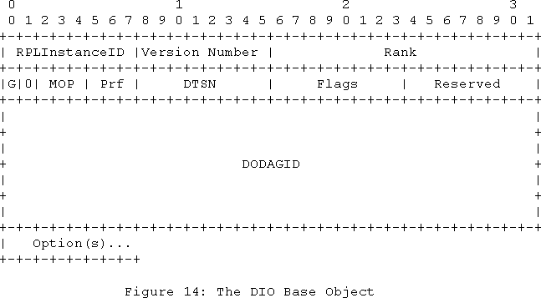
DODAGID: 128-bit IPv6 address set by a DODAG root which uniquely identifies a DODAG.
The DODAGID MUST be a routable IPv6 address belonging to the DODAG root.
Unassigned bits of the DIO Base are reserved. They MUST be set to zero on transmission and MUST be ignored on reception.
The RPL DIO Message
Destination Advertisement Trigger Sequence Number (DTSN): set by the node issuing the DIO used to maintain DAO routes
G: Grounded
Rank
Reserved
DODAGPreference (Prf): A 3-bit unsigned integer that defines how preferable the root of this DODAG is compared to other DODAG roots within the instance. DAGPreference ranges from 0x00 (least preferred) to 0x07 (most preferred). The default is 0 (least preferred).
Options
MOP:
0: no Downward route
1: Non Storing Mode
2: Storing without Multicast
3: Storing with Multicast

Slide 54
The RPL Objective Function
An objective function defines how nodes perform parent selection and how to compute rank based on metrics
Defined by the OCP
Combined with metrics/constraints
“Use the LQL as a global recorded metric and favor paths with the minimum number of low and fair quality links, use the link color as a link constraint to avoid non encrypted links”.
“Find the best path in term of latency (link latency is used as a global aggregated metric), while avoiding poor quality links and battery operated nodes”.

Slide 55
Mode of Operation
Parent selection governed by OF, decoupled from metrics and constraints
Node leaving a DODAG should remember the DODAG parameters for some period of time to avoid rejoining a node in a former sub-DAG, thus avoiding loops.
DODAGVersion governed by DAGroot according to implementation specific events
A node with DODAG parent set =={} may set G bit (with lower Pref)
DODAG selection is also implementation-specific

Slide 56
Mode of Operation (Cont’)
Movement within a DAG
Node may jump to a parent with a lower rank
Within a DODAG a node cannot advertise a rank L>L
+DAGMaxRankIncrease (RANK=INFINITY is an exception)
Node can select any parent advertising a higher DODAGVersion Node can at any time join a different DODAG within the same RPL
instance with no rank restriction (except if the node used to belong to this DODAG Version)
If a node needs to move down it MAY poison its sub-DAG
Poisoning
Means sending DIO with Rank=INFINITY
Node cannot select a parent advertising a Rank=Infinity
Still a node may detach without poisoning by setting the G Flag

Slide 57
Mode of Operation (Cont)
A node should prefer to stay in its DODAG via an alternate parent if any should the preferred parent have left its DODAG
DIO transmission is governed by Trickle Timer
Reception of DIO from less DAGRank causing no change to DODAG parent set, preferred parents, Rank, reception of unicast DIS,=> consistent
Trickle timer reset upon inconsistency detection: Packet forwarding error (Rank-error, Forwarding-error, …) Reception of DIS with all predicates==true
New DODAGVersion (new DODAGVersionNumber, new RPL Instance)
See Trickle Algorithm – next slide

Slide 58
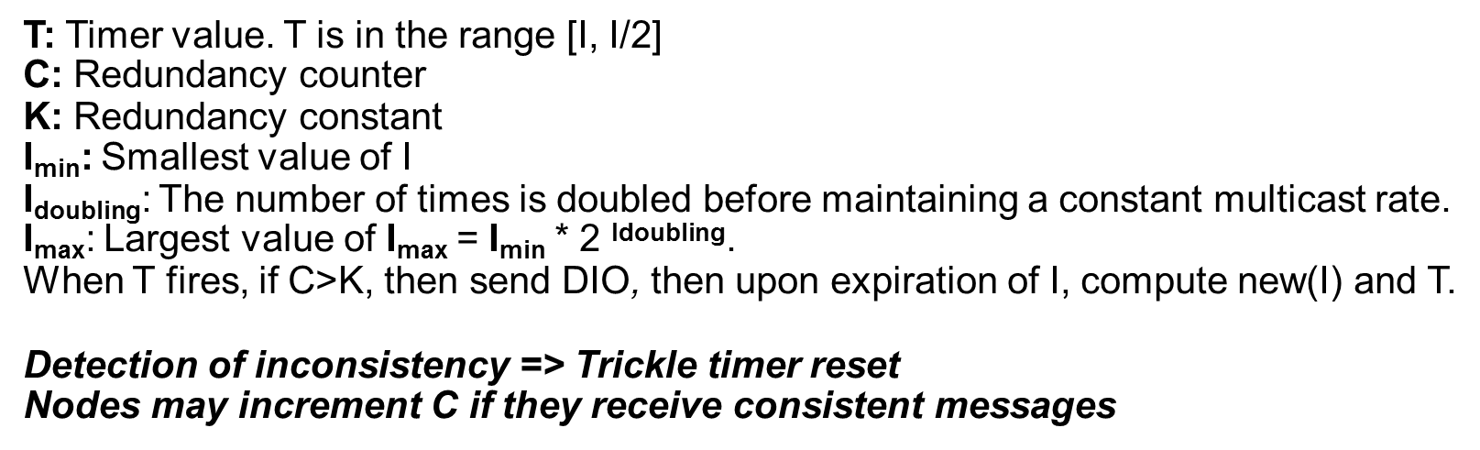
The use of Trickle Timers
Concerns
Broadcast is expensive
Wireless channel is a shared, spatial resource
Idea
Dynamic adjustment of transmission period
Suppress transmissions that may be redundant (key when resources such as energy and bandwidth are scarce)
Here is the algorithm:

Slide 59
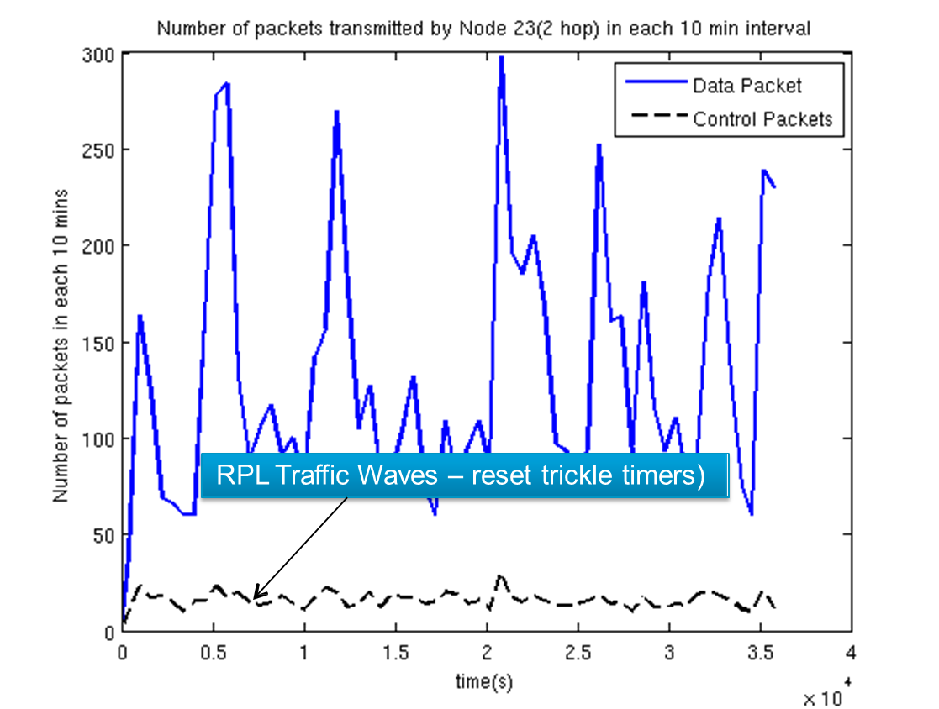
Trickle at works …

Slide 60



RPL DIS message and Option
Base Format:
Flags Option …
Reserved
Allows for predicate to solicit replies from subset of nodes
V: Version predicate
Receiver DOAGVersion=Version?
I: InstanceID predicate
Receiver RPLInstanceID=RPLInstanceID ?
Type=7
Option Length=19 RPLInstanceID V I D
Flags
DODAGID
Version num
Used to solicit a DIO from a RPL node in the vicinity
D: DODAGID predicate
Receiver DODAGID=DODAGID?
Ability to add filtering to the request to limit the number of replies (use of predicates)
Node reset trickle timer when all predicates are true.

Slide 61
Downward routing
RPL

Slide 62
Storing Versus Non-Storing Mode
RPL supports two modes (mix not allowed):
Storing mode: nodes do store/maintain routing tables
Non-storing mode: nodes use default routing upward and source routing downward
Upward routing similar
Differences in downward routing:
Storing mode: packets travel up to a common ancestor
Non storing mode: packets travel up to the DAG root, then source routed
Impact on forwarding:
Use of source routing in non-storing
No use of RPL option header (no risk of loops) in non-storing

Slide 63
Populating the Routing Tables
DAG provides UP connectivity
Requires DOWN connectivity (routes toward the leaves)
RPL specifies DAO messages used to advertize prefixes to parents (storing) or DAGRoot (non-storing)
Nodes capable of storing the prefixes populate their routing tables
Packets are routed up to a common ancestor for P2P routing with an optimization for 1-hop reachable nodes

Slide 64


The RPL DAO Message
++ each time a DAO is issued, used in DAO-ACK (unique to each node)
Reserved DAO Sequence
RPLInstanceID K D
Flags
* DODAGID
Options
Set if DAO-ACK
D=1 if DODAGID is
present (when
requested
LocalRPLInstance ID is used)

Slide 65


RPL Option: Target
RPL Target (may be in DAO): indicates reachability.
Transit Information (may be in DAO): may contain Parent address for an ancestor used with source routing (could be one Transit info per DAO parent for non-storing). A Path Control field used for non storing to influence the reverse path.
++ each time issuing a Target
E: External route
Type=6 Path Seq
Option Length Path Lifetime
E Flags
Path Control
Parent Address *
Path Control: Number of 1-bit fields specified in PCS of DODAG config (DIO).

Slide 66
























































Populating the routing tables using DAO
mssage
Two modes of operations: storing mode and non storing modes
DAO
LBR
STORING MODE
DAO
LBR
NON STORING MODE
3
1.3
3
1.3
1.5
1.5
11
12
1.8
13
1.7
11
12
1.8
13
1.7
1
1.1
2
1
1.1
2
21
22
23
24
1.3
21
22
23
24
1.3
1.9
2.5
1.4
1.9
2.5
1.4
2.4
2.7
*
35
2.4
2.7
*
35
31
32
33
34
31
32
33
34
41
42
43
44
45
46
41
42
43
44
45
46
Unicast to DAO parents
Unicast to DODAG Root (not processed by intermediate nodes)

Slide 67



















Triggering Multicast DAO for 1-hop routing
Node may multicast DAO using link local all-RPL-node
Used only to advertise information about the node itself (prefixes directly connected or owned by the node itself)
MUST NOT be used to relay information using unicast DAO
Usually preferred than routes learned through unicast DAO
LBR
STORING MODE
3
1.3
1.5
11
12
1.8
13
1.7
1
1.1
2
21
22
23
24
1.3
1.9
2.5
1.4
2.4
2.7
*
35
31
32
33
34
41
42
43
44
45
46

Slide 68
RPL network management
RPL

Slide 69
RPL network management
Fault-tolerance
DODAG repair
Loop avoidance and detection
QoS-aware routing
Security

Slide 70
DODAG repair
local repair
network inconsistency
in urgently finding a backup path without trying to repair the whole DODAG
global repair
local repairs are not efficient for network
increments the DODAG version number and initiates a new DODAG version.
The global repair operation leads to a fundamental reconstruction of the network topology. Nodes in the new DODAG version can choose a new position whose rank is neither constrained by nor dependent on their previous rank within the old DODAG version.

Slide 71
Global versus Local Repair
Global repair: rebuilt the DAG … requires a new DAG Sequence number generated by the root
Triggered by the root
Potentially signaled to the root (under investigation)
Local Repair: find a “quick” local repair path
Only requiring local changes !
May not be optimal according to the OF and overall DAG shape, which is fine

Slide 72










































































Step 0
Root
Step 2
11
12
13
11
12
13
21
22
23
24
21
22
23
31
32
33
34
35
36
31
32
33
34
35
36
41
42
43
44
45
46
41
42
43
44
45
46
Root
24
Step 1
11
12
13
21
22
23
24
DIO poisoning
31
32
33
34
35
36
41
42
43
44
45
46

Slide 73
Remember the DAGMaxRankIncrease ?
Before moving down, remember the rank r
Do not attach to any node with rank>r+H
This help reduce the size of infinity ☺
Let L be the lowest rank within a DODAG Version that a given node has advertised. Within the same DODAG Version, that node MUST NOT advertise an effective rank higher than L + DAGMaxRankIncrease. INFINITE_RANK is an exception to this rule: a node MAY advertise an INFINITE_RANK within a DODAG version without restriction. If a node's Rank were to be higher than allowed by L + DAGMaxRankIncrease, when it advertises Rank it MUST advertise its Rank as INFINITE_RANK.

Slide 74



























































Step 0
Root
Repair diameter: all nodes with a rank=1+3
11
12
13
21
22
23
24
Root
Worst Case
31
32
33
34
35
36
SenderRank=2,
O=1 => loop ! Reset Trickle CTI
41
42
43
44
45
46
11 5
2
Loop !
Root
12
13
Best Case
21
22
5
23
24
24
6
8
3
11
13
31
3
2
33
34
35
36
7
4
21
22
23
24
41
42
43
44
45
46
12
31
32
33
34
35
36
41
42
43
44
45
46

Slide 75
Potential Loops
Loops in DV are hardly avoidable (due to control message loss and sibling routing)
Tension between Loops avoidance and loop detection
RPL supports both
E.g. Rules about the rank: do not attach to a node deeper in the DAG
E.g. Set flags in the packet header to detect loops that may occur (datapath validation)
When loop could occur ?
DIO/DAO message loss is the most common example …
RPL makes use of on-demand loop detection with data packets (e.g. rank of sender and direction are used for loop detection)

Slide 76
Loops
DIO Loops—DIO messages are lost
max_depth rule：a node cannot select a parent whose rank is higher than the node minimum rank plus DAGMAXRankIncrease.
looking for alternate parents
DAO Loops—a node fails to inform its parent that a destination is no longer reachable
use of acknowledgment of DAO messages

Slide 77
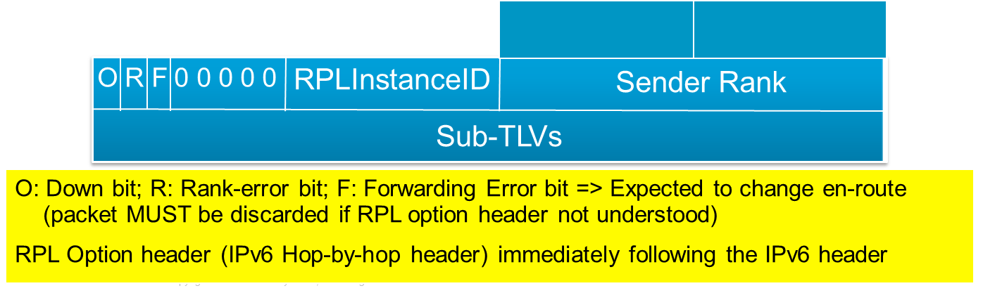
Loop Detection
Idea: add flags to data packets to detect and breaks loops
Receiving a packet with inconsistent flag according to the rank is a loop indication (Set to INFINITY when moving to new DODAGVersion)
DAG inconsistency loop detection:
O=1 from a node with higher Rank
O=0 from a node with a lower rank
Once an inconsistency is detected, the R bit is set. Upon receiving a packet with R=1, the packet MUST be dropped and trickle reset.

Slide 78
Loop Avoidance
LBR-1
Consider the case where the link B—D goes bad
Node D will remove B from its DAG parent set
Node D no longer has any DAG parents in the grounded DAG, so it will become the root of its own floating DAG
1
2
3
A
1
B
1
C
1
1
1
F
1
D
4
E
1
1
1
1
G
1
H
I

Slide 79
Loop Avoidance
LBR-1
Node D multicasts an RA-DIO to inform its sub-DAG of the change
Node I has an alternate DAG Parent, E, and does not have to leave the DAG rooted at LBR-1.
Node I removes Node D as a DAG Parent
1
2
3
A
1
B
1
C
1
1
1
F
1
D
4
E
1
1
1
1
G
1
H
I

Slide 80
Loop Avoidance
LBR-1
Node F does not have an option to stay in the DAG rooted at LBR-1 (no alternate DAG Parents), so Node F follows Node D into the floating DAG
Node F multicasts an RA-DIO
Nodes G and H follow Node F into the floating DAG
1
2
3
A
1
B
1
C
1
1
1
F
1
D
4
E
1
1
1
1
G
1
H
I

Slide 81
Loop Avoidance
LBR-1
The sub-DAG of node D has now been frozen
Nodes contained in the sub-DAG have been identified, and by following node D into the floating DAG, all old routes to LBR-1 have been purged
The floating DAG seeks to rejoin a grounded DAG…
1
2
3
A
1
B
1
C
1
1
1
F
1
D
4
E
1
1
1
1
G
1
H
I

Slide 82
Loop Avoidance
LBR-1
Node I multicasts an RA-DIO
Node D sees a chance to rejoin grounded DAG at depth 5 through Node I
Node D starts a DAG Hop timer of duration α 4 associated with Node I
1
2
3
A
1
B
1
C
1
1
1
F
1
D
4
E
1
1
1
1
G
1
H
I

Slide 83
Loop Avoidance
LBR-1
Suppose a link A—F becomes viable
Node A multicasts an RA-DIO
Node F sees a chance to rejoin grounded DAG at depth 2 through Node A
Node F starts a DAG Hop timer of duration α 1 associated with Node A
1
2
3
A
1
B
1
C
1
1
1
1
F
1
D
4
E
1
1
1
1
G
1
H
I

Slide 84
Loop Avoidance
LBR-1
Node F’s DAG Hop Timer expires
Node F joins to the grounded DAG at depth 2 by adding A as a DAG parent, and removing D
Node F multicasts an RA-DIO
Nodes G and H follow Node F to the grounded DAG
1
2
3
A
1
B
1
C
1
1
1
1
F
1
D
4
E
1
1
1
1
G
1
H
I

Slide 85
Loop Avoidance
LBR-1
Node D sees a chance to rejoin DAG LBR-1 at depth 3 through Node F
Node D starts a DAG Hop timer of duration α 2 associated with Node F, in addition the DAG Hop timer already running with duration α 4 associated with Node I
1
2
3
A
1
B
1
C
1
1
1
1
F
1
D
4
E
1
1
1
1
G
1
H
I

Slide 86
Loop Avoidance
LBR-1
Node D’s DAG Hop timer of duration α 2 tends to expire first
Node D joins the grounded DAG at depth 3 by adding Node F as a DAG Parent
The breaking-off and re-joining of the broken sub-DAG is thus coordinated with loop avoidance
1
2
3
A
1
B
1
C
1
1
1
1
F
1
D
4
E
1
1
1
1
G
1
H
I

Slide 87
QoS-aware routing
QoS-aware routing
RPL is able to provide different levels of QoS based on the underlying QoS metric ruling routing
Constraint-based routing
RPL defines constraints that reduce the search space for possible path satisfying QoS requirements

Slide 88
Routing Metrics and Constraints in LLNs
http://datatracker.ietf.org/doc/draft-ietf-roll-routing-metrics/
Specifies a set of link and node LLN routing metrics and constraints
Constraints provide a path “filter” for more suitable nodes and links
Metrics are the quantitative value used to evaluate the path cost
Concept of routing objects that can be treated as a metric or a constraint
Low pass thresholds used to avoid unnecessarily recomputing DAG
Computing dynamic metrics takes up power and can change rapidly
Solved by abstracting number of discrete values to a metric
Link Quality Metric
Value 0
1
2
3
Meaning Unknown
High Medium Low
Tradeoff
Reduced accuracy vs overhead and processing efficiency
IP in Smart Object Networks V1.8

Slide 89
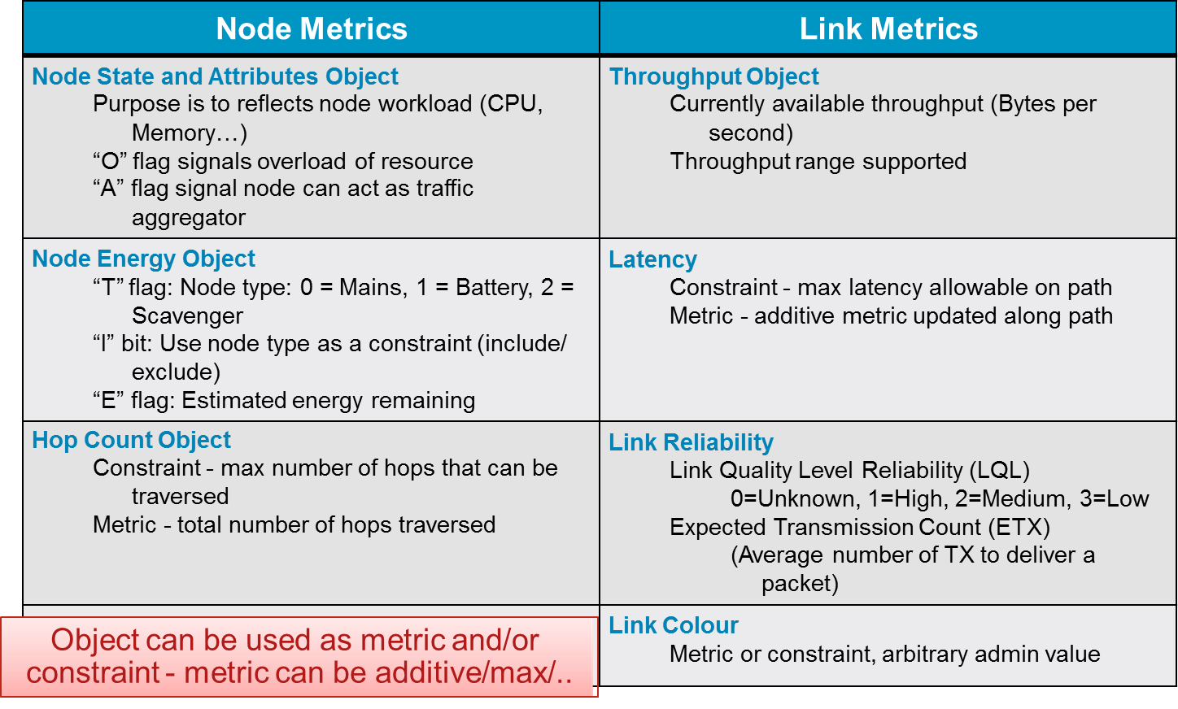
Routing Metrics in LLNs

Slide 90
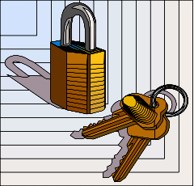
RPL Security
RPL has three basic security modes
Unsecured Mode
Relies on underlying link layer security mechanisms
Pre-Installed Mode
RPL nodes use same pre-shared/installed key to generate secure messages
Authenticated mode
Uses pre-installed key to allow RPL node to join as a leaf only
To function as a router requires obtaining a key from authentication authority

Slide 91
Performance evaluation
RPL

Slide 92
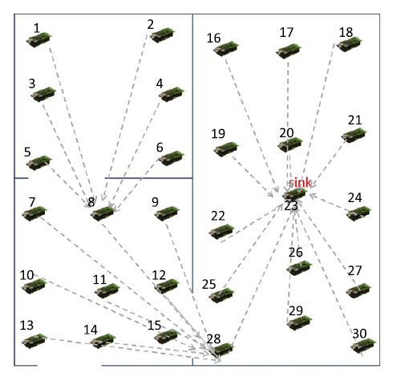
Settings
deployed a real network composed of 30 TelosB motes
one sink node acting as the DAG root
29 RPL routers
indoor office environment
ContikiRPL implementation
The trickle timer parameters Imin and Idoubling are set to 12 and 8
transmission power is set to 25 dBm
Default Objective Function in Contiki which is MRHOF with ETX metric
in three
The node with ID 23 is the DAG root.

Slide 93
Settings
We considered two scenarios:
a single broadcast domain scenario, where all nodes hear each other, and
a multiple broadcast domain scenario, where nodes are placed in a multi-hop topology such that the routers are distant from each other with a range varying from 1 to 4 hops.

Slide 94
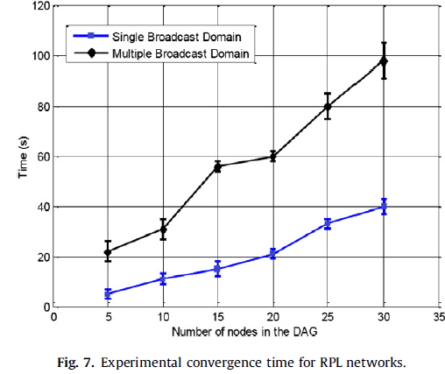
DAG convergence time
the time at which the DAG is completely constructed and all the nodes have joined the network
linearly increases with the number of nodes in the DAG for both single&multiple broadcast domains.
convergence time in the multiple broadcast domain is at least four times larger than that of the single broadcast domain. （the impact of the number of hops on the time needed to join the network）
convergence time becomes remarkably large when the number of nodes increases.
the lossy nature of the channel, since control packets need to be retransmitted when they are lost
The duty cycle radio protocol used in ContikiMAC, which induces additional delays in particular when the topology grows
the impact of the trickle timer parameter (Imin = 4 s), which makes the DIO retransmissions occur after an important delay.

Slide 95
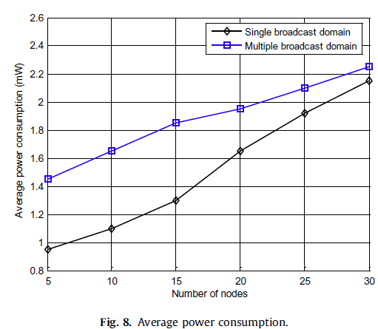
Power consumption
the average energy consumed of each node in the DAG during the DAG construction
process.
the power consumption increases with the number of routers in the DAG
the multiple broadcast domain consumes more power in the network set-up process than the single broadcast domain does. However, the gap becomes smaller as the number of nodes increases and the average consumed energy converges towards 2 mW for both scenarios.
This demonstrates that the effect of multi-hop becomes less important for large networks and that the number of nodes represents the major factor of energy dissipation.

Slide 96
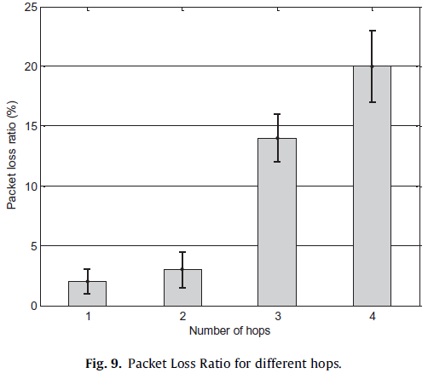
Packet loss
assess the reliability of RPL, we measured the packet loss ratio, which is defined as the ratio of the number of lost packets to the total number of packets.
the packet loss ratio for 1 and 2 hops is relatively low (between 1% and 4%).
However, this ratio significantly increases with greater hop counts reaching 20% for 4 hops. This is due to the following reasons:
packet losses have a cumulative effect when the number of hops increases, due to increasing chances for a packet to get lost from one hop to another,
link quality fluctuations of low-power and lossy links, which results in temporary losses of connectivity in particular for those disturbed by obstacles. This was the case of large hop counts in our experiment. These results raise questions about the effectiveness of the default Objective Function relying on the ETX metric to select routes.

Slide 97
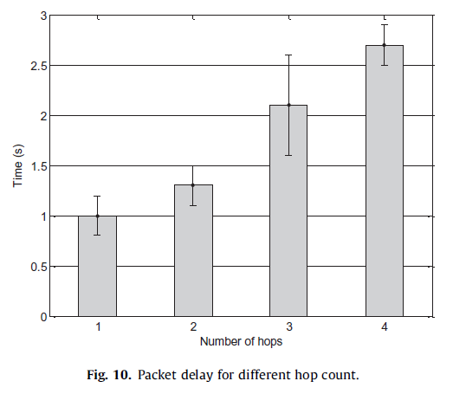
Packet delay
the duration between the transmission time of the Ping Request message and the reception time of the Ping Reply message. (analyzer tools Wireshark & Z-Monitor )
the packet delay increases almost linearly with the number of hops between the source and destination. It varies from 1 s for single hop distant motes to 2.7 s for motes that are 4 hops away.
The measured packet delays represent an acceptable real-time performance considering the low-power and resource limitation nature of sensor nodes.
We alert the reader that such observed delays are not tightly dependant on the design of the RPL routing protocol as they are biased by other factors such as sleepy devices and the packet loss ratio; i.e. a higher loss ratio induces more retransmissions and thus increases the delay.

Slide 98
Packet delay
the duration between the transmission time of the Ping Request message and the reception time of the Ping Reply message. (analyzer tools Wireshark & Z-Monitor )
the packet delay increases almost linearly with the number of hops between the source and destination. It varies from 1 s for single hop distant motes to 2.7 s for motes that are 4 hops away.
The measured packet delays represent an acceptable real-time performance considering the low-power and resource limitation nature of sensor nodes.
We alert the reader that such observed delays are not tightly dependant on the design of the RPL routing protocol as they are biased by other factors such as sleepy devices and the packet loss ratio; i.e. a higher loss ratio induces more retransmissions and thus increases the delay.

Slide 99
Thank you for your attention!
王瑜

Slide 100
TinyRPL
RPL

