Slide 1
Intro to drug design exemplified with opioids
Have you ever pondered the process of how drugs are conceived, rationalized, and eventually made? What are the mental and practical procedures that drive this sector, valued at several thousand billion dollars, making it one of the most economically significant sector of our society? If such questions have ever sparked your curiosity, join us at the ERA Chair Excursion at IMTM, where the world-renowned Professor and ERA Chair, Alexander Domling, will delve into the research and development of new drugs. He will focus on one of the most intriguing classes of drugs: *opioids. Among these, he will discuss **Fentanyl*, a drug that, for better or worse, is reshaping our world.
Intro: ppt presentation and tour through IMTM (Alex Domling, Tomáš Ozdian)
Computational entertainment (Riccardo Fusco): pymol, autodock vina, MD calculation

Slide 2

Where do I come from?
Study of Chemistry & Biology at TUM 1982
PhD with Ivar Ugi 1992
Postdoc with Barry Sharpless @ Scripps (La Jolla, CA)
Professorships at TUM, University of Pittsburg, University of Groningen, UPOL
Serial entrepreneur (Morphochem, Carmolex, etc etc)
Experienced Group Leader
  Hundreds of employees in companies
  >50 MS, >80 PhD students; >10 PD students
Lifetime focus on synthetic and computational MCR chemistry and applications in medicinal chemistry

Slide 3


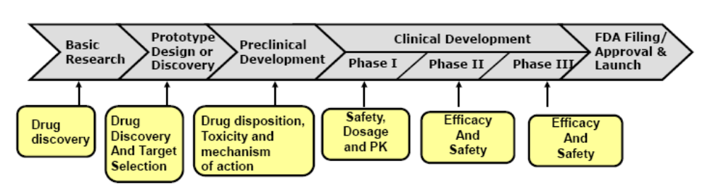
Drug Discovery and Development Overview

Slide 4
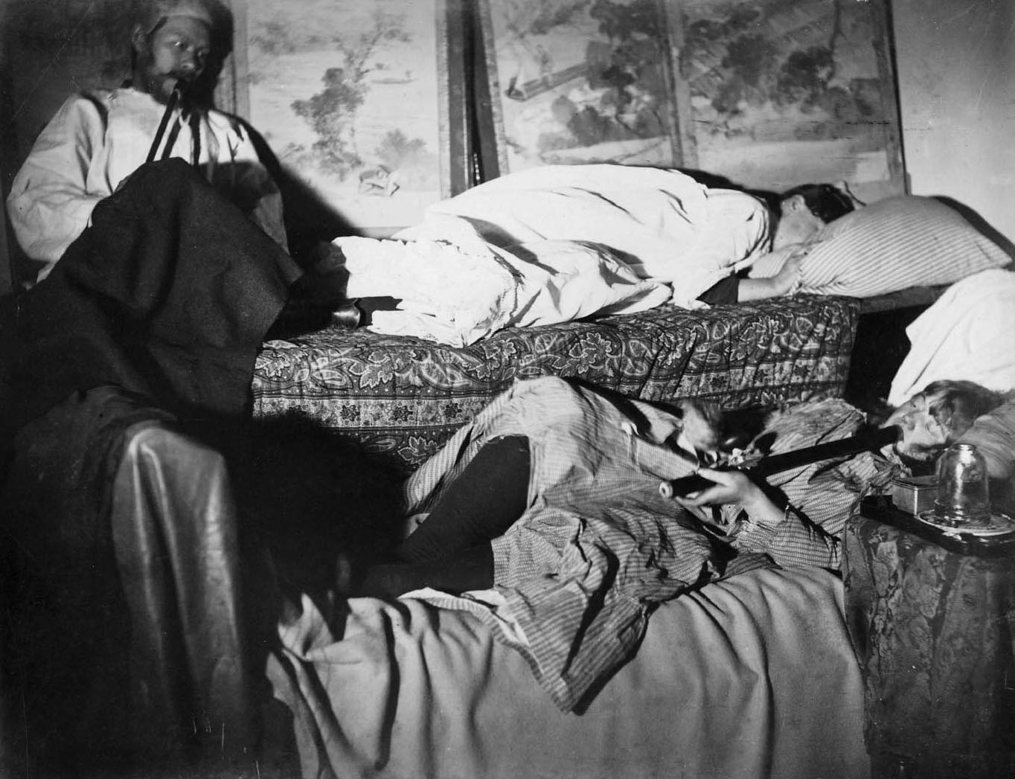
Opioid Analgetics & Antagonists

Slide 5
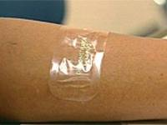
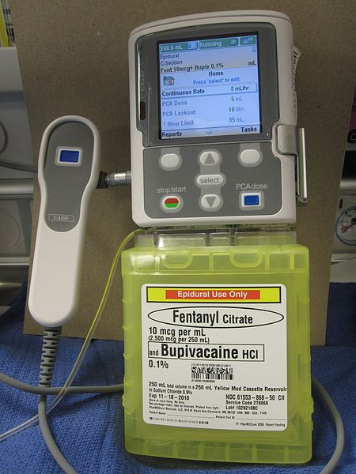
Clinical Pharmacology
Pain management is a most advanced area in medicine!
Severe constant pain management (cancer, terminal illness)
  Consider sustained release forms (MSContin, fentanyl patch)
  Obstetric labor
  Iv morphine for acute pulmonary edema associated with left ventricular heart failure
  Cough suppression at low doses
  Diarrhea control
  Shivering
  Premedication during anesthesia
Alternative administration routes
  Rectal suppository
  Transdermal patch
  Intranasal
  Buccal transmucosal
  Patient-controlled analgesia (PCA) in postoperative pain control

Slide 6
Toxicity
Tolerance / (Psychological) Dependence:
  T after 2-3 weeks of frequent exposure
  Compound dependent
  Cross tolerance (=> different receptor selectivity)
  Symptoms: hyperthermia, diarrhea, vomiting, hostility, chills, yawning, anxiety
  heroin and morphine dep. usually start 6-10 h after last dose
  Metadone, buprenorphine, clonidine treatment
Overdoes treatment with naloxone iv
Drug Drug Interaction in terminally ill patients due to multimedication (e.g. MAO inhibitors, tranquilizers, sedative-hypnothics)

Slide 7
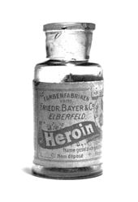
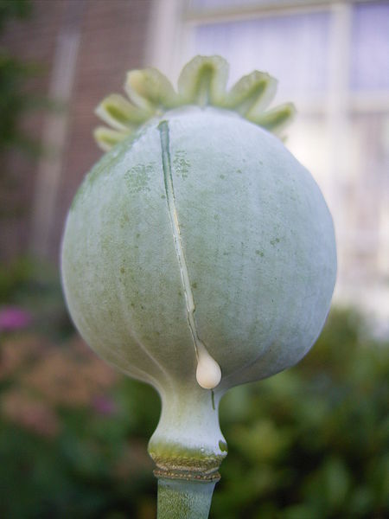
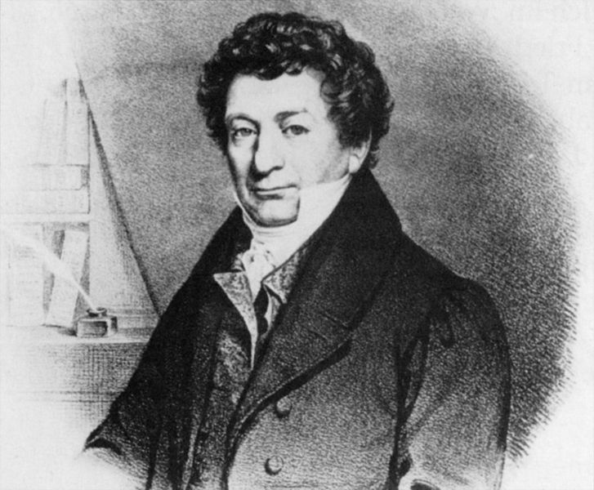
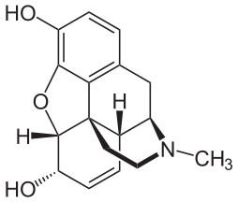
Summary
Opium (poppy tears) amongst the oldest in use analgesic of mankind
Friedrich Wilhelm Adam Sertürner isolated in 1803 morphine from crude opium from poppy
Morpheus = Greek god of dreams
(Ant)agonist (counter)act on the opioid receptors (morphine; naloxone)
CNS effects
  Analgesia, euphoria, sedation, respiratory depression, cough suppression, miosis, truncal rigidity, nausea & vomiting, temperature
Peripheral effects
  Cardiovascular, GI, biliary tract, renal, uterus, neuroendocrine, pruritus

Slide 8
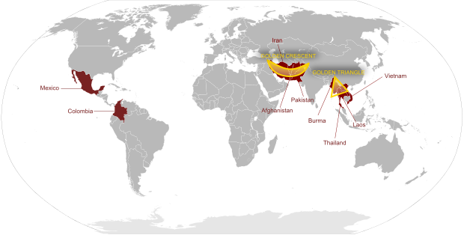
Opium Production
Illegal: Afghanistan, Laos, Thailand, Myanmar
Legal: Turkey, India, France,
From: Wikipedia

Slide 9
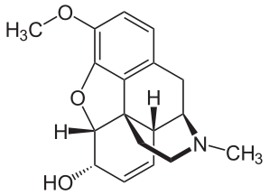
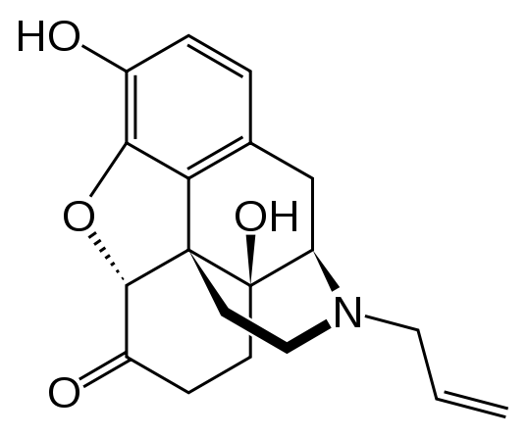

Morphium
Main alkaloid of opium (10%)
Full agonist of μ-opioid receptor
Codeine synthesized from morphine is a partial (“weak”) agonist of μ-opioid receptor
Other receptors: δ, κ
Naloxone is a strong μ-opioid receptor antagonist
3D information available on receptor ligand interaction (morphinan antagonist, naltrindole, JDTic, peptide ligand)
CNS receptors

Slide 10
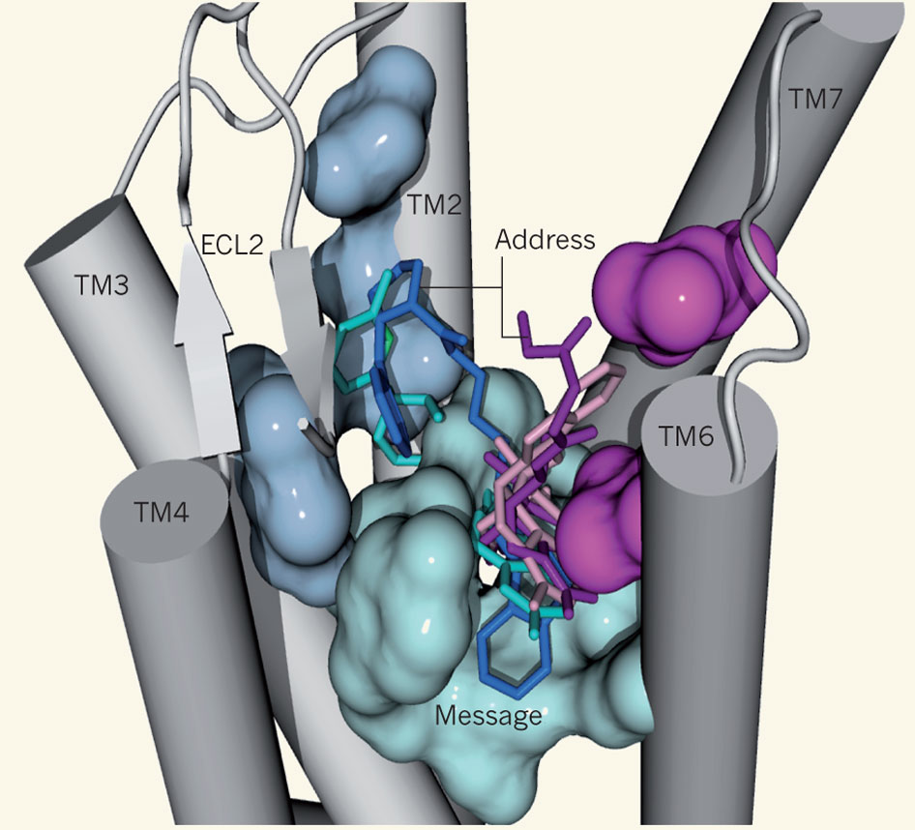
opioid selectivity
ligand's efficacy
Notes:
The structures of the four types of opioid receptor, each in complex with a different opioid antagonist, have been solved^{2, 3, 4, 5}. A side view of one of the structures — that of the nociceptin/orphanin FQ peptide (NOP) receptor — is depicted to show features shared by all four receptor types. Only five of the seven transmembrane helices (TM1–7) are shown (grey cylinders). ECL2 is a β-hairpin loop region; the arrows represent β-sheets. The four antagonists used in the studies are depicted as stick representations in the NOP receptor's binding pocket. The cyan surface indicates the amino-acid residues from TM3, TM6 and TM7 that interact with the ligands' 'message' regions, responsible for a ligand's efficacy. The magenta surfaces indicate the residues from TM6 and/or TM7 that interact with the 'address' region — responsible for opioid selectivity — of classical ligands, which contain the 'morphinan' chemical structure. The light-blue surfaces represent residues from TM2 and TM3 that interact with the address region of non-classical opioids.

Slide 11
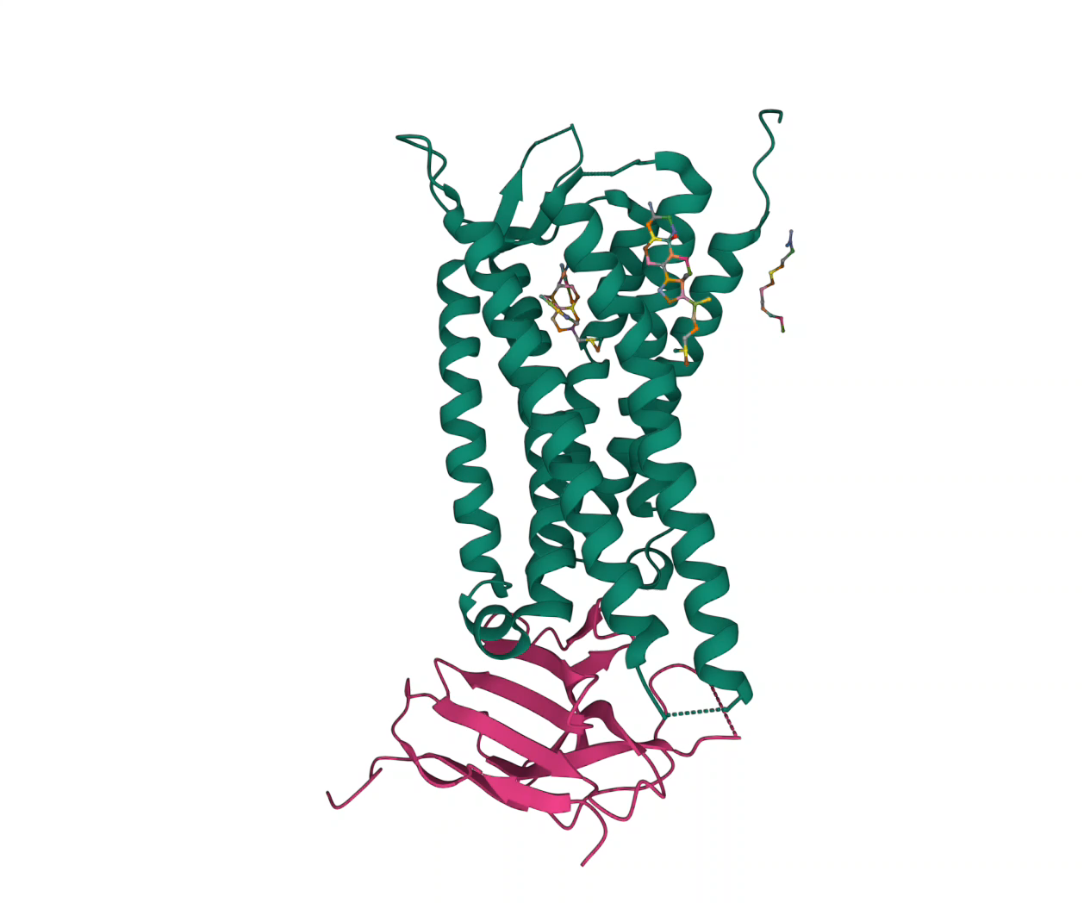
PDB ID 6B73
Crystal Structure of a nanobody-stabilized active state of the kappa-opioid receptor

