Slide 1

Unified Mentor

Slide 2
Project-1
Pizza Sales

Slide 3
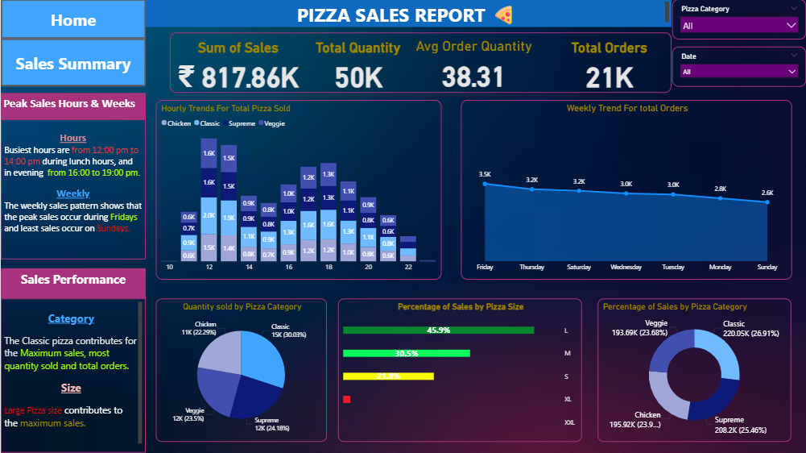

Slide 4
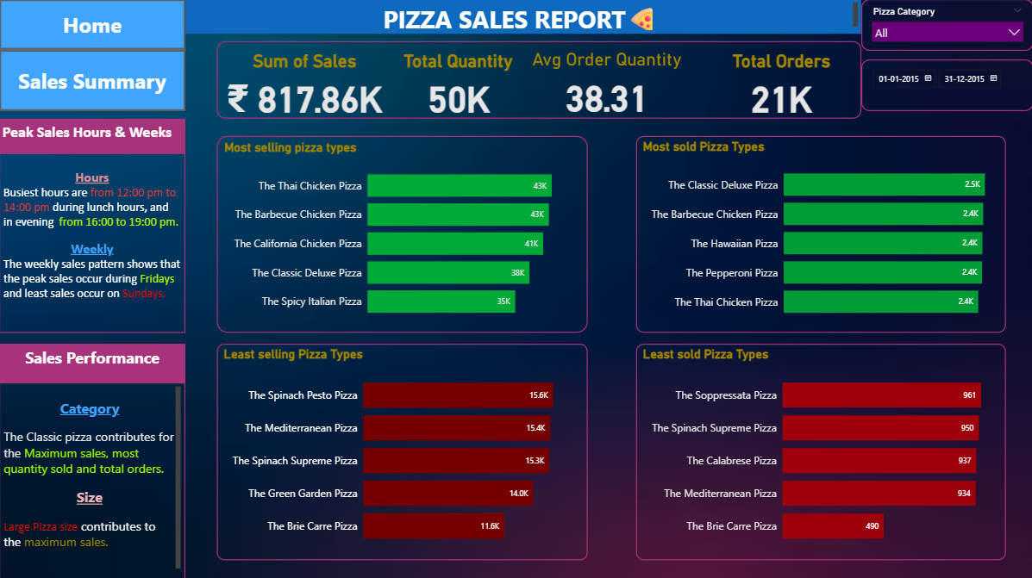

Slide 5
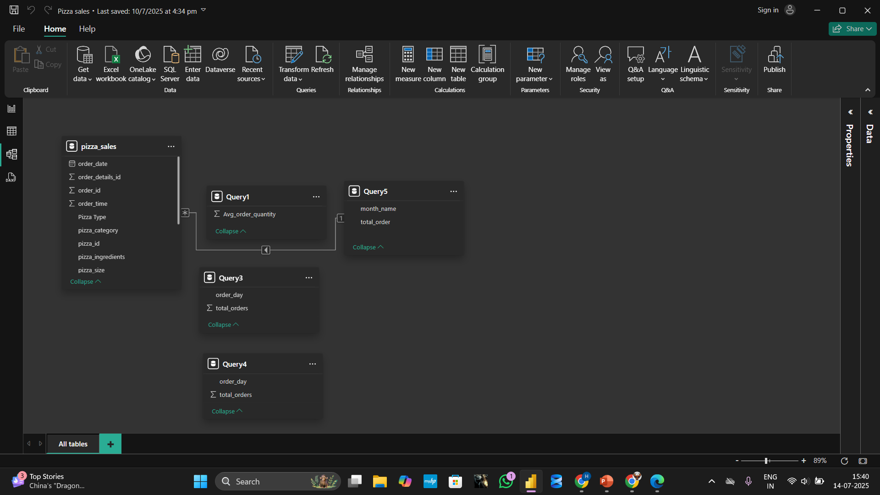

Slide 6
Pizza Sales Insights(KPIs)
1. Peak Sales Period:
Peak Hours
The peak sales hours are during lunch periods between 12:00 pm and 14:00 pm.
Peak Days
The days business tends to be most busiest is during Weekends.
The most orders are during Fridays, and the least orders are during Sundays.

Slide 7
2. Most and Least sold Pizza Category
Based on sales data the highest-selling pizza category is Classic and the lowest-selling pizza category is Veggie.
3. Sales by Pizza Size
According to the data the L size pizza is the most frequently ordered one, while the least ordered size is the XXL size pizza.

Slide 8
3. Five Most popular Pizza Types (Sales Volume)
The top 5 most popular pizza types are as follows:
The Thai Chicken Pizza at 43k sales.
The Barbecue Chicken Pizza at 43k sales.
The California Chicken Pizza at 41k sales.
The Classic Deluxe Pizza at 38k sales.
The Spicy Italian Pizza at 35k sales.

Slide 9
4. Five Least Popular Pizza Types (Sales Volume)
The bottom 5 least popular pizza types are as follows:
The Brie Carre Pizza at 11.6k sales.
The Green Garden Pizza at 14k sales.
The Spinach Supreme Pizza at 15.3k sales.
The Mediterranean Pizza art at 15.4k sales.
The Spinach Pesto Pizza at 15.6k sales.

