Slide 1
Aspect Based Sentiment Analysis
A study on crowdsourced game reviews
Hiten Gupta
Raseshwari Pulle
Sultan mira
Prakhar Rawat

Slide 2

Overview
Motivation
Background
Approach
Experimental Setup
Results
Demo
Conclusion

Slide 3
Motivation
Although the game companies invest a substantial amount of time and money in user experience design, the efforts of user experience specialists are not enough to guarantee a successful game release.
Though the users enjoyed separate parts of the game, a narrative that did not meet the players’ expectations spoiled their experience.

Slide 4
Background

Slide 5

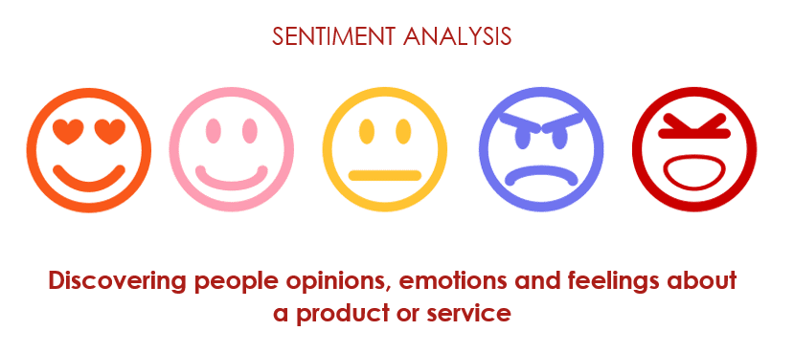
An aspect based sentiment analysis (ABSA) is performed when user sentiment of certain aspects of a multi-aspect entity is to be measured, in a dataset gathered from user comments, such as online forums or user created reviews. Video games have plenty of aspects that the user consider when playing, e.g. playability, graphics, storyline.

Slide 6



Aspect Based Sentiment Analysis

Slide 7



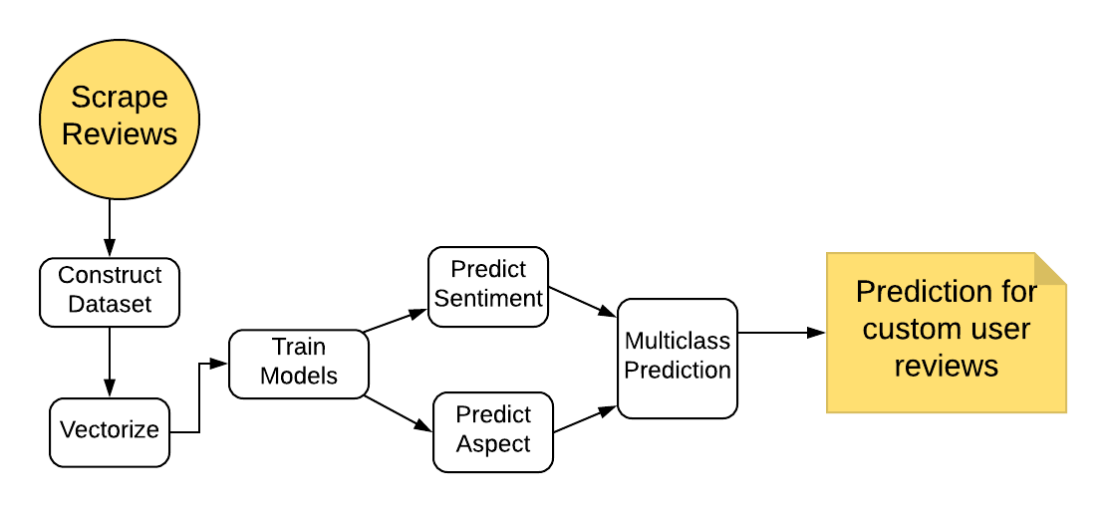
Approach Task Flow

Slide 8
Algorithms Used
Naïve – Bayesian Classifier
KNN
Linear SVM
Logistic Regression

Slide 9
Experimental Setup

Slide 10
Games in the Study
Devil May Cry
Overwatch
Call of Duty : Black Ops

Slide 11
Steps
Data crowdsourcing (Metacritic.com)
Data Cleansing/Preprocessing(NLTK & Pandas)
Train Model(scikit Learn)
Evaluate Prediction using custom reviews
Notes:
Tried different ratios in splitting dataset and finalized 70-30

Slide 12
Results

Slide 13
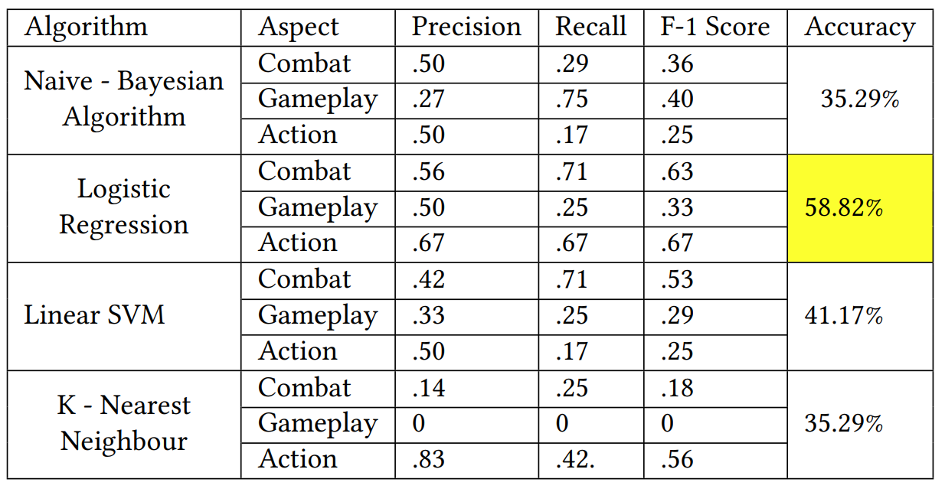
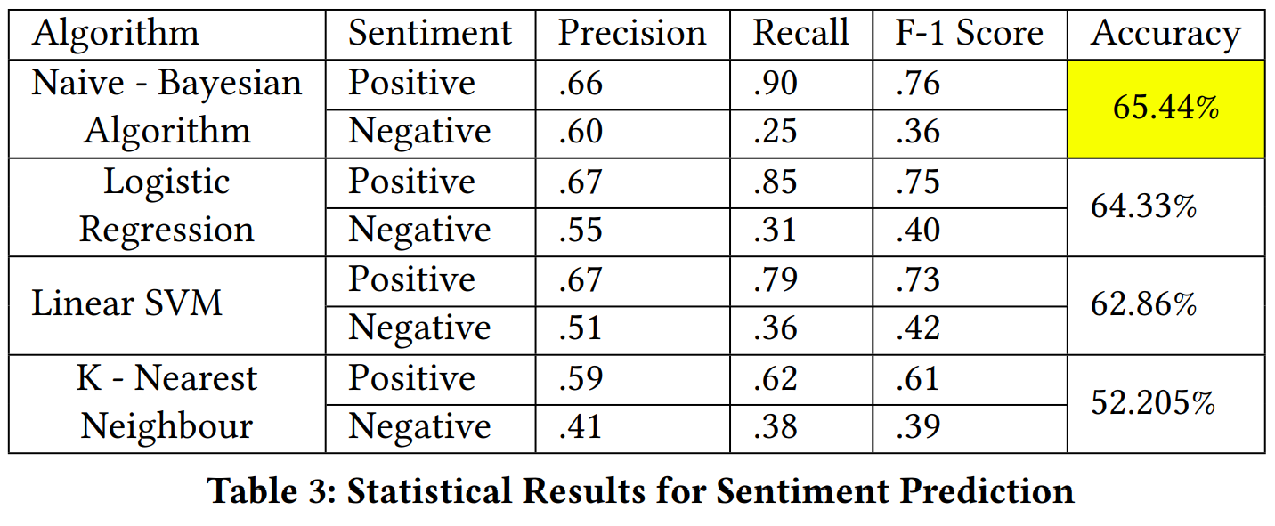
Classifier Performance
Sentiment
Aspect

Slide 14
Demo

Slide 15
Conclusion
We implemented aspect based sentiment analysis on game reviews scraped from Metacritic website.
Approach implemented and verified using four different Classifiers (NB - Classifiers, KNN, SVM, Logistic Regression)
Achieved 65% accuracy while predicting sentiments and 59% accuracy while predicting aspects.
Though we have manually created the dataset our results show potential for further extending this work by using reviews of more games and evaluating different classifiers

