Slide 1
Aspect Based Sentiment Analysis
A study on crowdsourced game reviews
Hiten Gupta
Raseshwari Pulle
Sultan mira
Prakhar Rawat

Slide 2
Overviews
Motivation
Context
Approach
Experimental Setup
Results
Validation
Threats to validity

Slide 3
Motivation
Although the game companies invest a substantial amount of time and money in user experience design, the efforts of user experience specialists are not enough to guarantee a successful game release.
Though the users enjoyed separate parts of the game, a narrative that did not meet the players’ expectations spoiled their experience.

Slide 4
Context

Slide 5

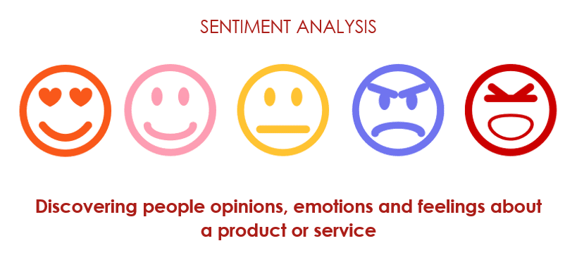
An aspect based sentiment analysis (ABSA) is performed when user sentiment of certain aspects of a multi-aspect entity is to be measured, in a dataset gathered from user comments, such as online forums or user created reviews. Video games have plenty of aspects that the user consider when playing, e.g. playability, graphics, storyline.

Slide 6
Games in the Study
Devil May Cry
Overwatch
Call of Duty : Black Ops

Slide 7
Approach

Slide 8



Sentiment Analysis

