Slide 1
Aspect Based Sentiment Analysis
A study on crowdsourced game reviews
Hiten Gupta
Raseshwari Pulle
Sultan mira
Prakhar Rawat

Slide 2

Overview
Motivation
Background
Approach
Experimental Setup
Results
Demo
Conclusion

Slide 3
Need for ABSA in Game Reviews
Reviews are a rich source of information
In recent times, customer/user attitude researchers have turned to user created content, such as social media, internet forum, and user reviews, with the intent of mining user attitudes from within.
Lack of studies related to analyzing aspects of games through reviews
A video game has many aspects(gameplay, story, etc.) which can be of importance to different stakeholder(developers, requirement engineer, etc.
Notes:
This knowledge of aspects and their reviews by the user helps the evolution of the game .

Slide 4
Problem Statement
To develop an application which predicts the aspect and sentiments of user reviews for games and enable the designers/developers to incorporate user feedback in the game

Slide 5
Background

Slide 6
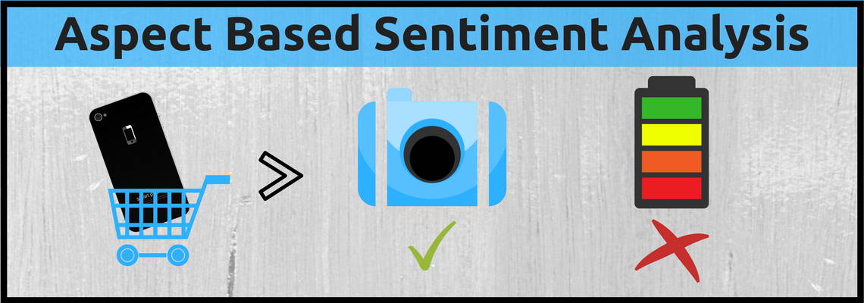
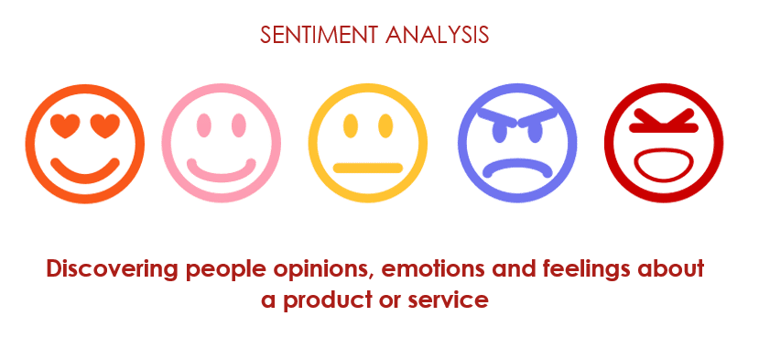
An aspect based sentiment analysis (ABSA) is performed when user sentiment of certain aspects of a multi-aspect entity is to be measured, in a dataset gathered from user comments, such as online forums or user created reviews. Video games have plenty of aspects that the user consider when playing, e.g. playability, graphics, storyline.

Slide 7



Aspect Based Sentiment Analysis

Slide 8



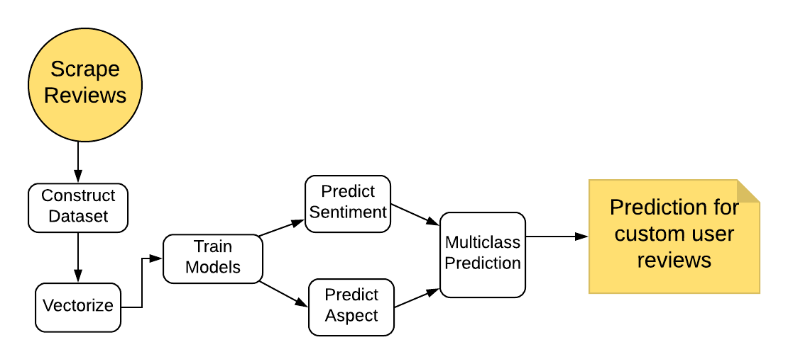
Approach Task Flow

Slide 9
Algorithms Used
Naïve – Bayesian Classifier
KNN
Linear SVM
Logistic Regression

Slide 10
Experimental Setup

Slide 11
Games in the Study
Devil May Cry
Overwatch
Call of Duty : Black Ops

Slide 12
Steps
Data crowdsourcing (Metacritic.com)
Data Cleansing/Preprocessing(NLTK & Pandas)
Train Model(scikit Learn)
Evaluate Prediction using custom reviews
Notes:
Tried different ratios in splitting dataset and finalized 70-30

Slide 13
Results

Slide 14
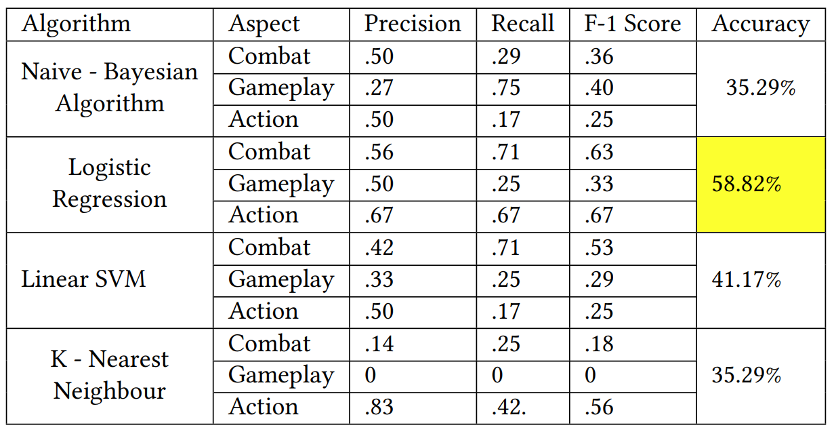
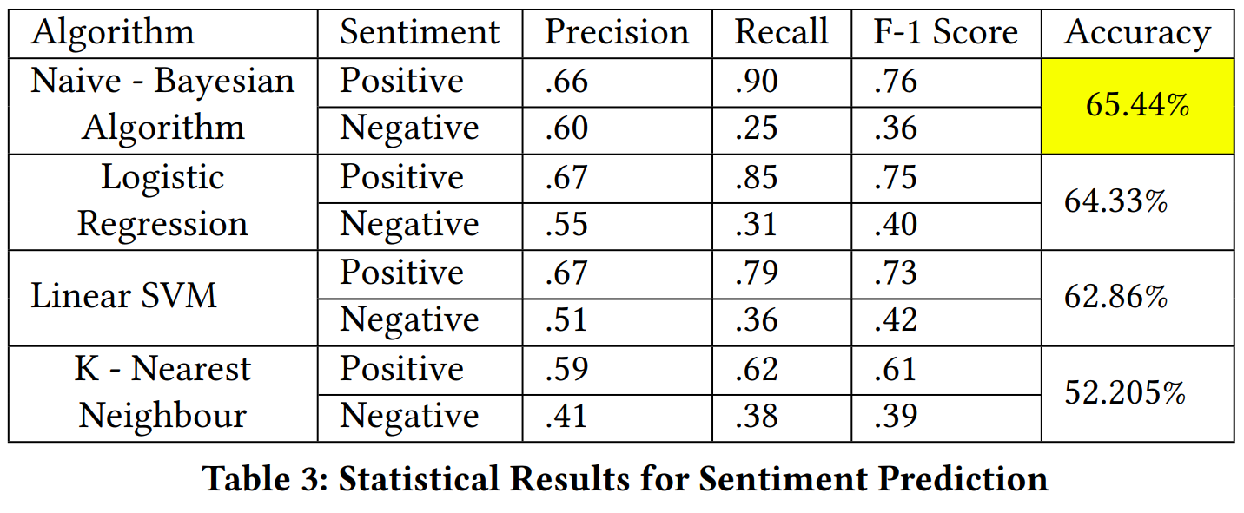
Classifier Performance
Sentiment
Aspect

Slide 15
Demo

Slide 16
Conclusion
We implemented aspect based sentiment analysis on game reviews scraped from Metacritic website.
Approach implemented and verified using four different Classifiers (NB - Classifiers, KNN, SVM, Logistic Regression)
Achieved 65% accuracy while predicting sentiments and 59% accuracy while predicting aspects.
Though we have manually created the dataset our results show potential for further extending this work by using reviews of more games and evaluating different classifiers

