Slide 1
Cyclistic Bike Share Analysis
Prepared by: Hiten Mehta
Audience: Business Team
Focus: Member vs Casual Behavior
Notes:
Welcome. This presentation summarizes insights from Cyclistic bike share data using SQL cleaning and Tableau visualization. The goal is to highlight customer behavior differences and propose business actions.

Slide 2
Executive Summary
• Casual riders take longer trips
• Members ride more frequently
• Clear weekday vs weekend split
• Conversion opportunity from casual to member
Notes:
Casual riders show leisure behavior with longer trips, while members ride frequently and consistently. This contrast reveals a strong opportunity to design conversion strategies that turn casual users into members.

Slide 3
Data Cleaning & Preparation (SQL)
• Calculated ride length in minutes
• Removed negative durations
• Removed rides exceeding 12 hours
• Standardized columns across years
• Merged 2019 and 2020 datasets
Notes:
All cleaning was done in SQL using DB Browser. We computed ride length, removed invalid records, and unified data across years to ensure reliable analysis.

Slide 4
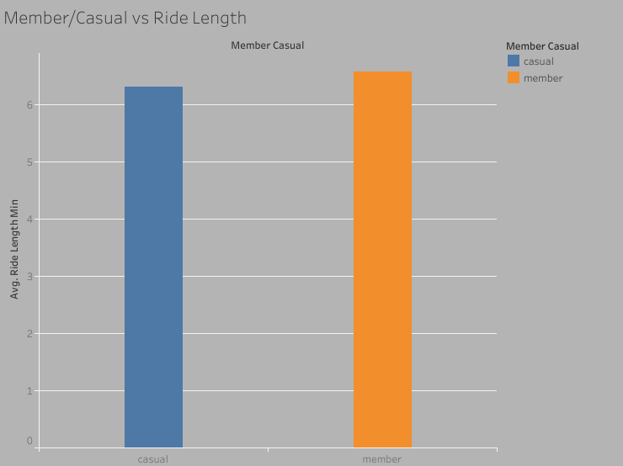
Average Trip Duration v/s Members or Casual
Notes:
Casual riders take longer rides than members, showing leisure usage patterns. This insight supports targeted pricing such as day passes and weekend bundles.

Slide 5
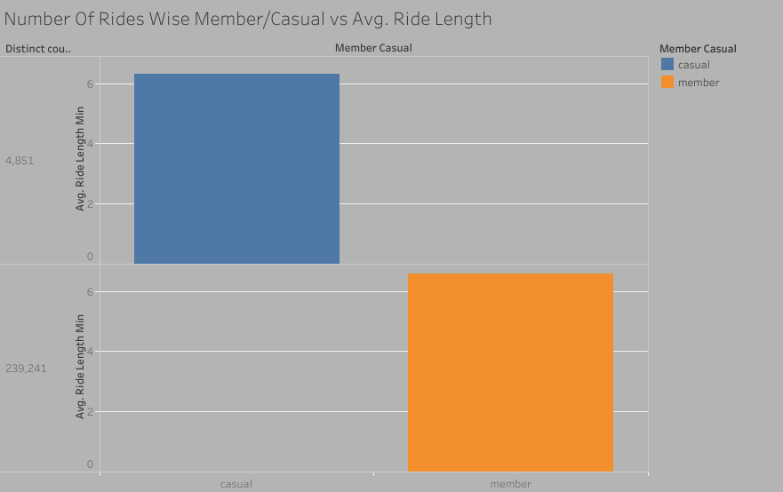
Number Of Rides wise
Average Trip Duration v/s Members or Casual
Notes:
Members generate significantly more rides, but casual riders stay longer per trip. Business focus should be on converting high-duration casual riders into subscriptions.

Slide 6
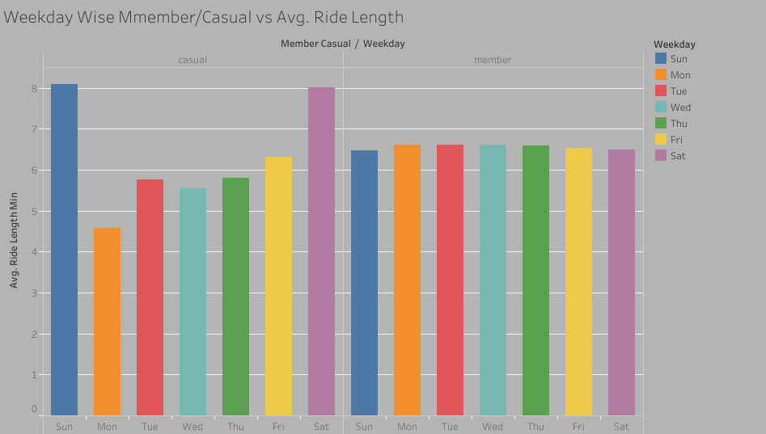
Weekdays Wise
Average Trip Duration v/s Members or Casual
Notes:
Members ride mostly on weekdays, indicating commuting. Casual riders peak on weekends, indicating leisure usage. Campaign timing should reflect these patterns.

Slide 7
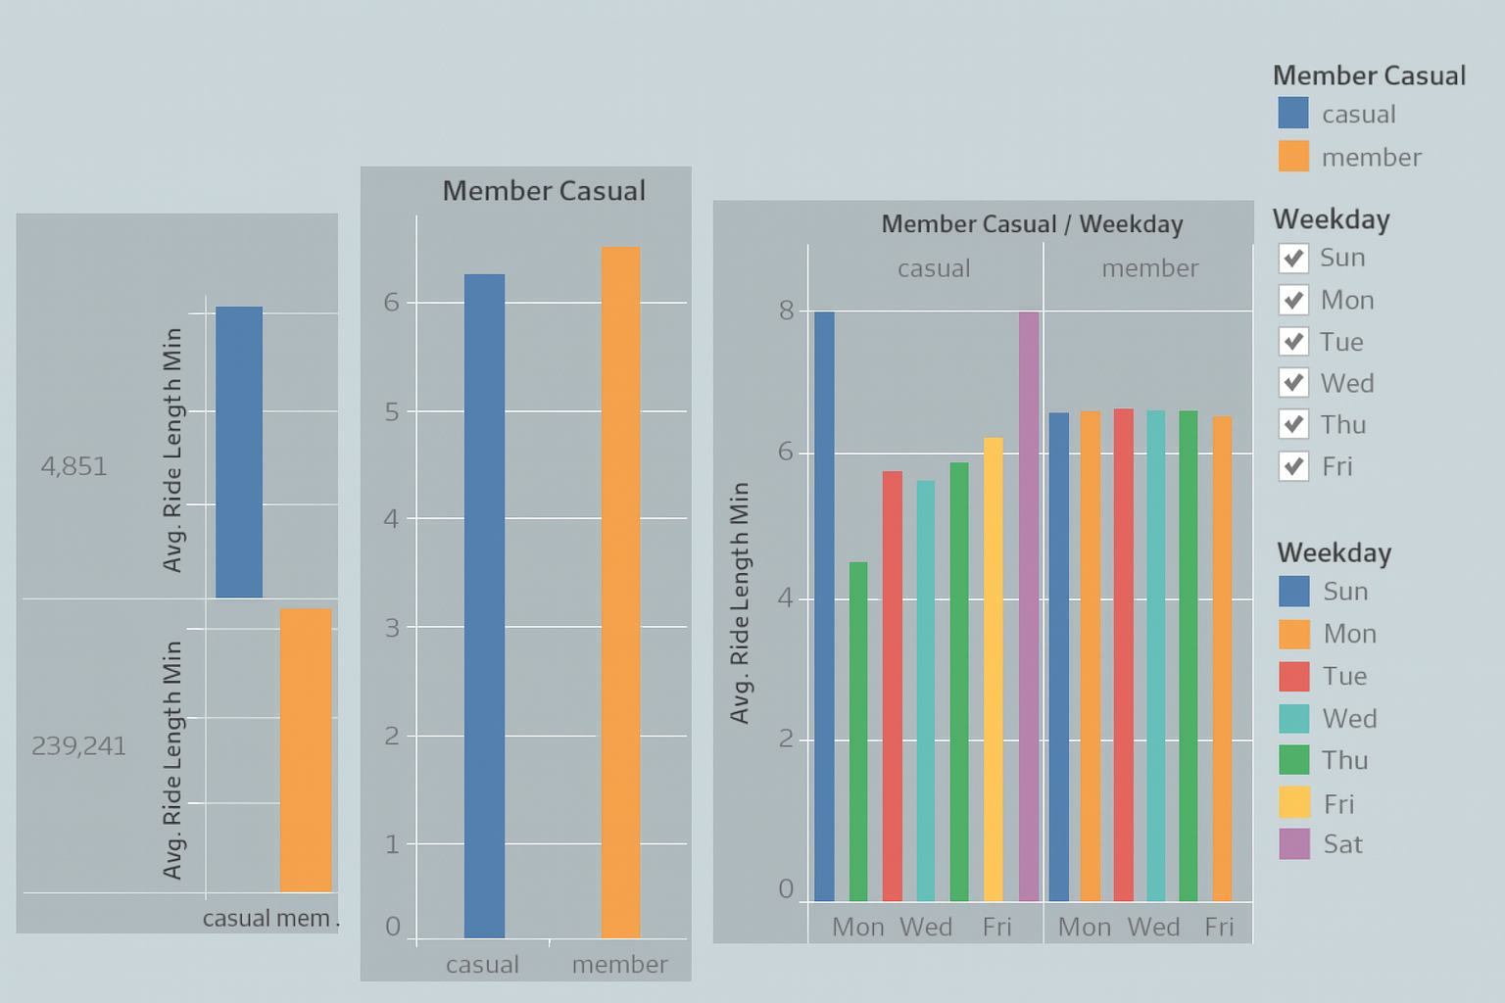
Dashboard Overview
Notes:
This dashboard consolidates rider behavior across metrics, providing a holistic overview for decision-making.

Slide 8
Business Recommendations
• Weekend membership trials
• Tourist-focused short-term plans
• Electric bike promotions
• Loyalty rewards for members
• Time-based commuter passes
Notes:
Recommendations focus on converting casual riders with trial offers and bundles. Members should be retained through loyalty incentives and commuter-friendly pricing.

Slide 9
Conclusion and Next Steps
• Casual riders represent growth
• Members provide stable revenue
• Data-driven strategy improves conversion
• Next: test campaigns and measure impact
Notes:
In summary, data shows a clear business opportunity in targeted conversion strategies. Next steps include controlled experiments and measurement of ROI.

