Slide 1
Logistic regression

Slide 2
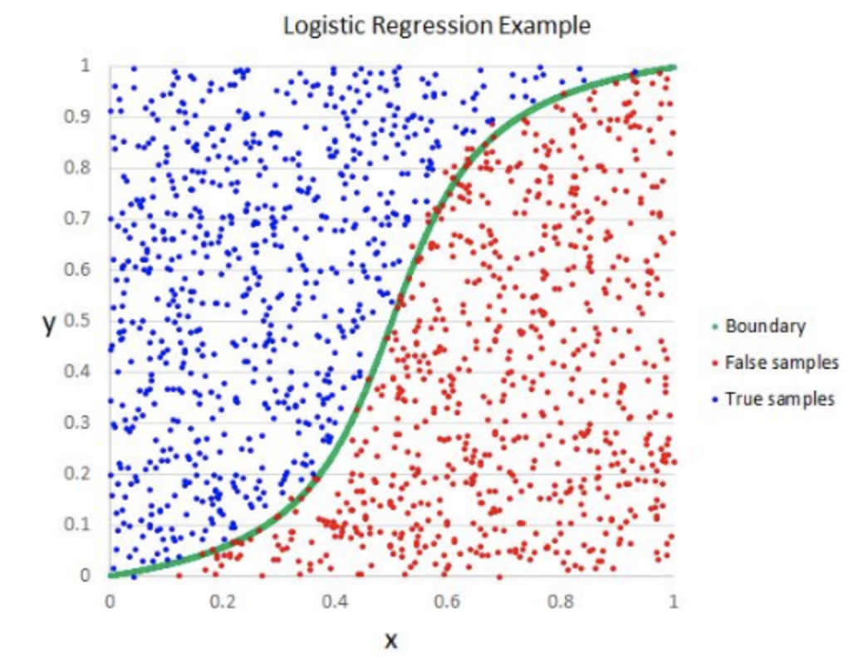
What does it look like?
Green curve is probability curve
A point has to be above the green line for the particular X value to be true.

Slide 3
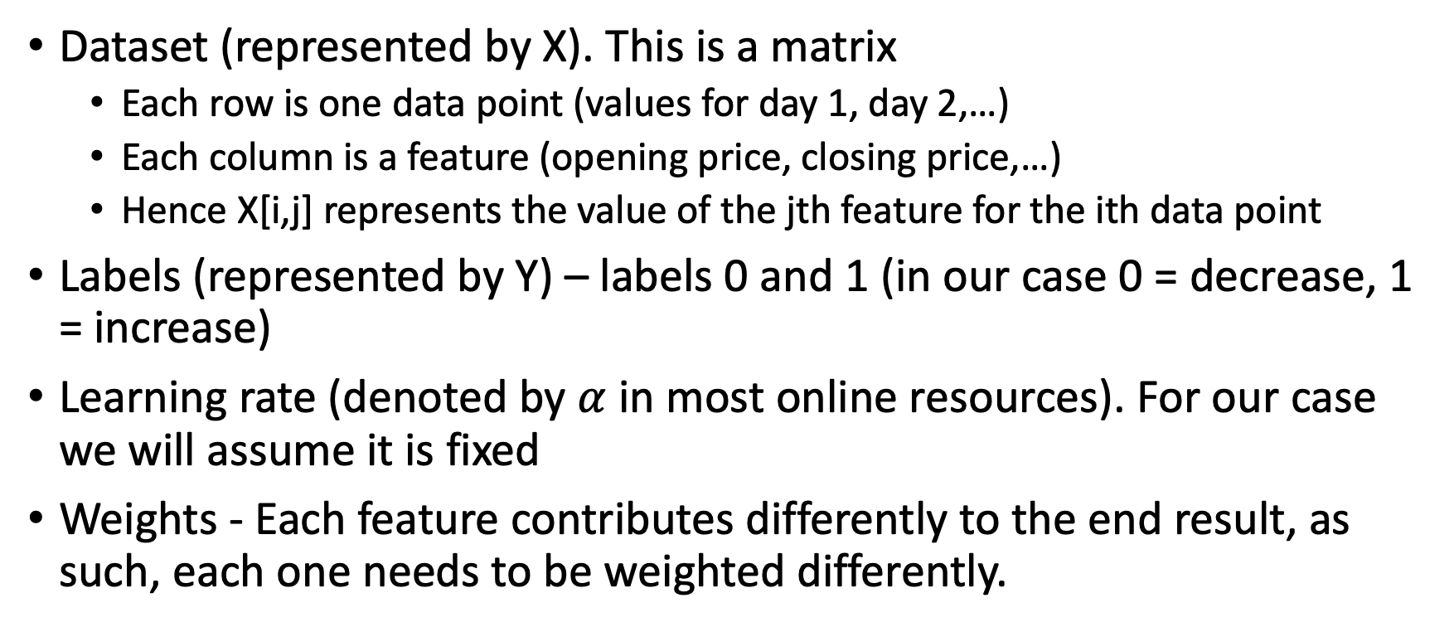
Terminology
Dataset (represented by X). This is a matrix
Each row is one data point (values for day 1, day 2,…)
Each column is a feature (opening price, closing price,…)
Hence X[i,j] represents the value of the jth feature for the ith data point
Labels (represented by Y) – labels 0 and 1 (in our case 0 = decrease, 1 = increase)
Learning rate (denoted by $α$ in most online resources). For our case we will assume it is fixed
Weights - Each feature contributes differently to the end result, as such, each one needs to be weighted differently.

Slide 4
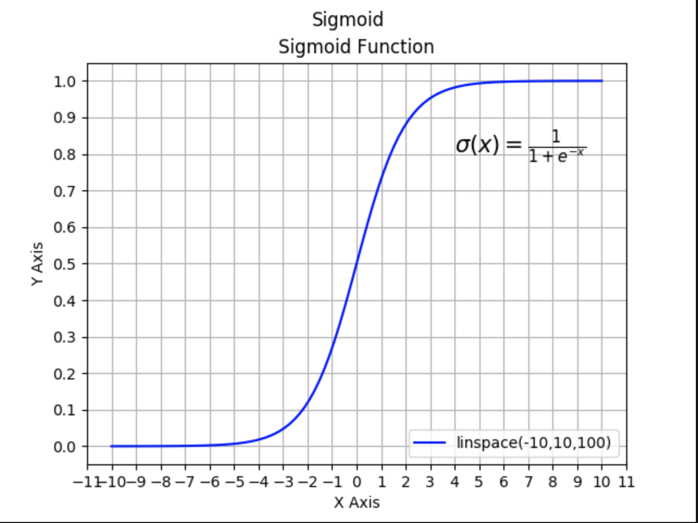
Sigmoid function
Looks a lot like the curve above, right?
We will use this to implement Logistic Regression

Slide 5
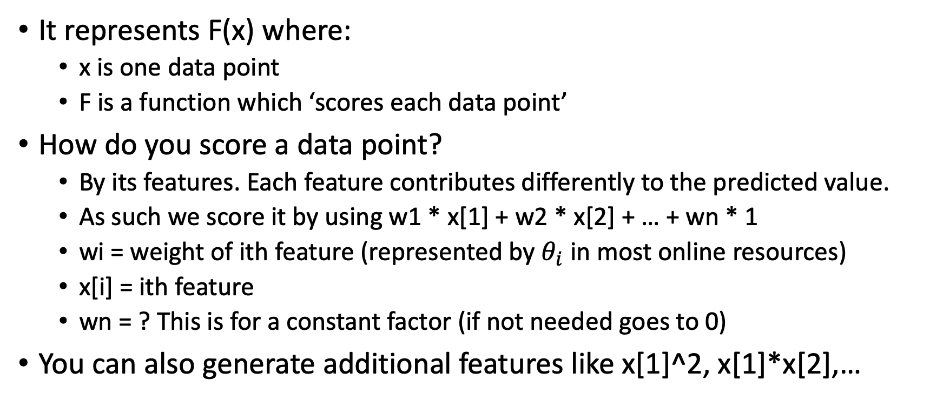
What does X axis represent for us?
It represents F(x) where:
x is one data point
F is a function which ‘scores each data point’
How do you score a data point?
By its features. Each feature contributes differently to the predicted value.
As such we score it by using w1 * x[1] + w2 * x[2] + … + wn * 1
wi = weight of ith feature (represented by $θ_{i}$ in most online resources)
x[i] = ith feature
wn = ? This is for a constant factor (if not needed goes to 0)
You can also generate additional features like x[1]^2, x[1]*x[2],…

Slide 6
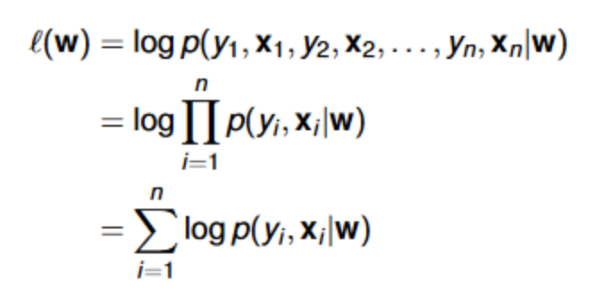
Log likelihood
How to determine if you are progressing or not?
Likelihood: How ‘likely’ is it that your current weights are accurate and fit the data well?
Find probability of data being generated given the weights and multiply them.
Since these are probabilities they’re tiny and multiplying them goes to 0, so take log and add them instead.
Never used to actually score a model, only used to compare two models.
Always negative,
Higher the value (closer to 0), better the model

Slide 7
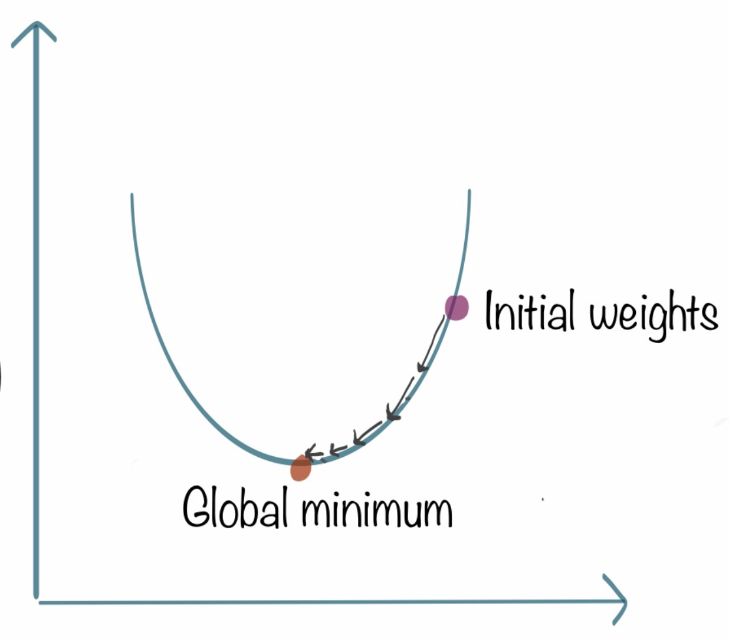
Gradient Descent
Gradient is the slope at any point
Tells you direction you need to go in
Gradient*learning rate is how much you travel by
If learning rate is too small, it takes forever to reach the minimum
If learning rate is too high, you can overshoot the minimum and just never reach it (go too far to the left, then too far to the right, continue indefinitely)
Y axis = loss value (global minimum = least loss => best model)
X – axis = Same as x-axis for sigmoid function

Slide 8
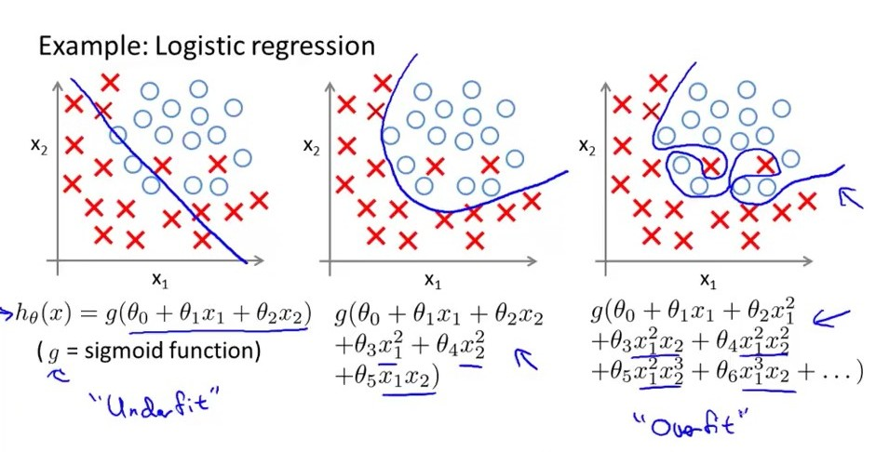
Overfitting, Underfitting (If we have time)
Look at left side. What’s the difference?
Left one has too little features, it can be made better
Right one has too many features, it is basically trying too hard to get everything right
In the long run (for testing), both approaches are bad, and the middle approach is the best
Very hard to figure out, do it by trial and error.
This Photo by Unknown Author is licensed under CC BY-SA

Slide 9
What now?
I know I said multiple times it is one of the easiest models to train and use, but a lot of it was dense math. As such, in the slides, I tried to ensure everything was standard notation so if you do look them up, you can find relevant resources easily
Please DON’T use this as your actual algorithm stock trading, it abstracts away a lot of information, and you’ll most definitely lose money but if this field does interest you, look at next slide (it is profitable with some time investment)
This barely scratches the surface of both ML and Stocks, there’s a ton of cool projects you can do with either!

Slide 10
Resources to get into trading
Field called: Quant
https://www.reddit.com/r/algotrading/comments/a291ir/any_resources_for_machine_learning_algo_trading/
https://github.com/stefan-jansen/machine-learning-for-trading
https://www.tradientblog.com/2019/11/lessons-learned-building-an-ml-trading-system-that-turned-5k-into-200k/
If you need more, just contact me… I’ll see what more I could do…

