Slide 1
Problem Statement
BIS standards are authoritative, but discovering the right IS code from dense PDFs is slow and error-prone.
Search Friction
Compliance Risk
Hackathon Goal
Small manufacturers often know the product description, not the exact standard number.
Wrong or missed standards can delay certification, procurement, QA, and documentation.
Return the correct BIS standards quickly, reproducibly, and without hallucinated codes.
Our project converts a BIS PDF corpus into a fast standards lookup system for MSE-style natural language queries.
BIS Standards Retriever | 1/8

Slide 2
Solution Overview
A deterministic hybrid retriever tuned for Indian Standards search
PDF Corpus
Page Index
Hybrid Retrieve
Rerank
Validated Top-K
Extracts text and IS-code mentions from `dataset.pdf` using PyMuPDF.
Builds cached search structures for repeatable and fast inference.
Combines BM25 lexical ranking with fuzzy token-set similarity.
Adds query expansion, explicit standard hints, category boosts, and method-standard penalties.
Delivered Artifacts
Judge entry point: `inference.py` Submission: `data/submission.json` Demo: `streamlit_app.py` Evaluation: `eval_script.py`
BIS Standards Retriever | 2/8

Slide 3
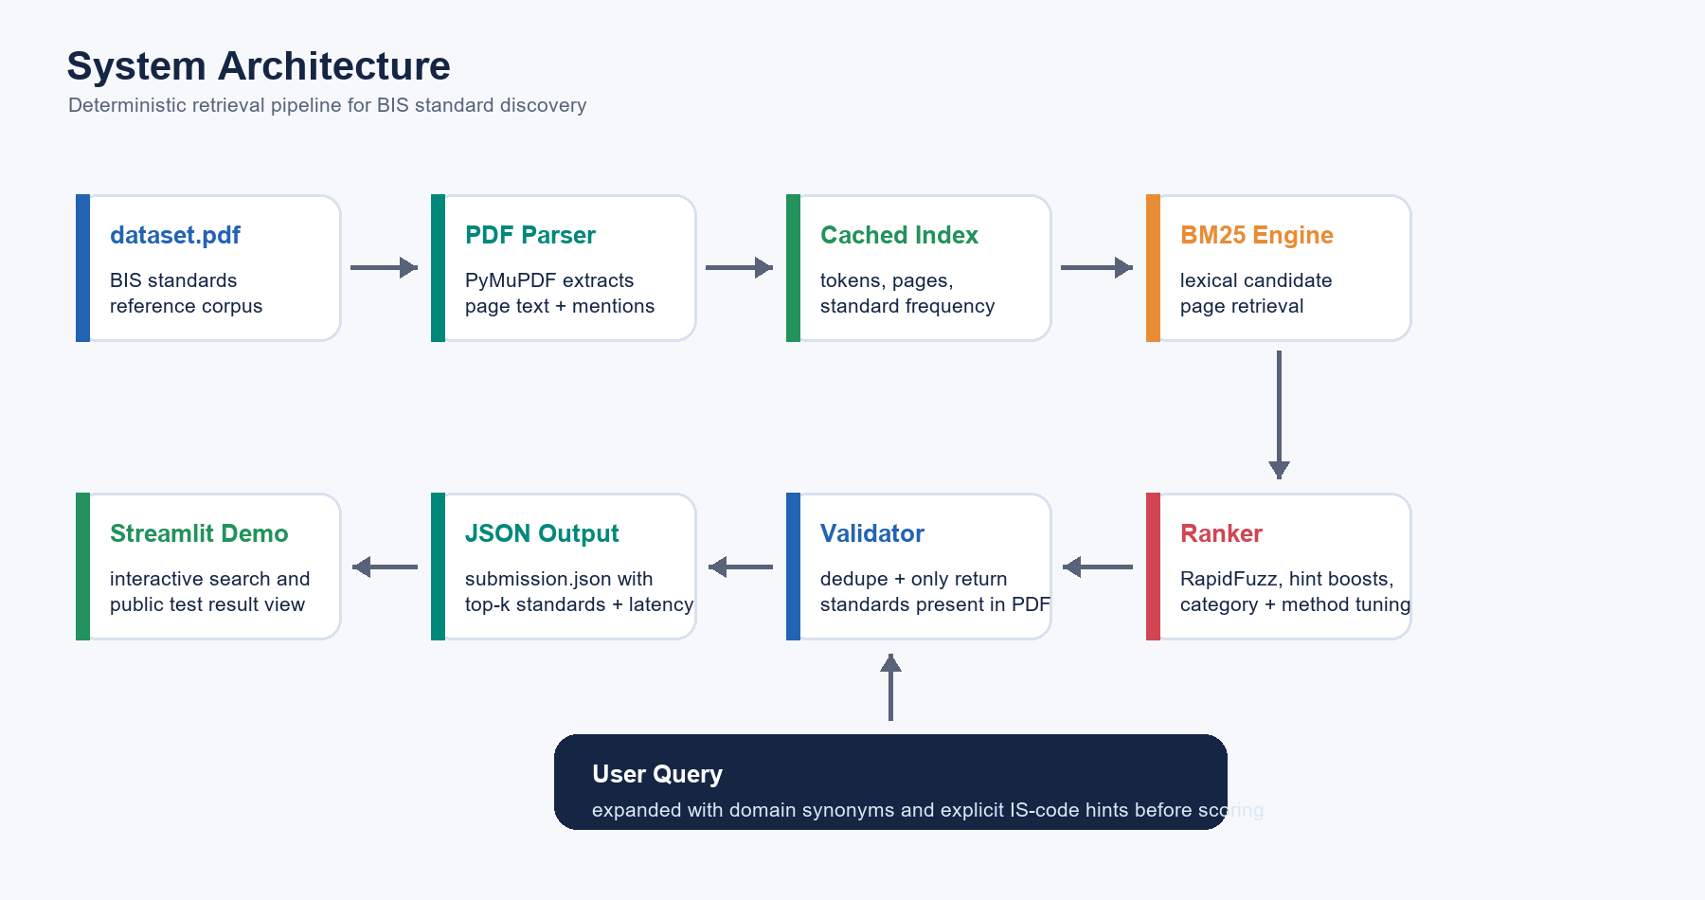
System Architecture
Pipeline generated from the actual project implementation
BIS Standards Retriever | 3/8

Slide 4
Chunking & Retrieval Strategy
Why the system stays fast while still finding exact IS codes
Chunking
Candidate Retrieval
Reranking
Page-level text extraction preserves local context around standard mentions and avoids over-fragmenting the PDF.
BM25 ranks top candidate pages from expanded query tokens; the search explores up to 200 pages.
RapidFuzz similarity, rarity weighting, year weighting, explicit hints, and category-aware boosts refine the final list.
Standard normalization deduplicates variants such as spacing, parts, and years.
Validation checks returned standards against the source-derived index to avoid hallucinations.
Fallback ranking fills top-k only from standards seen in the PDF corpus.
BIS Standards Retriever | 4/8

Slide 5
Demo Highlights
What reviewers can see live
Interactive Search
Public Test View
Streamlit query tab accepts natural language product queries and returns ranked BIS standards with scores/latency.
A second tab loads `data/submission.json`, compares results with expected standards, and marks hits.
Example Queries
Reproducible Commands
33 Grade Ordinary Portland Cement -> IS 269: 1989
Coarse and fine aggregates -> IS 383: 1970
White Portland cement -> IS 8042: 1989
`python inference.py`
`python eval_script.py --results data/submission.json`
`streamlit run streamlit_app.py`
BIS Standards Retriever | 5/8

Slide 6
Evaluation Results
Measured on the 10-query public test set
Hit Rate @3
MRR @5
Avg Latency
100.00%
0.8167
0.03 sec
Target: >80%
Target: >0.7
Target: <5 sec
All 10 public queries have at least one expected standard in the top 3 results.
Most product-specific queries rank the target at position 1; harder cement variants still land within top 3.
Cached indexing keeps inference lightweight and deterministic for judge evaluation.
BIS Standards Retriever | 6/8

Slide 7
Impact on MSEs
Turning dense standards documents into practical compliance support
Faster Compliance
Lower Risk
Better Operations
Teams can move from product description to relevant IS code in milliseconds instead of manual PDF search.
Validated retrieval reduces missed standards and discourages unsupported answers.
Useful for certification prep, procurement specs, QA checklists, and customer documentation.
The system is especially useful for small teams that need reliable standards discovery without maintaining a full compliance research function.
BIS Standards Retriever | 7/8

Slide 8
Team & Acknowledgements
BIS Standards Retriever
Team Members
Hiten Anand Manavi Bangani
Thank you
BIS Standards Retriever | 8/8

