Slide 1
Application of Multiple client services by server using Socket Programing
Prepared by : Hiten Padiya
Designation : Engineer (SW)
Employee ID : VVDN/2157
Application

Slide 2


Services
1. Create c file
2. Chatting
3. Read specific content from the text file

Slide 3
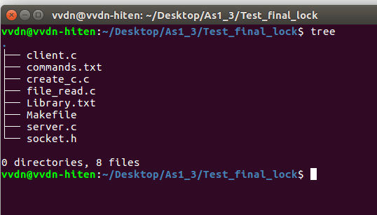
Application tree

Slide 4
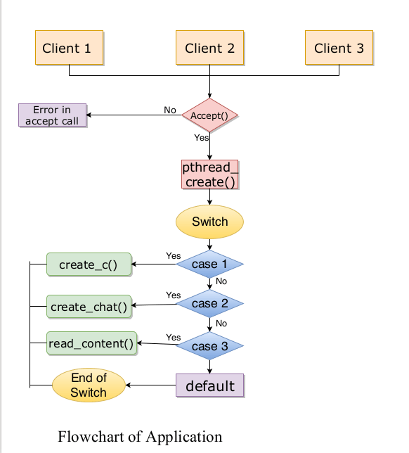
Flowchart of Application

Slide 5
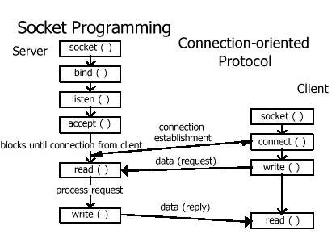
Socket Programming

Slide 6
Socket Programming
Socket programming is a way of connecting two nodes on a network to communicate with each other.
Server forms the listener socket with particular port and IP and while client reaches out to the server.

Slide 7
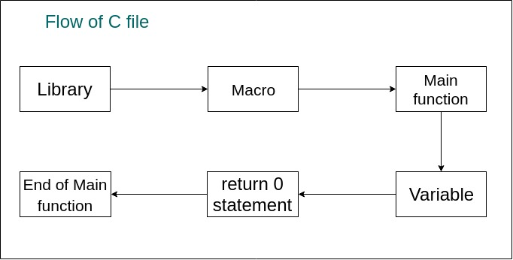
Create the C file

Slide 8
Create C file
Client will communicate with server through socket.
Client have to type the particular word(i.e library, variable ) to request the services.
In back-end, server make c file as per client requirement
If client type invalid details then server prompt to the client through socket.

Slide 9
Create C file
In the application, Server is divided into three common part of the C file.
1) Library part
2) Macro part
3) Variable part
We can add part as per client requirement.

Slide 10
Function call involve
1. File operation => fwrite(), fread(), fseek()
fopen(), fclose(), fgets()
2. string operation => strcat(), strcpy(), strtok()
3. Socket operation => socket, accept(),
connect(), listen(), read(), write(), memset(),
4. Thread call : pthread_create();

Slide 11
Chatting
Client – server communication involve
Client can communicate with server in half duplex mode.
Client – server used write() and read() system call for writing and reading operation respectively.

Slide 12
Read Content from the file
Client can read the content of particular keyword.
Client can request this services by typing keyword and server can respond by fetching the details from the text file.
If the require details have not found in the file then server will prompt to client by passing message.

