Slide 1
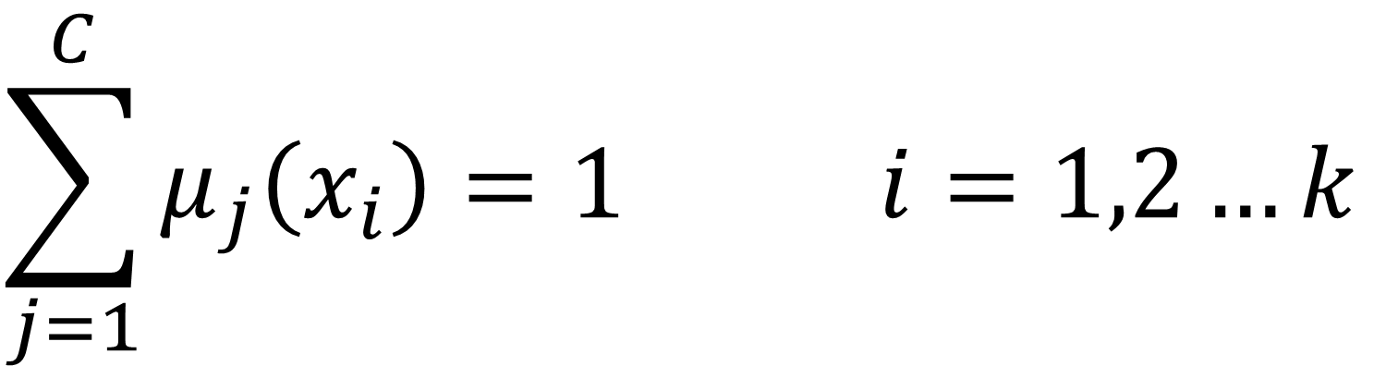
$$\sum_{j=1}^{C}{μ_{j}\left(x_{i}\right)=1 i=1,2…k}$$

Slide 2
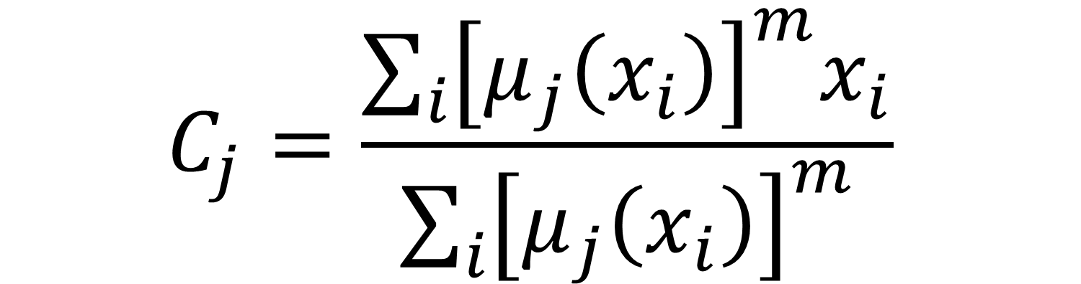
$$C_{j}=\frac{\sum_{i}{{\left[μ_{j}\left(x_{i}\right)\right]}^{m}x_{i}}}{\sum_{i}{{\left[μ_{j}\left(x_{i}\right)\right]}^{m}}}$$

Slide 3
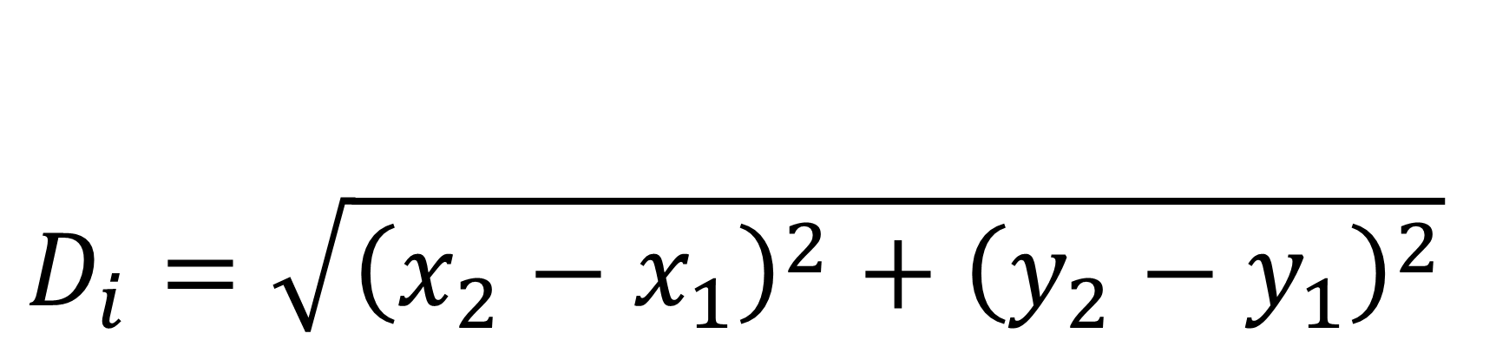
$$D_{i}=\sqrt{{\left(x_{2}−x_{1}\right)}^{2}+{\left(y_{2}−y_{1}\right)}^{2}}$$

Slide 4

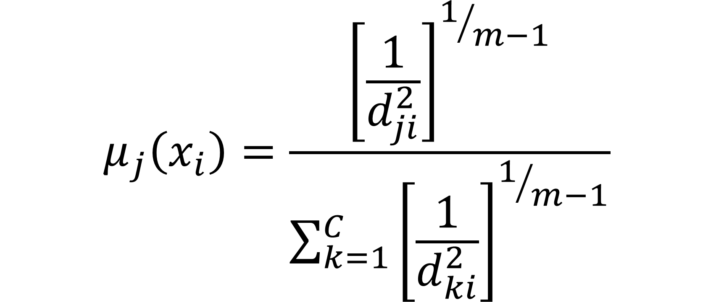
$$μ_{j}\left(x_{i}\right)=\frac{{\left[\frac{1}{d_{ji}^{2}}\right]}^{1/{m−1}}}{\sum_{k=1}^{C}{{\left[\frac{1}{d_{ki}^{2}}\right]}^{1/{m−1}}}}$$
$$ε$$
$$\left|{μ_{j}\left(x_{i}\right)}^{(k+1)}−{μ_{j}\left(x_{i}\right)}^{(k)}\right|<ε$$

Slide 5


Slide 6
$$D_{i}=\sqrt{{\left(x_{2}−x_{1}\right)}^{2}+{\left(y_{2}−y_{1}\right)}^{2}}$$

Slide 7
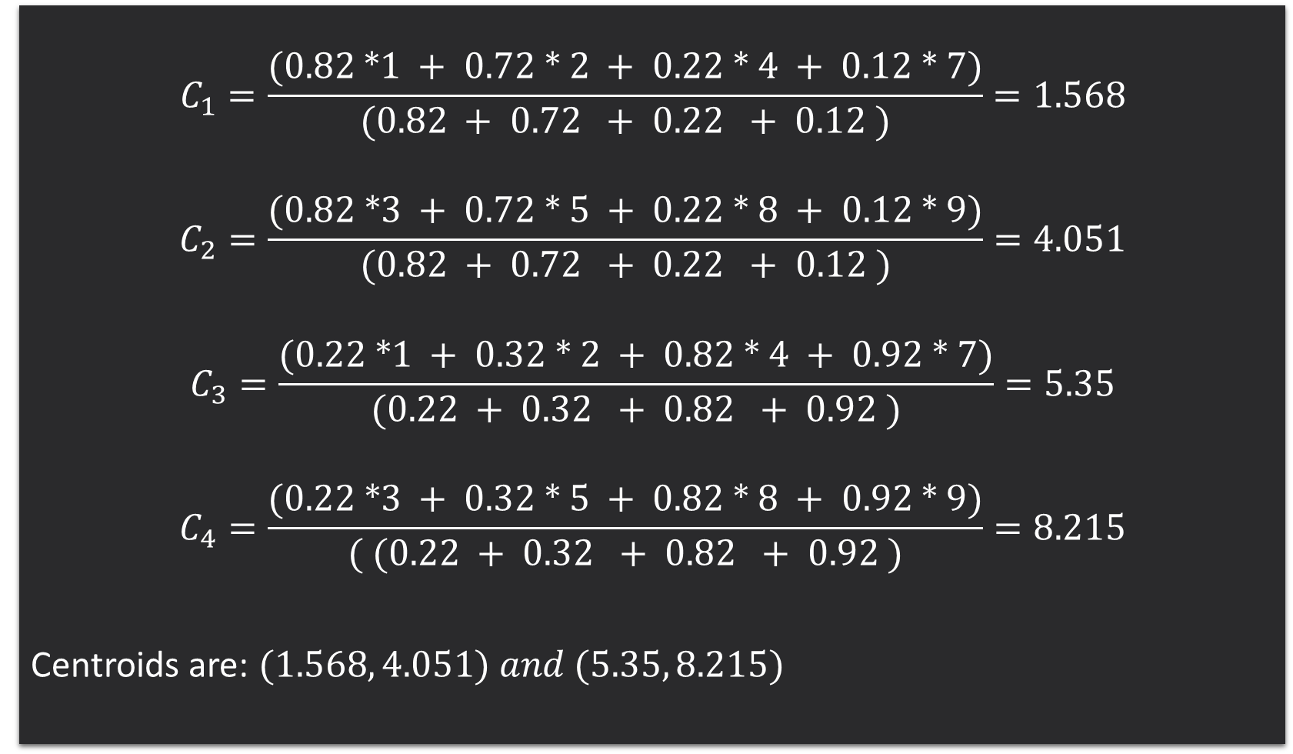
$$\left|{μ_{j}\left(x_{i}\right)}^{(k+1)}−{μ_{j}\left(x_{i}\right)}^{(k)}\right|<ε$$
(0.82 *1 + 0.72 * 2 + 0.22 * 4 + 0.12 * 7) / ( (0.82 + 0.72 + 0.22 + 0.12 )
(0.82 *1 + 0.72 * 2 + 0.22 * 4 + 0.12 * 7) / ( (0.82 + 0.72 + 0.22 + 0.12 )
$$C_{1}=\frac{(0.82 ∗1 + 0.72 ∗ 2 + 0.22 ∗ 4 + 0.12 ∗ 7)}{(0.82 + 0.72 + 0.22 + 0.12 )}=1.568$$
$$C_{2}=\frac{(0.82 ∗3 + 0.72 ∗ 5 + 0.22 ∗ 8 + 0.12 ∗ 9)}{(0.82 + 0.72 + 0.22 + 0.12 )}=4.051$$
$$C_{3}=\frac{(0.22 ∗1 + 0.32 ∗ 2 + 0.82 ∗ 4 + 0.92 ∗ 7)}{(0.22 + 0.32 + 0.82 + 0.92 )}=5.35$$
$$C_{4}=\frac{(0.22 ∗3 + 0.32 ∗ 5 + 0.82 ∗ 8 + 0.92 ∗ 9)}{( (0.22 + 0.32 + 0.82 + 0.92 )}=8.215$$
Centroids are: $(1.568, 4.051) and (5.35, 8.215)$

Slide 8
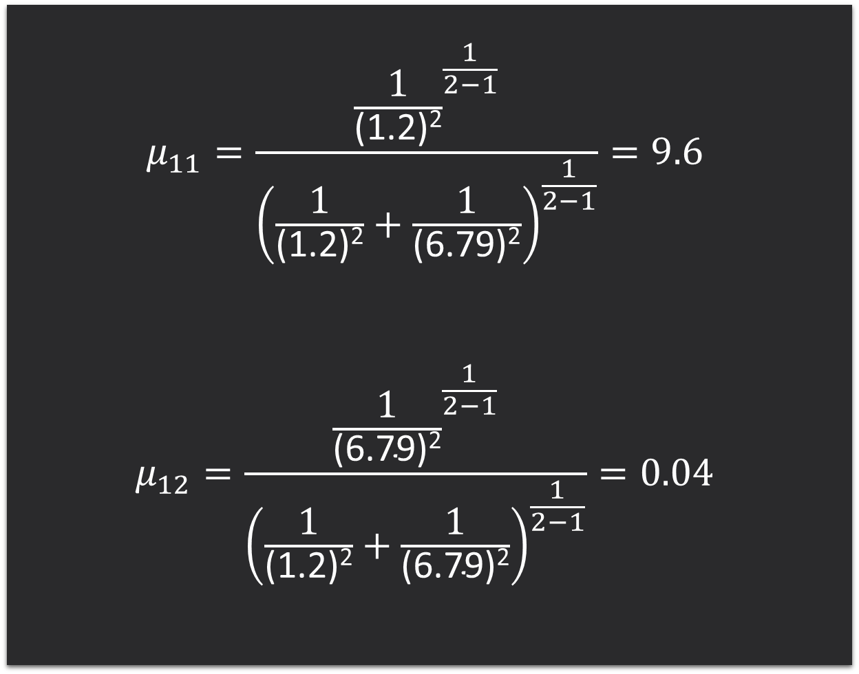
$$μ_{11}=\frac{{\frac{1}{\text{(1.2)}\text{2}}}^{\frac{1}{2−1}}}{{\left(\frac{1}{\text{(1.2)}\text{2}}+\frac{1}{\text{(}\text{6.79}\text{)}\text{2}}\right)}^{\frac{1}{2−1}}}=9.6$$
$$μ_{12}=\frac{{\frac{1}{\text{(}\text{6.79}\text{)}\text{2}}}^{\frac{1}{2−1}}}{{\left(\frac{1}{\text{(1.2)}\text{2}}+\frac{1}{\text{(}\text{6.79}\text{)}\text{2}}\right)}^{\frac{1}{2−1}}}=0.04$$

