Slide 1
Word Embedding

Slide 2
Topics to cover
One Hot encoding
Count vectorizer
Term Frequency-Inverse Document Frequency (TF-IDF)
N-grams
Co-occurrence matrix
Word embedding Recipe
Implementing fastText

Slide 3
Introduction to Bag-of-Words (BoW) and TF-IDF for Creating Features from Text
Review 1: This movie is very scary and long
Review 2: This movie is not scary and is slow
Review 3: This movie is spooky and good
You can see that there are some contrasting reviews about the movie as well as the length and pace of the movie. Imagine looking at a thousand reviews like these.
Clearly, there is a lot of interesting insights we can draw from them and build upon them to gauge how well the movie performed.
However, as we saw above, we cannot simply give these sentences to a machine learning model and ask it to tell us whether a review was positive or negative.

Slide 4
Creating Vectors from Text
Can you think of some techniques we could use to vectorize a sentence at the beginning? The basic requirements would be:
It should not result in a sparse matrix since sparse matrices result in high computation cost.
We should be able to retain most of the linguistic information present in the sentence

Slide 5
Word Embedding
Word Embedding is one such technique where we can represent the text using vectors. The more popular forms of word embeddings are:
BoW, which stands for Bag of Words
TF-IDF, which stands for Term Frequency-Inverse Document Frequency
Now, let us see how we can represent the above movie reviews as embeddings and get them ready for a machine learning model.

Slide 6
Bag of Words (BoW) Model
The Bag of Words (BoW) model is the simplest form of text representation in numbers. Like the term itself, we can represent a sentence as a bag of words vector (a string of numbers)
.
Let’s recall the three types of movie reviews we saw earlier:
Review 1: This movie is very scary and long
Review 2: This movie is not scary and is slow
Review 3: This movie is spooky and good
We will first build a vocabulary from all the unique words in the above three reviews.
The vocabulary consists of these 11 words: ‘This’, ‘movie’, ‘is’, ‘very’, ‘scary’, ‘and’, ‘long’, ‘not’, ‘slow’, ‘spooky’, ‘good’.

Slide 7
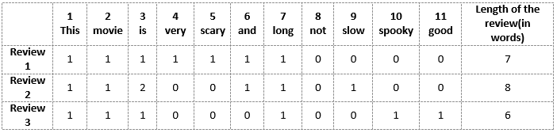
We can now take each of these words and mark their occurrence in the three movie reviews above with 1s and 0s. This will give us 3 vectors for 3 reviews:
Vector of Review 1: [1 1 1 1 1 1 1 0 0 0 0]
Vector of Review 2: [1 1 2 0 0 1 1 0 1 0 0]
Vector of Review 3: [1 1 1 0 0 0 1 0 0 1 1]

Slide 8
Drawbacks of using a Bag-of-Words (BoW) Model
In the above example, we can have vectors of length 11.
However, we start facing issues when we come across new sentences:
If the new sentences contain new words, then our vocabulary size would increase and thereby, the length of the vectors would increase too.
Additionally, the vectors would also contain many 0s, thereby resulting in a sparse matrix (which is what we would like to avoid)
We are retaining no information on the grammar of the sentences nor on the ordering of the words in the text.

Slide 9

Term Frequency-Inverse Document Frequency (TF-IDF)
“Term frequency–inverse document frequency, is a numerical statistic that is intended to reflect how important a word is to a document in a collection or corpus.”
Term Frequency (TF)
Let’s first understand Term Frequent (TF). It is a measure of how frequently a term, t, appears in a document, d:

Slide 10
Here, in the numerator, n is the number of times the term “t” appears in the document “d”. Thus, each document and term would have its own TF value.
We will again use the same vocabulary we had built in the Bag-of-Words model to show how to calculate the TF for Review #2:
Review 2: This movie is not scary and is slow
Here,
Vocabulary: ‘This’, ‘movie’, ‘is’, ‘very’, ‘scary’, ‘and’, ‘long’, ‘not’, ‘slow’, ‘spooky’, ‘good’
Number of words in Review 2 = 8
TF for the word ‘this’ = (number of times ‘this’ appears in review 2)/(number of terms in review 2) = 1/8

Slide 11
TF-IDF (contd..)
Similarly,
TF(‘movie’) = 1/8
TF(‘is’) = 2/8 = 1/4
TF(‘very’) = 0/8 = 0
TF(‘scary’) = 1/8
TF(‘and’) = 1/8
TF(‘long’) = 0/8 = 0
TF(‘not’) = 1/8
TF(‘slow’) = 1/8
TF( ‘spooky’) = 0/8 = 0
TF(‘good’) = 0/8 = 0

Slide 12
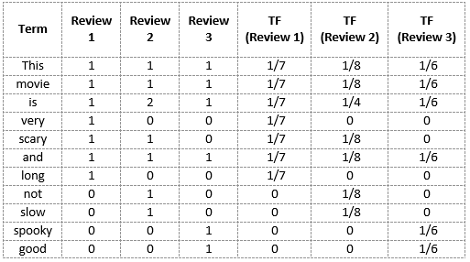
TF-IDF

Slide 13
Inverse Document Frequency (IDF)
IDF is a measure of how important a term is. We need the IDF value because computing just the TF alone is not sufficient to understand the importance of words:
We can calculate the IDF values for the all the words in Review 2:
IDF(‘this’) = log(number of documents/number of documents containing the word ‘this’) = log(3/3) = log(1) = 0
IDF(‘movie’, ) = log(3/3) = 0
IDF(‘is’) = log(3/3) = 0
IDF(‘not’) = log(3/1) = log(3) = 0.48
IDF(‘scary’) = log(3/2) = 0.18
IDF(‘and’) = log(3/3) = 0
IDF(‘slow’) = log(3/1) = 0.48

Slide 14
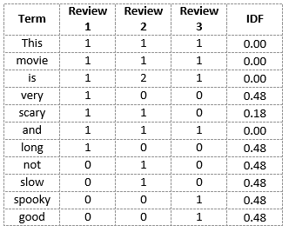
Hence, we see that words like “is”, “this”, “and”, etc., are reduced to 0 and have little importance; while words like “scary”, “long”, “good”, etc. are words with more importance and thus have a higher value.
We can now compute the TF-IDF score for each word in the corpus. Words with a higher score are more important, and those with a lower score are less important:

Slide 15

We can now calculate the TF-IDF score for every word in Review 2:
TF-IDF(‘this’, Review 2) = TF(‘this’, Review 2) * IDF(‘this’) = 1/8 * 0 = 0
Similarly,
TF-IDF(‘movie’, Review 2) = 1/8 * 0 = 0
TF-IDF(‘is’, Review 2) = 1/4 * 0 = 0
TF-IDF(‘not’, Review 2) = 1/8 * 0.48 = 0.06
TF-IDF(‘scary’, Review 2) = 1/8 * 0.18 = 0.023
TF-IDF(‘and’, Review 2) = 1/8 * 0 = 0
TF-IDF(‘slow’, Review 2) = 1/8 * 0.48 = 0.06

Slide 16
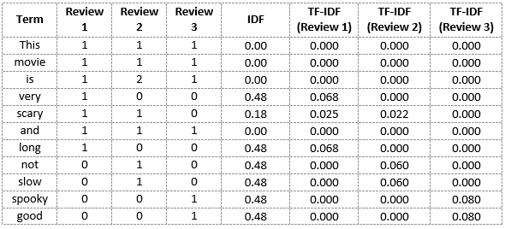
we can calculate the TF-IDF scores for all the words with respect to all the reviews:

Slide 17

Thank YOU

