Slide 1
Word embeddings LSA, Word2Vec
Presented By :
Prof.(Dr.) Archana Singh
Head – Dept of Artificial Intelligence
ASET, Amity University, Noida

Slide 2
Vector Embedding of Words
A word is represented as a vector.
Word embeddings depend on a notion of word similarity.
Similarity is computed using cosine.
A very useful definition is paradigmatic similarity:
Similar words occur in similar contexts. They are exchangeable.
POTUS
Yesterday The President called a press conference.
Trump
“POTUS: President of the United States.”

Slide 3
Vector Embedding of Words
Traditional Method - Bag of Words Model
Word Embeddings
Either uses one hot encoding.
Each word in the vocabulary is represented by one bit position in a HUGE vector.
For example, if we have a vocabulary of 10000 words, and “Hello” is the 4th word in the dictionary, it would be represented by: 0 0 0 1 0 0 . . . . . . . 0 0 0
Or uses document representation.
Each word in the vocabulary is represented by its presence in documents.
For example, if we have a corpus of 1M documents, and “Hello” is in 1th, 3th and 5th documents only, it would be represented by: 1 0 1 0 1 0 . . . . . . . 0 0 0
Context information is not utilized.
Stores each word in as a point in space, where it is represented by a dense vector of fixed number of dimensions (generally 300) .
Unsupervised, built just by reading huge corpus.
For example, “Hello” might be represented as : [0.4, -0.11, 0.55, 0.3 . . . 0.1, 0.02].
Dimensions are basically projections along different axes, more of a mathematical concept.

Slide 4
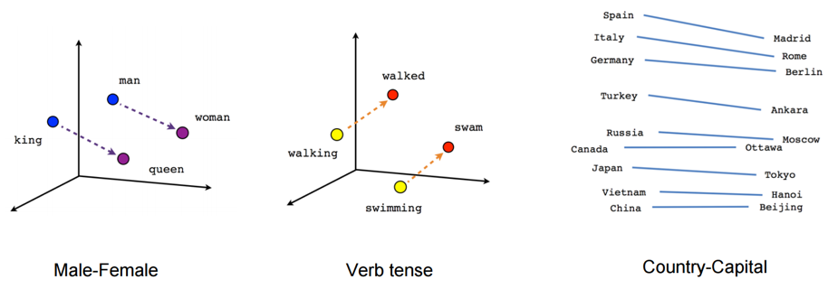
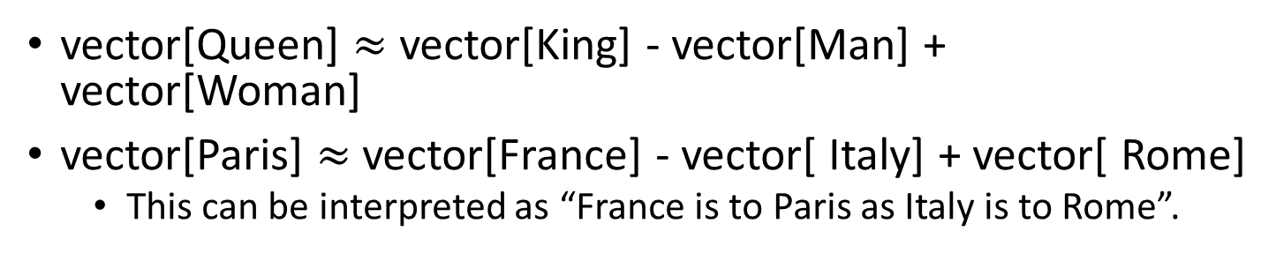
Example
vector[Queen] $≈$ vector[King] - vector[Man] + vector[Woman]
vector[Paris] $≈$vector[France] - vector[ Italy] + vector[ Rome]
This can be interpreted as “France is to Paris as Italy is to Rome”.

Slide 5

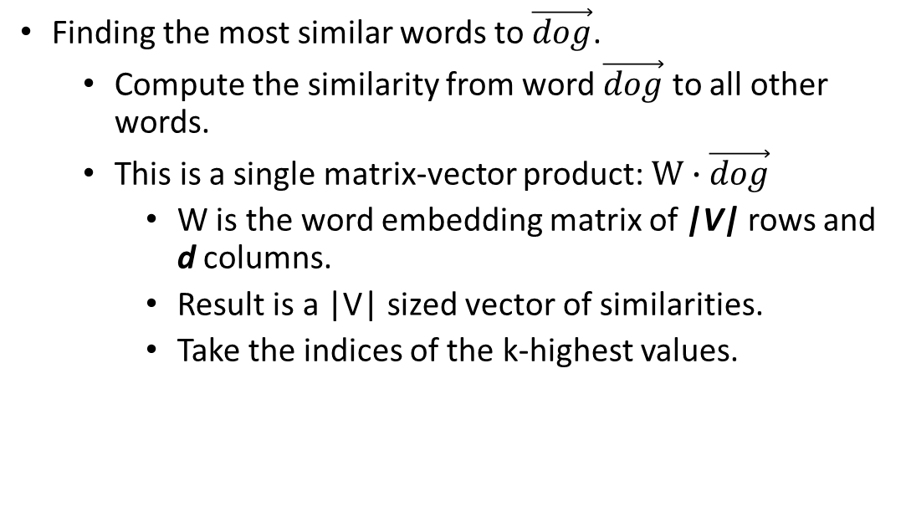
Working with vectors
Finding the most similar words to $\vec{dog}$.
Compute the similarity from word $\vec{dog}$ to all other words.
This is a single matrix-vector product: $W∙\vec{dog}$
W is the word embedding matrix of |V| rows and d columns.
Result is a |V| sized vector of similarities.
Take the indices of the k-highest values.

Slide 6
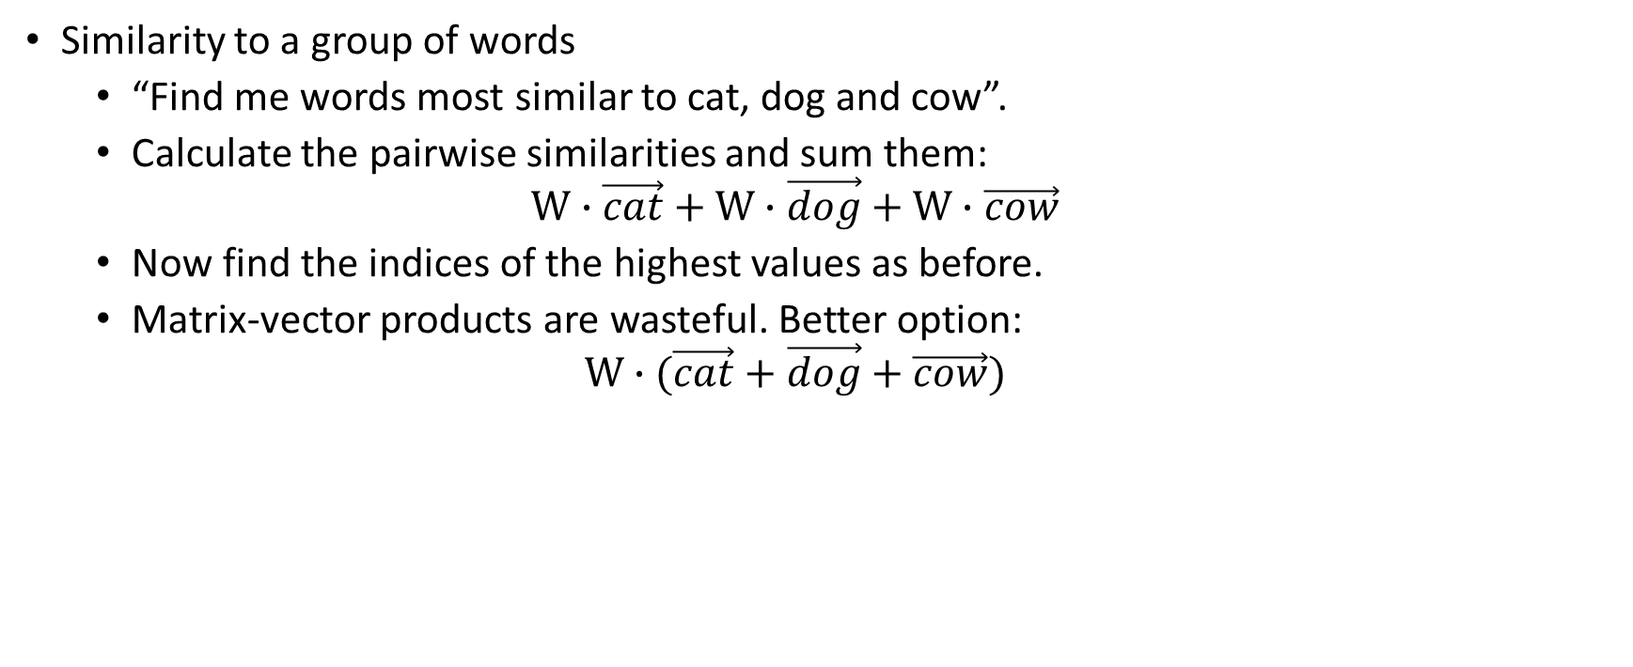
Working with vectors
Similarity to a group of words
“Find me words most similar to cat, dog and cow”.
Calculate the pairwise similarities and sum them:
$$W∙\vec{cat}+W∙\vec{dog}+W∙\vec{cow}$$
Now find the indices of the highest values as before.
Matrix-vector products are wasteful. Better option:
$$W∙(\vec{cat}+\vec{dog}+\vec{cow})$$

Slide 7

Applications of Word Vectors
Word Similarity
Machine Translation
Part-of-Speech and Named Entity Recognition
Relation Extraction
Sentiment Analysis
Co-reference Resolution
Chaining entity mentions across multiple documents - can we find and unify the multiple contexts in which mentions occurs?
Clustering
Words in the same class naturally occur in similar contexts, and this feature vector can directly be used with any conventional clustering algorithms (K-Means, agglomerative, etc). Human doesn’t have to waste time hand-picking useful word features to cluster on.
Semantic Analysis of Documents
Build word distributions for various topics, etc.

Slide 8
Vector Embedding of Words
Latent Semantic Analysis/Indexing (1988)
Term weighting-based model
Consider occurrences of terms at document level.
Word2Vec (2013)
Prediction-based model.
Consider occurrences of terms at context level.
GloVe (2014)
Count-based model.
Consider occurrences of terms at context level.
ELMo (2018)
Language model-based.
A different embedding for each word for each task.

Slide 9

Latent Semantic Analysis

Slide 10
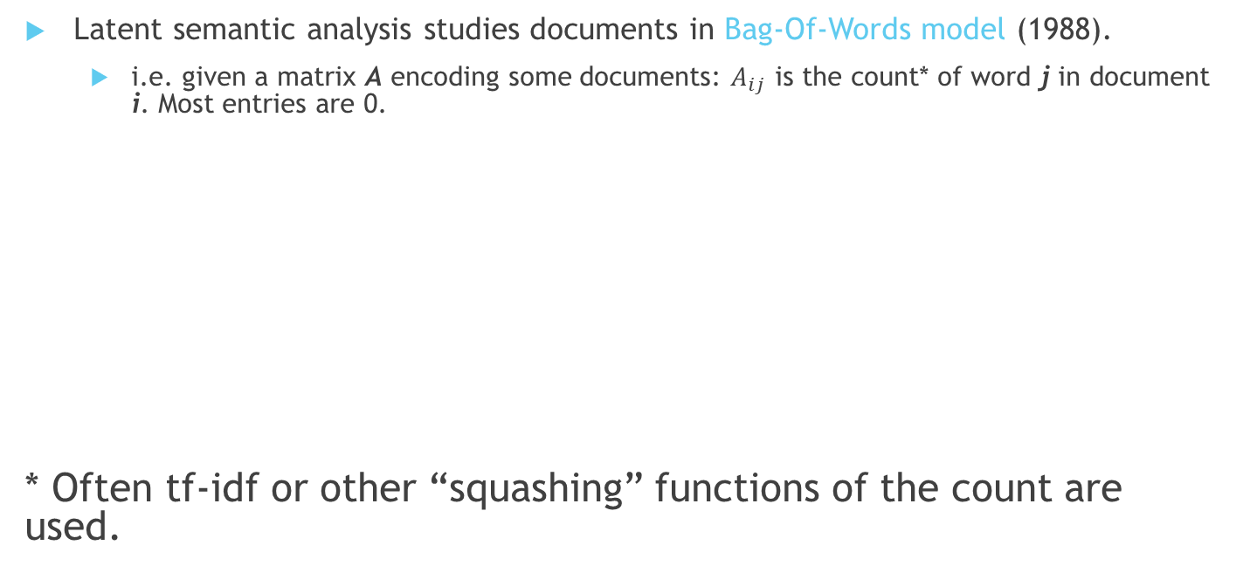
Embedding: Latent Semantic Analysis
Latent semantic analysis studies documents in Bag-Of-Words model (1988).
i.e. given a matrix A encoding some documents: $A_{ij}$ is the count* of word j in document i. Most entries are 0.
* Often tf-idf or other “squashing” functions of the count are used.
M words
A
N docs

Slide 11

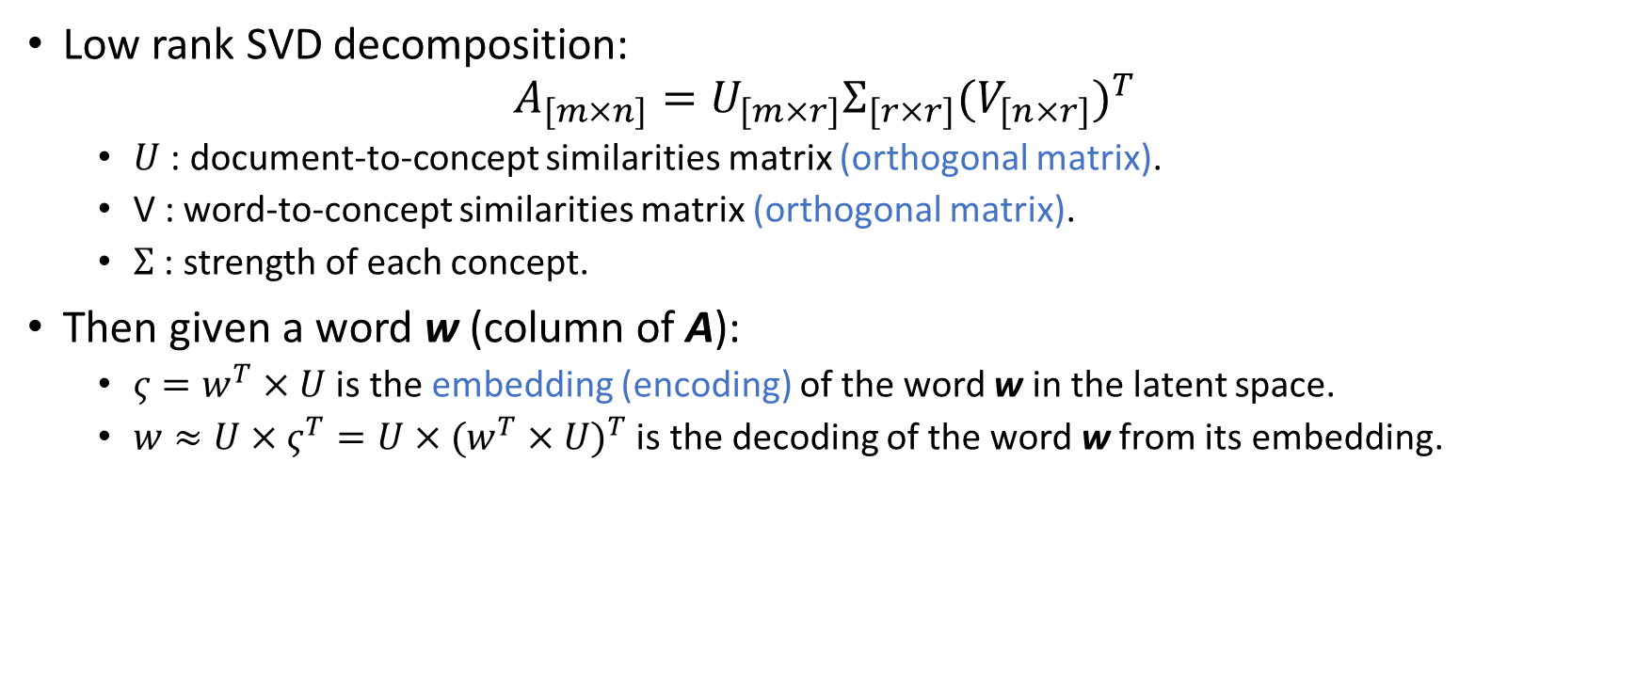
Embedding: Latent Semantic Analysis
Low rank SVD decomposition:
$$A_{[m×n]}=U_{[m×r]}Σ_{[r×r]}{(V_{[n×r]})}^{T}$$
$U$: document-to-concept similarities matrix (orthogonal matrix).
V : word-to-concept similarities matrix (orthogonal matrix).
$Σ$: strength of each concept.
Then given a word w (column of A):
$ς=w^{T}×U$ is the embedding (encoding) of the word w in the latent space.
$w≈U×ς^{T}=U×{(w^{T}×U)}^{T}$ is the decoding of the word w from its embedding.
M words
K latent dim
M words
A
U
$$Σ$$
V^{T}
≈
N docs

Slide 12
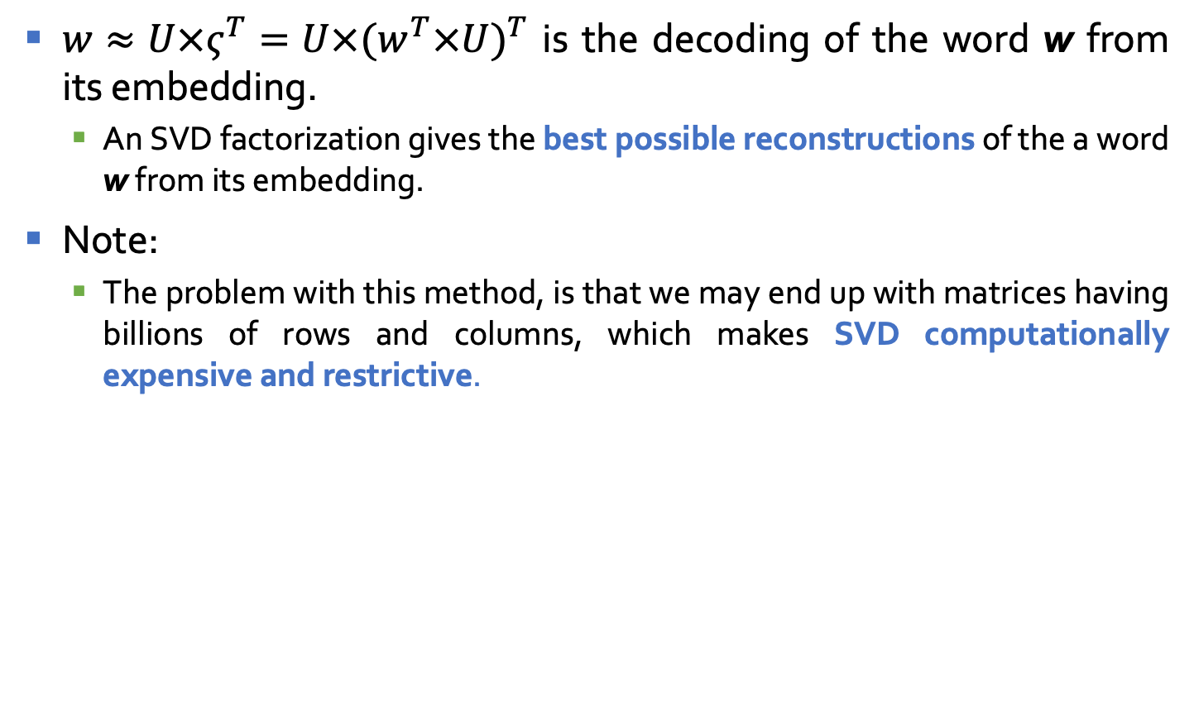
Embedding: Latent Semantic Analysis
$w≈U×ς^{T}=U×{(w^{T}×U)}^{T}$ is the decoding of the word w from its embedding.
An SVD factorization gives the best possible reconstructions of the a word w from its embedding.
Note:
The problem with this method, is that we may end up with matrices having billions of rows and columns, which makes SVD computationally expensive and restrictive.
M words
K latent dim
M words
A
U
$$Σ$$
V^{T}
≈
N docs

Slide 13
Word2Vec

Slide 14
word2Vec: Local contexts
Instead of entire documents, Word2Vec uses words k positions away from each center word.
These words are called context words.
Example for k=3:
“It was a bright cold day in April, and the clocks were striking”.
Center word: red (also called focus word).
Context words: blue (also called target words).
Word2Vec considers all words as center words, and all their context words.

Slide 15
Example
Example: d1 = “king brave man” , d2 = “queen beautiful women”

Slide 16
Word2Vec: Data generation (window size = 2)
word | Word one hot encoding | neighbor | Neighbor one hot encoding
king | [1,0,0,0,0,0] | brave | [0,1,0,0,0,0]
king | [1,0,0,0,0,0] | man | [0,0,1,0,0,0]
brave | [0,1,0,0,0,0] | king | [1,0,0,0,0,0]
brave | [0,1,0,0,0,0] | man | [0,0,1,0,0,0]
man | [0,0,1,0,0,0] | king | [1,0,0,0,0,0]
man | [0,0,1,0,0,0] | brave | [0,1,0,0,0,0]
queen | [0,0,0,1,0,0] | beautiful | [0,0,0,0,1,0]
queen | [0,0,0,1,0,0] | women | [0,0,0,0,0,1]
beautiful | [0,0,0,0,1,0] | queen | [0,0,0,1,0,0]
beautiful | [0,0,0,0,1,0] | women | [0,0,0,0,0,1]
woman | [0,0,0,0,0,1] | queen | [0,0,0,1,0,0]
woman | [0,0,0,0,0,1] | beautiful | [0,0,0,0,1,0]

Slide 17
Word2Vec: Data generation (window size = 2)
Example: d1 = “king brave man” , d2 = “queen beautiful women”
word | Word one hot encoding | neighbor | Neighbor one hot encoding
king | [1,0,0,0,0,0] | brave | [0,1,1,0,0,0]
 |  | man
brave | [0,1,0,0,0,0] | king | [1,0,1,0,0,0]
 |  | man
man | [0,0,1,0,0,0] | king | [1,1,0,0,0,0]
 |  | brave
queen | [0,0,0,1,0,0] | beautiful | [0,0,0,0,1,1]
 |  | women
beautiful | [0,0,0,0,1,0] | queen | [0,0,0,1,0,1]
 |  | women
woman | [0,0,0,0,0,1] | queen | [0,0,0,1,1,0]
 |  | beautiful

Slide 18
Word2Vec: main context representation models
Continuous Bag of Words
(CBOW)
Skip-Ngram
Input
Output
W₋₂
W₋₂
W₋₁
Output
Input
W₋₁
Sum and projection
Projection
w₀
w₀
w₁
w₁
w₂
w₂
Word2Vec is a predictive model.
Will focus on Skip-Ngram model

Slide 19
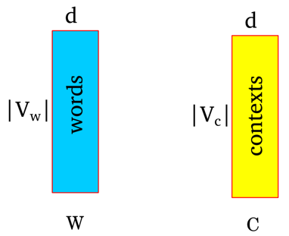
How does word2Vec work?
Represent each word as a d dimensional vector.
Represent each context as a d dimensional vector.
Initialize all vectors to random weights.
Arrange vectors in two matrices, W and C.

Slide 20
Word2Vec : Neural Network representation
Input layer
Hidden layer
Output (sigmoid)
|V_{w}|
|V_{c}|
w1
w2

Slide 21
Word2Vec : Neural Network representation
Input layer
Hidden layer
Output (sigmoid)
king
1
0
|V_{w}|
|V_{c}|
0
1
brave
0
w1
1
man
0
w2
0
0
0
0
0

Slide 22
Word2Vec : Neural Network representation
Input layer
Hidden layer
Output (sigmoid)
0
1
king
|V_{w}|
|V_{c}|
brave
1
0
0
w1
1
man
0
w2
0
0
0
0
0

Slide 23
Word2Vec : Neural Network representation
Input layer
Hidden layer
Output (sigmoid)
0
1
king
|V_{w}|
|V_{c}|
0
1
brave
man
1
w1
0
0
w2
0
0
0
0
0

Slide 24
Word2Vec : Neural Network representation
Input layer
Hidden layer
Output (sigmoid)
0
0
|V_{w}|
|V_{c}|
0
0
0
w1
0
queen
1
w2
0
0
1
beautiful
0
1
women

Slide 25
Word2Vec : Neural Network representation
Input layer
Hidden layer
Output (sigmoid)
0
0
|V_{w}|
|V_{c}|
0
0
0
w1
0
0
w2
1
queen
beautiful
1
0
0
1
women

Slide 26
Word2Vec : Neural Network representation
Input layer
Hidden layer
Output (sigmoid)
0
0
|V_{w}|
|V_{c}|
0
0
0
w1
0
0
w2
1
queen
1
1
beautiful
women
0
0

Slide 27
Thank you

