Slide 1

E-COMMERCE SALES ANALYTICS
A Power BI Dashboard for Global Sales & Profit Performance
This presentation walks through the dataset behind the dashboard and how each visual turns raw order, customer and product data into insight — covering data sources, the underlying data model, key metrics, and a guided tour of the dashboard itself.
E-commerce Sales Analytics
1

Slide 2




What We'll Cover
From raw data to dashboard insight
About the Dataset
01
Where the data comes from and what each record represents
The Data Model
02
How customers, products, and orders connect
Key Metrics
03
The sales and profit measures the dashboard tracks
Dashboard Walkthrough
04
A guided tour of every chart, card, and filter
E-commerce Sales Analytics
2

Slide 3

The dashboard is built on order-level e-commerce transaction data, modeled across five connected tables so that every sale can be traced back to the customer who bought it and the product that was sold.
About the
Dataset
5
150K+
1
Slide 1 of 3 — Understanding the Data
Connected tables in the data model
Order records in the core sales table
Order-item is the grain of the data
Core tables: order_items (transactions) · customer_master (buyers) · product_catalog (items) · dataset_statistics · a consolidated analytics table
Each row is one line item within an order — so a single order with three products contributes three rows, keeping product- and country-level analysis accurate.
E-commerce Sales Analytics
3

Slide 4


The Data Model
How the tables behind the dashboard connect
order_items sits at the center of the model, linked to customer_master and product_catalog — the pattern the dashboard's charts query directly to break profit and sales down by country and category.
customer_master
order_items
product_catalog
Buyer details incl. country
Fact table — one row per order line
Product & category details
Consolidated analytics table
Dataset statistics
Pre-joined view for reporting
Supporting reference data
E-commerce Sales Analytics
4

Slide 5

Key Metrics Tracked
The four numbers every visual in the dashboard is built from
Gross Sales
Net Sales
Total revenue generated before any discounts, returns, or deductions.
Revenue after discounts and returns — a truer view of realized sales.
Profit
Quantity
What remains after costs are subtracted from sales — the dashboard's headline measure.
Total units sold across all order line items.
E-commerce Sales Analytics
5

Slide 6


Dashboard Overview
A single, interactive page designed for at-a-glance monitoring
One page, built for quick scanning — no tabs to click through
KPI cards surface totals first, before any chart
Two charts break performance down by geography and category
A country slicer lets any viewer filter the whole page instantly
Title Banner
Profit by Country
Profit by Category
KPI Cards
Country Filter
Actual dashboard layout, shown to scale
E-commerce Sales Analytics
6

Slide 7
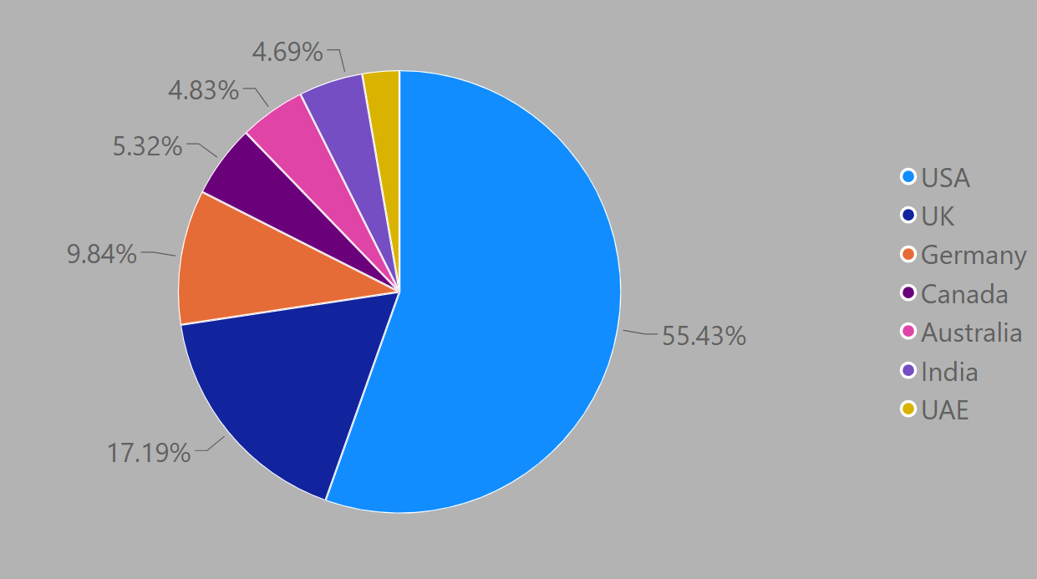
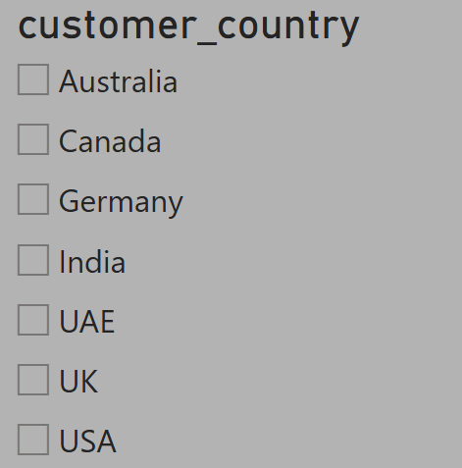
Profit by Country
Pie Chart + Country Slicer
The pie chart splits total profit by customer_country,
with each slice labeled by its percent of the whole
— an immediate read on which markets contribute
the most profit.
The country slicer beside it lets a viewer click one or more countries and instantly filter every other visual on the page — the pie, the bar chart, and the KPI cards — to that selection.
Why it matters: regional profit concentration is often uneven — this pairing lets a reviewer isolate a single country and see its full performance story on the same page.
E-commerce Sales Analytics
7

Slide 8
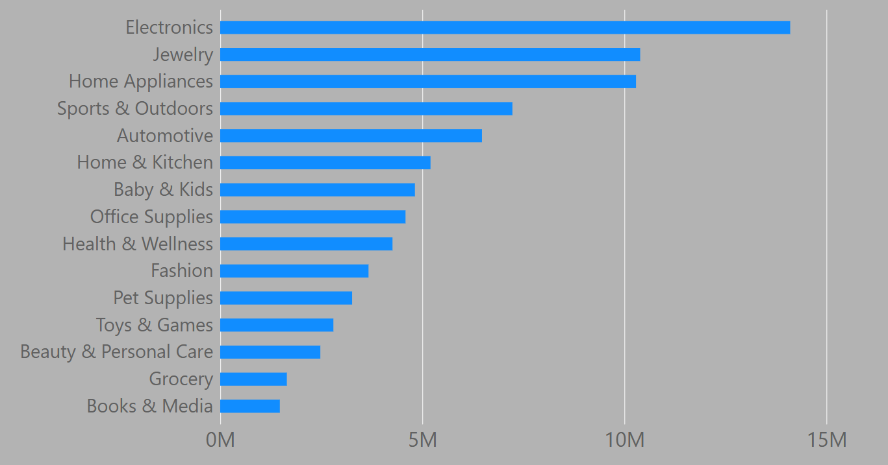
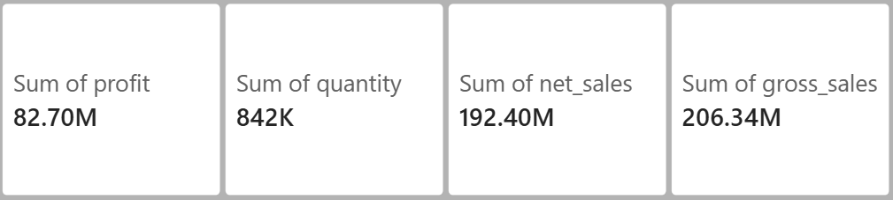
Profit by Product Category
Bar Chart + KPI Summary Cards
The bar chart ranks every product_category by total profit, sorted highest to lowest — making it easy to spot which categories drive the business and which lag behind.
Four KPI cards along the bottom surface the headline totals — Profit, Quantity, Net Sales, and Gross Sales — so the top-line numbers are visible before drilling into any chart.
Why it matters: because every card and chart shares the same slicer, the totals update together — there's never a mismatch between the headline numbers and the chart detail.
E-commerce Sales Analytics
8

Slide 9


Getting the Most From the Dashboard
Practical ways to put it to work
Spot top markets fast
Filter, don't guess
Use the country pie chart to find where profit is concentrated before planning regional campaigns.
Click the country slicer to see one market's full picture — profit, sales, and category mix together.
Compare categories
Trust the totals
The bar chart's ranking highlights which product categories to double down on, and which to review.
Because everything shares one filter, the KPI cards and charts always tell a consistent story.
E-commerce Sales Analytics
9

Slide 10
Thank You
Questions and discussion welcome
E-commerce Sales Analytics
10

