Slide 1
✦
AS
ASTROSAGE ANALYSIS

Slide 2
PROBLEM STATEMENT
The Challenge
AstroSage has received a ₹1 Crore investment and aims to optimize its call center operations.
The goal: determine how to allocate this investment to maximize operational efficiency, customer satisfaction, and profitability.
The analysis will consider historical call data, performance metrics, and market trends to make informed decisions.
👥
📚
💻
Option A
Option B
Option C
Hire More Agents
Improve Training Programs
Upgrade Call Center Technology
Key Question: Which investment strategy delivers maximum ROI — People, Process, or Technology?

Slide 3
OVERVIEW OF DATA
28,027
35
34
131
Consultation
Records
Data
Attributes
Days
Covered
Unique
Gurus
Considerations in Analysis
User Base Increment
Guru Performance Analysis
Addition of new users and revenue earned over the period.
Workload distribution and performance metrics across gurus.
Feedback Analysis
Consultation Type Analysis
Customer ratings and satisfaction scores by guru and session type.
Call vs. chat type preference and completion status by user.

Slide 4
METHODOLOGY
1
Data Cleaning
Tools & Functions Used
Removed duplicates, filled blank values, inserted required calculated columns.
Microsoft Excel
Data cleaning, pivot tables, charts, conditional formatting
2
Analysis
Identified major KPIs and created pivot tables to summarize data across dimensions.
COUNT / AVERAGE / SUM
Aggregation functions for KPI calculations
3
Visualization
Built charts and graphs to uncover trends in call volume, revenue, and ratings.
CORREL Function
Correlation analysis between call duration & satisfaction
4
Insights
Derived actionable insights for better utilization of the ₹1 Cr investment.
Slicers & Dashboard
Interactive dashboard for dynamic data exploration

Slide 5
USER PLATFORM DISTRIBUTION
Gurucool Dominates
65% of users prefer Gurucool (web portal) — the primary consultation channel.
App is #2
33% use the mobile app — strong secondary channel worth investment in UX.
Dashboard Minimal
Only 2% engage via dashboard — limited engagement via this channel.
Investment Focus: Gurucool web experience + Mobile app performance

Slide 6
CALL STATUS ANALYSIS
41%
Calls
Completed
35%
Failed or Not
Answered
8,365
Total Calls
Logged
Only 41% of calls are successfully completed — significant loss of potential interactions.
35% of calls are failed or not answered — indicating capacity/routing gaps.
Smart IVR routing and agent availability tools can meaningfully improve completion rates.

Slide 7
CHAT HANDLING DISTRIBUTION
📊 Completion Gap
Only 28.4% of chats complete — 37.2% fail outright, revealing a major service gap.
🤖 AI Automation Opportunity
AI-driven chatbots can handle incomplete sessions and rescue abandoned chats.
📈 Total Chats Analyzed
28,027 chat sessions analyzed; high failure rate signals training and process issues.
💡 Actionable Insight
Reducing fail rate by 10% could significantly boost user satisfaction scores.

Slide 8
RATING-WISE USER DISTRIBUTION
⚠️ Massive Unrated Pool
7,256 sessions carry a rating of 0 — indicating many users did not rate at all, skewing averages.
🎯 Specialist Skill Gap
High performers have niche expertise. Top gurus should mentor lower-rated counterparts.
📚 Training Needed
A large cluster of sessions rated 1–3 signals immediate coaching need for underperformers.
🔍 Top Insight
Avg overall rating = 2.93/8. A targeted training program could raise this to 4+ within 3 months.

Slide 9
TOP HIGHLY RATED GURUS
7.5 / 8
Highest Rating
(Astro Pujaa Rai & Tarot Mystical)
5.46
Average Rating
Among Top 10 Gurus
A small cohort of gurus consistently earn 7–7.5/8 — rare talent to be nurtured.
Insights from top performers should feed structured knowledge transfer sessions.
Tarot Mystical & Astro Pujaa Rai are benchmark performers for training material creation.

Slide 10
CALLS HOURLY ANALYSIS
⏰ Peak Window: 6AM–5PM
Customer activity peaks between 6 AM and 5 PM — especially 8 AM (660 calls) and 10 AM (605 calls).
🌙 Off-Peak: 10PM–2AM
Call volume drops below 130 late at night — opportunity to run maintenance/training.
📅 Workforce Planning
Use visualization to schedule peak staffing: more agents between 6–17 hours daily.
🔄 Demand-Based Scheduling
Automated scheduling powered by hourly demand data can reduce missed calls by 15–20%.

Slide 11
CONSULTATION TYPE WISE REVENUE
📞 Calls Dominate Revenue
₹1,68,442 from calls (78.7%) — highest-earning channel by far.
💬 Chat: Cost-Efficient Scale
₹45,495 from chats — scalable and lower cost per session.
🔴 Revenue Concentration Risk
Revenue heavily depends on top-performing gurus and peak hours.
Total Revenue: ₹2,13,987
📊 Astrologers' Earnings
Total guru payout: ₹99,147 (Dec 2023 + Jan 2024 combined).

Slide 12
GURUS PERFORMANCE ANALYSIS
76.3
Max Sessions/Day
(Astro Sakthi — Critical Burnout Risk)
131
Total Unique
Gurus in Dataset
Burnout Risk: Critical
Top gurus handle 50–78 sessions/day — far exceeding sustainable limits.
Zero-Rating Sessions
Significant number of gurus received zero ratings — immediate skill intervention needed.
Knowledge Transfer
Extract best practices from top performers to create training programs for others.

Slide 13
CALL VOLUME ANALYSIS
📈 Peak: Dec 10–11
430–424 calls/day — highest volume period, likely weekend/holiday surge.
📉 Low: Dec 8
Only 138 calls — sharpest single-day dip, signaling demand forecasting need.
📆 Weekdays Busier
Call demand is generally higher Mon–Fri, supporting demand-based scheduling.
📊 Avg: 246 calls/day
Average daily call volume across 34-day period (Total: 8,365 calls).

Slide 14
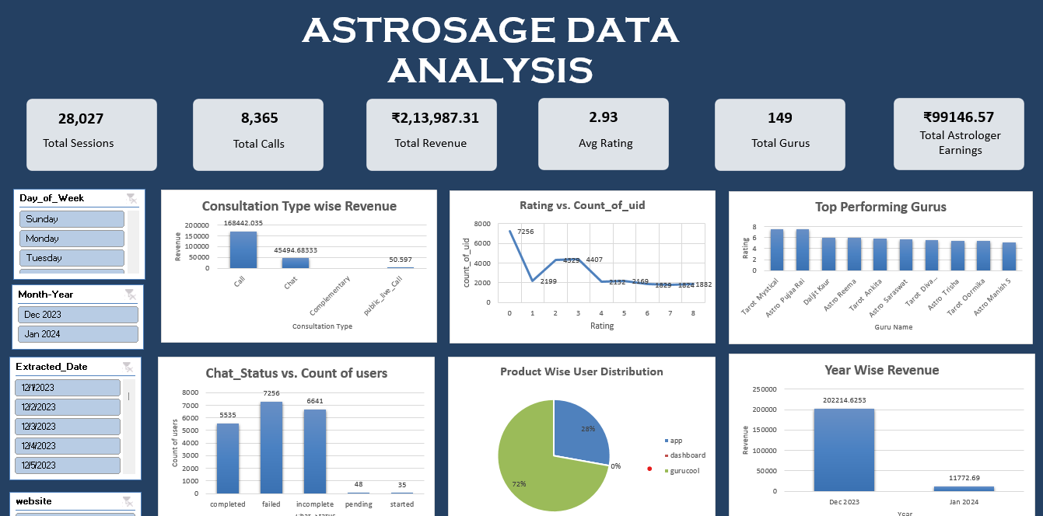
ASTROSAGE ANALYTICS DASHBOARD — KEY METRICS AT A GLANCE
📊 Full interactive dashboard available in the Excel workbook with real-time slicers
Correlation — Call Duration vs. Satisfaction: r = 0.055 (near zero) — suggests duration alone is NOT the key driver of satisfaction. | Avg Satisfaction by Month: Dec 2023: 2.95 / 8 Jan 2024: 2.68 / 8 — slight dip warrants investigation.

Slide 15
CONCLUSIONS
🔁 Key Gap: Repeat Callers
4,879 repeat calls from 275 repeat callers — 71.9% of all calls are repeats, signaling unresolved issues and efficiency gaps in the first interaction.
⭐ Performance: Rating Crisis
A majority of sessions rated 3 or below. Only a small set of high-performing gurus are pulling the overall experience — indicating a two-tier skill gap.
📈 Opportunity: Call Completion
41% completion rate is critically low. Technology upgrade (smart IVR, call routing) combined with peak-hour staffing can double this metric.
💡 Opportunity: Revenue Growth
Revenue is heavily concentrated. Diversifying across trained gurus and extending Gurucool web platform can unlock significant untapped revenue.
🎯 Core Insight
A balanced investment split — Technology (50%), Training (35%), Incentives (15%) — offers the highest expected ROI based on call center data.

Slide 16
RECOMMENDATIONS
01. Invest in Technology
02. Optimize Workforce Utilization
Improve call routing algorithms, deploy AI-powered IVR, and upgrade CRM systems to raise call completion rates. Estimated budget allocation: ₹50L.
Rebalance workloads to prevent top-guru burnout (some handle 76+ sessions/day). Implement demand-based scheduling using peak-hour data to right-size staffing every shift.
03. Enhance Training & Incentives
04. Implement Live Performance Monitoring
0. Expand High-Performing Guru Network
Launch structured coaching programs focusing on problem of consumer. Tie incentives to motivate agents. Estimated budget: ₹35L. Expected rating uplift: +1.5 pts.
Identify and recruit gurus with consistent 7+ ratings. Reduce over-reliance on top-10 by expanding the quality pool. Create a mentorship program pairing top and emerging gurus.
Deploy real-time dashboards with slicer-based drill-downs for shift supervisors. Enable proactive intervention for low-rated gurus. Helps identify coaching opportunities in real time.

Slide 17
Thank you…

