Slide 1
ConvNeXt-based Multi-Class Hydrocarbon Spill Classification in Hyperspectral Imagery

Slide 2
Milap Patel, Tathya Patel, Anuja Nair, Tarjni Vyas, Shivani Desai, Sudeep Tanwar
D e p a r t m e n t o f C o m p u t e r S c i e n c e a n d E n g i n e e r i n g , S c h o o l o f T e c h n o l o g y , N i r m a U n i v e r s i t y , A h m e d a b a d , G u j a r a t , I n d i a

Slide 3
Methods
Dataset: Hydrocarbon Spill Hyperspectral Dataset (HSHD) with 124 HSIs (1024x1024x20) categorized into four classes: clean, gasoline, motor oil, and thinner.
Methodology: Patch-based approach dividing each HSI into 16 smaller patches (256x256x20) to manage computational complexity while preserving spatial-spectral information.
Model: Fine-tuned ConvNeXt CNN architecture adapted for 20 spectral channels and multi-class classification.
Training: AdamW optimizer, CrossEntropyLoss function, 20 epochs, learning rate scheduler, and early stopping to prevent overfitting.
Additional Context: The patch-based approach is a common technique to handle large hyperspectral images, balancing computational efficiency and information preservation. Other CNN architectures were also considered and compared.

Slide 4
Results
ConvNeXt achieved a test accuracy of 96.93% and an F1-score of 0.97.
Figure 4: Comparative analysis of ConvNeXt, AlexNet, EfficientNetV2, and ResNet50, showcasing ConvNeXt's superior performance.
Figure 5: Training and testing accuracy and loss curves over epochs, demonstrating model convergence and slight overfitting.
Figure 6: Confusion matrix illustrating the model's classification performance for each class, highlighting high accuracy and minimal misclassifications.
Additional Context: The performance metrics (accuracy, F1-score, precision, recall) are standard evaluation measures for classification tasks. The confusion matrix provides a detailed breakdown of the model's performance across different classes.

Slide 5
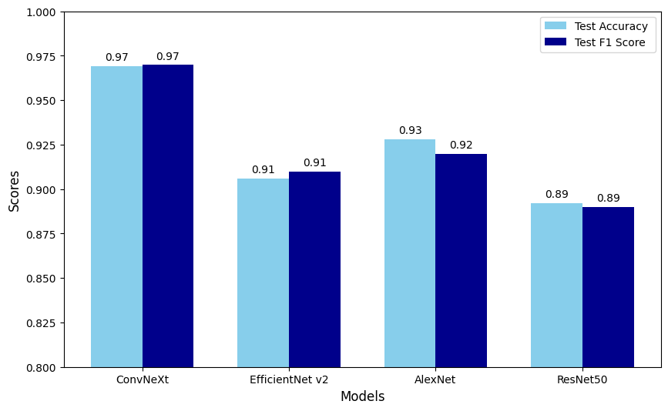
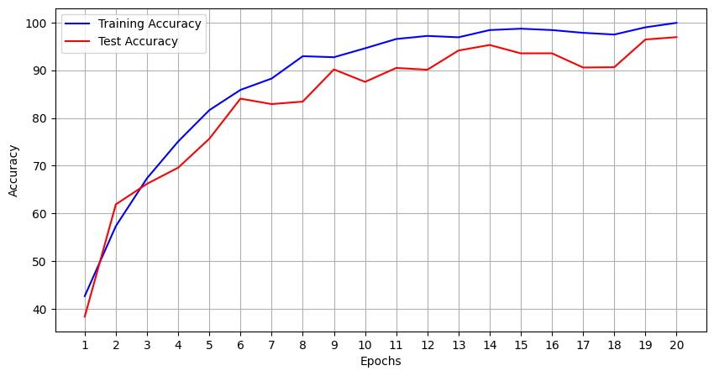
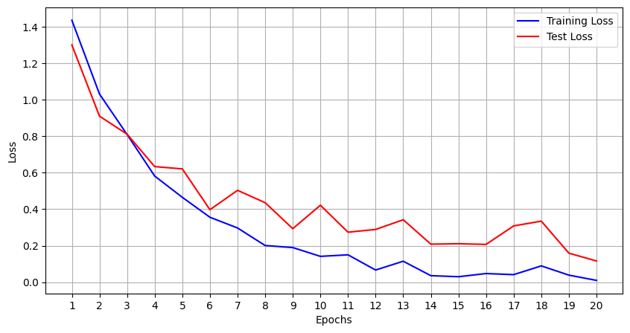
Graphs Slide

Slide 6
Discussion
ConvNeXt's superior performance is attributed to its hybrid CNN-Transformer architecture, effectively capturing both local and global features in HSIs.
Comparison with other CNN models (AlexNet, EfficientNetV2, ResNet50) highlights ConvNeXt's advantage in handling complex spatial-spectral patterns in hydrocarbon spill detection.
Slight overfitting observed, suggesting potential improvements through regularization techniques or data augmentation.
Confusion matrix analysis reveals high accuracy in classifying clean samples and motor oil, with minor misclassifications between gasoline and thinner, potentially due to overlapping spectral characteristics.
Additional Context: The choice of ConvNeXt was motivated by its recent success in image classification tasks. Future work could explore different hyperparameter settings or architectural modifications to further improve performance.

Slide 7
Conclusion
Proposed a robust deep learning framework for multi-class hydrocarbon spill classification using HSI and a fine-tuned ConvNeXt model.
Achieved high accuracy (96.93%) and F1-score (0.97) demonstrating the effectiveness of the patch-based approach and ConvNeXt architecture.
Future work: Explore larger datasets, incorporate advanced data augmentation techniques, and investigate real-world deployment for practical applications.
Additional Context: The research contributes to the field of environmental monitoring and disaster response by providing a more accurate and efficient method for detecting hydrocarbon spills.

Slide 8
References
[1] A. Bhargava, A. Sachdeva, K. Sharma, M. H. Alsharif, P. Uthansakul, and M. Uthansakul, “Hyperspectral imaging and its applications: A review,” Heliyon, vol. 10, no. 12, p. e33208, 2024.
[2] S. S, R. R, S. M, and V. S, “Detection of oil spill events at sea using machine learning,” in 2023 5th International Conference on Inventive Research in Computing Applications (ICIRCA), pp. 53–58, 2023.
[3] K. Sherif, F. H. Rizk, A. M. Zaki, M. M. Eid, N. Khodadadi, A. Ibrahim, A. A. Abdelhamid, L. Abualigah, and E.-S. M. El-Kenawy, “Revolutionizing oil spill detection: A machine learning approach for satellite image classification,” in 2024 International Telecommunications Conference (ITC-Egypt), pp. 245–250, 2024.
[4] N. A. Bui, Y. Oh, and I. Lee, “Oil spill detection and classification through deep learning and tailored data augmentation,” International Journal of Applied Earth Observation and Geoinformation, vol. 129, p. 103845, 2024.
[5] J. Yang, Y. Hu, J. Zhang, Y. Ma, Z. Li, and Z. Jiang, “Identification of marine oil spill pollution using hyperspectral combined with thermal infrared remote sensing,” Frontiers in Marine Science, vol. 10, 2023.
[6] J. M. Haut, S. Moreno-Alvarez, R. Pastor-Vargas, A. Perez-Garcia, and M. E. Paoletti, “Cloud-based analysis of large-scale hyperspectral imagery for oil spill detection,” IEEE Journal of Selected Topics in Applied Earth Observations and Remote Sensing, vol. 17, pp. 2461–2474, 2024.
[7] S. Jia, S. Jiang, Z. Lin, N. Li, M. Xu, and S. Yu, “A survey: Deep learning for hyperspectral image classification with few labeled samples,” Neurocomputing, vol. 448, pp. 179–204, 2021.
[8] D. Rivas-Lalaleo and C. Hernandez, “Hydrocarbon spill hyperspectral dataset (hshd,” 2024.
[9] Spectral Python Development Team, “Spectral python (spy).” Accessed: 2025-01-19.
[10] Z. Liu, H. Mao, C.-Y. Wu, C. Feichtenhofer, T. Darrell, and S. Xie, “A convnet for the 2020s,” 2022.
[11] A. Dosovitskiy, L. Beyer, A. Kolesnikov, D. Weissenborn, X. Zhai, T. Unterthiner, M. Dehghani, M. Minderer, G. Heigold, S. Gelly, J. Uszkoreit, and N. Houlsby, “An image is worth 16x16 words: Transformers for image recognition at scale,” 2021.

