Slide 1
Tableau’s Dashboards and stories
Created by : Hitesh

Slide 2
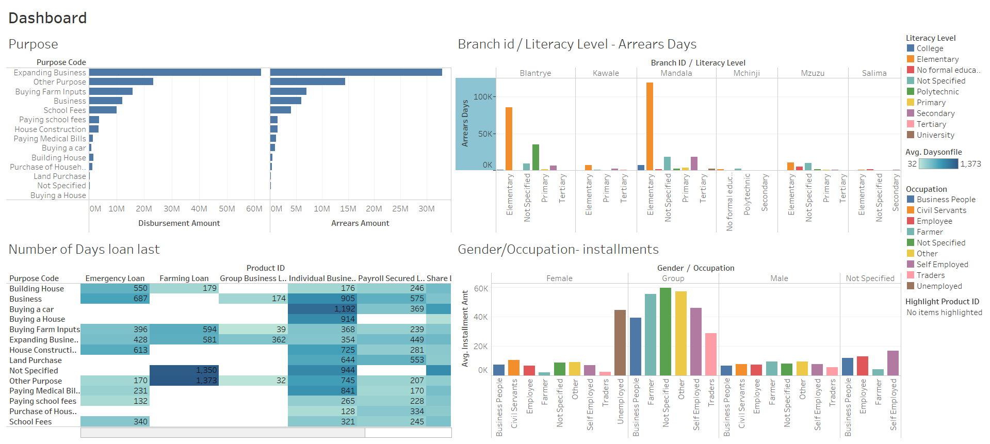

Slide 3
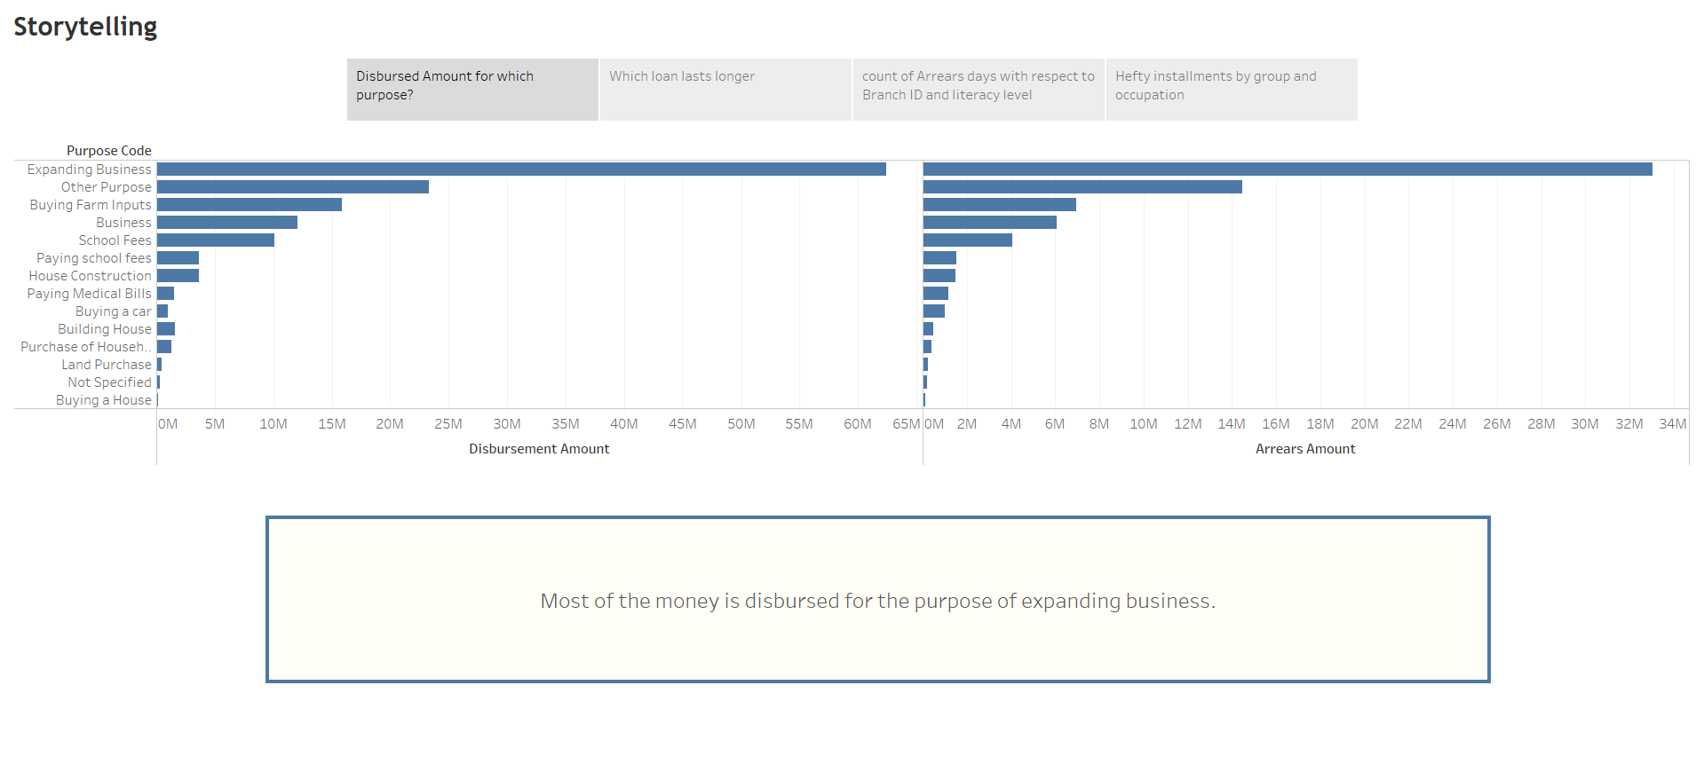

Slide 4
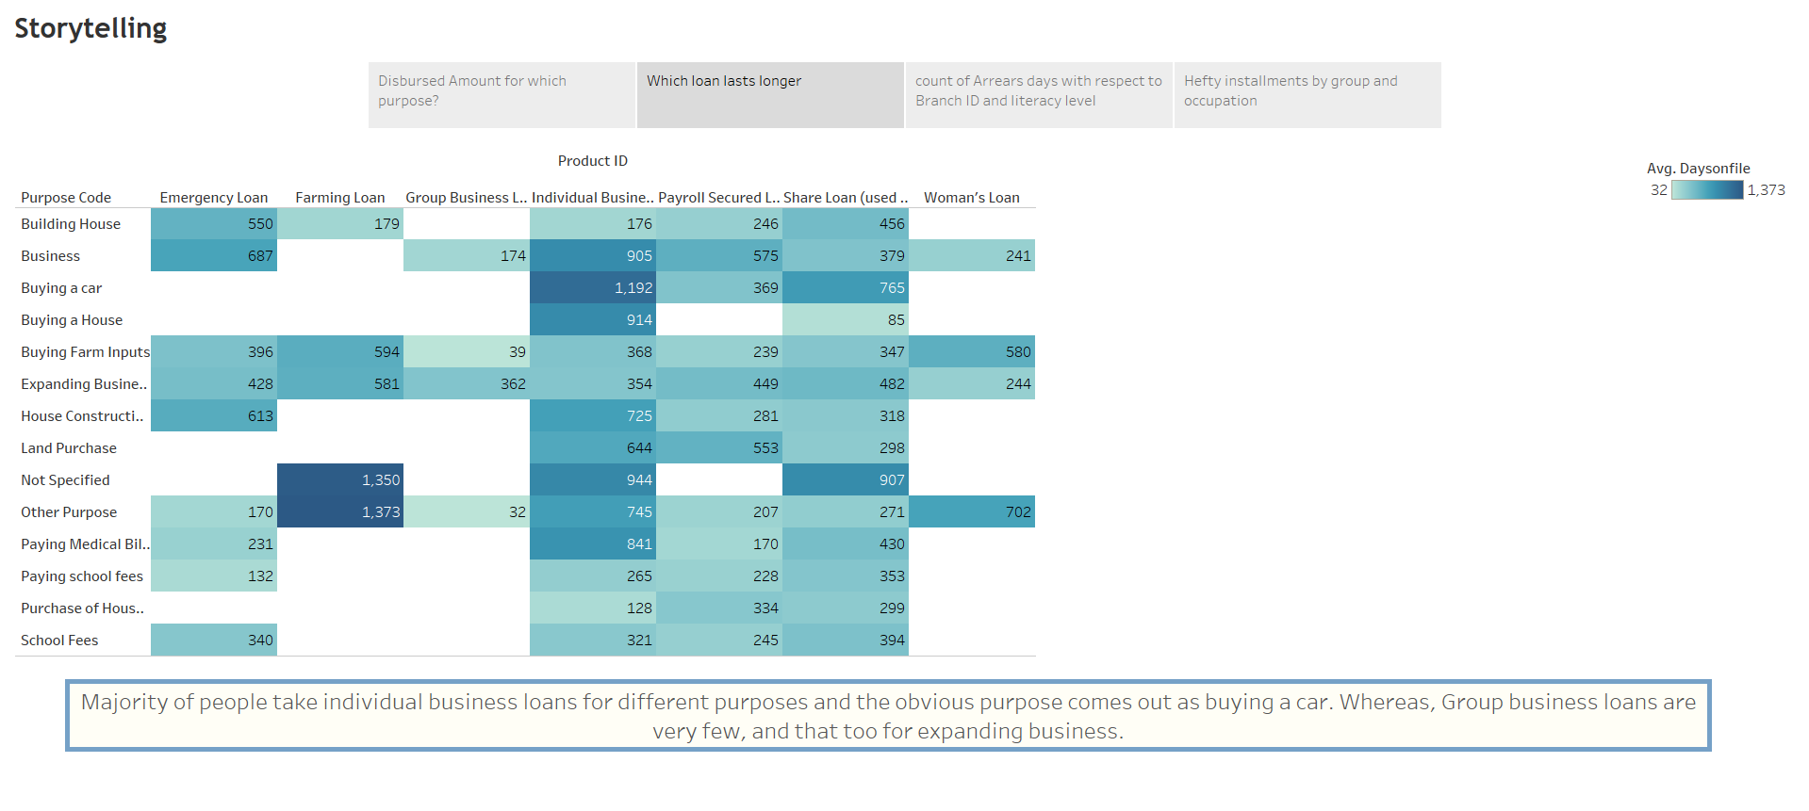

Slide 5
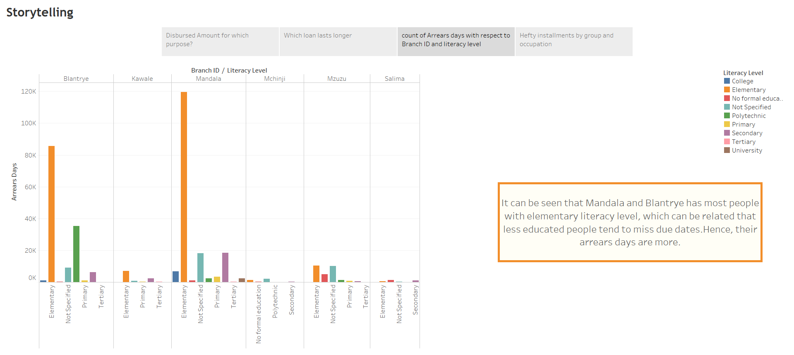

Slide 6
