Slide 1


Slide 2
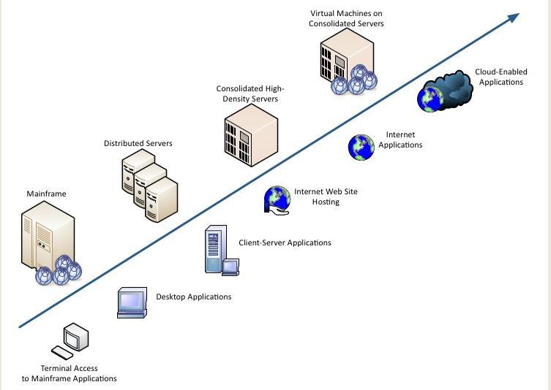
Evolution of Computing….

Slide 3

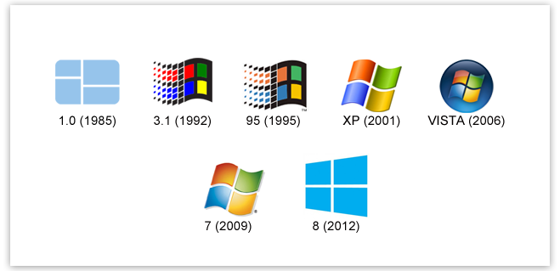

Slide 4
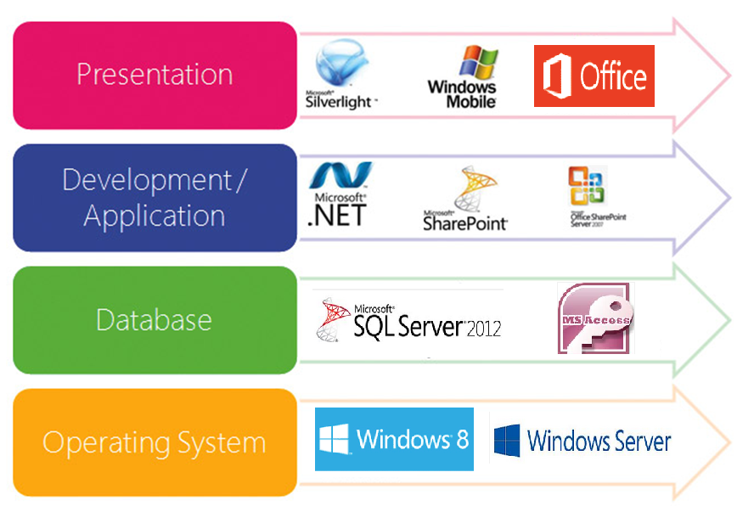

Slide 5












Slide 6
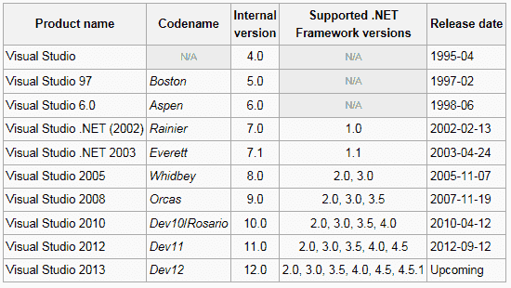





Slide 7
.NET Framework Overview and future roadmap

Slide 8

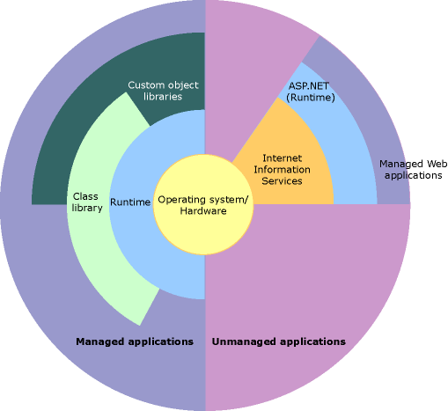
What is .NET?
The .NET Framework is a managed execution environment that provides a variety of services to its running applications.
Major components :
The Common Language Run time (CLR) - execution engine that handles running applications
The .NET Framework Class Library (FCL) - provides a library of tested, reusable code that developers can call from their own applications
Services .NET Framework provides to running applications:
Memory Management
Common Type System (CTS)
An Extensive Class Library
Development Framework and Technologies
Language Interoperability
Version Compatibility
Side-by-side execution
Multi-targeting
Notes:
http://msdn.microsoft.com/en-us/library/hh425099(v=vs.110).aspx

Slide 9
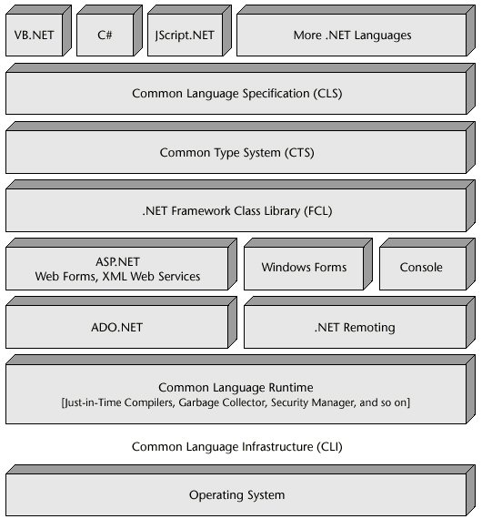
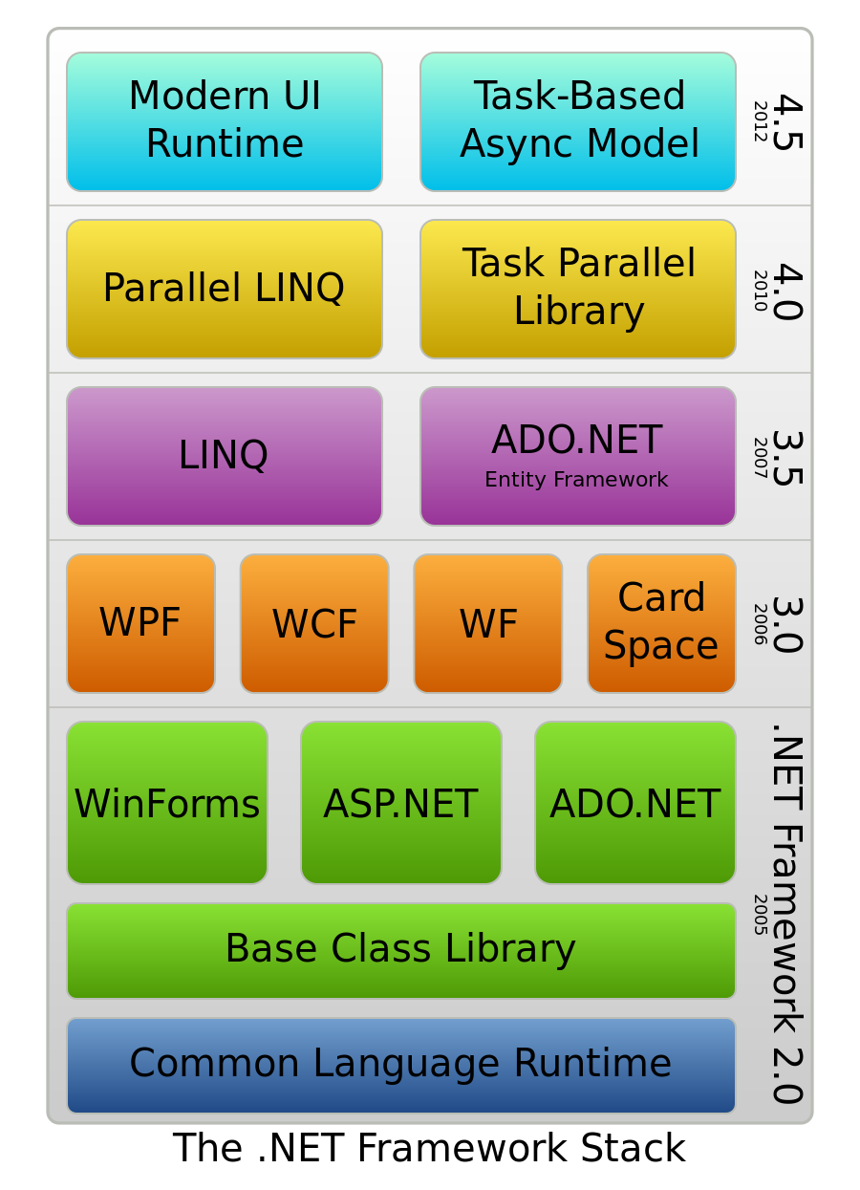
.NET Overview
.NET Architecture stack

Slide 10
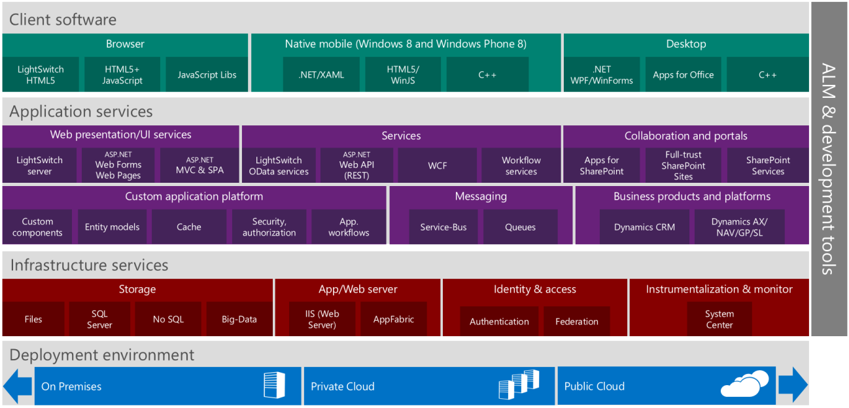
Microsoft Development Platform Technologies

Slide 11

Where do I start?
.NET Framework is used for
Web Application Development (thin client)
  ASP.NET
  ASP.NET MVC
  ASP.NET AJAX
  Web Services
  WCF
  Silverlight
Windows Application Development (thick client)
  Windows Application
  Console Application
  Windows Services
  WPF
  WF
Cloud Application Development
Windows Phone Applications
Windows Store Applications
Applications for Embedded Systems
  Xbox Game Development
Refer to .NET universe poster for more detailed categories.

Slide 12
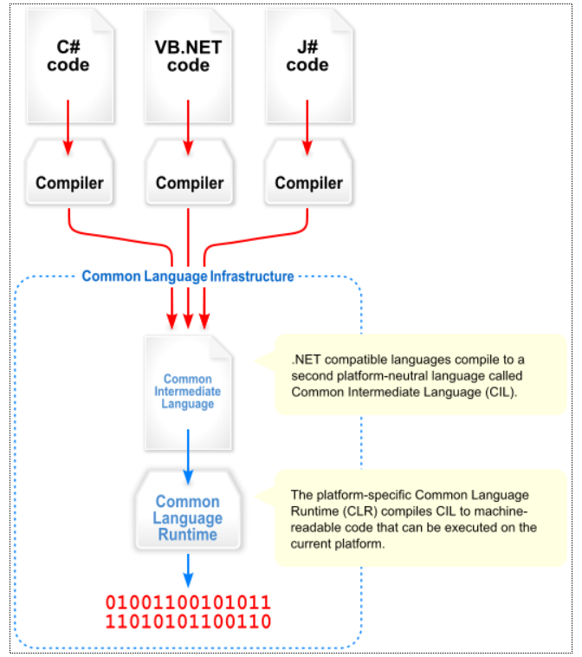
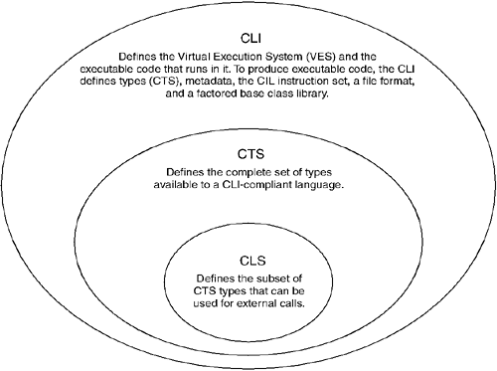
Common Language Infrastructure
Common Language Infrastructure is an open specification developed by Microsoft that describes the executable code and runtime environment that form the core of the Microsoft .NET Framework.
The CLI specification describes the following four aspects:
The Common Type System (CTS) - A set of data types and operations that are shared by all CTS-compliant programming languages.
Metadata - Information about program structure and it is language-agnostic, so that it can be referenced between languages and tools
Common Language Specification (CLS) - A set of base rules to which any language targeting the CLI should conform in order to interoperate with other CLS-compliant languages. The CLS rules define a subset of the Common Type System.
Virtual Execution System (VES) - The VES loads and executes CLI-compatible programs. When the code is executed, the platform-specific VES will compile the CIL to the machine language according to the specific hardware and OS.

Slide 13
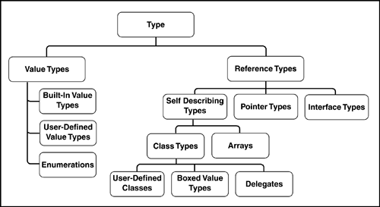
.Net Types
The common type system supports two general categories of types:
Value types
  directly contain their data,
  instances of value types are either allocated on the stack or allocated inline in a structure.
  can be built-in (implemented by the runtime), user-defined, or enumerations.
Reference types
  store a reference to the value's memory address, and are allocated on the heap.
  can be self-describing types, pointer types, or interface types.
  The type of a reference type can be determined from values of self-describing types.
  Self-describing types are further split into arrays and class types. The class types are user-defined classes, boxed value types, and delegates.
  This distinction helps in memory and security management.
All types are derived from System.Object
  Public Methods: Equals, GetHashCode, ToString, GetType
  Protected Methods: MemberwiseClone, Finalize
new operator
  Calculate & allocates memory required.
  Initializes object type’s object pointer
  Default constructor is called.
Casting between types
  Employee e = (Employee) o;
  Boolean b1 = (o is Employee)
  Employee e = o as Employee; (if the cast fails no exception is thrown, but employee is set to null)
Boxing and un-boxing

Slide 14
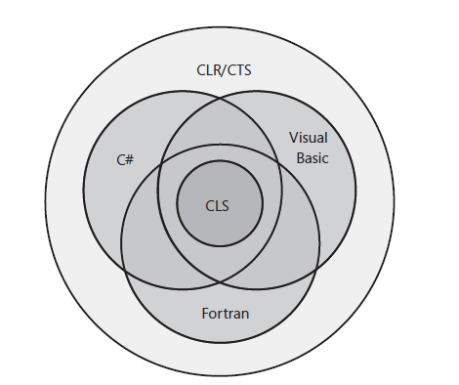
The Common Language Specification (CLS)
  CLS defines the minimum set of features that all languages must support.
  Enables Interoperability between modules from different languages.
  The CLS rules define a subset of the CTS; all the rules that apply to the Common Type System apply to the CLS, except where stricter rules are defined in the CLS.
  [Assembly:CLSComplaint(true)]
If you want your code to be CLS-compliant, you must expose functionality in a way that is CLS-compliant in the following places:
  Definitions of your public classes
  Definitions of the public members of public classes, and of members accessible to derived classes
  Parameters and return types of public methods of public classes and of methods accessible to derived classes.
  It is perfectly acceptable to write non–CLS-compliant code. However, if you do, the compiled IL code isn’t guaranteed to be fully language interoperable.

Slide 15
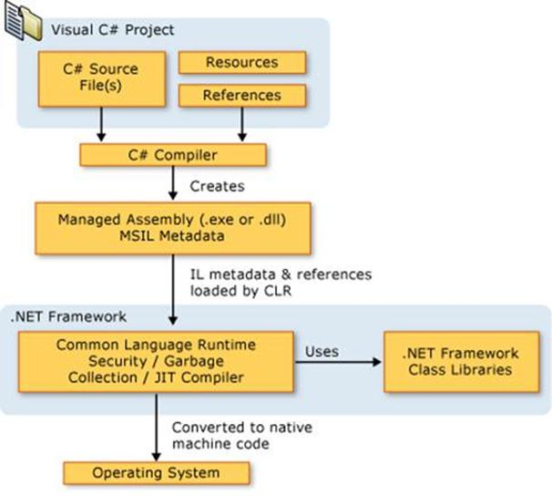
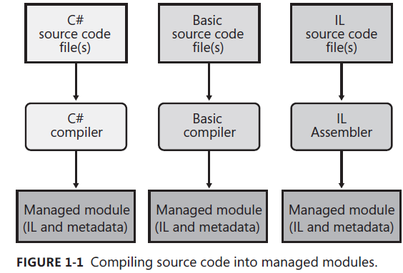
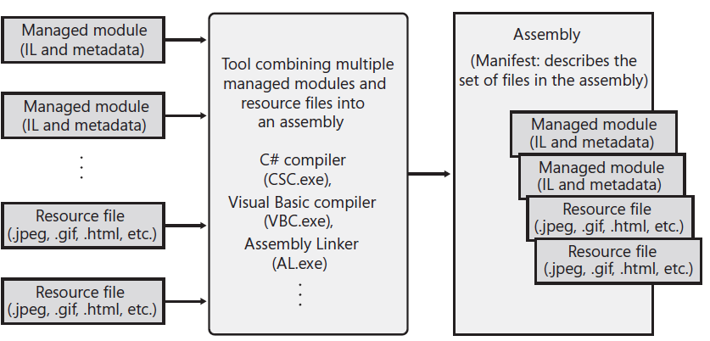
.Net Code compilation produces MSIL
MSIL – Microsoft intermediate language
  IL is stack based.
  IL instructions are type less (no separate version for 32-bit or 64-bit)
  IL enables security. – CLR performs an operation called Verification that examines the high level IL code and ensures that everything the code does is safe.
  Avoids memory overlap.
  IL is simple hence Reverse engineering is simple.

Slide 16
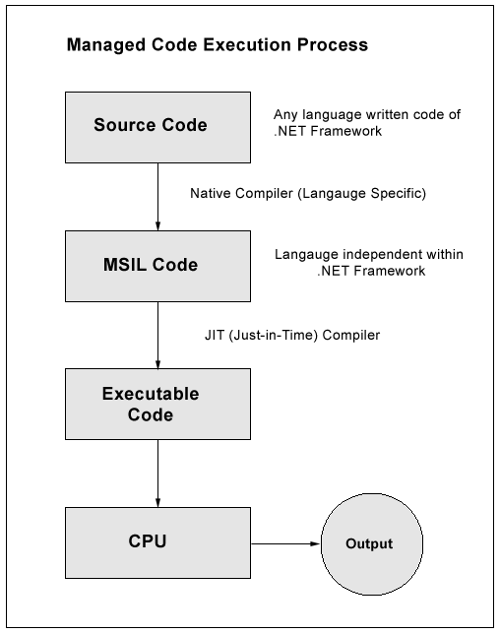
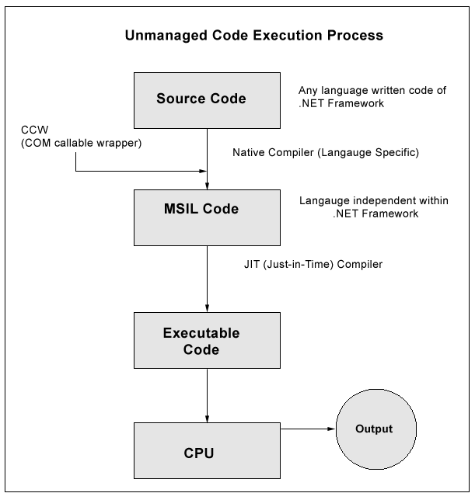
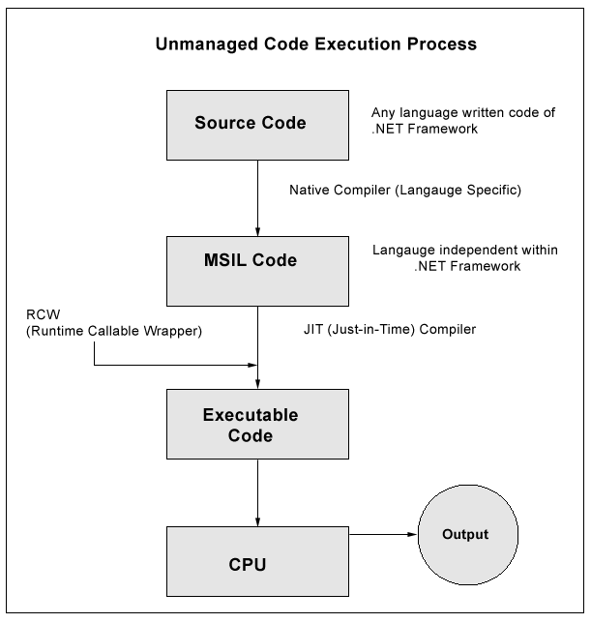
Managed Code Vs Un-managed Code
Interoperability with Un-managed code
  Managed code can call unmanaged code DLL (E.g. calling a method on VB.DLL)
  Managed can use existing COM.
  Un-managed code can use managed type

Slide 17
Manage code vs unmanaged code
MSIL code generated is called managed code. Only managed code is interoperable
Code that targets the runtime is known as managed code, while code that does not target the runtime is known as unmanaged code.
Managed Code will be executed by CLR. Unmanaged code cannot be executed by CLR
Memory management and Garbage collection works only with managed code
When a compiler produces MSIL, it also produces metadata which describes the types in your code, including the definition of each type, the signatures of each type's members, the members that your code references, and other data that the runtime uses at execution time.
The MSIL and metadata are contained in a portable executable (PE) file that is based on and extends the published Microsoft PE and common object file format (COFF) used for executable content. The runtime locates and extracts the metadata from the file as needed during execution. This file is called Assembly.
This file format enables the operating system to recognize common language runtime images. The presence of metadata in the file along with the MSIL enables your code to describe itself.

Slide 18
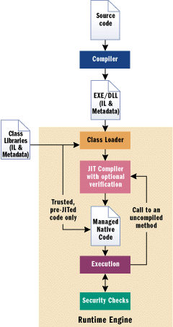
How to execute code from different languages ? – CLR VES

Slide 19
Common Language Runtime (CLR)
The CLR is the execution engine for .NET applications and serves as the interface between .NET applications and the operating system.
The CLR provides many services such as:
  Loads and executes code
  Converts intermediate language to native machine code
  Separates processes and memory
  Manages memory and objects
  Enforces code and access security
  Handles exceptions
  Interfaces between managed code, COM objects, and DLLs
  Provides type-checking
  Provides code meta data (Reflection)
  Provides profiling, debugging, etc

Slide 20
Common Language Runtime
.NET Framework Class Library Support
Thread Support
COM Marshaler
Type Checker
Exception Manager
Security Engine
Debugger
MSIL to Native
Compilers
Code
Manager
Garbage
Collection
Class Loader

Slide 21
Version of .NET
How do you know which version of the .NET Framework is installed on your machine?
  By looking at MSCorEE.ddl in %SystemRoot%\Microsoft.NET\Framework; %SystemRoot%\Microsoft.NET\Framework64
  You can also use CLRVer.exe (from .NET SDK)
  64 bit version of windows allows 32 bit applications to run using technology called WoW64(Windows on Windows 64)

Slide 22
What is an Assembly?
Assemblies are a fundamental part of programming with the .NET Framework.
It contains code that the common language runtime executes.
It forms a security boundary. An assembly is the unit at which permissions are requested and granted.
It forms a type boundary. Every type's identity includes the name of the assembly in which it resides. A type called MyType loaded in the scope of one assembly is not the same as a type called MyType loaded in the scope of another assembly.
It forms a reference scope boundary. It specifies the types and resources that are exposed outside the assembly.
It forms a version boundary. The assembly is the smallest versionable unit in the common language runtime; all types and resources in the same assembly are versioned as a unit.
It forms a deployment unit
It is the unit at which side-by-side execution is supported.
It is .Net’s answer to versioning conflicts and DLL hell

Slide 23
Types of Assemblies
Assemblies can be static or dynamic.
  Static assemblies can include .NET Framework types (interfaces and classes), as well as resources for the assembly (bitmaps, JPEG files, resource files, and so on). Static assemblies are stored on disk in portable executable (PE) files.
  dynamic assemblies can be created using .NET Framework APIs and these can be run directly from memory and are not saved to disk before execution. You can save dynamic assemblies to disk after they have executed.
Assemblies can be private or public.
  Private assemblies are the simplest type. They normally ship with software and are intended to be used only with that software.
  Because a private assembly is entirely self-contained, the process of deploying it is simple. You simply place the appropriate file(s) in the appropriate folder in the file system (no registry entries need to be made). This process is known as zero impact (xcopy) installation.
Shared assemblies are intended to be common libraries that any other application can use.

Slide 24
Global Assembly Cache (GAC)
Each computer where the common language runtime is installed has a machine-wide code cache called the global assembly cache. The global assembly cache stores assemblies specifically designated to be shared by several applications on the computer
There are two ways to deploy an assembly into the global assembly cache:
  Use an installer designed to work with the global assembly cache.
  Use a developer tool called the Global Assembly Cache tool (Gacutil.exe), provided by the Windows Software Development Kit (SDK).
the default location for the global assembly cache is %windir%\Microsoft.NET\assembly or %windir%\assembly
depending on the .Net framework version installed

Slide 25
Visual Studio.Net
Visual Studio .NET is a complete set of development tools for building .Net applications including the IDE
Visual Studio – IDE for .Net programming
You can use Visual Studio to build any type of .Net application - Windows Store apps, desktop apps, mobile apps, ASP.NET web apps, and XML web services.
You can write code in Visual Basic, Visual C#, Visual C++, Visual F#, and JavaScript, and create mixed-language solutions more easily.
And you can simplify the development of web apps and XML web services by accessing key technologies in the .NET Framework.

Slide 26
Compiler Options
Compile Directly from a Command Prompt Window
  >csc HelloDemoCS.cs
Use /t to indicate target
  >csc /t:exe HelloDemoCS.cs
Use /reference to reference assemblies
  >csc /t:exe /reference:assemb1.dll HelloDemoCS.cs

Slide 27










What Tools Does the .NET Framework SDK Provide?
Caspol.exe
Gacutil.exe
Makecert.exe
Ildasm.exe
Ngen.exe
Sn.exe
Tool Name | Purpose
Caspol.exe | Enables users to modify the machine, user, and enterprise security policy
MakeCert.exe | Enables users to create x.509 certificates for use in their development environment.
Gacutil.exe | Enables users to manipulate the assemblies in the GAC.
Ngen.exe | Enables users to improve the performance of .NET applications
ILDASM.exe | Enables users to manipulate assemblies i.e. disassembling an assembly to view MSIL code.
Sn.exe | Enables users to sign assemblies with strong names.
Notes:
Module 1: Introducing C# and the .NET Framework
Course 10266A
Explain the purpose of each tool on the slide and provide examples of when you could use them.
Show students the location of tools in:
C:\Windows\Microsoft.NET\Framework\v2.0.50727
C:\Program Files\Microsoft SDKs\Windows\v7.0A\bin
Question: You have created two applications that both use an assembly called Contoso.ReportGenerator.dll. Both applications will run on the same machine. What is the best approach to share the Contoso.ReportGenerator.dll assembly and which tool would you use?
Answer: You would install the assembly into the Global Assembly Cache (GAC) by using the Gacutil.exe tool.

Slide 28
Overview of .NET Framework release history
Generation | Version number | CLR version | Release date | Development tool | Distributed with |  | Supersedes
 |  |  |  |  | Windows | Windows Server
1.0 | 1.0.3705.0 | 1.0 | 2002-02-13 | Visual Studio .NET | N/A | N/A | N/A
1.1 | 1.1.4322.573 | 1.1 | 2003-04-24 | Visual Studio .NET 2003 | N/A | 2003 | 1.0
2.0 | 2.0.50727.42 | 2.0 | 2005-11-07 | Visual Studio 2005 | N/A | 2003, 2008 SP2, 2008 R2 SP1 | N/A
3.0 | 3.0.4506.30 | 2.0 | 2006-11-06 | Microsoft Blend | Vista | 2008 SP2, 2008 R2 SP1 | 2.0
3.5 | 3.5.21022.8 | 2.0 | 2007-11-19 | Visual Studio 2008 | 7, 8, 8.1 | 2008 R2 SP1 | 2.0, 3.0
4.0 | 4.0.30319.1 | 4 | 2010-04-12 | Visual Studio 2010 | N/A | N/A | N/A
4.5 | 4.5.50709.17929 | 4 | 2012-08-15 | Visual Studio 2012 | 8 | 2012 | 4.0
4.5.1 | 4.5.50938.18408 | 4 | 2013-10-17 | Visual Studio 2013 | 8.1 | 2012 R2 | 4.0, 4.5
4.5.2 | 4.5.51641 | 4 | 2014-05-05 | Visual Studio 2013 | N/A | N/A | 4.0, 4.5, 4.5.1

Slide 29
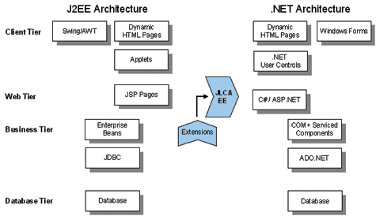
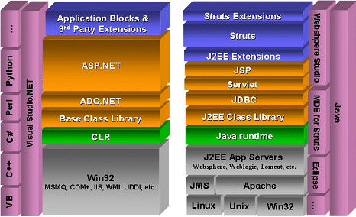
Comparison between J2EE and .NET Architectures
Execution Engine
J2EE: Java source code compiles into machine-independent byte code . Runtime Environment : JVM
.NET: Any compliant language compiles into MSIL. Runtime environment : CLR
Both JVM and CLR ,support services, such as code verification, memory management via garbage collection, and code security.
Cross Platform Portability
J2EE: Platform Independent. JDK should exist on target machine
.NET: Supports Windows platform.CLR should exist on target machine
Can support other platforms provided it has its own JIT complier
Language Support
J2EE: Tied to Java. Supports other languages via interface technology.
.NET: Language independent. Supports any language if mapping exists from that language to IL.
Tools Support
J2EE: Can employ any number of tools.
Pro :Developer has a great deal of choice
Con :Difficulty in choosing a right tool for a given job
.NET
Visual Studio.NET, single IDE for building an application

