Slide 1
Module 3 : Advanced Features of C#

Slide 2
Table of Contents
Evolution of C#
Generics
Data Structures and Collections in .NET
What’s new in C#
Partial Classes and Partial Methods
Nullable Types
Impilict Types
Automatic Properties
Object Initializers
Anonymous Types
Lambda Expressions
Extension Methods
Dynamic Keyword

Slide 3
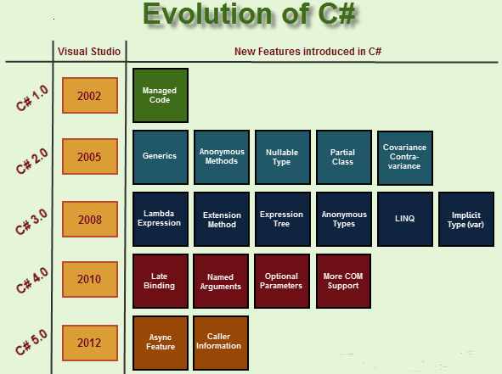

Slide 4
Generics with C#
Why Generics ?
Boxing and Unboxing :
Boxing is the process of converting a value type to the type object or to any interface type implemented by this value type. When the CLR boxes a value type, it wraps the value inside a System.Object and stores it on the managed heap. Unboxing extracts the value type from the object. Boxing is implicit; unboxing is explicit. The concept of boxing and unboxing underlies the C# unified view of the type system in which a value of any type can be treated as an object.
ArrayList al = new ArrayList();
al.Add("Tapo");
al.Add("Kishore");
al.Add(12345);
string name = al[0].ToString();
int num = (int)al[2];

Slide 5
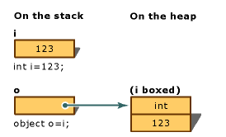
Why Generics Contd….
Boxing :
int i = 123; // The following line boxes i. object o = i;
Unboxing :
o = 123; i = (int)o; // unboxing

Slide 6
Generics
List<Employee> empList = new List<Employee>
{
new Employee() { Name = "Tapo", EmpNo = 12345 },
new Employee() { Name = "Kishore", EmpNo = 456}
};
empList.Add(123); // this will throw an error
Generic types allow code re-use with type safety
Class defers instantiation of a type until instantiated by client
Internal algorithms remain the same, only the type changes
Eliminates performance overhead with avoidance of boxing and unboxing
System.Collections.Generic

Slide 7
Data Structures and Collections in .NET
Arrays
Collection Interfaces
Queue
Stack
Hashtable
Lists
Dictionaries
Sets
Enumerators

Slide 8
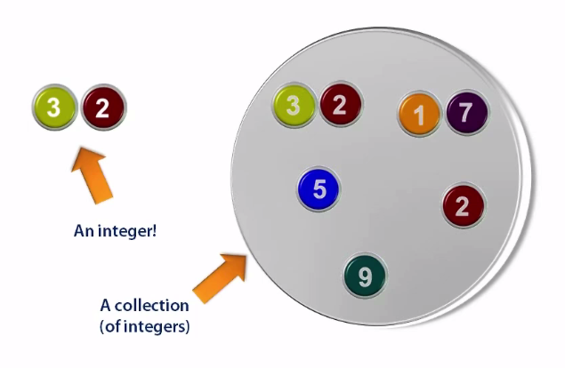
What is a collection ?
Definition : Type responsible for managing groups of objects in memory.

Slide 9
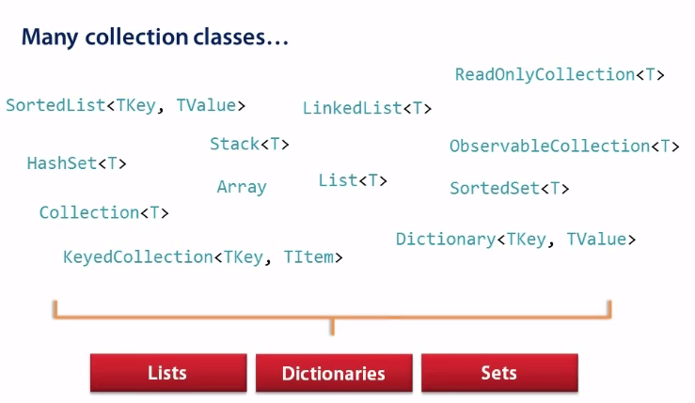
Collections in .NET

Slide 10
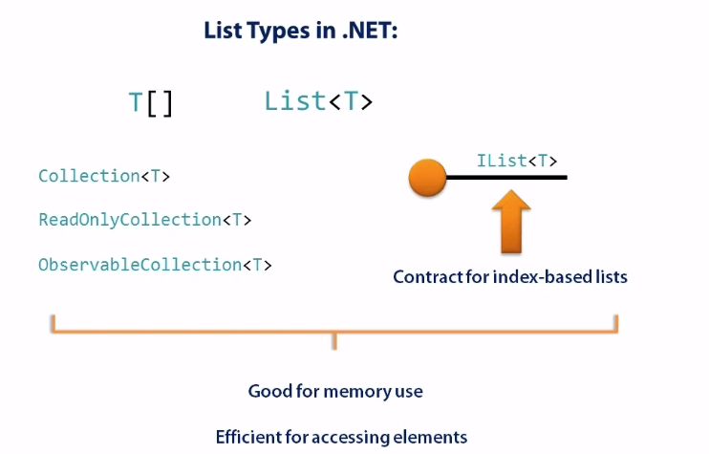
Lists
Used when order of elements is very important (top 100, top 10 etc).
Need to access elements by position in order
Index = position in order
First item has an index of zero
Zero based indexing

Slide 11
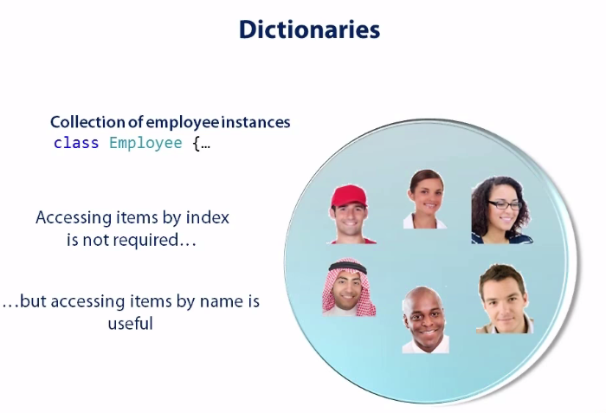
Dictionaries

Slide 12
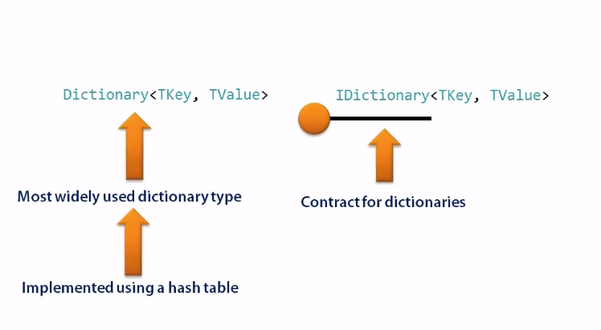
Dictionaries

Slide 13
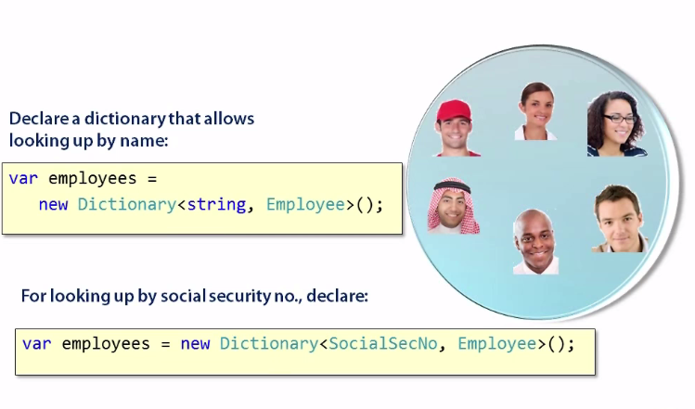
Dictionaries

Slide 14
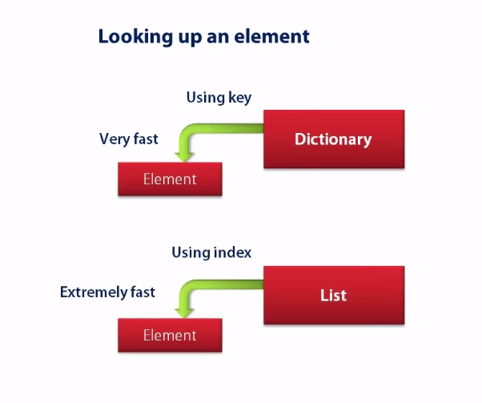
Dictionary vs List

Slide 15
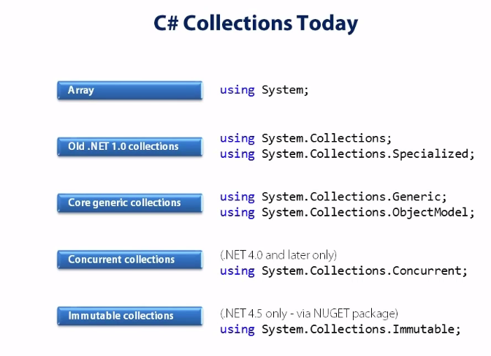
C# Collections today

Slide 16
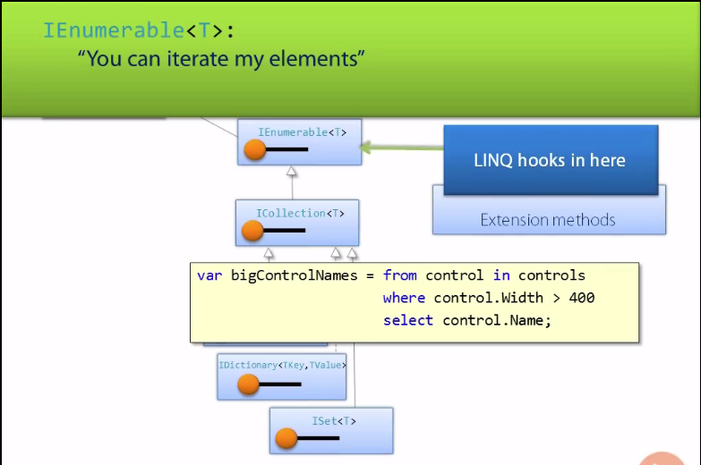
IEnumerable <T>

Slide 17
List<T> Methods
Add (T item)
Add item at end of list
Insert (int index, T item)
Insert item at a specific position
Remove (T item)
Remove first occurance of item
RemoveAt (int index)
Remove item at specified position

Slide 18
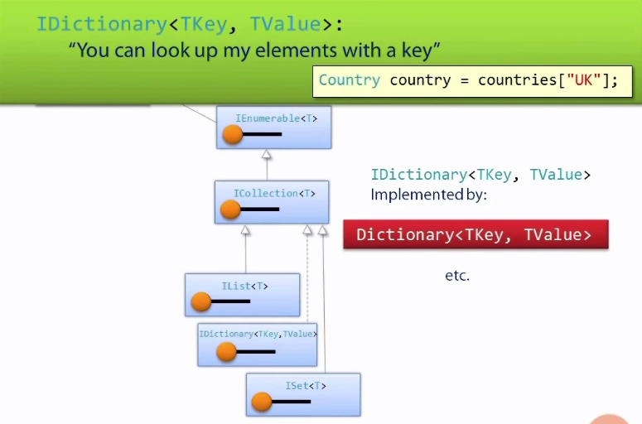
IDictionary<TKey, TValue>

Slide 19
IDictionary <TKey, TValue> Contd…
Query elements of the collection :
this [key]
Keys
Values
ContainsKey()
Modifying the collection :
Add()
Remove()
Collection of Key Value Pairs
Practical Usage ?

Slide 20
Stack<T>
LIFO
Example : A Pile of Books
POP
PUSH
Items can be added only here
n Item
n-1 Item
2nd Item
1st Item
PEEK

Slide 21
Queue <T>
FIFO
Items can be added only here
Enqueue
n Item
n-1 Item
2nd Item
1st Item
Common Scenario : Tasks to be processed
n Item
n-1 Item
2nd Item
1st Item
Can only remove items from here
Dequeue

Slide 22
What’s new in C#
C# 2.0 | C# 3.0/3.5 | C# 4.0
Partial Types | Auto Implemented properties | Tuples
Anonymous Methods | Implicit Typed local variable | Covariance and Contravariance
Property and Index Visibility | Anonymous Types | Dynamic Language Runtime
Static Classes | Extension Methods
 | Object and Collection Initializers
 | Lambda Expressions

Slide 23
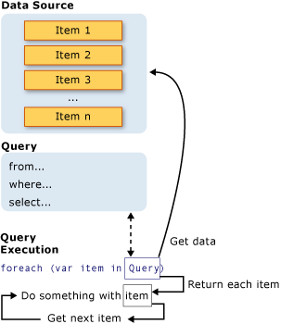
LINQ
Language-Integrated Query
Set of features that extends powerful query capabilities
Can be used with .NET Framework collections, SQL Server databases, ADO.NET Datasets, and XML documents.

Slide 24
Using Partial Classes and Partial Methods
Split a class definition across multiple source files
Prefix the class and method declarations with the partial keyword
public partial class Residence
{
partial void SaleResidence(string name);
}
Definition of SaleResidence method
public partial class Residence
{
partial void SaleResidence(string name)
{
//Logic goes here.
}
}
Implementation of SaleResidence method
All parts of the partial class and method must be available during compilation
Compiled into a single entity
Notes:
Mention that there may be situations where you want to split a class definition across multiple source files (for example, multiple developers may work on the same file, or you may want to keep aspects of the class that you do not want to change in a different file).
Some classes in the .NET Framework and Visual Studio projects use the partial concept (ASP.NET Web applications – control definitions – your custom code).
Explain that there are some rules to using partial classes:
Each part of the class must be available when your application is compiled.
Each part of the class must be prefixed with the partial keyword.
The partial type cannot be split over multiple assemblies.
The partial keyword must prefix the class keyword.
Mention that you can split a method definition by prefixing your method declaration with the partial keyword. Also mention that the implementation of a partial method is optional. If the method is not implemented, all calls to the method are removed by the compiler.
Explain that there are some rules to using partial methods:
All partial methods must be void and cannot return a value.
All partial methods are implicitly private.
All partial method declarations must be prefixed with the partial keyword.
Partial methods can have ref parameters but not out parameters. Ref parameters are covered in "Lesson 4: Comparing References to Values" later in this module.
Question: What happens if you define a partial method, but do not provide an implementation of this method?
Answer: Your code will still compile and run, and you will be able to call the method. However, because the method contains no implementation, it will not do anything.
Additional Reading
For more information about partial classes and methods, see the Partial Classes and Methods (C# Programming Guide) page at http://go.microsoft.com/fwlink/?LinkId=192927.

Slide 25
Partial Methods
Partial methods can only be defined within a partial class.
Partial methods must return void.
Partial methods can be static or instance level.
Partial methods can have arguments (including parameters modified by this, ref, or params—but not with the out modifier).
Partial methods are always implicitly private.

Slide 26
Nullable Types
You can set a reference variable to null to indicate that it has not been initialized
The null value is itself a reference, and there is no corresponding value for value types to indicate that they are uninitialized
Currency myCurrency = null; // illegal
You use a question mark (?) to indicate that a value type is nullable
Currency? myCurrency = null; // legal
if (myCurrency == null)
{
}
Nullable types expose the HasValue and Value properties
Currency? myCurrency = null;
if (myCurrency.HasValue)
{
Console.WriteLine(myCurrency.Value);
}
Notes:
Mention that you cannot use a reference variable until you have assigned it a value, but at the point in your code at which you declare the variable, you may not know what to initialize it to.
Explain that you can set a reference variable to null, but there is no corresponding null value for value types.
Explain that you can declare a nullable value type, which enables you to assign a null value.
Explain that you can use the <type>? syntax to declare a nullable type.
Explain that nullable types expose two useful properties:
The HasValue property to determine whether the nullable type has a value.
The Value property to get the value.
Question: What is wrong with the following code?
int amount = null;
if (amount != null)
{
...
}
Answer: The int variable amount has not been declared by using the nullable int type. The following code example illustrates this.
int? i = null;

Slide 27
Implicit Type
Implicit Type Local Variable
Defining types at runtime as per initial value
“var” is used for creating implicit types
“var” is not a keyword
Can be defined any types (string , int , arrays, etc)
Strongly Typed Data
Examples :
var marks = 200;
var str = "This is implicit type";
var b = true;
Restriction in Implicit Types
Can be only local variables
Must assign value at the time of declaration except null.

Slide 28
Automatic Properties
class Product
{
public string Name {get; private set;}
//used to be
/*
string name;
public string Name
{
get {return name;}
set { name = value;}
}
*/
}
The compiler implements a getter and/or setter to a private backing field of the same type as the property.
The property names can only be used now across the class improving consistency.
Notes:
With C# 1.0 having a public getter meant that the matching setter needed to be public too. C# 2.0 allows properties with a private setter.
C# 3.0 cuts the fluff in creating properties with automatically implemented properties.

Slide 29
Simplified Initialization : Using Object Initializers
To simplify object initialization, any accessible fields or properties of an object can be set via an object initializer.
Eg:
Bunny b1 = new Bunny { Name="Bo", LikesCarrots=true, LikesHumans=false };
Where Name, LikesCarrots and LikesHumans are properties.
Internally, the code to initialize would use temporary variables to ensure that any exception resulting while constructing the object does not end up with a part initialized object.
Bunny temp1 = new Bunny();//temp1 is a compiler generated name
Temp1.Name = "Bo";
-------
-------
Bunny b1 = temp1;

Slide 30
Simplified Initialization : Using Collection Initializers
You can use the Add method to add items to a collection
ArrayList al = new ArrayList();
al.Add("Value");
al.Add("Another Value");
You can also use a collection initializer to add items to a collection when you define the collection
// Assume person1 and person 2 are instantiated // Person objects.
ArrayList al2 = new ArrayList()
{
person1,
person2
};
You can combine collection initializers with object initializers
ArrayList al3 = new ArrayList()
{
new Person() {Name="James", Age =45},
new Person() {Name="Tom", Age =31}
};
Notes:
Simplified initialization for parameters as implicitly typed arrays can also be mentioned here –
MyMethod(new string[] {“one”,”two”,”three”}); can be rewritten as
MyMethod(new [] {“one”,”two”,”three”});

Slide 31
Defining Anonymous Types
var obj = new { pcode = "E001", pname = "ABC", psal = 45000 };
MessageBox.Show(obj.pcode + " " + obj.pname + " " + obj.psal);
Limitation of Anonymous Types :
You don’t control the name of the anonymous type.
Anonymous types always extend System. Object.
The fields and properties of an anonymous type are always read-only.
Anonymous types cannot support events, custom methods, custom operators, or custom overrides.
• Anonymous types are always implicitly sealed.
• Anonymous types are always created using the default constructor.

Slide 32


Defining Anonymous Methods
Add the anonymous method as a handler for a delegate
Use the overloaded delegate keyword
Optionally specify the parameter names and types for the anonymous method
myDelegateInstance += new myDelegate
(delegate (int parameter)
{
// Perform operation.
return 10;
});
Add the method body for the anonymous method
Do not specify a return type; the compiler will work out the return type based on the context
Notes:
This is an animated slide.
Explain that you add anonymous methods as handler methods for delegates. You cannot use an anonymous method without assigning it to a delegate, because it does not have a name and you will not be able to invoke the method.
[Click 1]: Explain how anonymous methods are defined by using the delegate keyword. Explain that this usage of the keyword differs from the previous usage (defining a delegate type) and this is an overload of the delegate keyword.
[Click 2]: Explain how to define parameters. Explain that defining parameters is optional. If parameters are defined, the method signature must match the delegate signature to which it is assigned; however, if the anonymous method does not specify parameters, the anonymous method can be assigned to any delegate, and the compiler will create randomly assigned parameters.
[Click 3]: Describe how to add the method body by using the normal syntax for a method.
[Click 4]: Highlight that an anonymous method returns like any other method, except the return type is inferred from the delegate to which it is assigned.
Question: If you specify parameters for an anonymous method, do you need to specify the types of those parameters?
Answer: Yes. Anonymous methods infer the return type, but not the type of parameters. However, you can omit the parameter list if you do not need to access any of the parameter values in the method.
Additional Reading
For more information about anonymous methods, see the Anonymous Methods (C# Programming Guide) page at http://go.microsoft.com/fwlink/?LinkId=192961.

Slide 33
What Is a Lambda Expression?
A lambda expression is an unnamed method written in place of a delegate instance.
Lambda expressions are defined by using the => operator
(parameters) => expression-or-statement-block
Lambda expressions use a natural and concise syntax
x => x * x
This code example can be read as: Given x, calculate x * x
The parameter and return types are inferred

Slide 34
Defining Lambda Expressions
A simple expression where the type of the x parameter is inferred from the context
x => x * x
An expression that uses a Visual C# statement block instead of a simple expression
x => { return x * x ; }
An expression that calls a method and takes no parameters
() => myObject.MyMethod(0)
An expression where the parameter type is stated explicitly
(int x) => x / 2
An expression with multiple parameters and a parameter passed by reference
(ref int x,int y) => {x++; return x/y;}

Slide 35
Creating and Using Extension Methods
Add extension methods to an existing class without:
- Having access to the source of the existing class
- Modifying or recompiling the existing class
- Deriving a new type from the existing class
namespace Fabrikam.Extensions
{
static class IntExtension
{
internal static int NextRand(this int seed, int
maxValue)
{
Random randomNumberGenerator = new Random(seed);
return randomNumberGenerator.Next(maxValue);
}
}
}
Static method
Extension type
using Fabrikam.Extensions;
...
int i = 8;
int j = i.NextRand(20);
No reference to the IntExtension class
Notes:
Extension methods, like instance methods, provide a tidy way to chain functions.
Any compatible instance method will always take precedence over an extension method.

Slide 36
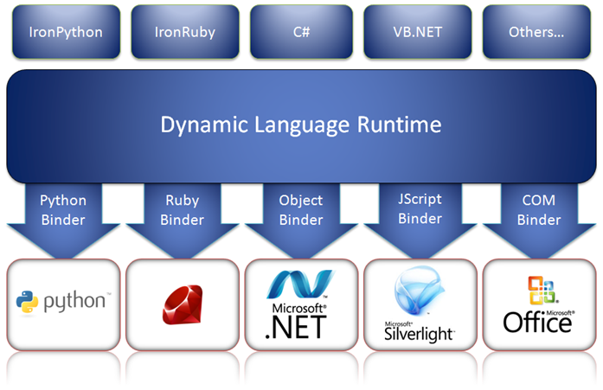
What Is the Dynamic Language Runtime?
A translation layer that can invoke dynamic objects and marshal data between the CLR and a dynamic object

Slide 37
Using the dynamic Keyword
Specifies that the C# compiler should defer type checking until run time
Syntactically similar to a type
Semantically, it defines an object
dynamic dynamicObject;
Use dynamic to refer to dynamic objects whose type can only be determined at run time
A dynamic variable can hold any type at any time
dynamic var1 = 99;
...
var1 = “Hello”;
IntelliSense is not available with dynamic variables
Code will compile, but may result in run-time errors if methods, operators, and properties do not exist or are misspelled
dynamic var2 = var1 * 5; // ? Will compile but may not run

Slide 38
Instantiating a Dynamic Object
You cannot use the C# new operator to instantiate a dynamic object
The runtime for a dynamic object is responsible for creating the object
A common technique is to provide a factory method for the dynamic object and call the factory method from Visual C# through the DLR
[Python]
class Customer:
def __init__(self, id, name, telephone):
...
def GetNewCustomer(id, name, telephone):
return Customer(id, name, telephone)
To call the method, start the runtime for the dynamic object, and invoke the script that defines the object (details will vary)
[Example – IronPython]
dynamic pythonScript =
Python.CreateRuntime().UseFile("Customer.py");
dynamic customer =
pythonScript.GetNewCustomer(99, "Fred", "111");

