Slide 1
ADO.NET

Slide 2
What is ADO.Net?
ADO .NET is a collection of classes, interfaces, structures, and enumerated types that manage data access from relational data stores within the .NET Framework
Designed for highly efficient data access
Designed to access relational databases
Support for XML and disconnected record sets

Slide 3
ADO versus ADO.NET
Feature | ADO | ADO.NET
Primary Aim | Client/server coupled | Disconnected collection of data from data server
Form of data in memory | Uses RECORDSET object (contains one table) | Uses DATASET object (contains one or more DATATABLE objects)
Disconnected access | Uses CONNECTION object and RECORDSET object with OLEDB | Uses DATASETCOMMAND object with OLEDB
Disconnected access across multi-tiers | Uses COM to marshal RECORDSET | Transfers DATASET object via XML. No data conversions required
Data Reads | Sequential | Sequential or non-sequential
Data Sources | OLE/DB via the Connection object | Managed provider calls the SQL APIs

Slide 4
ADO.NET and the .NET Framework
Microsoft .NET Framework
Web Services
User Interface
Data and XML
ADO.NET
XML
...
...
Base Classes
Common Language Runtime

Slide 5
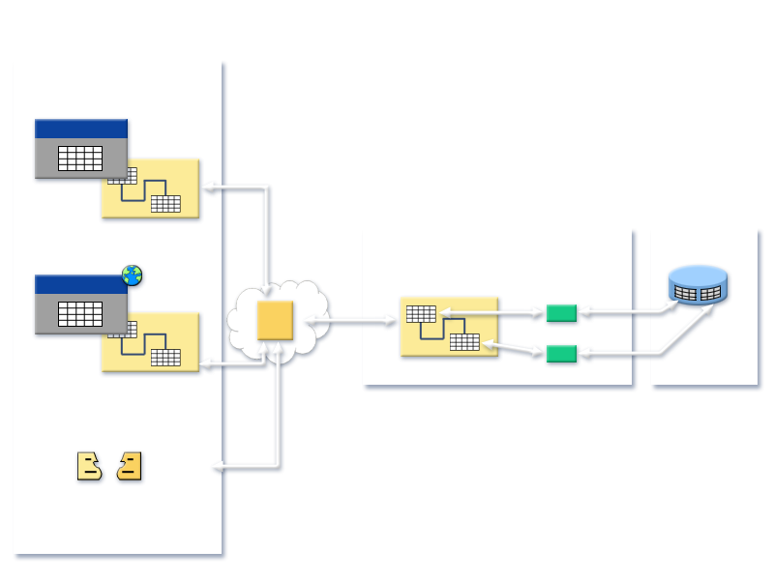
Data access 3-tier Architecture
Presentation Tier
Windows Forms
MyApp.Exe
DataSet
Business Tier
Data Tier
Internet
Intranet
Web Forms
Data Object (Class)
IE
Data Adapter
XML
DataSet
DataSet
Data Adapter
Business to Business
(BizTalk, for example)
Notes:
Example of a 3 tier architecture

Slide 6
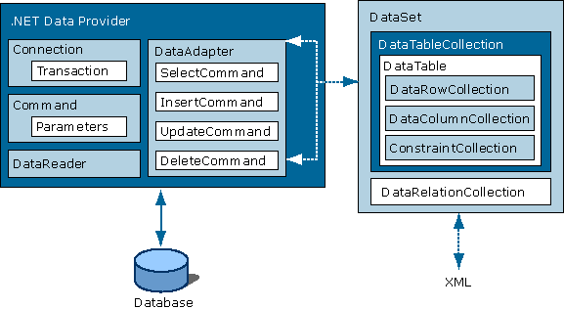
ADO.NET Architecture Diagram

Slide 7
The (ADO).NET Data Providers
A .NET Framework data provider is used for connecting to a database, executing commands, and retrieving results.
Encapsulate DB-specific details .
.NET Programmer
ADO.NET
Data Provider
DB

Slide 8

Data Providers
.NET Framework Data Providers available in ADO.NET
.NET Framework Data Provider for SQL Server
.NET Framework Data Provider for OLE DB
.NET Framework Data Provider for ODBC
.NET Framework Data Provider for Oracle
Entity Client Provider
Core Objects of .NET Framework Data Providers
Database
.NET Framework Data Provider:
DbConnection
DbCommand
DbDataReader
DbDataAdapter
Notes:
External providers

Slide 9
ADO.NET Namespaces
System.data - Core namespace, defines types that represent data
System.Data.SqlClient - Types that are optimized to connect to Microsoft® SQL Server
System.Data.SqlTypes - Native data types in Microsoft® SQL Server
System.Data.Common - Types shared between managed providers
System.Data.OleDb - Types that allow connection to OLE DB compliant data sources

Slide 10
Connected Architecture
Connection must be opened to access the data retrieved from database.
Built on the classes connection, command, data reader and transaction
Disadvantages :
1. Constant trips to the database for any CRUD operations
2. More traffic to the database
3. Read-only
Advantage :
1. More faster for Smaller operations
2. Less memory – dataset consumes more memory
3. Processing time saved – Datasets to be created and filled with data

Slide 11
Disconnected Architecture
Data retrieved from database can be accessed even when connection to database was closed.
Built on classes connection, dataadapter, commandbuilder and dataset and dataview.
Advantages :
1. Less Database Traffic.
2. Better scalability
3. No need of an open connection for the data all of the time
4. Data transfer between tiers or from an XML Web service.
The ADO.NET DataSet is the core component of the disconnected architecture of ADO.NET. The DataSet is explicitly designed for data access independent of any data source.

Slide 12
Connection Object
Basic steps are:
  Establish connection to database using Connection object.
  Open the Connection
  Perform Database Operations using Command Object
  Close the connection

Slide 13






Connecting to a Data Source by Using a DbConnection Object
Configuration
file
DbConnection
Database
Connection
string
DbConnectionStringBuilder
object
<connectionStrings>
<add name="AdventureWorks" connectionString="Server=MyServer; Database=AdventureWorks; Integrated Security=SSPI"/>
</connectionStrings>
Notes:
Module 14: Using ADO.NET
Course 10265A
Explain that you use the DbConnection class to establish a connection to a specified data source.
Explain that you should store connection strings in the application configuration file, or you can build them dynamically by using a DbConnectionStringBuilder object.
Explain that the SqlConnection class is the implementation of the DbConnection class from the Microsoft SQL Server® data provider.
Explain that you should use a using block to automatically close connections, because this can help to preserve resources.
Mention the connection events that an application can subscribe to (the InfoMessage event is specific to the SqlConnection class).
Question: Why should you use a using block when you open a connection to the database by using the DbConnection object?
Answer: The using block automatically closes the connection when it goes out of scope and ensures that database connection resources are reclaimed.
Additional Reading
For information about connection events, see the Connection Events (ADO.NET) page at http://go.microsoft.com/fwlink/?LinkId=194114.
For more information about establishing connections, see the Establishing the Connection (ADO.NET) page at http://go.microsoft.com/fwlink/?LinkId=194115.

Slide 14
Connection strings
Connections are opened based on connection string info
contains the information that the provider need to know to be able to establish a connection to the database or the data file.
Each providers have multiple ways to make a connection there are many different ways to write a connection string
Access - Provider=Microsoft.ACE.OLEDB.12.0;Data Source=C:\myFolder\myAccess2007file.accdb;
Jet OLEDB:Database Password=MyDbPassword;
Excel - Data Source =c:\myExcelFile.xlsx;HDR=no;Format=xlsx;
SQL Server - Server=myServerName\myInstanceName;Database=myDataBase;User Id=myUsername;
Password=myPassword;

Slide 15
Connecting to a Data Source
  string connectionString = "server=(local)\\NetSDK; Trusted_Connection=yes;
  database=northwind“;
  SqlConnection mySqlConnection = new SqlConnection(connectionString );
  mySqlConnection.open();
Defining Connection String
Creating Connection
Opening Connection
Each providers have multiple ways to make a connection there are many different ways to write a connection string
Notes:
. Show a live example
. Talk about Web.config file

Slide 16
Command Object
Command: Command is used to execute almost any SQL command from within the .NET application. The SQL command like insert, update, delete , select, create, alter drop can be executed with command object and you can also call stored procedures with the command object.
Command objects have multiple constructors.
Properties of Command Object
  Connection
  CommandType
  CommandText
  Transaction

Slide 17
Command Object
Command object has the following important execution method.
Use a DbCommand object to execute a SQL command or stored procedure
DbCommand
ExecuteDataReader
ExecuteScalar
ExecuteNonQuery
Returns a DbDataReader object
Returns a single value from the first column in the first row
Returns the number of rows affected. Used for insert, update, and delete operations
Use parameters to reduce chances of SQL injection attacks

Slide 18
DataReader Object
Provides methods and properties that deliver a forward-only stream of data rows from a data source
When a DataReader is used, parts of the ADO.NET model are cut out, providing faster and more efficient data access
DataReader objects are highly optimised for fast, forward only enumeration of data from a data command
A DataReader is not disconnected
Access to data is on a per record basis.
Forward only Read only
Does support multiple recordsets

Slide 19
Data Binding
ASP.NET allows powerful feature of data binding, you can bind any server control to simple properties, collections, expressions and/or methods
Data binding provides simple, convenient, and powerful way to create a read/write link between the controls on a form and the data in their application.
Web Forms provides many controls that support data binding. You can connect these controls to ADO.NET components such as a data reader, DataView, DataSet

Slide 20

GridView Control
Grid View – ASP.NET Control for showing tabular data in a grid
You can use the GridView control to do the following:
  Automatically bind to and display data from a data source control.
  Select, sort, page through, edit, and delete data from a data source control.
Sample Gridview

Slide 21
Bind Gridview with DataReader in ASP.net
private void BindGrid()
{
string strConnString = ConfigurationManager.ConnectionStrings["constr"].ConnectionString;
using (SqlConnection con = new SqlConnection(strConnString))
{
using (SqlCommand cmd = new SqlCommand())
{
cmd.CommandText = "select top 10 * from Customers";
cmd.Connection = con;
con.Open();
GridView1.DataSource = cmd.ExecuteReader();
GridView1.DataBind();
con.Close();
}
}
}

Slide 22
DataAdapters
Pipeline between DataSets and data sources
Disconnected by design
Supports select, insert, delete, update commands and methods
Must always specify a select command. All other commands can be generated or specified.
Allows the use of stored procedures
Connects to the database to fill the DataSet and also update the database
Notes:
. Overview of disconnected – architecture

Slide 23
Using the DataAdapter
SQLDataAdapter sqlDA =
new SqlDataAdapter();
sqlDA.SelectCommand =
new SqlCommand ("select * from authors“, sqlConnection);
DataSet sqlDS = new DataSet("authorsTable");
sqlDA.Fill(sqlDS, "authorsTable");

Slide 24
DataSets
In-memory representation of data contained in a database/XML .The data is local to the .NET-based application in which it resides, but can be populated from a data source such as Microsoft SQL Server using a DataAdapter
Can be created programmatically, using a Data Adapter or XML schema and document (or any mixture)
Contains tables, columns, relationships, and constraints, just like a database
Regardless of where the source data comes from, data can all be placed into DataSet objects
Tracks changes that are made to the data it holds before updating the source data
Works with all current models of data storage: flat, relational, and hierarchical

Slide 25
What Is a DataSet Object?
In-memory cache of data
Typically populated from a database
DataSet object
DataTable object
DataTable object
DataRow
Unique
Constraint
Data
Column
Unique
Constraint
ForeignKeyConstraint
DataRelation
Notes:
Module 14: Using ADO.NET
Course 10265A
Explain that a DataSet object provides an in-memory cache of data.
Explain that a DataSet object is independent of any data source.
Describe how DataSet objects enable applications to operate in a disconnected manner.
Explain the structure of a DataSet object and how it mirrors the relational structure of tables in a database.
Explain when you should use a DataSet object rather than a DbDataReader object.
Question: Identify an advantage of using a DataSet object.
Answer: Answers may vary, but could include:
A DataSet object can hold data in a format that is independent of the underlying data source.
A DataSet object enables your application to operate in a disconnected manner.
Additional Reading
For more information about creating DataRelation objects, see the Adding DataRelations (ADO.NET) page at http://go.microsoft.com/fwlink/?LinkId=194120.
For more information about navigating data by using DataRelation objects, see the Navigating DataRelations (ADO.NET) page at http://go.microsoft.com/fwlink/?LinkId=194121.
For more information about the DataView class, see the DataViews (ADO.NET) page at http://go.microsoft.com/fwlink/?LinkId=194122.

Slide 26
DataSets
Creating a DataSet
  DataSet customerOrders = new DataSet("CustomerOrders");
The DataSet is populated :
  Manually
  A DataAdapter's Fill method
  Using the ReadXml method
Update Datasource from Data Adapter
  The Update method of the DataAdapter is called to resolve changes from a Data Set back to the data source
Notes:
Manual
DataSet ds = new DataSet();
// Create DataTable object: “Customers”.
DataTable dt= new DataTable( “Customers” );
// Create and add columns to the table
// 1. Explicitly create and Add a DataColumn
DataColumn dc;
dc = new DataColumn( “CustID”, Type.GetType("System.Int16"));
dt.Columns.Add( dc );
// 2. Implicitly Create and Add columns (DataColumn).
dt.Columns.Add( “First_Name”,Type.GetType("System String”));
dt.Columns.Add( “Last_Name”, Type.GetType("System String”));
// Add the DataTable object to the DataSet
ds.Tables.Add( dt );

Slide 27
Populating a DataSet Object and Accessing Data
Use a DbDataAdapter object to populate each DataTable object in a DataSet object
The Fill method of a DbDataAdapter object:
  Connects to the database (if the connection is not open)
  Performs the query specified by the SelectCommand property
  Fetches data and constructs the DataTable object
  Disconnects from the database (if the connection was closed initially)
Retrieving data from a DataSet object by using LINQ to DataSet
[Visual C#]
var contactsNamedSmith =
from ct in myDataSet.Tables[0].AsEnumerable()
where ct.Field<string>(2) == “Smith”
select ct;
[Visual Basic]
Dim contactsNamedSmith = _
From ct In myDataSet.Tables(0).AsEnumerable() _
Where ct.Field(Of String)(2) = “Smith”_
Select ct
Notes:
Module 14: Using ADO.NET
Course 10265A
Explain that you use a DataAdapter object to populate a DataSet object. DataAdapter objects make use of DbConnection, DbCommand, and DbDataReader objects.
Explain that the DataAdapter object manages the connection, so there is no need to explicitly open and close connections.
Explain that commands are associated with a data adapter to enable you to query, insert, update, and delete data.
Describe how to access data in a DataSet object and highlight the use of Language-Integrated Query (LINQ) to DataSet.
Question: Do you need to open the database connection before you use the Fill method of a DataAdapter object?
Answer: No. The DataAdapter object automatically opens the database connection if it is not already open and closes it again when it has retrieved the data if the connection was closed initially.

Slide 28
Updating a Database From a DataSet
Reconnect, and apply adapter's Update() method
  Can use CommandBuilder object to generate necessary SQL . Constructs the action SQL that changes the data specified in the DataAdapter SelectCommand.
  _dataAdapter.InsertCommand.CommandText =
  "INSERT INTO customers " + "(CustomerId, CompanyName, ContactName, ContactTitle, " + "Address, City, PostalCode, Phone) " +
  "VALUES(@CustomerId, @CompanyName, @ContactName, " +
  "@ContactTitle, @Address, @City, @PostalCode, @Phone)";
  _dataAdapter.UpdateCommand = con.CreateCommand();
  _dataAdapter.UpdateCommand.CommandText =
  "UPDATE customers SET CompanyName = @CompanyName " +
  "WHERE CustomerID = @CustomerId";
  _dataAdapter.DeleteCommand = con.CreateCommand();
  _dataAdapter.DeleteCommand.CommandText =
  "DELETE FROM customers WHERE customerID = @CustomerId";

Slide 29
Stored Procedures
- A group of one or more Transact-SQL statements that can
- Accept input parameters
- Return multiple values in the form of output parameters to the calling program.
- Contain programming statements that perform operations in the database. These include calling other procedures.
-Return a status value to a calling program to indicate success or failure (and the reason for failure).
--Advantages
- Reuse of code
- Easier maintenance
- Reduced server/client network traffic
- Improved performance - compiles the first time creates an execution plan that is reused
- Enhance Security – No need to grant permissions at the individual object level and simplifies the security layers

Slide 30
Calling Stored Procedure with Data reader
//Create command object
SqlCommand storedProcCommand = new SqlCommand ("CustOrdersDetail", con);
storedProcCommand.CommandType = CommandType.StoredProcedure;
ArrayList rowList = new ArrayList();
SqlDataReader reader = storedProcCommand.ExecuteReader();
//read the results
// Process each result
while (reader.Read())
{
// Add each order ID in the result to the listview containing the orders IDs.
iOrderID = reader.GetOrdinal("OrderID");
orderIDsList.Items.Add (reader.GetInt32(iOrderID));
}
// Close the reader and the connection
reader.Close();
this.con.Close();
}

Slide 31
Calling Stored Procedure with DataSet
Public DataSet GetCustomerDetails()
{
  DataSet ds = new DataSet();
  System.Data.SqlClient.SqlConnection sqlConnection = new System.Data.SqlClient. SqlConnection(System.Configuration.ConfigurationManager.ConnectionStrings["ConnectionString"].ConnectionString);
  System.Data.SqlClient.SqlDataAdapter dataAdapter = new System.Data.SqlClient.SqlDataAdapter();
  System.Data.SqlClient.SqlCommand select = new System.Data.SqlClient. SqlCommand(sqlQueryString);
  select.CommandType = CommandType.StoredProcedure;
  select.Connection = sqlConnection;
  dataAdapter.SelectCommand = “spGetCustomerDetail”;
  dataAdapter.Fill(ds);
  return ds;
}

Slide 32
Stored Procedure with Parameters
CREATE PROCEDURE SPCOUNTRY
@COUNTRY VARCHAR(20) AS
SELECT PUB_NAME FROM publishers WHERE COUNTRY = @COUNTRY
GO
- To pass the paramenet from c# code
command.CommandType = CommandType.StoredProcedure;
param = new SqlParameter("@COUNTRY", "Germany");
param.Direction = ParameterDirection.Input;
param.DbType = DbType.String;
command.Parameters.Add(param);
--command.Parameters.Add("@A_CNT", OdbcType.Int);
--To get output parameters
--param.Direction = ParameterDirection.Output
--To get the return values from Stored Procedures
-Int32 count = Convert.ToInt32(command.ExecuteScalar());

