Slide 1
NET Win Forms

Slide 2
Agenda
Win Forms
Windows Services
User Controls
Delegates & Events
Dialog box (Modal and Modeless)
Threading
Debugging windows applications

Slide 3
Win Forms
A program may be text-based. It may require no graphical user interface. But often a GUI is important. The Windows Forms platform supports native Windows applications. These applications have high-quality user experiences.
Using winforms we can develop two types of windows applications
1) SDI(Single Document Interface): This is the simplest interface you can present to the user. SDI applications allow only one open document frame window at a time
2)MDI(Multiple Document Interface): Multiple-document interface (MDI) applications enable you to display multiple documents at the same time, with each document displayed in its own window. MDI applications often have a Window menu item with submenus for switching between windows or documents
Graphical computer applications with a multiple document interface (MDI) are those whose windows reside under a single parent window (usually except for modal windows), as opposed to all windows being separate from each other (single document interface). In the usability community, there has been much debate about which interface type is preferable. Generally, SDI is seen as more useful in cases where users work with more than one application. Software companies have used both interfaces with mixed responses. For example, Microsoft changed its Office applications from SDI to MDI mode and then back to SDI, although the degree of implementation varies from one component to another

Slide 4
Win Forms …Contd
Common controls
Label
TextBox
CheckBox
CheckedListBox
ComboBox
ListBox
ListView
DateTimePicker
Button
RadioButton
Containers
GroupBox
Panel
FlowLayoutPanel
TabControl
Menus & ToolBars
ContextMenuStrip
MenuStrip
ToolStrip

Slide 5
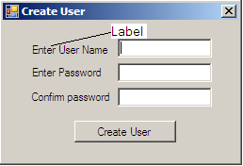
Win Forms …Contd
Label controls are typically used to provide descriptive text for a control.
For example, you can use a Label to add descriptive text for a TextBox control
to inform the user about the type of data expected in the control.
Label has property Text, when set will be displayed as shown in the form
Ex: label1.Text = “Enter User name”
Commonly used properties for Label control are
Properties Description
AutoSize This property is used to set or get a value specifying if the control should be automatically resized.
BorderStyle This property is used to get or set the border style for the control.
FlatStyle This property is used to get or set the flat style appearance of label control.
ImageProperty is used to set or get the image that is displayed on a label.
ImageAlign Property is used to set or get the alignment of an image that is displayed in the control.
TextAlign Property is used set or get the alignment of text in the control.
UseMnemonic Property is used set or get a value specifying whether to consider ampersand as an access key character.

Slide 6
Win Forms …Contd
TextBox: With the TextBox control, the user can enter text in an application. This control has additional functionality that is not found in the standard Windows text box control, including multiline editing and password character masking. Typically, a TextBox control is used to display, or accept as input, a single line of text.
Commonly used properties for TextBox control are
Properties Description
Enabled Indicates whether control is enabled or disabled for user to input.
Font Font used to display text in control
ForeColor Foreground color to display text color
MaxLength Maximum length of the characters to accept in text box
Multiline By default text is single line, if set to true text can be span to more than one line
PasswordChar Indicates the characters to display for password input
ReadOnly If set readonly to true, text in control cannot be changed
ScrollBars Scrollbars to be shown for multiline edit controls
TextAlign Indicates how the text is aligned in the control
Visible Determines whether the control is visible or hidden

Slide 7
Win Forms …Contd
Commonly used events for TextBox control are
Events Description
TextChanged
Validating
Validated
MouseHover
MouseLeave
CheckBox: Use a CheckBox to give the user an option, such as true/false or yes/no. The CheckBox control can display an image or text or both. CheckBox and RadioButton controls have a similar function: they allow the user to choose from a list of options. CheckBox controls let the user pick a combination of options. In contrast, RadioButton controls allow a user to choose from mutually exclusive options. Checkbox controls have states: checked and unchecked.
Commonly used properties for Checkbox control are
Properties Description
Checked Indicates whether component is in checked state.
Enabled Indicates whether control is enabled or disabled for user to input.
Visible Determines whether the control is visible or hidden
Commonly used events for Checkbox control are
Events Description
CheckedChanged Occurs when the check property is changed

Slide 8
Win Forms …Contd
ListBox: The ListBox control is a regular list box that enables the user to make a single selection from a list of predetermined values. The ListBox represents a Windows control to display a list of items to a user. A user can select an item from the list. It allows the programmer to add items at design time by using the properties window, or at the runtime.
Commonly used properties for ListBox control are
Properties Description
Items The items to be shown in the listbox
SelectionMode Single or Multiple
Muilticolumn Indicates values should be displayed in columns horizontally
ScrollAlwaysVisible Scrollbars are always visible
DataSource Indicates the list that this control will use to get its items
DataMember Indicates the property to display for the items in this control
CheckedListBox Displays a ListBox in which a check box is displayed to the left of each item.
Commonly used properties for CheckedListBox control are
Properties Description
Items The items to be shown in the listbox
CheckOnClick Indicates checkbox should be toggled on the first click

Slide 9
Win Forms …Contd
ComboBox : The ComboBox control displays a drop-down list of predefined values and an edit field into which the user can enter a value. To associate this control with a string or integer property, enter the property's name in the Property column of the Control table.
Events Description
SelectedIndexChanged Occurs when user selects one of the item from the combo box
ListView: A list-view control is a window that displays a collection of items. List-view controls provide several ways to arrange and display items and are much more flexible than simple List Boxes. For example, additional information about each item can be displayed in columns to the right of the icon and label.
DateTimePicker: A date and time picker (DTP) control provides a simple and intuitive interface through which to exchange date and time information with a user. For example, with a DTP control you can ask the user to enter a date and then easily retrieve the selection.

Slide 10
Win Forms …Contd
Button: A button is a control the that user can click to provide input to an application.
A Button can be clicked by using the mouse, ENTER key, or SPACEBAR if the button has focus.
Commonly used properties for Button control are
Properties Description
Text Text that is to be displayed on button control
Commonly used events for Checkbox control are
Events Description
Click Occurs when user clicks button.
RadioButton: Radio buttons are used to select one of several options, usually within a dialog box. A radio button contains a small circle with text next to it. When selected, the circle has a smaller, filled circle inside it. Selecting one button in a set deselects the previously selected button, so only one of the options in the set is selected at a time
Commonly used properties for Button control are
Properties Description
Text Text that is to be displayed after radio button control
Checked Indicates whether radio button is checked or not
Commonly used events for Checkbox control are
Events Description
CheckedChanged Occurs when checks radio button.

Slide 11
Win Forms …Contd
DataGridView: This control provides a customizable table for displaying data. Binding data to the DataGridView control is straightforward and intuitive, and in many cases it is as simple as setting the DataSource property. When you bind to a data source that contains multiple lists or tables, set the DataMember property to a string that specifies the list or table to bind to
Properties Description
DataSource Text that is to be displayed on button control
DataMember

Slide 12
Win Forms …Contd
Containers Provides focus-management functionality for controls that can function as a container for other controls.
A ContainerControl represents a control that can function as a container for other controls and provides focus management.
GroupBox: The GroupBox displays a frame around a group of controls with or without a caption. Use a GroupBox to logically group a collection of controls on a form. The group box is a container control that can be used to define groups of controls.
The typical use for a group box is to contain a logical group of RadioButton controls. If you have two group boxes, each containing several radio buttons, each group of buttons is mutually exclusive, setting one option value per group.
Panel: Panel is used to group collections of controls. Like other container controls, if the Panel control's Enabled property is set to false, the controls contained within the Panel will also be disabled.
Panel Have Auto Scroll Property But GroupBox Don't Have Auto Scroll Property
GroupBox Control Display The Caption But Panel Does Not Show Caption
A GroupBox always displays a border; a Panel’s border is determined by its BorderStyle property. It may be set to BorderStyle.None, BorderStyle.Single, or BorderStyle.Fixed3D.
A GroupBox does not support scrolling; a Panel enables automatic scrolling when its AutoScroll property is set to true.
FlowLayoutPanel:
The FlowLayoutPanel control arranges its contents in a horizontal or vertical flow direction. Its contents can be wrapped from one row to the next, or from one column to the next. Alternatively, its contents can be clipped instead of wrapped.
You can specify the flow direction by setting the value of the FlowDirection property. The FlowLayoutPanel control correctly reverses its flow direction in right-to-left (RTL) layouts. You can also specify whether the contents of the FlowLayoutPanel control are wrapped or clipped by setting the value of theWrapContents property.
Any Windows Forms control, including other instances of FlowLayoutPanel, can be a child of the FlowLayoutPanel control. With this capability, you can construct sophisticated layouts that adapt to your form's dimensions at run time.

Slide 13
Win Forms …Contd
TabControl This control contains tab pages, which are represented by TabPage objects that you add through the Controls property. TabPage represents a single tab page in a TabControl.
TabControl presents a tabbed layout in the user interface. The .NET Framework provides this versatile and easy-to-use control. This tutorial walks you through adding the control, changing its pages, manipulating it in C# code, and changing its visual settings
Menus Toolbars: A toolbar is a horizontal or vertical strip that contains buttons bound to commands. The length of a toolbar in a tool window is always the same as the width or height of the tool window, depending on where the toolbar is docked. Unlike toolbars in the integrated development environment (IDE), a toolbar in a tool window must be docked and cannot be moved or customized. In managed code, the toolbar in a tool window is always docked to the upper edge of the window.
A menu controller is a split control. The left side of the menu controller shows the last-used command, and it can be run by clicking it. The right side of the menu controller is a drop-down arrow that, when clicked, opens a drop-down list of additional commands. When you click a command on the list, the command runs, and it replaces the command on the left side of the menu controller. In this way, the menu controller operates like a command button that always shows the last-used command from a list.
Menu controllers can appear on menus but they are most often used on toolbars. Menu controllers can display the icon of the last-used command, the text of the last-used command, or both.
MenuStrip: The MenuStrip control represents the container for the menu structure of a form. You can add ToolStripMenuItem objects to the MenuStrip that represent the individual menu commands in the menu structure. Each ToolStripMenuItem can be a command for your application or a parent menu for other submenu items.
ToolStrip: Use this control and its associated classes in new Windows Forms applications to create toolbars that can have a Windows XP, Office, Internet Explorer, or custom appearance and behavior, all with or without themes, and with support for overflow and run-time item reordering.

Slide 14
Win Forms …Contd
ContextMenuStrip class represents shortcut menus that are displayed when the user clicks the right mouse button over a control or area of the form. Shortcut menus are typically used to combine different menu items from a MenuStrip of a form that are useful for the user given the context of the application. For example, you can use a shortcut menu assigned to a TextBox control to provide menu items for changing the font of the text, finding text within the control, or Clipboard features for copying and pasting text. You can also expose new ToolStripMenuItem objects in a shortcut menu that are not located within a MenuStrip to provide situation-specific commands that are inappropriate for the MenuStrip to display.
ErrorProvider Provides a user interface for indicating that a control on a form has an error associated with it. ErrorProvider presents a simple mechanism for indicating to the end user that a control on a form has an error associated with it. If an error description string is specified for the control, an icon appears next to the control. The icon flashes in the manner specified by BlinkStyle, at the rate specified by BlinkRate. When the mouse hovers over the icon, a ToolTip appears showing the error description string.

Slide 15
Windows Services
Microsoft Windows services, enable you to create long-running executable applications that run in their own Windows sessions.
These services can be automatically started when the computer boots, can be paused and restarted.
These features make services ideal for use on a server or whenever you need long-running functionality that does not interfere with other users who are working on the same computer.
You can also run services in the security context of a specific user account that is different from the logged-on user or the default computer account.
Services have no UI (If you want to show UI from a service, you need to do it via a separate process) and mostly do not interact directly with users
How to Create Windows Service
http://www.codeproject.com/Articles/3990/Simple-Windows-Service-Sample

Slide 16
Dialog box
Standalone applications typically have a main window that both displays the main data over which the application operates and exposes the functionality to process that data through user interface (UI) mechanisms like menu bars, tool bars, and status bars. A non-trivial application may also display additional windows to do the following:
Display specific information to users.
Gather information from users.
Both display and gather information.
These types of windows are known as dialog boxes, and there are two types: modal and modeless.
A modal dialog box is displayed by a function when the function needs additional data from a user to continue. Because the function depends on the modal dialog box to gather data, the modal dialog box also prevents a user from activating other windows in the application while it remains open. In most cases, a modal dialog box allows a user to signal when they have finished with the modal dialog box by pressing either an OK or Cancel button. Pressing the OK button indicates that a user has entered data and wants the function to continue processing with that data. Pressing the Cancel button indicates that a user wants to stop the function from executing altogether. The most common examples of modal dialog boxes are shown to open, save, and print data.

Slide 17
Dialog box …Contd
A modeless dialog box, on the other hand, does not prevent a user from activating other windows while it is open. For example, if a user wants to find occurrences of a particular word in a document, a main window will often open a dialog box to ask a user what word they are looking for. Since finding a word doesn't prevent a user from editing the document, however, the dialog box doesn't need to be modal. A modeless dialog box at least provides a Close button to close the dialog box, and may provide additional buttons to execute specific functions, such as a Find Next button to find the next word that matches the find criteria of a word search
Windows application allows to create several types of dialog boxes, including message boxes, common dialog boxes, and custom dialog boxes.
Message Boxes
Common Dialog Boxes
OpenFlieDialog
SaveFileDialog
FolderBrowserDialog
FontDialog
ColorDialog

Slide 18
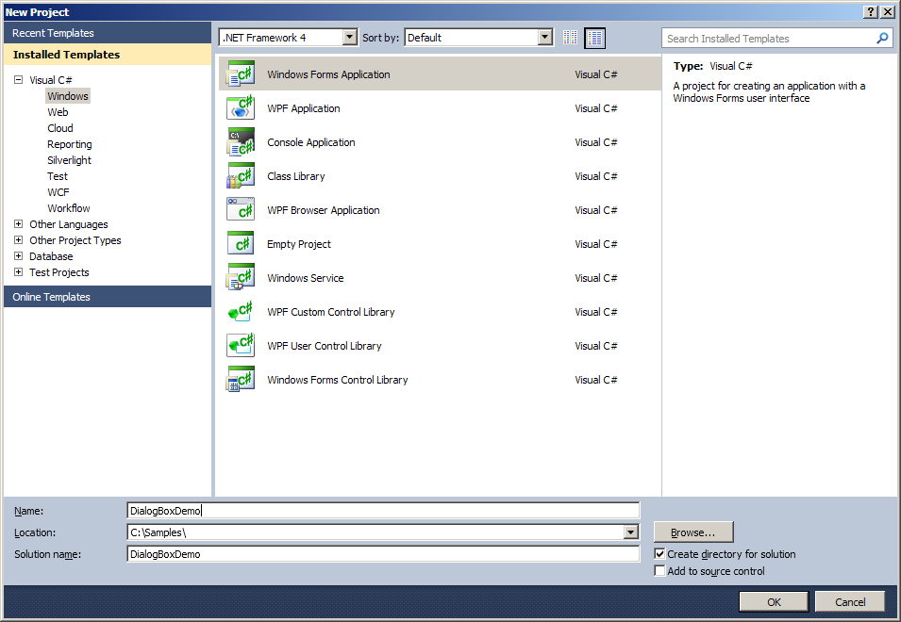
Dialog box …Contd
To create a console application in Visual C#, click on New on the File menu and select Project. Click on the C# Windows Forms Application project template, provide the filename that you want, and click OK.

Slide 19
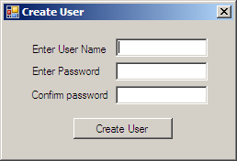
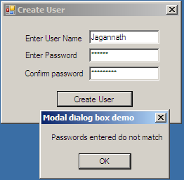
Dialog box (Message box demo) …Contd
Drag and drop label controls, text box controls and button control from Toolbox panel
If user enters passwords that do not match with confirm password, a friendly message to be displayed to user
Message box is Model dialog box, since user cannot access parent window without entering input in model dialog

Slide 20
Dialog box (Opendialog & Savedialog)…Contd
The OpenFileDialog component allows users to browse the folders of their computer or any computer on the network and select one or more files to open. The dialog box returns the path and name of the file the user selected in the dialog box.
Once the user has selected the file to be opened, there are two approaches to the mechanism of opening the file. If you prefer to work with file streams, you can create an instance of the StreamReader class. Alternately, you can use the OpenFile method to open the selected file
OpenFileDialog component is instantiated with a filter on it, allowing the user to choose only files with the file name extension.
Example: We can choose to filter only text files to show in the opened dialog
openFileDialog1.Filter = "Text files (*.txt)|*.txt";
The SaveFileDialog component allows users to browse the file system and select files to be saved. The dialog box returns the path and name of the file the user has selected in the dialog box. However, you must write the code to actually write the files to disk.

Slide 21

Dialog box (FolderBrowerdialog)…Contd
In various cases, applications allow the user to open a single file, but also a particular folder. For instance, in an MP3 player the user can either add a single file to the play list or can choose an entire folder of MP3 files. FolderBrowserDialog class provides a way to prompt the user to browse, create, and eventually select a folder. Use this class when you only want to allow the user to select folders, not files. Browsing of the folders is done through a tree control.
To create a FolderBrowserDialog control at design-time, you simply drag and drop a FolderBrowserDialog control from Toolbox to a Form in Visual Studio. After you drag and drop a FolderBrowserDialog on a Form, the FolderBrowserDialog looks like
FolderBrowserDialog Properties
SelectedPath property represents the selected path in a FolderBrowserDialog control.
RootFolder property represents the root folder where the browsing starts from.
ShowNewFolderButton property represents a value indicating whether the New Folder button appears in the folder browser dialog box.

Slide 22
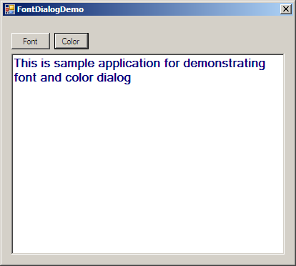
Dialog box (Font & Color dialog)…Contd
FontDialog presents a font selection dialog box. It allows the user to select a font from the list of installed fonts in the C# Windows Forms program. With the FontDialog control, we quickly add the ability for users to select their favorite fonts.
ColorDialog presents a color selection dialog box. It allows the user to select a color from the list of installed fonts in the C# Windows Forms program. With the ColorDialog control, we quickly add the ability for users to select their favorite color.

Slide 23
Debugging
Introduction
Breakpoints
Debugging with Breakpoints
Step Over
Step Into
Step Out
Continue
Set Next Statement
Show Next Statement
Conditional Breakpoint
Changing values while debugging
Watch Windows
Locals
Autos
Watch
Immediate Window
Call Stack

Slide 24
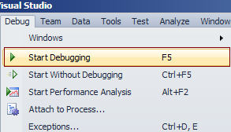
Debugging …Contd
Introduction
In the software development life cycle, testing and defect fixing take more time than actually code writing. In general, debugging is a process of finding out defects in the program and fixing them.
Visual Studio IDE gives us a lot of tools to debug our application. You can start debugging from the Debug menu of VS IDE. From the Debug Menu, you can select "Start Debugging" or just press F5 to start the program. If you have placed breakpoints in your code, then execution will begin automatically.

Slide 25
Debugging …Contd
Breakpoint is used to notify debugger where and when to pause the execution of program. You can put a breakpoint in code by clicking on the side bar of code or by just pressing F9 at the front of the line. So before keeping a breakpoint, you should know what is going wrong in your code and where it has to be stopped. When the debugger reaches the breakpoint, you can check out what's going wrong within the code by using a different debugging tool.
Debugging with breakpoints You have already set a breakpoint in your code where you want to pause the execution. And now start the program by pressing "F5". When the program reaches the breakpoint, execution will automatically pause. Now you have several options to check your code. After hitting the breakpoint, breakpoint line will show as yellow color which indicates that this is the line which will execute next.
Now you have several commands available in break mode, using which you can proceed for further debugging.
Step Over: After debugger hits the breakpoint, you may need to execute the code line by line. "Step Over" [F10] command is used to execute the code line by line. This will execute the currently highlighted line and then pause. If you select F10 while a method call statement is highlighted, the execution will stop after the next line of the calling statement. Step Over will execute the entire method at a time.
Step Into: This is similar to Step Over. The only difference is, if the current highlighted section is any methods call, the debugger will go inside the method. Shortcut key for Step Into is "F11".

Slide 26
Debugging …Contd
Step Out: This is related when you are debugging inside a method. If you press the Shift - F11 within the current method, then the execution will complete the execution of the method and will pause at the next statement from where it called
Continue: It's like run your application again. It will continue the program flow unless it reaches the next breakpoint. The shortcut key for continue is "F5“.
Set Next Statement: Set Next Statement allows you to change the path of execution of program while debugging. If your program paused in a particular line and you want to change the execution path, go to the particular line, Right click on the line and select "Set Next Statement" from the context menu. You will see, execution comes to that line without executing the previous lines of code. This is quite useful when you found some line of code may causing breaking your application and you don’t want to break at that time. Shortcut key for Set Next Statement is Ctrl + Shift + F10.
Show Next Statement [ Ctrl+*]: This line is marked as a yellow arrow. These lines indicate that it will be executed next when we continue the program
Conditional BreakPoint: Suppose you are iterating through a large amount of data and you want to debug a few of them. It means you want to pause your program on some specific condition. Visual Studio Breakpoints allow you to put conditional breakpoint. So if and only if that condition is satisfied, the debugger will pause the execution.
To do this, first of all you need to put the breakpoint on a particular line where you want to pause execution. Then just "Right Click" on the "Red" breakpoint icon. From there you just click on "Condition

Slide 27
Debugging …Contd
Changing values while debugging: For testing purpose you can change values of variables while debugging
Watch Windows
Locals: It automatically displays the list of variables within the scope of current methods. If your debugger currently hits a particular breakpoint and if you open the "Autos" window, it will show you the current scope object variable along with the value.
Auto: These variables are automatically detect by the VS debugger during the debugging. Visual Studio determines which objects or variables are important for the current code statement and based on that, it lists down the "Autos"
Watch: Watch windows are used for adding variables as per requirement. It displays variables that you have added. You can add as many variables as you want into the watch window. To add variables in the watch window, you need to "Right Click" on variable and then select "Add To Watch"
Immediate Window: It's very much helpful in debug mode of the application if you want to change the variable values or execute some statement without impacting your current debugging steps. You can open the Immediate window from menu Debug > Window > Immediate Window { Ctrl + D, I / Alt + Ctrl - I }.
Call Stack: These features also improve the productivity during debugging. If you have multiple method calling or nested calling all over your application and during debugging, you want to check from where this method has invoked, "Call Stack" comes into the picture. The Call Stack Window shows that current method call nesting.

