Slide 1
Design and Simulation of Radiation Hardened SRAM Cell SET Conference ID:- 222082
GUIDED BY- Dr. Arun Dev Dhar Dwivedi (CHACHA)
Presented By:
Hitesh Paliwal 22MVD0128
Pratyush Parashar 22MVD0129
Sachindra Mane 22MVD0140

Slide 2
Table of Content
6T cell array
SRAM Sizing Constraint
SRAM operation
Graphs

Slide 3
1. 6T SRAM Cell
BL
BLB
WL
WL
M3
M6
M2
M5
QB
Q
M1
M4

Slide 4
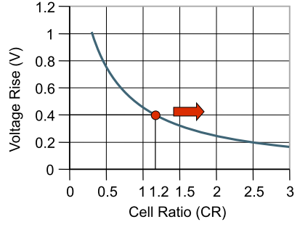
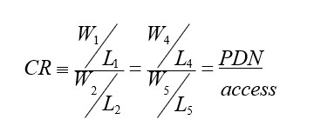

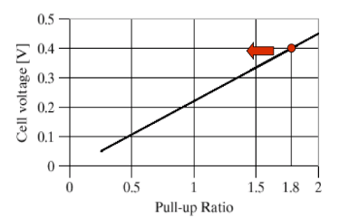
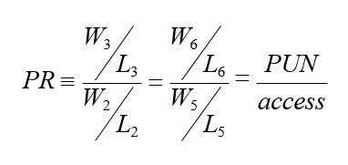
2. SRAM Sizing Constraints
Read Constraint
^{K}PDN ^{> K}access ^{> K}PUN
Write Constraint
^{K}access^{> K}PUN

Slide 5
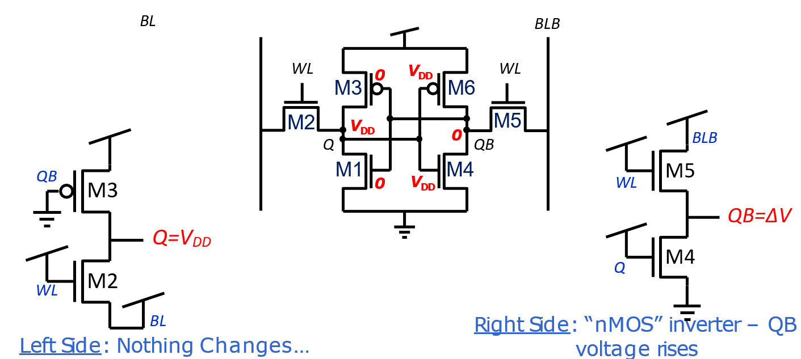
3. SRAM Operation: i. Read

Slide 6
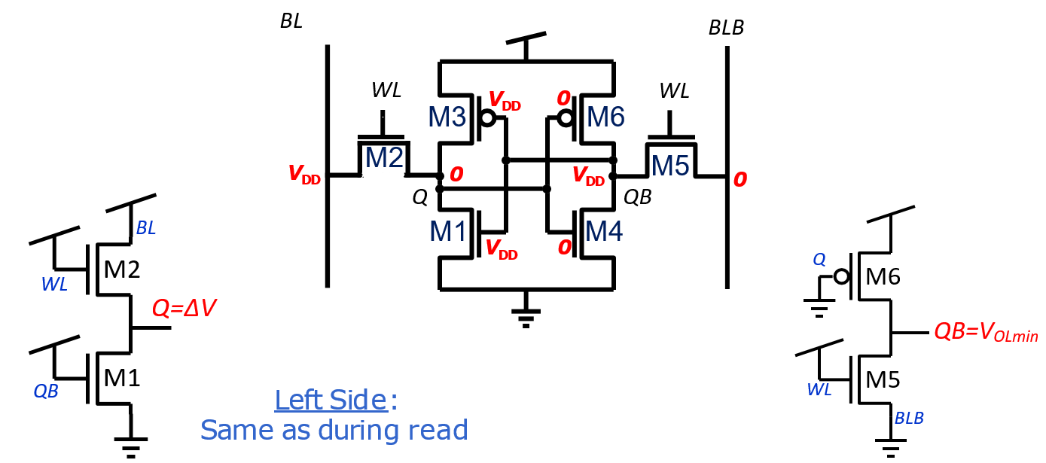
ii. Write

Slide 7
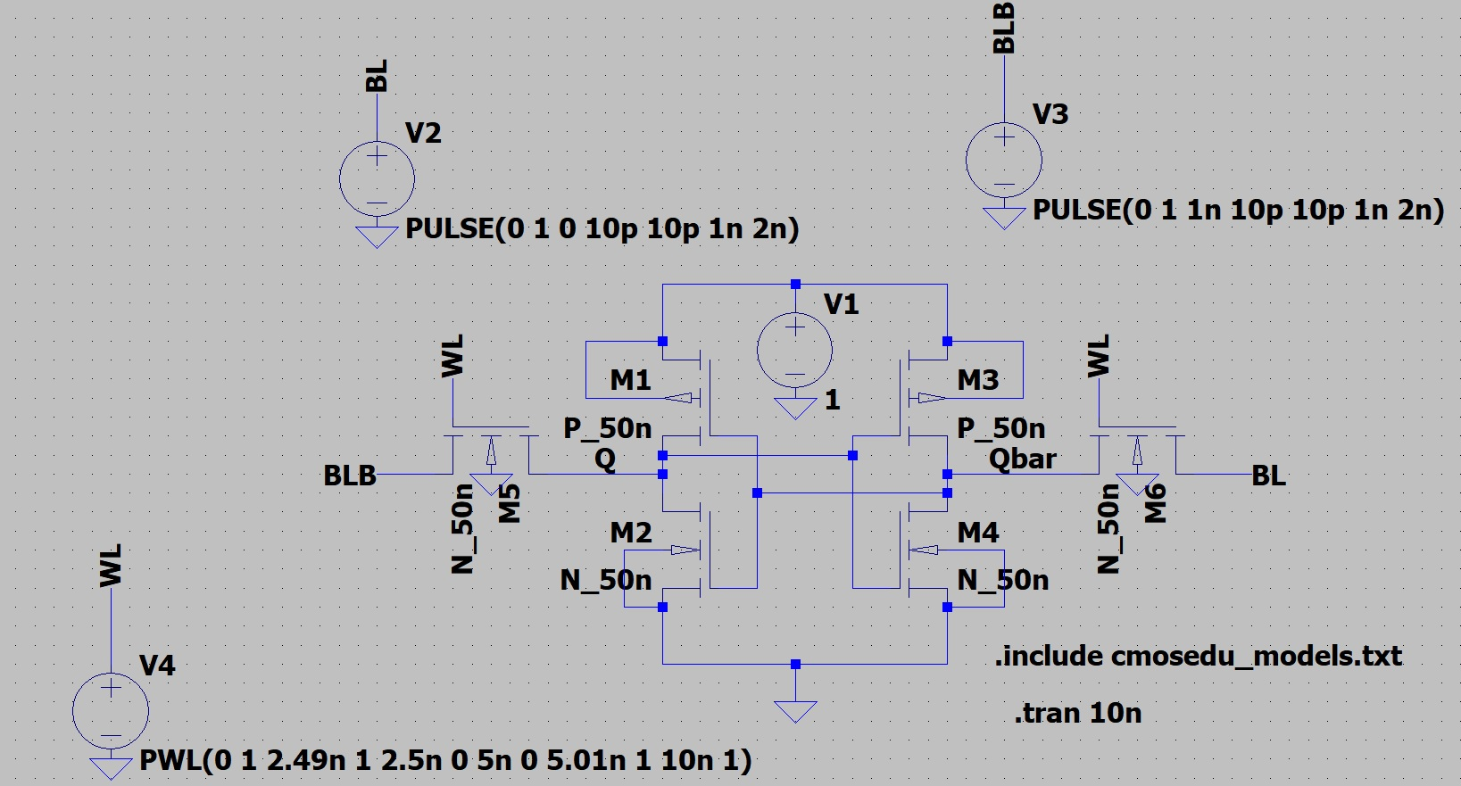
Schematic Diagram

Slide 8
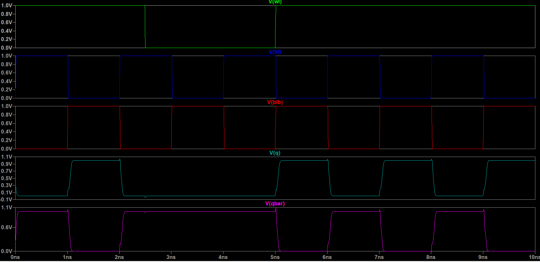
4. Graphs:
Write Operation

Slide 9
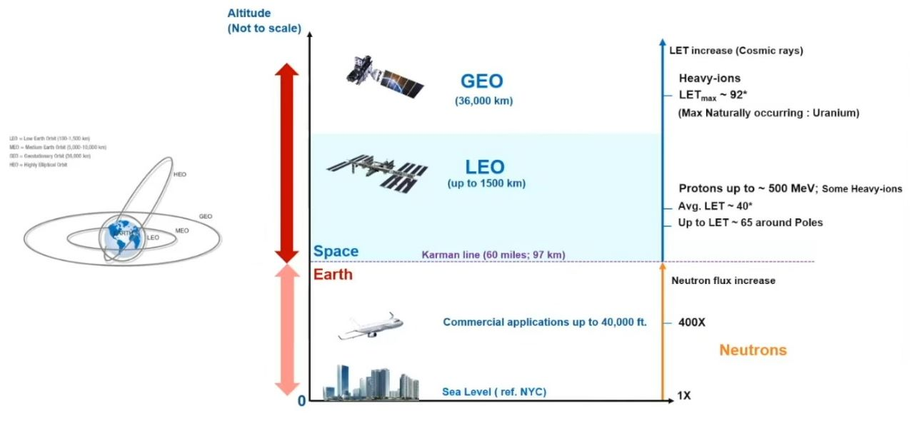
Radiation in terrestrial and space environments :-

Slide 10
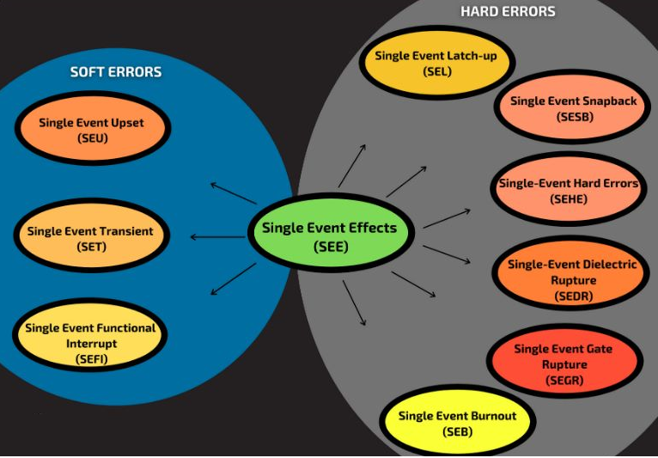
SOFT ERROR AND HARD ERRORS

Slide 11

CRITICAL CHARGE
Critical charge is defined as the minimum amount of charge necessary so as to flip a binary "1" to a "0" or vice-versa but it has to be less than the total charge that is stored. Qcrit (critical charge) is basically the difference between the charge at the storage node and the least value of charge required so that the sense amplifier can read correctly

Slide 12
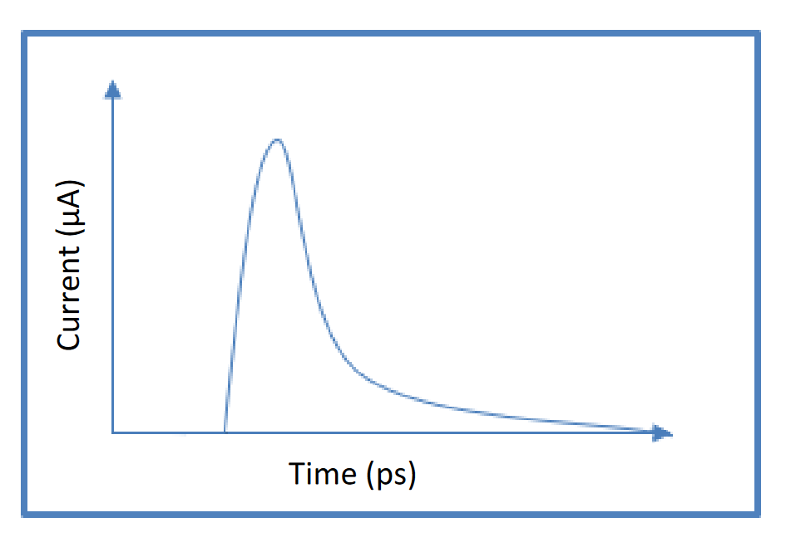
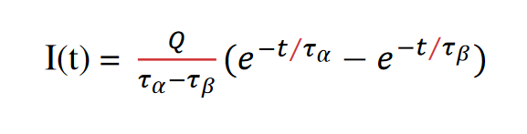
Double Exponential Transient Current Model :
The physical phenomenon that is taking place during the occurrence of an SET is the generation of a double exponential current pulse from particle strike.
This is the most widely used analytical model to approximate the transient current waveform that is induced at the struck node
It has a rapid rise time and gradual fall time
I(t) denotes the transient current waveform
Q denotes the negative or positive charge deposited by the particle strike.
τα is the fall time of current pulse
τβ is the rise time.

Slide 13
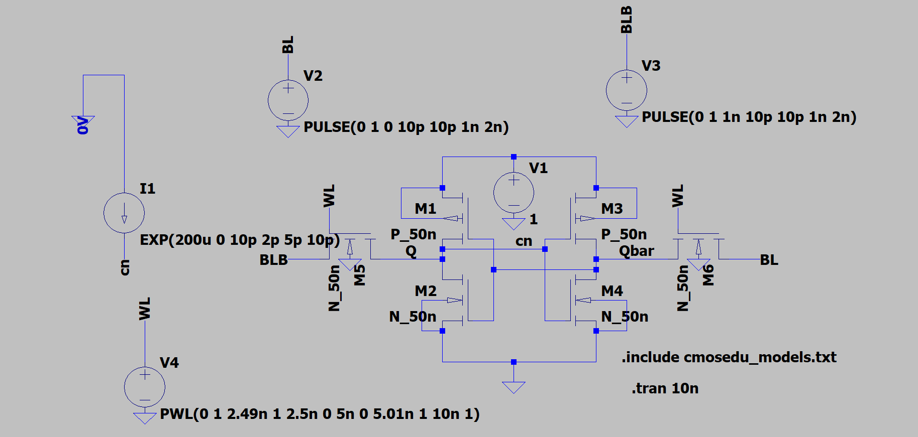

Slide 14
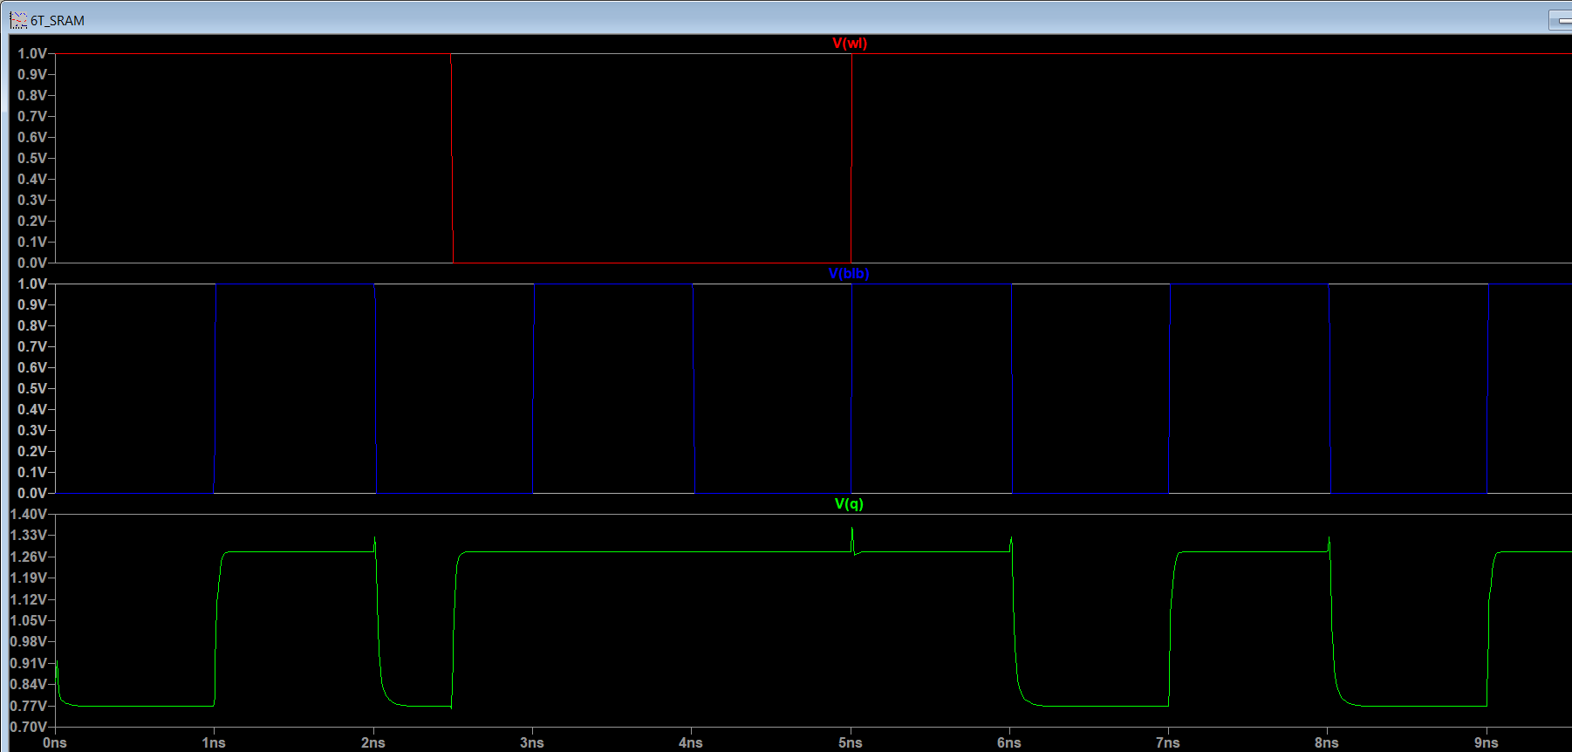

Slide 15
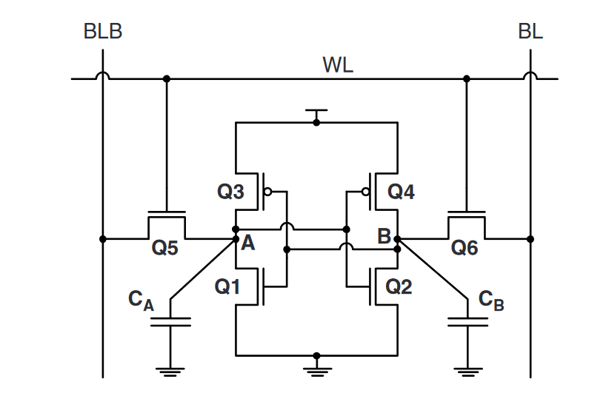
Radiation Hardening Techniques:
1. Increasing the Capacitance of the Storage Nodes
The critical charge Qcrit is proportional to Cnode ×Vnode.
Connecting extra capacitance to the storage nodes of an SRAM cell effectively increases the Cnode capacitance. As a result, the Q crit of a cell will be larger.
The longer discharge time of the more capacitive storage node will lead to a decrease in the SER(Soft Error Rate).

Slide 16
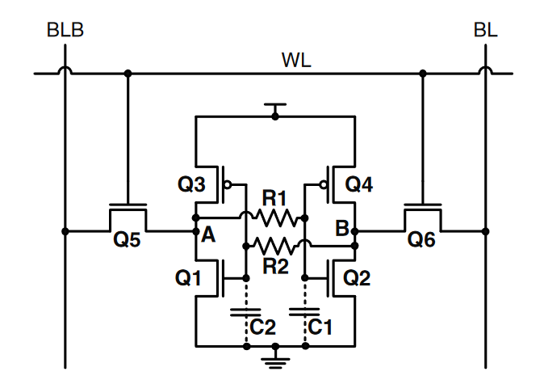
2. Inserting Resistors in the Feedback Loop of an SRAM Cell
Resistors R1 and R2 are inserted in the feedback loop of an SRAM cell to increase the RC time constant τ of the cell.
The SRAM cell will not be flipped by an ionizing particle as long as the RC time constant of the cell exceeds the recovery time of the output of the inverter.
The amount of the recovery time of such a radiation-hardened SRAM cell can be adjusted by varying the resistance of resistors R1 and R2.

Slide 17
9. References
A. Haran et al., "Single-Event Upset Tolerance Study of a Low-Voltage 13T Radiation-Hardened SRAM Bitcell," in IEEE Transactions on Nuclear Science, vol. 67, no. 8, pp. 1803-1812, Aug. 2020, doi: 10.1109/TNS.2020.3002654.
M. Fazeli, A. Patooghy, S. G. Miremadi and A. Ejlali, "Feedback Redundancy: A Power Efficient SEU-Tolerant Latch Design for Deep Sub-Micron Technologies," 37th Annual IEEE/IFIP International Conference on Dependable Systems and Networks (DSN'07), Edinburgh, UK, 2007, pp. 276-285, doi: 10.1109/DSN.2007.51.
A. Agal, Pardeep, B. Krishan, 6T SRAM Cell: Design And Analysis, Int. J. Eng. Res. Appl. 4 (2014) 574–577
S. Ahmad, N. Alam and M. Hasan, "Radiation Hardened Area-Efficient 10T SRAM Cell for Space Applications," 2021 25th International Symposium on VLSI Design and Test (VDAT), Surat, India, 2021, pp. 1-6, doi: 10.1109/VDAT53777.2021.9601130.
Gul, W.; Shams, M.; Al-Khalili, D.SRAM Cell Design Challenges in Modern Deep Sub-Micron Technologies: An Overview.Micromachines 2022, 13, 1332.https://doi.org/10.3390/ mi13081332

Slide 18
THANK YOU

